Slide 1

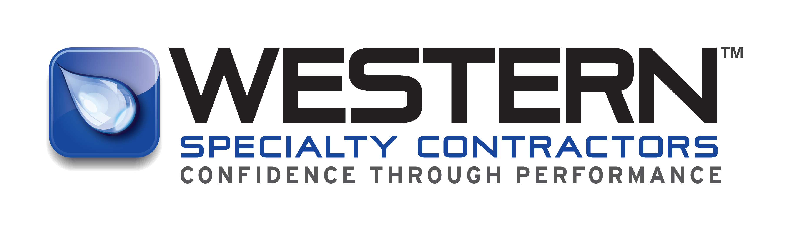
Self-performing specialty contractor
Building envelope &
Concrete repair
Notes:
---

Slide 2
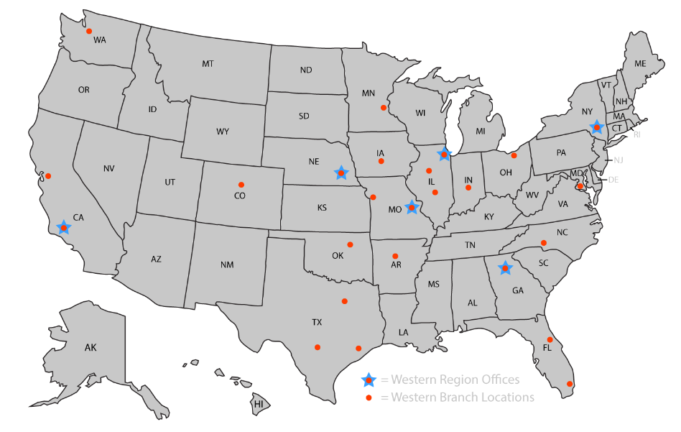
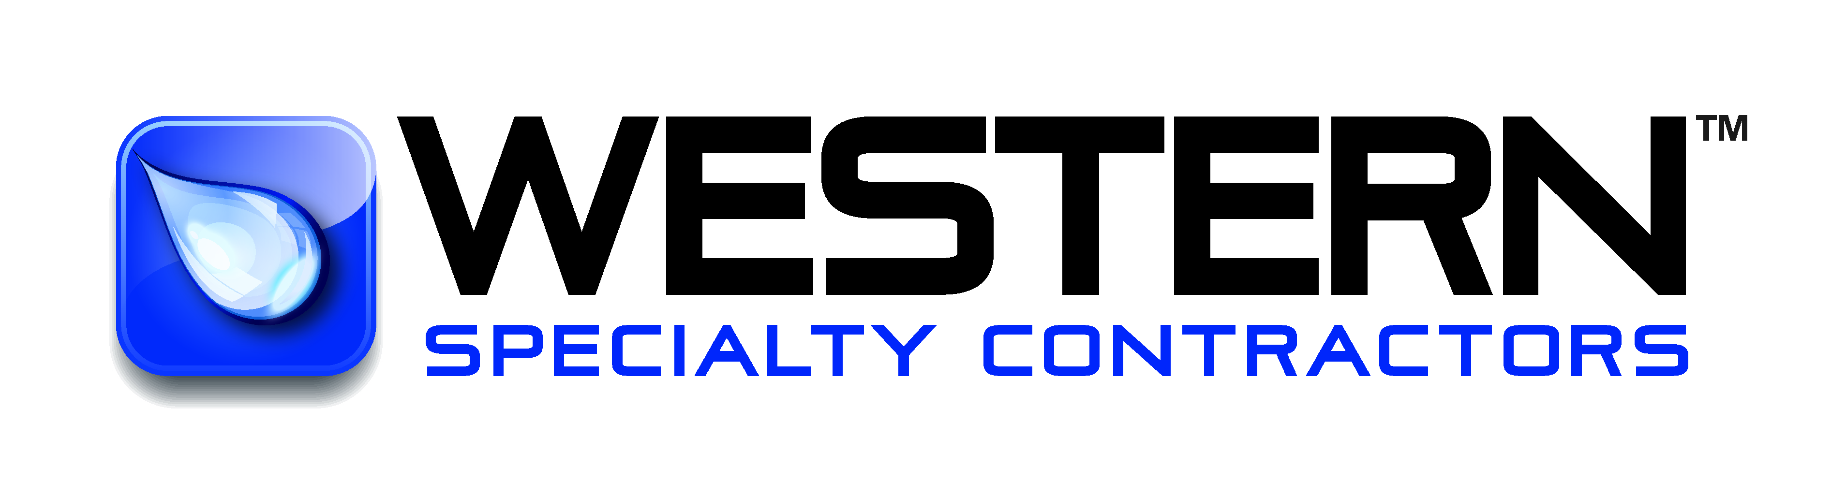
America’s largest building envelope restoration contractor
Founded in 1915
33+ Branches Nationwide
Employee Owned & Operated
Invested in Client Satisfaction
Clients Are Our Partners
95% of Services are Self-Performed
Industry Leader in Safety
Notes:
Western Specialty Contractors serves as a trusted preferred vendor through Deltaworks, providing specialized expertise when conditions exceed routine maintenance or present an immediate safety concern. Facility teams should contact Western when they encounter deepening or rapidly spreading cracks, persistent leaks that continue despite drain cleaning, or visible rebar exposure, as these signs indicate that deterioration is beyond surface-level repair. Hollow‑sounding slabs, widespread spalling, or any structural distress in beams or columns also require professional evaluation. Western brings advanced inspection techniques, corrosion mitigation strategies, and structural repair capabilities that adhere to best‑practice safety and industry standards. Additionally, Western’s familiarity with Delta and JLL expectations ensures streamlined communication, quicker mobilization, and coordinated project execution. Engaging Western early not only restores structural integrity but also prevents hazards from escalating, offering peace of mind to facility managers responsible for high-traffic environments such as airport parking structures or operational facilities.

Slide 3
Industry leader in safety
Experience Modification Rating
Western = 0.75
Industry Average = 1.0
OSHA Recordable
Western = 1.64
Active & Compliant
ISNet Avetta
Industry Average = 3.0
Corrigo Coupa GRMS
Supplier Shield & more
Notes:
Importance of Preventative Maintenance for Facility Safety

Slide 4
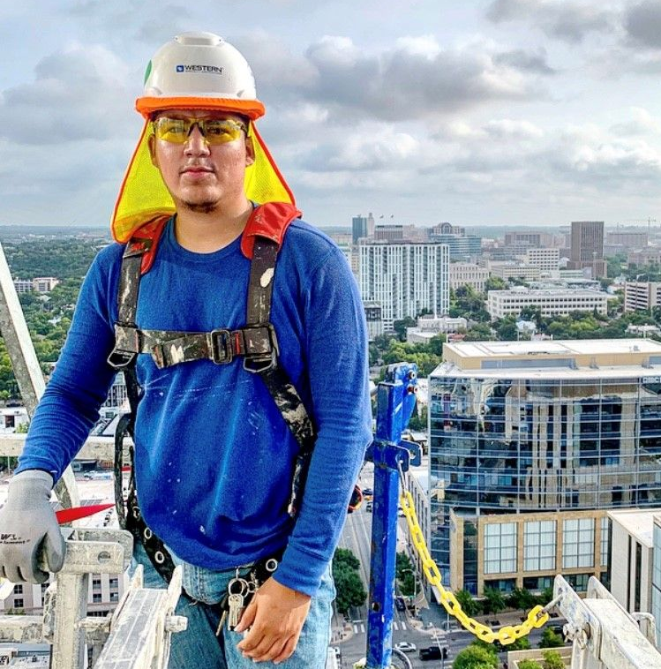
Western’s core services
Facade and Masonry Restoration
Concrete Repair & Strengthening
Coatings & Sealants
Expansion Joint Systems
Parking & Plaza Deck Restoration
Waterproofing
Building Cleaning
Historic Restoration
Notes:
Western Specialty Contractors offers a comprehensive range of services designed to enhance safety, durability, and performance across parking structures and building envelopes. Core capabilities include structural concrete repair such as spall patching, form‑and‑place repairs, and shotcrete applications. Western’s waterproofing expertise ensures effective protection against moisture infiltration through deck coatings, sealants, and joint replacement. Masonry restoration services address deterioration in brick, stone, and façade systems with techniques such as tuckpointing, repointing, and material replacement. For structural strengthening, Western provides reinforcement solutions that address corrosion‑related weakening or load‑capacity concerns. The company also performs detailed inspections, condition assessments, and leak investigations that support long-term asset management strategies. These services collectively contribute to safer environments, prolonged structural life, and reduced operational risks, making Western a valuable partner for Delta, JLL, and other facilities teams responsible for maintaining high-traffic environments.

Slide 5
Services & projects
GWS Clients Include:
Honeywell
Coca Cola
Eli Lilly
Kelloggs
META
State Farm
JP Morgan Chase
Wells Fargo
Providence Healthcare
And more!
Notes:
Importance of Preventative Maintenance for Facility Safety

Slide 6
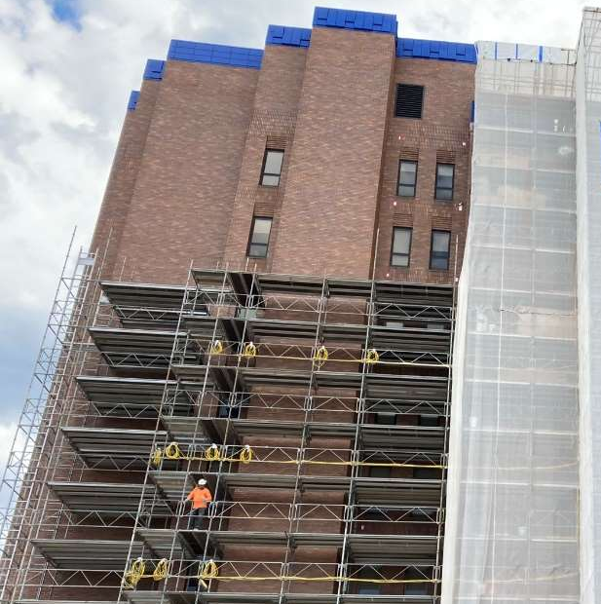
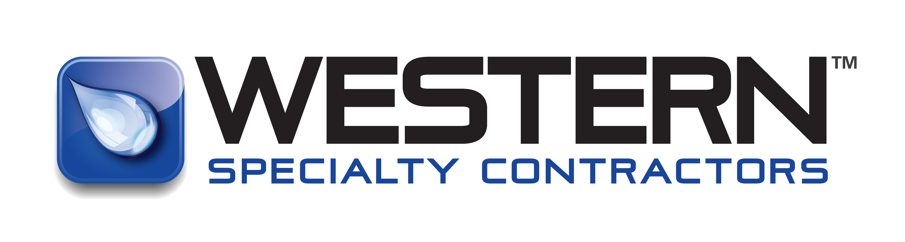
Masonry, façade, &
Stone Restoration
Caulking and Sealants
Building Cleaning or Sealing
Curtain Wall and Window Systems
Exterior Wall Coating
Mortar Joint Repairs
Structural Steel Repair / Replacement
Repointing / Tuckpointing
Stone/ Brick / Terra Cotta Restoration
Historic Repair and Preservation
Notes:
Preventative maintenance is the backbone of ensuring a safe and structurally sound parking deck or facility environment, especially in high-traffic areas such as those managed by Delta and JLL. Small defects—such as cracks, water infiltration, and surface deterioration—may appear harmless at first but can escalate into major structural concerns if left unaddressed. These seemingly minor issues can compromise the integrity of concrete surfaces, beams, columns, and joints, eventually leading to hazards such as loose concrete, corroded reinforcing steel, delamination, and potential falling debris. Identifying and addressing these problems early protects both people and property by minimizing the risk of trip hazards, falling material, and unexpected structural failures. Moreover, preventative maintenance supports operational continuity by reducing the likelihood of sudden closures or emergency repairs, creating a safer, more reliable environment for employees and customers alike. This proactive approach also extends the lifespan of structural components by preventing accelerating damage caused by moisture, chlorides, freeze–thaw cycles, or insufficient drainage. When routine inspections are paired with the correct repair methods, facilities teams can effectively mitigate risks that develop from daily wear and environmental exposure. For organizations like Delta and JLL, which oversee high-traffic facilities, a strong maintenance program reinforces compliance expectations, protects brand reputation, and enhances user safety. Ultimately, preventative maintenance is not just a cost-saving strategy—it’s a comprehensive safety-driven practice that ensures long-term stability, reduces liability, and keeps working environments secure for all.

Slide 7
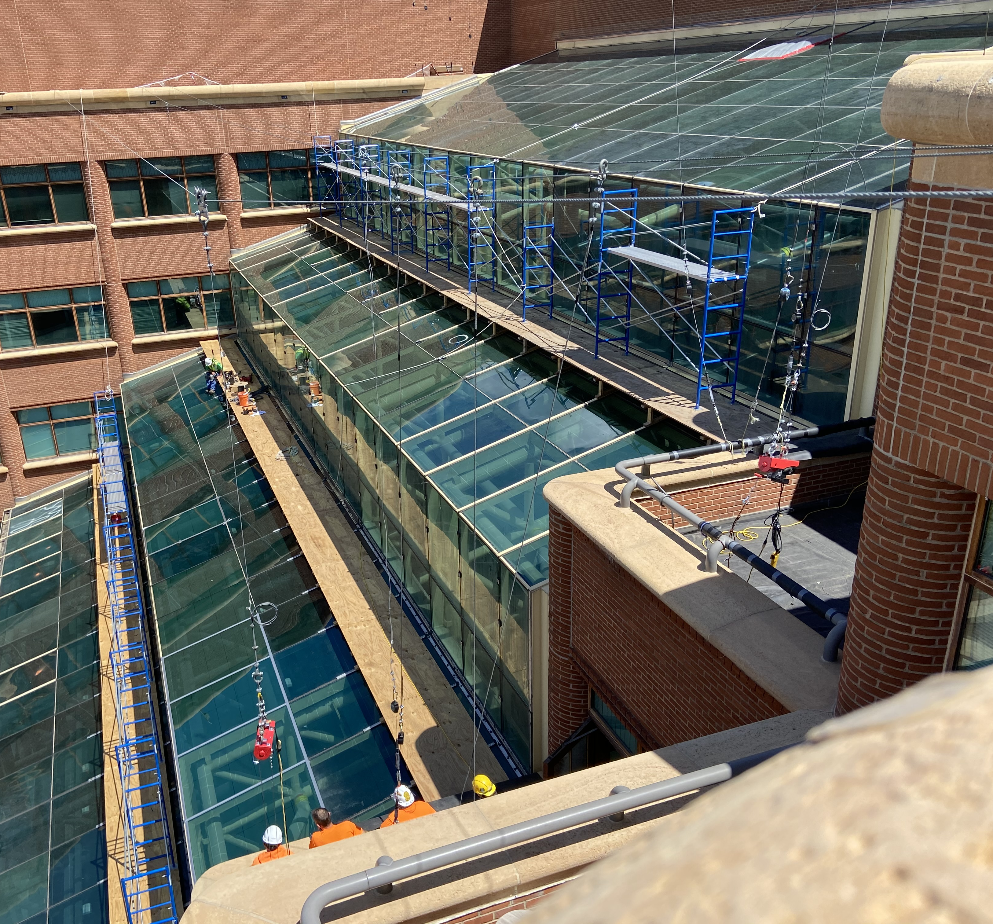
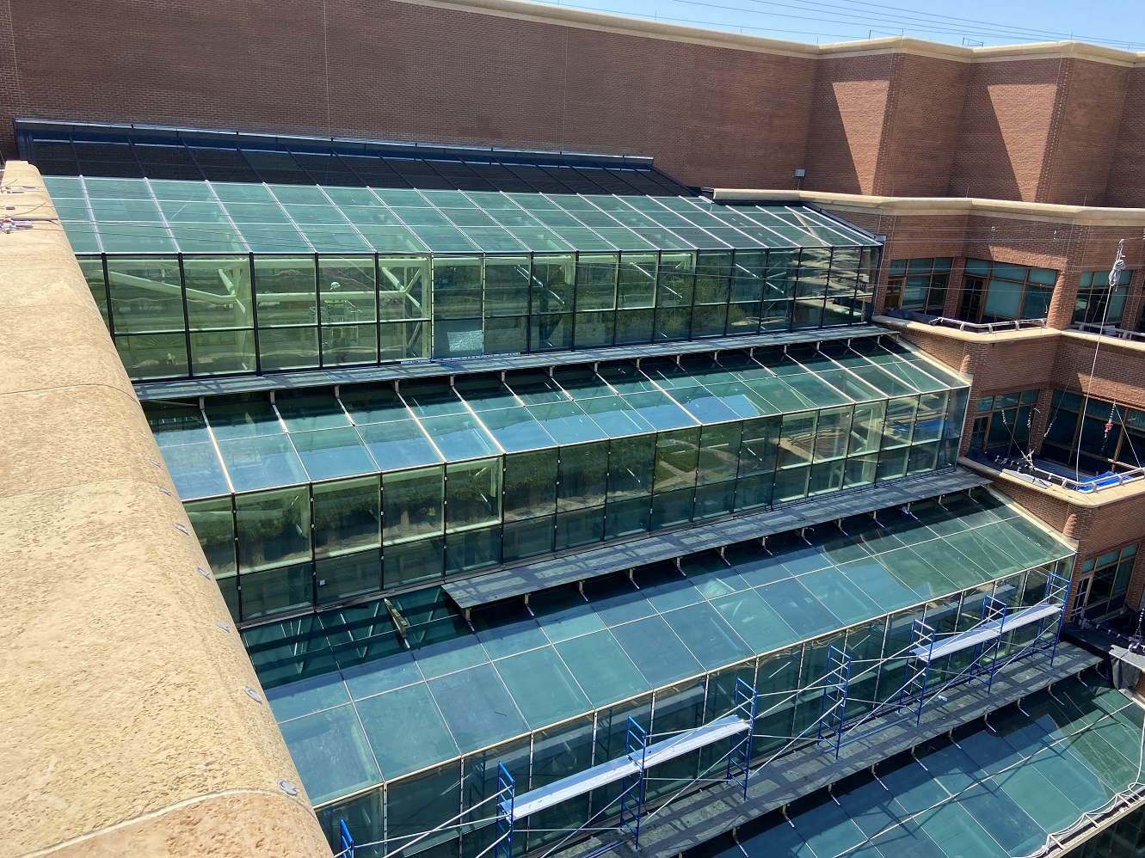
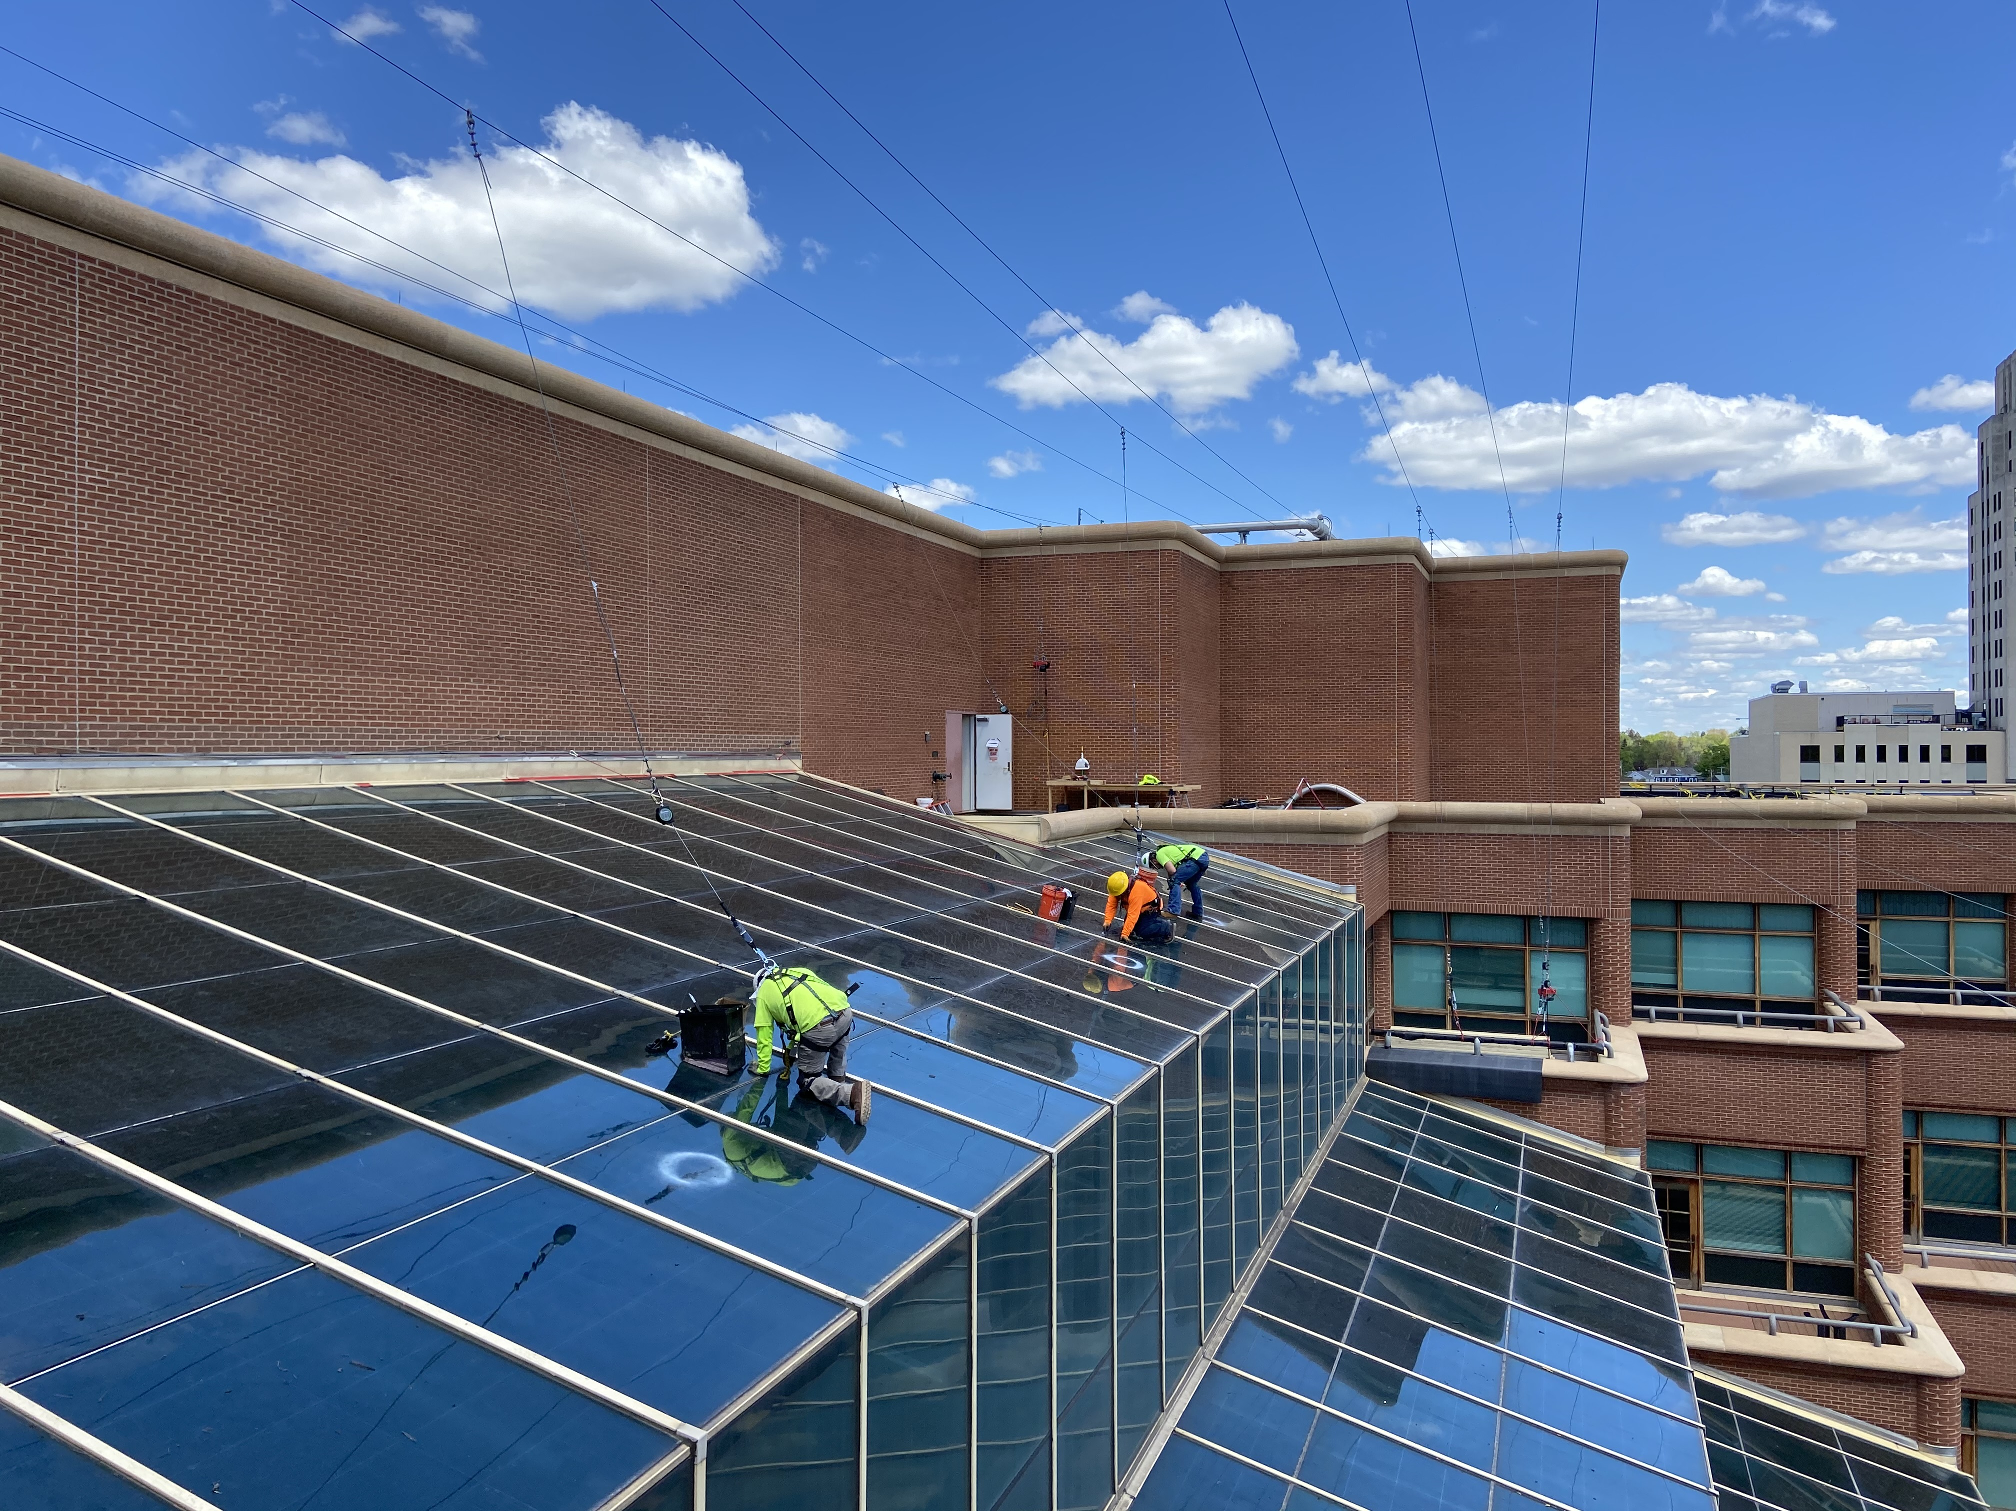
One Kellogg’s square
100% Structural Silicone Sealant Replacement
100% Glazing and Perimeter Sealant Replacement
100% Metal Snap Cover Replacement
Paint Coating of existing sheet metal
Adjacent Tuckpointing & Brick Masonry Repairs
Partial Glass Replacement
Battle Creek, MI
Notes:
Importance of Preventative Maintenance for Facility Safety

Slide 8
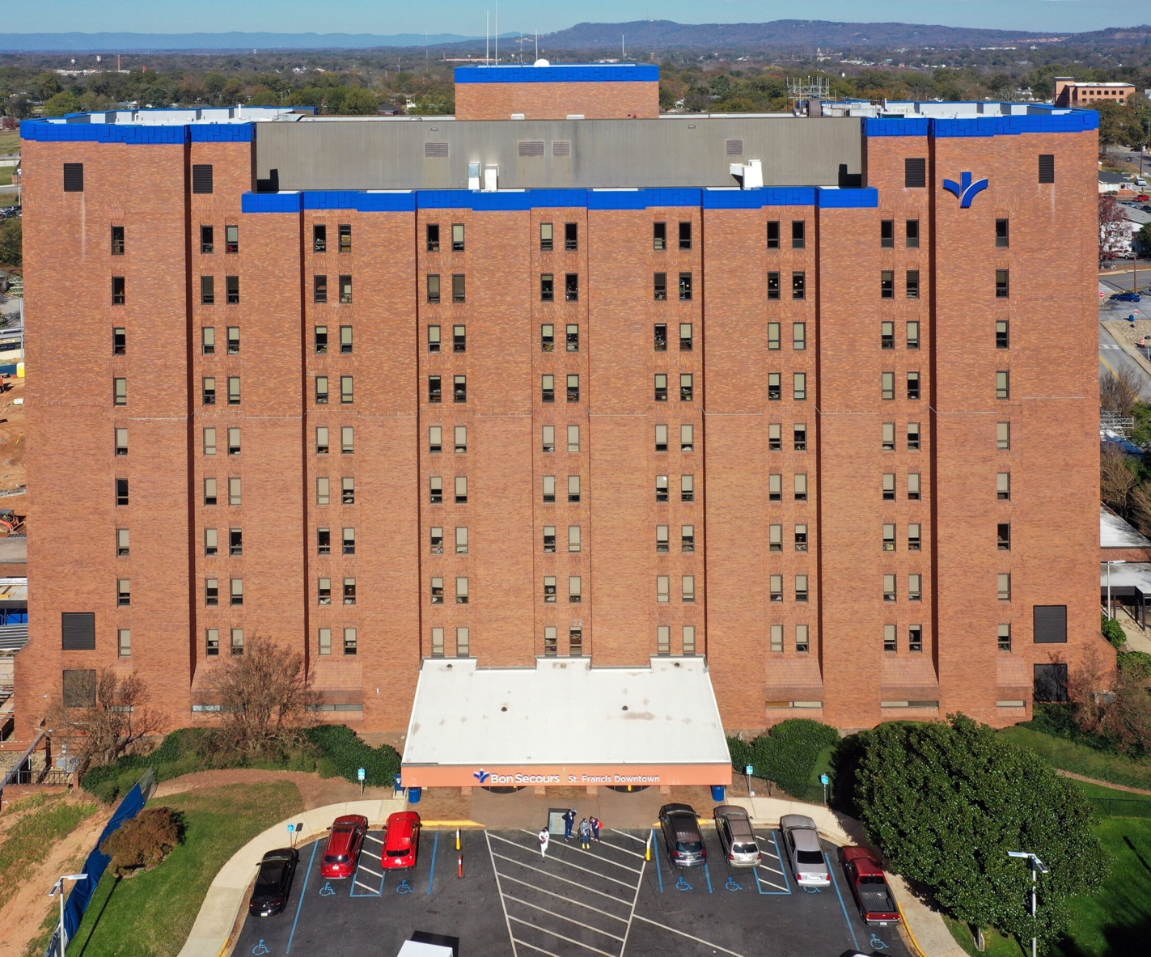
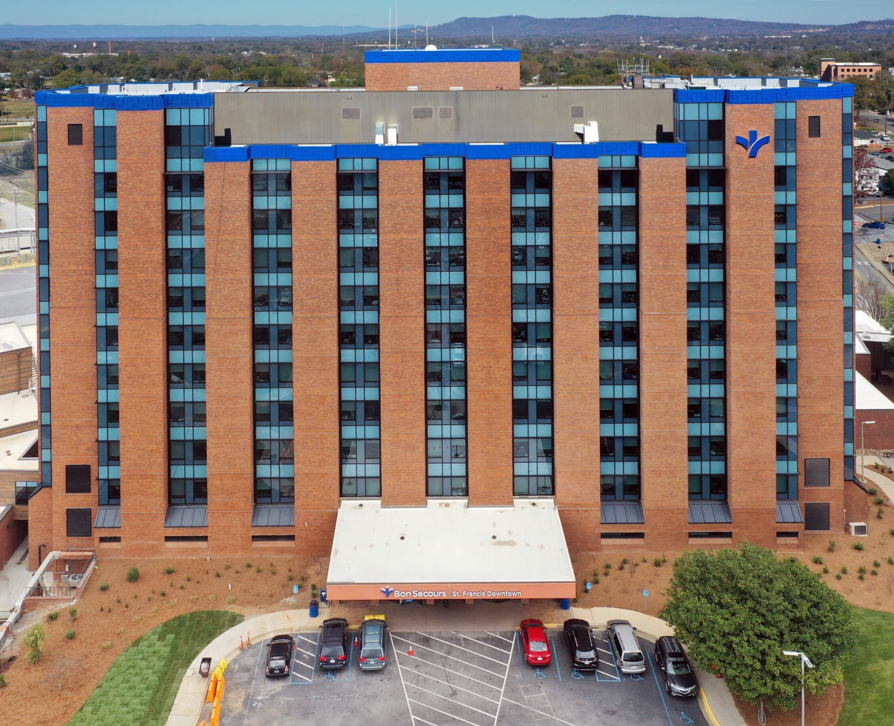
Bon secours st. Francis
Replacement of all punched windows
New curtainwall system
Metal panel re-cladding of vertical inset areas
10 vertical phases over two years
12,573 workdays and 100,584 hours
78.6 miles of tuckpointing
24,350sf of façade demolition
Greenville, SC
Notes:
Importance of Preventative Maintenance for Facility Safety

Slide 9
Honeywell
CHALLENGE: A lot of equipment on the interior that would have been very costly to move
SOLUTION: Replace the exterior face of the wall while keeping the interior face in place using a combination of new block and grout.
Block Wall Issues
Tuckpointing
Replacement of block
Caulk control joints
Replace downspouts below grade piping
Paint façade after work was complete
Geneva, OH
Notes:
Importance of Preventative Maintenance for Facility Safety

Slide 10
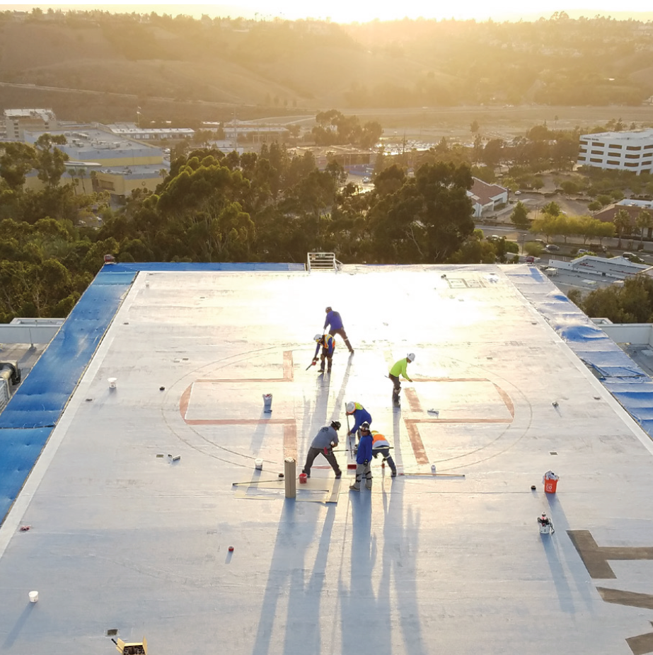
Waterproofing, Coatings, & sealants
Façade & Parking Garage Sealant
Traffic & Deck Coating Systems
Plaza Deck Restoration & Waterproofing
Vertical Façade Wall Coatings
Liquid Applied Air & Water Barrier
Caulking and Sealants
Above/Below Grade Waterproofing
Notes:
Preventative maintenance is the backbone of ensuring a safe and structurally sound parking deck or facility environment, especially in high-traffic areas such as those managed by Delta and JLL. Small defects—such as cracks, water infiltration, and surface deterioration—may appear harmless at first but can escalate into major structural concerns if left unaddressed. These seemingly minor issues can compromise the integrity of concrete surfaces, beams, columns, and joints, eventually leading to hazards such as loose concrete, corroded reinforcing steel, delamination, and potential falling debris. Identifying and addressing these problems early protects both people and property by minimizing the risk of trip hazards, falling material, and unexpected structural failures. Moreover, preventative maintenance supports operational continuity by reducing the likelihood of sudden closures or emergency repairs, creating a safer, more reliable environment for employees and customers alike. This proactive approach also extends the lifespan of structural components by preventing accelerating damage caused by moisture, chlorides, freeze–thaw cycles, or insufficient drainage. When routine inspections are paired with the correct repair methods, facilities teams can effectively mitigate risks that develop from daily wear and environmental exposure. For organizations like Delta and JLL, which oversee high-traffic facilities, a strong maintenance program reinforces compliance expectations, protects brand reputation, and enhances user safety. Ultimately, preventative maintenance is not just a cost-saving strategy—it’s a comprehensive safety-driven practice that ensures long-term stability, reduces liability, and keeps working environments secure for all.

Slide 11
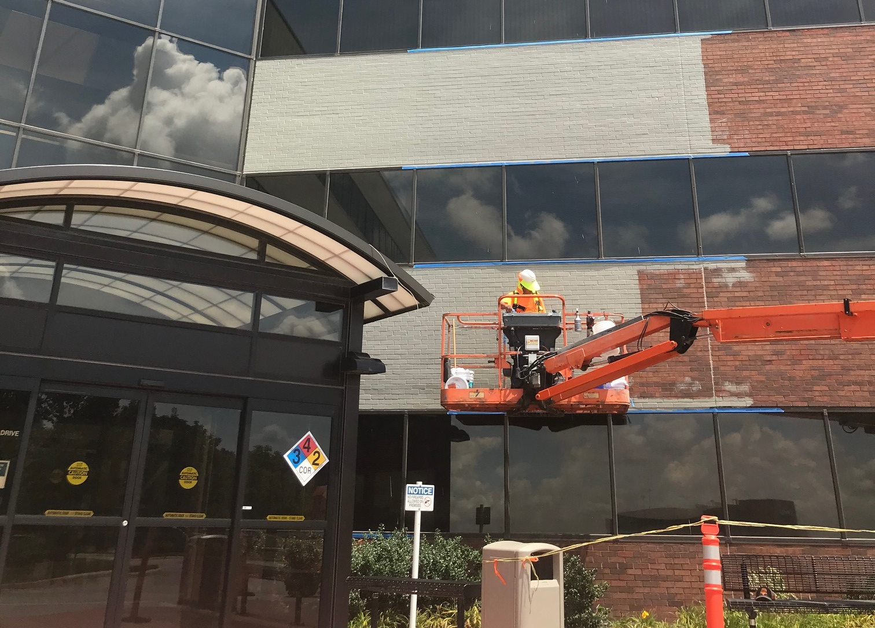
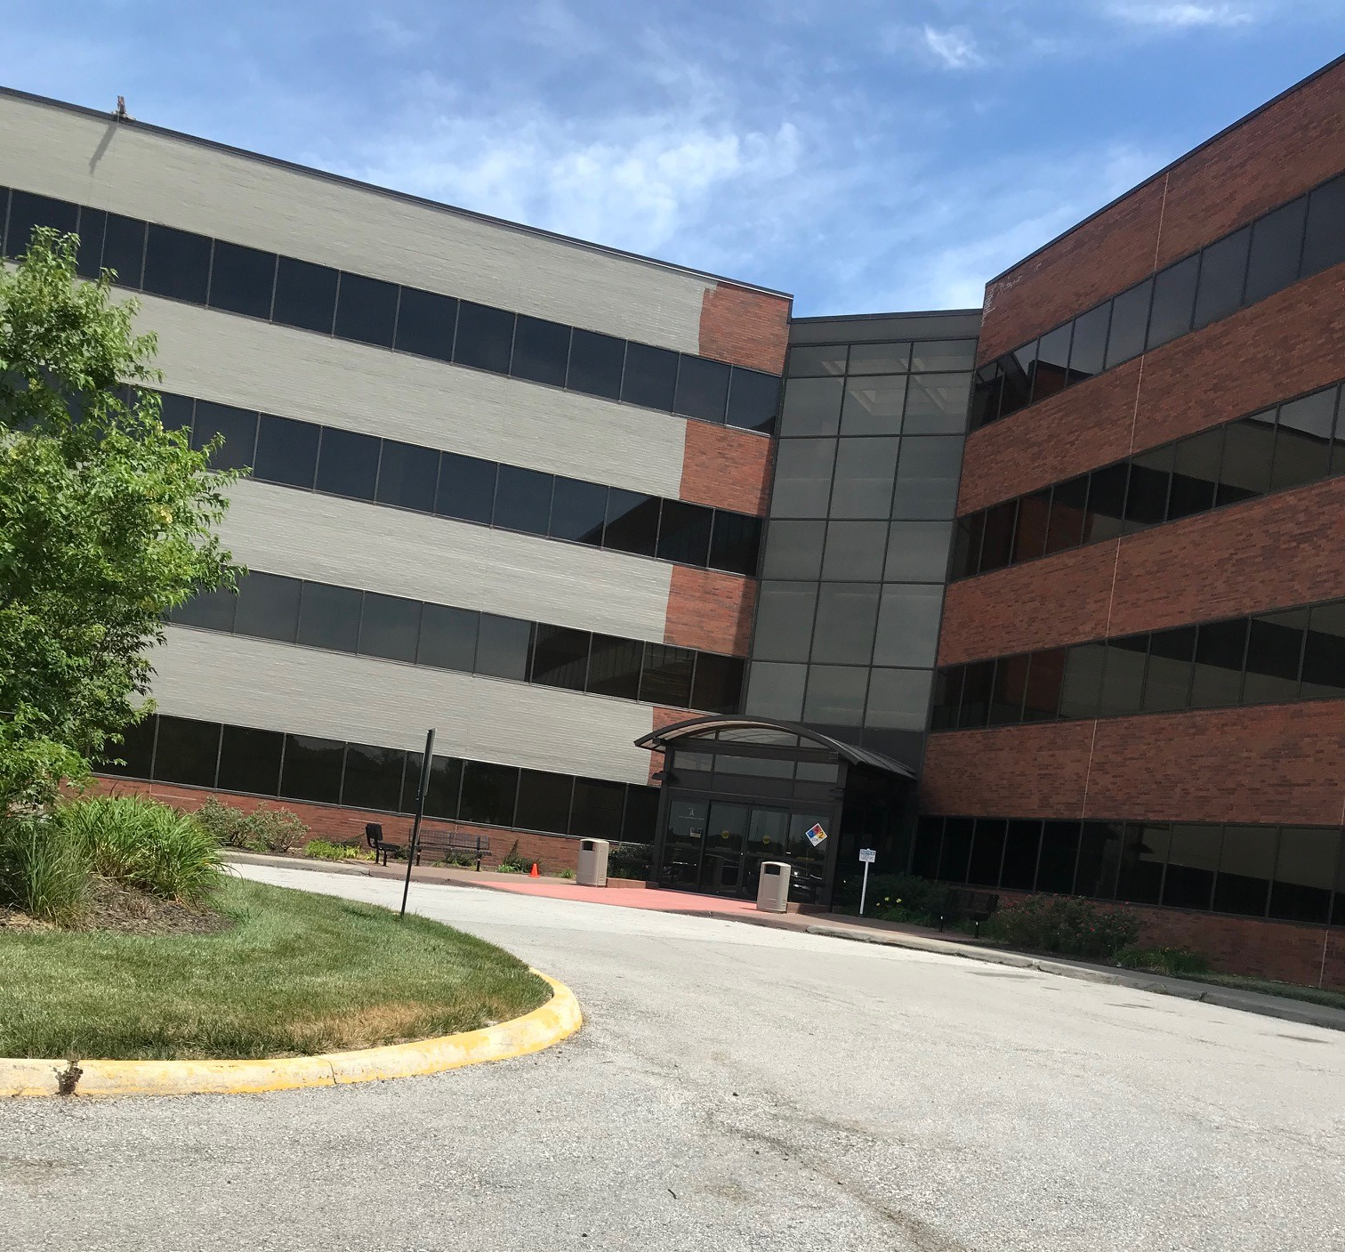
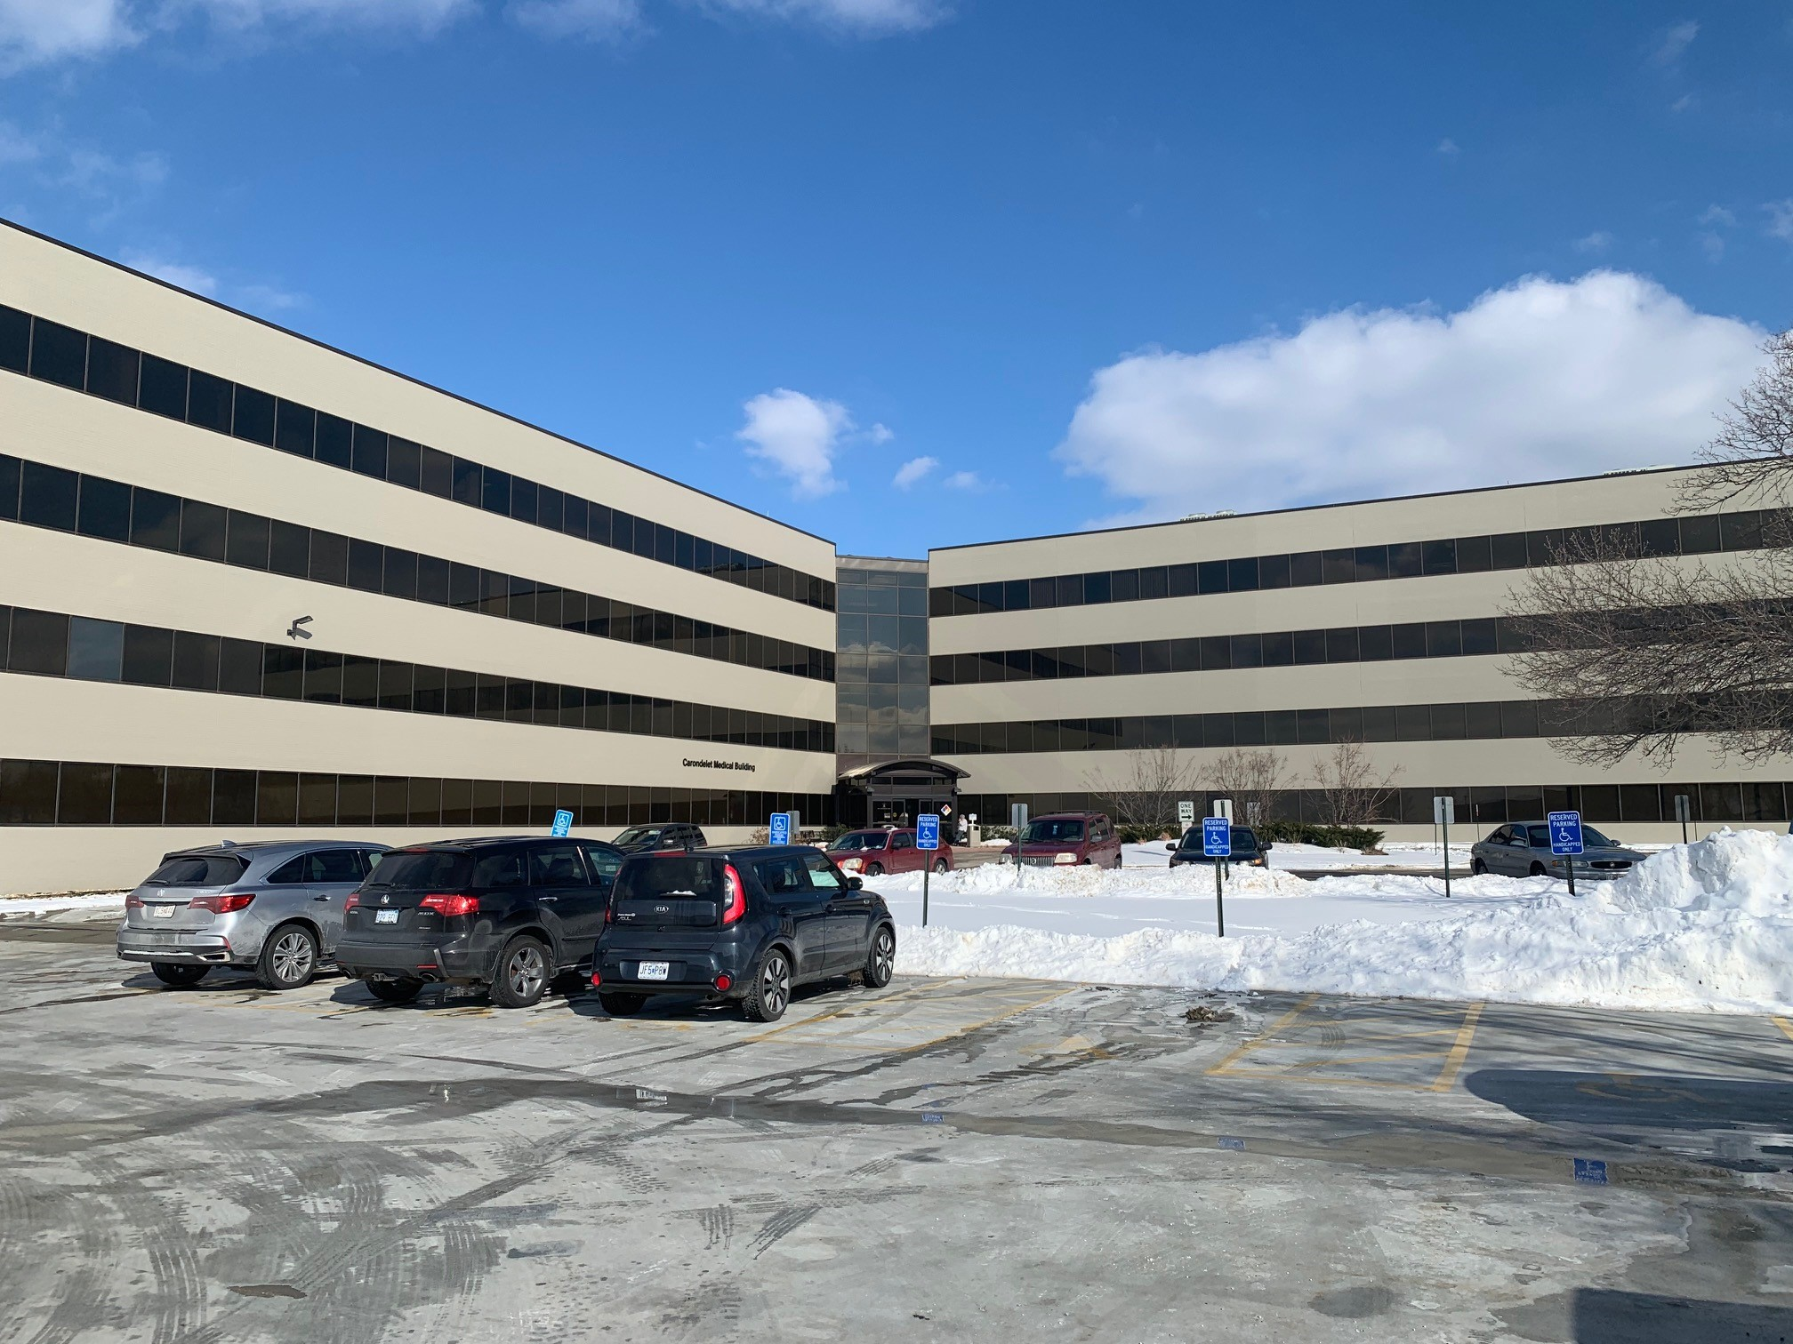
Lillibridge healthcare services
Repaired bricks
Pressure washed & cleaned building
Applied elastomeric coating to all elevations
Kansas City, MO
Notes:
Importance of Preventative Maintenance for Facility Safety

Slide 12
Mondial River West roof terrace
Removed pedestal pavers and 2-ply modified-bitumen roof membrane
Installed liquid-applied membrane with Sika 3-coat system, overburden and flashing materials, reinstallation of original pedestal pavers
Chicago, IL
Notes:
Importance of Preventative Maintenance for Facility Safety

Slide 13
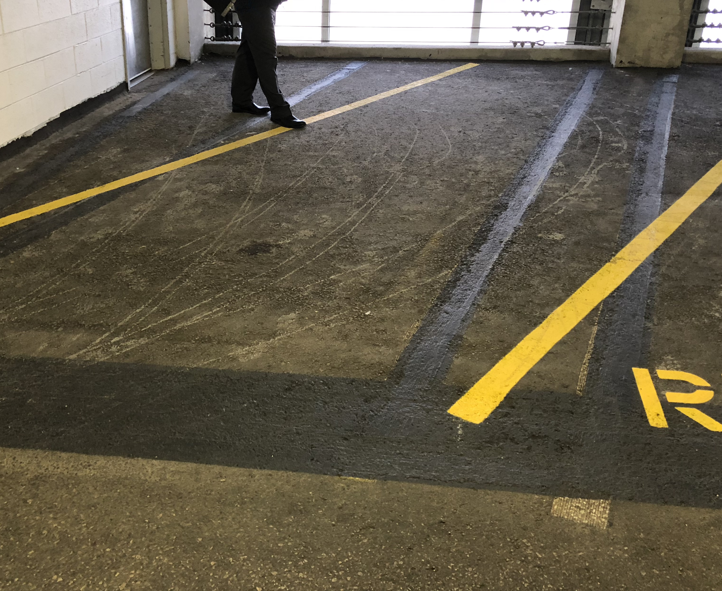
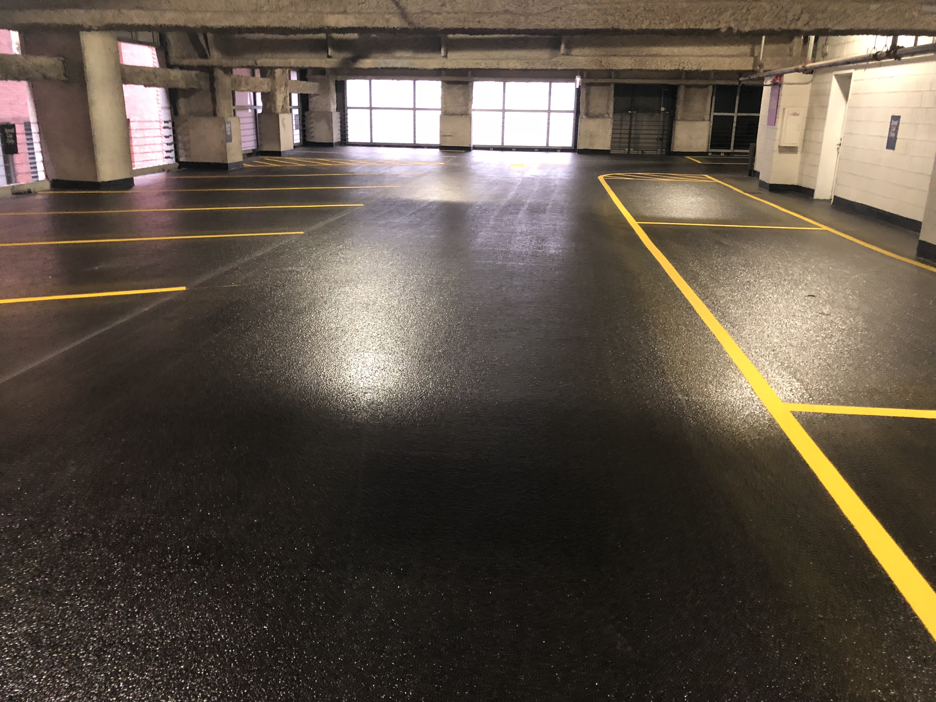
Boeing building
Traffic Coating Application
Work Completed "Off Hours" to minimize impact
Chicago, IL
Notes:
Importance of Preventative Maintenance for Facility Safety

Slide 14
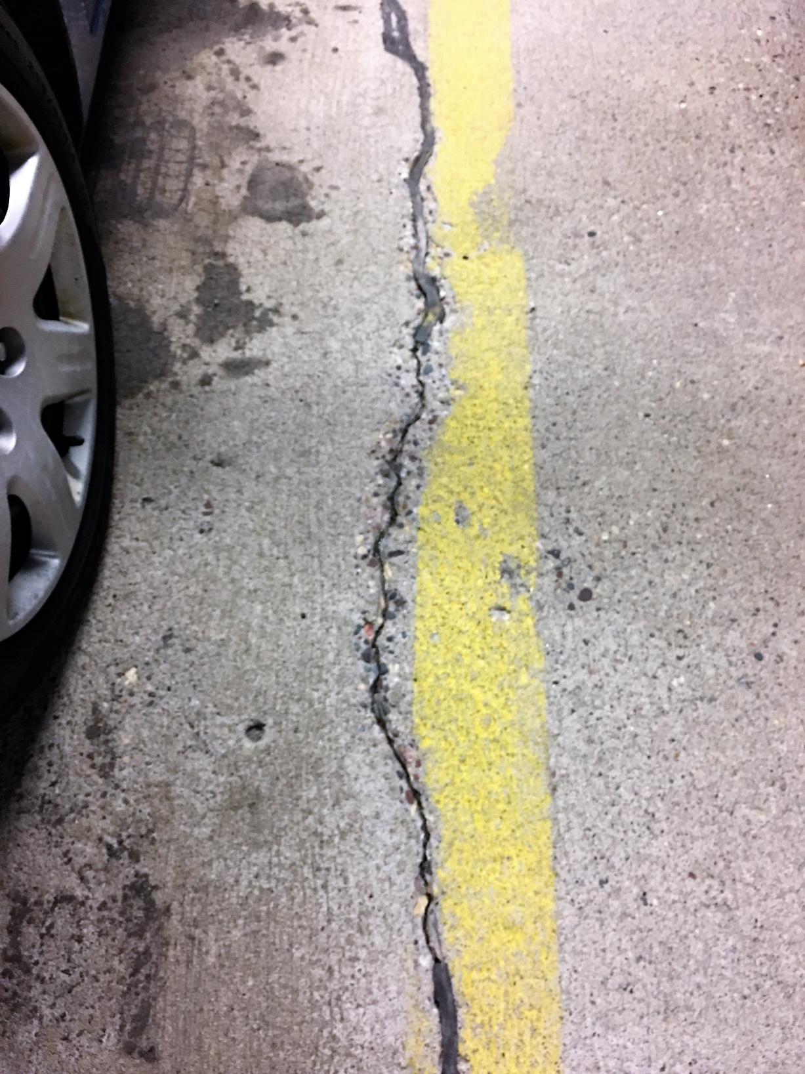
Concrete repair & strengthening
Structural Concrete Repair, Replacement, & Retrofit
Unbonded Post-Tension Repairs
Parking Garage Repairs
Parking Deck / Plaza Deck Restoration
Balcony Repairs
Pedestrian / Vehicular Coating Systems
Epoxy Injection / Chemical Grout Injection
Expansion Joint Systems
FRP – Carbon Fiber Strengthening
Clear Sealer Application
Notes:
Preventative maintenance is the backbone of ensuring a safe and structurally sound parking deck or facility environment, especially in high-traffic areas such as those managed by Delta and JLL. Small defects—such as cracks, water infiltration, and surface deterioration—may appear harmless at first but can escalate into major structural concerns if left unaddressed. These seemingly minor issues can compromise the integrity of concrete surfaces, beams, columns, and joints, eventually leading to hazards such as loose concrete, corroded reinforcing steel, delamination, and potential falling debris. Identifying and addressing these problems early protects both people and property by minimizing the risk of trip hazards, falling material, and unexpected structural failures. Moreover, preventative maintenance supports operational continuity by reducing the likelihood of sudden closures or emergency repairs, creating a safer, more reliable environment for employees and customers alike. This proactive approach also extends the lifespan of structural components by preventing accelerating damage caused by moisture, chlorides, freeze–thaw cycles, or insufficient drainage. When routine inspections are paired with the correct repair methods, facilities teams can effectively mitigate risks that develop from daily wear and environmental exposure. For organizations like Delta and JLL, which oversee high-traffic facilities, a strong maintenance program reinforces compliance expectations, protects brand reputation, and enhances user safety. Ultimately, preventative maintenance is not just a cost-saving strategy—it’s a comprehensive safety-driven practice that ensures long-term stability, reduces liability, and keeps working environments secure for all.

Slide 15
Parking garage repairs
300 surface and 60 covered parking spots
Post-tension beam tendons corroded; required supplemental external post-tensioning beam system
Repairs also included shoring, partial depth topside and underside, post tension cable repairs, joint sealant installation, traffic coating removal, HD traffic membrane installation, and expansion joint replacement
St. Louis, MO
Notes:
Importance of Preventative Maintenance for Facility Safety

Slide 16
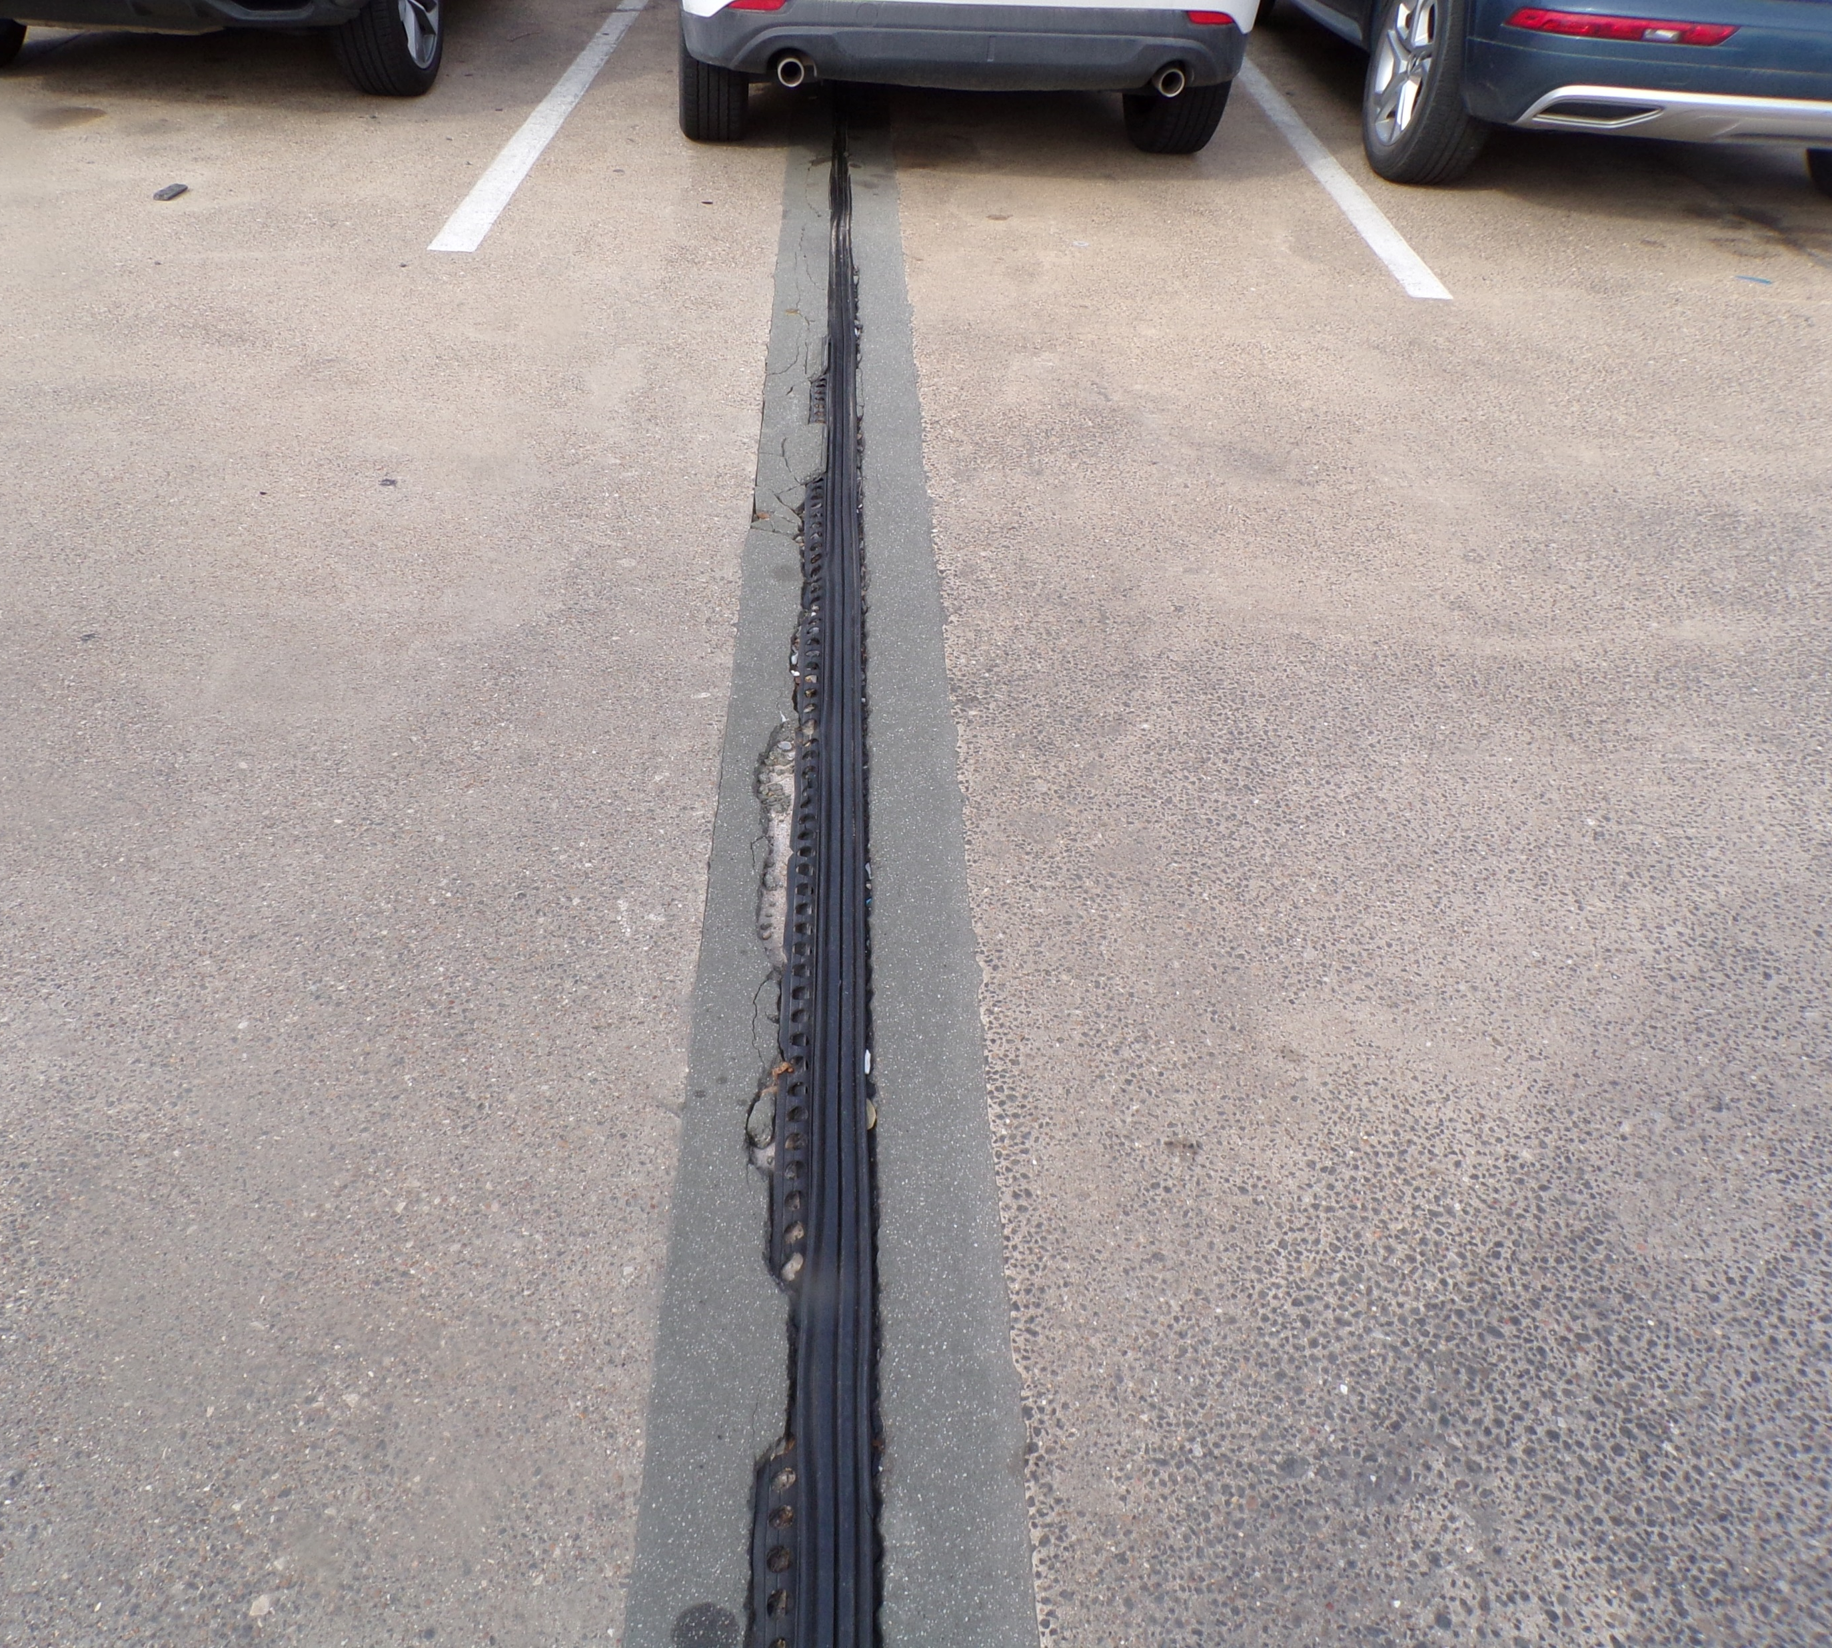
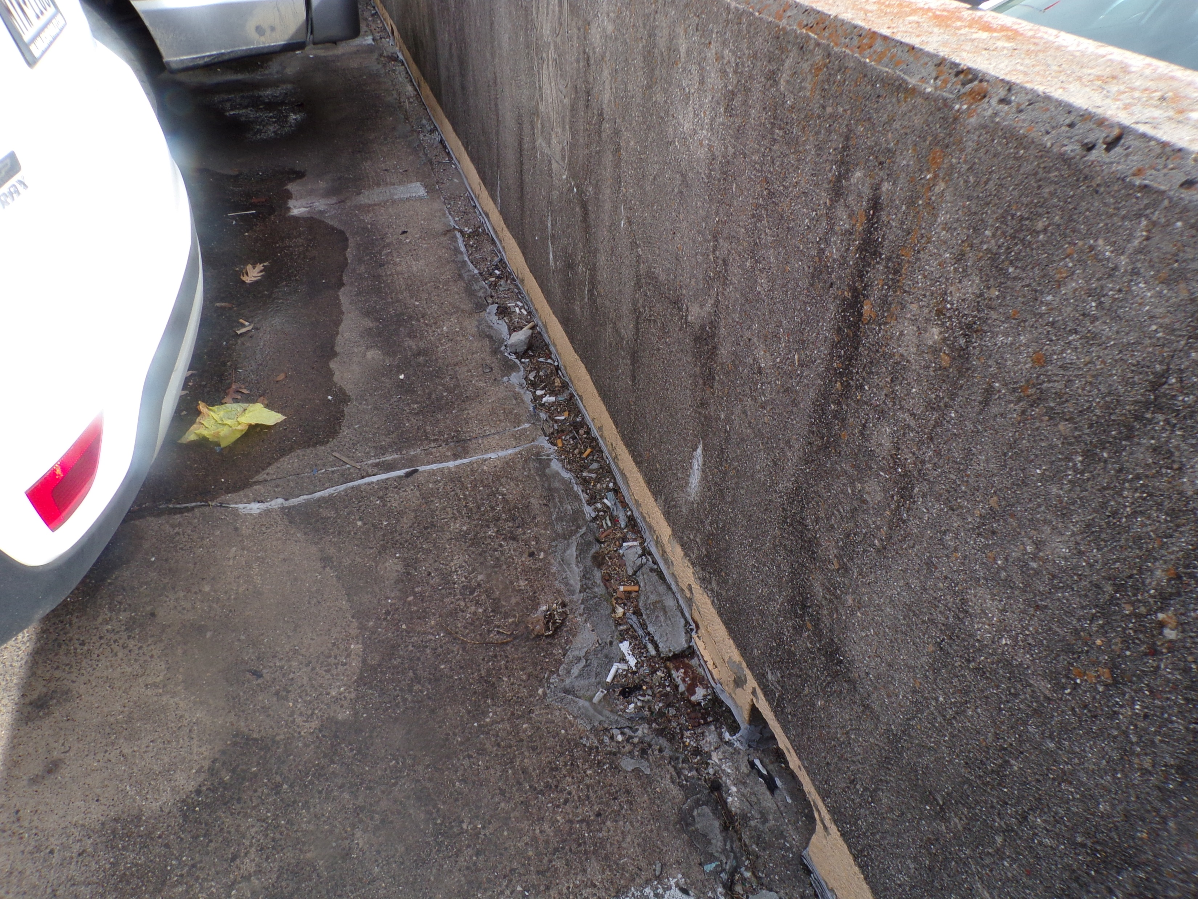
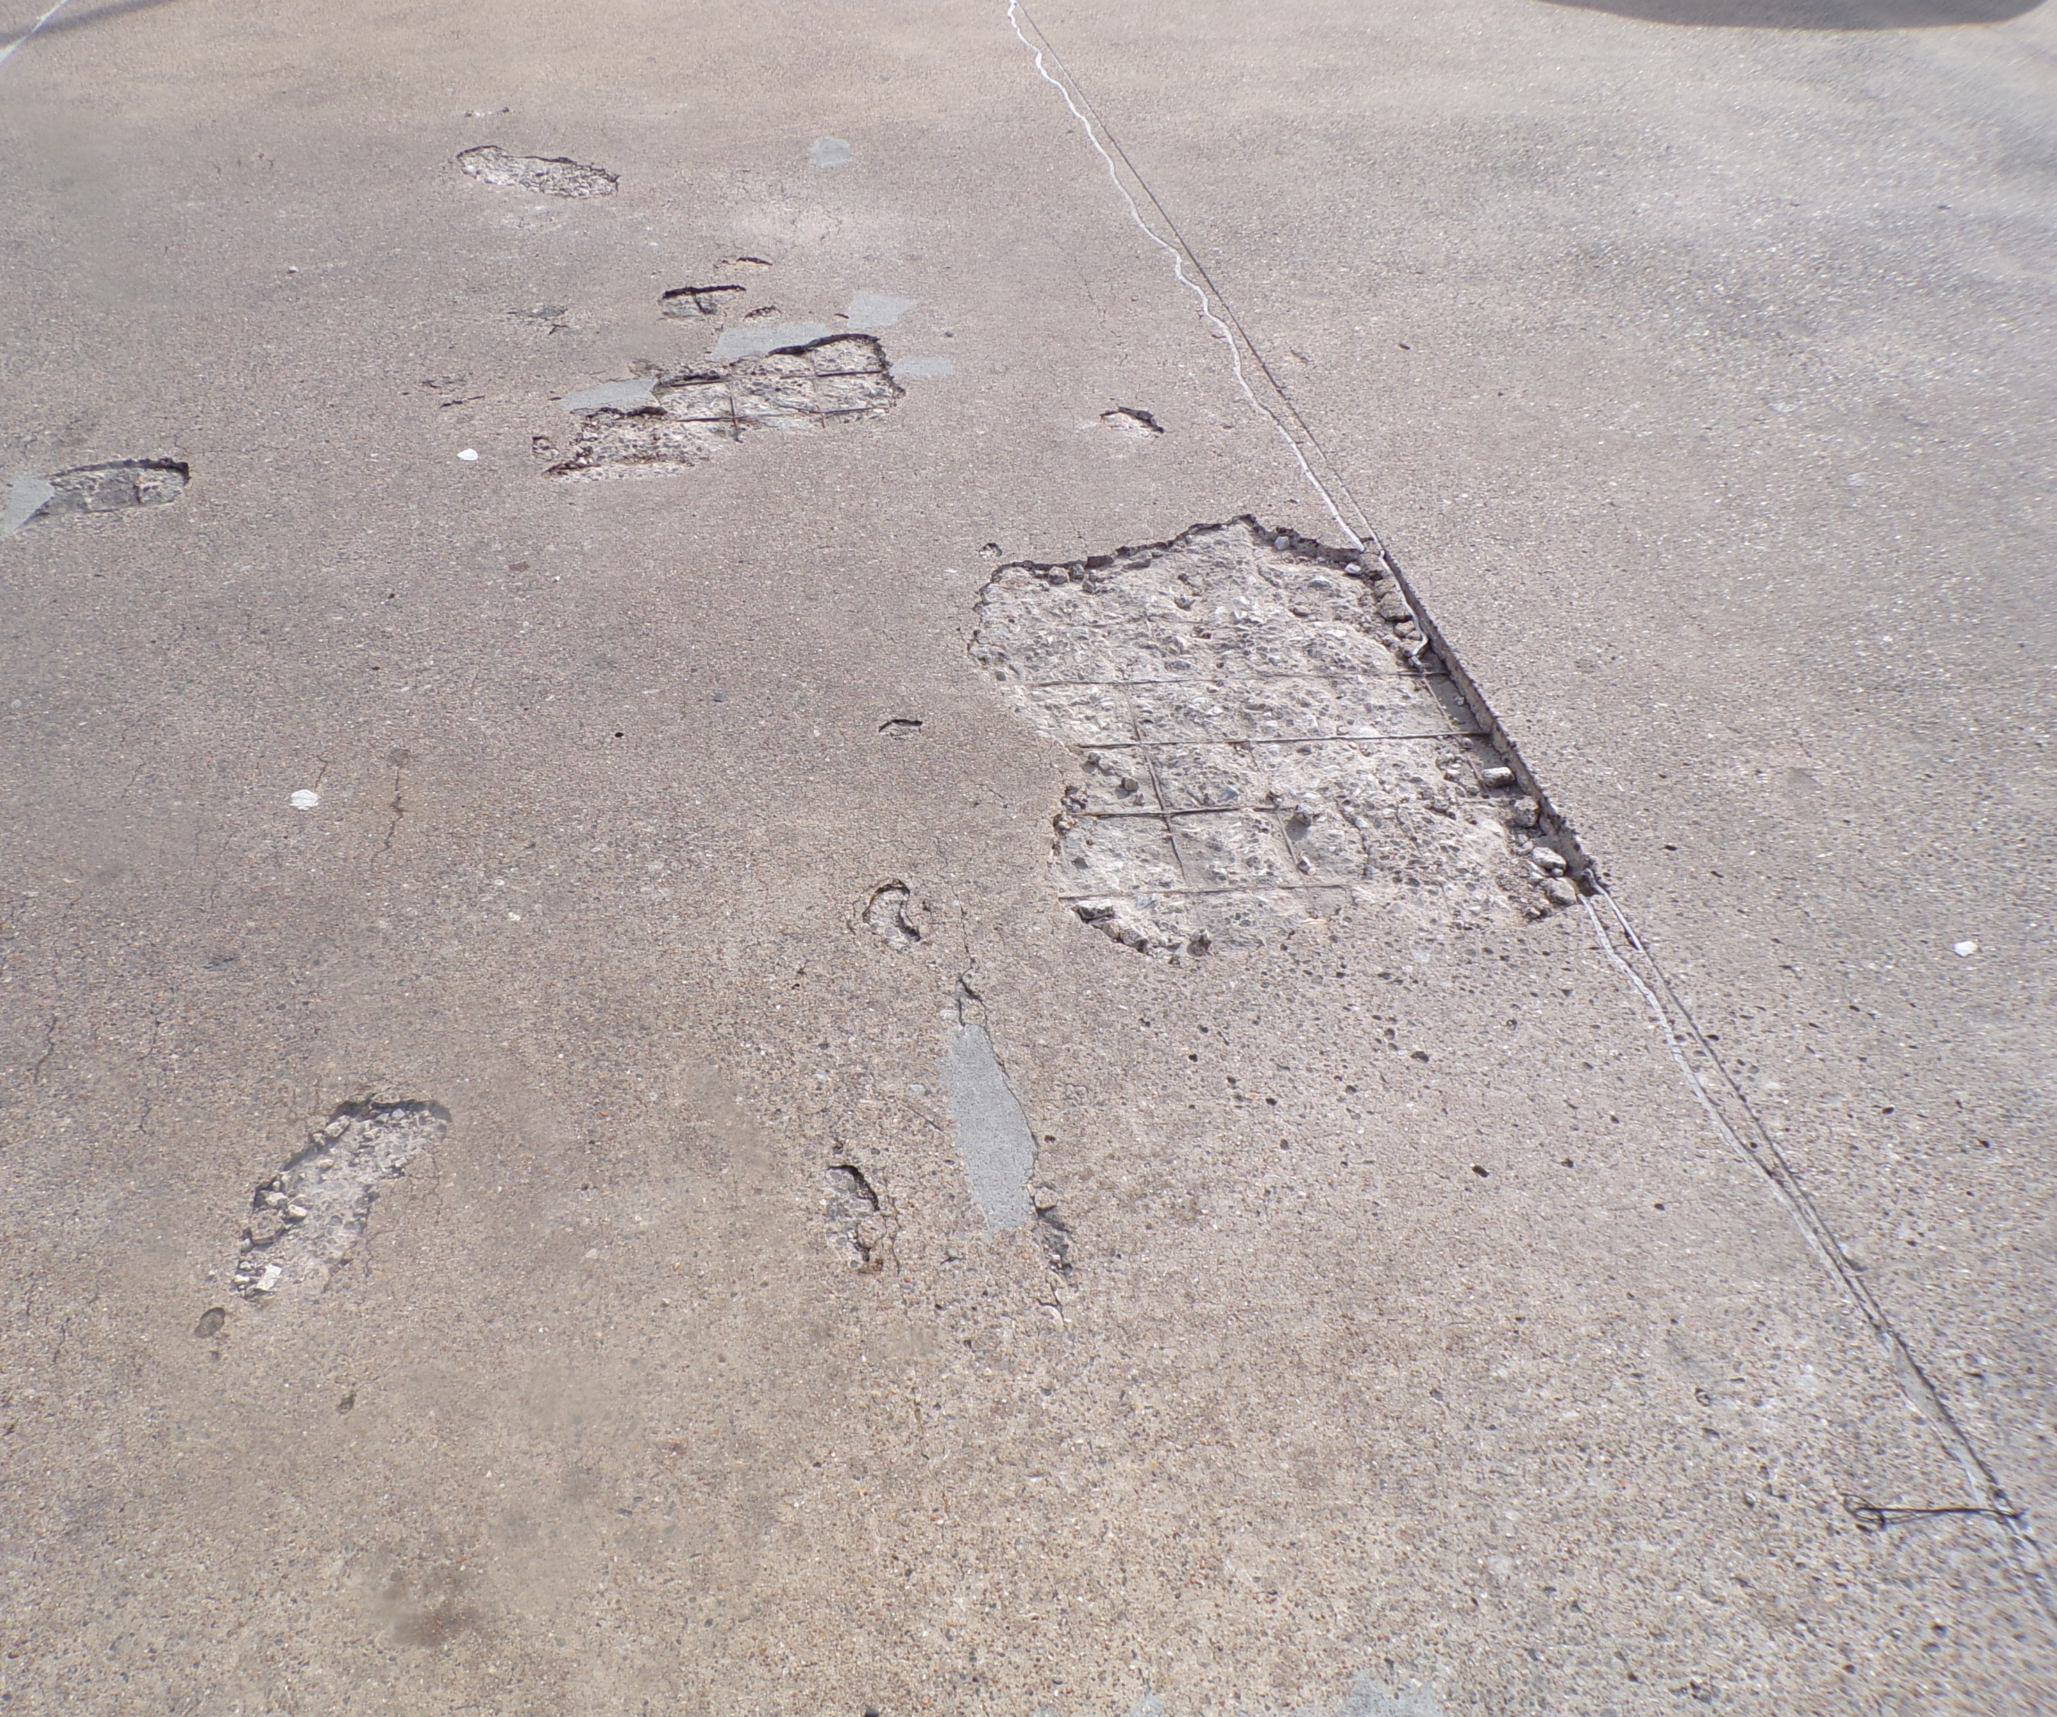
HCA Hospital Garage
2-level precast garage on grade, 1 elevated deck
Damaged/spalled concrete on top deck perimeter
Damaged/failed expansion joint
Damaged precast panel
Damaged column and inverted TEE beam
Plano, TX
Notes:
Importance of Preventative Maintenance for Facility Safety

Slide 17
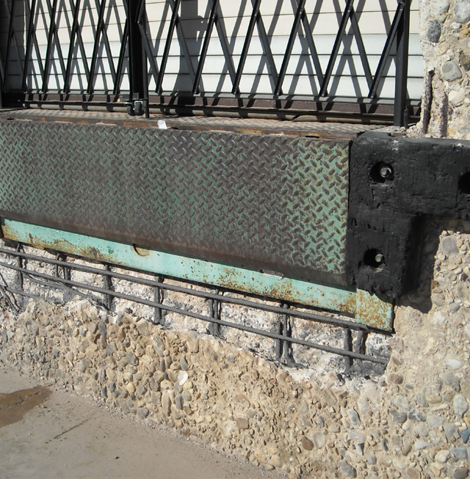
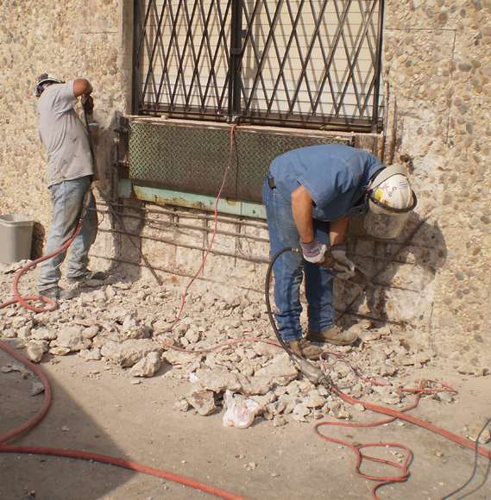
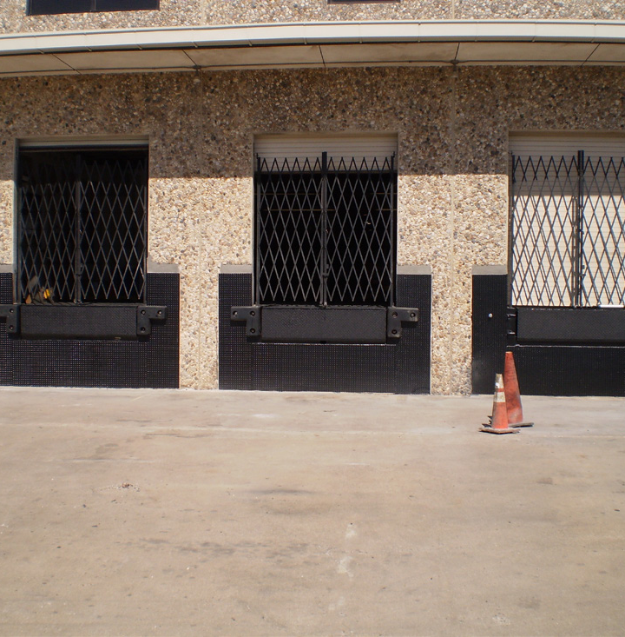
Attorney general warehouse
Applied non-slip, anti-corrosion coating to all horizontal surfaces in loading dock area
Removed deteriorated concrete & treated the reinforcing steel for corrosion
Areas were formed with steel plates & high strength concrete was placed
New rubber bumpers were added & coating was applied to the diamond steel plate
The scope of work also included replacing sealants, water repellent, sand blasting, painting & small miscellaneous repairs
Austin, TX
Notes:
Importance of Preventative Maintenance for Facility Safety

Slide 18
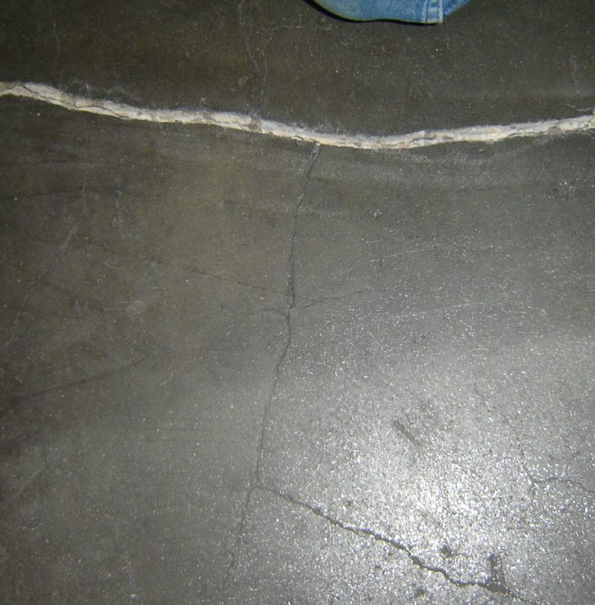
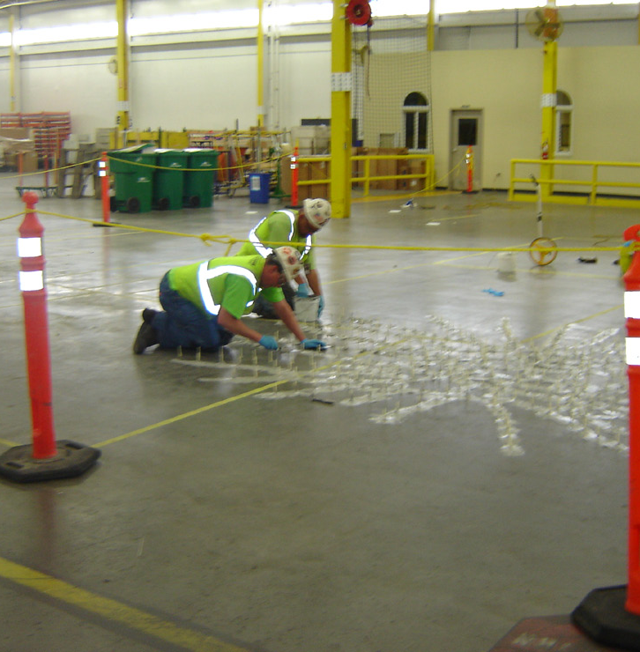
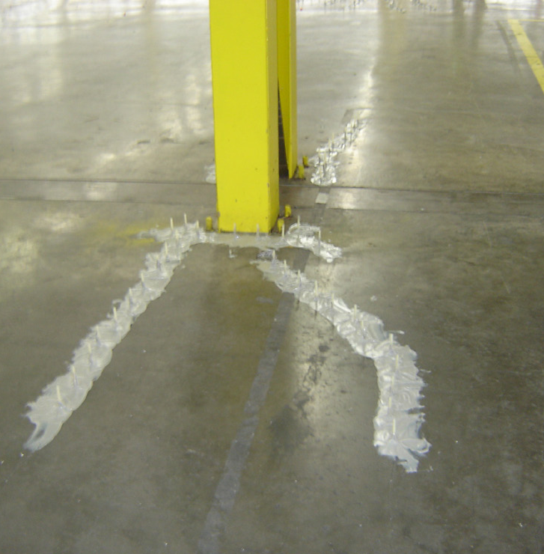
Anderson windows
Concrete floor cracks varied in width & depth
Different means & methods were tried but epoxy injection under low pressure was the method chosen for gluing the concrete slab back together
Taking cores of slab proved the epoxy had achieved four inches of penetration
9,000+ lineal feet of cracks were injected, mainly on the column tops
Bayport, MN
Notes:
Importance of Preventative Maintenance for Facility Safety

Slide 19
Roofing services
Emergency Repairs
Leak investigations
Full and Partial Roof Replacements
Single-ply Roofing (EPDM, TPO, PVC)
Modified Bitumen Roofing
Green Roofs
Maintenance Programs
New Construction
Capital Budgeting
**Full install available in select markets
**New construction available in select markets
Notes:
Preventative maintenance is the backbone of ensuring a safe and structurally sound parking deck or facility environment, especially in high-traffic areas such as those managed by Delta and JLL. Small defects—such as cracks, water infiltration, and surface deterioration—may appear harmless at first but can escalate into major structural concerns if left unaddressed. These seemingly minor issues can compromise the integrity of concrete surfaces, beams, columns, and joints, eventually leading to hazards such as loose concrete, corroded reinforcing steel, delamination, and potential falling debris. Identifying and addressing these problems early protects both people and property by minimizing the risk of trip hazards, falling material, and unexpected structural failures. Moreover, preventative maintenance supports operational continuity by reducing the likelihood of sudden closures or emergency repairs, creating a safer, more reliable environment for employees and customers alike. This proactive approach also extends the lifespan of structural components by preventing accelerating damage caused by moisture, chlorides, freeze–thaw cycles, or insufficient drainage. When routine inspections are paired with the correct repair methods, facilities teams can effectively mitigate risks that develop from daily wear and environmental exposure. For organizations like Delta and JLL, which oversee high-traffic facilities, a strong maintenance program reinforces compliance expectations, protects brand reputation, and enhances user safety. Ultimately, preventative maintenance is not just a cost-saving strategy—it’s a comprehensive safety-driven practice that ensures long-term stability, reduces liability, and keeps working environments secure for all.

Slide 20
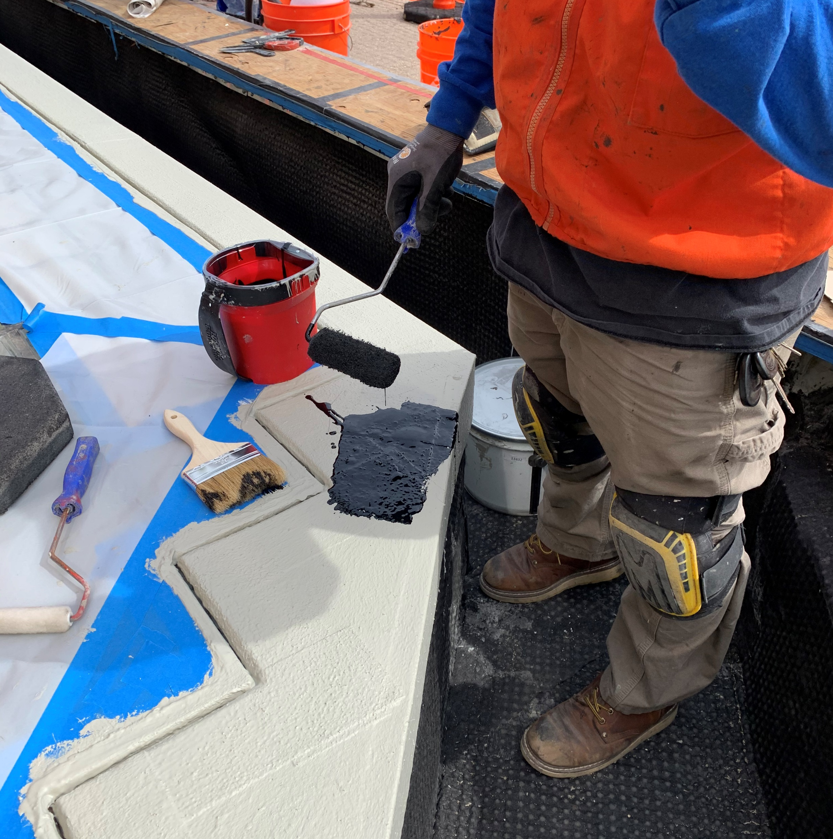
Miscellaneous services
Terraces
Balconies
Planter Waterproofing
Fountain & Tank Submersible Coating Liners
Vertical Access Solutions
Swing Stages / Lifts / Scaffolding
Floor Drain Replacement
Railing Repairs & Replacement
Notes:
Preventative maintenance is the backbone of ensuring a safe and structurally sound parking deck or facility environment, especially in high-traffic areas such as those managed by Delta and JLL. Small defects—such as cracks, water infiltration, and surface deterioration—may appear harmless at first but can escalate into major structural concerns if left unaddressed. These seemingly minor issues can compromise the integrity of concrete surfaces, beams, columns, and joints, eventually leading to hazards such as loose concrete, corroded reinforcing steel, delamination, and potential falling debris. Identifying and addressing these problems early protects both people and property by minimizing the risk of trip hazards, falling material, and unexpected structural failures. Moreover, preventative maintenance supports operational continuity by reducing the likelihood of sudden closures or emergency repairs, creating a safer, more reliable environment for employees and customers alike. This proactive approach also extends the lifespan of structural components by preventing accelerating damage caused by moisture, chlorides, freeze–thaw cycles, or insufficient drainage. When routine inspections are paired with the correct repair methods, facilities teams can effectively mitigate risks that develop from daily wear and environmental exposure. For organizations like Delta and JLL, which oversee high-traffic facilities, a strong maintenance program reinforces compliance expectations, protects brand reputation, and enhances user safety. Ultimately, preventative maintenance is not just a cost-saving strategy—it’s a comprehensive safety-driven practice that ensures long-term stability, reduces liability, and keeps working environments secure for all.

Slide 21
National account program
National Footprint with a Single Point of Contact
Consistency = Quality Control Program
Top-Rated Safety Program
Building Evaluations, Phasing, Repair Prioritizations
Training & Education
Notes:
Importance of Preventative Maintenance for Facility Safety

Slide 22
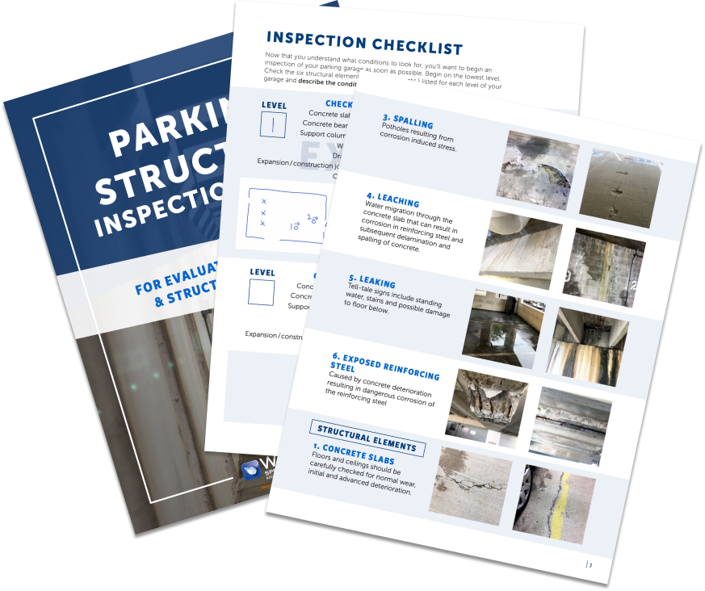
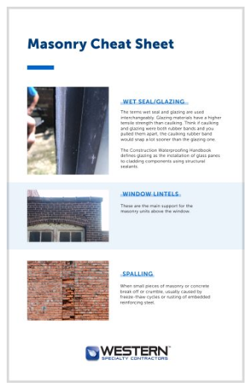
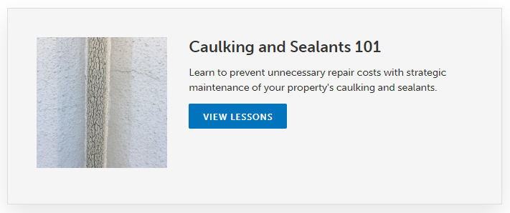
Western’s learning platform
eBooks
Tips
Inspection Guides
Courses
Notes:
Western Specialty Contractors offers a comprehensive range of services designed to enhance safety, durability, and performance across parking structures and building envelopes. Core capabilities include structural concrete repair such as spall patching, form‑and‑place repairs, and shotcrete applications. Western’s waterproofing expertise ensures effective protection against moisture infiltration through deck coatings, sealants, and joint replacement. Masonry restoration services address deterioration in brick, stone, and façade systems with techniques such as tuckpointing, repointing, and material replacement. For structural strengthening, Western provides reinforcement solutions that address corrosion‑related weakening or load‑capacity concerns. The company also performs detailed inspections, condition assessments, and leak investigations that support long-term asset management strategies. These services collectively contribute to safer environments, prolonged structural life, and reduced operational risks, making Western a valuable partner for Delta, JLL, and other facilities teams responsible for maintaining high-traffic environments.

Slide 23

Contact information
Lauren Kurtzeborn
National Account Manager
314-956-6457
LaurenK@Westerngroup.com

Slide 24
NATIONAL FOOTPRINT WITH SINGLE POINT OF CONTACT
CONSISTENCY = QUALITY CONTROL PROGRAM
TOP RATED SAFETY PROGRAM
OSHA = 1.66
EMR = 0.68
ASSISTANCE WITH ASSET MANAGEMENT, BUDGET PLANNING, PROJECT PHASING
PREFERRED PRICING & SCHEDULING
TRAINING & EDUCATION:
MAINTENANCE PROGRAM, REPAIR PRIORITIZATION

