Slide 1
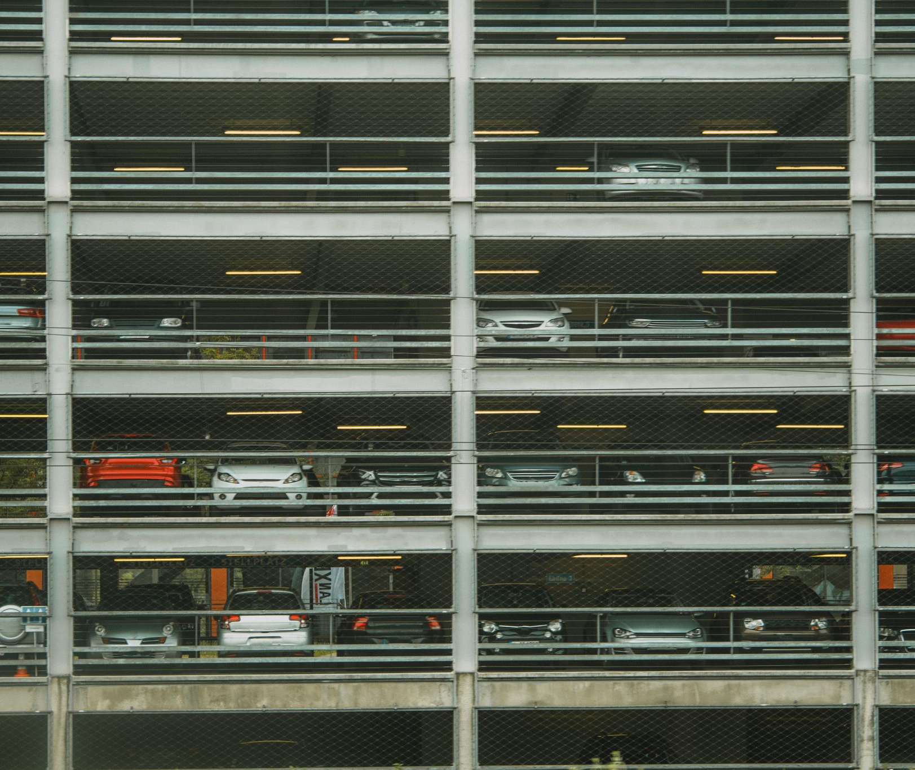
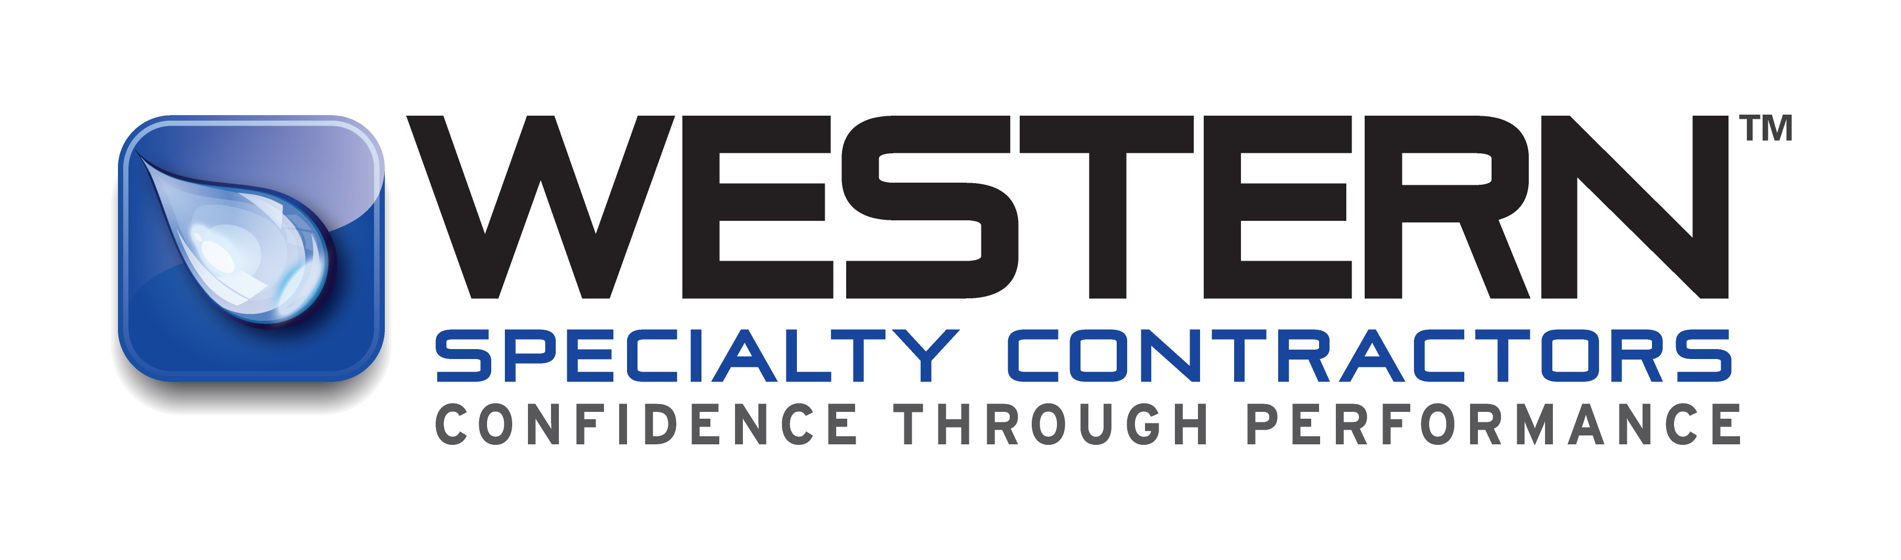
Preventative Maintenance for Parking Decks and Facilities Safety
Ensuring longevity and safety through regular upkeep
Notes:
---

Slide 2
Who is western specialty contractors

Slide 3
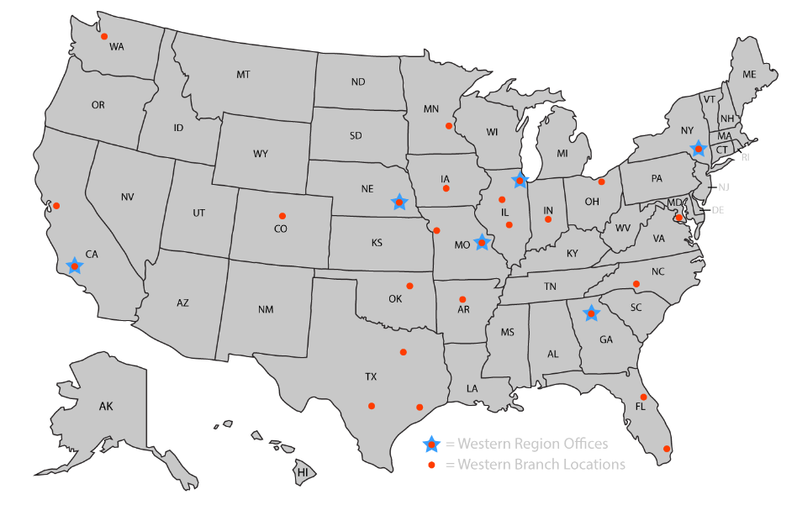
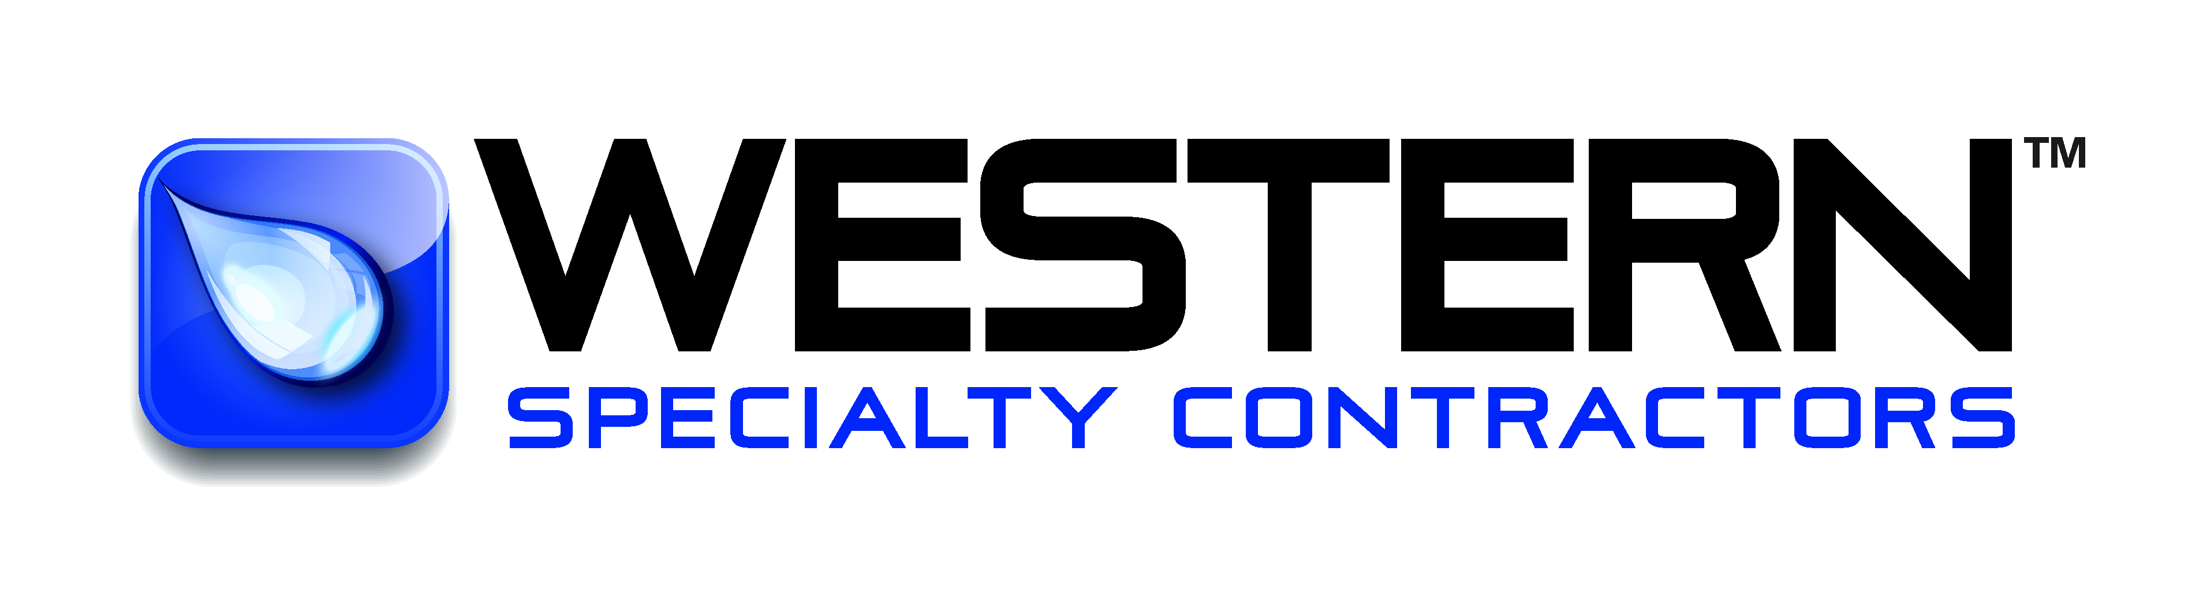
America’s largest building envelope restoration contractor
Founded in 1915
33 Branches Nationwide
Family Owned & Operated
Invested in Client Satisfaction
Clients Are Our Partners
95% of Services are Self-Performed
Industry Leader in Safety
Notes:
Western Specialty Contractors serves as a trusted preferred vendor through Deltaworks, providing specialized expertise when conditions exceed routine maintenance or present an immediate safety concern. Facility teams should contact Western when they encounter deepening or rapidly spreading cracks, persistent leaks that continue despite drain cleaning, or visible rebar exposure, as these signs indicate that deterioration is beyond surface-level repair. Hollow‑sounding slabs, widespread spalling, or any structural distress in beams or columns also require professional evaluation. Western brings advanced inspection techniques, corrosion mitigation strategies, and structural repair capabilities that adhere to best‑practice safety and industry standards. Additionally, Western’s familiarity with Delta and JLL expectations ensures streamlined communication, quicker mobilization, and coordinated project execution. Engaging Western early not only restores structural integrity but also prevents hazards from escalating, offering peace of mind to facility managers responsible for high-traffic environments such as airport parking structures or operational facilities.

Slide 4
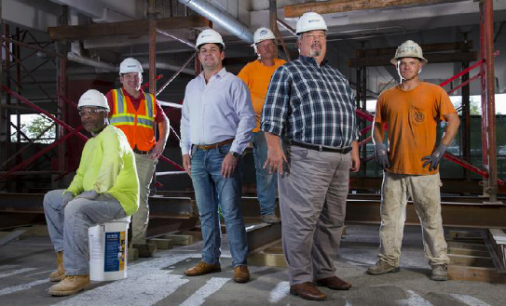
Concrete, Facade and Masonry Restoration
Expansion Joint Systems
Exterior Wall Coatings
Parking & Plaza Deck Restoration
Waterproofing
Historic Restoration
Western’s Core Services for Parking Decks and Buildings
Notes:
Western Specialty Contractors offers a comprehensive range of services designed to enhance safety, durability, and performance across parking structures and building envelopes. Core capabilities include structural concrete repair such as spall patching, form‑and‑place repairs, and shotcrete applications. Western’s waterproofing expertise ensures effective protection against moisture infiltration through deck coatings, sealants, and joint replacement. Masonry restoration services address deterioration in brick, stone, and façade systems with techniques such as tuckpointing, repointing, and material replacement. For structural strengthening, Western provides reinforcement solutions that address corrosion‑related weakening or load‑capacity concerns. The company also performs detailed inspections, condition assessments, and leak investigations that support long-term asset management strategies. These services collectively contribute to safer environments, prolonged structural life, and reduced operational risks, making Western a valuable partner for Delta, JLL, and other facilities teams responsible for maintaining high-traffic environments.

Slide 5
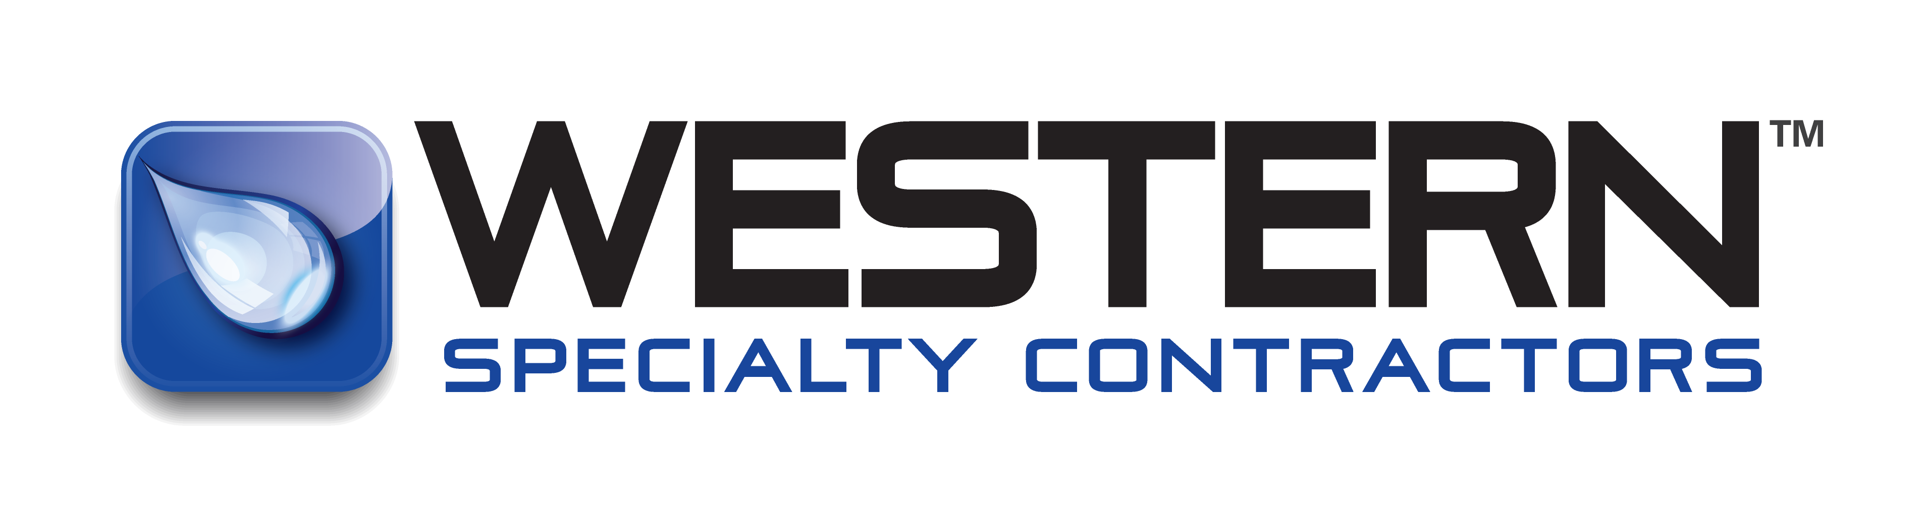
Preventative Maintenance and Safety Foundations
Notes:
Importance of Preventative Maintenance for Facility Safety

Slide 6
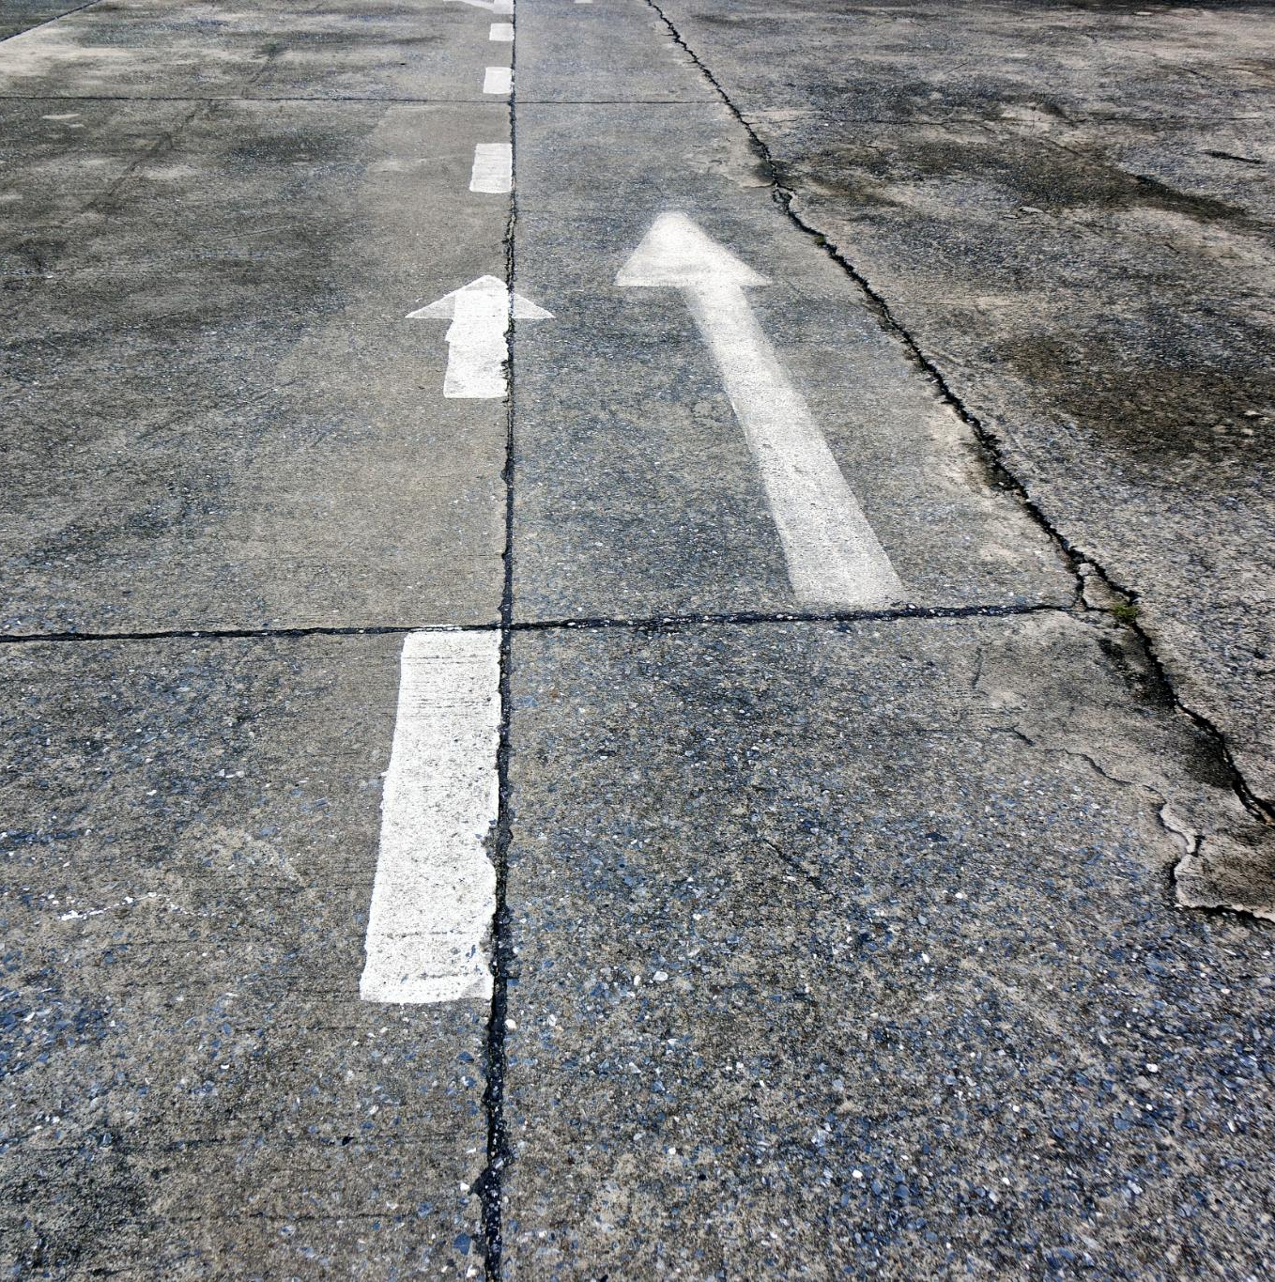
Importance of Preventative Maintenance for Facility Safety
Early Defect Identification
  Detecting minor defects like cracks and water infiltration early prevents major structural damage and safety hazards.
Safety Risk Mitigation
  Addressing structural issues early reduces risks of falling debris, trip hazards, and structural failures in facilities.
Operational Continuity
  Preventative maintenance minimizes unexpected closures and emergency repairs, ensuring reliable facility operations.
Extended Structural Lifespan
  Proper maintenance protects structural components from moisture damage, corrosion, and environmental wear over time.
Notes:
Preventative maintenance is the backbone of ensuring a safe and structurally sound parking deck or facility environment, especially in high-traffic areas such as those managed by Delta and JLL. Small defects—such as cracks, water infiltration, and surface deterioration—may appear harmless at first but can escalate into major structural concerns if left unaddressed. These seemingly minor issues can compromise the integrity of concrete surfaces, beams, columns, and joints, eventually leading to hazards such as loose concrete, corroded reinforcing steel, delamination, and potential falling debris. Identifying and addressing these problems early protects both people and property by minimizing the risk of trip hazards, falling material, and unexpected structural failures. Moreover, preventative maintenance supports operational continuity by reducing the likelihood of sudden closures or emergency repairs, creating a safer, more reliable environment for employees and customers alike. This proactive approach also extends the lifespan of structural components by preventing accelerating damage caused by moisture, chlorides, freeze–thaw cycles, or insufficient drainage. When routine inspections are paired with the correct repair methods, facilities teams can effectively mitigate risks that develop from daily wear and environmental exposure. For organizations like Delta and JLL, which oversee high-traffic facilities, a strong maintenance program reinforces compliance expectations, protects brand reputation, and enhances user safety. Ultimately, preventative maintenance is not just a cost-saving strategy—it’s a comprehensive safety-driven practice that ensures long-term stability, reduces liability, and keeps working environments secure for all.

Slide 7
Common Conditions and Their Safety Impact
Notes:
Cracking, Scaling, and Spalling Risks, Leaking, Drainage Failures, and Water Intrusion, Corrosion, Rust, and Exposure of Reinforcing Steel, Key Structural Components to Inspect Regularly

Slide 8
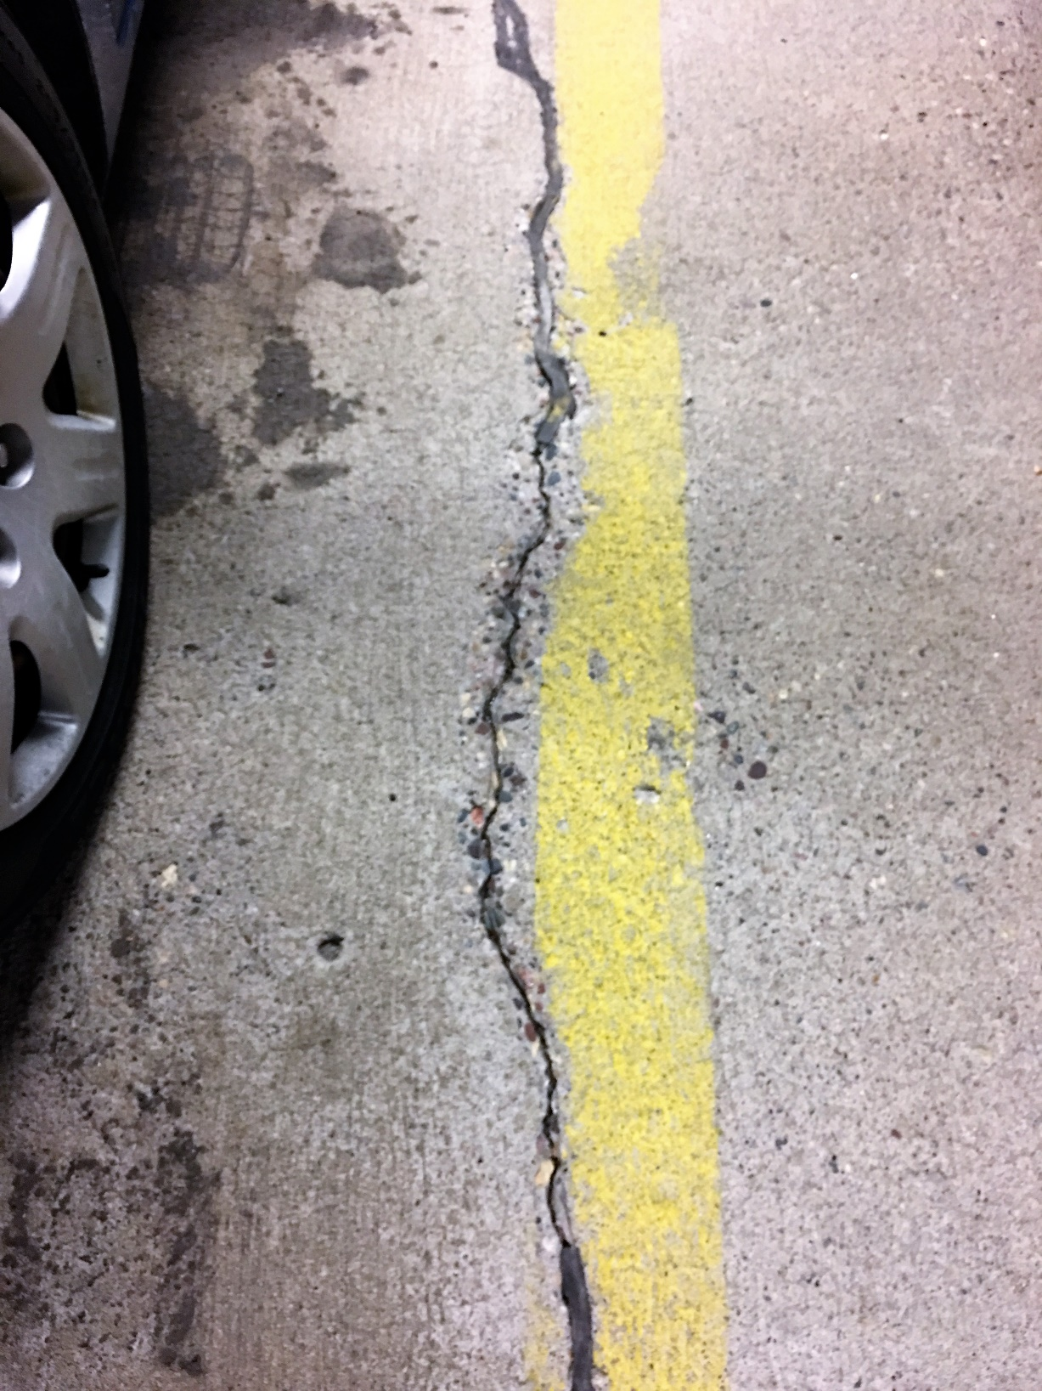
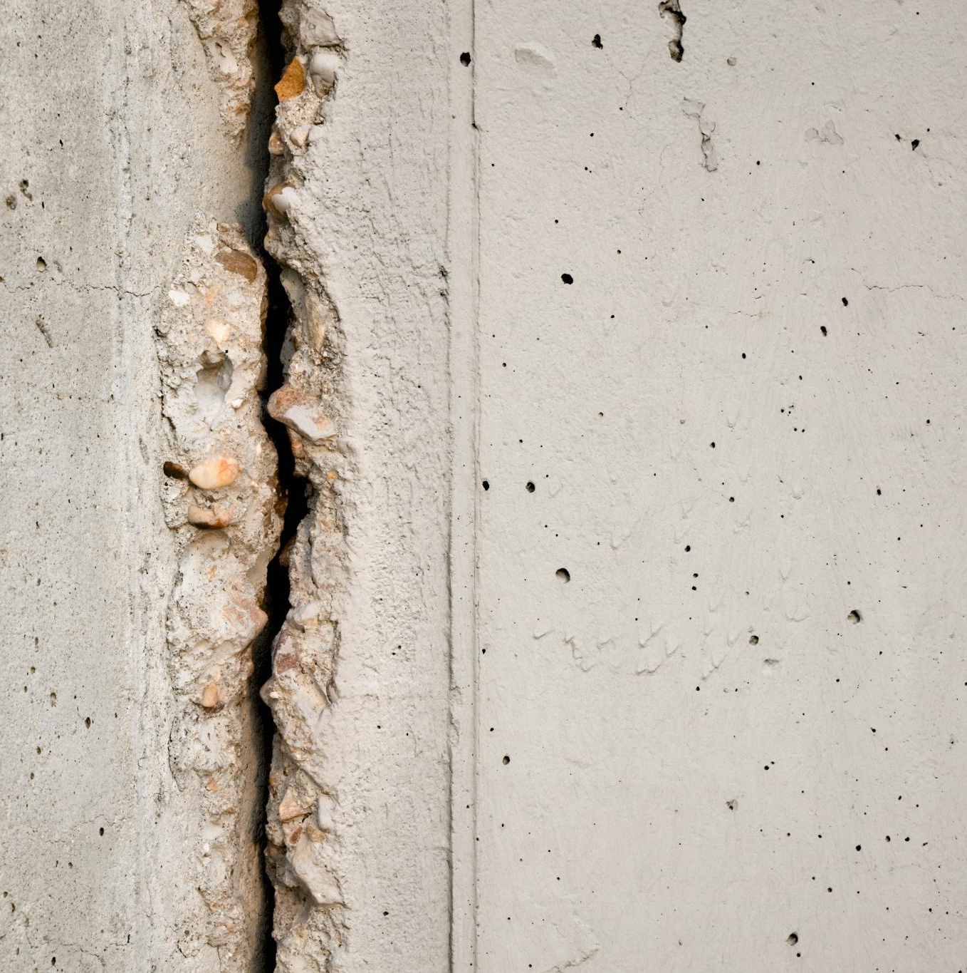
Cracking, Scaling, and Spalling Risks
Cracking and Water Infiltration
  Cracks allow water and chlorides to penetrate concrete, accelerating steel corrosion and reducing load capacity.
Scaling and Surface Deterioration
  Scaling deteriorates the concrete surface, causing uneven, slippery conditions that increase pedestrian and vehicle hazards.
Spalling and Structural Damage
  Spalling causes chunks of concrete to detach, exposing rebar and creating potholes that pose safety risks.
Importance of Early Intervention
  Early detection and repair prevent safety incidents and preserve structural integrity of parking facilities.
Notes:
Cracking, scaling, and spalling are among the most common deterioration types found in parking structures, and each poses distinct safety threats. Cracks in concrete often result from structural stress, freeze–thaw cycles, or long-term usage, and while they may start small, they create pathways for water and chlorides to penetrate deeper into the slab. This infiltration accelerates corrosion of reinforcing steel, ultimately compromising load-bearing capacity. Scaling occurs when the surface layer of concrete deteriorates, often due to freeze–thaw cycles or insufficient air entrainment. This can produce uneven and slippery surfaces, increasing trip-and-fall risks for pedestrians and vehicle skidding hazards. Spalling—where chunks of concrete detach—is usually a direct indicator of advancing corrosion below the surface. Spalled areas create potholes that damage vehicles, catch pedestrians off guard, and reveal dangerously exposed rebar. When not addressed, these conditions evolve into widespread degradation that demands larger-scale structural repairs. Facilities teams who routinely identify and intervene early in cracking, scaling, and spalling can prevent most safety incidents associated with unstable surfaces and falling material. Addressing these issues is not simply cosmetic—it is essential to preserving structural integrity, eliminating hazards, and ensuring predictable operational conditions across the entire parking system.

Slide 9
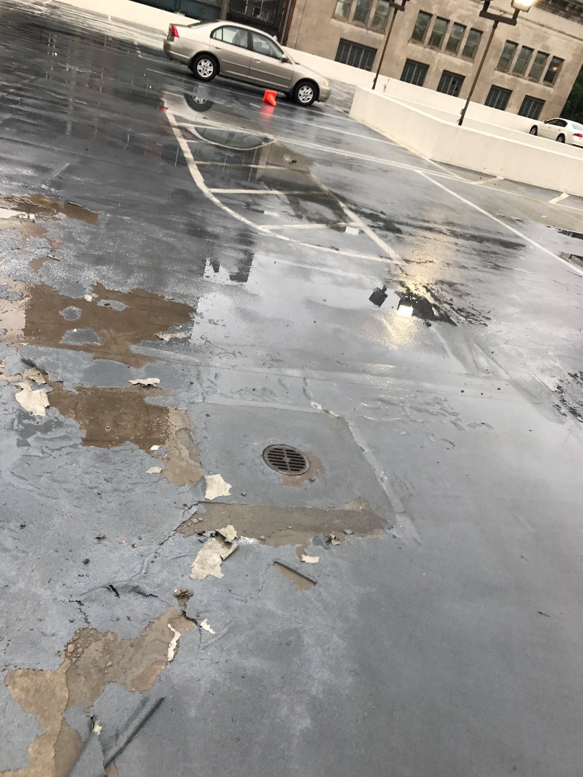
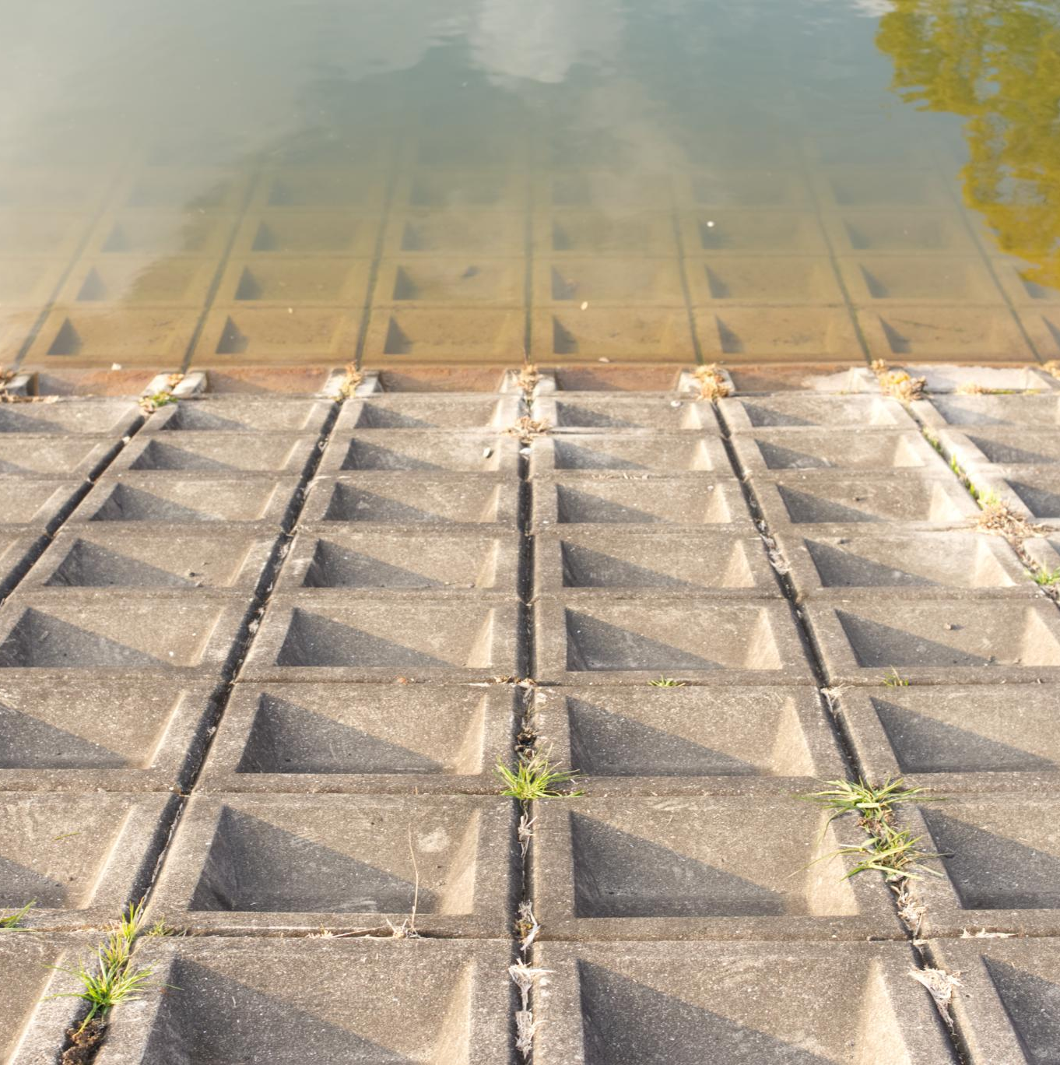
Leaking, Drainage Failures, and Water Intrusion
Causes of Water Intrusion
  Clogged drains and failed waterproofing cause water to pool and seep into structural cracks.
Structural Damage Due to Moisture
  Persistent moisture leads to corrosion, delamination, and internal cracking within concrete structures.
Safety Hazards
  Wet or icy surfaces increase slip hazards for employees and visitors in parking and structural facilities.
Maintenance and Prevention
  Regular inspections and drain maintenance help prevent water-related structural damage and safety risks.
Notes:
Water intrusion is one of the leading causes of accelerated deterioration in parking decks and structural facilities. When drains become clogged or when waterproofing systems fail, water begins to pond on surfaces, seep into cracks, and migrate through concrete slabs. Over time, this movement can lead to leaching, where mineral deposits accumulate on surfaces, signaling that moisture is infiltrating deep into the structure. Persistent moisture exposure contributes to corrosion of reinforcing steel, delamination, and internal cracking—conditions that are often hidden until advanced damage occurs. Additionally, wet or icy surfaces significantly increase slip hazards for employees, tenants, or travelers. Poor drainage systems may cause water infiltration into lower levels, potentially damaging electrical systems, mechanical spaces, or vehicle storage areas. Effective drainage maintenance—combined with scheduled inspections—is critical to preventing long-term structural issues, environmental damage, and personal injury. By actively monitoring drains, sealants, joints, and slope direction, facilities teams can ensure water is properly directed away from vulnerable areas, reducing both immediate risks and future remediation costs.

Slide 10
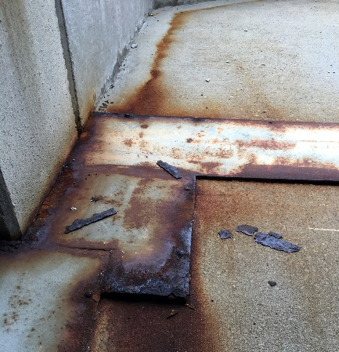
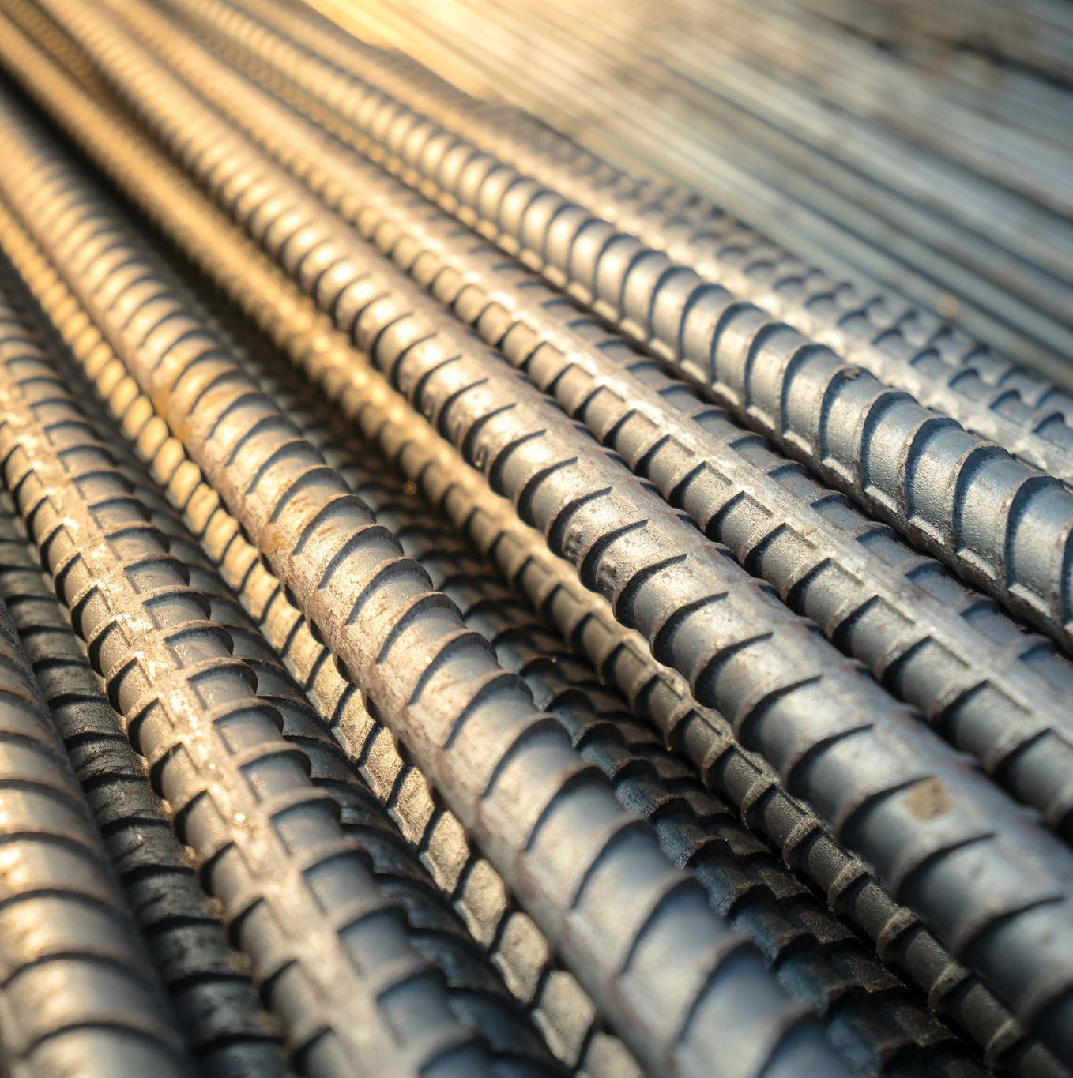
Corrosion, Rust, and Exposure of Reinforcing Steel
Corrosion Impact on Concrete
  Corrosion causes reinforcing bars to expand and exert pressure, leading to concrete cracking and spalling.
Rust as Early Warning
  Rust staining indicates ongoing corrosion, helping maintenance teams detect issues early and intervene timely.
Exposed Reinforcing Steel Risks
  Exposed steel accelerates deterioration as it loses protection, worsening structural damage rapidly.
Preventive Maintenance Actions
  Early cleaning, treatment of rebar and concrete repair extend structure lifespan and prevent failures.
Notes:
Corrosion is one of the most destructive forces affecting reinforced concrete structures. When moisture and chlorides enter the concrete matrix, they disrupt the high-alkalinity environment that typically protects steel reinforcement. As corrosion progresses, the reinforcing bars expand up to several times their original size, exerting immense pressure on the surrounding concrete—upwards of several thousand PSI. This pressure causes cracking, delamination, and eventual spalling, leading to chunks of concrete separating from overhead or vertical surfaces. Such conditions pose immediate safety concerns due to the risk of falling concrete and reduced structural capacity. Rust staining is an early warning sign that corrosion is underway, allowing maintenance teams to intervene before significant structural compromises occur. Exposed reinforcing steel, whether due to spalling or inadequate concrete cover, accelerates deterioration even more rapidly since the steel is no longer protected. Addressing corrosion early often involves cleaning and treating rebar, removing unsound concrete, and patching areas with appropriate repair materials. For high-traffic environments such as parking decks used by Delta and JLL teams, understanding corrosion processes and recognizing early indicators are essential in preventing hazardous structural failures and extending the lifespan of critical infrastructure.

Slide 11
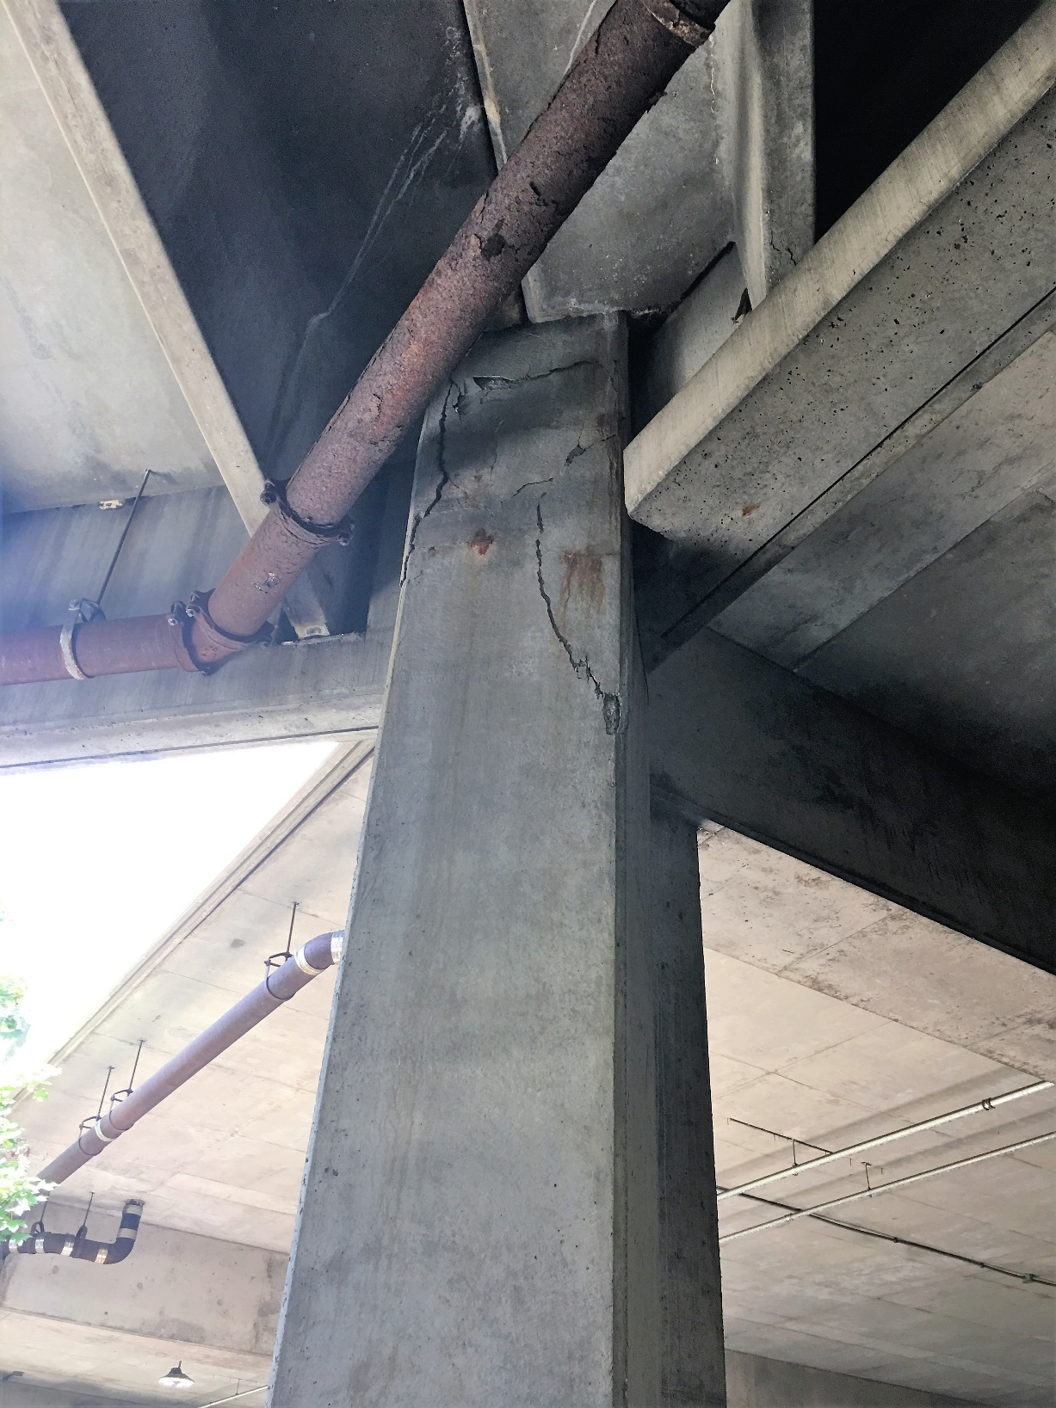
Key Structural Components to Inspect Regularly
Beam Inspection
  Monitor beams for cracking, sagging, and visible corrosion to ensure load-bearing integrity.
Slab Condition Monitoring
  Regularly check slabs for wear, deflection, impact damage, and surface deterioration.
Wall and Vertical Elements
  Inspect walls for water intrusion, cracks, and migration paths indicating structural issues.
Notes:
Regular inspection of structural components is essential to ensuring safety within parking decks and building facilities, especially when deterioration can progress quickly under environmental exposure. Beams should be monitored for cracking, sagging, or visible corrosion, as they serve as primary load-bearing elements. Slabs require consistent observation to detect wear, downward deflection, impact damage, or surface deterioration. Walls and vertical elements must be checked for water intrusion, cracks, and migration pathways that may indicate deeper structural issues. Drains represent one of the most maintenance-critical features, as clogged or impaired drainage can lead to ponding water that spreads deterioration. Expansion joints and sealants should be inspected for tears, gaps, or deterioration caused by traffic loads or temperature fluctuations, since failing joints can allow water infiltration and compromise the structure’s ability to accommodate movement. Columns must be checked for cracking, settlement indicators, or early signs of stress, as column failure can result in catastrophic structural collapse. By implementing structured and routine walkthroughs focused on these components, facility teams can proactively identify hazards, maintain system integrity, and prevent safety incidents before they occur.

Slide 12
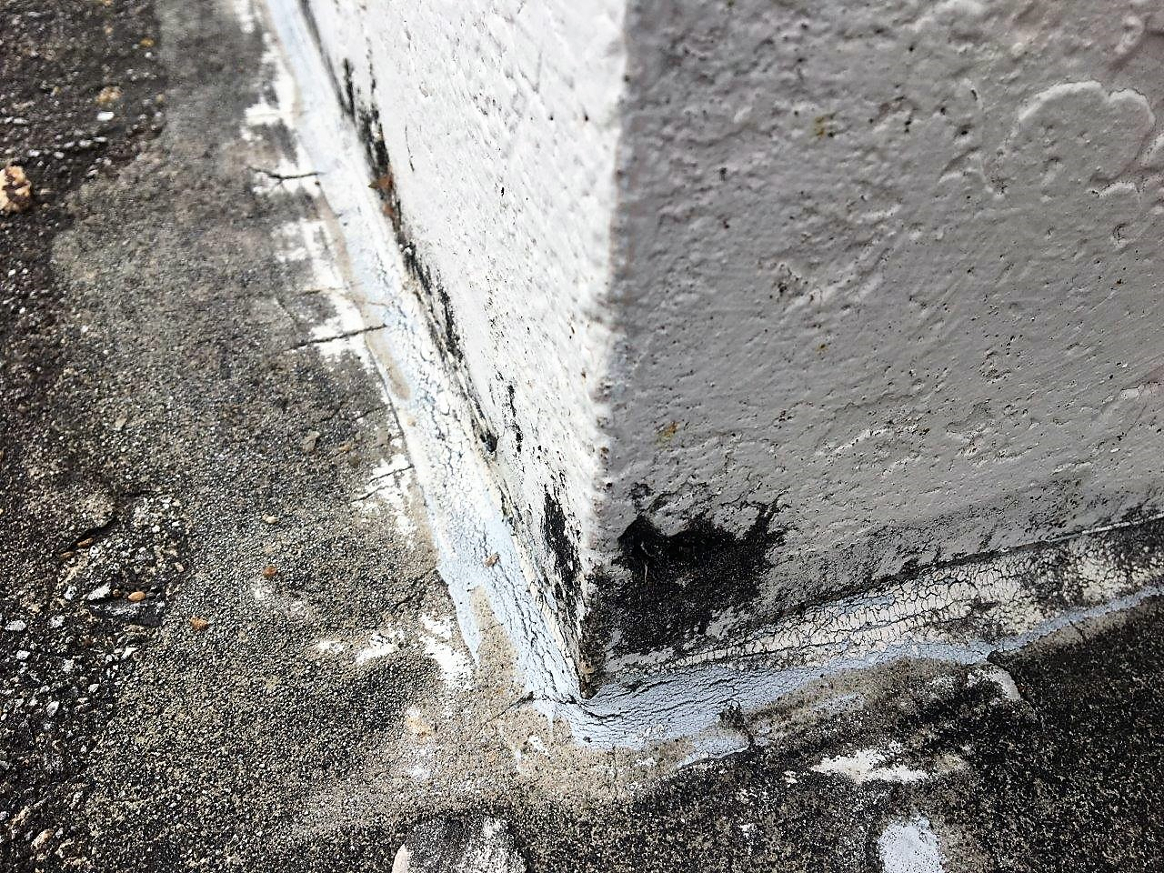
Key Structural Components to Inspect Regularly
Drainage and Expansion Joints
  Check drains for clogging and expansion joints for tears or gaps to prevent water infiltration.
Column Health Assessment
  Examine columns for cracks, settlement, and early stress signs to avoid structural collapse.
Notes:
Regular inspection of structural components is essential to ensuring safety within parking decks and building facilities, especially when deterioration can progress quickly under environmental exposure. Beams should be monitored for cracking, sagging, or visible corrosion, as they serve as primary load-bearing elements. Slabs require consistent observation to detect wear, downward deflection, impact damage, or surface deterioration. Walls and vertical elements must be checked for water intrusion, cracks, and migration pathways that may indicate deeper structural issues. Drains represent one of the most maintenance-critical features, as clogged or impaired drainage can lead to ponding water that spreads deterioration. Expansion joints and sealants should be inspected for tears, gaps, or deterioration caused by traffic loads or temperature fluctuations, since failing joints can allow water infiltration and compromise the structure’s ability to accommodate movement. Columns must be checked for cracking, settlement indicators, or early signs of stress, as column failure can result in catastrophic structural collapse. By implementing structured and routine walkthroughs focused on these components, facility teams can proactively identify hazards, maintain system integrity, and prevent safety incidents before they occur.

Slide 13
Understanding Corrosion and Structural Impact
Notes:
How Corrosion Develops and Spreads in Structures, Warning Signs of Corrosion‑Driven Structural Loss

Slide 14
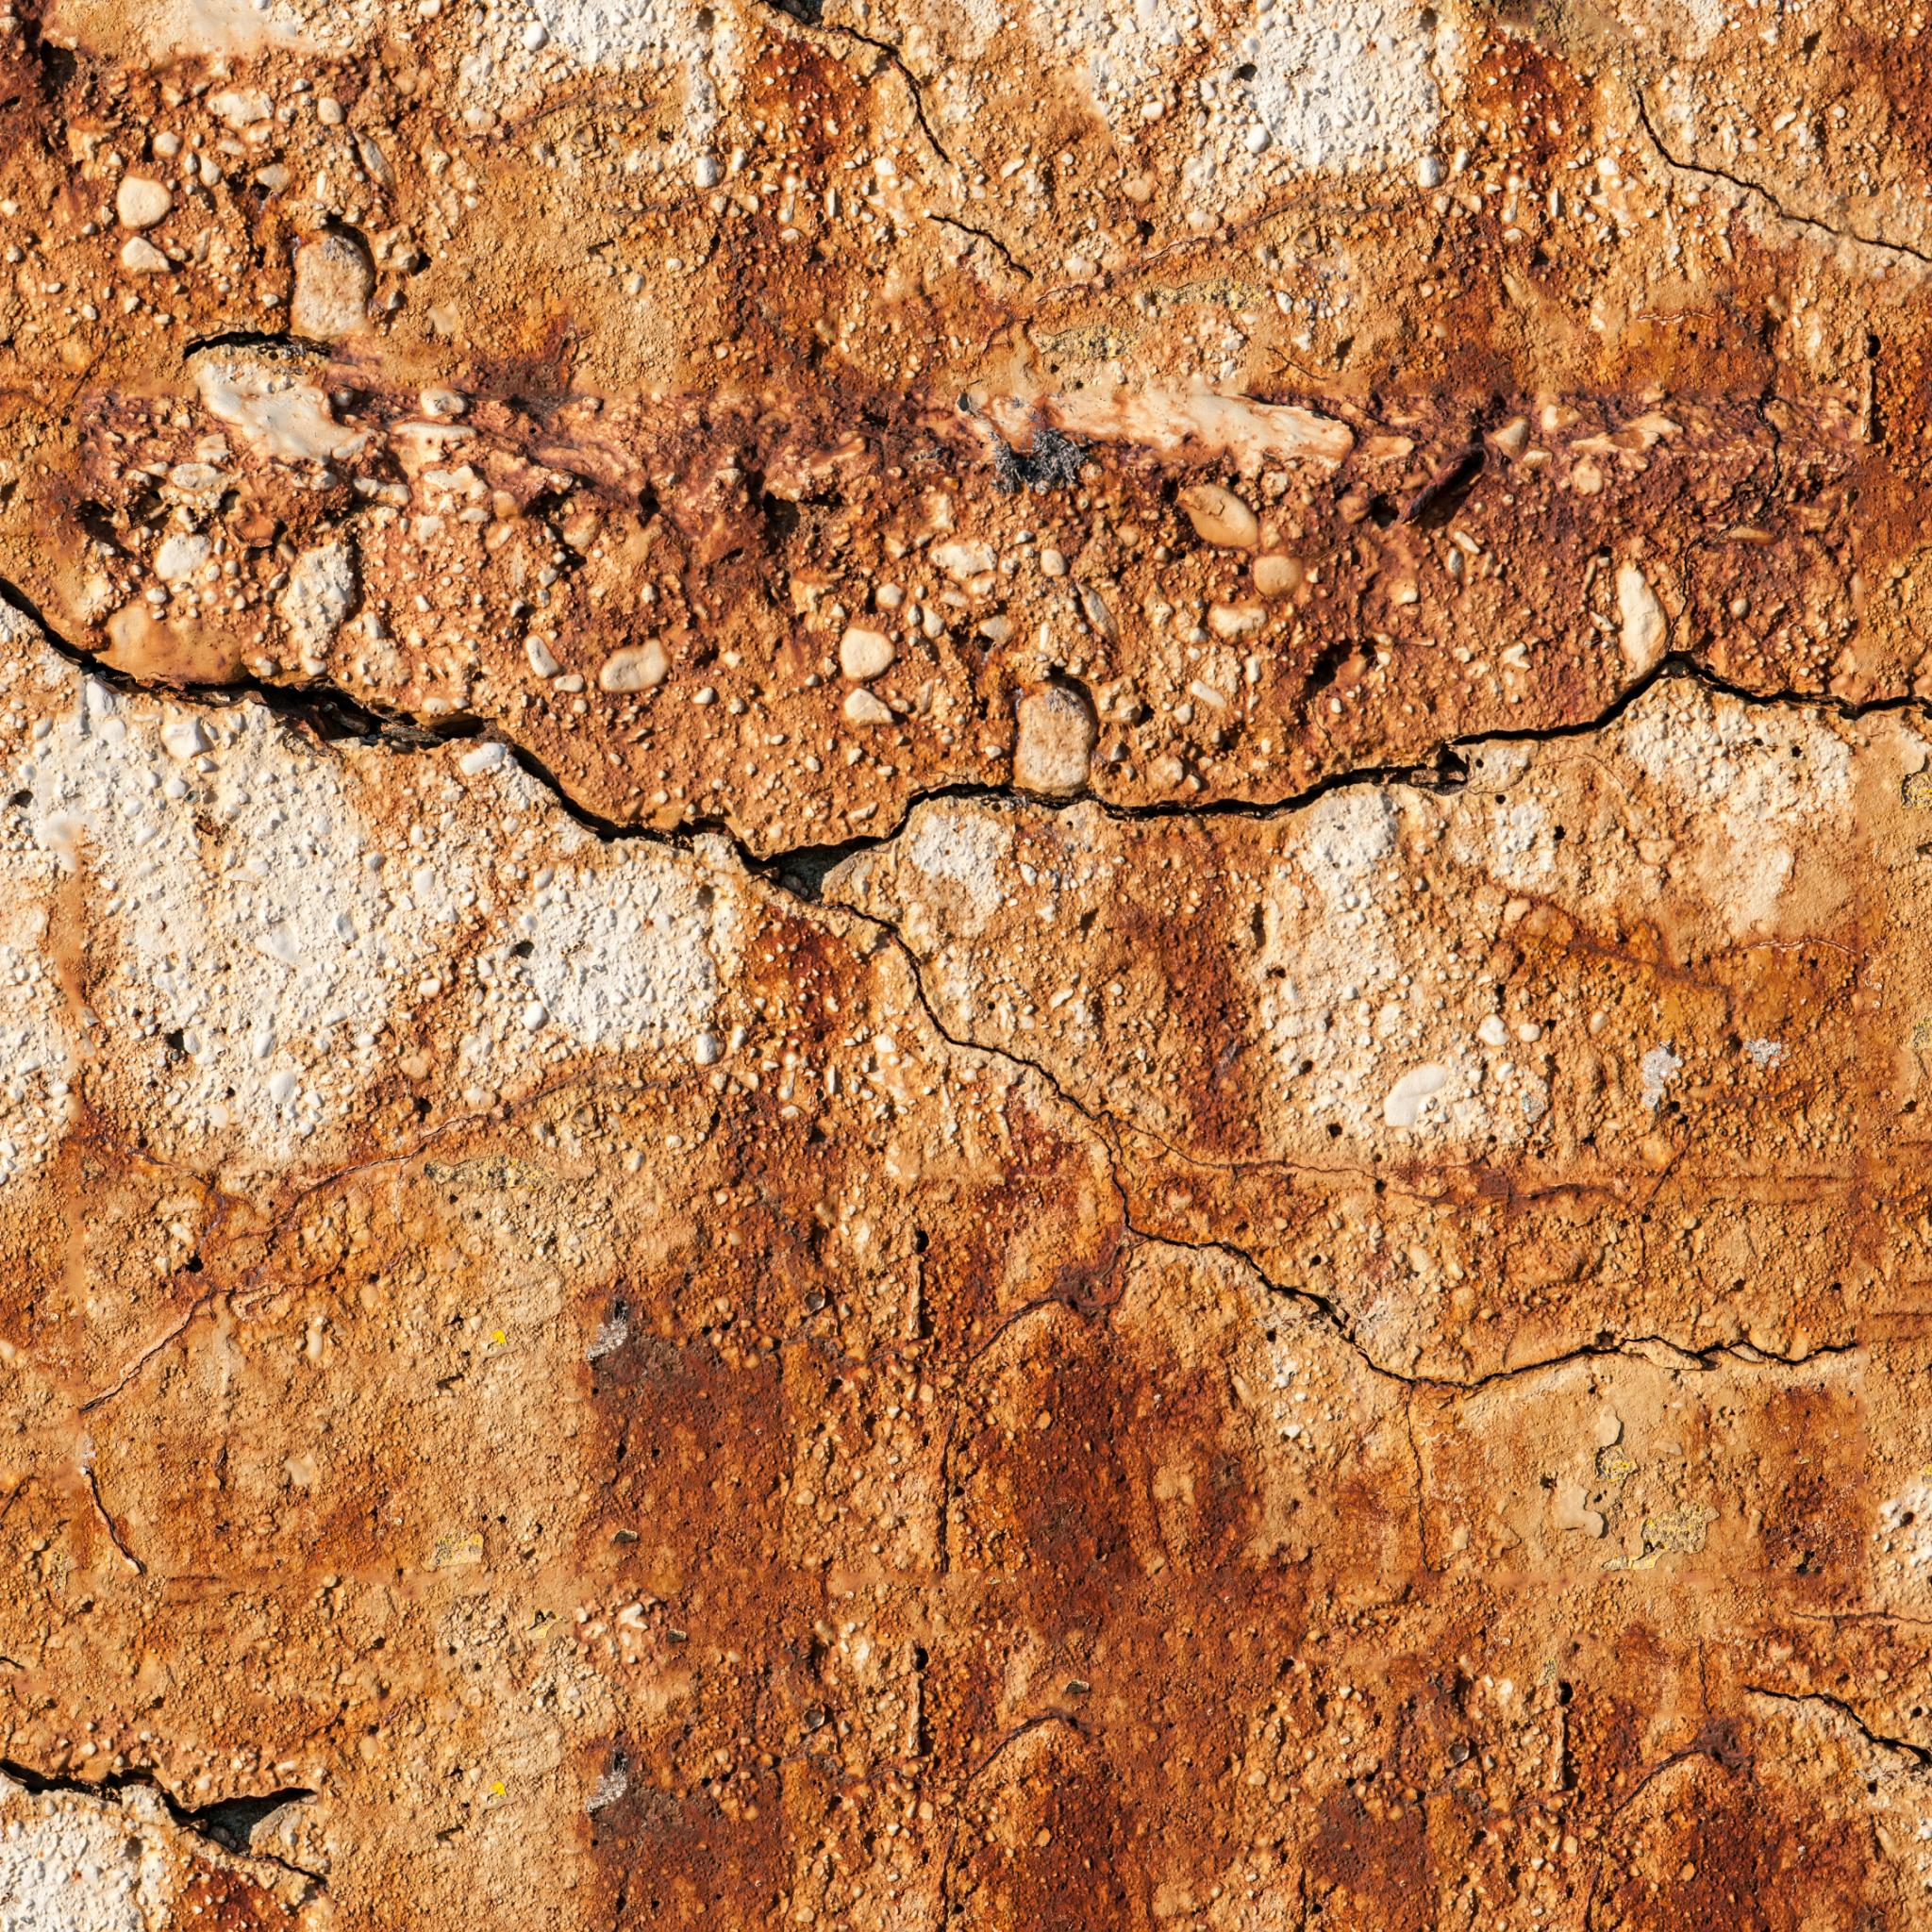
How Corrosion Develops and Spreads in Structures
Chemical Corrosion Process
  Corrosion starts when chloride contamination or moisture breaks down the protective alkaline layer around steel reinforcement.
Structural Damage Mechanism
  Steel expansion during corrosion cracks concrete, creating pathways for water and oxygen, accelerating deterioration.
Consequences of Corrosion
  Corrosion weakens structural components leading to hazards like falling debris and compromised beams or columns.
Early Detection and Prevention
  Recognizing rust stains, cracks, and hollow sounds enables timely interventions to prolong structural service life.
Notes:
Corrosion in reinforced concrete is a chemical process triggered when protective alkaline conditions surrounding the embedded steel begin to break down due to chloride contamination or sustained moisture exposure. Chlorides often originate from deicing salts, ocean air, or contaminated water sources, and once they penetrate the concrete matrix, they disrupt the passivation layer that typically protects steel reinforcement. As corrosion progresses, the steel expands significantly, cracking the concrete around it and creating pathways for more water and oxygen—fueling a cycle of accelerated degradation. This expansion can increase internal pressure by several thousand pounds per square inch, causing delamination between concrete layers. Over time, the weakened structural components lose their ability to perform under load, posing potential hazards such as falling debris, weakened deck surfaces, and compromised beams or columns. The effects of corrosion compound when left unaddressed, often requiring substantial structural rehabilitation once the damage reaches an advanced stage. Understanding the progressive nature of corrosion—and recognizing early indicators such as rust stains, cracking, and hollow‑sounding surfaces—enables facility teams to implement timely interventions that maintain safety, prevent costly shutdowns, and prolong the service life of critical infrastructure.

Slide 15
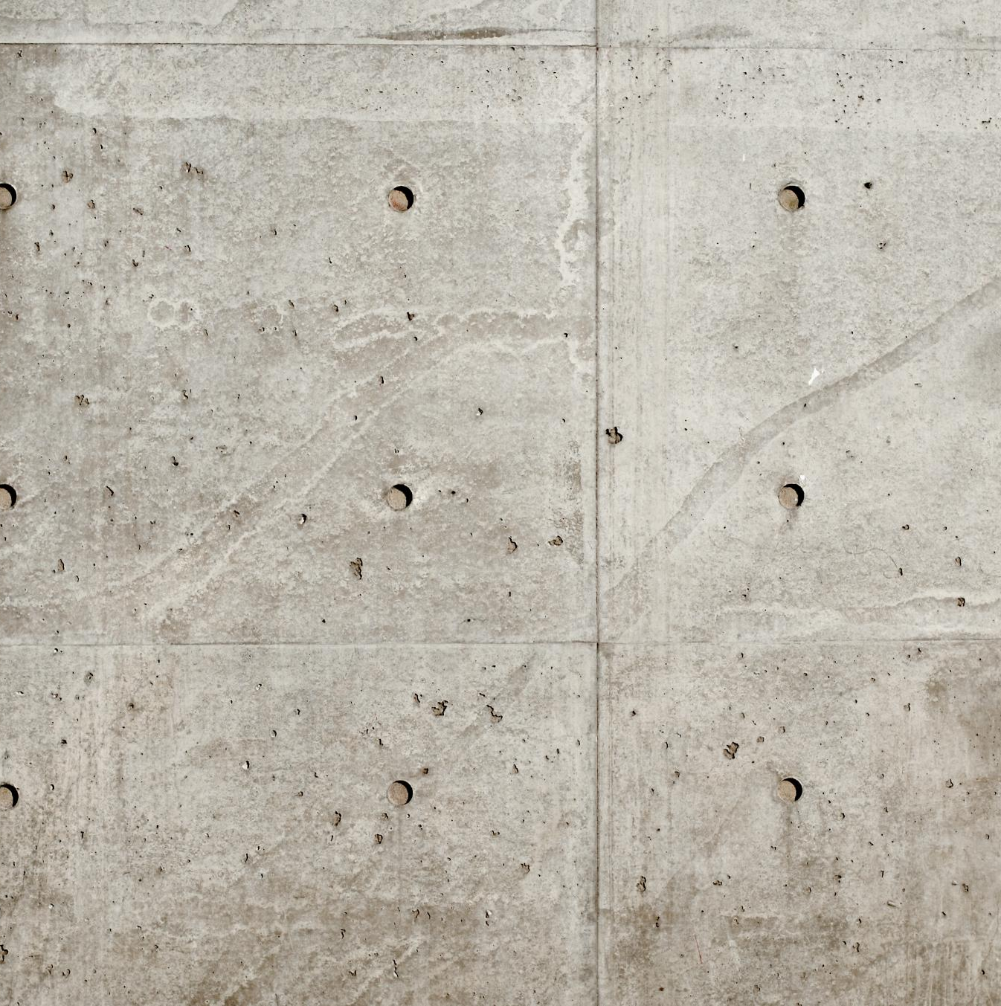
Warning Signs of Corrosion‑Driven Structural Loss
Delamination Detection
  Delamination causes hollow sounds during inspections and indicates concrete separation due to corrosion pressure.
Rust Staining Indicators
  Rust stains on concrete surfaces reveal active corrosion of steel reinforcement beneath.
Cracking Patterns
  Radiating and expanding cracks around reinforcement suggest internal steel swelling from corrosion.
Spalling and Exposed Rebar
  Spalled concrete with exposed rebar indicates advanced deterioration and poses safety risks.
Notes:
Early identification of corrosion‑driven deterioration is essential for preventing severe structural failures. Key indicators include delamination, which is often detected by a hollow sound during sounding inspections and signifies that concrete has separated from underlying layers due to internal corrosion pressure. Rust staining is another visible sign that steel reinforcement is actively corroding, allowing oxidized material to migrate through the concrete surface. Cracking patterns that radiate or expand around reinforcement locations often suggest that steel is swelling internally. Spalled areas, especially those revealing exposed rebar, signal advanced deterioration and pose immediate hazards due to potential falling concrete or weakened structural capacity. Previous repairs that exhibit new cracking or detachment can also indicate ongoing or recurring corrosion activity. These signs should prompt professional evaluation, as they often signal deeper, concealed damage that may not be visible at the surface. Regular visual surveys—combined with sounding, moisture mapping, and corrosion potential testing—provide essential information for determining the extent of structural compromise. Addressing these warning signs early prevents further damage, reduces safety risks, and helps maintain reliable facility operations.

Slide 16
Facility Team Roles and Safety Responsibilities
Notes:
Daily and Weekly Preventative Actions for Facility Teams, When to Engage Western as a Preferred Deltaworks Vendor

Slide 17

Daily and Weekly Preventative Actions for Facility Teams
Regular Structural Inspections
  Daily and weekly walkthroughs help identify early signs of damage like cracks and potholes to prevent hazardous conditions.
Drainage and Corrosion Prevention
  Inspecting and clearing drains regularly prevents corrosion and slipping hazards caused by poor drainage.
Seasonal Maintenance Vigilance
  Increased inspection during freeze–thaw cycles helps mitigate accelerated deterioration from water infiltration in cold months.
Documentation and Reporting
  Photographing and logging observations supports tracking deterioration and aids external assessments and repairs.
Notes:
Facility teams play a central role in maintaining safety and reliability in parking structures and building envelopes. Daily and weekly walkthroughs allow personnel to identify early signs of deterioration before they escalate into hazardous conditions. Key tasks include monitoring drive lanes and walkways for cracks, spalls, potholes, and changes in surface texture that might indicate subsurface issues. Teams should inspect drains regularly to ensure they are free from debris, as poor drainage is a leading cause of corrosion and slipping hazards. Seasonal considerations—such as freeze–thaw cycles—require increased vigilance, as water infiltration during colder months can accelerate deterioration. Facility staff should also examine expansion joints, sealants, and transitions for gaps or tearing that could allow water migration. Documenting observations with photographs and maintaining an ongoing log helps track the progression of conditions over time and supports more accurate assessments when external contractors are involved. Through consistent monitoring, early reporting, and understanding basic deterioration patterns, facility teams can significantly reduce the likelihood of structural hazards, improve safety, and minimize unexpected operational disruptions.

Slide 18
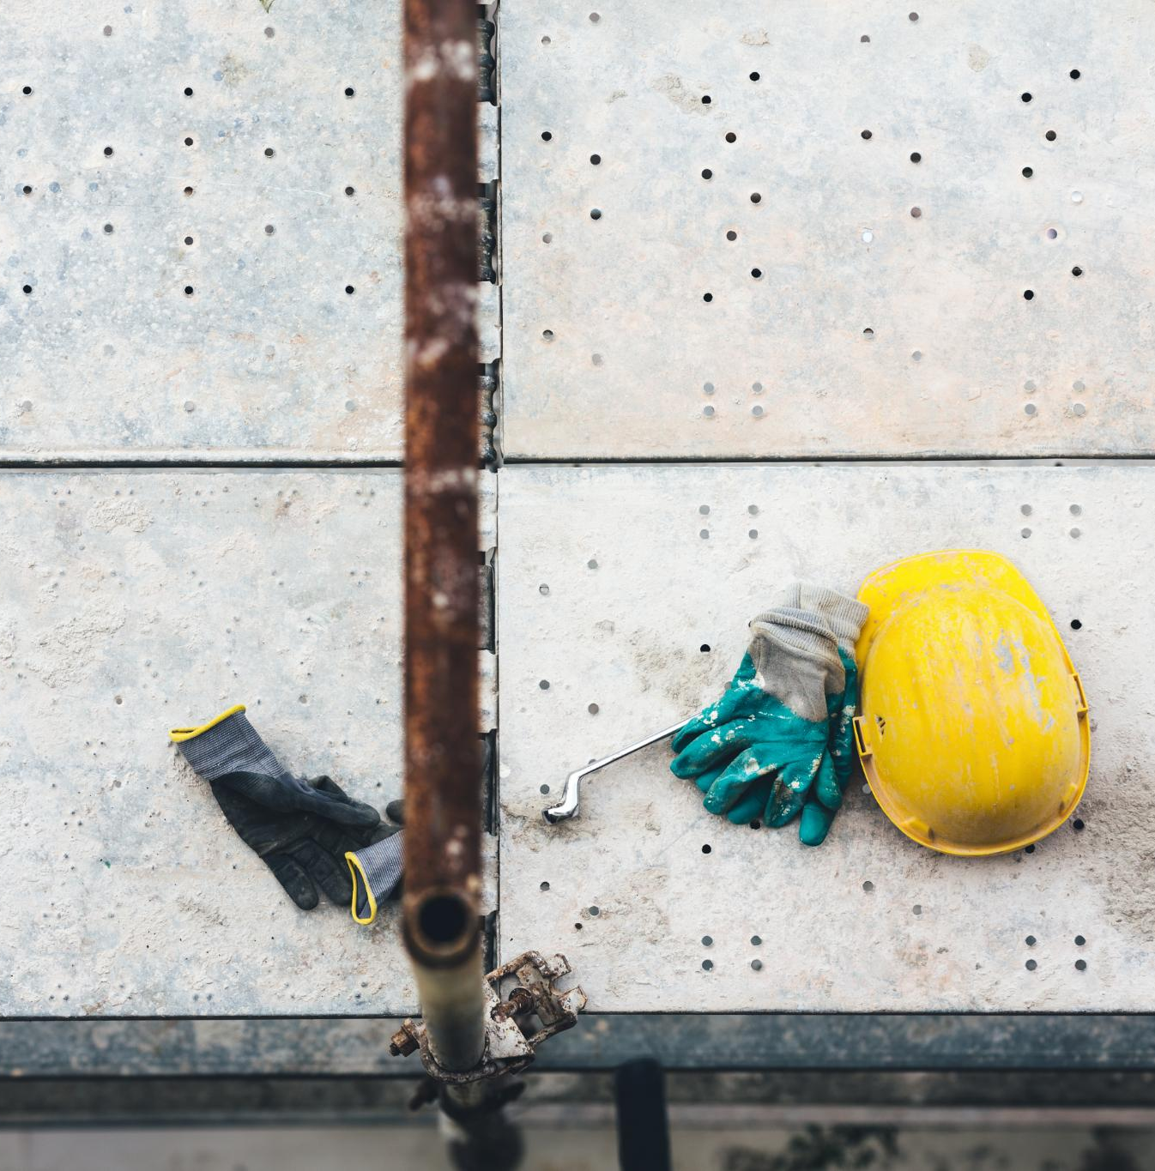
When to Engage Western as a Preferred Delta works Vendor
Signs to Engage Western
  Contact Western when cracks deepen, leaks persist, rebar is exposed, or structural distress is visible in concrete elements.
Western's Expertise and Services
  Western provides advanced inspection, corrosion mitigation, and structural repair following safety and industry standards.
Benefits of Early Engagement
  Early involvement ensures quicker mobilization, streamlined communication, hazard prevention, and peace of mind for facility managers.
Notes:
Western Specialty Contractors serves as a trusted preferred vendor through Deltaworks, providing specialized expertise when conditions exceed routine maintenance or present an immediate safety concern. Facility teams should contact Western when they encounter deepening or rapidly spreading cracks, persistent leaks that continue despite drain cleaning, or visible rebar exposure, as these signs indicate that deterioration is beyond surface-level repair. Hollow‑sounding slabs, widespread spalling, or any structural distress in beams or columns also require professional evaluation. Western brings advanced inspection techniques, corrosion mitigation strategies, and structural repair capabilities that adhere to best‑practice safety and industry standards. Additionally, Western’s familiarity with Delta and JLL expectations ensures streamlined communication, quicker mobilization, and coordinated project execution. Engaging Western early not only restores structural integrity but also prevents hazards from escalating, offering peace of mind to facility managers responsible for high-traffic environments such as airport parking structures or operational facilities.

Slide 19
Western’s Safety Performance and Services
Notes:
Western’s OSHA and Industry Safety Performance, Western’s Core Services for Parking Decks and Buildings

Slide 20
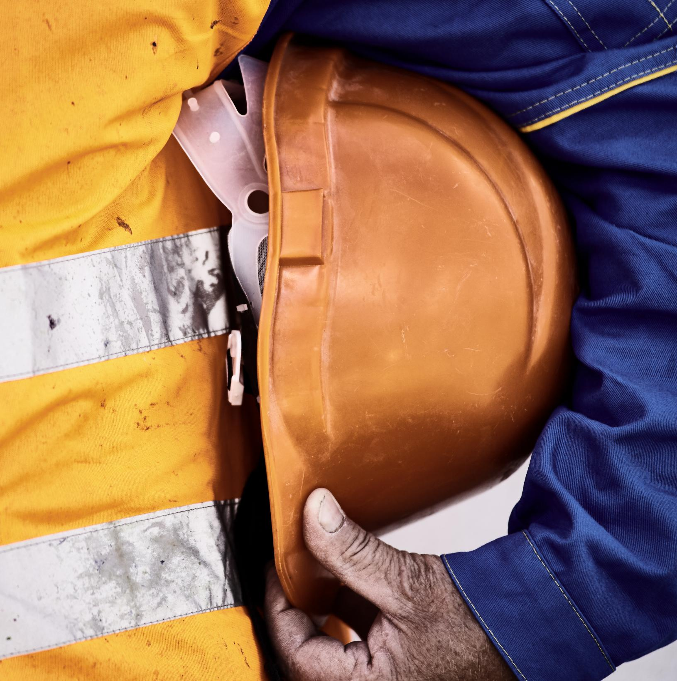
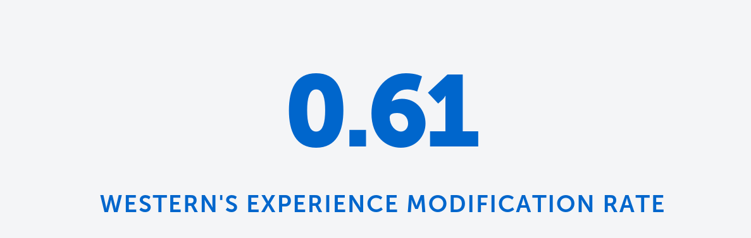
What is an experience modification rate?
Definition of Experience Modification Rate (EMR)
  A number used by insurance companies to gauge both past cost of injuries and future chances of risk. The lower the EMR, the lower a company pays in workers compensation insurance premiums.
Industry Standard EMR
  An EMR of 1.0 is considered industry average.
0.69
The lower the rate, the safer the contractor
Notes:
Western Specialty Contractors maintains an industry-leading safety record supported by comprehensive training, strong corporate culture, and adherence to OSHA standards. The company’s performance metrics, including its Experience Modification Rate (EMR), reflect its commitment to reducing workplace incidents and ensuring safe operational environments for both employees and clients. Robust safety programs, regular field training, and thorough jobsite assessments reinforce Western’s reputation as a reliable and safety-conscious partner. These achievements are especially critical when working in sensitive environments such as airport facilities, where risk mitigation and operational continuity are paramount. By maintaining consistently strong safety ratings, Western provides clients with confidence that projects will be completed responsibly and with minimal disruption. This dedication to safe practices aligns with Delta and JLL’s expectations for high‑performing facility partners.

Slide 21
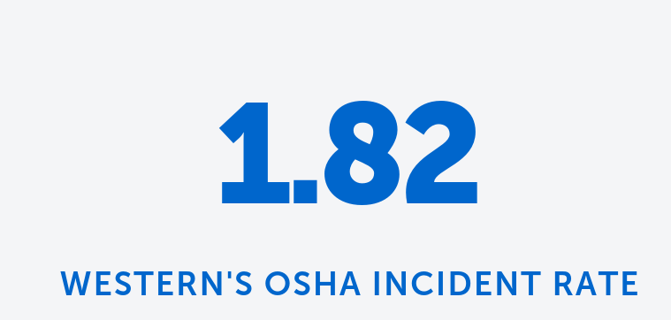
What is an OSHA INCIDENT RATE?
Definition of OSHA Incident Rate
  The rating is a safety benchmark to gauge performance with other companies in the same business group so that you can make an “apples to apples” comparison.
Industry Standard EMR
  An OSHA Incident Rate of 3.8 is considered industry average.
0.69
It’s like golf, low scores are good
Notes:
Western Specialty Contractors maintains an industry-leading safety record supported by comprehensive training, strong corporate culture, and adherence to OSHA standards. The company’s performance metrics, including its Experience Modification Rate (EMR), reflect its commitment to reducing workplace incidents and ensuring safe operational environments for both employees and clients. Robust safety programs, regular field training, and thorough jobsite assessments reinforce Western’s reputation as a reliable and safety-conscious partner. These achievements are especially critical when working in sensitive environments such as airport facilities, where risk mitigation and operational continuity are paramount. By maintaining consistently strong safety ratings, Western provides clients with confidence that projects will be completed responsibly and with minimal disruption. This dedication to safe practices aligns with Delta and JLL’s expectations for high‑performing facility partners.

Slide 22
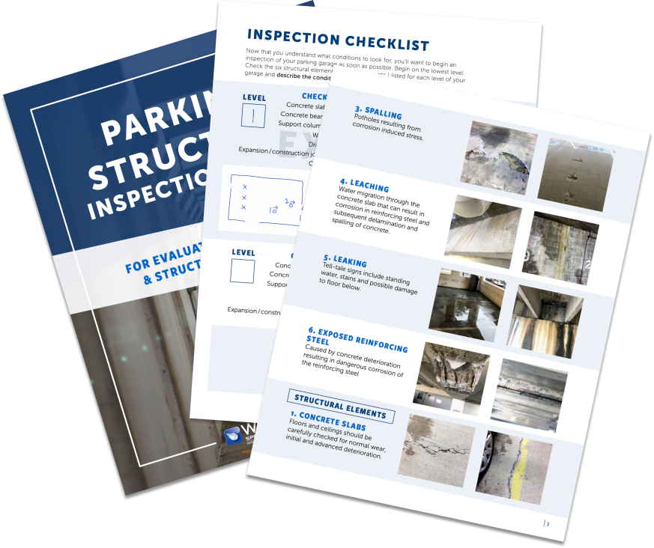




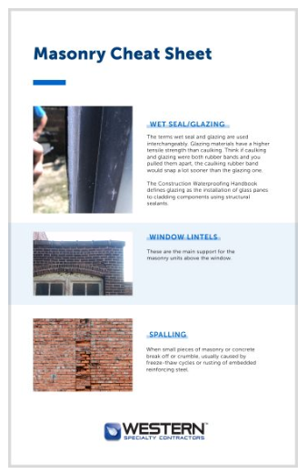
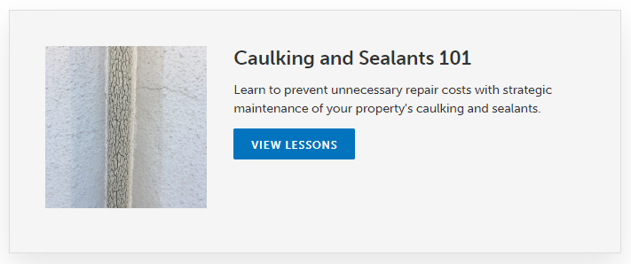
Western’s learning platform
eBooks
Tips
Inspection Guides
Courses
Notes:
Western Specialty Contractors offers a comprehensive range of services designed to enhance safety, durability, and performance across parking structures and building envelopes. Core capabilities include structural concrete repair such as spall patching, form‑and‑place repairs, and shotcrete applications. Western’s waterproofing expertise ensures effective protection against moisture infiltration through deck coatings, sealants, and joint replacement. Masonry restoration services address deterioration in brick, stone, and façade systems with techniques such as tuckpointing, repointing, and material replacement. For structural strengthening, Western provides reinforcement solutions that address corrosion‑related weakening or load‑capacity concerns. The company also performs detailed inspections, condition assessments, and leak investigations that support long-term asset management strategies. These services collectively contribute to safer environments, prolonged structural life, and reduced operational risks, making Western a valuable partner for Delta, JLL, and other facilities teams responsible for maintaining high-traffic environments.

Slide 23
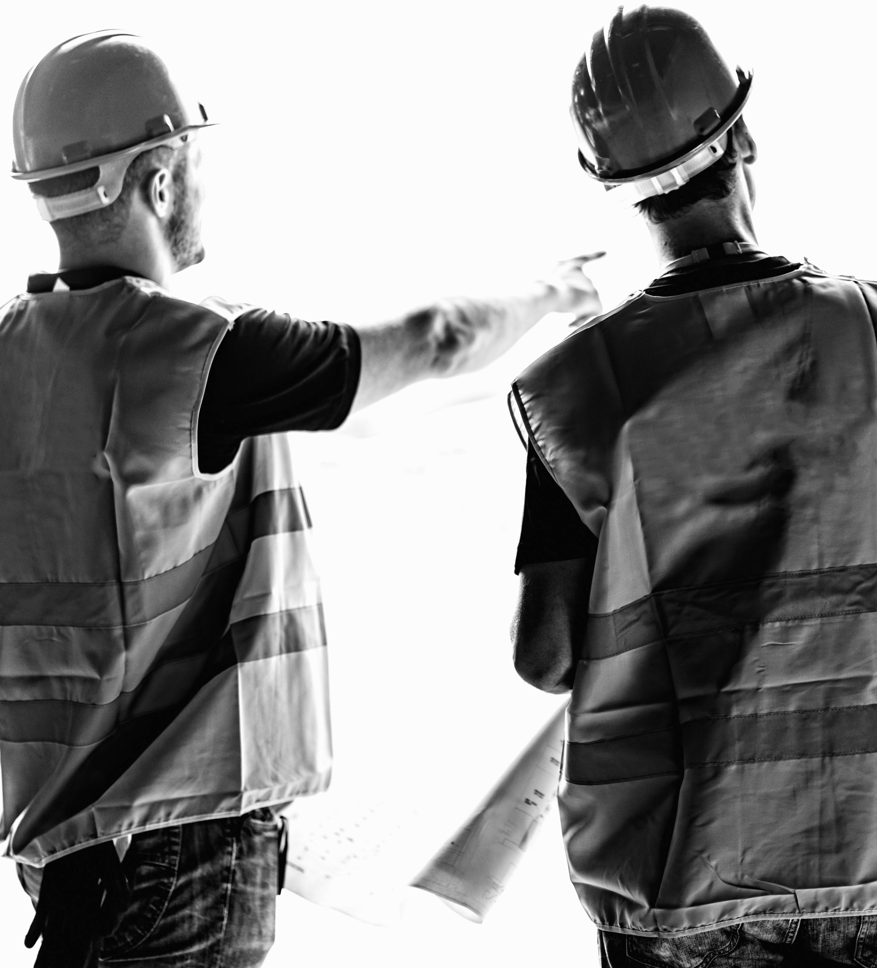
Western’s got your back!
Structural Concrete Repair
  Services include spall patching, form-and-place repairs, and shotcrete to restore concrete integrity.
Waterproofing Solutions
  Deck coatings, sealants, and joint replacements prevent moisture infiltration and protect structures.
Masonry Restoration
  Tuckpointing, repointing, and material replacement restore brick, stone, and façade systems effectively.
Structural Strengthening and Inspections
  Reinforcement solutions and detailed inspections ensure load capacity and long-term asset management.

Slide 24
Conclusion
Notes:
Key Takeaways and Commitment to Safety

Slide 25
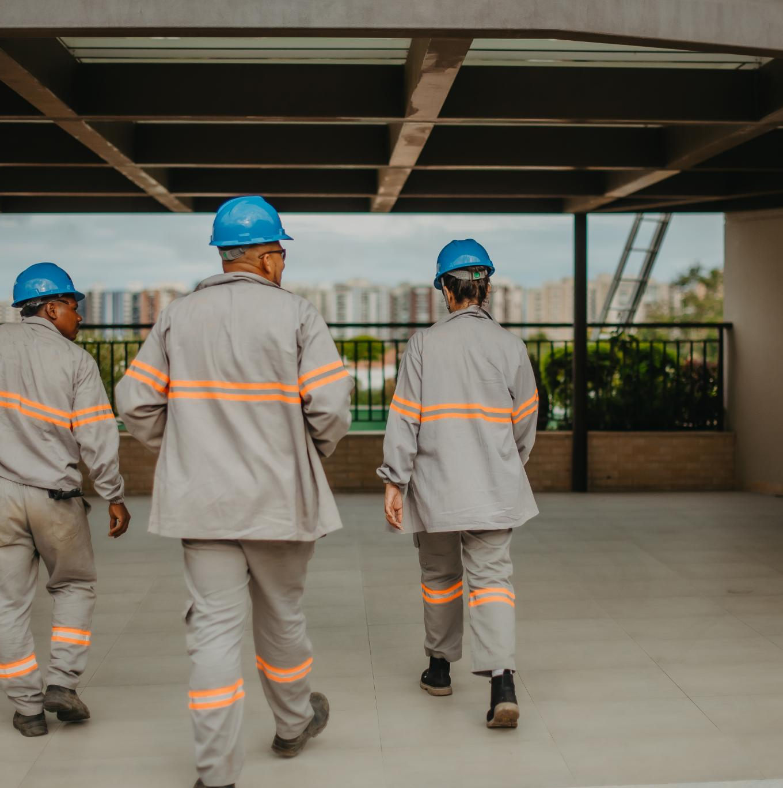
Key Takeaways and Commitment to Safety
Importance of Preventative Maintenance
  Preventative maintenance protects structural integrity and operational safety of parking decks and facilities.
Early Detection Benefits
  Early detection of damage reduces risks, prevents accidents, and extends infrastructure lifespan.
Collaboration for Safety
  Facility teams and Western Specialty Contractors collaborate to ensure safety and expert repairs.
Commitment to Long-Term Solutions
  Western Specialty Contractors delivers superior repair and reliable safety solutions as a trusted vendor.
Notes:
Preventative maintenance is essential for protecting the structural integrity and operational safety of parking decks and facilities. Early detection of cracking, spalling, corrosion, and drainage failures significantly reduces risks, prevents accidents, and extends the lifespan of critical infrastructure. Facility teams play a key role in identifying early warning signs, while Western Specialty Contractors provides the advanced expertise needed when deterioration reaches more serious levels. As a preferred vendor through Deltaworks, Western is committed to supporting Delta and JLL with industry‑leading safety practices, superior repair capabilities, and reliable long-term solutions. Together, proactive inspection and professional intervention create a safer, more predictable environment for employees, tenants, and the public.

Slide 26





NATIONAL FOOTPRINT WITH SINGLE POINT OF CONTACT
CONSISTENCY = QUALITY CONTROL PROGRAM
TOP RATED SAFETY PROGRAM
OSHA = 1.66
EMR = 0.68
ASSISTANCE WITH ASSET MANAGEMENT, BUDGET PLANNING, PROJECT PHASING
PREFERRED PRICING & SCHEDULING
TRAINING & EDUCATION:
MAINTENANCE PROGRAM, REPAIR PRIORITIZATION

Slide 27




Contact information
Steven Johnson
Chester Scott
Sr. Sales/Project Manager
Sr. Sales/Project Manager
404-398-9432
404-435-0763
StevenJ@Westerngroup.com
ChesterS@Westerngroup.com
Daniele Portal
Business Development Manager
305-812-6498
DanieleP@Westerngroup.com

