Slide 1
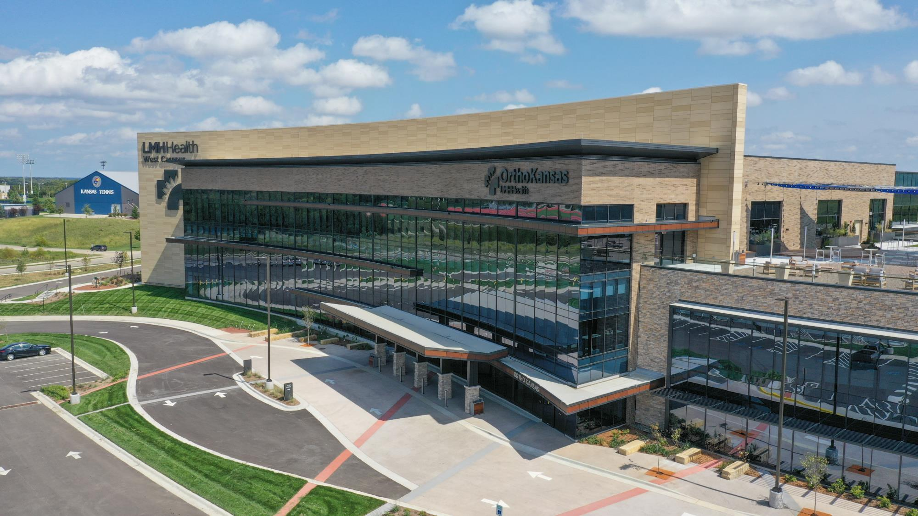

Architectural Sheet Metal

Slide 2
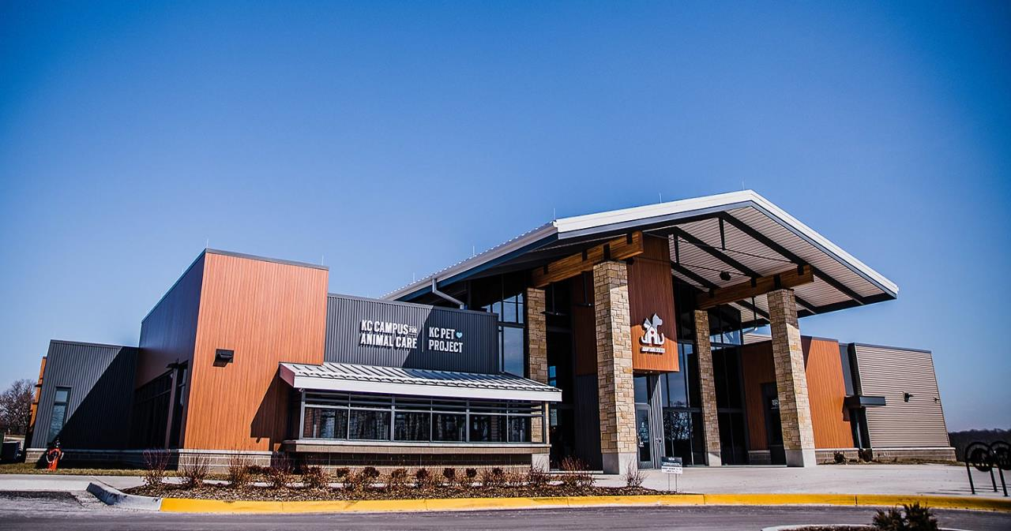

Standing
Seam Roofs
Gutters/Scuppers/
Downspouts
Signage
Acoustical
Metal Deck
Wall Panels
Electrical
Flashings
Structural
Coping
Metal
Canopy

Slide 3
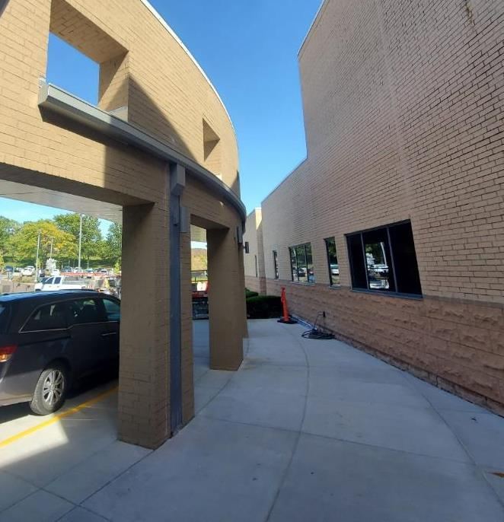
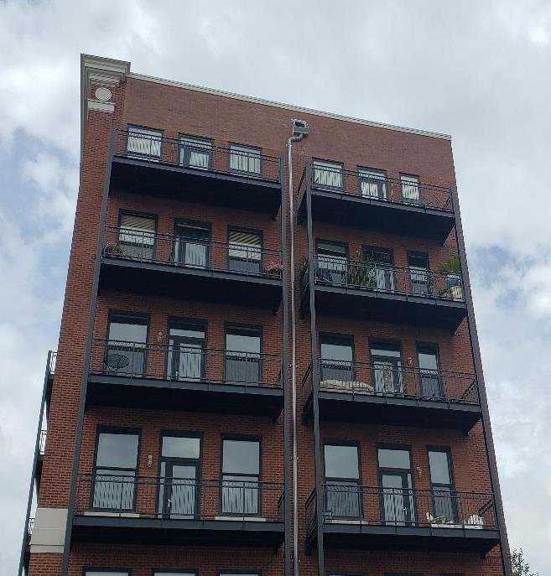
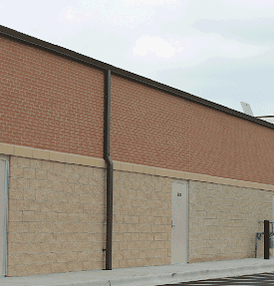
Metal Components
Gutters | Downspouts | Scuppers | Coping | Roof flashings

Slide 4
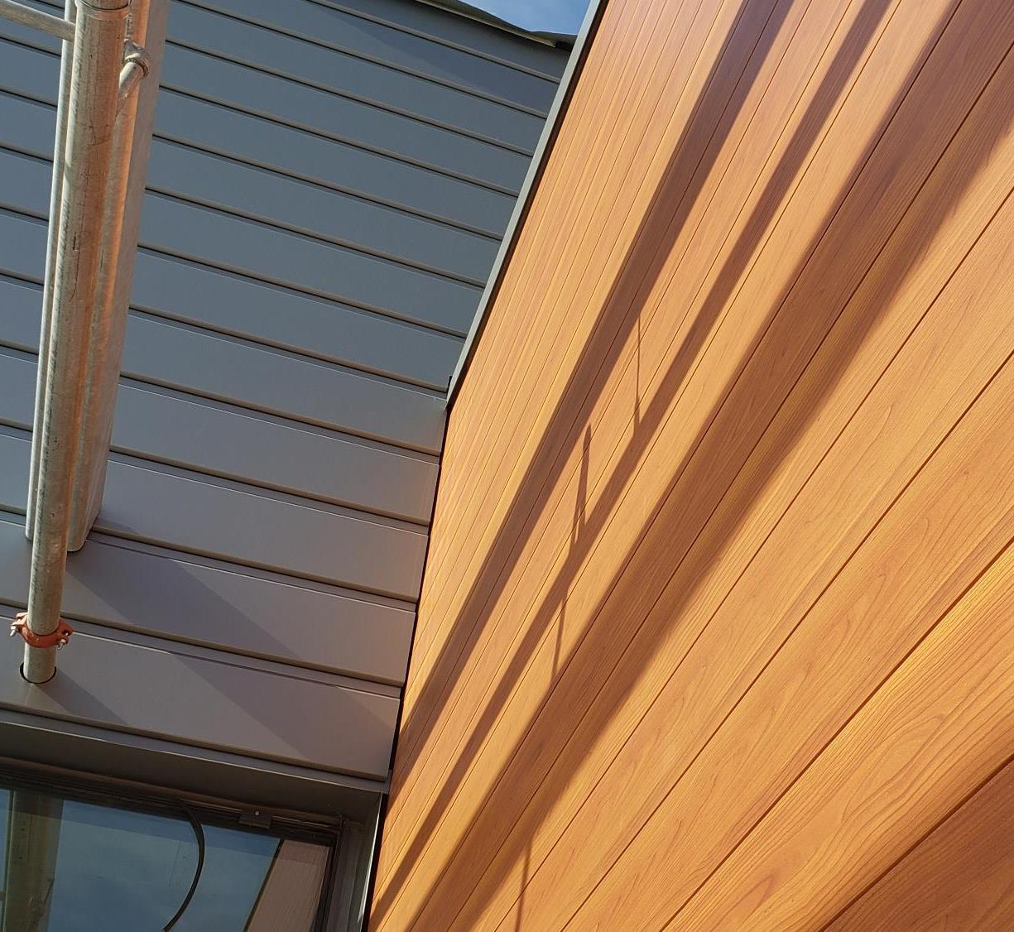
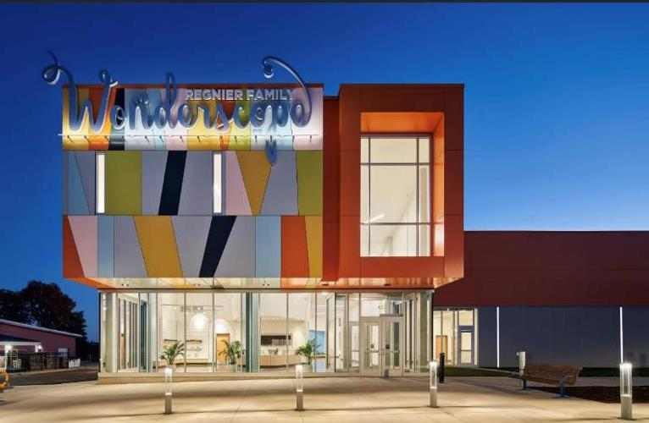
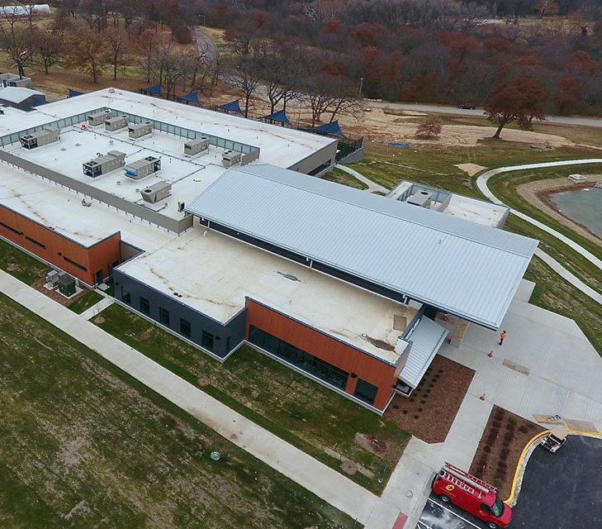
ARCHITECTURAL
SYSTEMS

Slide 5
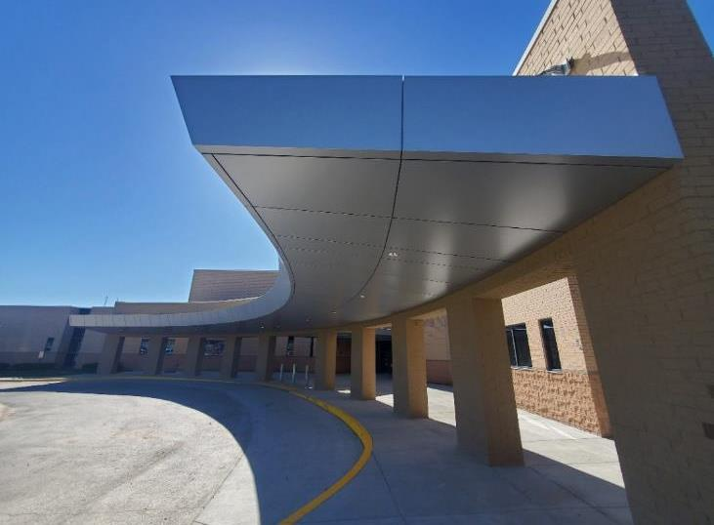
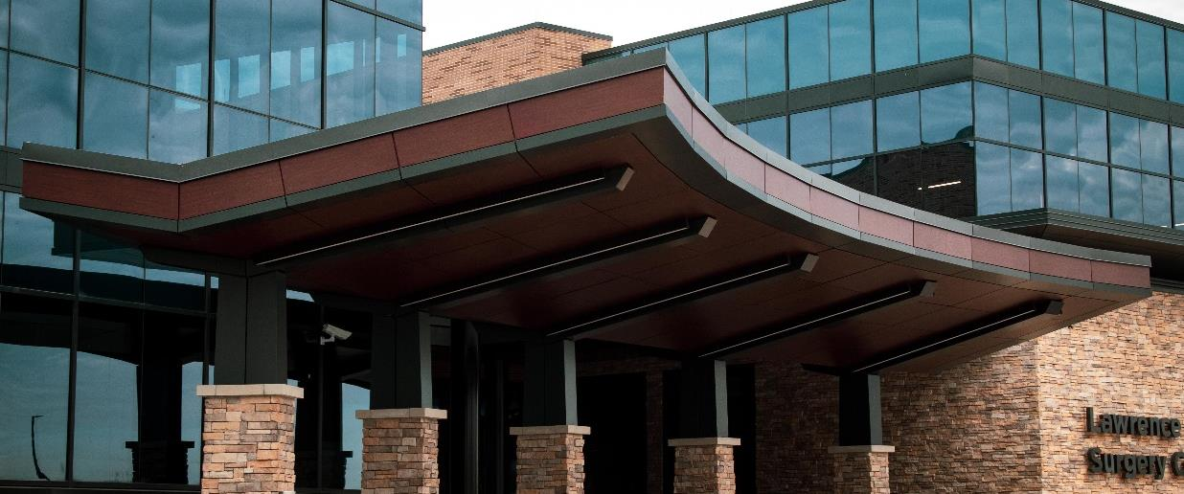
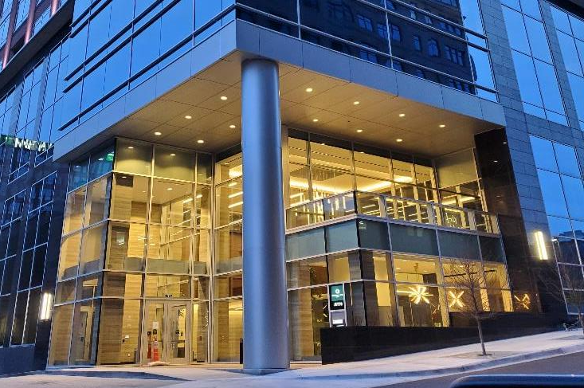
Composite Wall
Panels (ACM/MCM)
Typically used as cladding to external walls
Notes:
Lightweight and rigid material, consisting of two aluminum
cover sheets bonded to an extruded fire rated core
Simple, versatile, weather resistant,
unbreakable, and shock resistant
Available in a wide range of finishes and colors
Types:
Wet Seal System
Dry Seal System
Rainscreen System

Slide 6
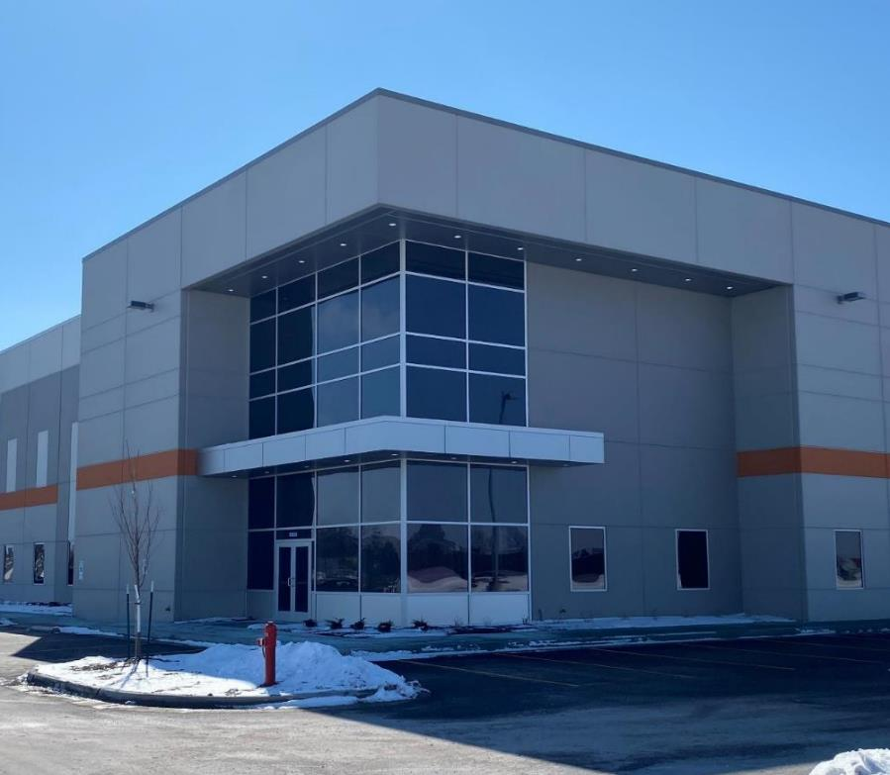
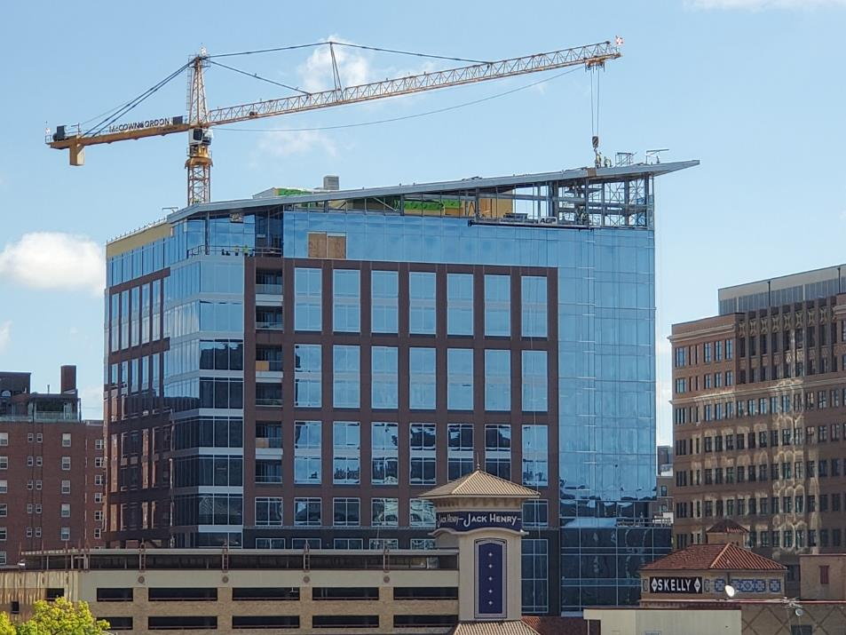
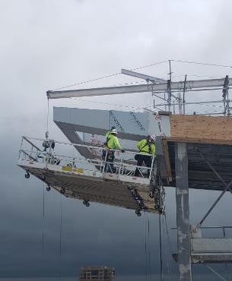

Slide 7
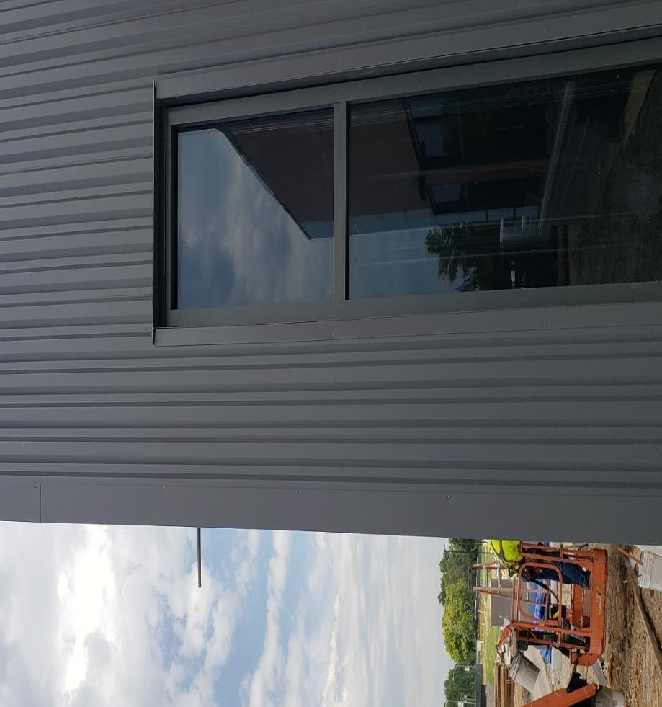
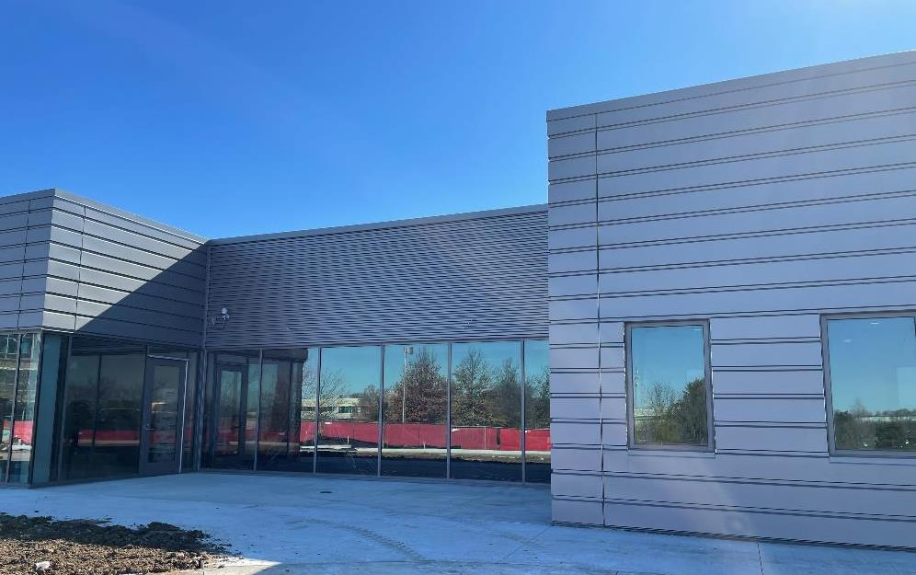
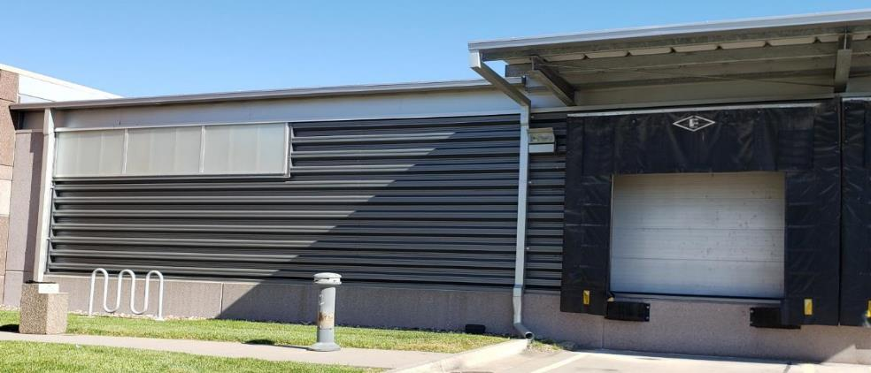
Single Skin Panels
Notes:
Roll formed to specific shape or profile
Preformed; Single-skin is the most varied, cost-effective and readily available panel on the market
Metal wall panels can often be installed faster than other wall materials, resulting in savings in construction costs.

Slide 8
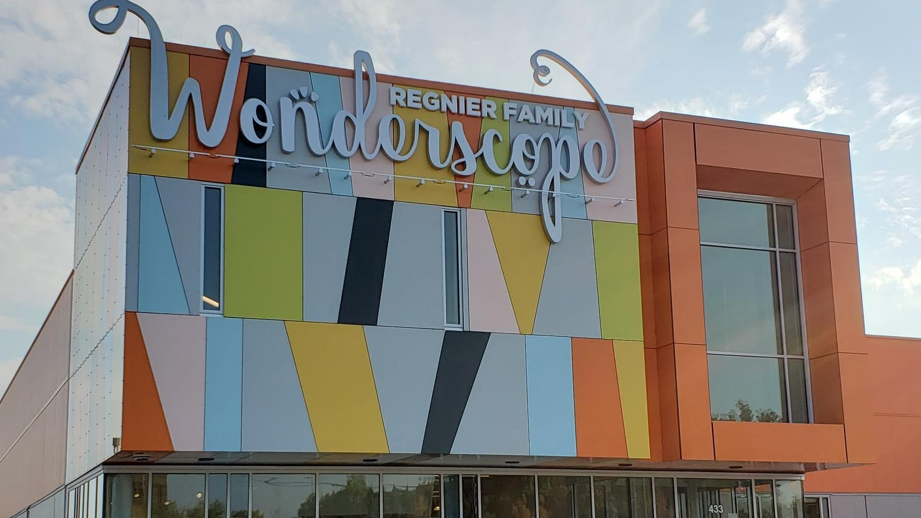
Plate Wall
Wall system that uses aluminum plates
Notes:
Custom cut and painted to create a design typically speced

Slide 9
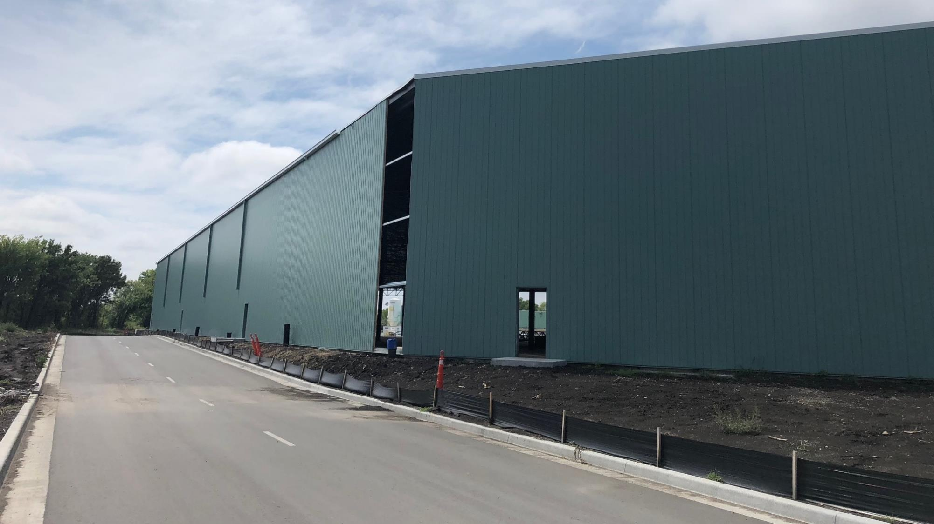
Insulated Metal Panels (IMP)
Notes:
IMPs are an all-in-one building enclosure solution and increases the speed of build and minimizes delays
Sustainable
A single component system
Superior insulating R-values
Variety of design options
Low maintenance
Unique
.

Slide 10
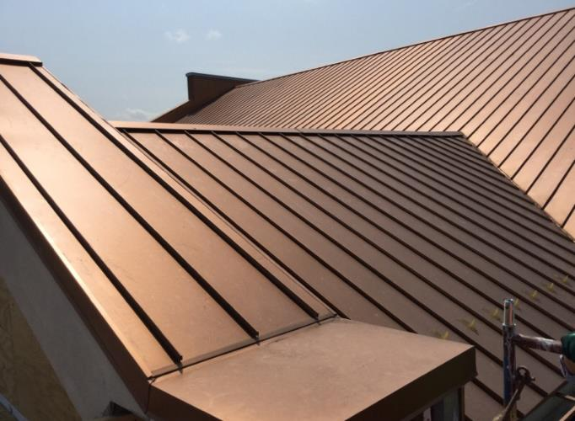
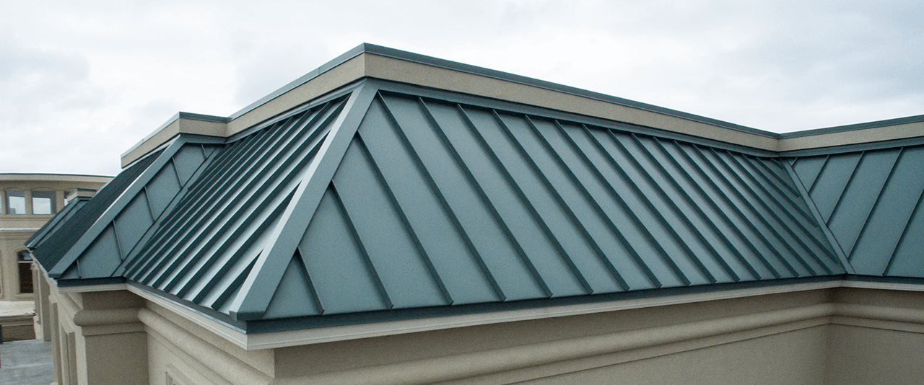
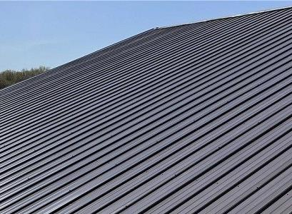
Metal Roofing
Notes:
Custom Fabricated
New Construction & Retrofit Projects
Range of Material & Color Options
22-24 Gauge
STEEP SLOPE IS IMPORTANT
- Proper installation of a metal roof curb/exhaust fan on standing seam roof.
- 99% of leaks on a metal roof are found at penetrations.
Durability: If installed correctly, metal roofs can withstand wind gusts of 140 mph, will not corrode or crack, and may not need as much maintenance as other roofing types.
Energy Efficient: Metal roofs reflect the suns UV and infrared rays; this can result in a 10-25% reduction in cooling costs.
Environmentally friendly: Metal roofs have 25-95% recycled material, depending on the product, and are also 100% recyclable at the end of their life.
Longevity: Metal roofs can last 40 -70 years, depending on the product.
Safety: Can sustain lighting strikes; will not spark or ignite.

Slide 11
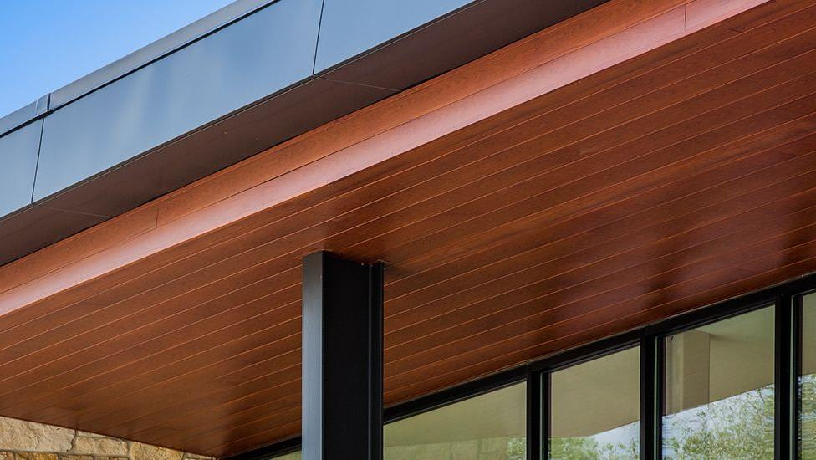
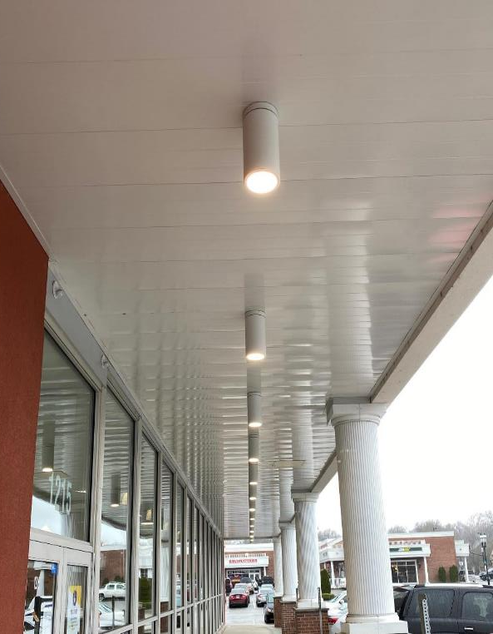
Soffits
Notes:
Underside of a structure
Can be vented or non-vented
Exterior or interior
Aesthetic and functional
Helps keep moisture, insects & birds away

Slide 12
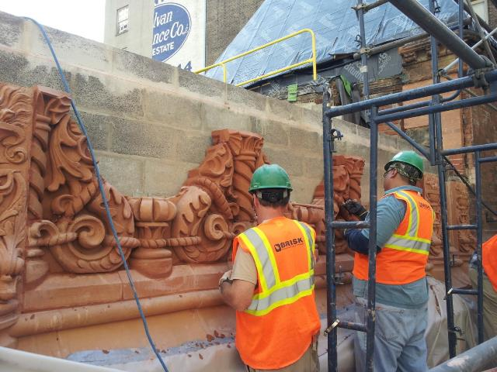
SPECIALTY
METAL WORK

Slide 13
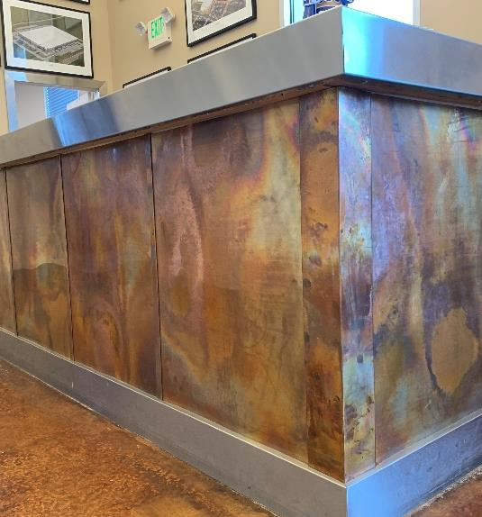
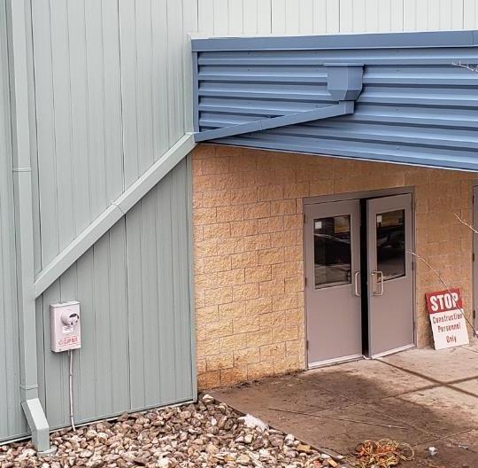

Slide 14
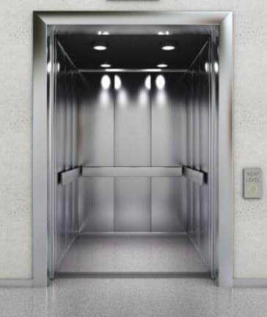
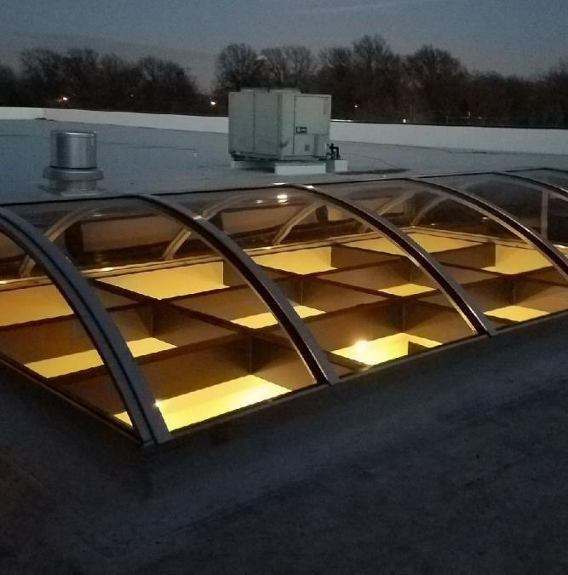

Slide 15
