Slide 1
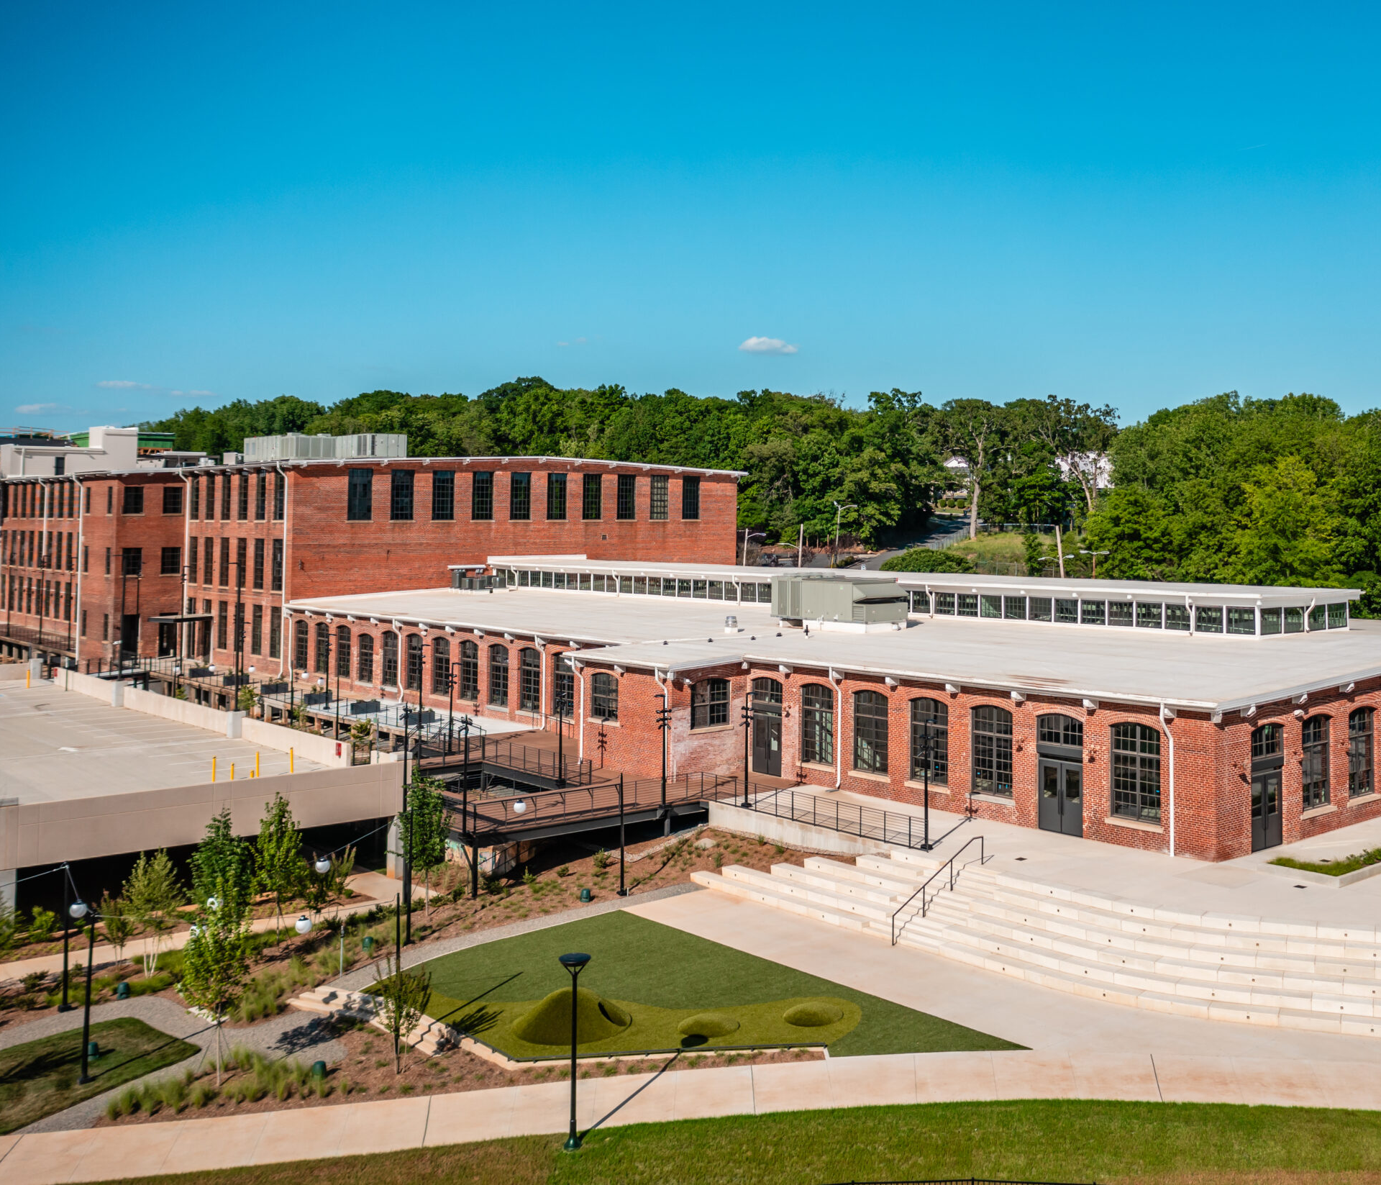
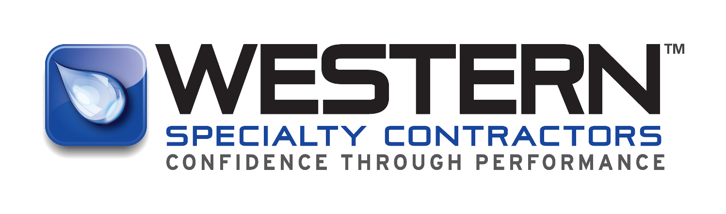

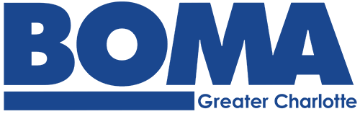
Inside the parking deck: a hands-on learning session at savona mill
Notes:
---

Slide 2

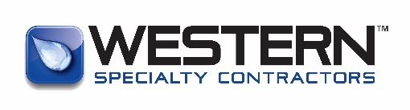
Common Types of Parking Decks
Key Structural Components
Common Conditions & Impacts
Savona Mill Parking Deck Condition Assessment
Parking Deck Repair Timeline43
Proposal Dissection
Who is Western
AGENDA
Notes:
Western Specialty Contractors offers a comprehensive range of services designed to enhance safety, durability, and performance across parking structures and building envelopes. Core capabilities include structural concrete repair such as spall patching, form‑and‑place repairs, and shotcrete applications. Western’s waterproofing expertise ensures effective protection against moisture infiltration through deck coatings, sealants, and joint replacement. Masonry restoration services address deterioration in brick, stone, and façade systems with techniques such as tuckpointing, repointing, and material replacement. For structural strengthening, Western provides reinforcement solutions that address corrosion‑related weakening or load‑capacity concerns. The company also performs detailed inspections, condition assessments, and leak investigations that support long-term asset management strategies. These services collectively contribute to safer environments, prolonged structural life, and reduced operational risks, making Western a valuable partner for Delta, JLL, and other facilities teams responsible for maintaining high-traffic environments.

Slide 3
Common types of parking decks

Slide 4
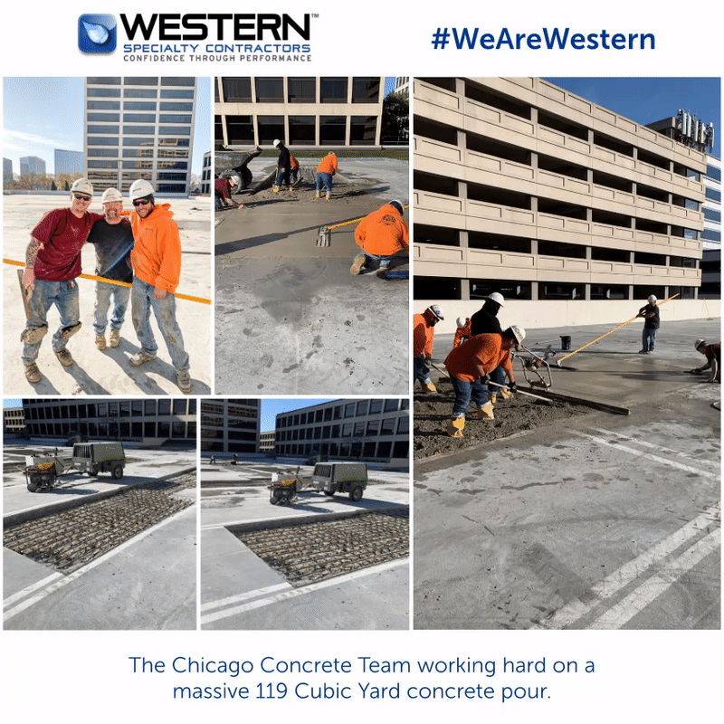
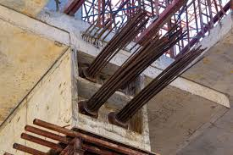
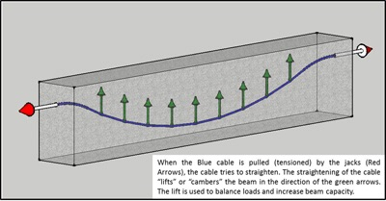
Post Tension Cast in place
Notes:
Western Specialty Contractors offers a comprehensive range of services designed to enhance safety, durability, and performance across parking structures and building envelopes. Core capabilities include structural concrete repair such as spall patching, form‑and‑place repairs, and shotcrete applications. Western’s waterproofing expertise ensures effective protection against moisture infiltration through deck coatings, sealants, and joint replacement. Masonry restoration services address deterioration in brick, stone, and façade systems with techniques such as tuckpointing, repointing, and material replacement. For structural strengthening, Western provides reinforcement solutions that address corrosion‑related weakening or load‑capacity concerns. The company also performs detailed inspections, condition assessments, and leak investigations that support long-term asset management strategies. These services collectively contribute to safer environments, prolonged structural life, and reduced operational risks, making Western a valuable partner for Delta, JLL, and other facilities teams responsible for maintaining high-traffic environments.

Slide 5
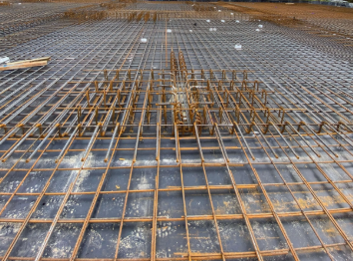
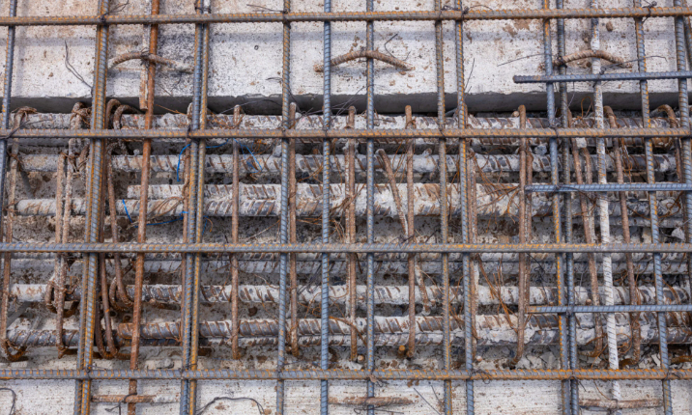
Conventional reinforced Cast in place
Notes:
Western Specialty Contractors offers a comprehensive range of services designed to enhance safety, durability, and performance across parking structures and building envelopes. Core capabilities include structural concrete repair such as spall patching, form‑and‑place repairs, and shotcrete applications. Western’s waterproofing expertise ensures effective protection against moisture infiltration through deck coatings, sealants, and joint replacement. Masonry restoration services address deterioration in brick, stone, and façade systems with techniques such as tuckpointing, repointing, and material replacement. For structural strengthening, Western provides reinforcement solutions that address corrosion‑related weakening or load‑capacity concerns. The company also performs detailed inspections, condition assessments, and leak investigations that support long-term asset management strategies. These services collectively contribute to safer environments, prolonged structural life, and reduced operational risks, making Western a valuable partner for Delta, JLL, and other facilities teams responsible for maintaining high-traffic environments.

Slide 6
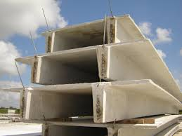
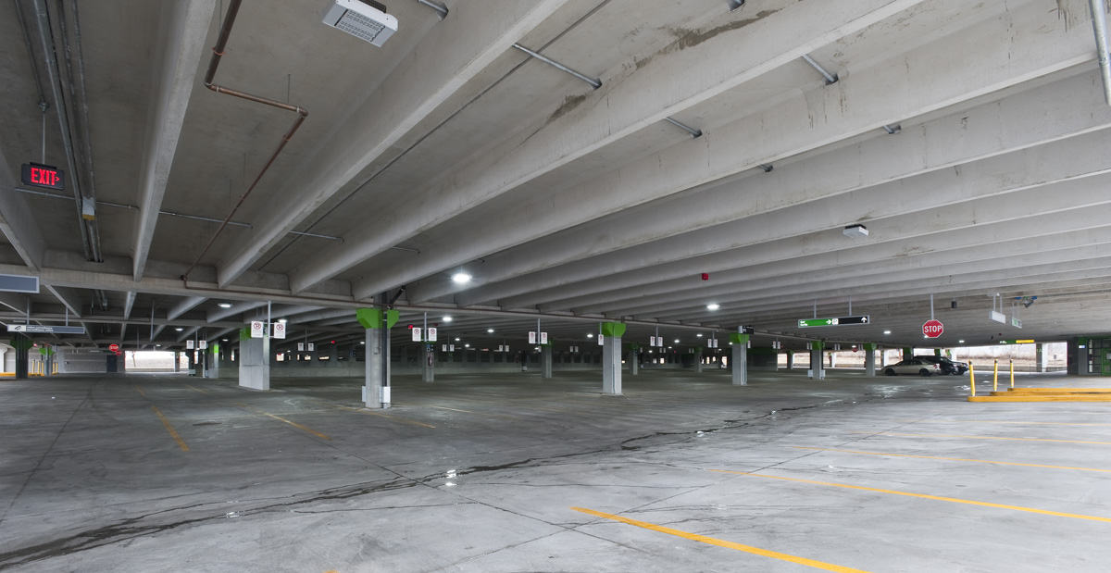
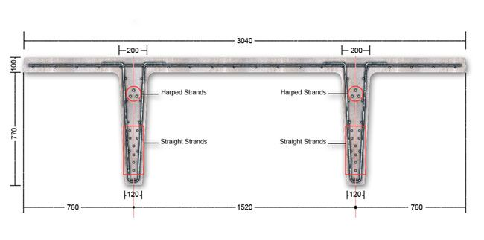
Double t precast
Notes:
Western Specialty Contractors offers a comprehensive range of services designed to enhance safety, durability, and performance across parking structures and building envelopes. Core capabilities include structural concrete repair such as spall patching, form‑and‑place repairs, and shotcrete applications. Western’s waterproofing expertise ensures effective protection against moisture infiltration through deck coatings, sealants, and joint replacement. Masonry restoration services address deterioration in brick, stone, and façade systems with techniques such as tuckpointing, repointing, and material replacement. For structural strengthening, Western provides reinforcement solutions that address corrosion‑related weakening or load‑capacity concerns. The company also performs detailed inspections, condition assessments, and leak investigations that support long-term asset management strategies. These services collectively contribute to safer environments, prolonged structural life, and reduced operational risks, making Western a valuable partner for Delta, JLL, and other facilities teams responsible for maintaining high-traffic environments.

Slide 7

Key structural components to inspect

Slide 8
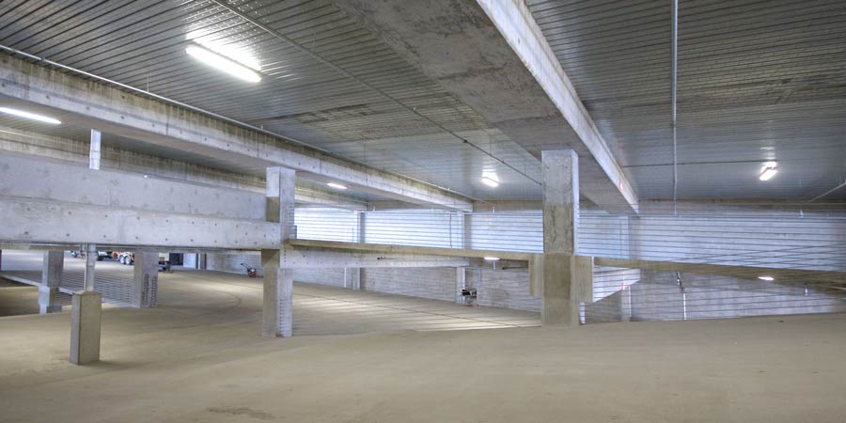
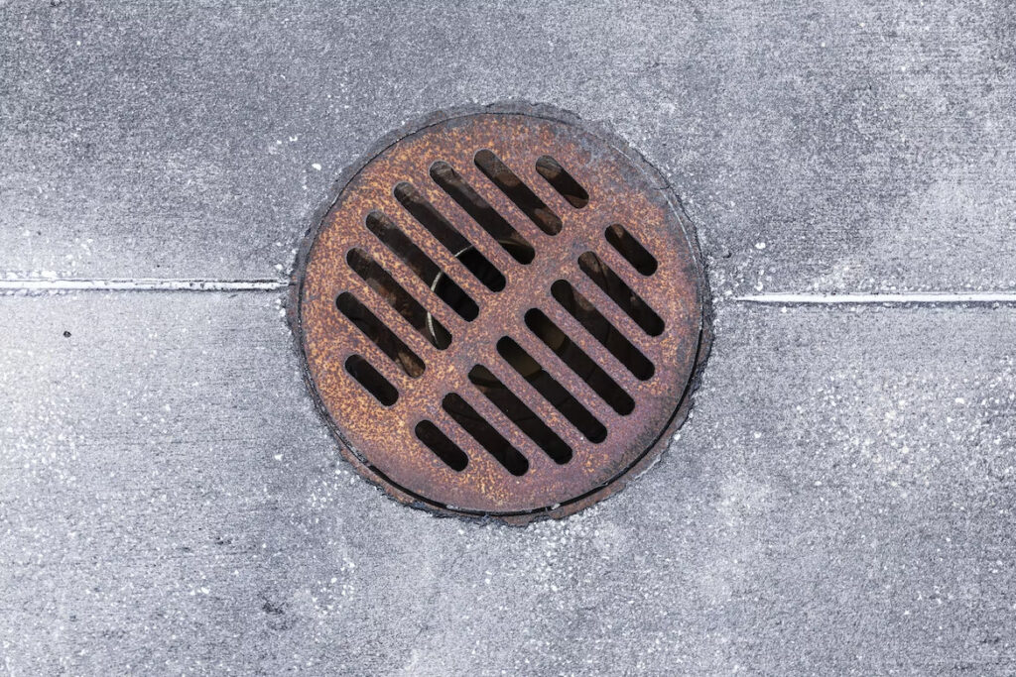
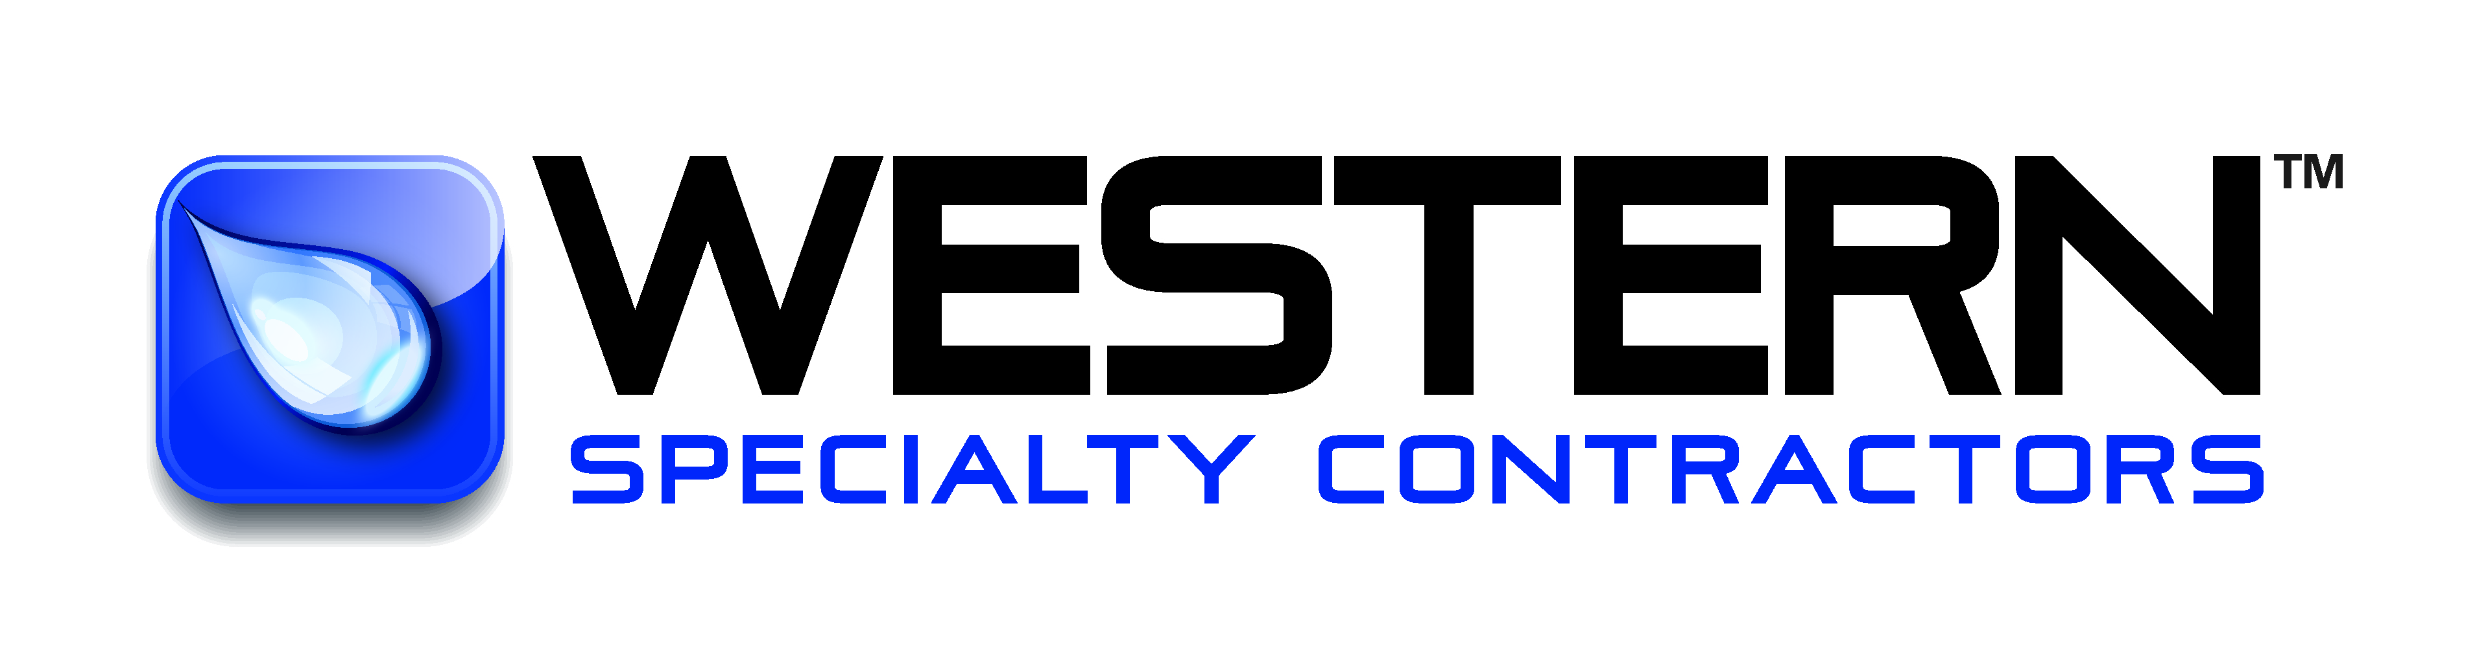
Concrete slab
Concrete beams
WAlls
Support columns
Drains
Notes:
Regular inspection of structural components is essential to ensuring safety within parking decks and building facilities, especially when deterioration can progress quickly under environmental exposure. Beams should be monitored for cracking, sagging, or visible corrosion, as they serve as primary load-bearing elements. Slabs require consistent observation to detect wear, downward deflection, impact damage, or surface deterioration. Walls and vertical elements must be checked for water intrusion, cracks, and migration pathways that may indicate deeper structural issues. Drains represent one of the most maintenance-critical features, as clogged or impaired drainage can lead to ponding water that spreads deterioration. Expansion joints and sealants should be inspected for tears, gaps, or deterioration caused by traffic loads or temperature fluctuations, since failing joints can allow water infiltration and compromise the structure’s ability to accommodate movement. Columns must be checked for cracking, settlement indicators, or early signs of stress, as column failure can result in catastrophic structural collapse. By implementing structured and routine walkthroughs focused on these components, facility teams can proactively identify hazards, maintain system integrity, and prevent safety incidents before they occur.

Slide 9
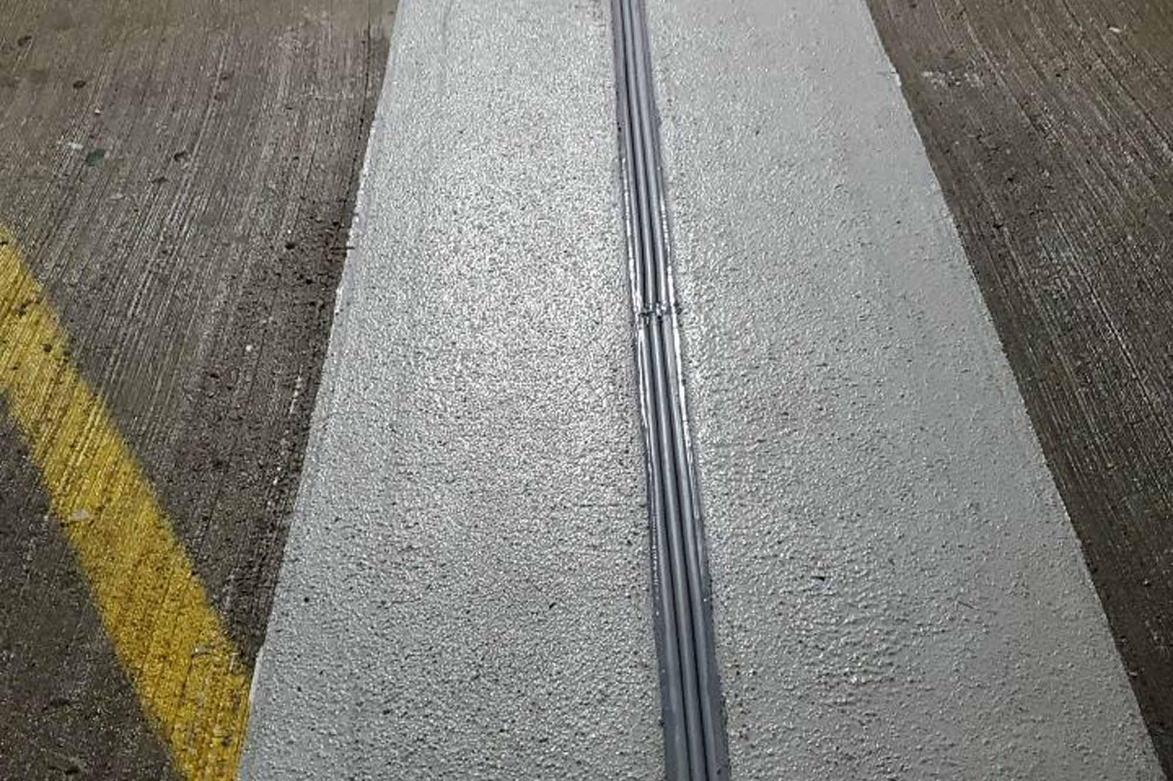
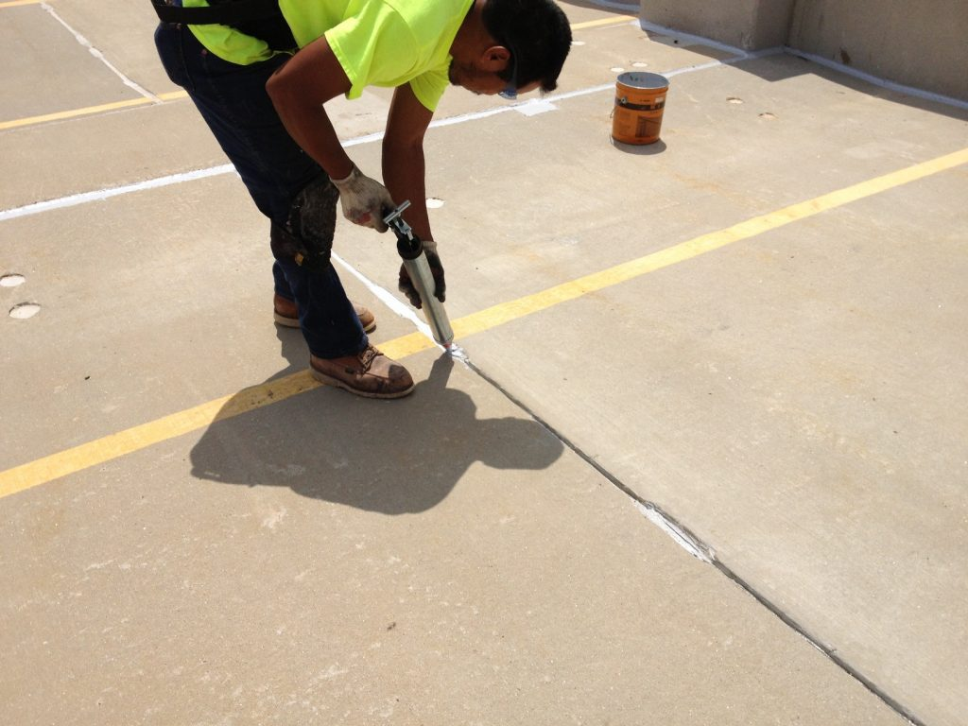
Expansion joints vs control joints
  Expansion Joint
  Allows movement due to temperature changes, expansion & contraction
  Completely separates two sections of a structure
  Filled with flexible materials
  Prevents major structural damage from significant movement
  Placed at corners, perimeters, changes in elevation, between large structural sections
  Control Joint
  Shallow surface cuts or connections designed to guide cracking
  Guides crack along a straight line, preventing random, unsightly cracks
  Manage shrinkage during drying and thermal movement
  Spaced closely (10-15 feet) in slab
  Both act as shock absorbers for vehicle traffic!
Notes:
Regular inspection of structural components is essential to ensuring safety within parking decks and building facilities, especially when deterioration can progress quickly under environmental exposure. Beams should be monitored for cracking, sagging, or visible corrosion, as they serve as primary load-bearing elements. Slabs require consistent observation to detect wear, downward deflection, impact damage, or surface deterioration. Walls and vertical elements must be checked for water intrusion, cracks, and migration pathways that may indicate deeper structural issues. Drains represent one of the most maintenance-critical features, as clogged or impaired drainage can lead to ponding water that spreads deterioration. Expansion joints and sealants should be inspected for tears, gaps, or deterioration caused by traffic loads or temperature fluctuations, since failing joints can allow water infiltration and compromise the structure’s ability to accommodate movement. Columns must be checked for cracking, settlement indicators, or early signs of stress, as column failure can result in catastrophic structural collapse. By implementing structured and routine walkthroughs focused on these components, facility teams can proactively identify hazards, maintain system integrity, and prevent safety incidents before they occur.

Slide 10
Common conditions & Impacts

Slide 11
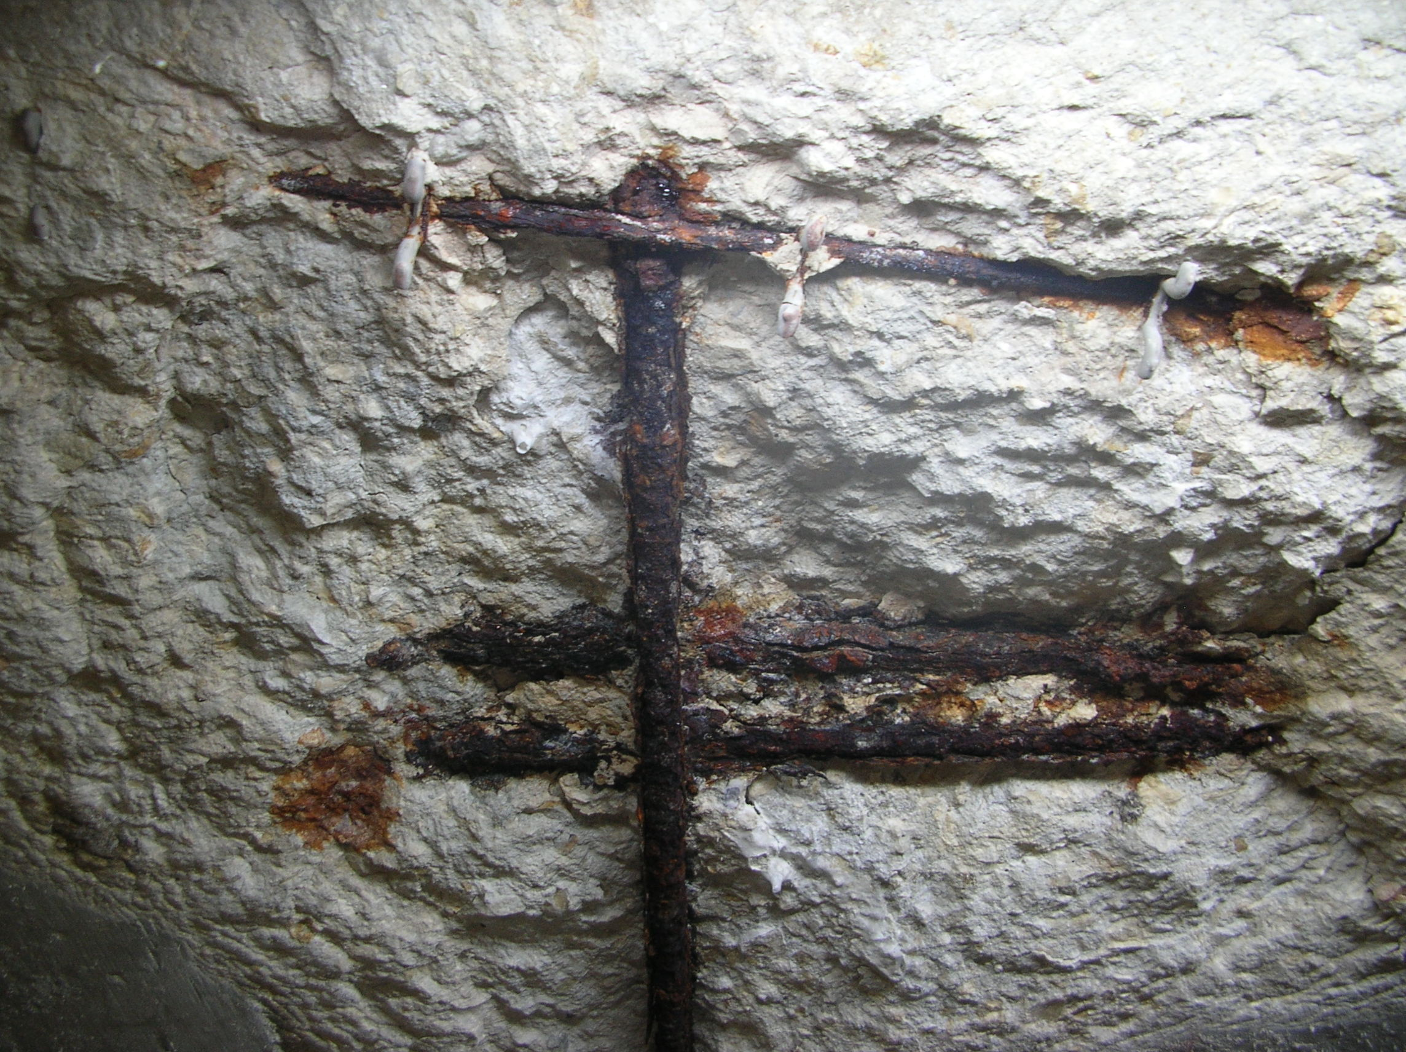
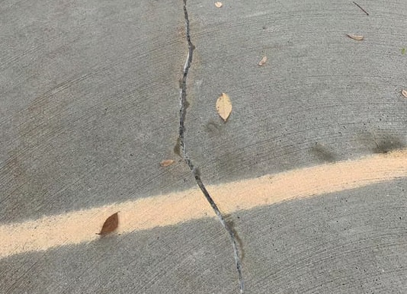
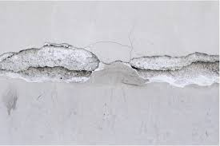
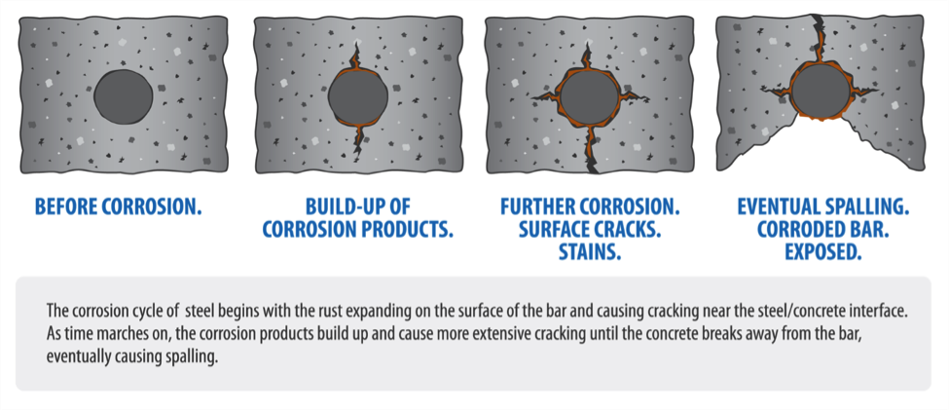

Cracking → Delamination → spalling → exposed steel/corrosion
Notes:
Cracking, scaling, and spalling are among the most common deterioration types found in parking structures, and each poses distinct safety threats. Cracks in concrete often result from structural stress, freeze–thaw cycles, or long-term usage, and while they may start small, they create pathways for water and chlorides to penetrate deeper into the slab. This infiltration accelerates corrosion of reinforcing steel, ultimately compromising load-bearing capacity. Scaling occurs when the surface layer of concrete deteriorates, often due to freeze–thaw cycles or insufficient air entrainment. This can produce uneven and slippery surfaces, increasing trip-and-fall risks for pedestrians and vehicle skidding hazards. Spalling—where chunks of concrete detach—is usually a direct indicator of advancing corrosion below the surface. Spalled areas create potholes that damage vehicles, catch pedestrians off guard, and reveal dangerously exposed rebar. When not addressed, these conditions evolve into widespread degradation that demands larger-scale structural repairs. Facilities teams who routinely identify and intervene early in cracking, scaling, and spalling can prevent most safety incidents associated with unstable surfaces and falling material. Addressing these issues is not simply cosmetic—it is essential to preserving structural integrity, eliminating hazards, and ensuring predictable operational conditions across the entire parking system.

Slide 12
Corrosion prevention
  Sounding:
  Easy, nondestructive testing method used to detect internal defects like delamination, voids, or spalling
  Solid concrete produces high-pitched, ring
  Damaged concrete produces dull, hollow thud
  Hollow sounding proves delamination (precursor to spalling)
  Prevention includes:
  Proper concrete mix
  Install control joins
  Seal the surface
  Avoid overloading
Notes:
Cracking, scaling, and spalling are among the most common deterioration types found in parking structures, and each poses distinct safety threats. Cracks in concrete often result from structural stress, freeze–thaw cycles, or long-term usage, and while they may start small, they create pathways for water and chlorides to penetrate deeper into the slab. This infiltration accelerates corrosion of reinforcing steel, ultimately compromising load-bearing capacity. Scaling occurs when the surface layer of concrete deteriorates, often due to freeze–thaw cycles or insufficient air entrainment. This can produce uneven and slippery surfaces, increasing trip-and-fall risks for pedestrians and vehicle skidding hazards. Spalling—where chunks of concrete detach—is usually a direct indicator of advancing corrosion below the surface. Spalled areas create potholes that damage vehicles, catch pedestrians off guard, and reveal dangerously exposed rebar. When not addressed, these conditions evolve into widespread degradation that demands larger-scale structural repairs. Facilities teams who routinely identify and intervene early in cracking, scaling, and spalling can prevent most safety incidents associated with unstable surfaces and falling material. Addressing these issues is not simply cosmetic—it is essential to preserving structural integrity, eliminating hazards, and ensuring predictable operational conditions across the entire parking system.

Slide 13
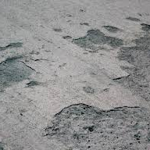
scaling
  Loss of surface concrete caused by freeze-thaw cycle.
  Water seeps into concrete and expands placing immense pressure on the surface
  Concrete that is not air-entrained is highly susceptible
  Using deicing salts lowers freezing point of water, forcing concrete to undergo more frequent freeze-thaw cycles
  Prevention includes:
    Air-entrained concrete
    Ensure proper curing using sealing compounds
    Avoid deicers (specifically salt) in the first winter
Notes:
Cracking, scaling, and spalling are among the most common deterioration types found in parking structures, and each poses distinct safety threats. Cracks in concrete often result from structural stress, freeze–thaw cycles, or long-term usage, and while they may start small, they create pathways for water and chlorides to penetrate deeper into the slab. This infiltration accelerates corrosion of reinforcing steel, ultimately compromising load-bearing capacity. Scaling occurs when the surface layer of concrete deteriorates, often due to freeze–thaw cycles or insufficient air entrainment. This can produce uneven and slippery surfaces, increasing trip-and-fall risks for pedestrians and vehicle skidding hazards. Spalling—where chunks of concrete detach—is usually a direct indicator of advancing corrosion below the surface. Spalled areas create potholes that damage vehicles, catch pedestrians off guard, and reveal dangerously exposed rebar. When not addressed, these conditions evolve into widespread degradation that demands larger-scale structural repairs. Facilities teams who routinely identify and intervene early in cracking, scaling, and spalling can prevent most safety incidents associated with unstable surfaces and falling material. Addressing these issues is not simply cosmetic—it is essential to preserving structural integrity, eliminating hazards, and ensuring predictable operational conditions across the entire parking system.

Slide 14
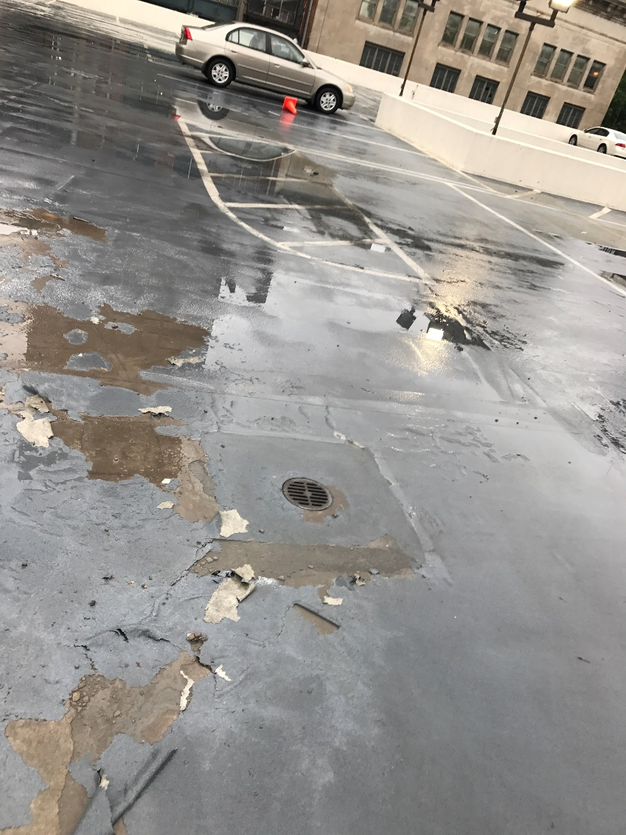
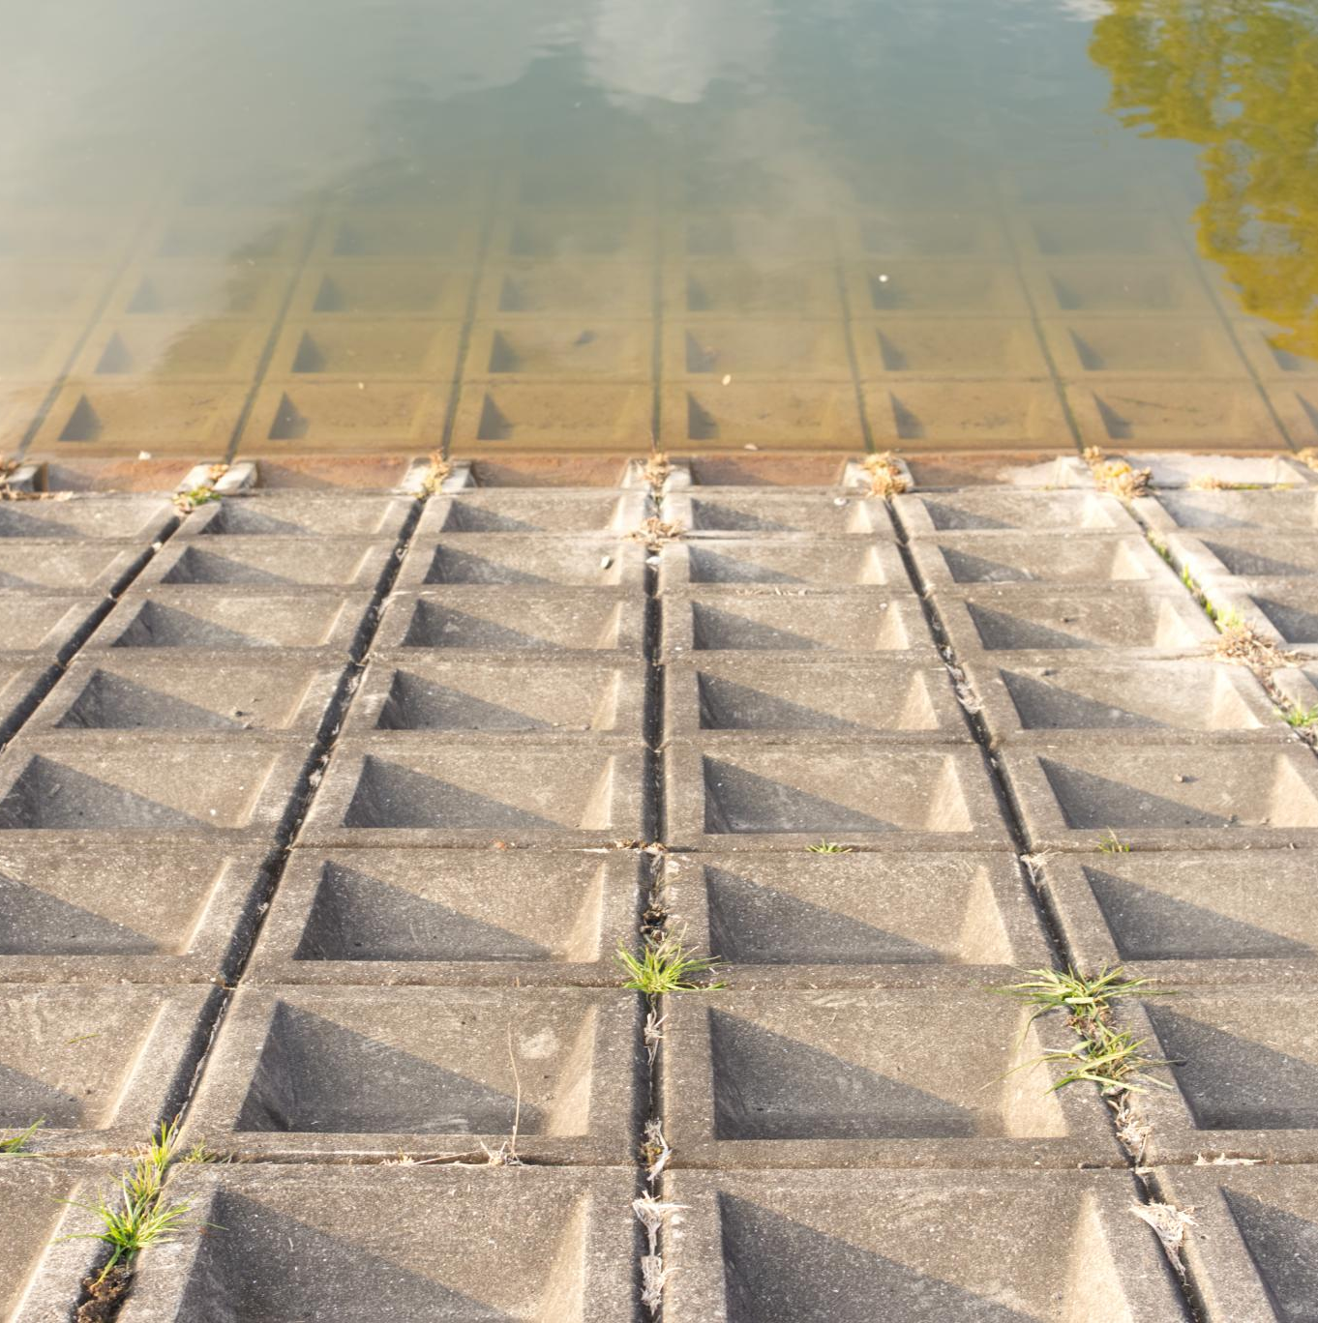
Leaching, leaking, and Water Intrusion
  Leaching – water migration through the concrete slab
  Leaking – water migration through holes or cracks
  Clogged drains and failed waterproofing cause water to pool and seep into structural cracks.
  Persistent moisture leads to corrosion, delamination, and internal cracking within concrete structures.
  Wet or icy surfaces increase slip hazards for employees and visitors in parking and structural facilities.
  Prevention Includes:
  Apply and maintain deck coatings, specifically on exposed roof
  Maintain drainage systems, ensure 2% slope towards drains
  Apply penetrating sealers to block moisture
  Seal expansion joints and cracks
  Regular maintenance and inspection
Notes:
Water intrusion is one of the leading causes of accelerated deterioration in parking decks and structural facilities. When drains become clogged or when waterproofing systems fail, water begins to pond on surfaces, seep into cracks, and migrate through concrete slabs. Over time, this movement can lead to leaching, where mineral deposits accumulate on surfaces, signaling that moisture is infiltrating deep into the structure. Persistent moisture exposure contributes to corrosion of reinforcing steel, delamination, and internal cracking—conditions that are often hidden until advanced damage occurs. Additionally, wet or icy surfaces significantly increase slip hazards for employees, tenants, or travelers. Poor drainage systems may cause water infiltration into lower levels, potentially damaging electrical systems, mechanical spaces, or vehicle storage areas. Effective drainage maintenance—combined with scheduled inspections—is critical to preventing long-term structural issues, environmental damage, and personal injury. By actively monitoring drains, sealants, joints, and slope direction, facilities teams can ensure water is properly directed away from vulnerable areas, reducing both immediate risks and future remediation costs.

Slide 15
Savona Mill parking deck assessment

Slide 16
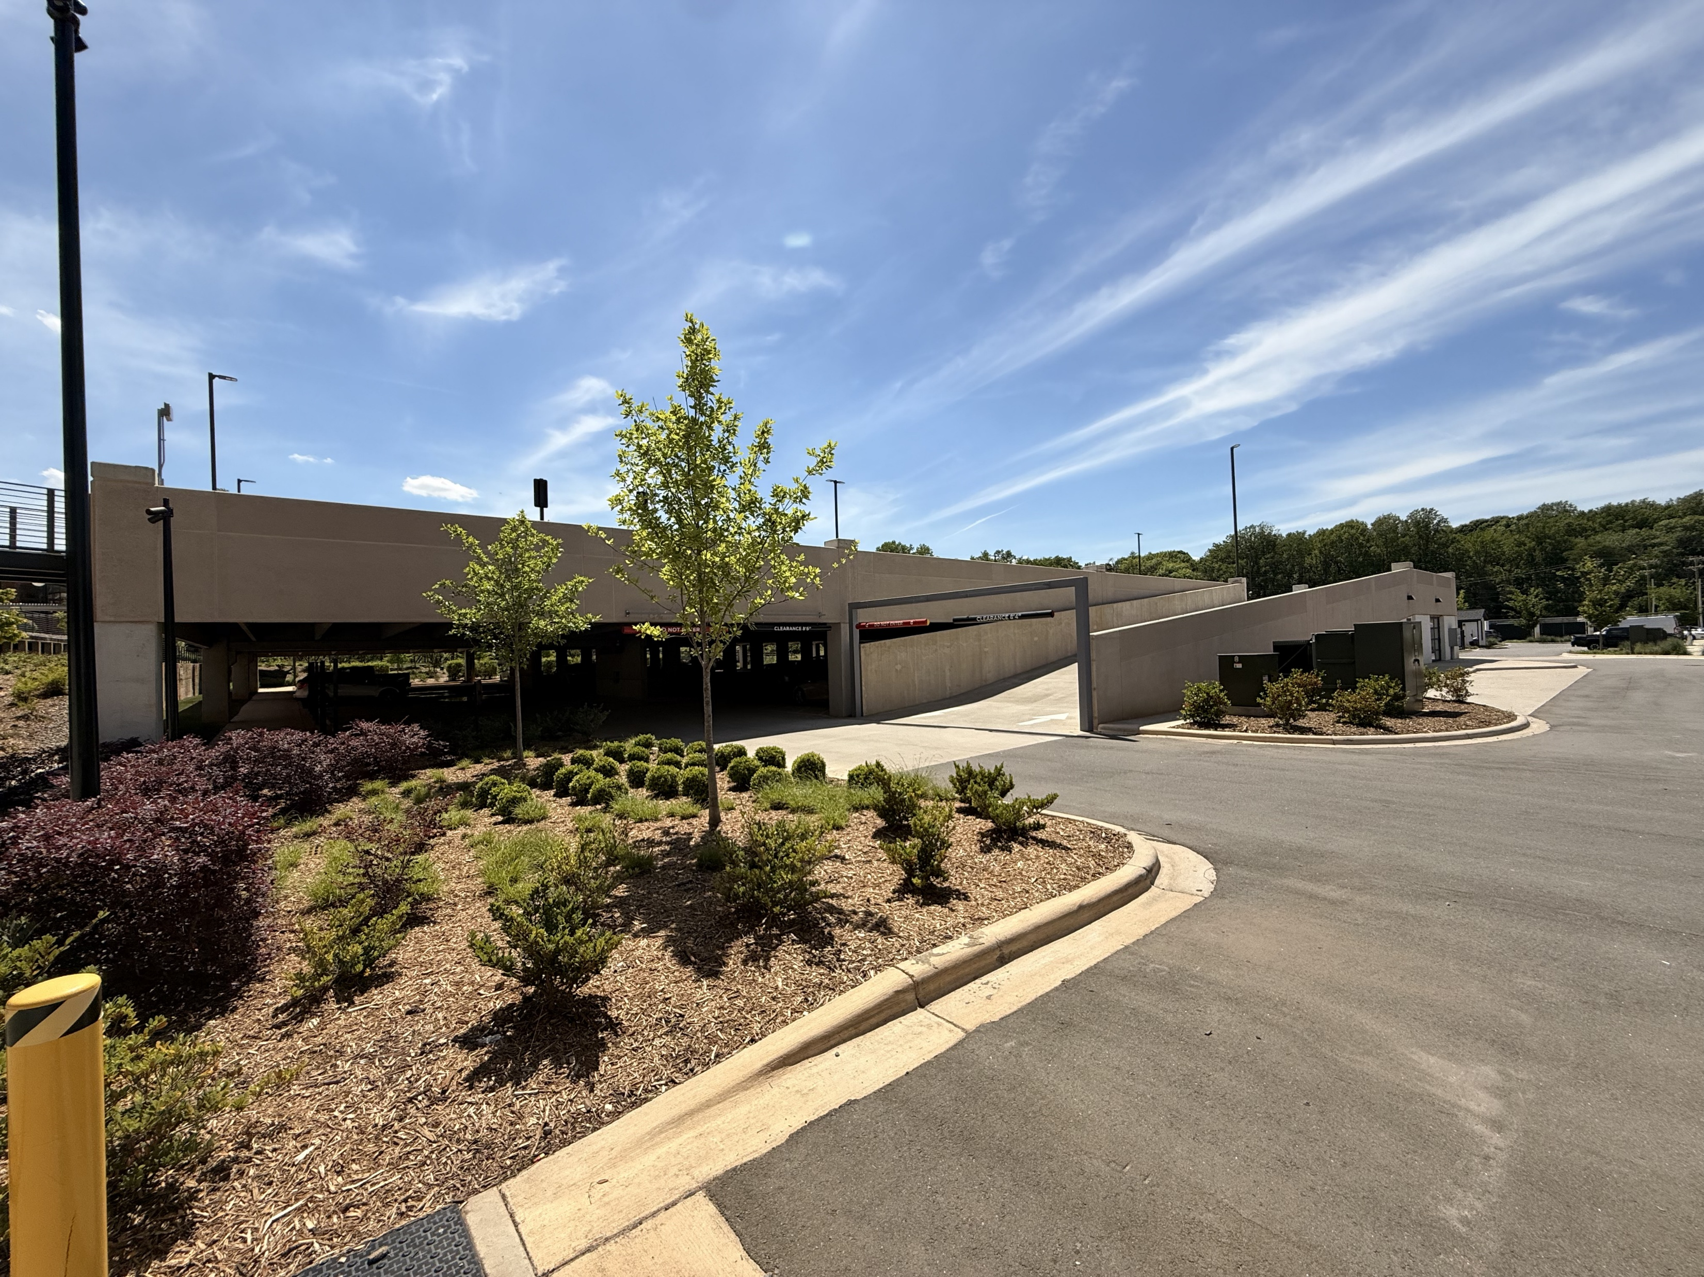
Savona mill parking deck overview
  Adaptive reuse renovation and revitalization delivered in fall 2023
  Deck is considered “very good” condition
  Issues observed are typical early-life maintenance items
  Strong example of early intervention preventing long-term structural repairs
  Main issues observed:
    Concrete cracking and delamination
    Failed sealants
Notes:
Water intrusion is one of the leading causes of accelerated deterioration in parking decks and structural facilities. When drains become clogged or when waterproofing systems fail, water begins to pond on surfaces, seep into cracks, and migrate through concrete slabs. Over time, this movement can lead to leaching, where mineral deposits accumulate on surfaces, signaling that moisture is infiltrating deep into the structure. Persistent moisture exposure contributes to corrosion of reinforcing steel, delamination, and internal cracking—conditions that are often hidden until advanced damage occurs. Additionally, wet or icy surfaces significantly increase slip hazards for employees, tenants, or travelers. Poor drainage systems may cause water infiltration into lower levels, potentially damaging electrical systems, mechanical spaces, or vehicle storage areas. Effective drainage maintenance—combined with scheduled inspections—is critical to preventing long-term structural issues, environmental damage, and personal injury. By actively monitoring drains, sealants, joints, and slope direction, facilities teams can ensure water is properly directed away from vulnerable areas, reducing both immediate risks and future remediation costs.

Slide 17
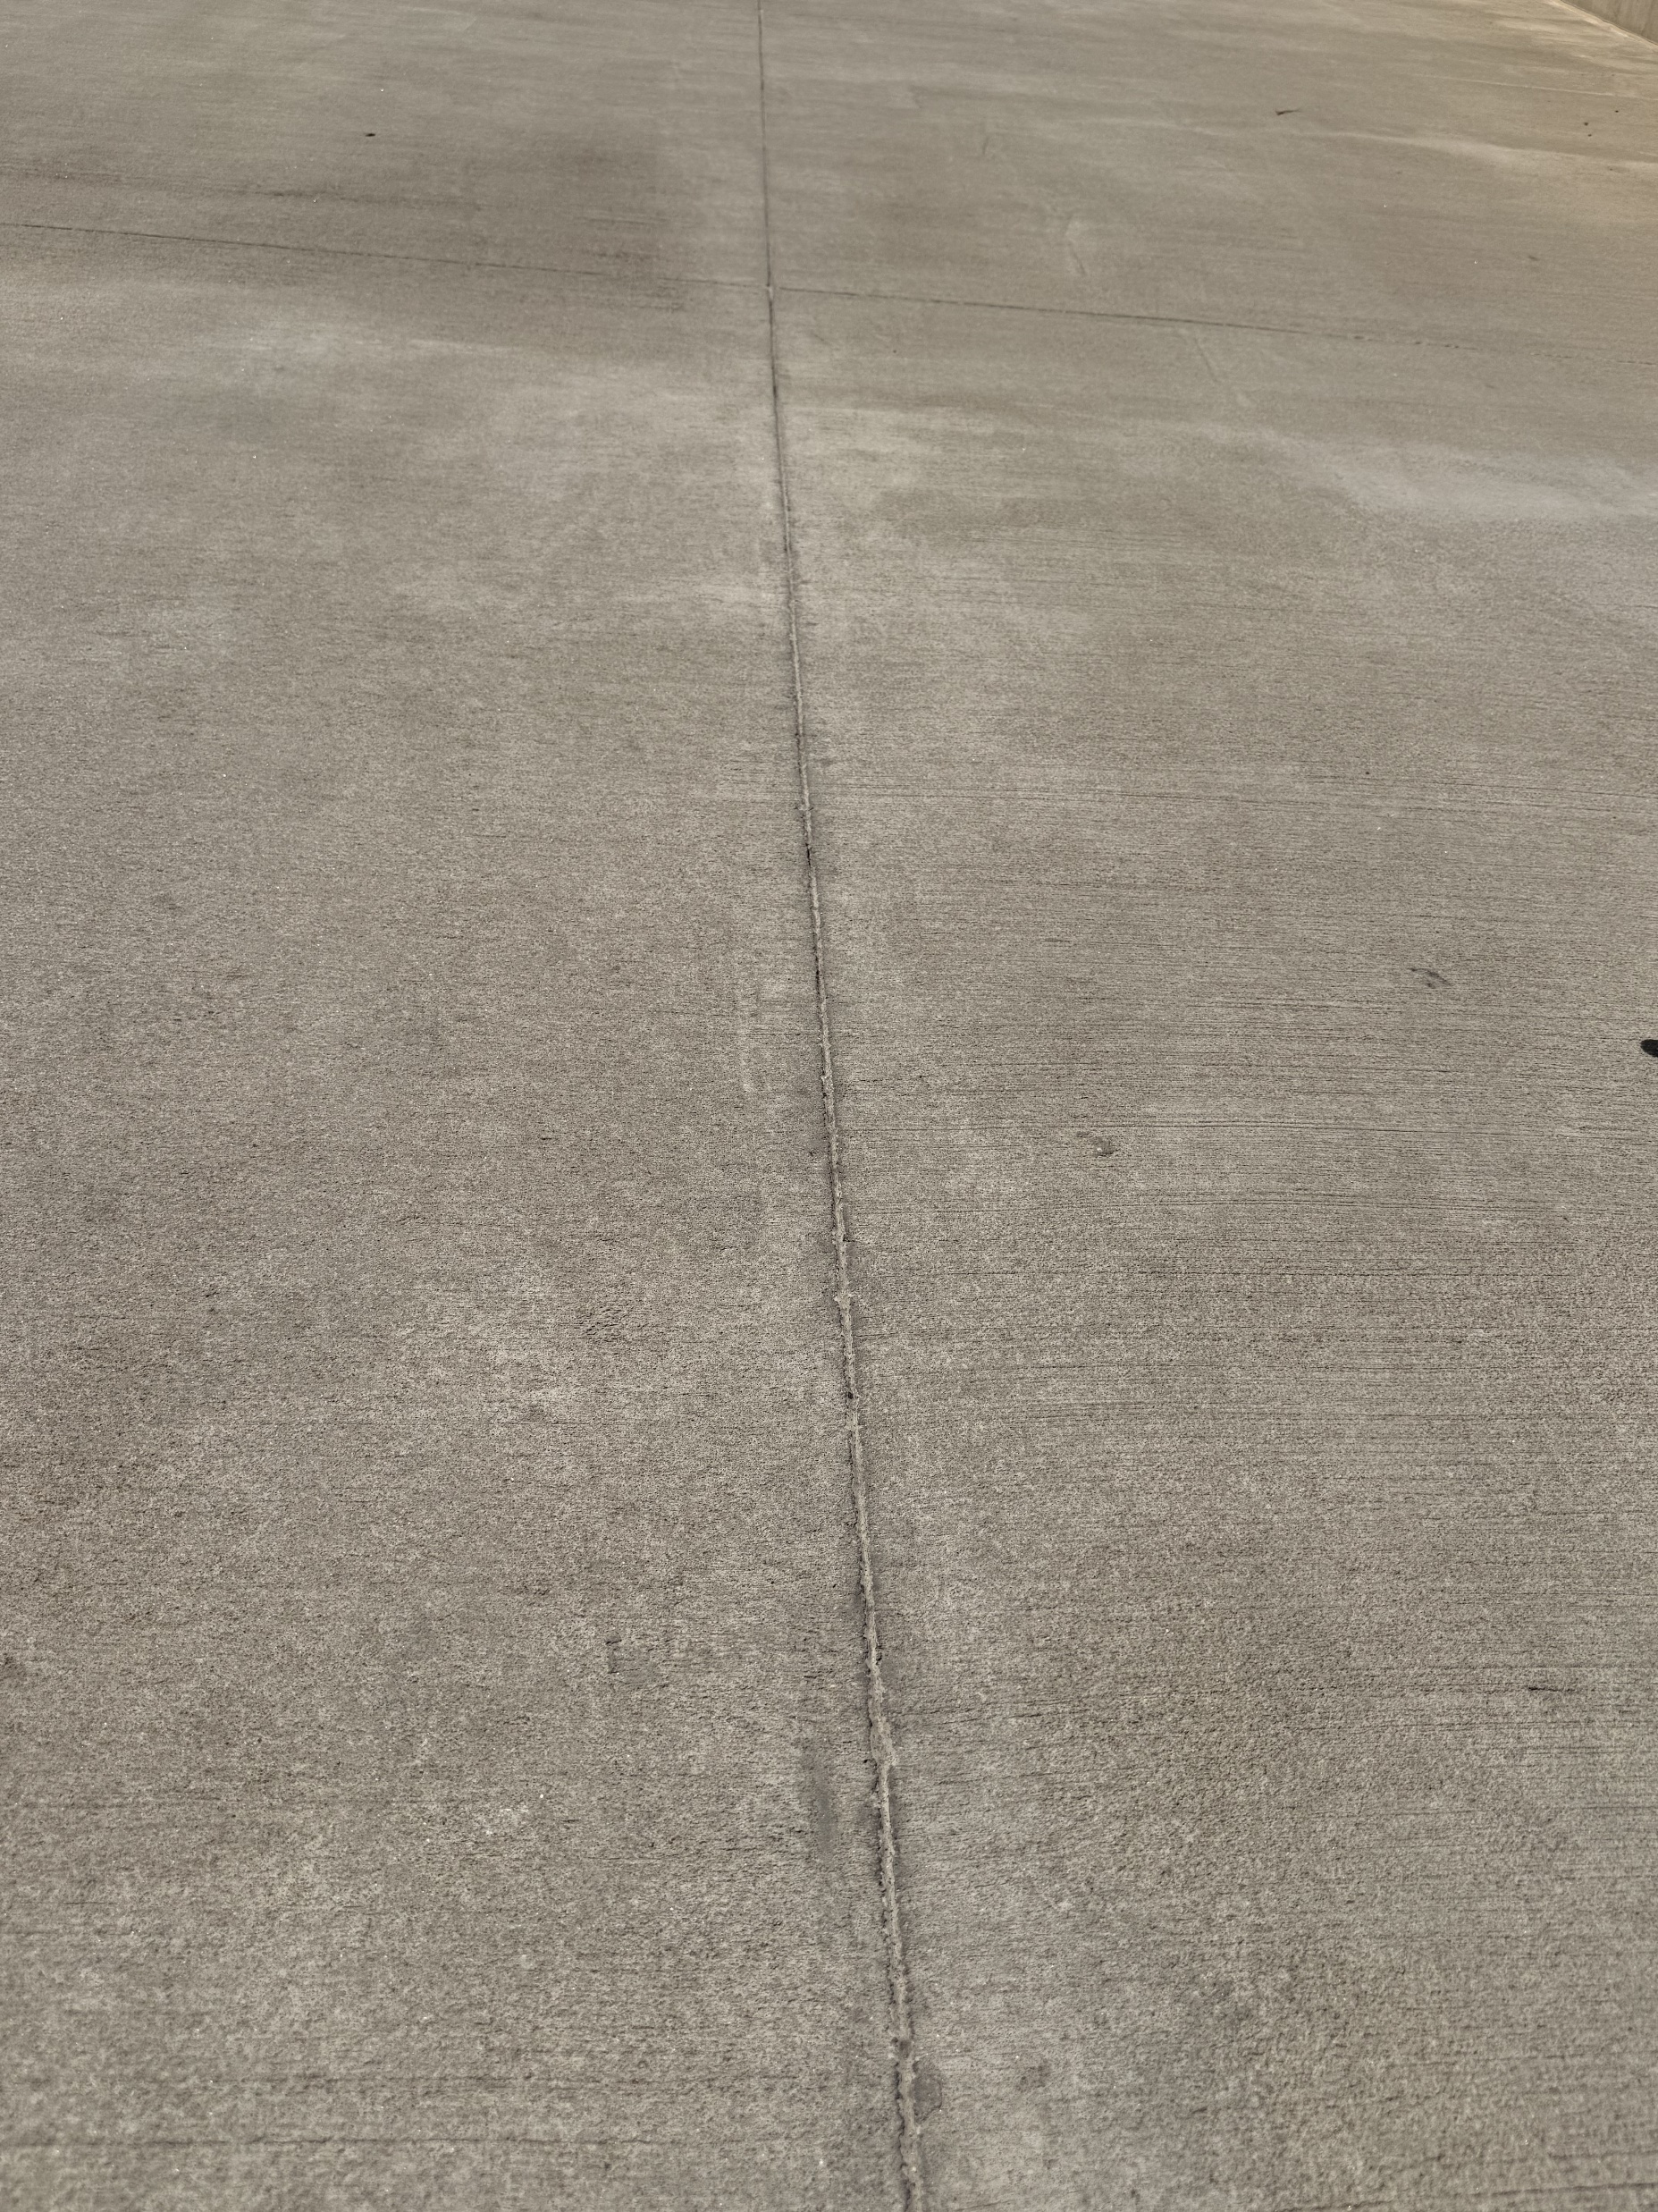
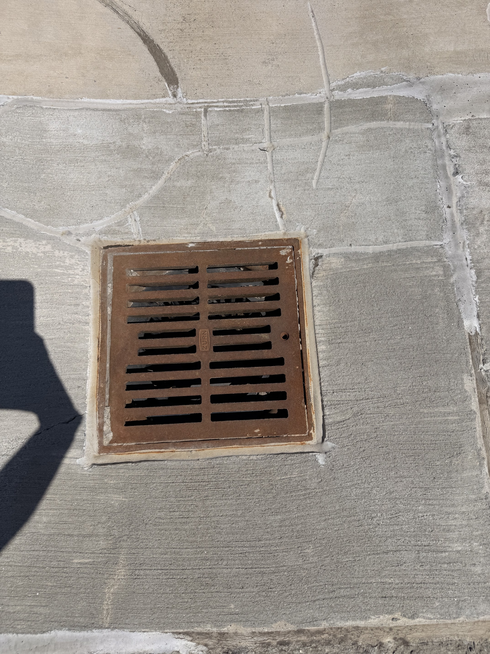
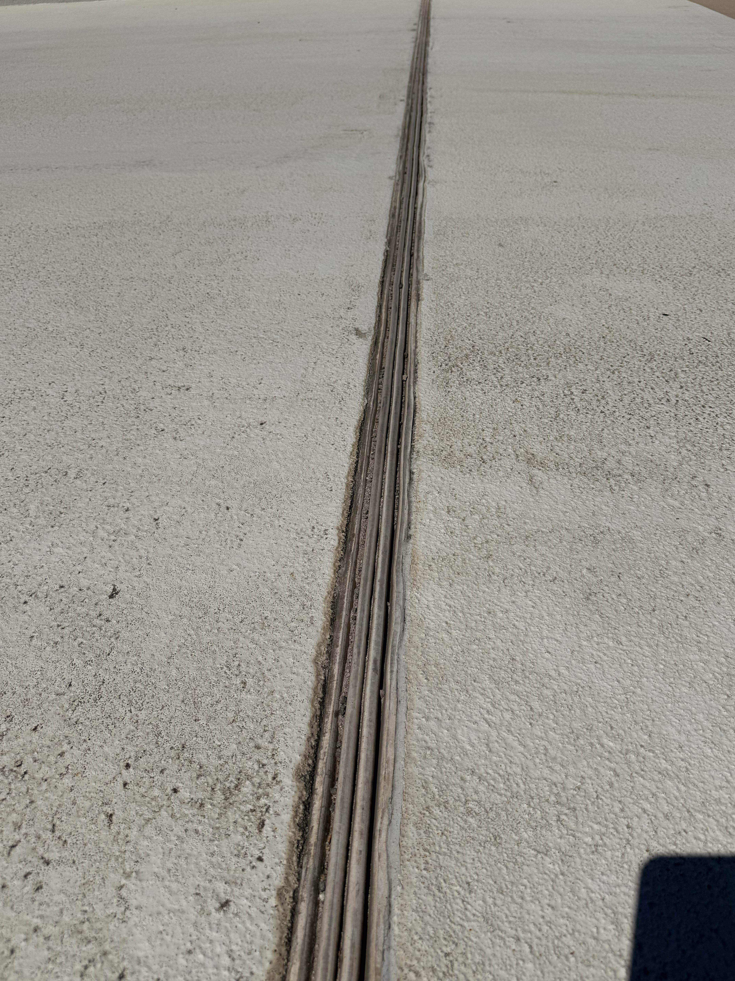
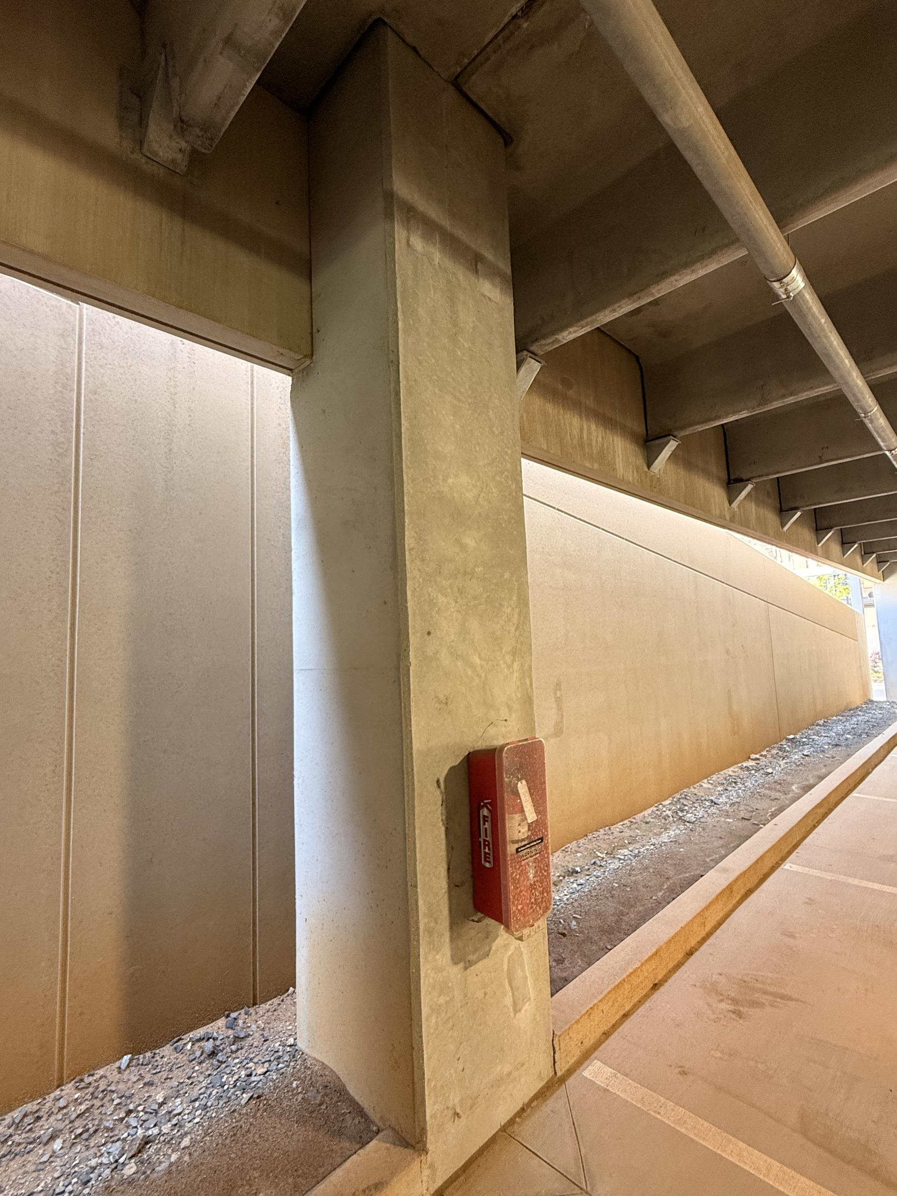
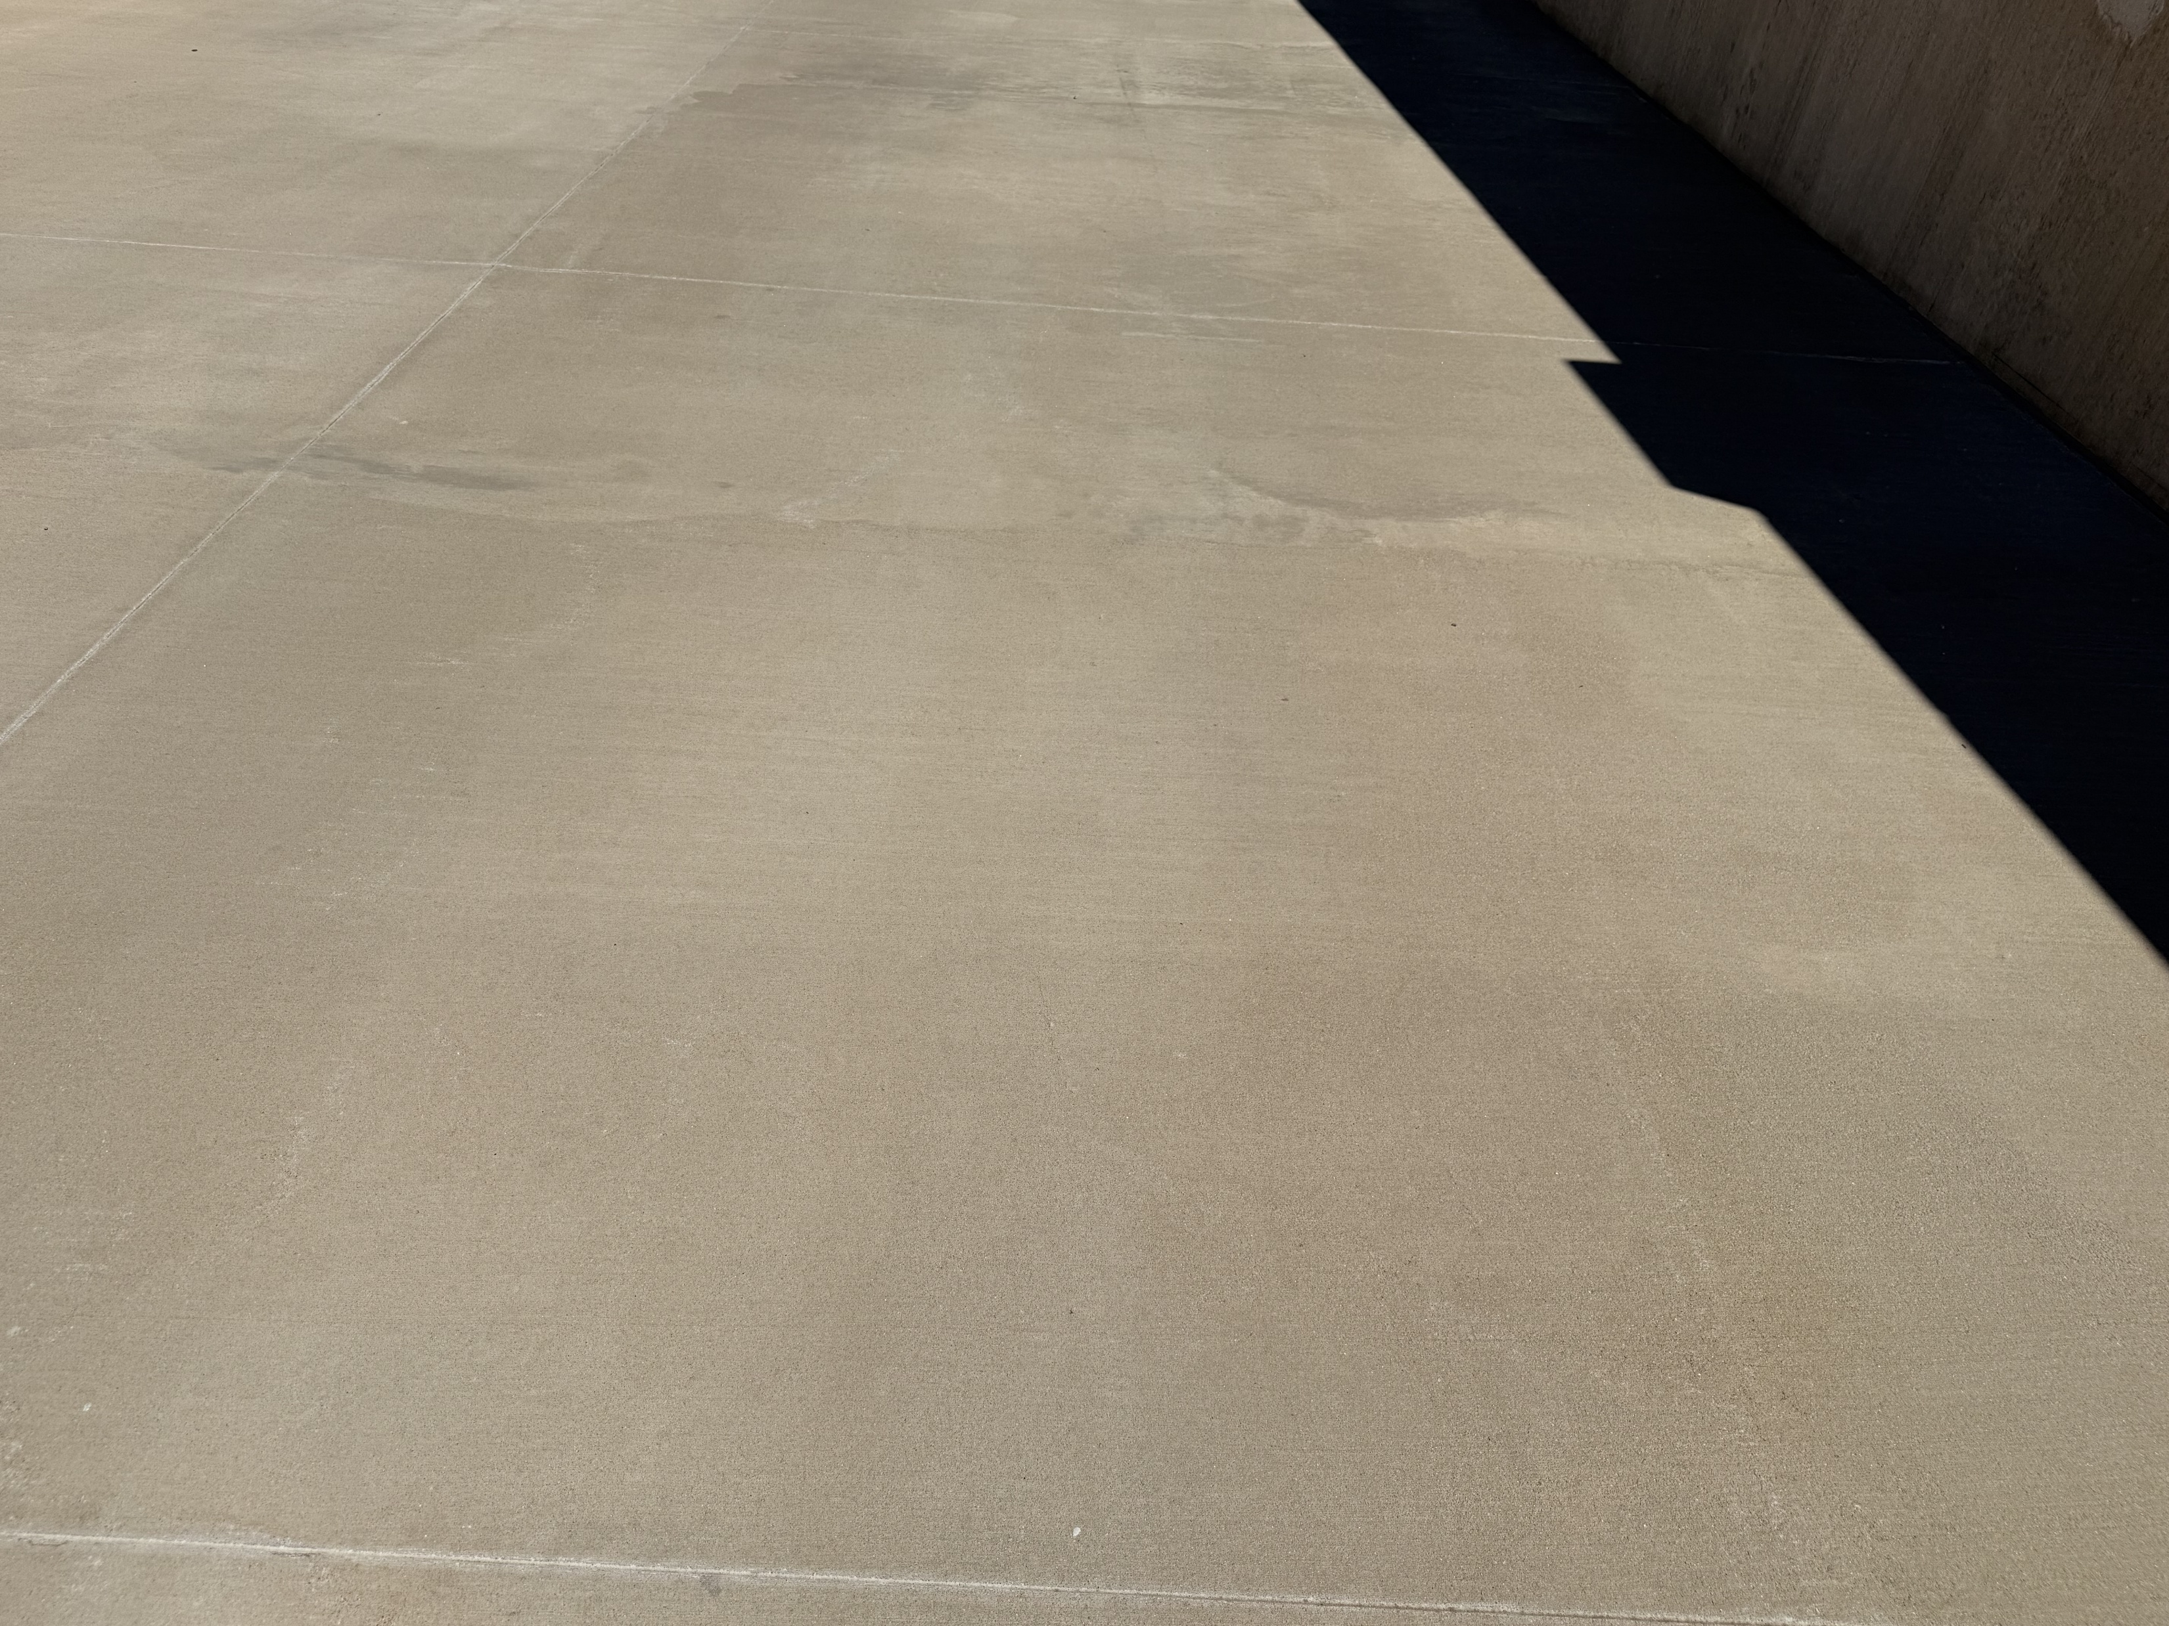
drain
Expansion joint
Caulk joint
Good condition
Concrete slab
Support column
Notes:
Western Specialty Contractors offers a comprehensive range of services designed to enhance safety, durability, and performance across parking structures and building envelopes. Core capabilities include structural concrete repair such as spall patching, form‑and‑place repairs, and shotcrete applications. Western’s waterproofing expertise ensures effective protection against moisture infiltration through deck coatings, sealants, and joint replacement. Masonry restoration services address deterioration in brick, stone, and façade systems with techniques such as tuckpointing, repointing, and material replacement. For structural strengthening, Western provides reinforcement solutions that address corrosion‑related weakening or load‑capacity concerns. The company also performs detailed inspections, condition assessments, and leak investigations that support long-term asset management strategies. These services collectively contribute to safer environments, prolonged structural life, and reduced operational risks, making Western a valuable partner for Delta, JLL, and other facilities teams responsible for maintaining high-traffic environments.

Slide 18
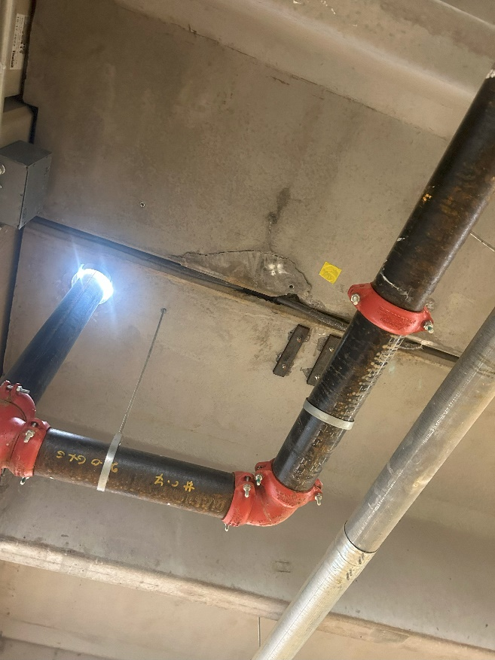
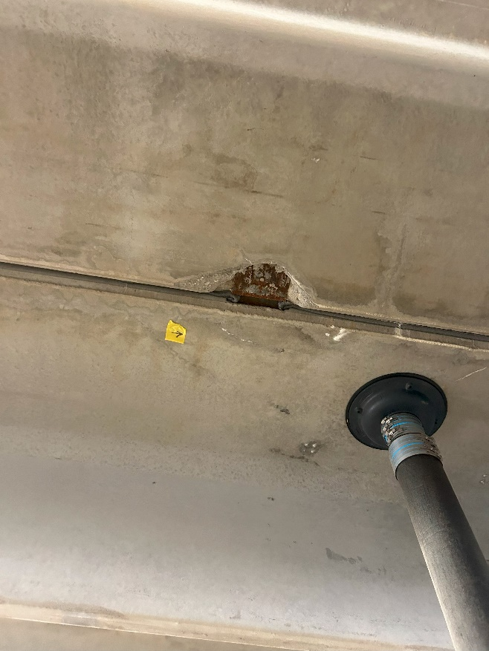
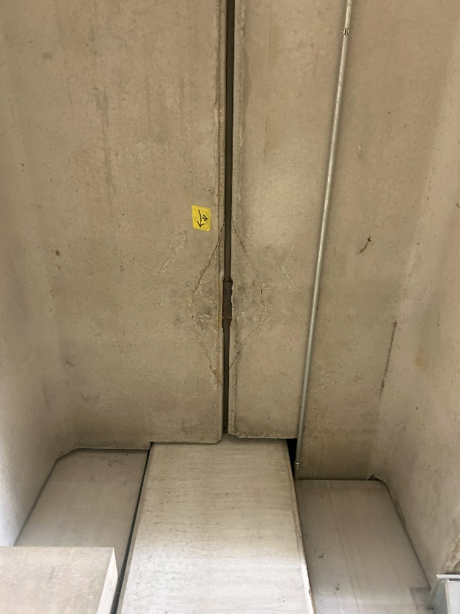
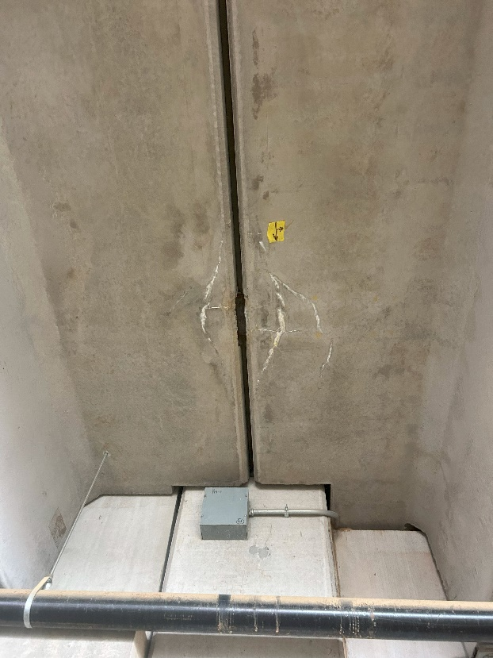
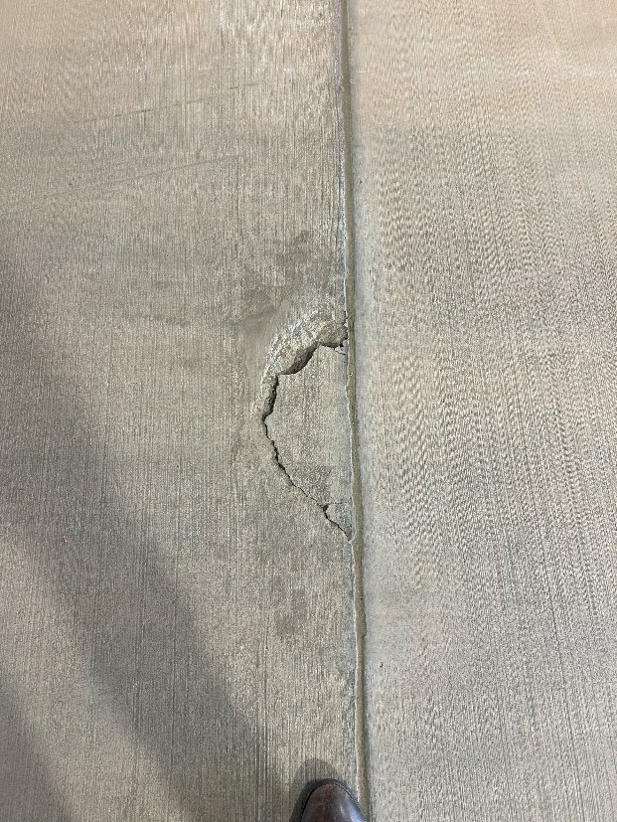
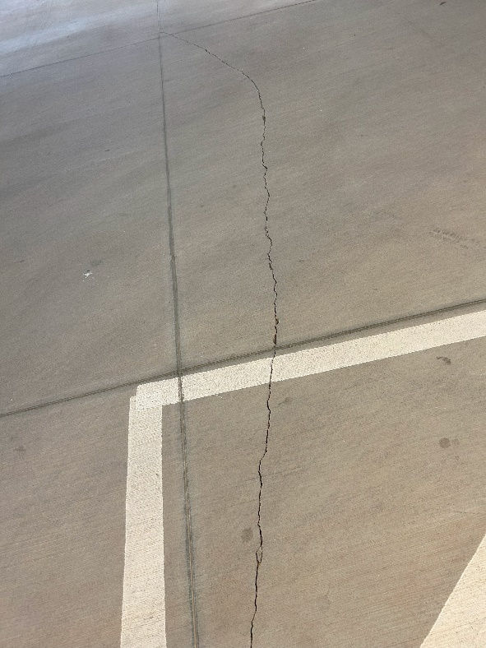
Overhead concrete repairs
Priority 1 –
1-12 months
Horizontal concrete cracking
Notes:
Western Specialty Contractors offers a comprehensive range of services designed to enhance safety, durability, and performance across parking structures and building envelopes. Core capabilities include structural concrete repair such as spall patching, form‑and‑place repairs, and shotcrete applications. Western’s waterproofing expertise ensures effective protection against moisture infiltration through deck coatings, sealants, and joint replacement. Masonry restoration services address deterioration in brick, stone, and façade systems with techniques such as tuckpointing, repointing, and material replacement. For structural strengthening, Western provides reinforcement solutions that address corrosion‑related weakening or load‑capacity concerns. The company also performs detailed inspections, condition assessments, and leak investigations that support long-term asset management strategies. These services collectively contribute to safer environments, prolonged structural life, and reduced operational risks, making Western a valuable partner for Delta, JLL, and other facilities teams responsible for maintaining high-traffic environments.

Slide 19
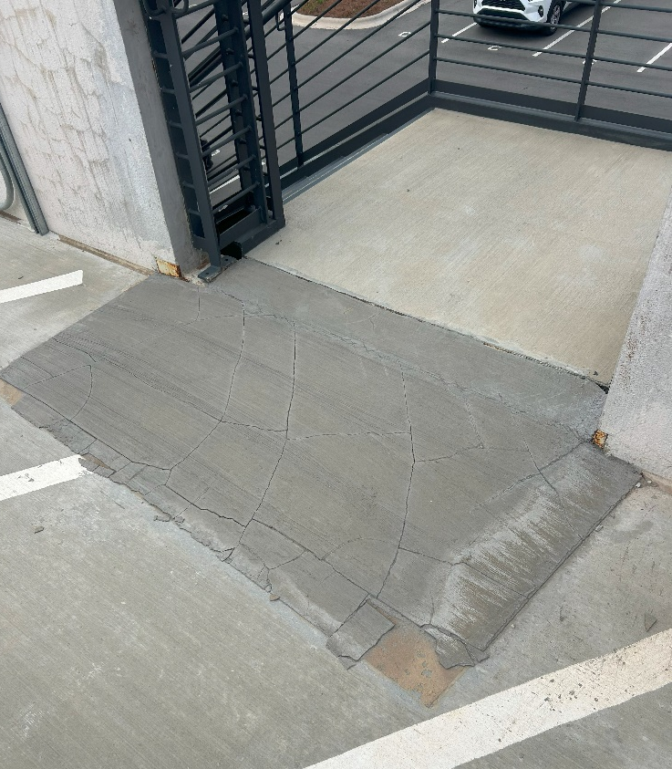
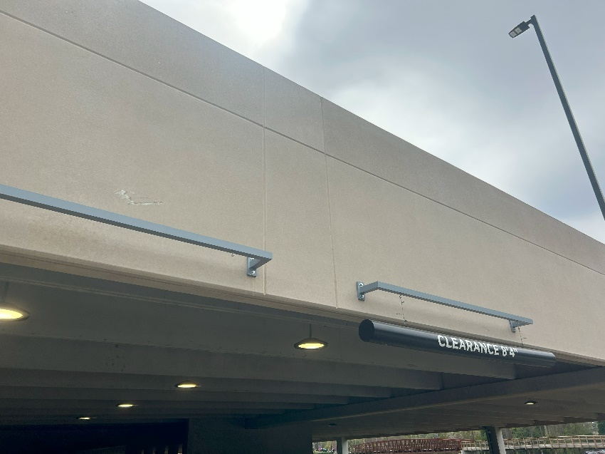
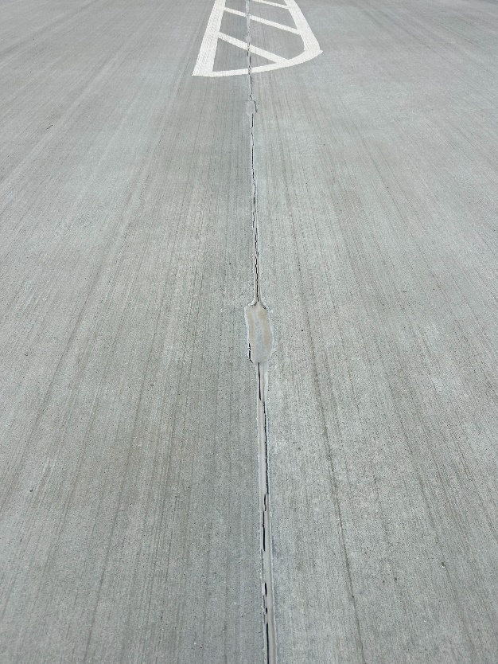
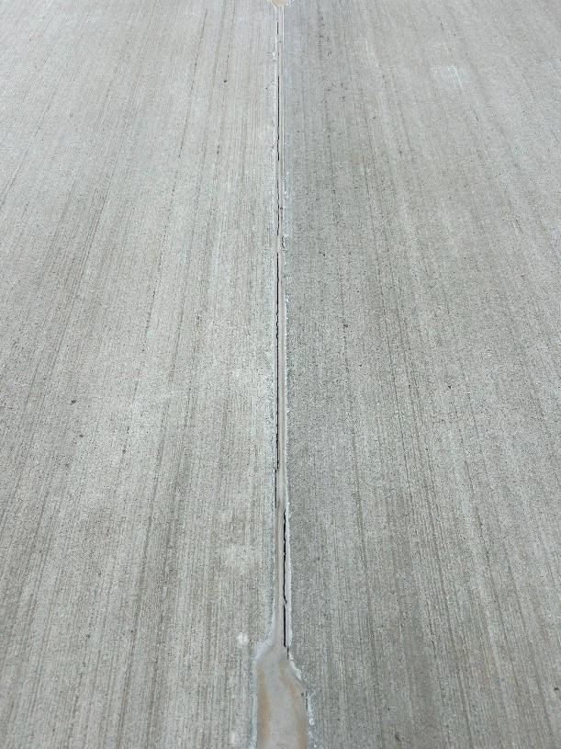
No headache bar
Spalled concrete overlay
Priority 1 –
1-12 months
Failed sealants
Notes:
Western Specialty Contractors offers a comprehensive range of services designed to enhance safety, durability, and performance across parking structures and building envelopes. Core capabilities include structural concrete repair such as spall patching, form‑and‑place repairs, and shotcrete applications. Western’s waterproofing expertise ensures effective protection against moisture infiltration through deck coatings, sealants, and joint replacement. Masonry restoration services address deterioration in brick, stone, and façade systems with techniques such as tuckpointing, repointing, and material replacement. For structural strengthening, Western provides reinforcement solutions that address corrosion‑related weakening or load‑capacity concerns. The company also performs detailed inspections, condition assessments, and leak investigations that support long-term asset management strategies. These services collectively contribute to safer environments, prolonged structural life, and reduced operational risks, making Western a valuable partner for Delta, JLL, and other facilities teams responsible for maintaining high-traffic environments.

Slide 20
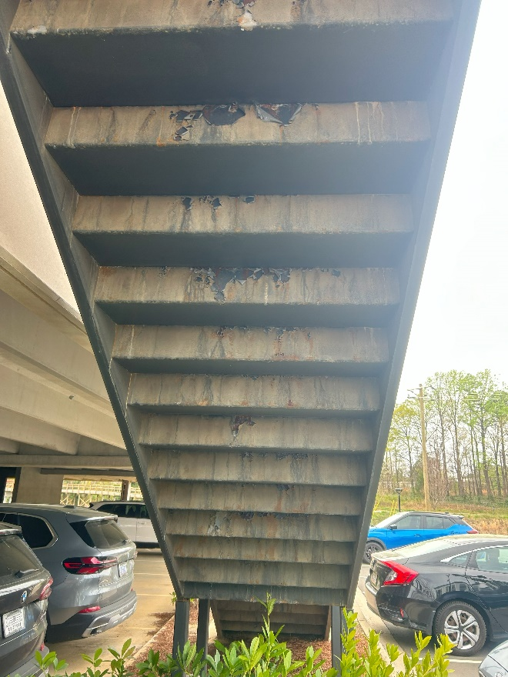
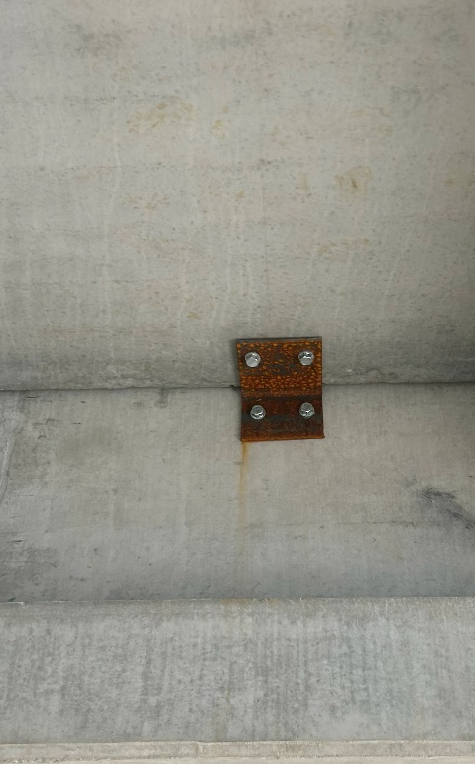
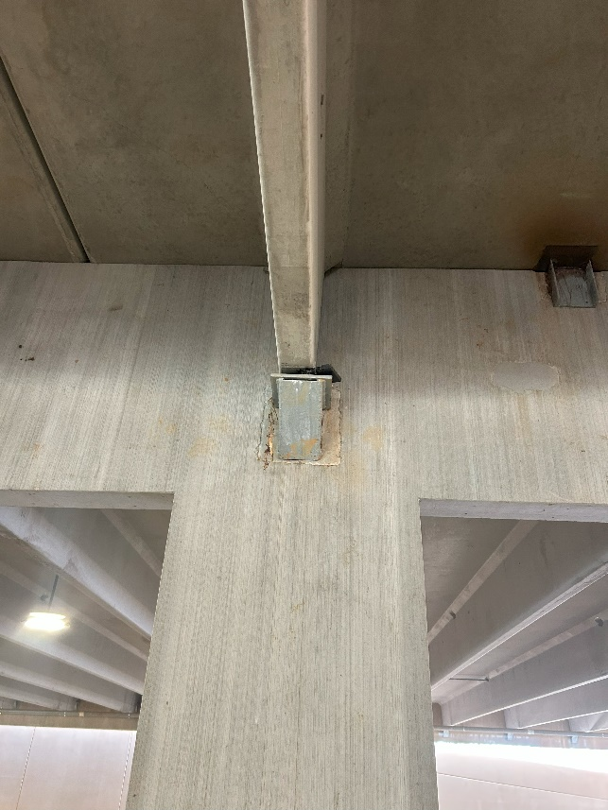
Rusted metal clips
Stair deterioration
Priority 2 –
12-24 months
Bearing pad replacement
Notes:
Western Specialty Contractors offers a comprehensive range of services designed to enhance safety, durability, and performance across parking structures and building envelopes. Core capabilities include structural concrete repair such as spall patching, form‑and‑place repairs, and shotcrete applications. Western’s waterproofing expertise ensures effective protection against moisture infiltration through deck coatings, sealants, and joint replacement. Masonry restoration services address deterioration in brick, stone, and façade systems with techniques such as tuckpointing, repointing, and material replacement. For structural strengthening, Western provides reinforcement solutions that address corrosion‑related weakening or load‑capacity concerns. The company also performs detailed inspections, condition assessments, and leak investigations that support long-term asset management strategies. These services collectively contribute to safer environments, prolonged structural life, and reduced operational risks, making Western a valuable partner for Delta, JLL, and other facilities teams responsible for maintaining high-traffic environments.

Slide 21
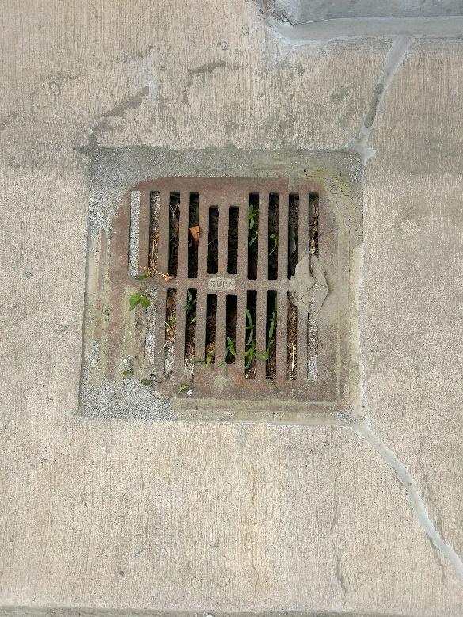
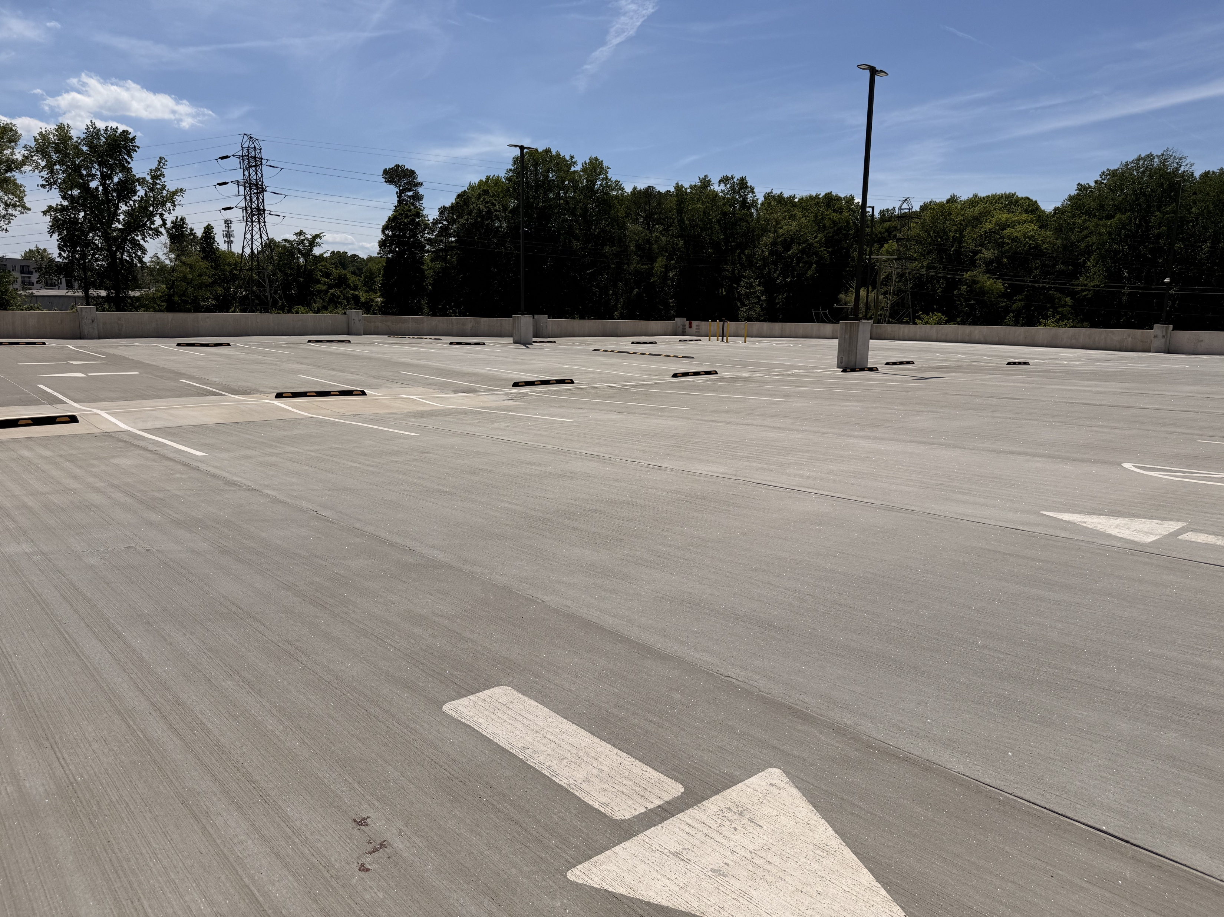
  Regular drain cleaning to prevent ponding on roof deck and minimize repair costs
  Ponding leads to leaching, leaching leads to concrete cracking and leads to corrosion
  Protective roof coating can help prevent long term issues with concrete both on roof and first floor of deck
Other recommendations
Notes:
Western Specialty Contractors offers a comprehensive range of services designed to enhance safety, durability, and performance across parking structures and building envelopes. Core capabilities include structural concrete repair such as spall patching, form‑and‑place repairs, and shotcrete applications. Western’s waterproofing expertise ensures effective protection against moisture infiltration through deck coatings, sealants, and joint replacement. Masonry restoration services address deterioration in brick, stone, and façade systems with techniques such as tuckpointing, repointing, and material replacement. For structural strengthening, Western provides reinforcement solutions that address corrosion‑related weakening or load‑capacity concerns. The company also performs detailed inspections, condition assessments, and leak investigations that support long-term asset management strategies. These services collectively contribute to safer environments, prolonged structural life, and reduced operational risks, making Western a valuable partner for Delta, JLL, and other facilities teams responsible for maintaining high-traffic environments.

Slide 22
Let’s take a walk!

Slide 23
Parking deck Repair timeline

Slide 24
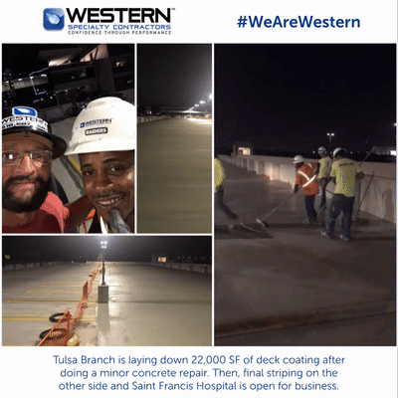
Ideal maintenance cycle
Annually
Maintenance Items:
  Delaminated, cracking, and/or falling concrete
  Immediate Safety Concerns
  Stall striping visibility
5-10 Years
Deck Coatings
Sealants
Concrete cracking maintenance
Maintaining striping/signage is withing ADA compliance
15-20 Years
Continued concrete maintenance
Exposed structural steel components
Preventative maintenance: add or recoat existing sealers and/or protective coatings
Notes:
Water intrusion is one of the leading causes of accelerated deterioration in parking decks and structural facilities. When drains become clogged or when waterproofing systems fail, water begins to pond on surfaces, seep into cracks, and migrate through concrete slabs. Over time, this movement can lead to leaching, where mineral deposits accumulate on surfaces, signaling that moisture is infiltrating deep into the structure. Persistent moisture exposure contributes to corrosion of reinforcing steel, delamination, and internal cracking—conditions that are often hidden until advanced damage occurs. Additionally, wet or icy surfaces significantly increase slip hazards for employees, tenants, or travelers. Poor drainage systems may cause water infiltration into lower levels, potentially damaging electrical systems, mechanical spaces, or vehicle storage areas. Effective drainage maintenance—combined with scheduled inspections—is critical to preventing long-term structural issues, environmental damage, and personal injury. By actively monitoring drains, sealants, joints, and slope direction, facilities teams can ensure water is properly directed away from vulnerable areas, reducing both immediate risks and future remediation costs.

Slide 25
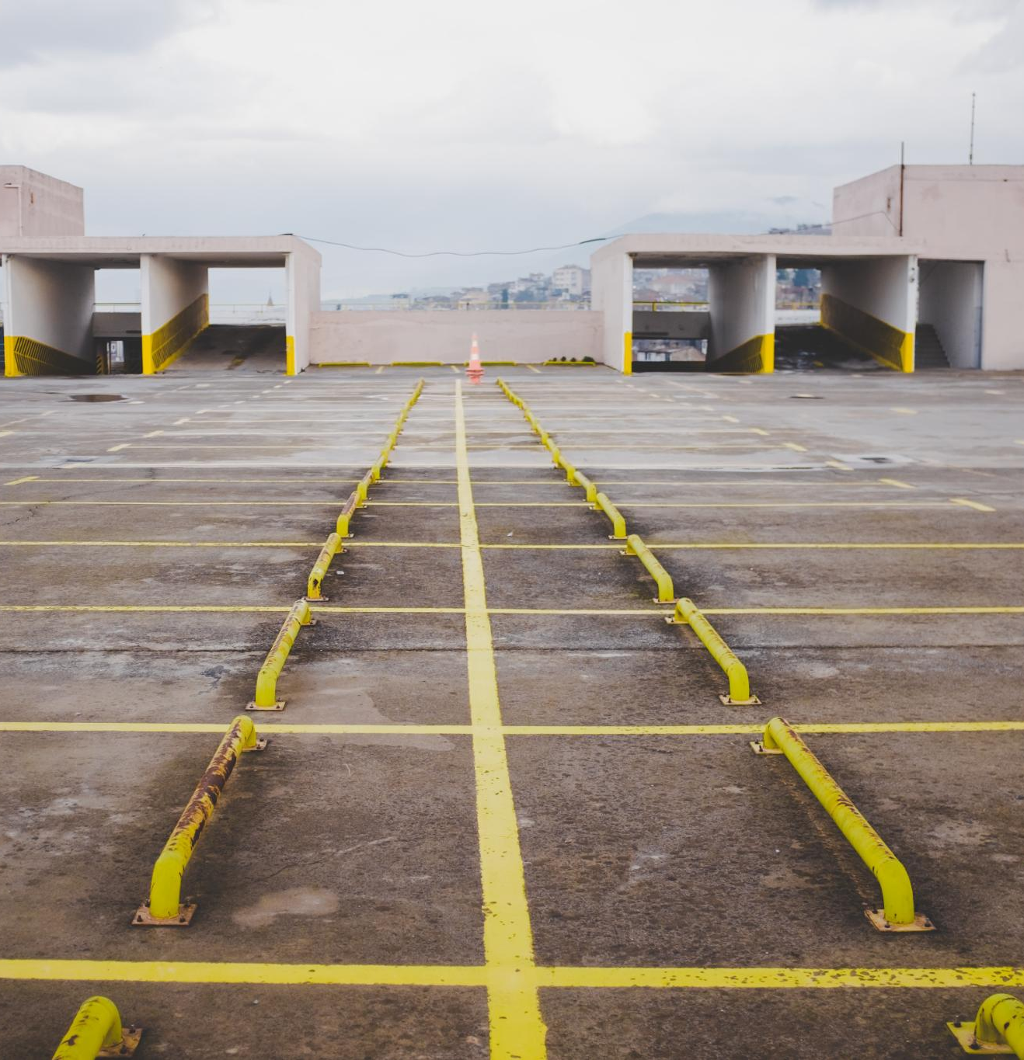
Cosmetic vs structural
Cosmetic Issues Defined
  Cosmetic issues include surface stains, minor wear, and hairline cracks that do not affect structural performance.
Structural Concerns Explained
  Structural concerns are serious problems like exposed rebar, delamination, corrosion, and movement that threaten safety.
Prioritizing Maintenance
  Separating Priority 1 safety issues from Priority 2 monitoring helps allocate resources efficiently and ensure prompt repairs.
Notes:
Water intrusion is one of the leading causes of accelerated deterioration in parking decks and structural facilities. When drains become clogged or when waterproofing systems fail, water begins to pond on surfaces, seep into cracks, and migrate through concrete slabs. Over time, this movement can lead to leaching, where mineral deposits accumulate on surfaces, signaling that moisture is infiltrating deep into the structure. Persistent moisture exposure contributes to corrosion of reinforcing steel, delamination, and internal cracking—conditions that are often hidden until advanced damage occurs. Additionally, wet or icy surfaces significantly increase slip hazards for employees, tenants, or travelers. Poor drainage systems may cause water infiltration into lower levels, potentially damaging electrical systems, mechanical spaces, or vehicle storage areas. Effective drainage maintenance—combined with scheduled inspections—is critical to preventing long-term structural issues, environmental damage, and personal injury. By actively monitoring drains, sealants, joints, and slope direction, facilities teams can ensure water is properly directed away from vulnerable areas, reducing both immediate risks and future remediation costs.

Slide 26
Moisture & deterioration indicators
Visible Moisture Indicators
  Cracks, peeling paint, staining, and surface deterioration reveal trapped water or poor drainage in structures.
Design and Drainage Issues
  Poor drainage and design details, like water trapped in stair pans, lead to localized deterioration in new structures.
Preventive Measures
  Applying protective coatings and improving water management significantly slows structural deterioration caused by moisture.
Understanding Water Migration
  Walkthroughs help identify how water moves through structures and reveal hidden moisture risks not visible on surfaces.
Notes:
Water intrusion is one of the leading causes of accelerated deterioration in parking decks and structural facilities. When drains become clogged or when waterproofing systems fail, water begins to pond on surfaces, seep into cracks, and migrate through concrete slabs. Over time, this movement can lead to leaching, where mineral deposits accumulate on surfaces, signaling that moisture is infiltrating deep into the structure. Persistent moisture exposure contributes to corrosion of reinforcing steel, delamination, and internal cracking—conditions that are often hidden until advanced damage occurs. Additionally, wet or icy surfaces significantly increase slip hazards for employees, tenants, or travelers. Poor drainage systems may cause water infiltration into lower levels, potentially damaging electrical systems, mechanical spaces, or vehicle storage areas. Effective drainage maintenance—combined with scheduled inspections—is critical to preventing long-term structural issues, environmental damage, and personal injury. By actively monitoring drains, sealants, joints, and slope direction, facilities teams can ensure water is properly directed away from vulnerable areas, reducing both immediate risks and future remediation costs.

Slide 27

Deferred maintenance escalation
Approximately 20% growth of repair area/year
Approximately 3-5% cost increase/year
Notes:
Water intrusion is one of the leading causes of accelerated deterioration in parking decks and structural facilities. When drains become clogged or when waterproofing systems fail, water begins to pond on surfaces, seep into cracks, and migrate through concrete slabs. Over time, this movement can lead to leaching, where mineral deposits accumulate on surfaces, signaling that moisture is infiltrating deep into the structure. Persistent moisture exposure contributes to corrosion of reinforcing steel, delamination, and internal cracking—conditions that are often hidden until advanced damage occurs. Additionally, wet or icy surfaces significantly increase slip hazards for employees, tenants, or travelers. Poor drainage systems may cause water infiltration into lower levels, potentially damaging electrical systems, mechanical spaces, or vehicle storage areas. Effective drainage maintenance—combined with scheduled inspections—is critical to preventing long-term structural issues, environmental damage, and personal injury. By actively monitoring drains, sealants, joints, and slope direction, facilities teams can ensure water is properly directed away from vulnerable areas, reducing both immediate risks and future remediation costs.

Slide 28
Proposal dissection

Slide 29

What should all bids show?
Same scope of work
Same type of material
Warranty
Quantities of repair(s)
Verbiage on material utilization
Notes:
Water intrusion is one of the leading causes of accelerated deterioration in parking decks and structural facilities. When drains become clogged or when waterproofing systems fail, water begins to pond on surfaces, seep into cracks, and migrate through concrete slabs. Over time, this movement can lead to leaching, where mineral deposits accumulate on surfaces, signaling that moisture is infiltrating deep into the structure. Persistent moisture exposure contributes to corrosion of reinforcing steel, delamination, and internal cracking—conditions that are often hidden until advanced damage occurs. Additionally, wet or icy surfaces significantly increase slip hazards for employees, tenants, or travelers. Poor drainage systems may cause water infiltration into lower levels, potentially damaging electrical systems, mechanical spaces, or vehicle storage areas. Effective drainage maintenance—combined with scheduled inspections—is critical to preventing long-term structural issues, environmental damage, and personal injury. By actively monitoring drains, sealants, joints, and slope direction, facilities teams can ensure water is properly directed away from vulnerable areas, reducing both immediate risks and future remediation costs.

Slide 30
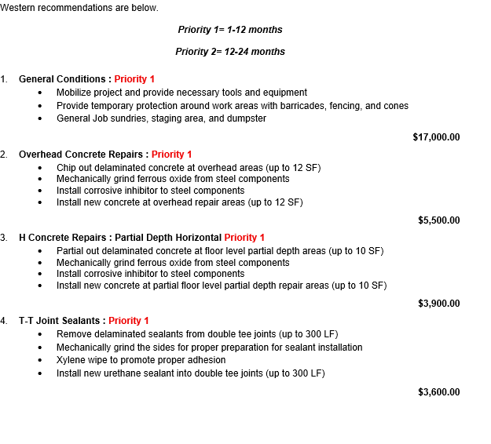
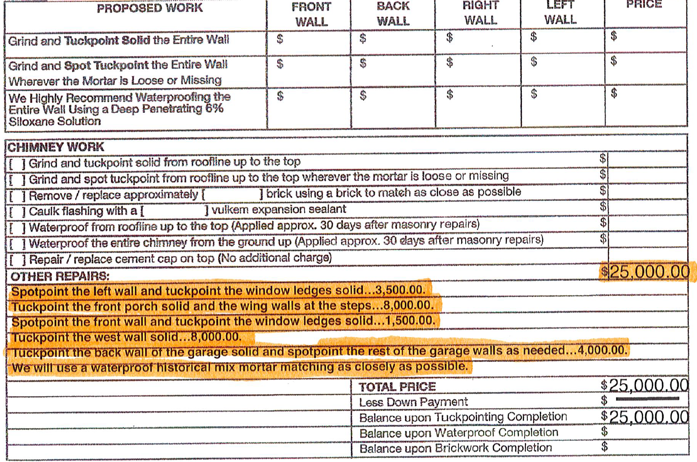
What should all bids show?
Proposal examples
Notes:
Water intrusion is one of the leading causes of accelerated deterioration in parking decks and structural facilities. When drains become clogged or when waterproofing systems fail, water begins to pond on surfaces, seep into cracks, and migrate through concrete slabs. Over time, this movement can lead to leaching, where mineral deposits accumulate on surfaces, signaling that moisture is infiltrating deep into the structure. Persistent moisture exposure contributes to corrosion of reinforcing steel, delamination, and internal cracking—conditions that are often hidden until advanced damage occurs. Additionally, wet or icy surfaces significantly increase slip hazards for employees, tenants, or travelers. Poor drainage systems may cause water infiltration into lower levels, potentially damaging electrical systems, mechanical spaces, or vehicle storage areas. Effective drainage maintenance—combined with scheduled inspections—is critical to preventing long-term structural issues, environmental damage, and personal injury. By actively monitoring drains, sealants, joints, and slope direction, facilities teams can ensure water is properly directed away from vulnerable areas, reducing both immediate risks and future remediation costs.

Slide 31
Who is western specialty contractors

Slide 32
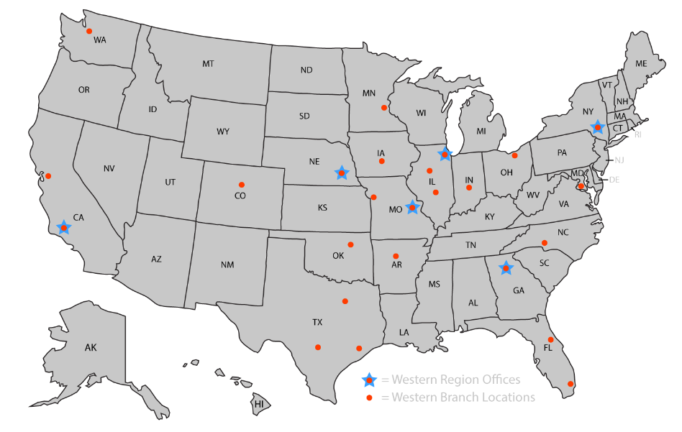
America’s largest self performing specialty contractor
Founded in 1915
33 Branches Nationwide
Family Owned & Operated
Invested in Client Satisfaction
Clients Are Our Partners
Self Performed Services
Industry Leader in Safety
Notes:
Western Specialty Contractors serves as a trusted preferred vendor through Deltaworks, providing specialized expertise when conditions exceed routine maintenance or present an immediate safety concern. Facility teams should contact Western when they encounter deepening or rapidly spreading cracks, persistent leaks that continue despite drain cleaning, or visible rebar exposure, as these signs indicate that deterioration is beyond surface-level repair. Hollow‑sounding slabs, widespread spalling, or any structural distress in beams or columns also require professional evaluation. Western brings advanced inspection techniques, corrosion mitigation strategies, and structural repair capabilities that adhere to best‑practice safety and industry standards. Additionally, Western’s familiarity with Delta and JLL expectations ensures streamlined communication, quicker mobilization, and coordinated project execution. Engaging Western early not only restores structural integrity but also prevents hazards from escalating, offering peace of mind to facility managers responsible for high-traffic environments such as airport parking structures or operational facilities.

Slide 33

Concrete, Facade and Masonry Restoration
Expansion Joint Systems
Exterior Wall Coatings
Parking & Plaza Deck Restoration
Waterproofing
Historic Restoration
Localized Roof Repairs and Fluid Applied Systems
Western’s Core Services for Parking Decks and Buildings
Notes:
Western Specialty Contractors offers a comprehensive range of services designed to enhance safety, durability, and performance across parking structures and building envelopes. Core capabilities include structural concrete repair such as spall patching, form‑and‑place repairs, and shotcrete applications. Western’s waterproofing expertise ensures effective protection against moisture infiltration through deck coatings, sealants, and joint replacement. Masonry restoration services address deterioration in brick, stone, and façade systems with techniques such as tuckpointing, repointing, and material replacement. For structural strengthening, Western provides reinforcement solutions that address corrosion‑related weakening or load‑capacity concerns. The company also performs detailed inspections, condition assessments, and leak investigations that support long-term asset management strategies. These services collectively contribute to safer environments, prolonged structural life, and reduced operational risks, making Western a valuable partner for Delta, JLL, and other facilities teams responsible for maintaining high-traffic environments.

Slide 34



Western’s learning platform
eBooks
Tips
Inspection Guides
Courses
Notes:
Western Specialty Contractors offers a comprehensive range of services designed to enhance safety, durability, and performance across parking structures and building envelopes. Core capabilities include structural concrete repair such as spall patching, form‑and‑place repairs, and shotcrete applications. Western’s waterproofing expertise ensures effective protection against moisture infiltration through deck coatings, sealants, and joint replacement. Masonry restoration services address deterioration in brick, stone, and façade systems with techniques such as tuckpointing, repointing, and material replacement. For structural strengthening, Western provides reinforcement solutions that address corrosion‑related weakening or load‑capacity concerns. The company also performs detailed inspections, condition assessments, and leak investigations that support long-term asset management strategies. These services collectively contribute to safer environments, prolonged structural life, and reduced operational risks, making Western a valuable partner for Delta, JLL, and other facilities teams responsible for maintaining high-traffic environments.

Slide 35

Western’s Safety Performance
Notes:
Western’s OSHA and Industry Safety Performance, Western’s Core Services for Parking Decks and Buildings

Slide 36

What is an experience modification rate?
Definition of Experience Modification Rate (EMR)
  A number used by insurance companies to gauge both past cost of injuries and future chances of risk. The lower the EMR, the lower a company pays in workers compensation insurance premiums.
Industry Standard EMR
  An EMR of 1.0 is considered industry average.
0.69
Western’s Experience Modification Rate
The lower the rate, the safer the contractor
Notes:
Western Specialty Contractors maintains an industry-leading safety record supported by comprehensive training, strong corporate culture, and adherence to OSHA standards. The company’s performance metrics, including its Experience Modification Rate (EMR), reflect its commitment to reducing workplace incidents and ensuring safe operational environments for both employees and clients. Robust safety programs, regular field training, and thorough jobsite assessments reinforce Western’s reputation as a reliable and safety-conscious partner. These achievements are especially critical when working in sensitive environments such as airport facilities, where risk mitigation and operational continuity are paramount. By maintaining consistently strong safety ratings, Western provides clients with confidence that projects will be completed responsibly and with minimal disruption. This dedication to safe practices aligns with Delta and JLL’s expectations for high‑performing facility partners.

Slide 37
What is an OSHA INCIDENT RATE?
Definition of OSHA Incident Rate
  The rating is a safety benchmark to gauge performance with other companies in the same business group so that you can make an “apples to apples” comparison.
Industry Standard EMR
  An OSHA Incident Rate of 3.8 is considered industry average.
1.82
Western’s OSHA Incident Rate
It’s like golf, low scores are good
Notes:
Western Specialty Contractors maintains an industry-leading safety record supported by comprehensive training, strong corporate culture, and adherence to OSHA standards. The company’s performance metrics, including its Experience Modification Rate (EMR), reflect its commitment to reducing workplace incidents and ensuring safe operational environments for both employees and clients. Robust safety programs, regular field training, and thorough jobsite assessments reinforce Western’s reputation as a reliable and safety-conscious partner. These achievements are especially critical when working in sensitive environments such as airport facilities, where risk mitigation and operational continuity are paramount. By maintaining consistently strong safety ratings, Western provides clients with confidence that projects will be completed responsibly and with minimal disruption. This dedication to safe practices aligns with Delta and JLL’s expectations for high‑performing facility partners.

Slide 38
Conclusion
Notes:
Key Takeaways and Commitment to Safety

Slide 39

Key Takeaways
Follow a structured maintenance cycle
Early detection dramatically lowers repair costs
Moisture is the #1 risk to parking decks
Western’s Value
Self work ensures consistency and quality control
Industry leading safety metrics
Notes:
Preventative maintenance is essential for protecting the structural integrity and operational safety of parking decks and facilities. Early detection of cracking, spalling, corrosion, and drainage failures significantly reduces risks, prevents accidents, and extends the lifespan of critical infrastructure. Facility teams play a key role in identifying early warning signs, while Western Specialty Contractors provides the advanced expertise needed when deterioration reaches more serious levels. As a preferred vendor through Deltaworks, Western is committed to supporting Delta and JLL with industry‑leading safety practices, superior repair capabilities, and reliable long-term solutions. Together, proactive inspection and professional intervention create a safer, more predictable environment for employees, tenants, and the public.

Slide 40
CONSISTENCY = QUALITY CONTROL PROGRAM
TOP RATED SAFETY PROGRAM
OSHA = 1.82
EMR = 0.69
ASSISTANCE WITH ASSET MANAGEMENT, BUDGET PLANNING, PROJECT PHASING
TRAINING & EDUCATION:
MAINTENANCE PROGRAM, REPAIR PRIORITIZATION

Slide 41


Contact information
Quinn Griffith
Daniele Portal
Branch Manager
Business Development Manager
954-298-5439
305-812-6498
QuinnG@Westerngroup.com
DanieleP@Westerngroup.com

