Slide 1


Western was founded in 1915.
A lot has changed since then. And Western has been right here in the trenches the entire time, providing trusted advice about building envelope restoration and maintenance to thousands of people.
Our Services
Caulking & Sealants
Concrete Restoration
Masonry Restoration
Waterproofing
Deck Coating
Disaster Recovery
Roofing
Architectural Sheet Metal
Budgeting & Phasing
And a lot more!

Slide 2

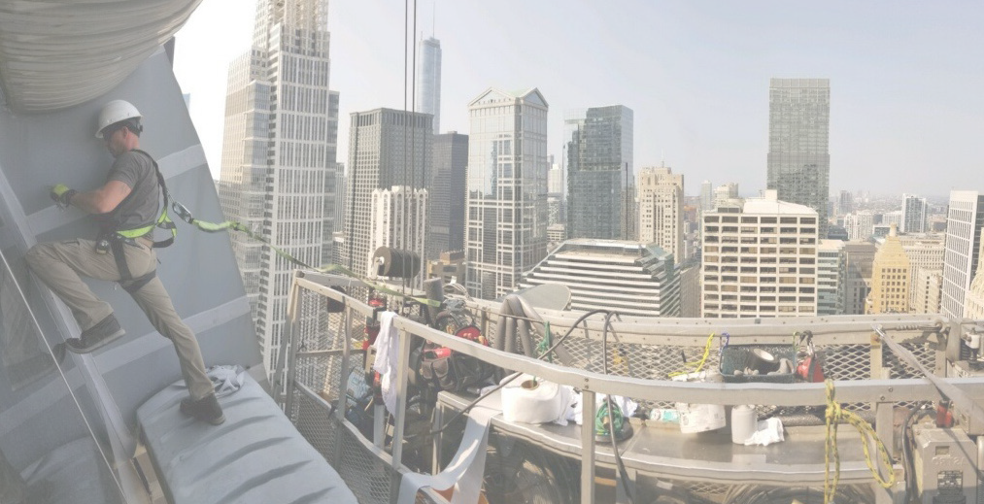

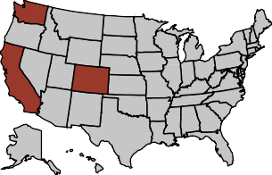
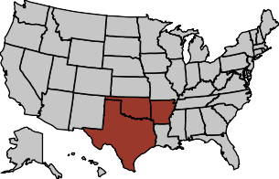
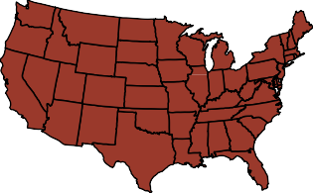
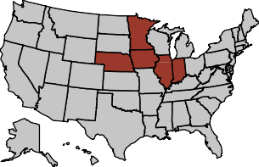
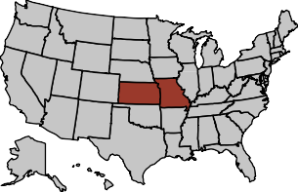
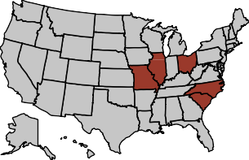
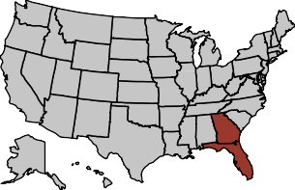
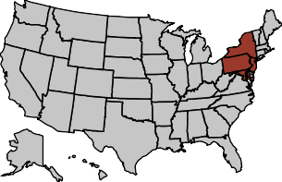
Crystal Moyer
Doug Phillips & Joel Goold
Jillian Le
Dir., National Accounts & Marketing
South BD Manager
West Coast BD Manager
Arkansas
Oklahoma
Texas
Tanya Shepherd
Colorado California
Washington
Dir., Business Development
Jessica Gitto
Add our national contacts to
your device
National Accounts Manager
Lauren Kurtzeborn
Kourtney Graham
Jason Paoli
Emily Sarvies
Tanya Shepherd
Daniel Rodriguez
National Accounts Manager
Midwest BD Manager
Midwest BD Manager
Southeast BD Manager
Chicago, IL
Indiana
Iowa
Minnesota
Nebraska
Midwest BD Manager, Special Projects
Central Illinois
Ohio
Missouri
North Carolina
South Carolina
Florida
Georgia
Northeast BD Manager
Washington, DC
New York
Stephen Bishop
Kansas
Missouri
Sheet Metal
Stadium Restoration Manager
wsc.tiny.us/wsc-national-contacts

