Slide 1
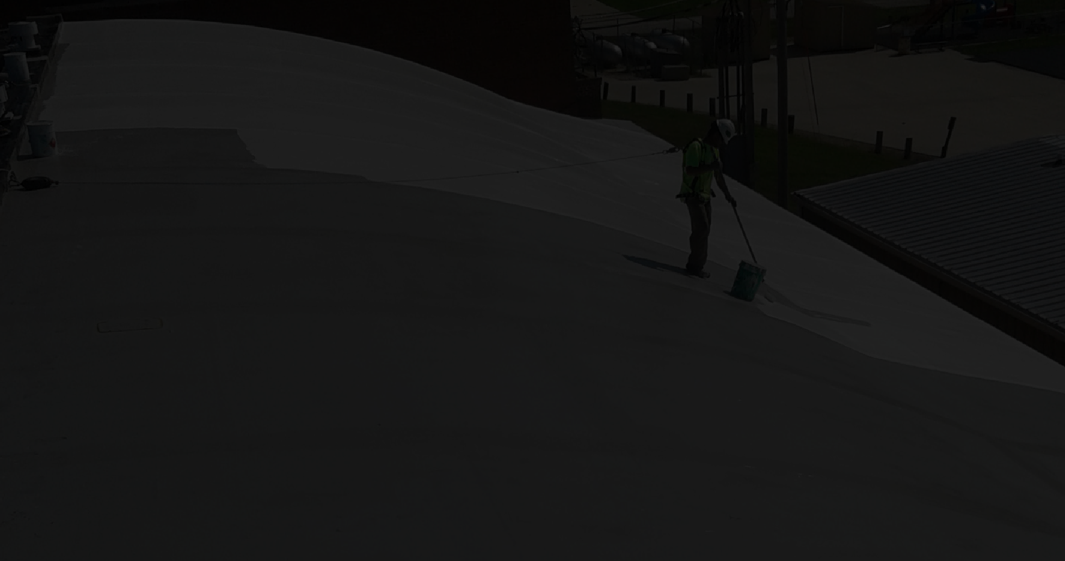















The What, Why, How & When of:
LIQUID
APPLIED ROOFING
February 23, 2022

Slide 2
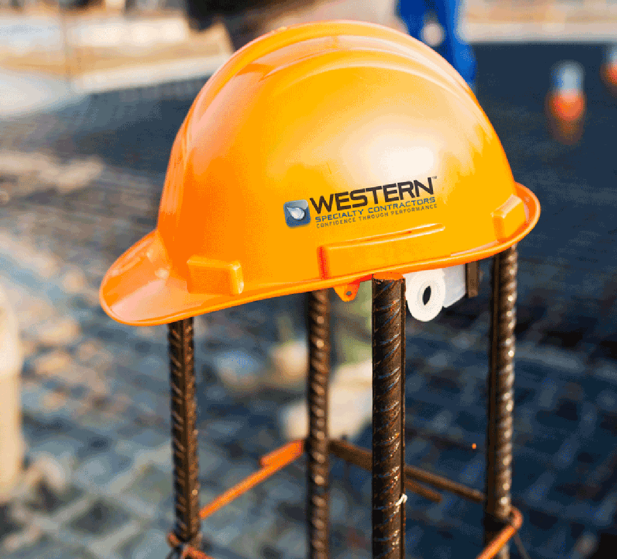
ABOUT
WESTERN
KOURTNEY GRAHAM
Founded in 1915
30 Branches Nationwide
Family Owned and Operated Invested in Client Satisfaction Clients Are Our Partners
Industry Leader in Safety
LOWER
IS BETTER
Experience Modification Factor = 0.75
Industry Average = 1.0
OSHA Recordable = 1.6
Industry Average = 3.0

Slide 3

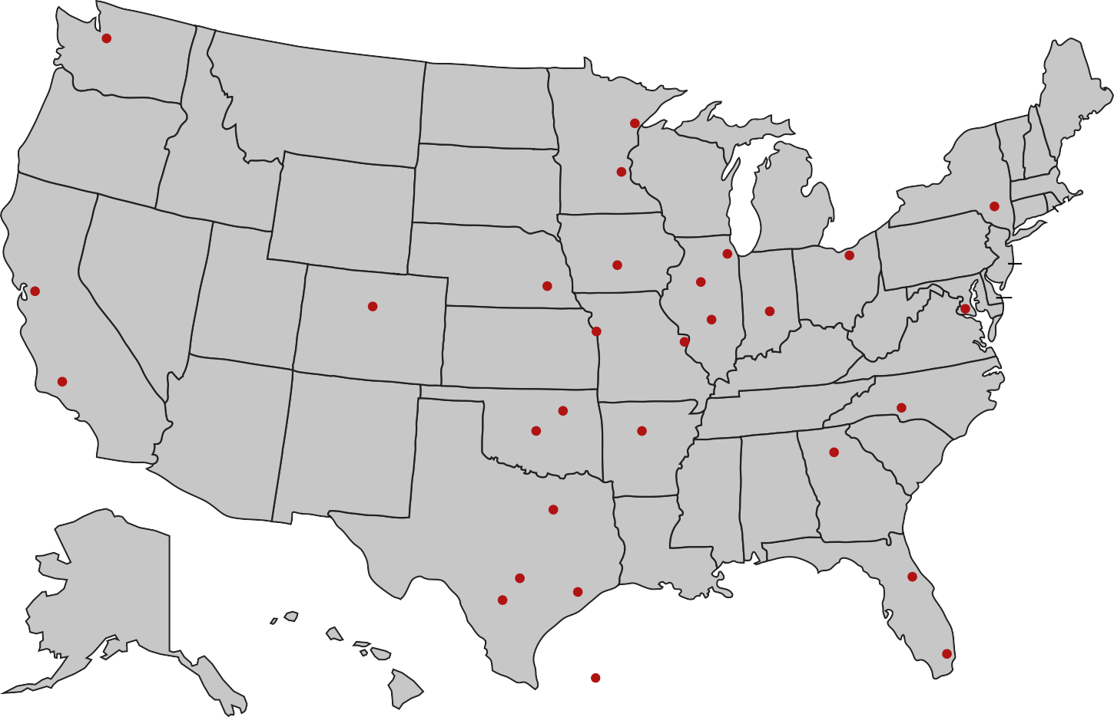
WA
MT
ND
ME
OR
MN
VT
NH
MA CT
ID
SD
WI
NY
WY
MI
RI
NE
IA
PA
NJ
DE
NV
OH
MD
UT
IL
IN
CA
CO
WV
VA
KS
MO
KY
TN
NC
AZ
NM
OK
AR
SC
MS
AL
GA
WESTERN
FOOTPRINT
TX
LA
AK
FL
HI
= Western’s Branch Locations

Slide 4




Benefits of self-performing contractors
Hiring a self-performing contractor for your next project will save you time and money, produce higher quality results, and improve safety.
Self-Performed Services
Masonry & Facade Restoration
Architectural Sheet Metal
Concrete Restoration
Building Cleaning
95%
Exterior Coating Sealant Repairs
Historic Preservation
Deck Coating
Waterproofing
of Services Self-Performed
Full-Service Roofing
Plaza Restoration

Slide 5
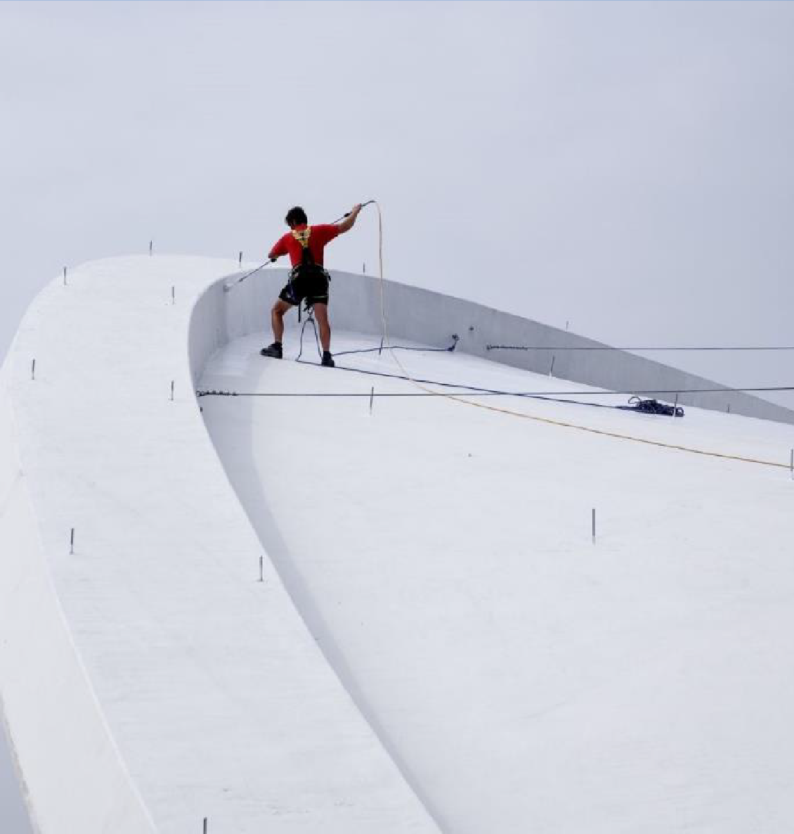
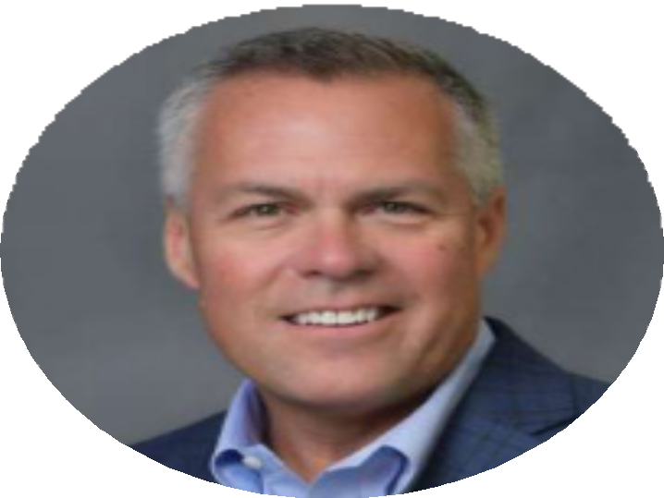

THE WHAT, WHY, HOW & WHEN OF LIQUID APPLIED ROOFING
SEAN FRAKER

Slide 6

ABOUT
SIKA
Sika is a specialty chemicals company with a leading position in the development and production of systems and products for bonding, sealing, damping, reinforcing and protecting in the building sector and motor vehicle industry.
SIKA AT A GLANCE
25,000 EMPLOYEES
100+ COUNTRIES
300+ PLANTS WORLDWIDE
6 NEW & EXPANDED PLANTS IN 2020
83 NEW PATENTS IN 2020
1 ACQUISITION IN 2020
7.88 BN NET SALES IN 2020 (IN CHF)
WE ARE THERE
Our products might not always be visible but the results they achieve bring clear added value to customers and society.

Slide 7
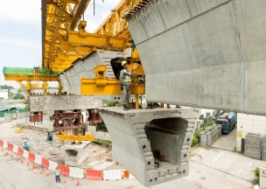
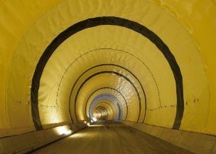
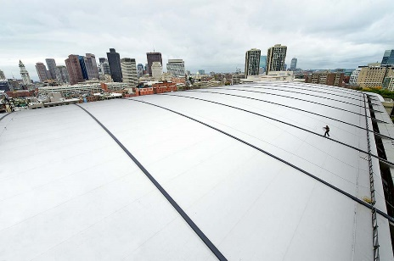
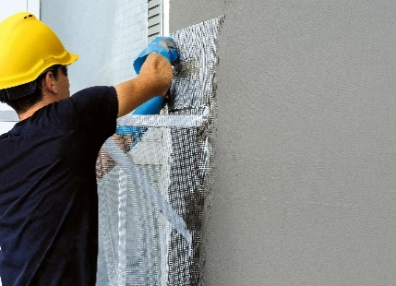
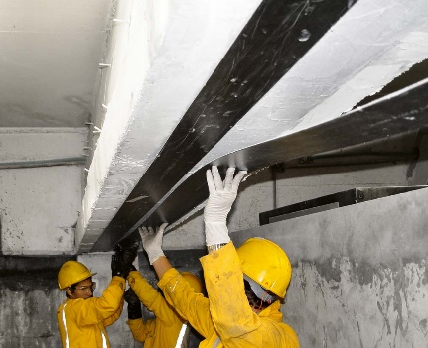
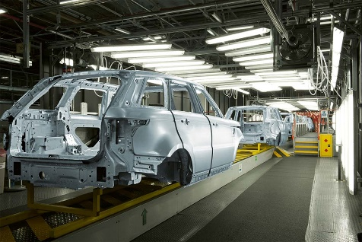
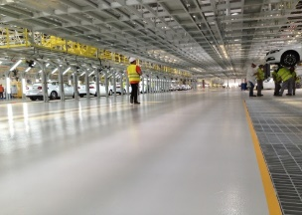
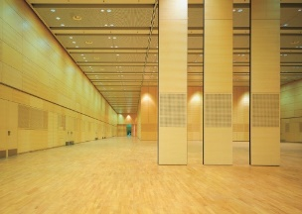
FOCUS ON Attractive MARKETS:
CROSS-Selling, Life-CYCLE MANAGEMENT, ONE STRONG BRAND
Concrete
Waterproofing
Roofing
Building Finishing
Flooring & Coating
Sealing & Bonding
Refurbishment
Indutry

Slide 8
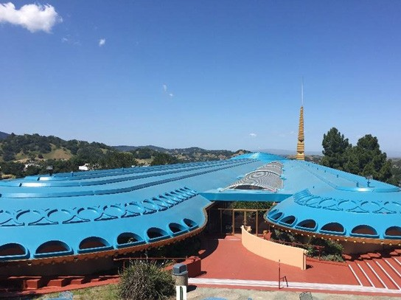
SIKALASTIC ROOFPRO & SIKALASTIC ROOFCOAT
Liquid Applied Roofing & Waterproofing Membranes/Coatings

Slide 9
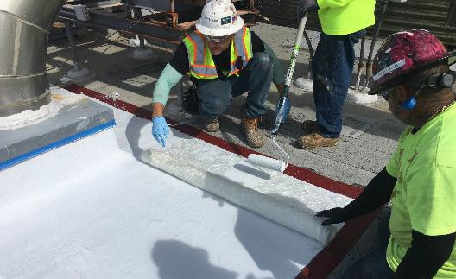
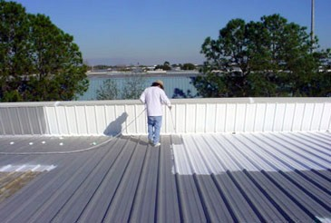


OVERVIEW LIQUID APPLIED MEMBRANES & COATINGS
How we define them in the US
Liquid applied membrane or coating
A monolithic, fully bonded cold applied resin which is applied by brush,
roller, or spray application. Cures to form a seamless and durable waterproofing membrane or coating.
Membrane systems (RoofPro)
Include full reinforcement.
Suitable for a wide range of roofing and waterproofing applications.
Coatings (Sikalastic RoofCoat)
Local reinforcement only.
Suitable for roof re-covers of:
Metal Roofs
Modified Bituminous Membranes
EPDM
Membranes
PVC & TPO
Membranes

Slide 10
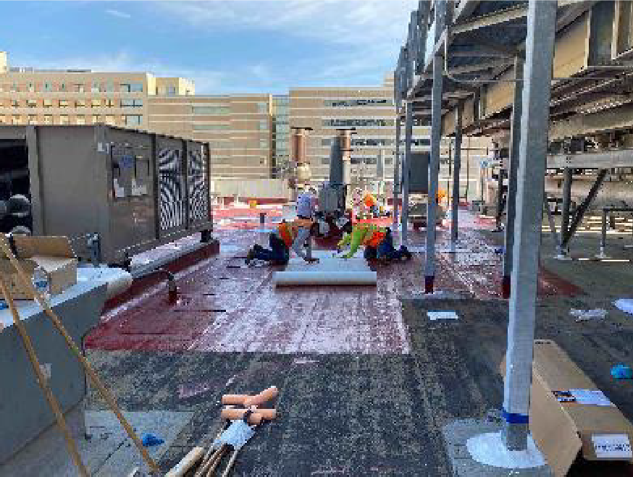
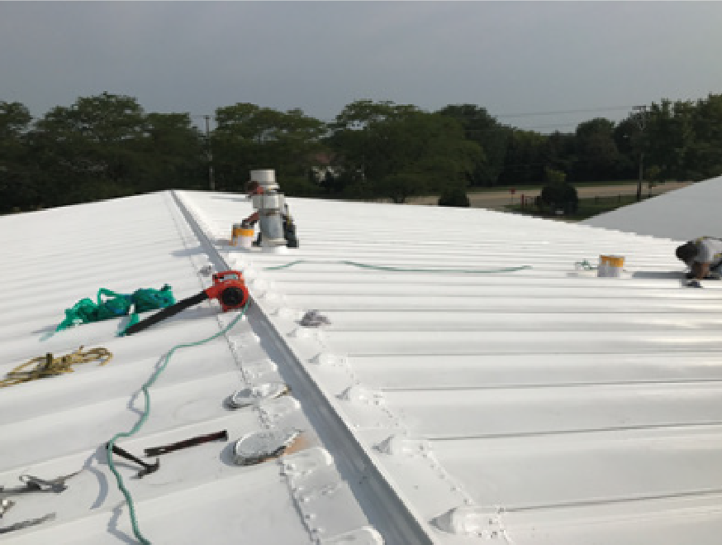
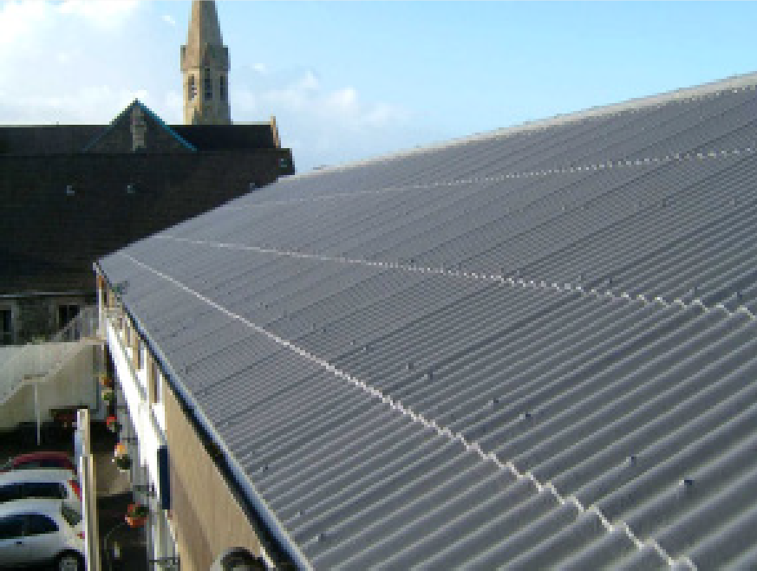
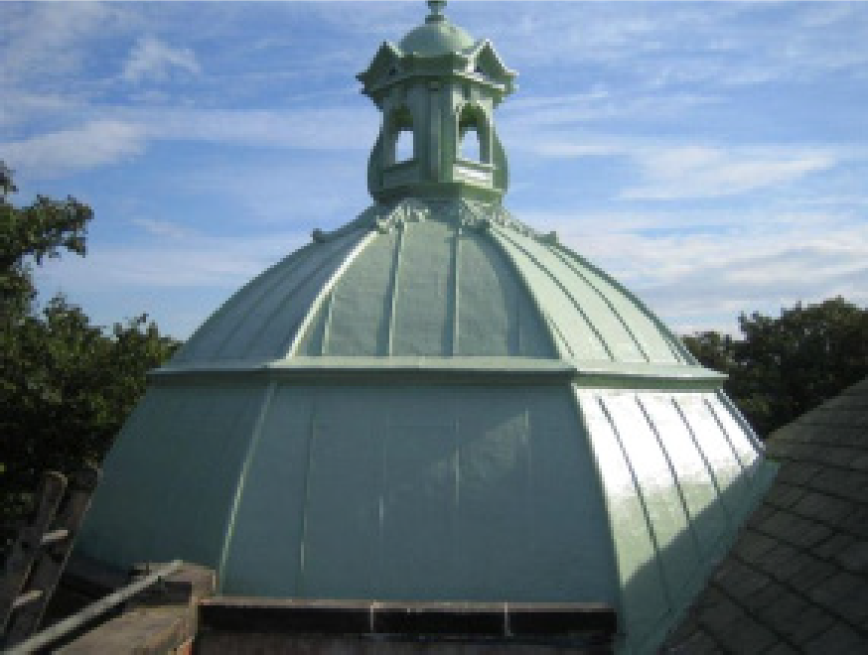
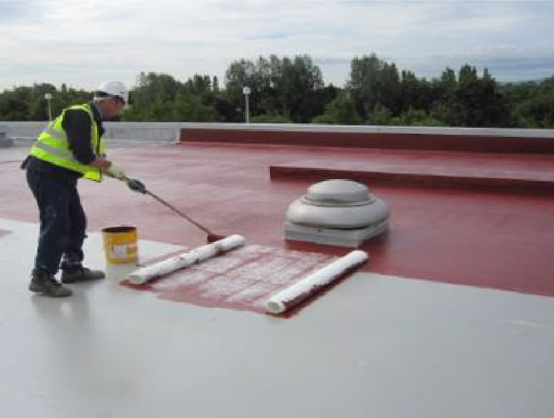
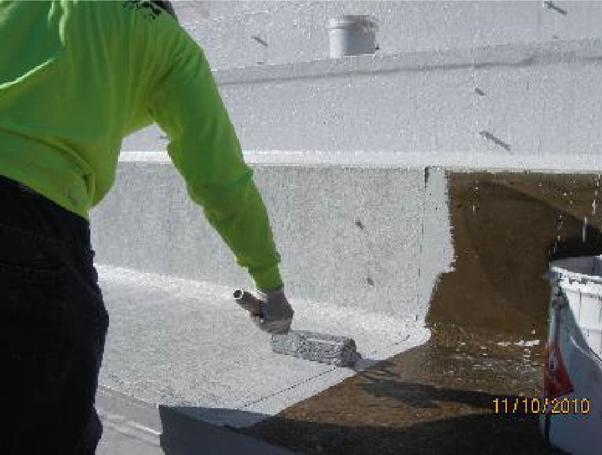
MAIN FEATURES
LIQUID APPLIED MEMBRANES & COATINGS
Suitable
for various
kinds of roof structures & substrates
Bituminous
Metal
Fiber Cement / Tile
Very versatile
Copper
PVC / FPO / EPDM
Concrete

Slide 11
TYPICAL APPLICATIONS
SIKALASTIC ROOFPRO
Liquid Applied Roofing & Waterproofing Membranes/Coatings

Slide 12
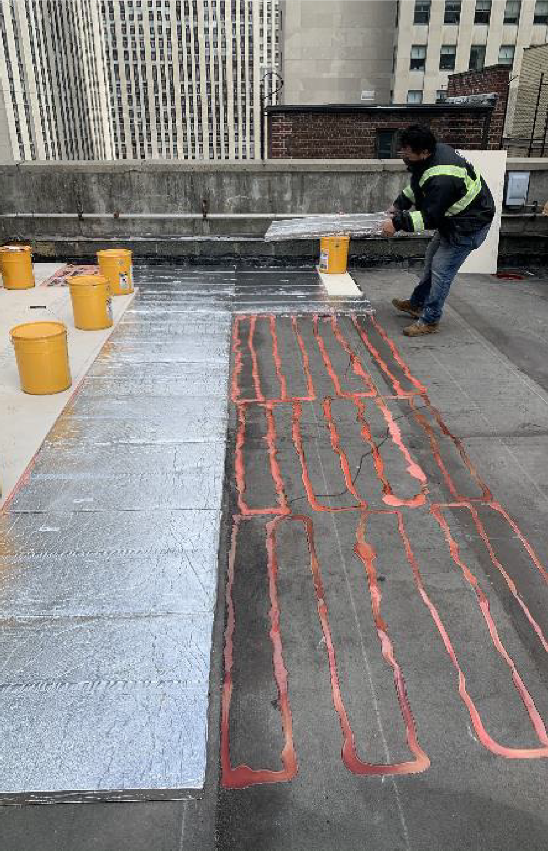
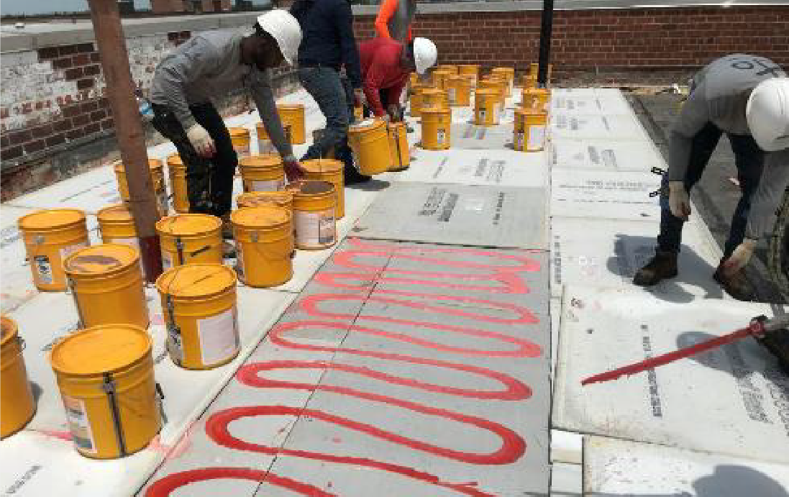
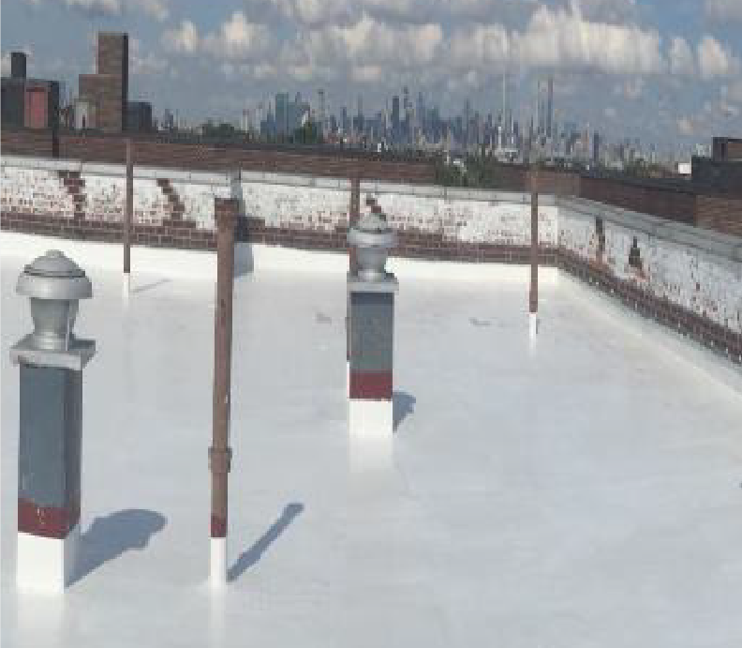
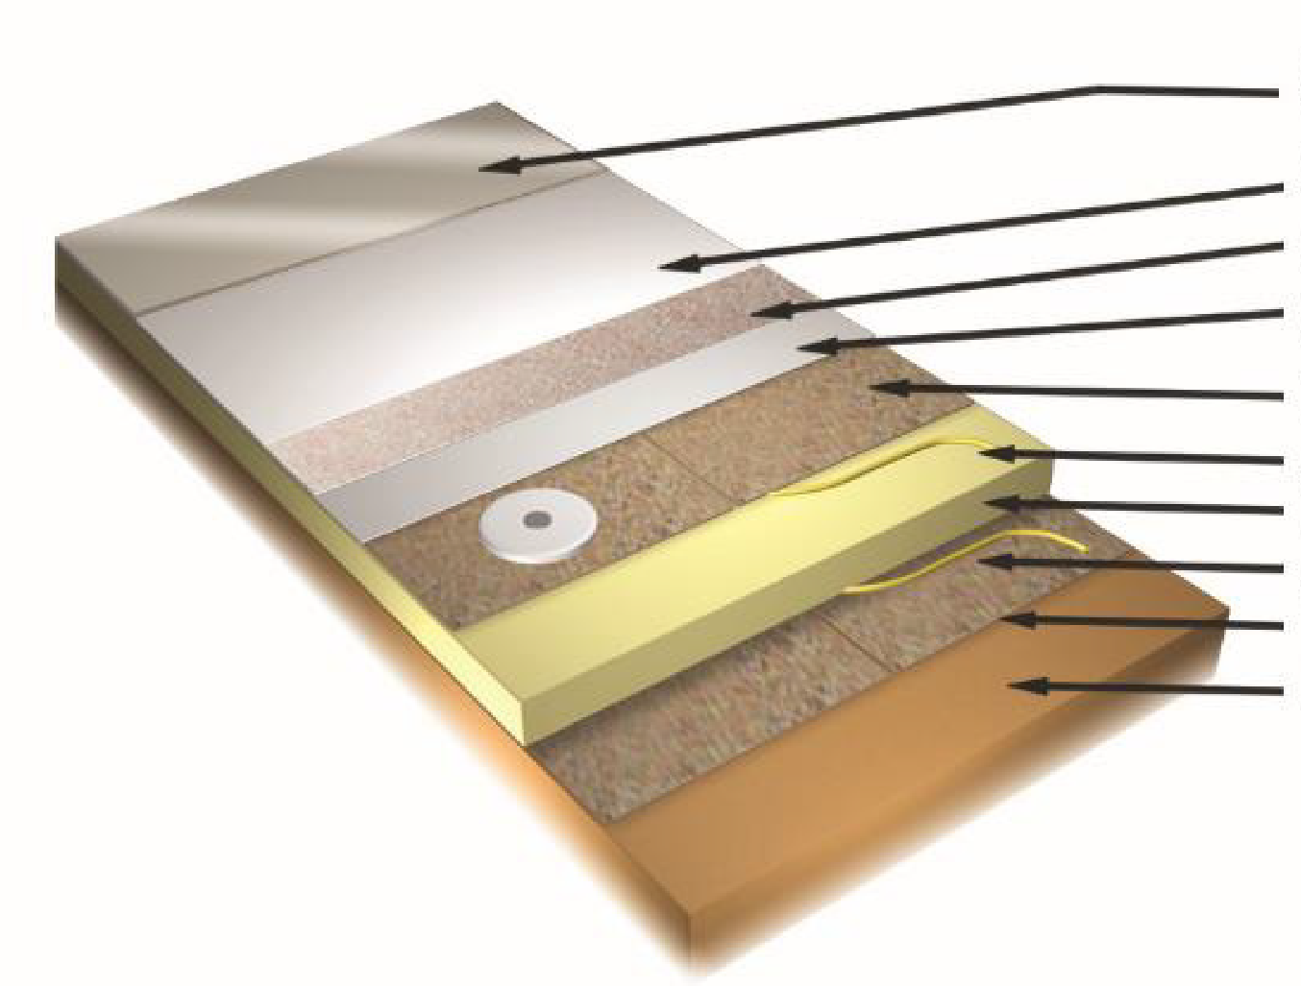
TYPICAL APPLICATIONS WITH SIKALASTIC ROOFPRO
Build up roofing systems on existing or new roof construction
Sikalastic RoofPro liquid resin with
aggregate for pedestrian traffic (optional)
Sikalastic RoofPro liquid resin
Sikalastic Reemat or Sika Fleece
Sikalastic RoofPro liquid resin
Rigid cover board (with optional base sheet) Adhesive / Mechanical fasteners
Polyisocyanurate insulation
Adhesive / Mechanical fasteners
Vapor control layer (when required) Prepared deck primed as required

Slide 13
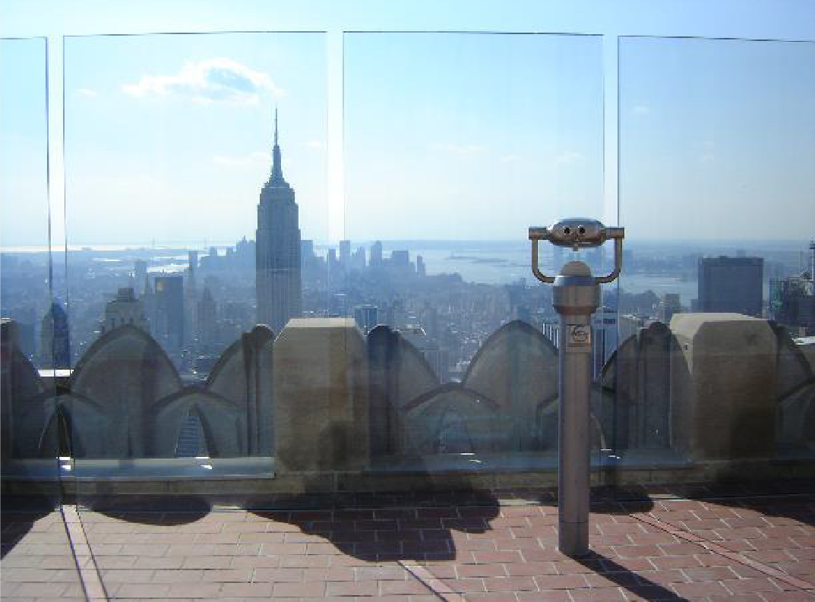
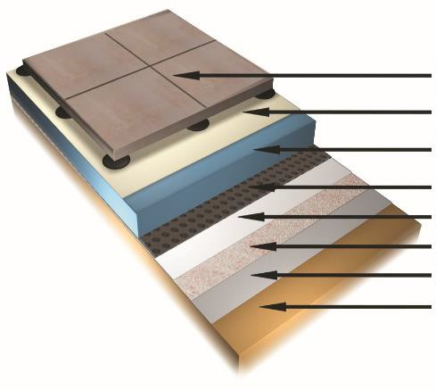
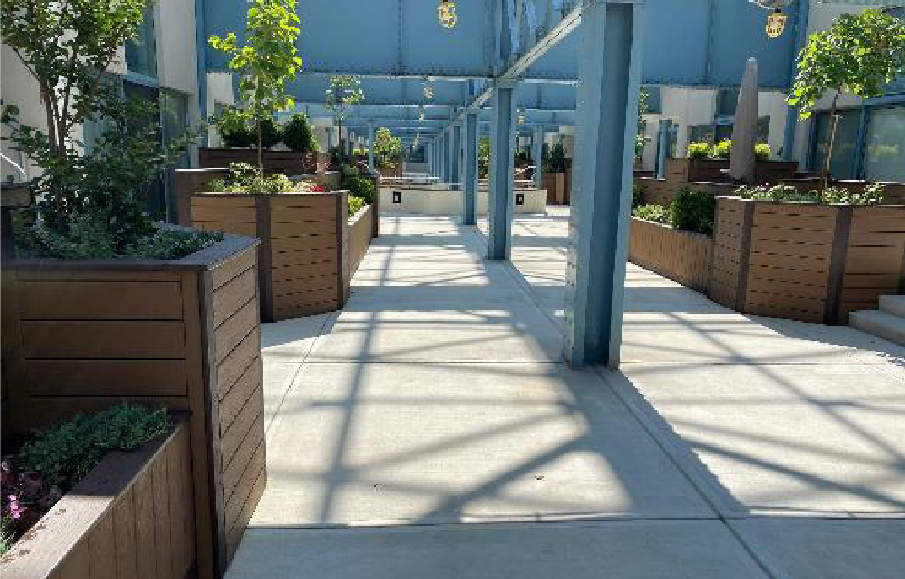
TYPICAL APPLICATIONS WITH SIKALASTIC ROOFPRO
Plaza Decks and Terraces
Pavers on pedestals, concrete topping or other overburden finish
Filter fabric (when required)
Extruded polystyrene insulation (when required)
Drainage layer, and separation layer (when required)
Sikalastic RoofPro liquid resin
Sika Reemat or Sika Fleece
Sikalastic RoofPro liquid resin
Prepared deck primed as required

Slide 14
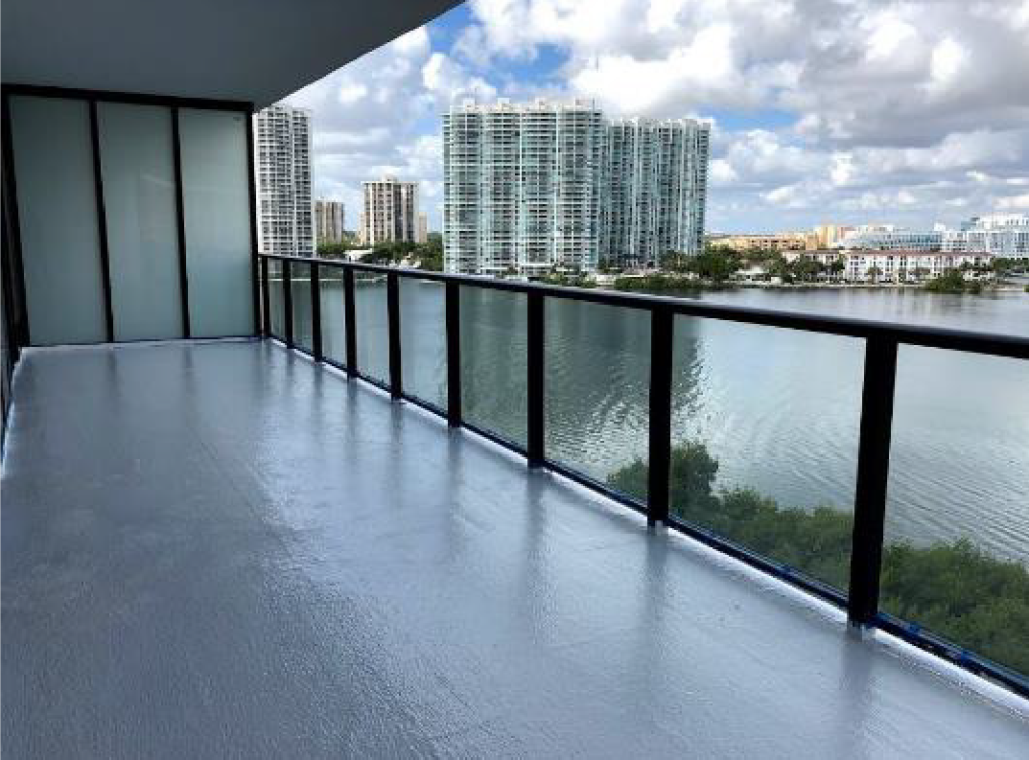
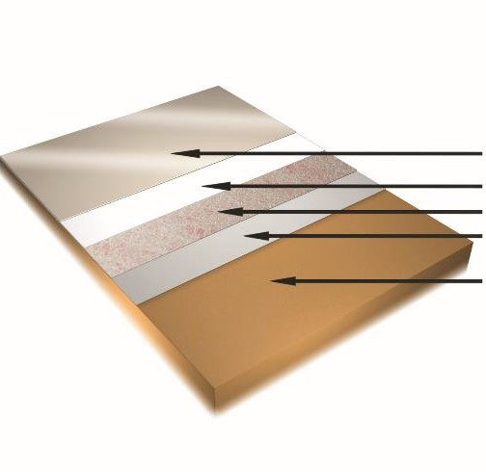
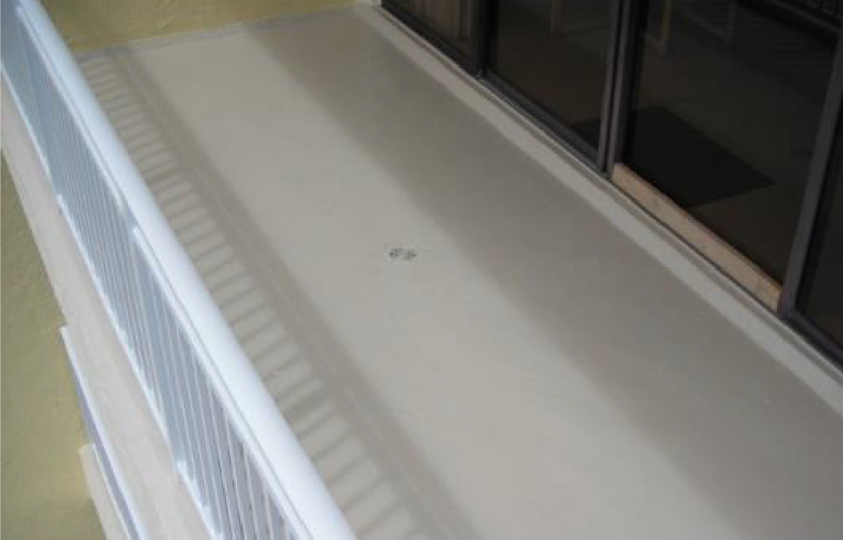
TYPICAL APPLICATIONS WITH SIKALASTIC ROOFPRO
Balconies
Sikalastic RoofPro liquid resin with
aggregate for pedestrian traffic (optional)
Sikalastic RoofPro liquid resin Sika Reemat or Sika Fleece
Sikalastic RoofPro liquid resin
Prepared deck primed as required

Slide 15
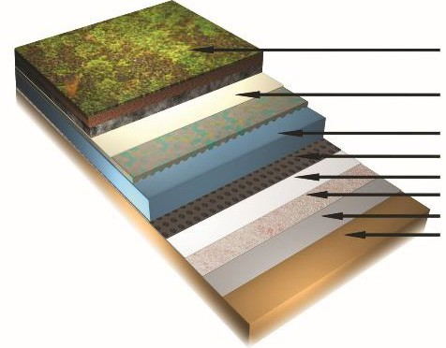
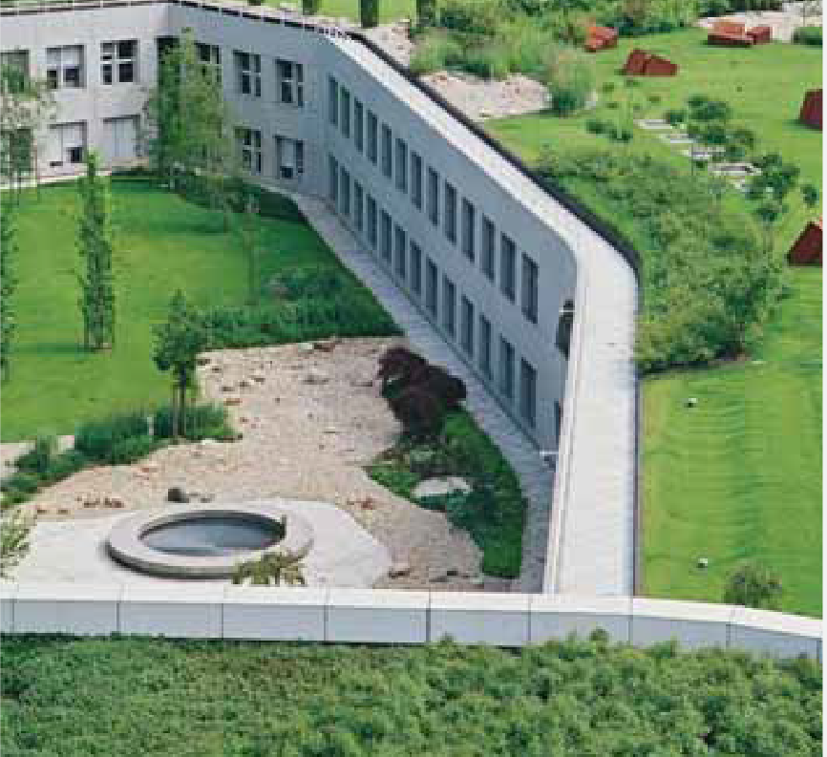
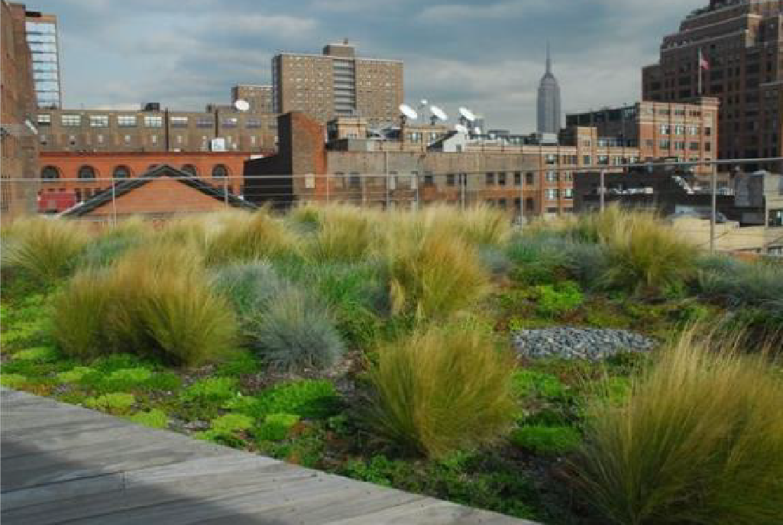
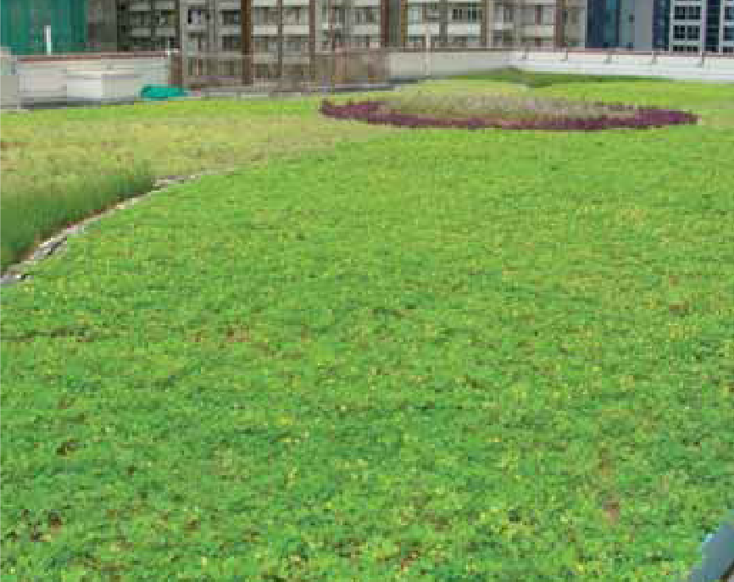
TYPICAL APPLICATIONS WITH SIKALASTIC ROOFPRO
Vegetated hardscape system / green roofs
Vegetative roof coating
Filtration and drainage layer depending upon vegetation
Extruded polystyrene insulation
Drainage, root barrier and separation layers Sikalastic RoofPro liquid resin
Sika Reemat or Sika Fleece
Sikalastic RoofPro liquid resin
Prepared deck primed as required
Fully adhered
to the substrate
Lower risk of water ingress

Slide 16
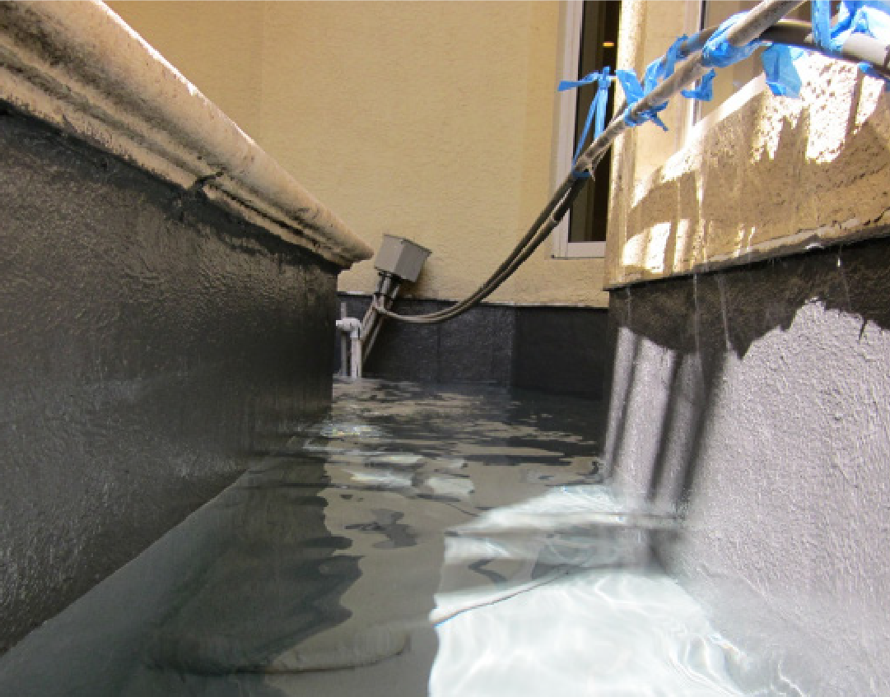
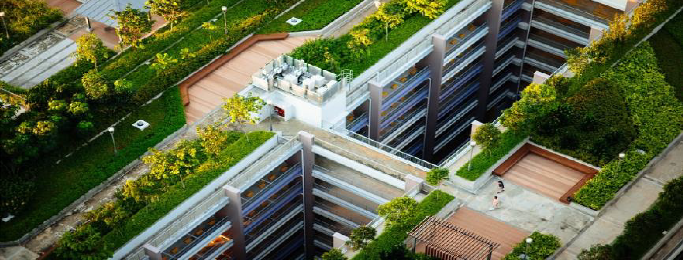
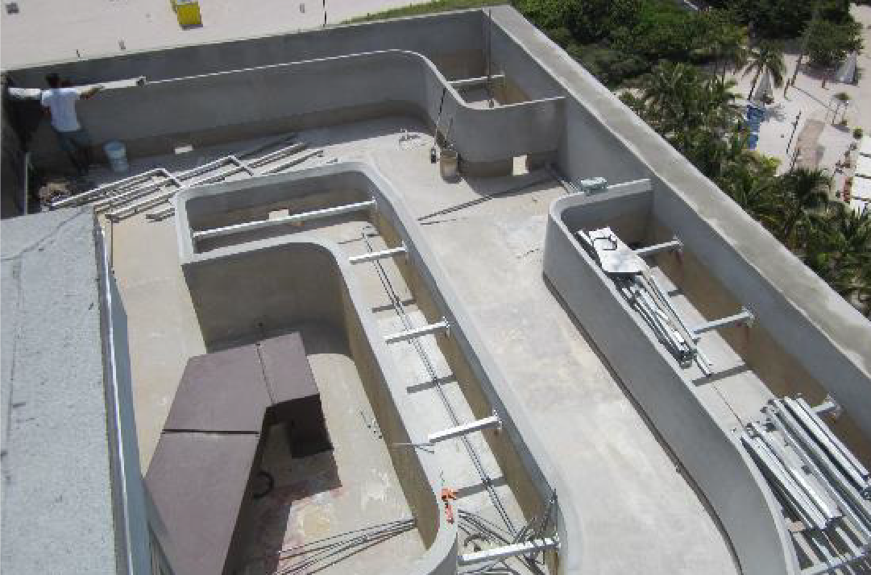
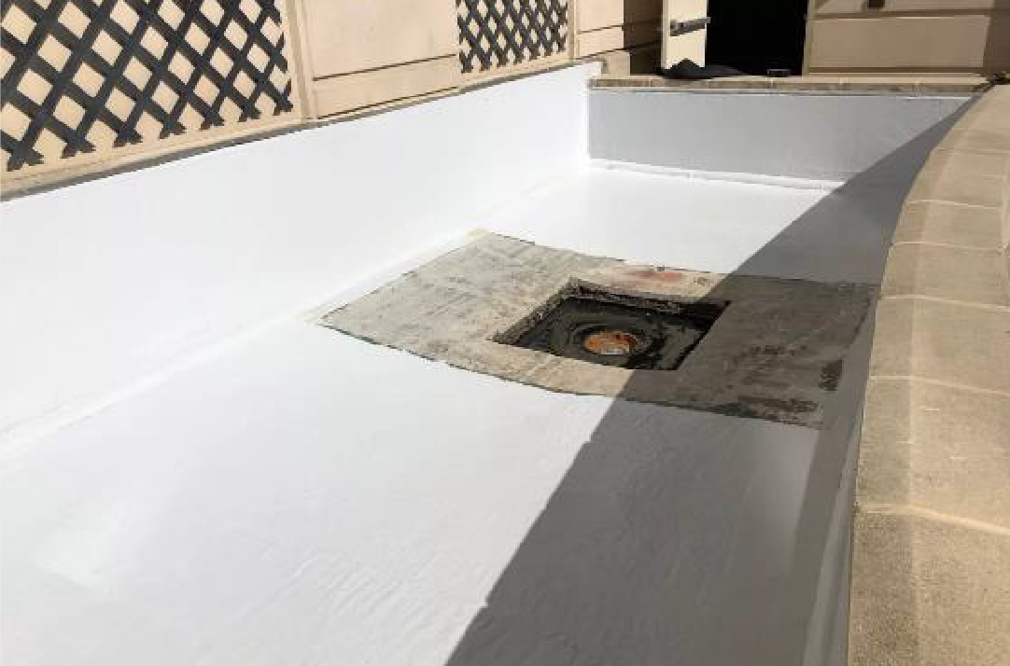
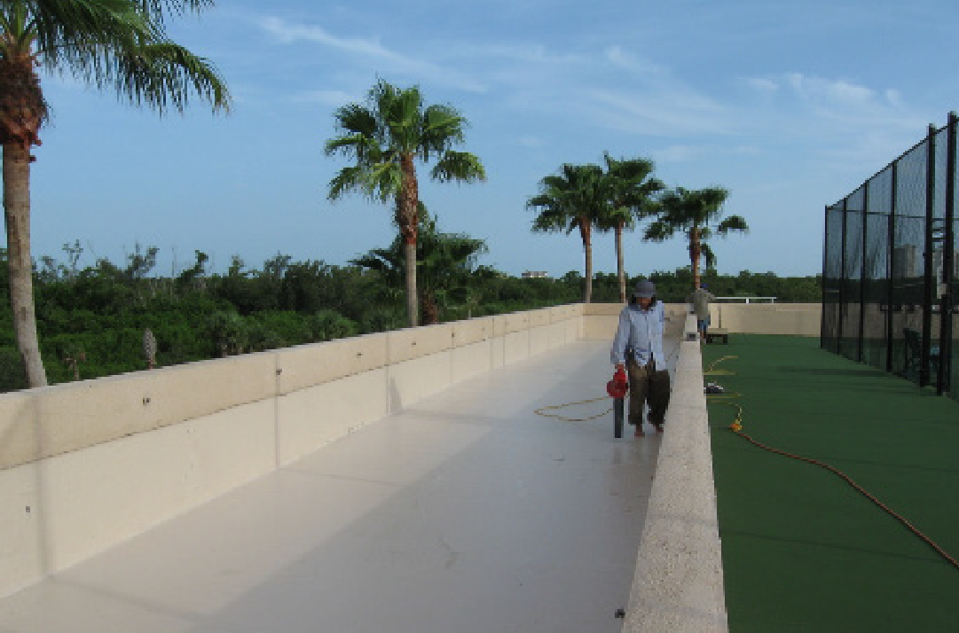
TYPICAL APPLICATIONS WITH SIKALASTIC ROOFPRO
Planters

Slide 17

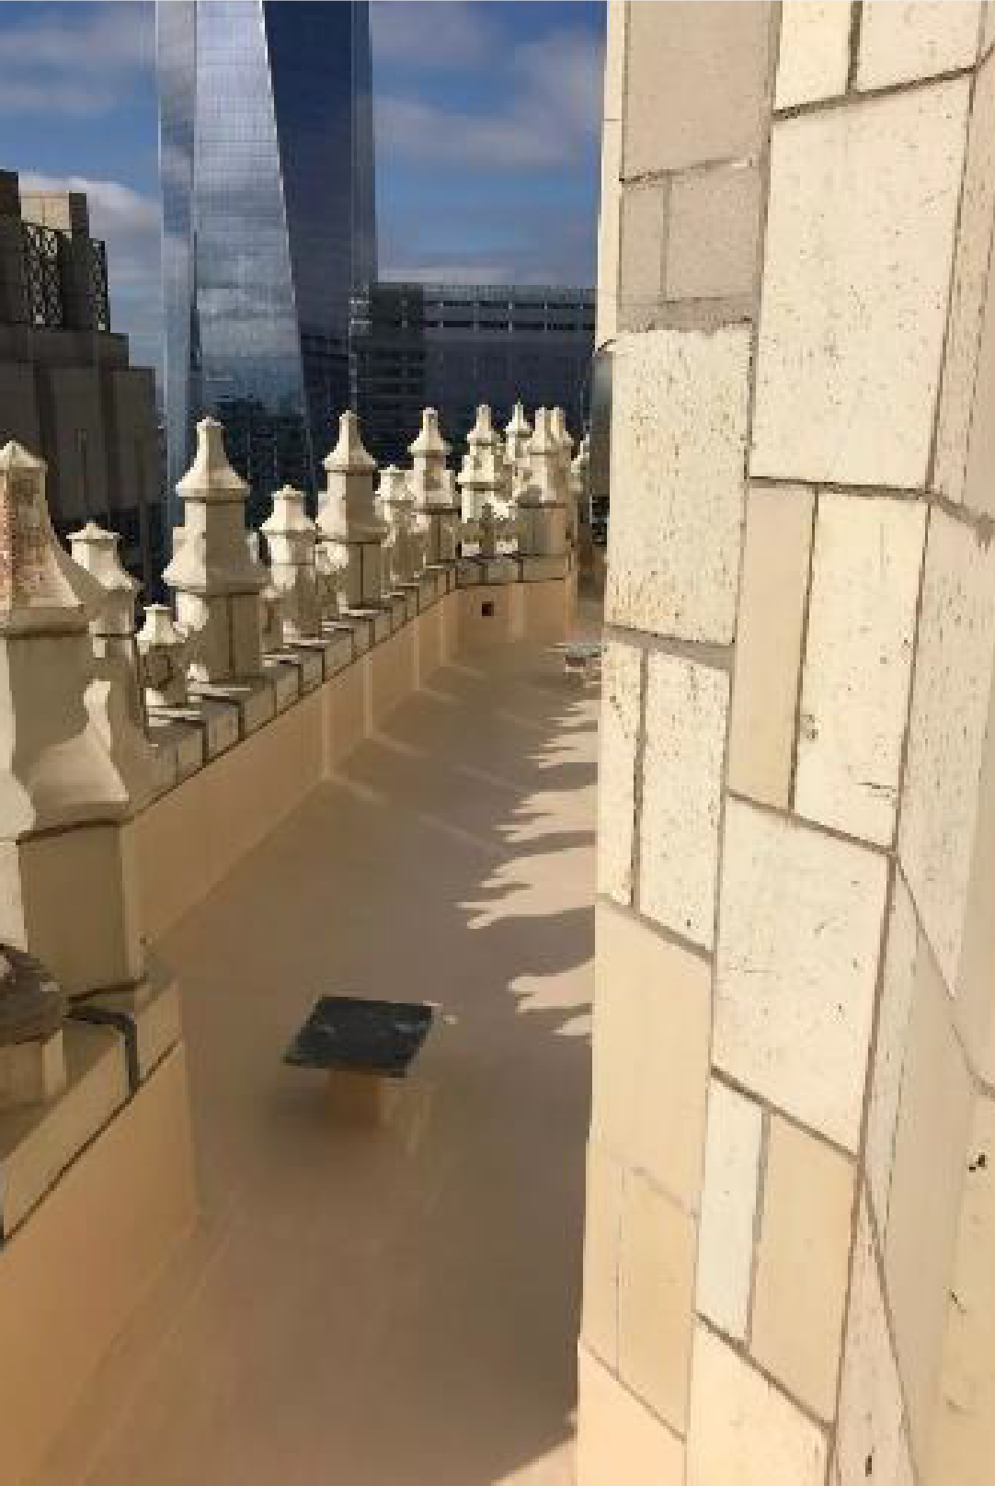
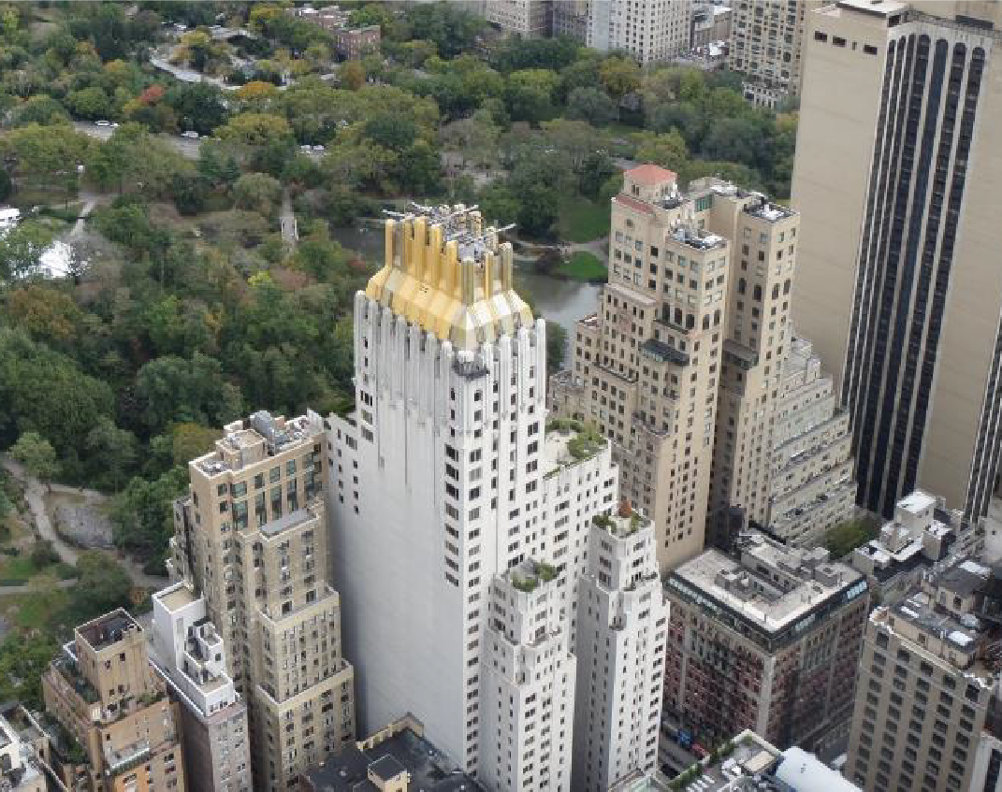
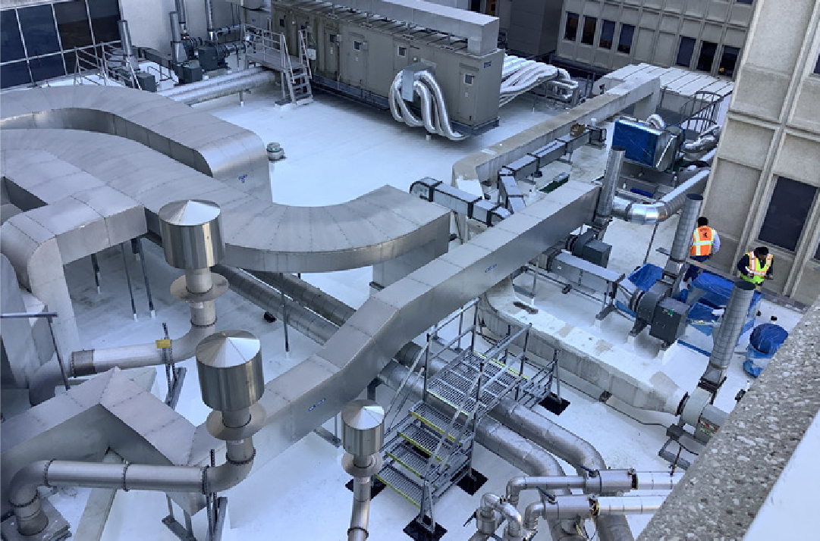
TYPICAL APPLICATIONS WITH SIKALASTIC ROOFPRO
For complex roof geometries with limited access

Slide 18
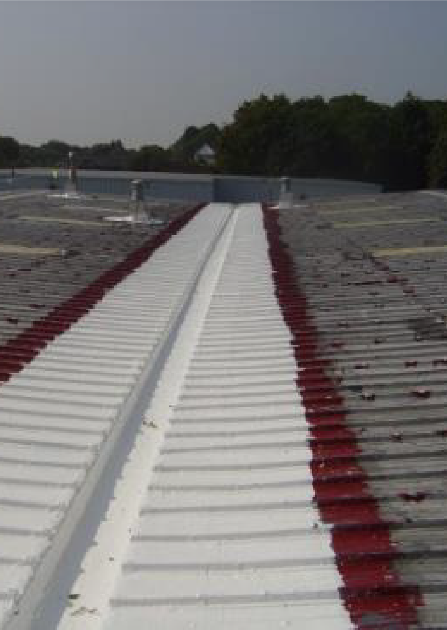
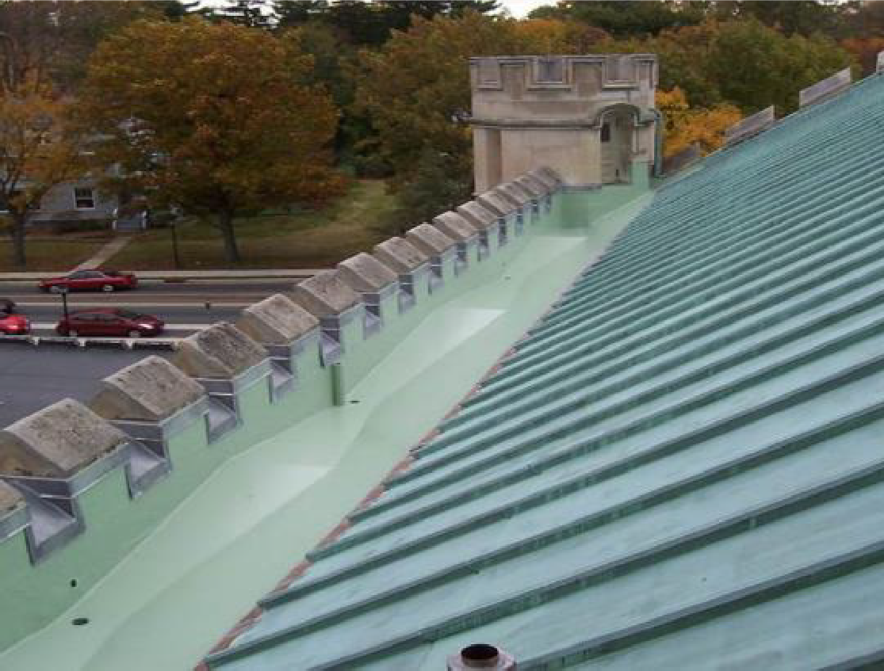
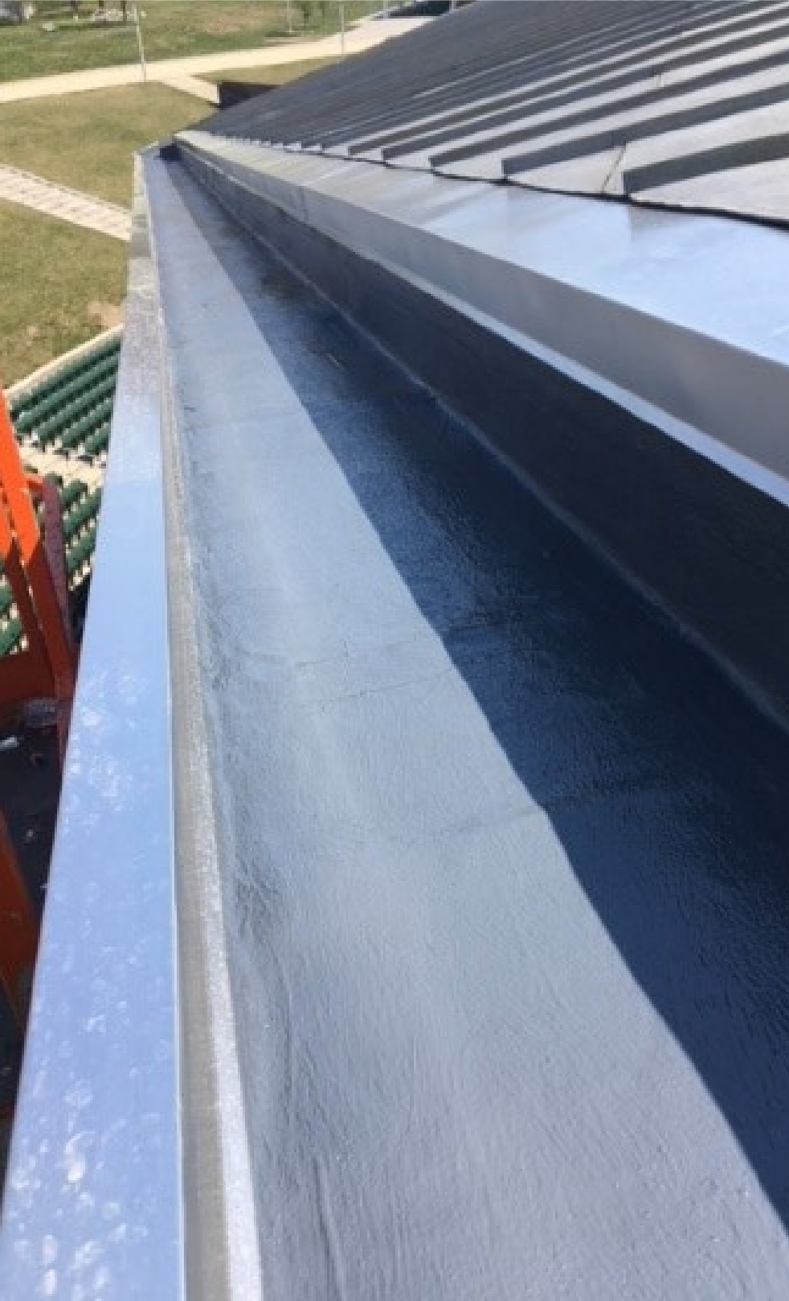
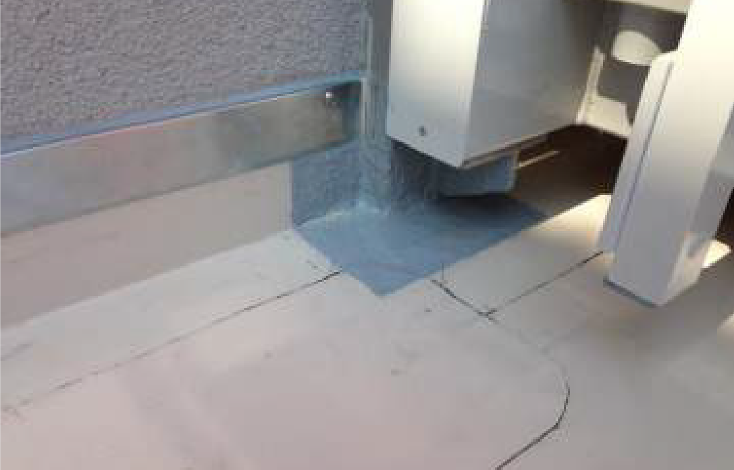
TYPICAL APPLICATIONS WITH SIKALASTIC ROOFPRO
Flashing on sheet membranes, gutters, parapets, etc.

Slide 19
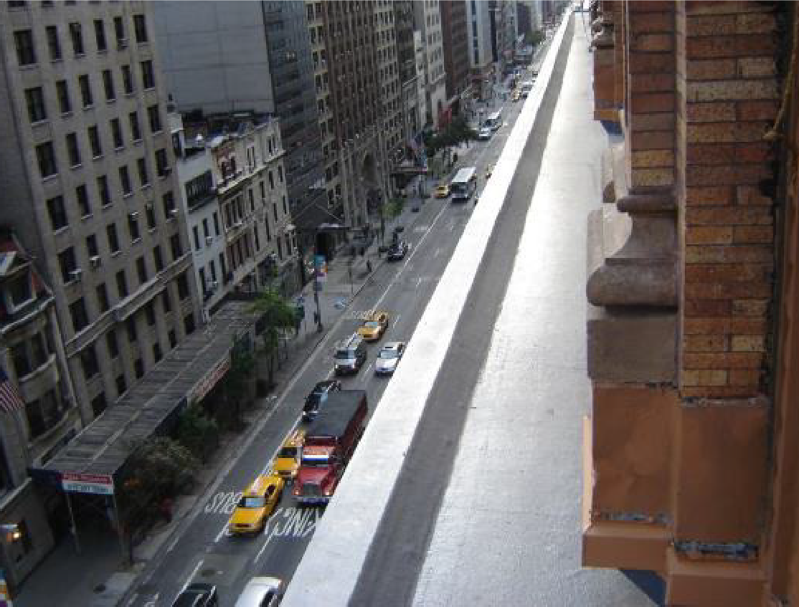
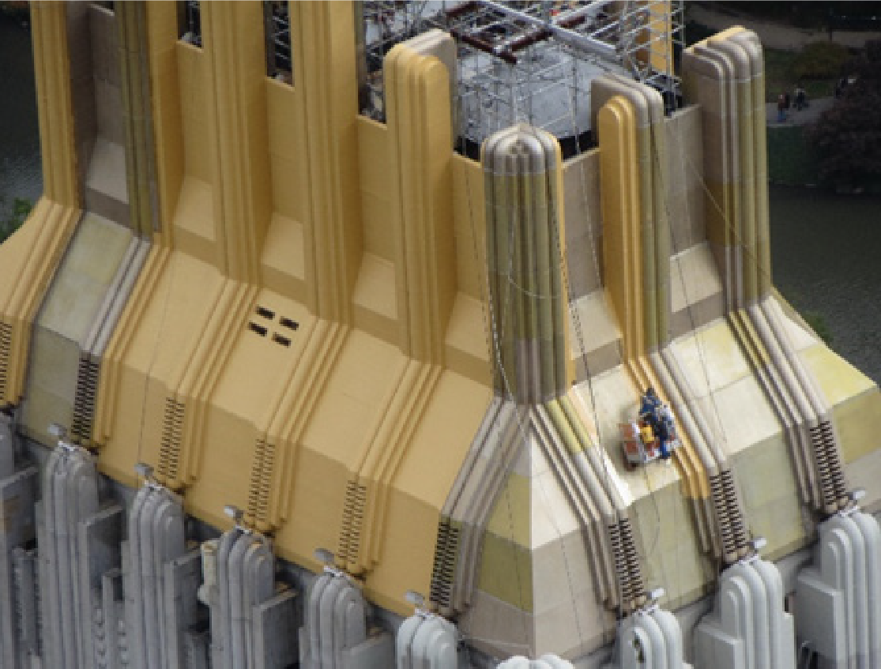



TYPICAL APPLICATIONS WITH SIKALASTIC ROOFPRO
Façade Preservation / Waterproofing

Slide 20





TYPICAL APPLICATIONS WITH SIKALASTIC ROOFPRO
Skylights with Sikalastic Clearglaze

Slide 21
TYPICAL APPLICATIONS
SIKALASTIC ROOFCOAT
Liquid Applied Roofing & Waterproofing Membranes/Coatings

Slide 22



TYPICAL APPLICATIONS WITH SIKALASTIC ROOFCOAT
Overcoat of Metal Roofs
Fast and easy application

Slide 23



TYPICAL APPLICATIONS WITH SIKALASTIC ROOFCOAT
Overcoat of EPDM Membranes
Cost efficient life extension of existing roofs

Slide 24



TYPICAL APPLICATIONS WITH SIKALASTIC ROOFCOAT
Overcoating of Modified Bituminous Membranes
Cost efficient life
extension of existing roofs

Slide 25


TYPICAL APPLICATIONS WITH SIKALASTIC ROOFCOAT
Overcoating of PVC Membranes
Cost efficient life
extension of existing
roofs

Slide 26


TYPICAL APPLICATIONS WITH SIKALASTIC ROOFCOAT
Overcoating of existing coatings
Cost efficient life extension of existing roofs

Slide 27




THE WHAT, WHY, HOW & WHEN OF LIQUID APPLIED ROOFING
KEEGAN TUNE

Slide 28

WHY CHOOSE WESTERN FOR
LIQUID ROOFING
Coating experts
40+ Years roofing experience
Manufacturer partnerships Full building envelope
capabilities

Slide 29

Liquid
Roofing
System
Vs.
Coating
REINFORCED
LABOR / MATERIAL WARRANTY 50+ MILS THICK
$$$
NON-REINFORCED
MATERIAL ONLY WARRANTY 23-40 MILS THICK
$$

Slide 30

WHY LAM
BENEFITS
Roof Recovery
Restoration of existing roof Increases useful life
Not considered an additional layer of roof
Categorized as a repair Depreciate in one year

Slide 31

WHY LAM
BENEFITS
Sustainability
Saves from tear off Saves landfill space
Cool and reflective (Energy savings)
Low VOC options
Less material quantities
(Fewer material shortages)
Re-coating is an option

Slide 32

WHY LAM
BENEFITS
Versatility
Many material choices Varying price points
Great for difficult access Great for busy roofs
Color selections (Energy savings)

Slide 33

WHY LAM
BENEFITS
Occupant Friendly
Low noise installation
Shorter project duration Low VOC
Lower risk of water intrusion

Slide 34

WHY NOT LAM
WHAT IT’S NOT
A one-size fits all solution
Miracle in a can Easy
Cheap

Slide 35

“
I THINK I WANT L I QUID ROOF.
WHAT DO I DO NOW?
”
Keep repairing existing roof
Contact a professional
Plan ahead
Account for contingency

Slide 36

LIQUID APPLIED
MEMBRANE
TAKEAWAYS
Liquid roofing is a tool in the roofing toolbox
Be proactive
Choose professionals

Slide 37

LIQUID APPLIED
MEMBRANE
HOW
Precautions
Must survey for moisture Prep, prep, prep!
Watch warranty language Use certified installer

Slide 38

PROACTIVE VS. REACTIVE
Savings $$$$
Strategic approach
More time planning = less time dealing with emergencies
Asset life extended
Downtime / inconvenience to tenants is reduced
Budget control

Slide 39

BUDGETING
Get to know the components
Inquire about phasing
options to minimize financial impact
that make up the parking
garage portfolio
Understand age and
Advantage of allowing
contractors adequate time to prepare scopes and pricing
remaining useful life of
components
Work with contractors /
consultant / engineer to
identify issues early

Slide 40

Penthouse roof area in scope of work
351 California Street
DOWNTOWN
SAN FRANCISCO PROJECT

Slide 41
PROJECT PROFILE
Plan Changes
The original plan was to remove only loose roofing material.
Additional Work
Once the project began, it was determined that all three (3) layers of existing roof material had to be removed.
Due to the scope change, the system needed to be altered to
include: 1) cement board, 2) tape, 3) fabric and 4) additional coating.
Price Increases
Additions to scope of work raised the project pricing.
Sika increased warranty from 10 years to 20 years.

Slide 42


PROJECT CHALLENGES
Inclement Weather
Rain caused project delays.
Supply Shortages
White base coat and gray top coat was used to meet the customers’ expectations.
Material Challenges
Getting the reinforcement to conform to the sharp corners was the main challenge the crew experienced.

Slide 43




351
CALIFORNIA
STREET

Slide 44




351
CALIFORNIA
STREET

Slide 45





351
CALIFORNIA
STREET

Slide 46

WATERGATE HOTEL
Washington, DC

Slide 47


PROJECT PROFILE
Plan
The Owner wanted a waterproofing membrane that would be
aesthetically pleasing to the tenants.
Including a finish that could withstand the elements over the
years while looking just as new as the day the product was applied.
Area
Comprised of 15,000 SF
2,700 sf of mechanical space
12,300 sf of public and private terraces
Solution
Sikalastic® RoofPro system, with its 20-year single source labor
and material warranty

Slide 48


WATERGATE
HOTEL

Slide 49

MEMORIAL HALL
Philadelphia, PA

Slide 50

PROJECT PROFILE
Overview
National Historic Landmark, was built as the art gallery for the
Centennial Exhibition, the first major World’s Fair in the US.
A six-months, $1.25 million restoration project.
Challenges
The mullions and statues were a vast variety of difficult geometries
and shapes
Imitating the original copper patina
The iron and glass dome, topped by a 23-foot-tall statue of Columbia
Products Use
Sikalastic RoofPro in a Copper Green
Sika's transparent Sikalastic® Clearglaze

Slide 51


MEMORIAL
HALL

Slide 52







FIVE DIFFERENT WAYS
WESTERN CAN HELP YOU
Repair
prioritization and cost analysis
Provide short- and long-term repair plans
Facade condition assessment
budgeting & estimating
in-house training

