Slide 1
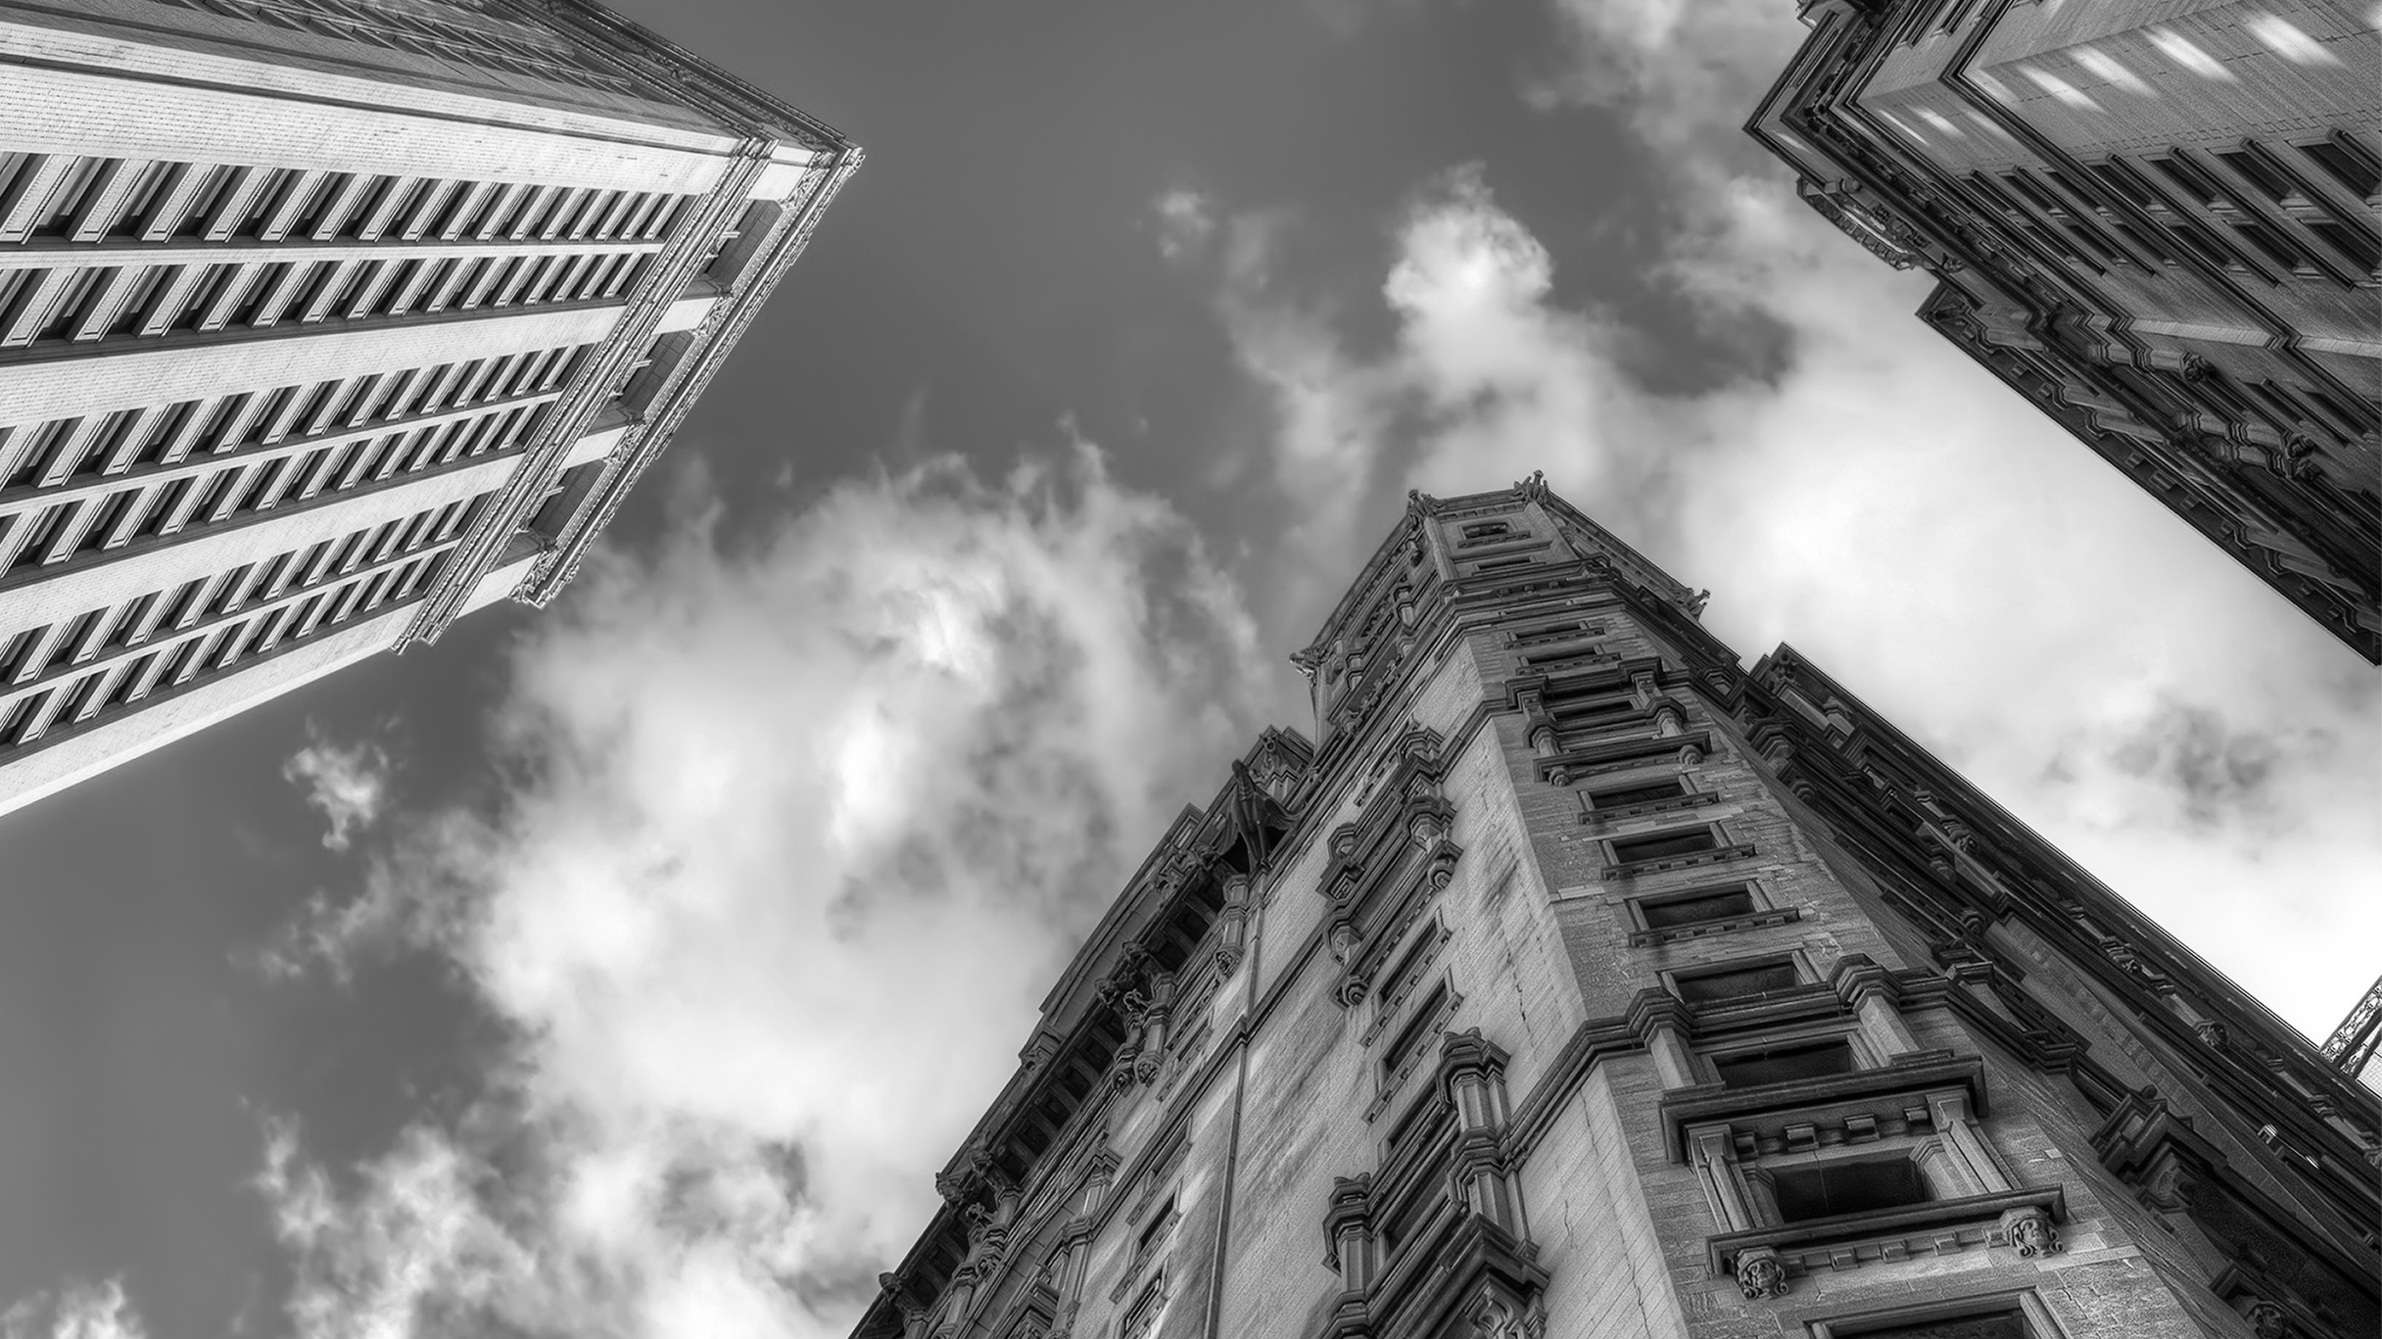

CONCRETE
MASONRY
WATERPROOFING
FAÇADE RESTORATION

Slide 2
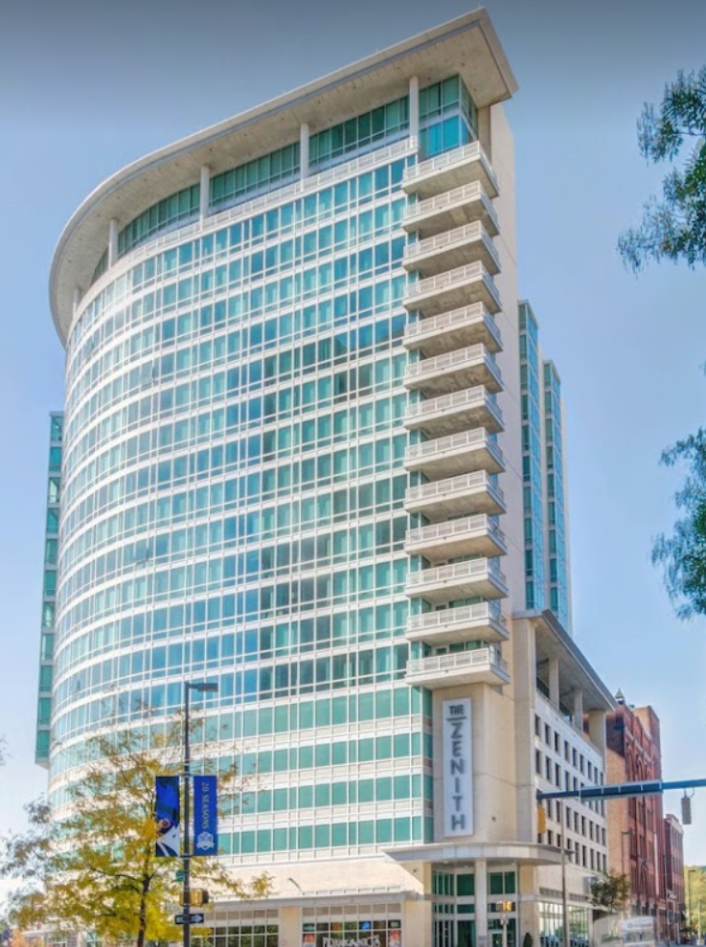
Zenith Apartment
Garage Restoration
Contract Value: $1.1 Million
Owner: Bentall Green Oak
Architect/Engineer: Simpson, Gumpertz, & Heger
Service Type: Structural Concrete Repairs, PT Repairs, Barrier Cable Repairs, Traffic Coatings
Completion Date: OCT 2020
Challenges: Phasing with an occupied parking garage and shoring design; the COVID pandemic kept occupants at home and required being cognizant of noise and scheduling; VE cost savings to Owner for traffic coatings, utilizing ASTM D541 adhesion testing with Elcometer.

Slide 3
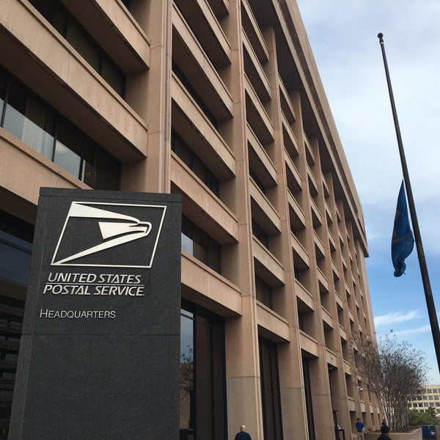
USPS HQ Garage Repair
Contract Value: $3.3 Million
Owner: United States Postal Service
Architect/Engineer: Parsons
Service Type: Structural Concrete Repairs, Epoxy Traffic Coatings, M.E.P. Repairs, Complete Slab Half Cell Potential Testing, Sacrificial Embedded Galvanic Anodes, Fusion Two-Phase Galvanic Anodes
Completion Date: MAY 2020
Challenges: All concrete repairs were made using manufactured, pre-bagged high-early repair concrete and a retarder additive to achieve workability. 80% of structural repairs were completed on weekends and reopened to traffic on Monday mornings. Multi-level phasing with occupied parking, stacked shoring, dust control, working over occupied space on the lowest level, sloped shoring for ramp repairs, and spread-load shoring working over a highly sensitive government SCIF.

Slide 4
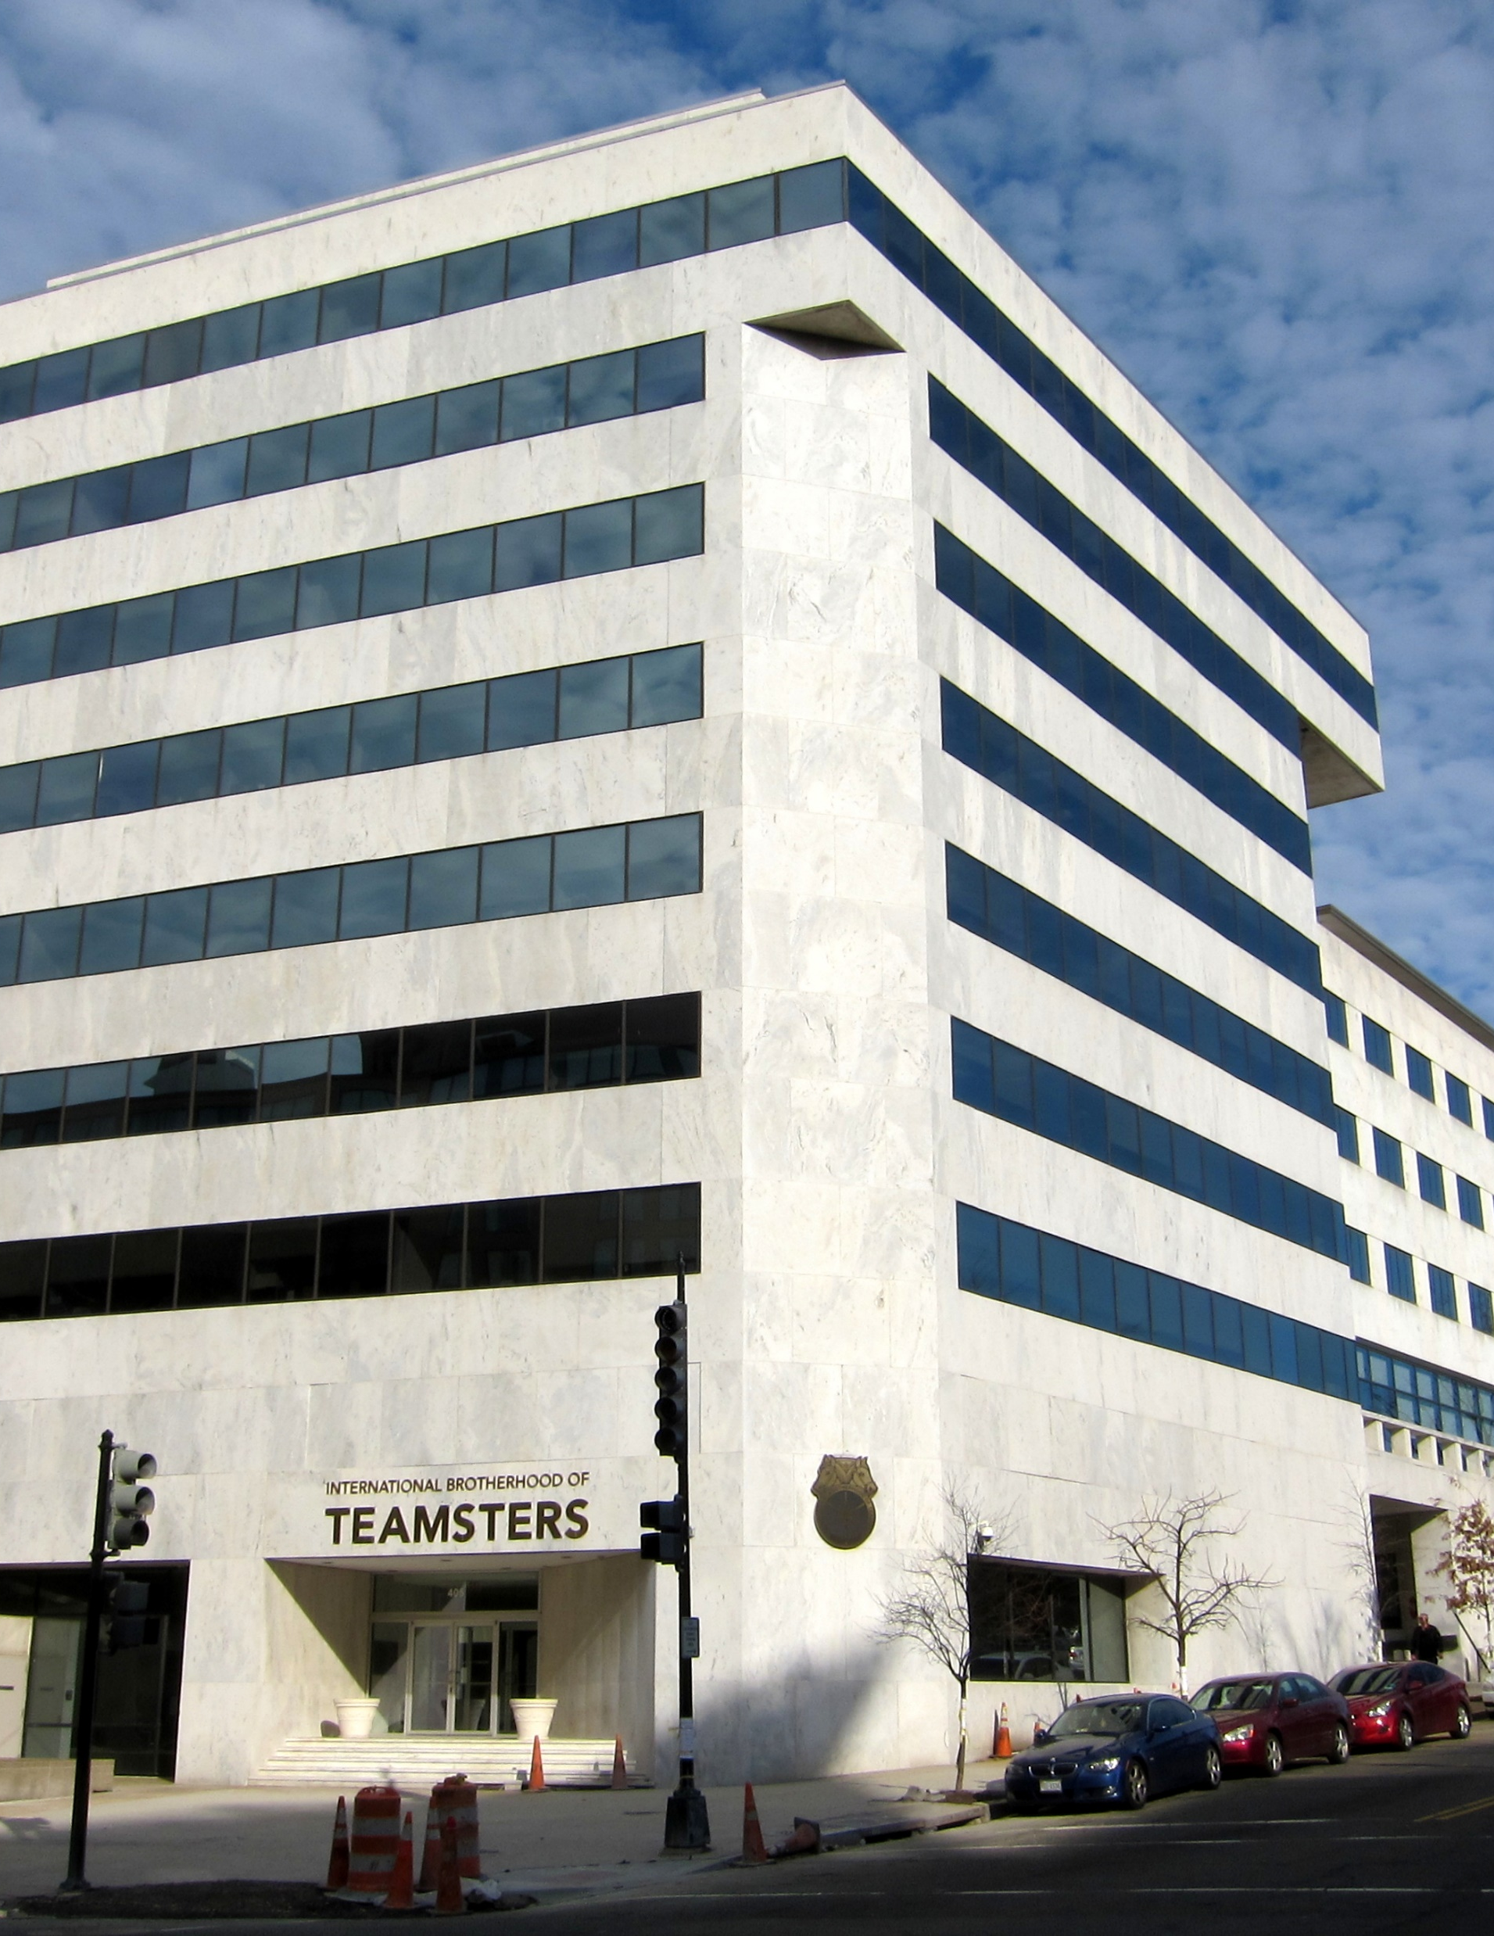
Teamsters HQ Façade Remediation, Terrace Waterproofing, Garage Repairs
Contract Value: $1.8 MIL
Owner: International Brotherhood of Teamsters
Architect/Engineer: Construction Insight, Lenkin Enterprises, Inc.
Service Type: Sealant Replacement, Brick Replacement, Tuckpointing, Façade Cleaning, HRA Waterproofing, Concrete Repairs, Epoxy Flint Traffic Coating
Completion Date: 2021
Challenges: Asbestos abatement in sealant discovered on day one; suspended swing stage rigging access solutions; overhead protection; and a fully operational alleyway under our work. Temporary waterproofing solutions during HRA waterproofing, safety fire watch utilizing a hot kettle on an occupied building. High-rise heavy debris removal.

Slide 5
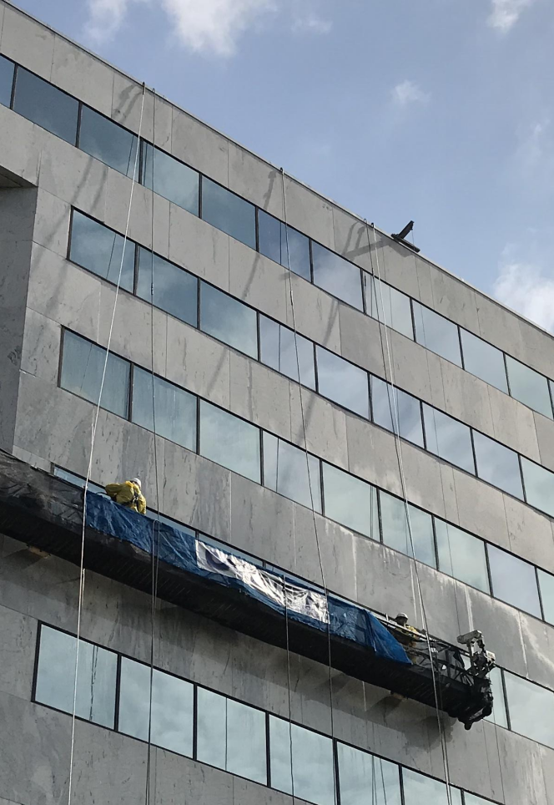
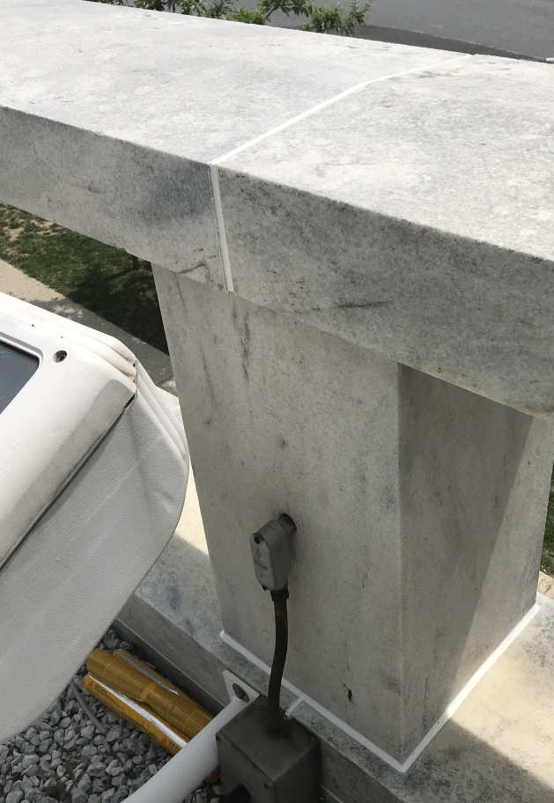
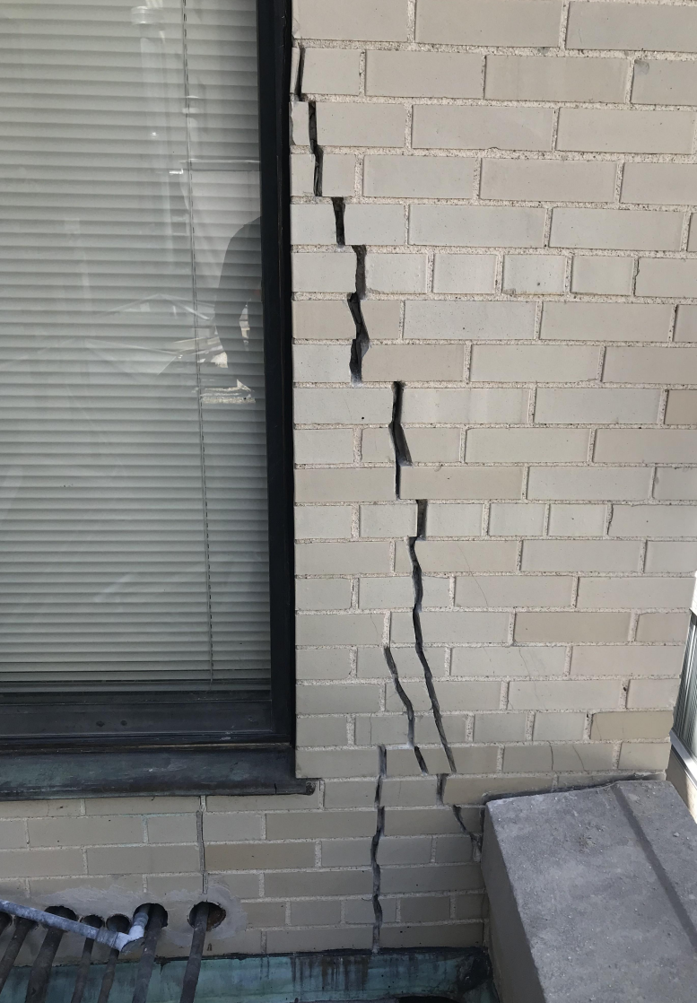
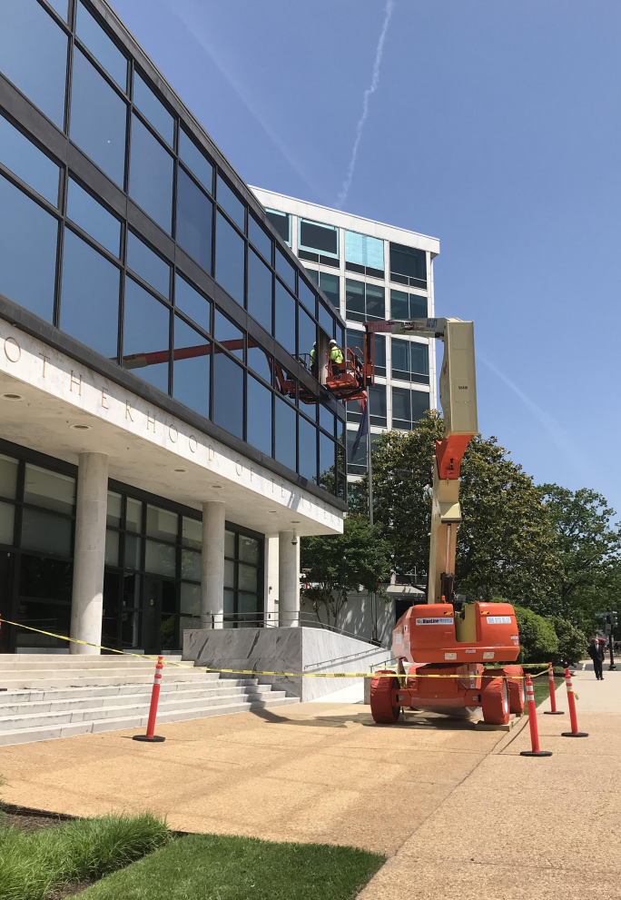
Teamsters HQ Façade Remediation

Slide 6
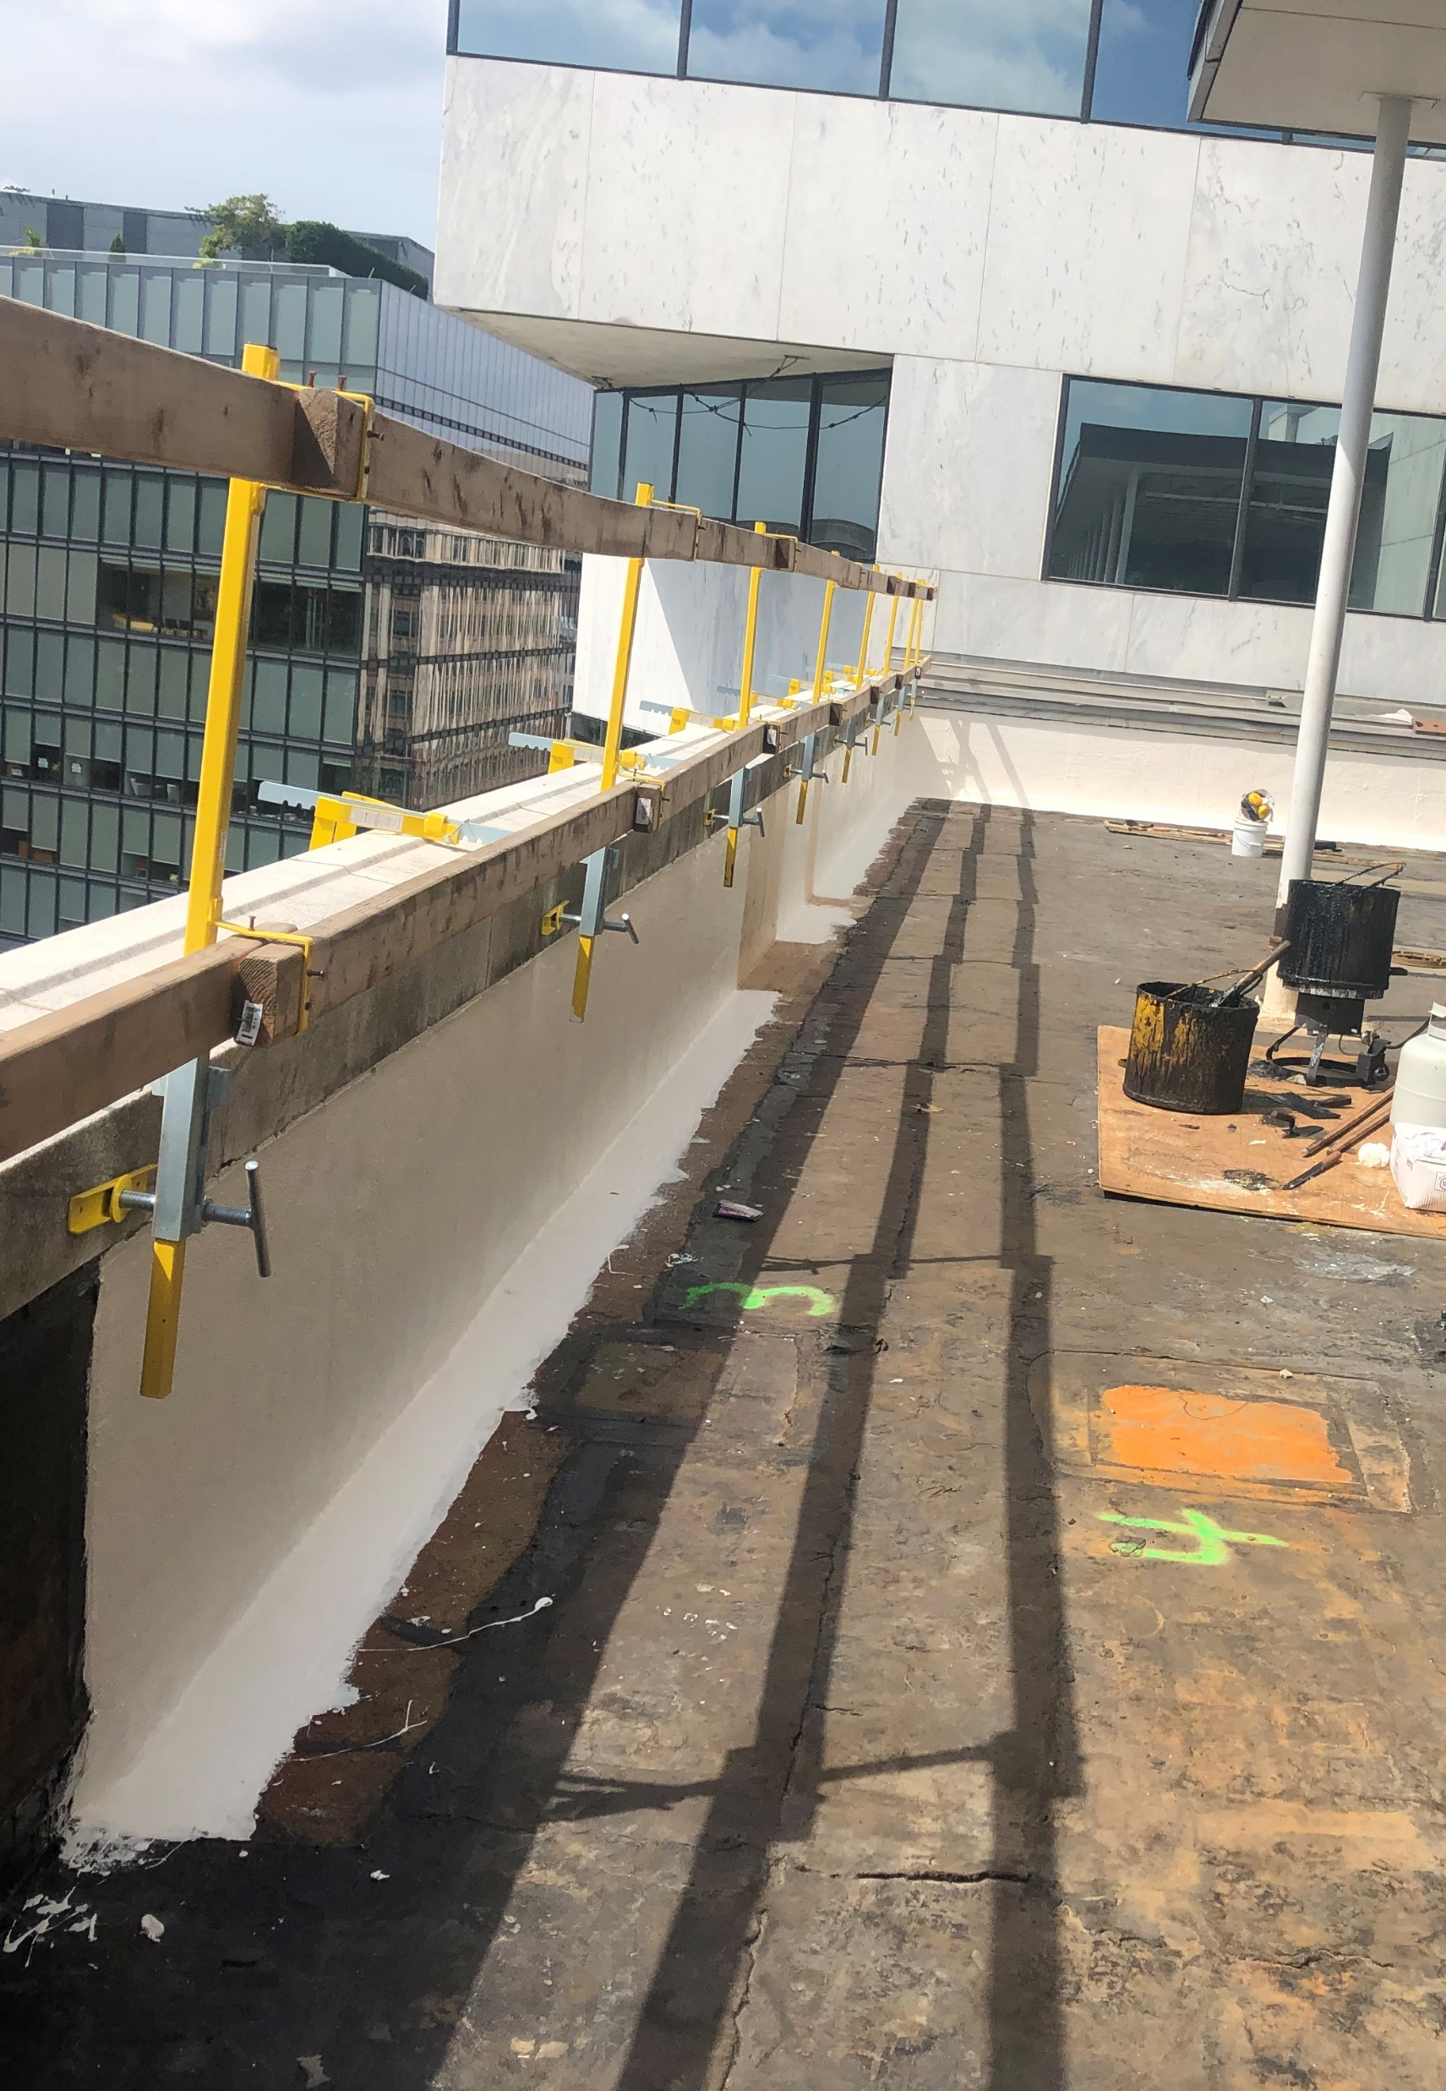
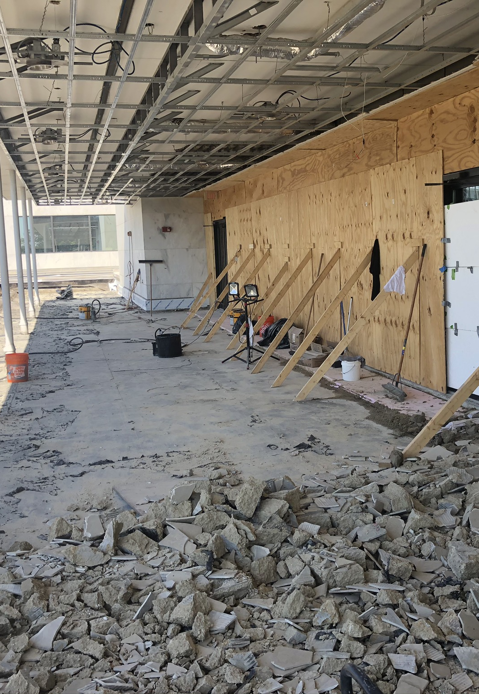
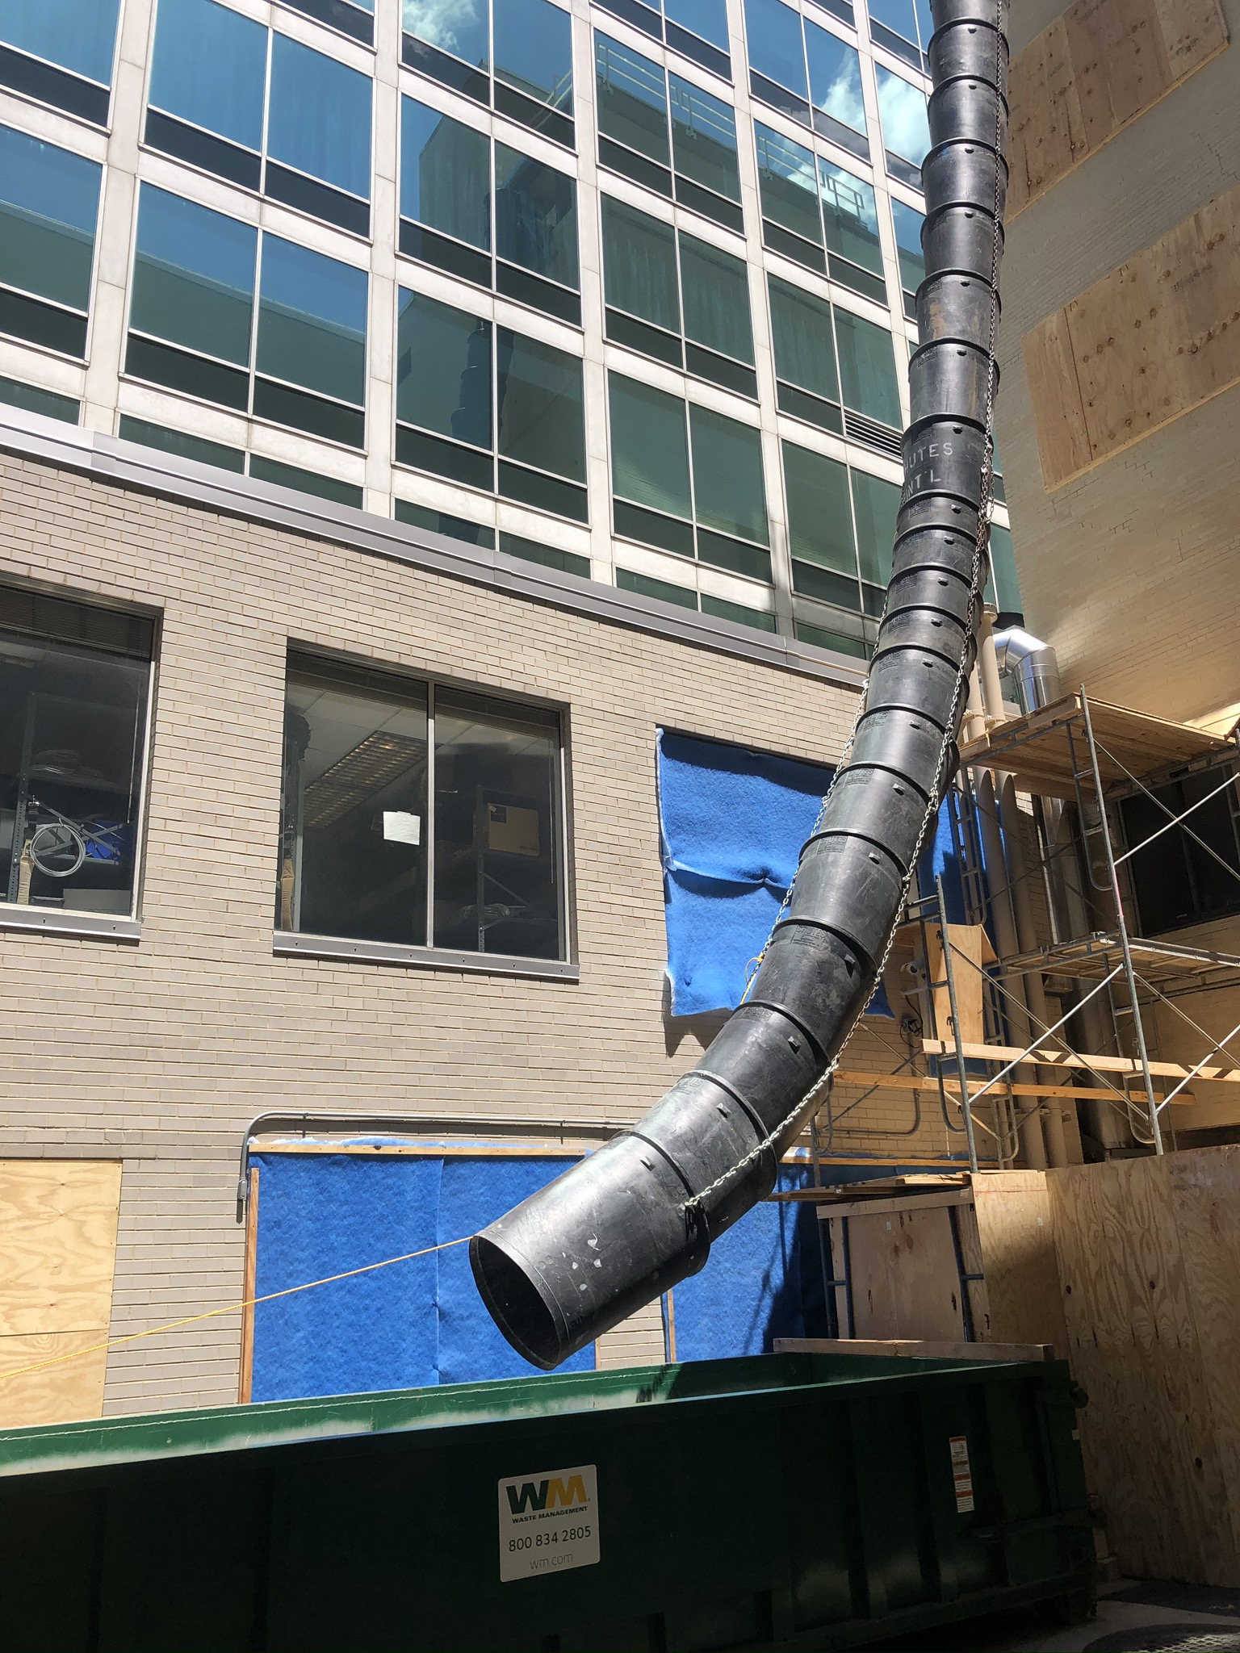
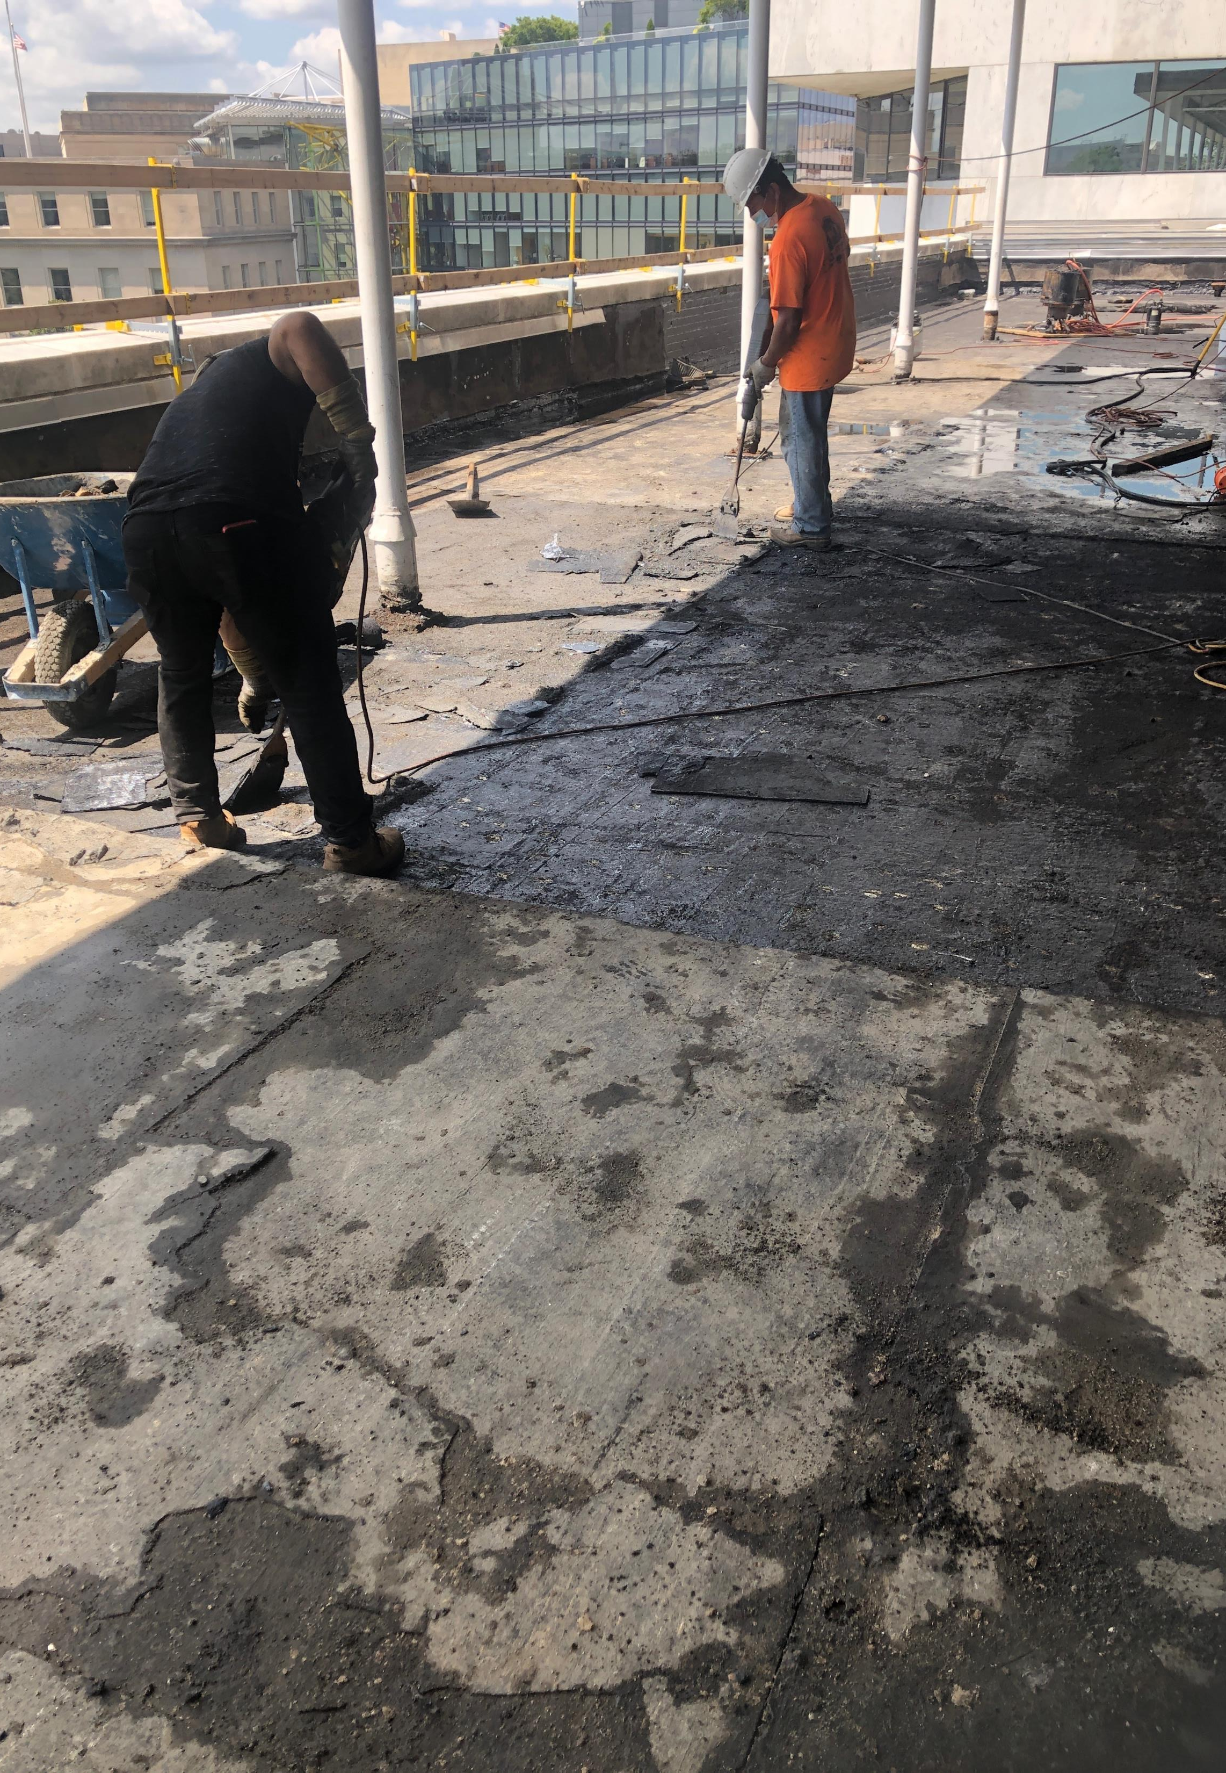
Teamsters HQ Terrace Waterproofing
(In Progress)

Slide 7
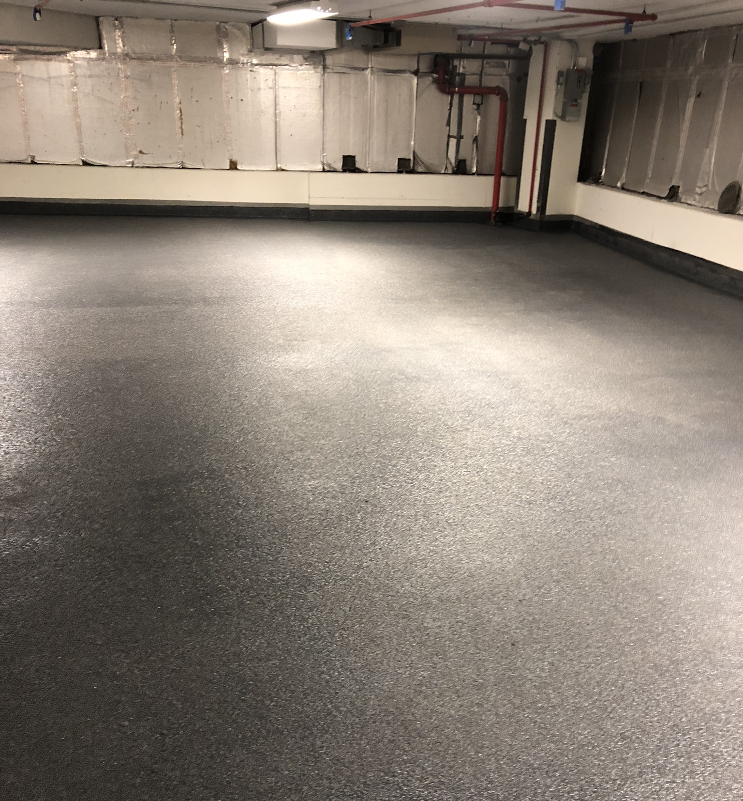
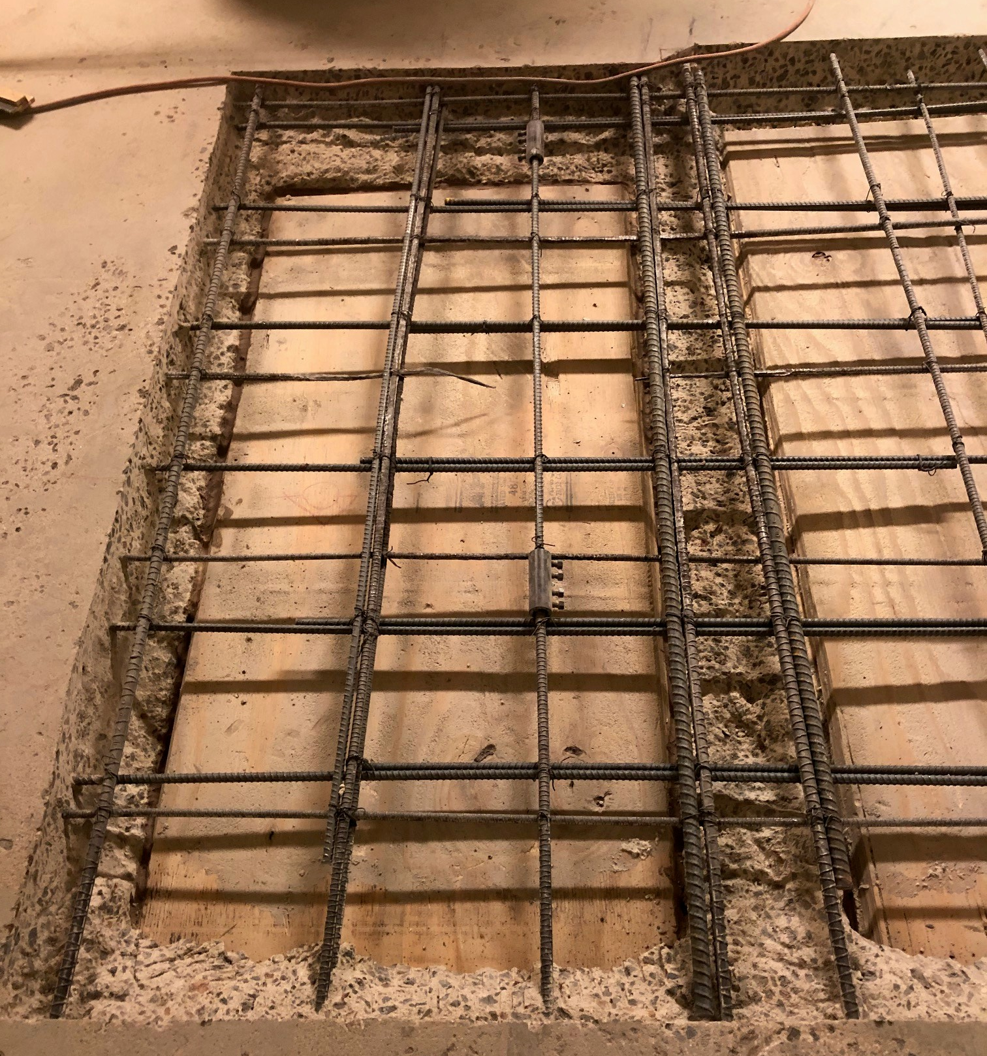
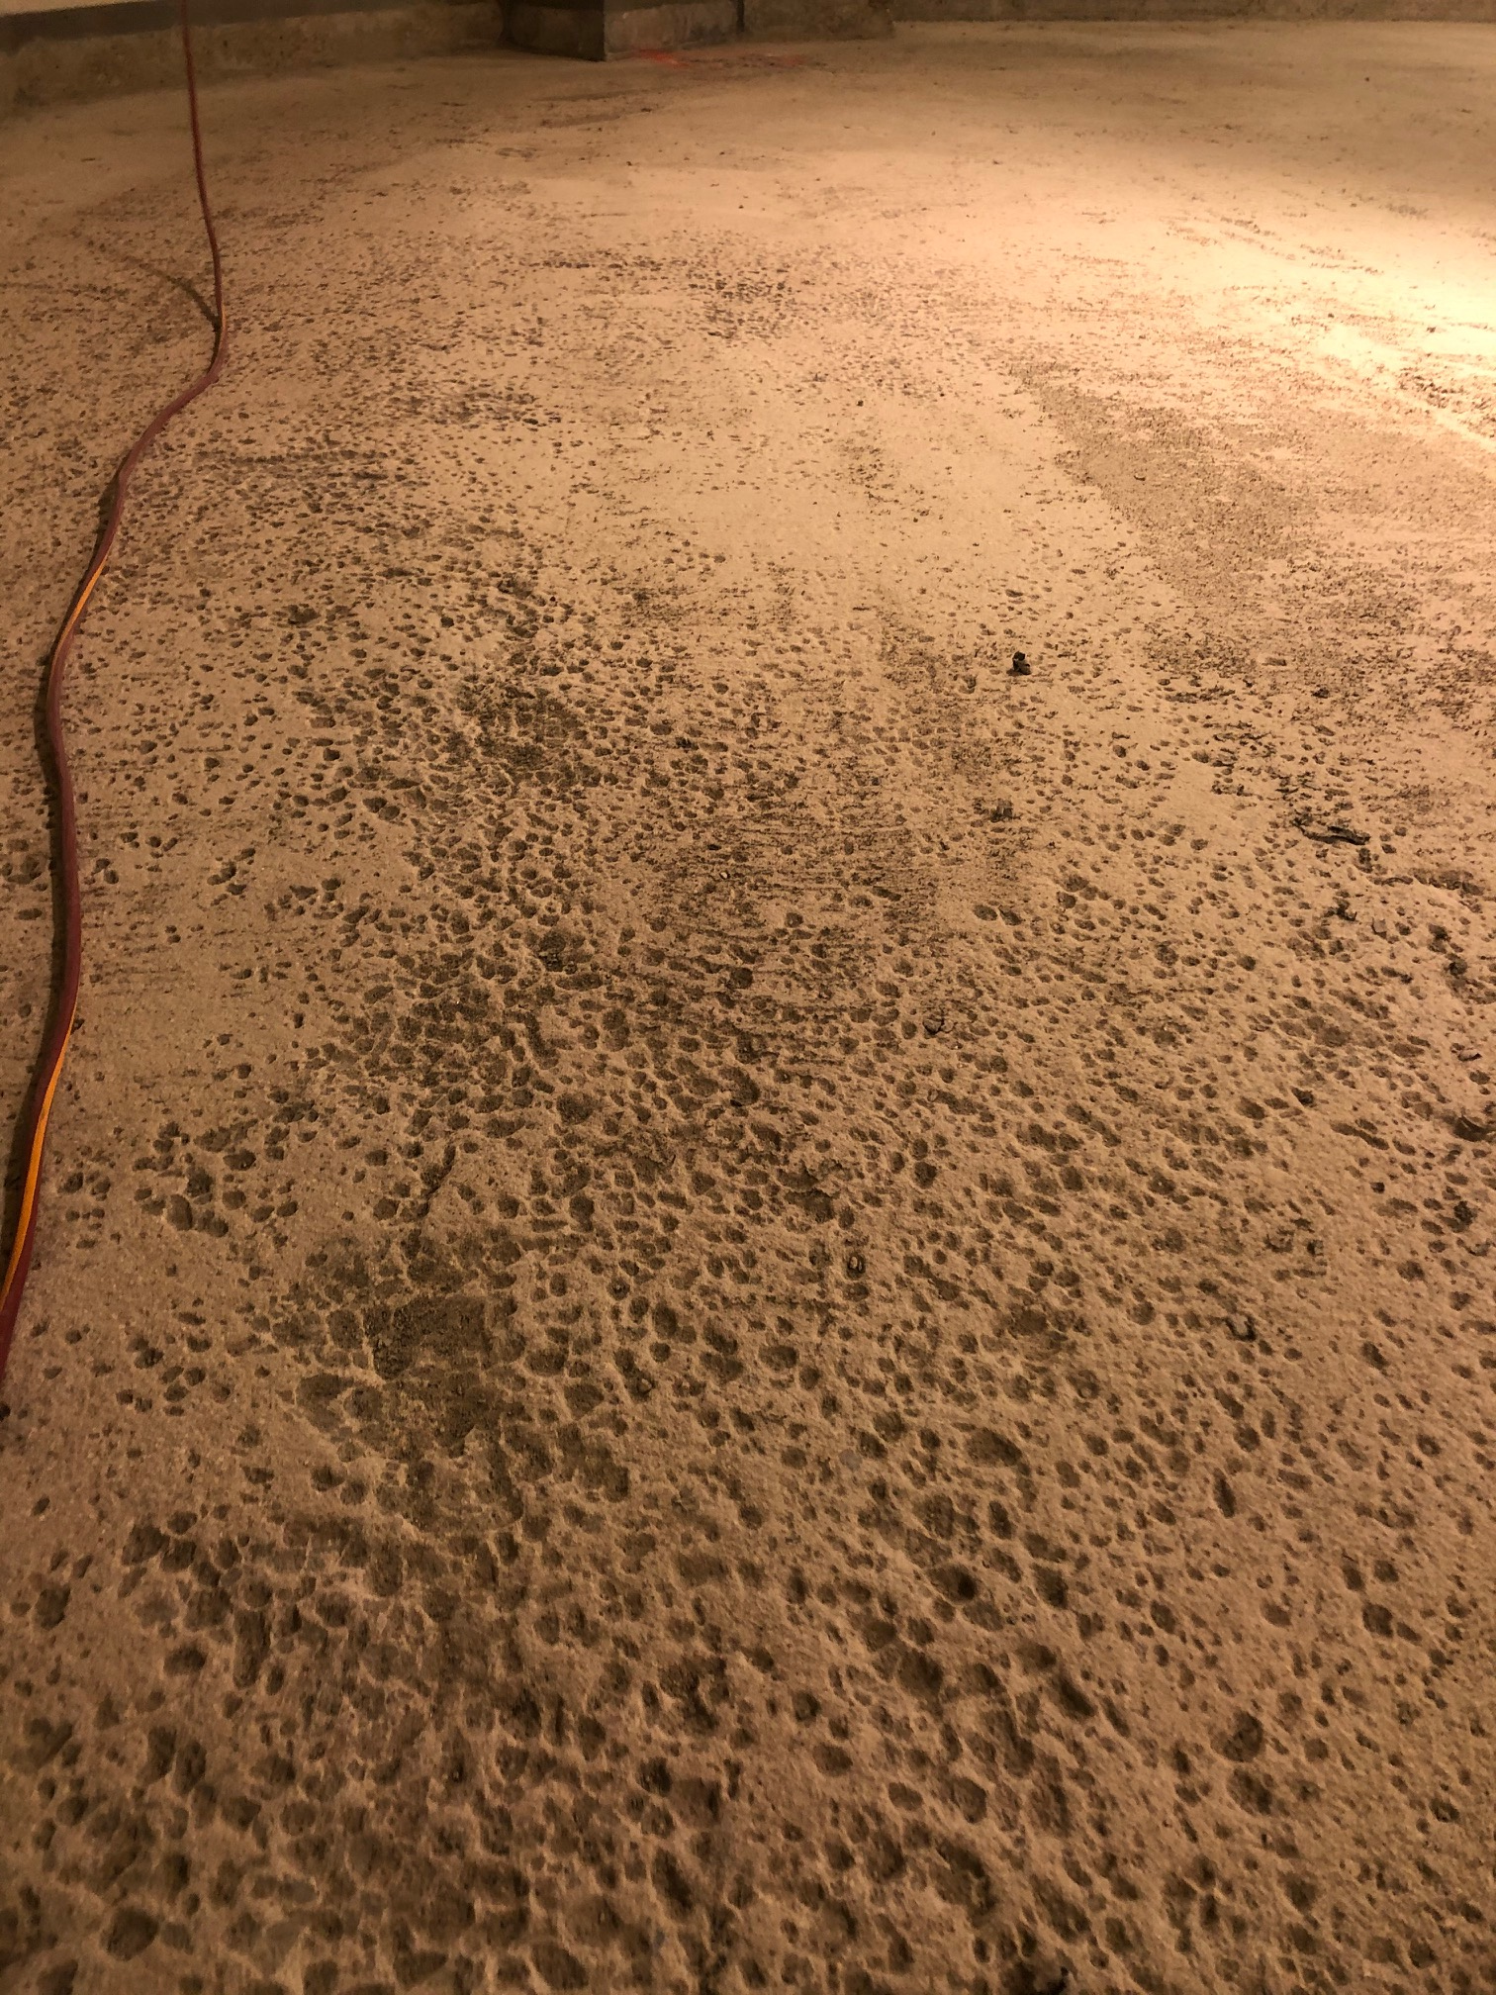
Teamsters HQ Garage Repairs

Slide 8
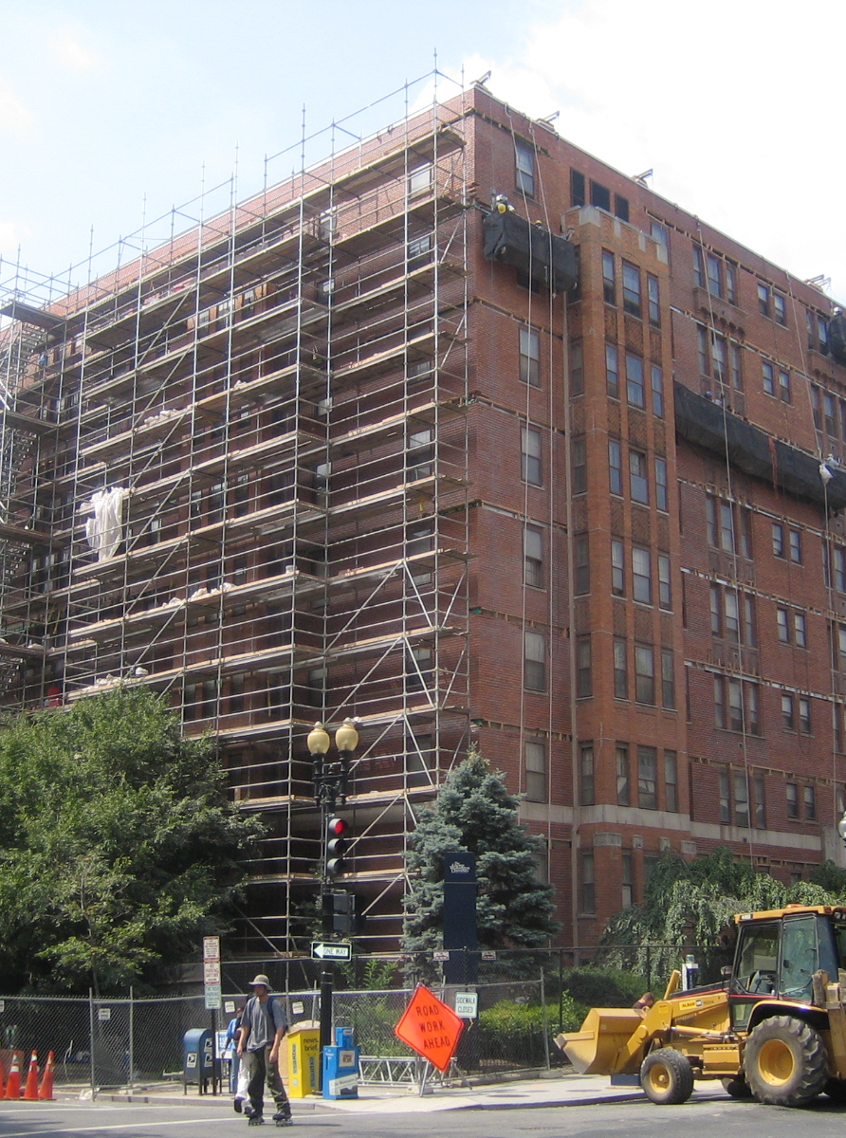
GWU – Thurston Hall Façade Repair and Window Replacement
Contract Value: $12 MIL
Owner: George Washington University
Architect/Engineer: Desman
Service Type: Brick masonry repairs, repointing, lintel replacement, air and water barrier, limestone restoration, pinning, window replacements, lead and asbestos abatement, and concrete slab and waterproofing.
Completion Date: AUG 2007
Challenges: The entire project was completed with a crew of nearly 60 men working 7 days a week for more than 10 hours per day over a 12-week schedule across 3 summers. Even with a nearly impossible schedule and extensive unforeseen conditions, the project came in on time and on budget. More than 1,100 students moved into their assigned rooms as scheduled after summer break.

Slide 9
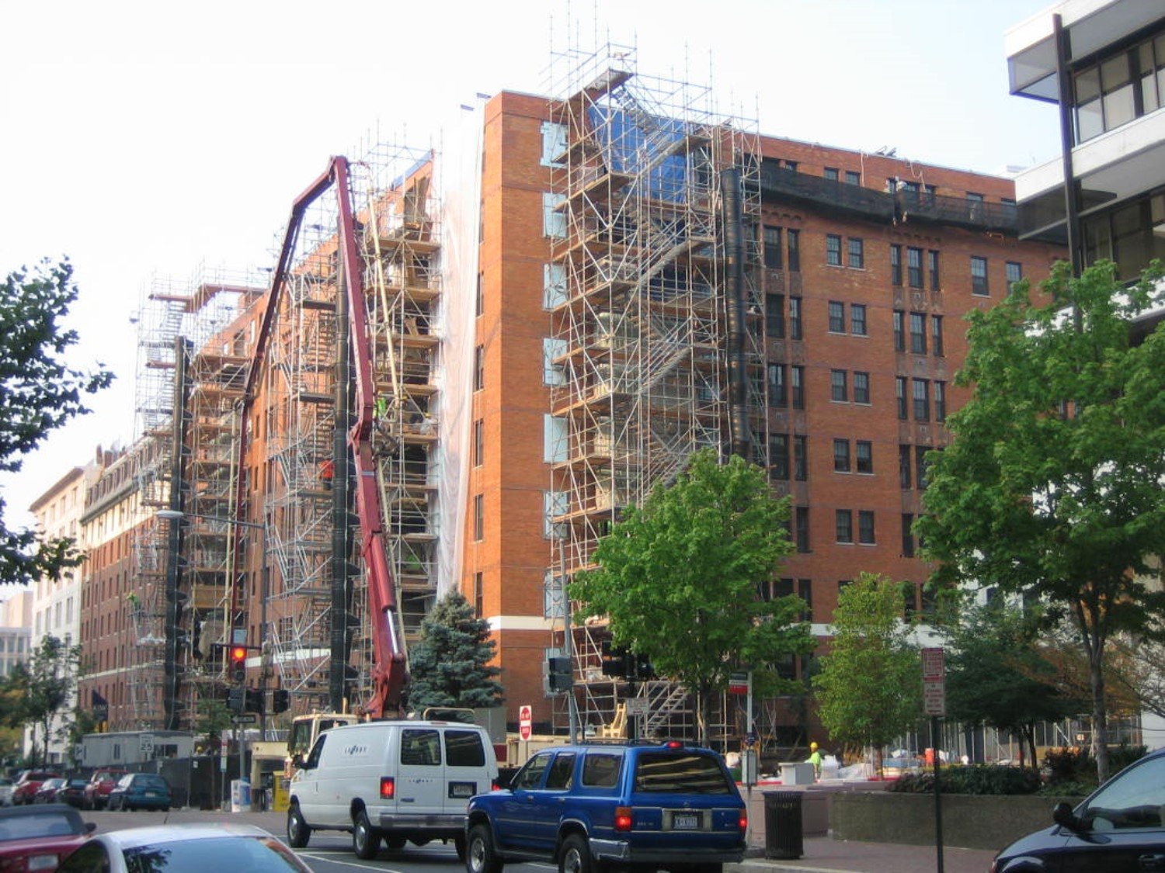
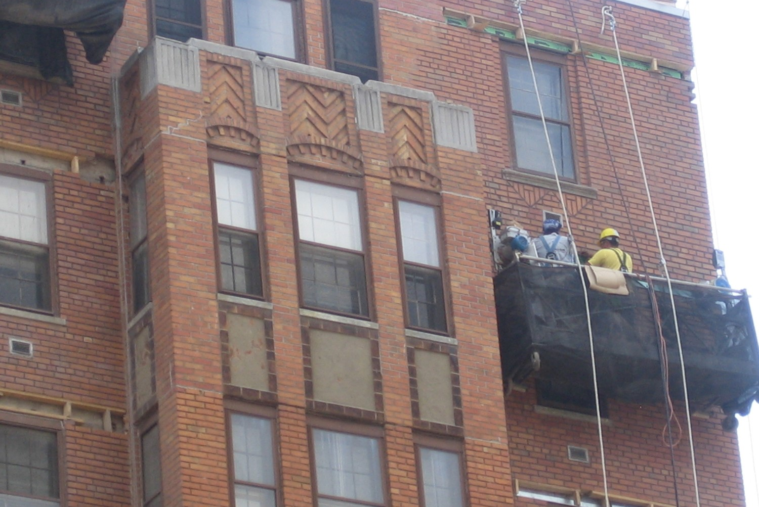
GWU | Thurston Hall Façade Repair and Window Replacement

Slide 10
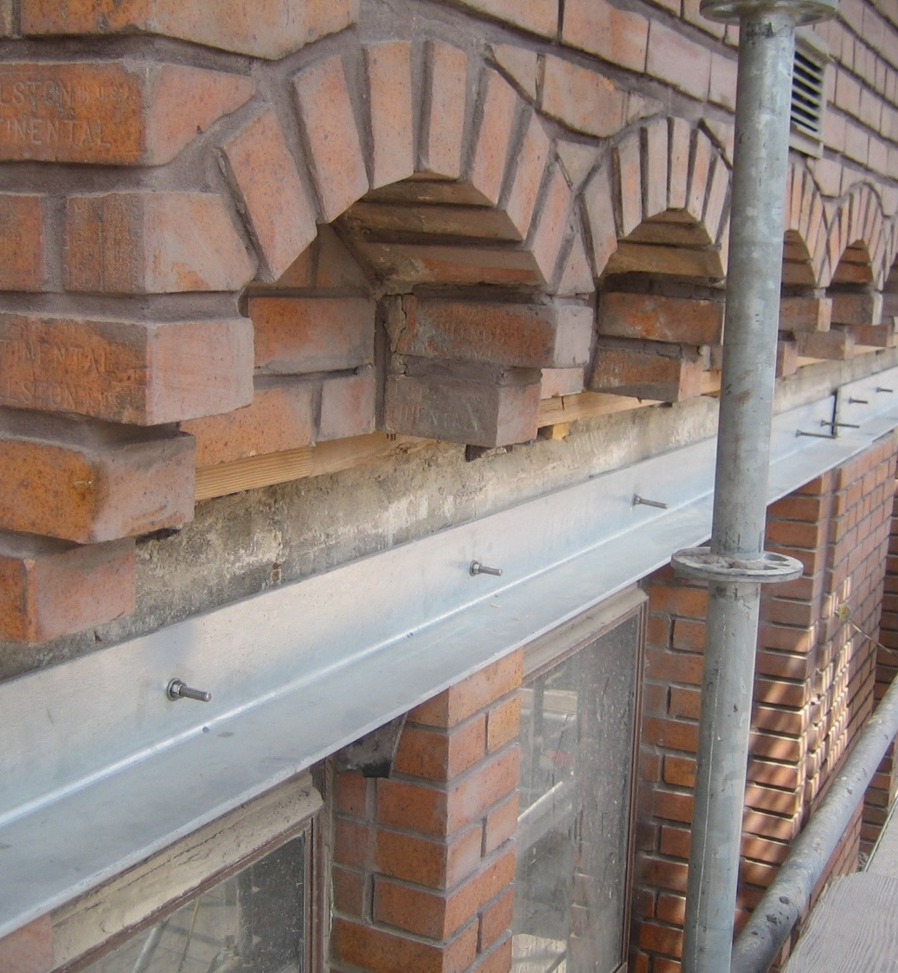
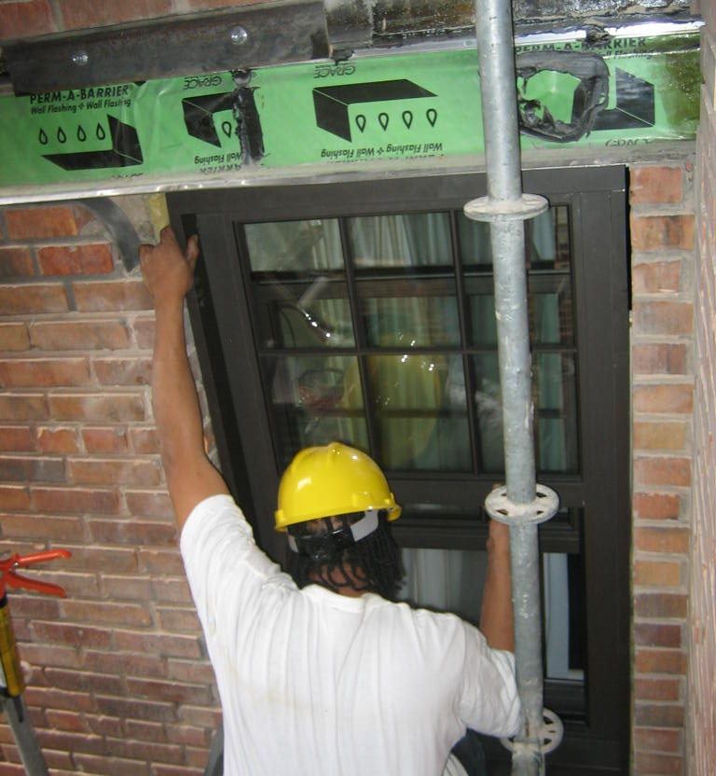
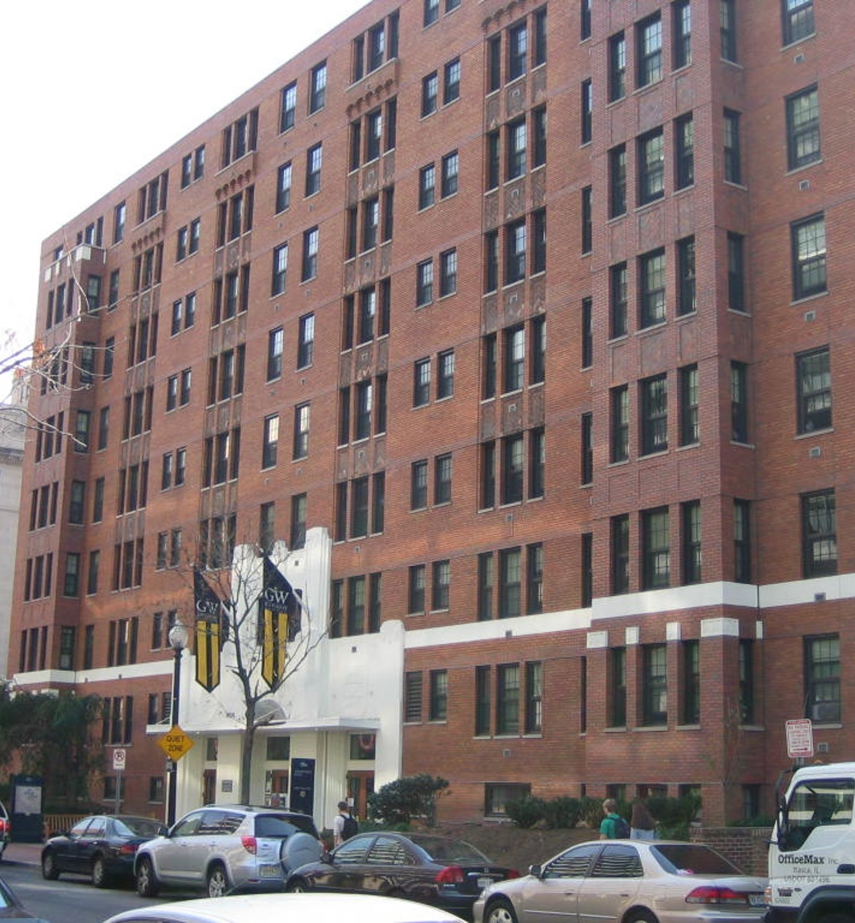
GWU | Thurston Hall Façade Repair and Window Replacement

Slide 11
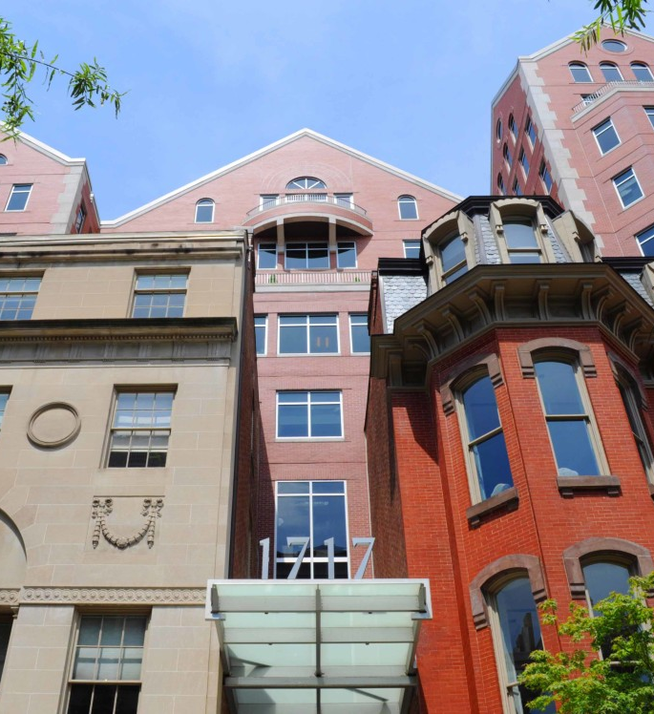
1717 Rhode Island Masonry Façade Replacement
Contract Value: $7 MIL
Owner: Bentall Kennedy
Architect/Engineer: Building Technology Consultants, PC
Service Type: Complete brick removal, v limestone fascia and coping stones, new aluminum roof coping, and complete caulking replacement.
Completion Date: 2011
Challenges: The repairs were conducted on several types of scaffolding (swing, tube, mast climber and hanging scaffolds) that enveloped the whole building at the peak of the project. These intricate access systems had to be carefully installed around adjoining buildings without disturbance. The crew size peaked at 90 men, many of whom were skilled bricklayers with the expertise to tackle the challenging task of recreating several of the building’s intricate patterns.

Slide 12
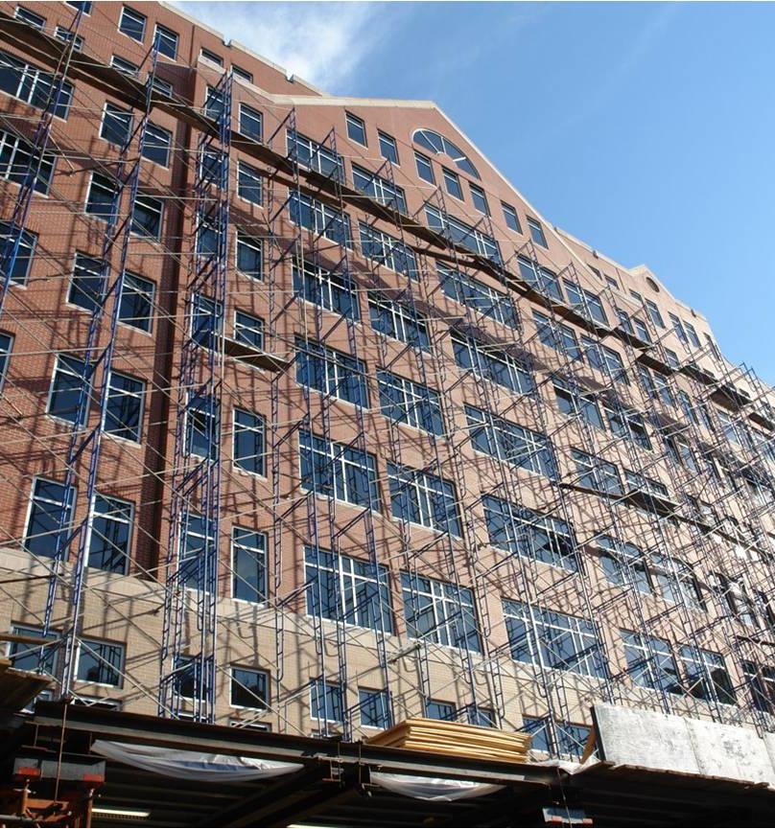
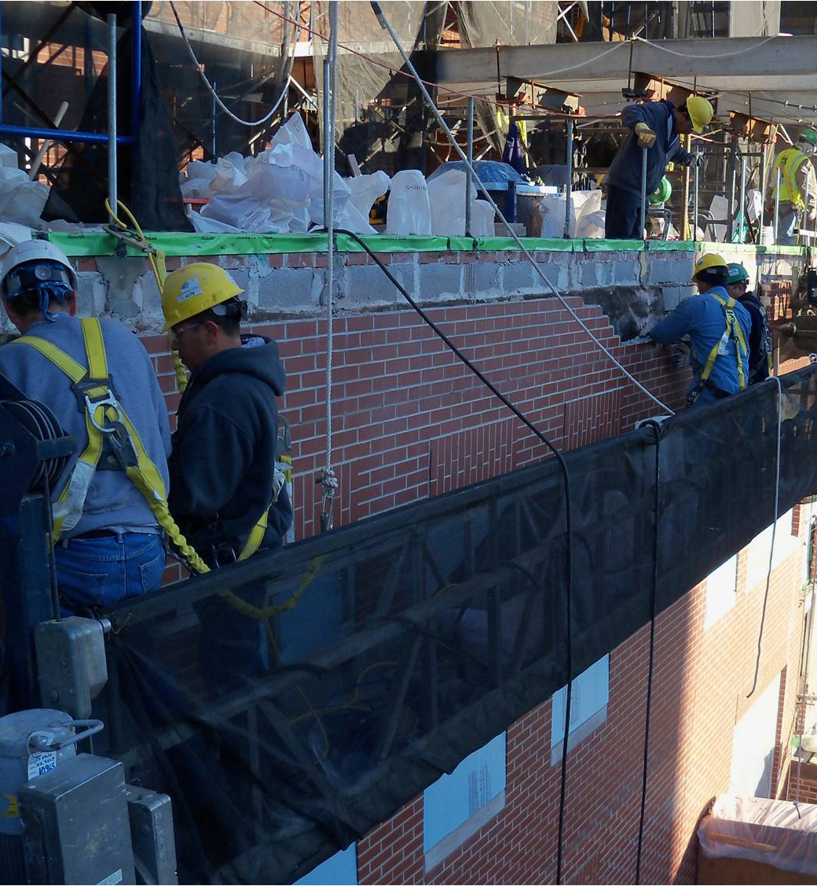
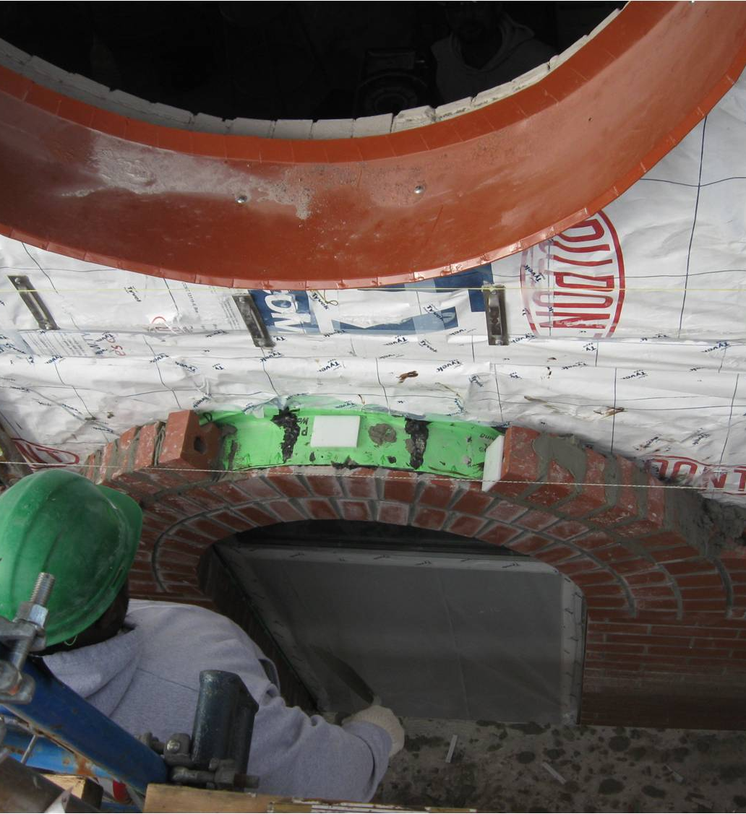
1717 Rhode Island Masonry Façade Replacement

Slide 13
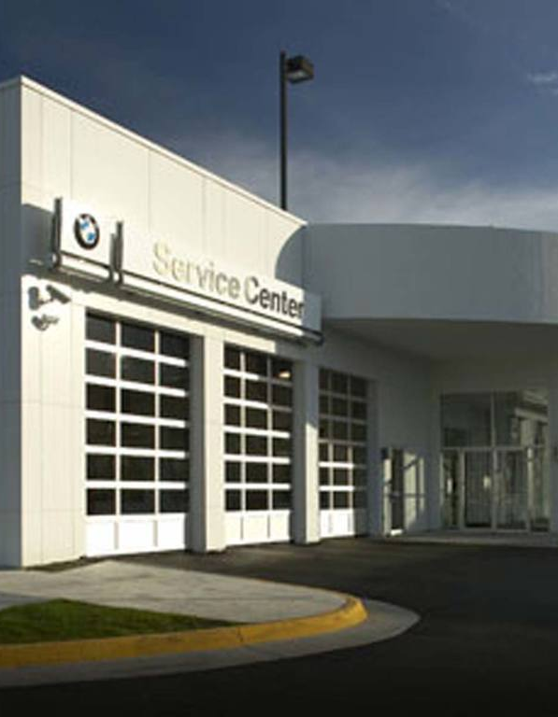
BMW of Fairfax Waterproofing Remediation
Contract Value: $1.7 MIL
Owner: Sonic Automotive
Architect/Engineer: Simpson, Gumpertz, & Heger
Service Type: Concrete Topping Slab Replacement, Split Slab HRA Waterproofing Repairs, Hydronic Snow Melt Installation, Drain Retrofit, Silicone Wall Coatings, Sealants, Expansion Joint System Replacement
Completion Date: DEC 2019
Challenges: Fully operational car dealership service center did not shut down while completing the project. Care had to be taken when working around luxury vehicles. When removing existing waterproofing it was necessary to re-install the HRA waterproofing detail the same day in order to keep leaks out of the service center. One way car traffic was utilized on the ramp using temporary traffic lights.

Slide 14
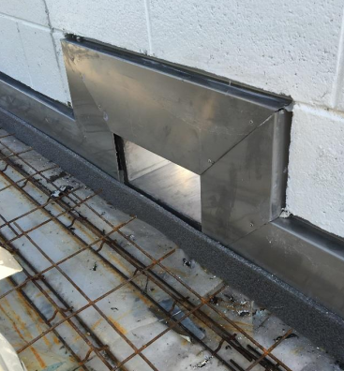
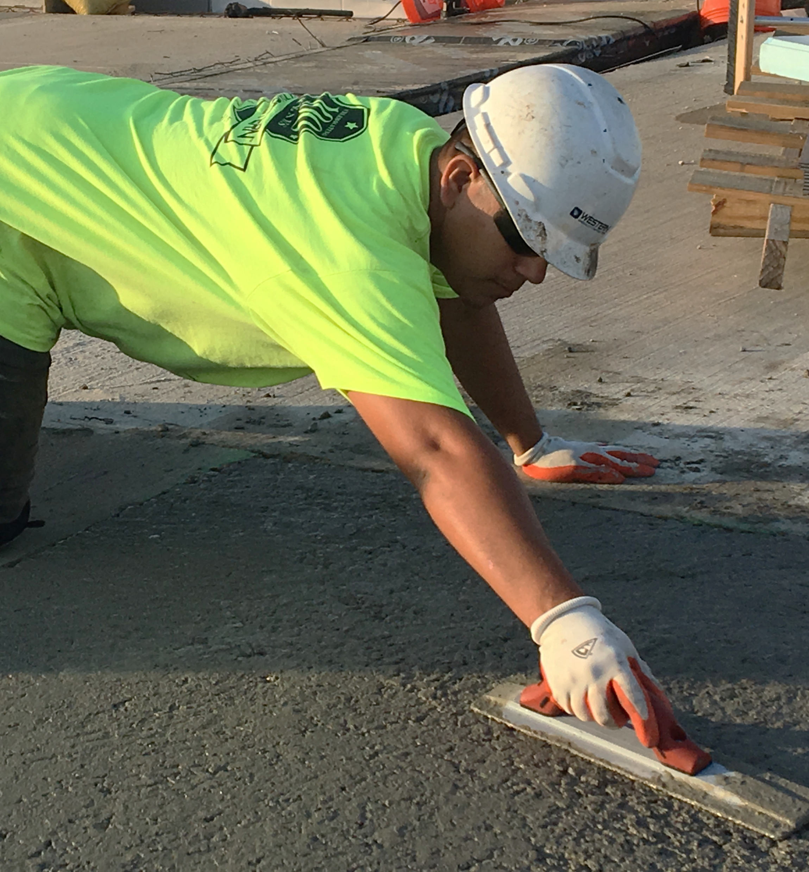
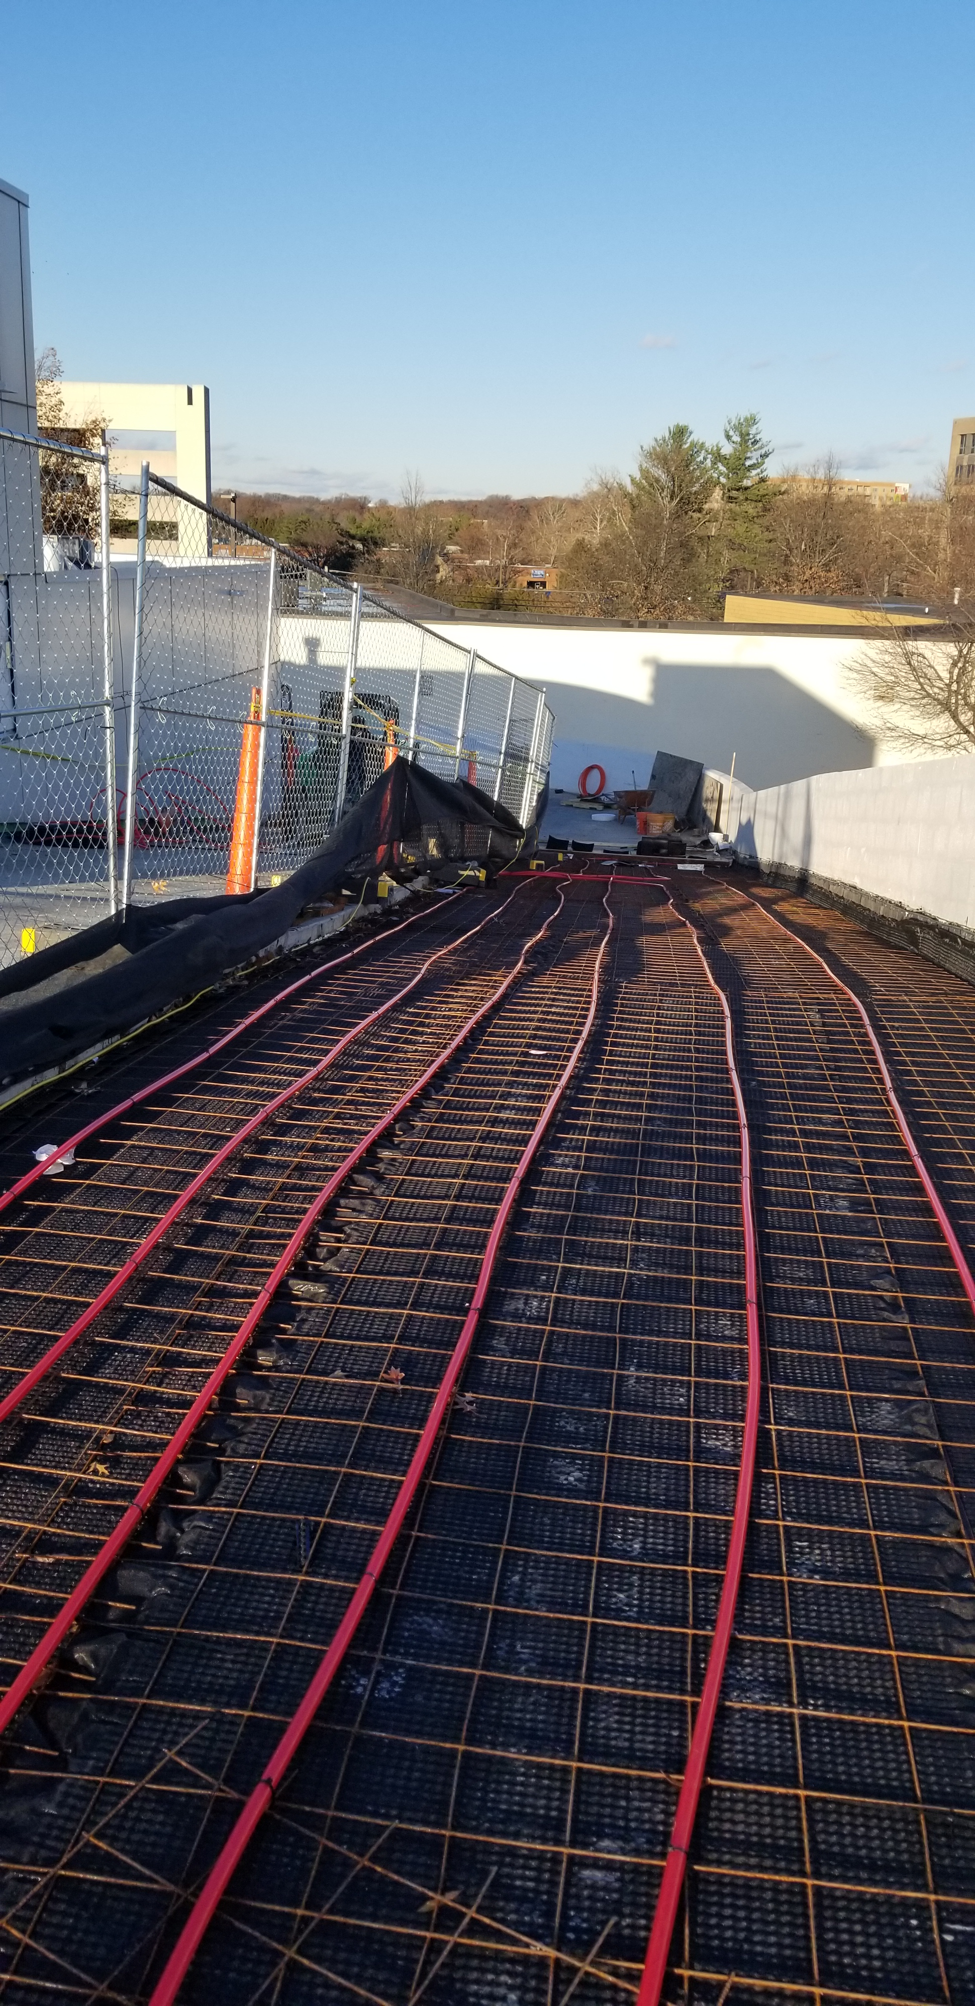
BMW of Fairfax Waterproofing Remediation

Slide 15
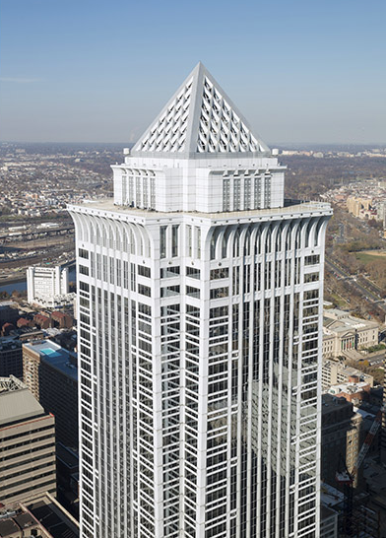
BNY Mellon
Sealant Remediation
Contract Value: $1.1 MIL
Owner: CBRE/Silverstein Prop
Architect/Engineer: Ascent Restoration
Service Type: Wet Seal/Glazing Windows
Completion Date: SEPT 2019
Challenges: Two-Year Project, Single-House Rig, Pedestrian Protection, Wet Seal, VE phasing recommendations utilizing shift work to save on ownership costs and overall schedule. VE pedestrian canopy protection in an owner-controlled alleyway. Mandatory house rig annual maintenance and window washing scheduling during the project.

Slide 16
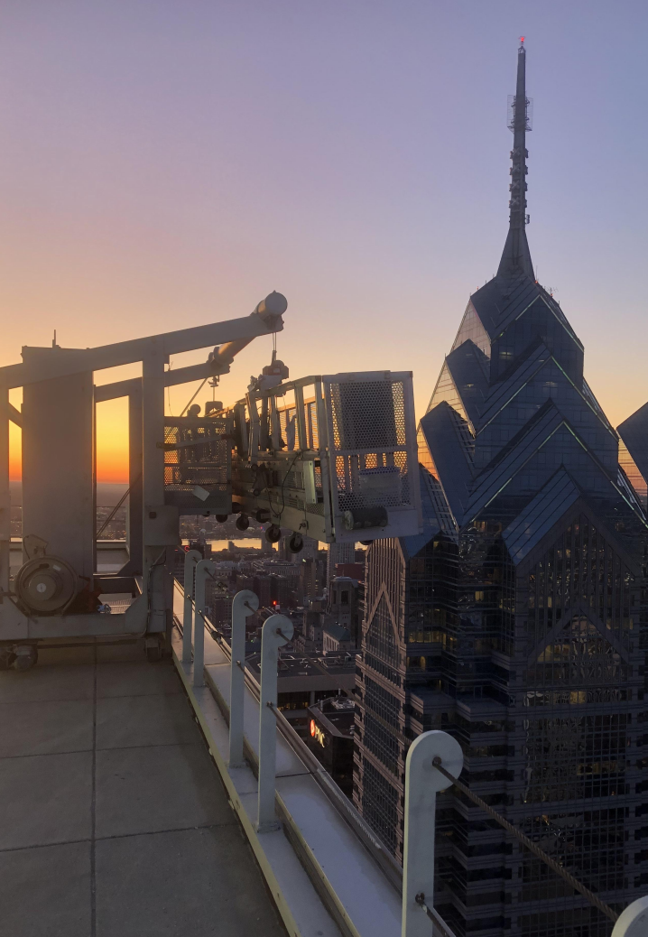
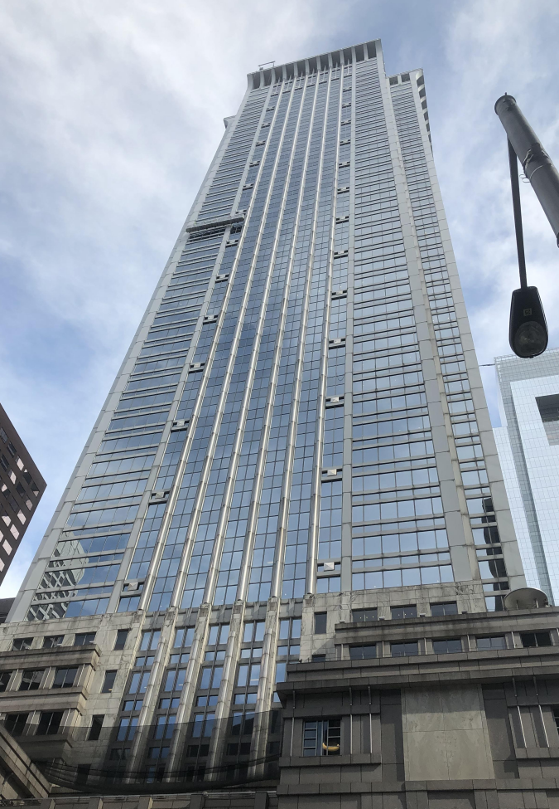
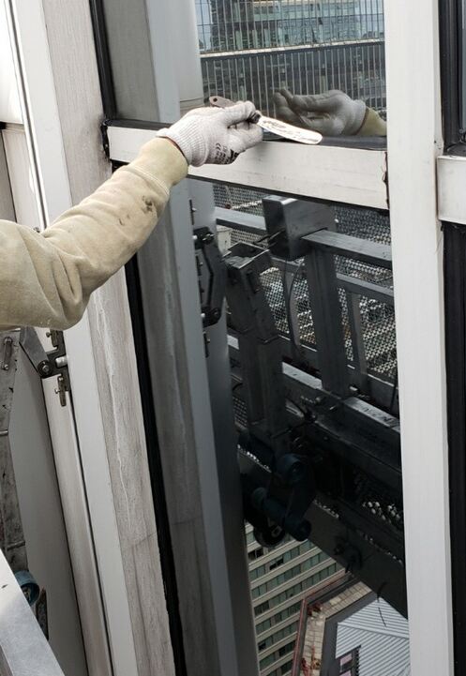
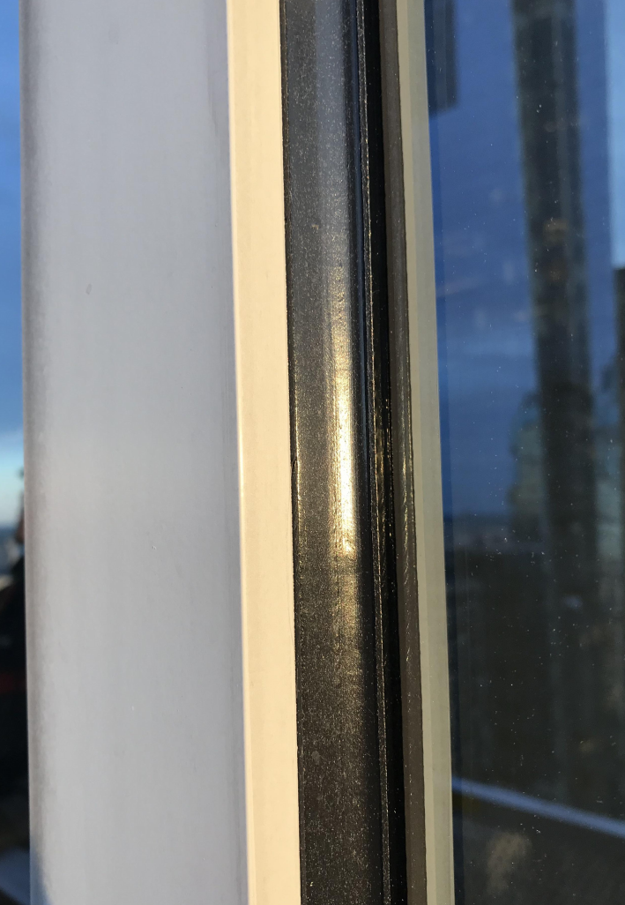
BNY Mellon Tower Sealant Remediation

Slide 17

How Western Can Help
Facade and parking garage condition survey
Repair prioritization and cost analysis
Budgeting and estimating
Pre-construction services
Provide short- and long-term repair plans
Investigation contractor support services
Vertical facade access solutions
Local and national coverage
Self-performed work
Training resource for design professionals

Slide 18

Reach out today for all your façade, concrete, and waterproofing needs!
John Burnett
DC Branch Manager
johnb1@westerngroup.com
Tanya Shepherd
DC Business Development Manager
tanyas@westerngroup.com

