Slide 1
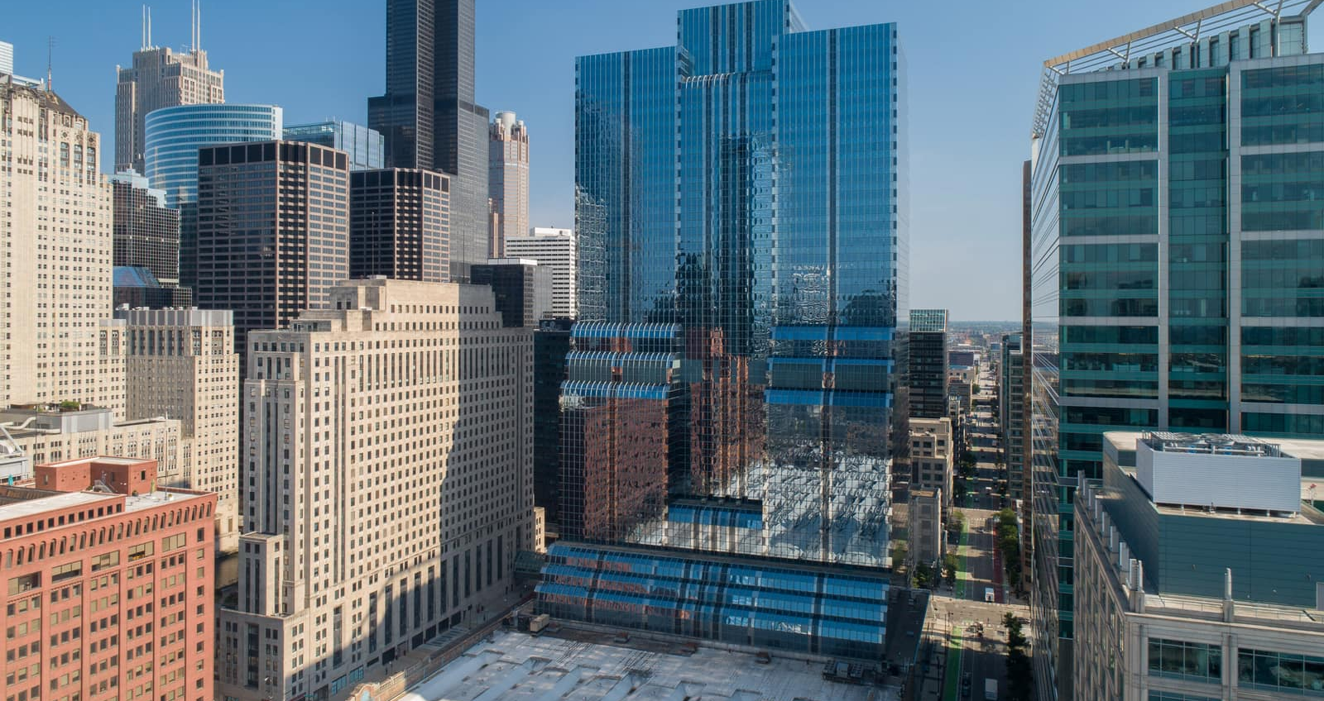

BUDGET SEASON TIPS
FOR THE ENTIRE BUILDING ENVELOPE

Slide 2


STEPHEN BISHOP
PRESENTATION OVERVIEW
Western Overview Roofing
Facades Concrete
Budgeting Tips

Slide 3
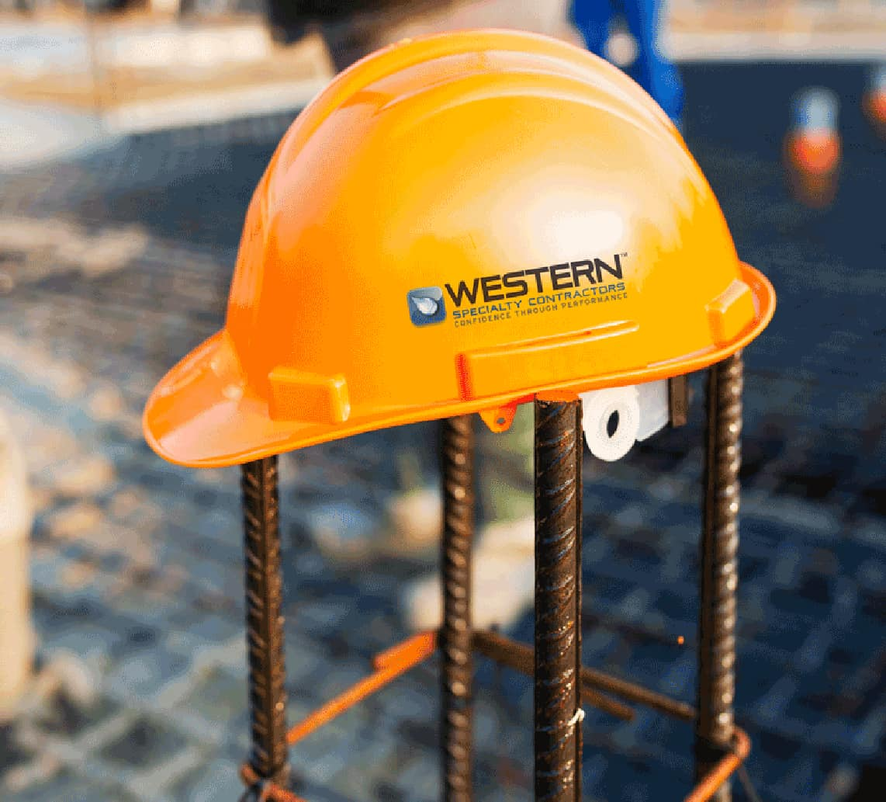
ABOUT
WESTERN
TANYA SHEPHERD
Founded in 1915
30 Branches Nationwide
Family Owned and Operated Invested in Client Satisfaction Clients Are Our Partners
Industry Leader in Safety
Experience Modification Factor = 0.81
Industry Average = 1.0
OSHA Recordable = 1.64
Indusrry Average = 3.0

Slide 4
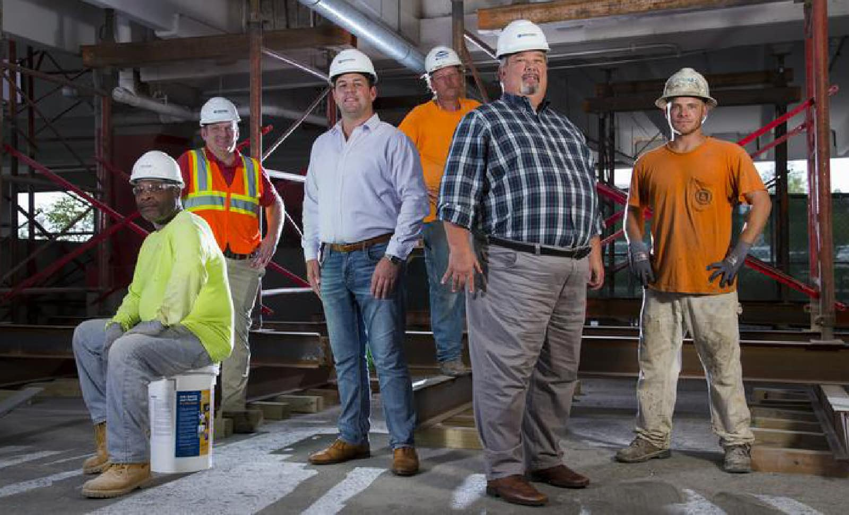
1915
2020
Concrete, Facade and Masonry
Restoration
Roofing Repairs and Restoration Expansion Joint Systems
OUR SERVICES
TANYA SHEPHERD
Exterior Wall Coatings
Parking Deck Restoration
Plaza Deck Restoration
Waterproofing
Historic Restoration

Slide 5
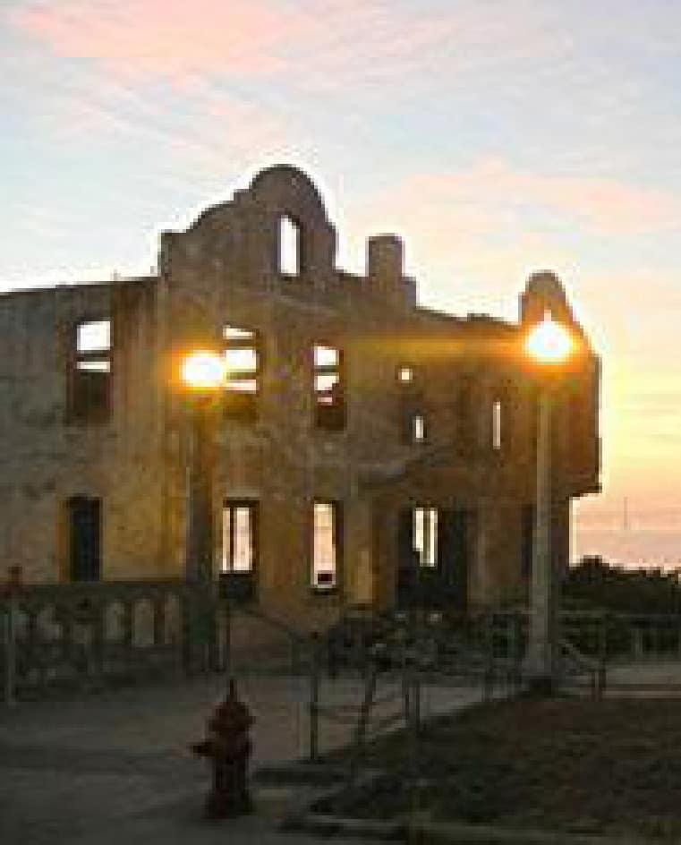
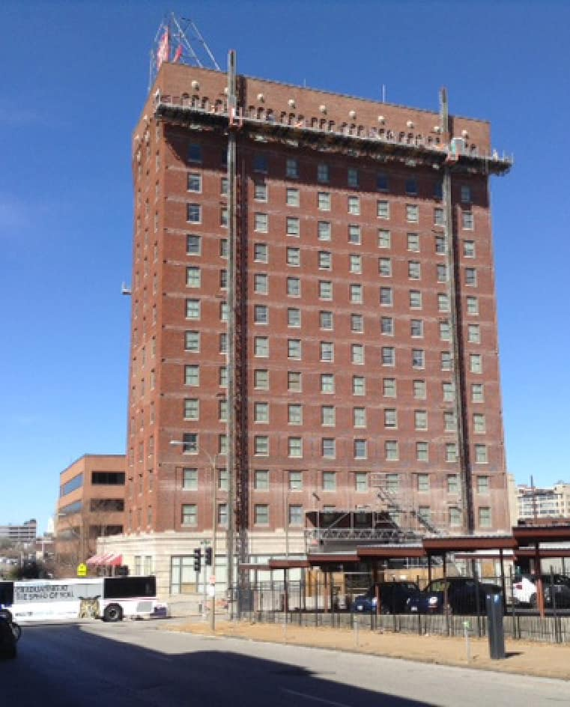

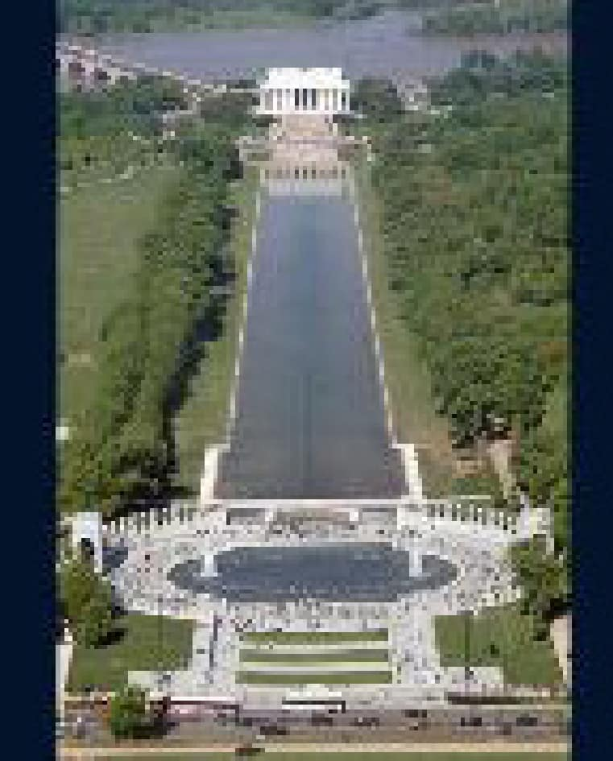
PROJECTS
The Arch Grounds—Saint Louis, MO
Eads Bridge—Saint Louis, MO
Salvation Army Building—Saint Louis, MO
Alcatraz—San Francisco, CA
Lincoln Memorial Reflecting Pool—Washington, D.C.
Maggie Daley Park—Chicago, IL
ODOT Stone Arch Bridges—Cleveland, OH
Moolah Temple—Saint Louis, MO
Corbin Building—New York, NY
NOTABLE

Slide 6
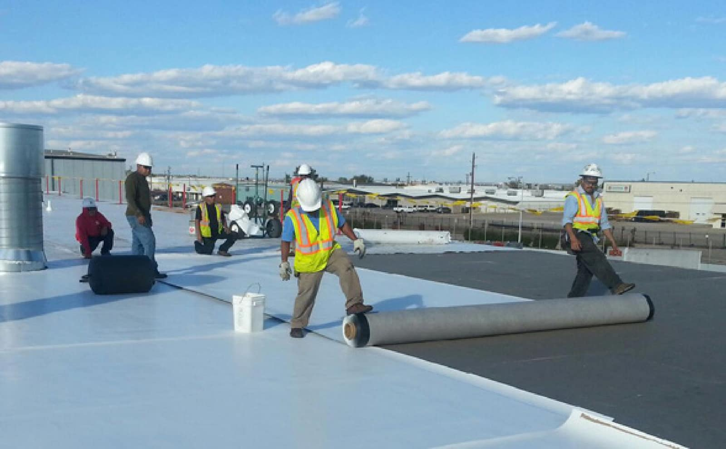
TYPES OF
COMMERCIAL BUILDING
ROOFING SYSTEMS
AND WHAT ISSUES YOU SHOULD BE
LOOKING FOR
KEEGAN TUNE

Slide 7
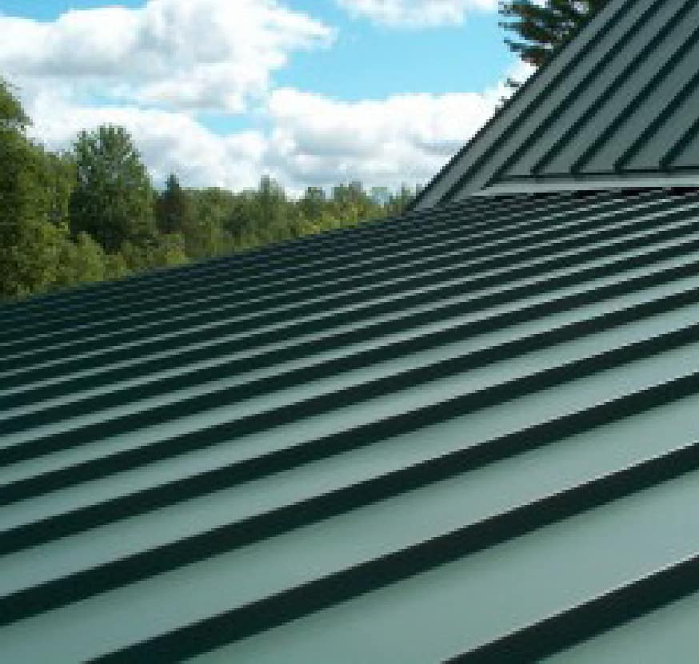
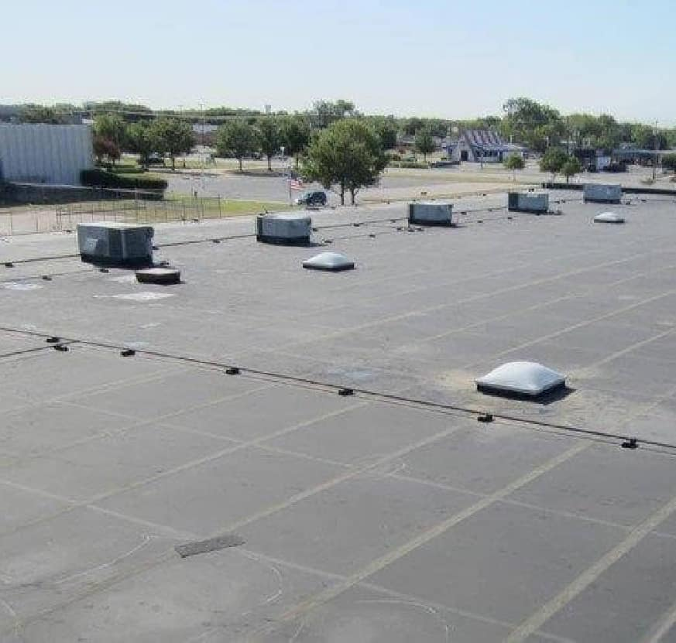
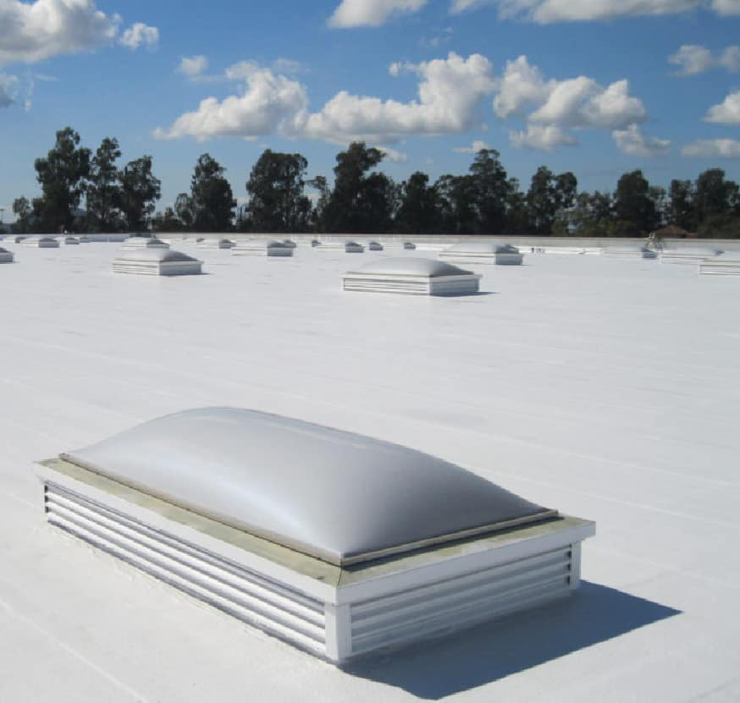

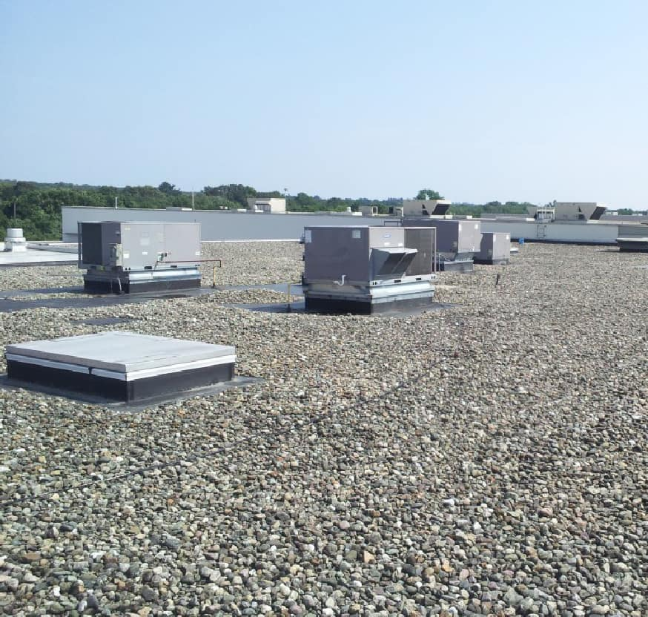
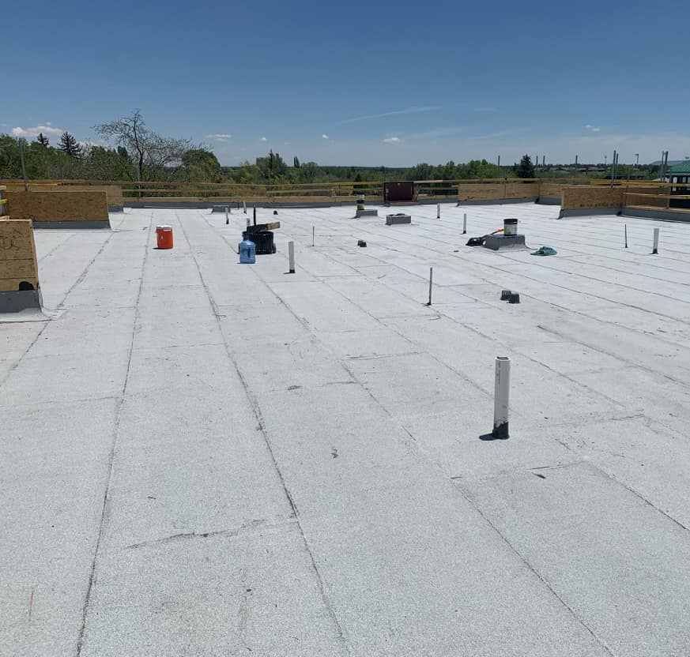
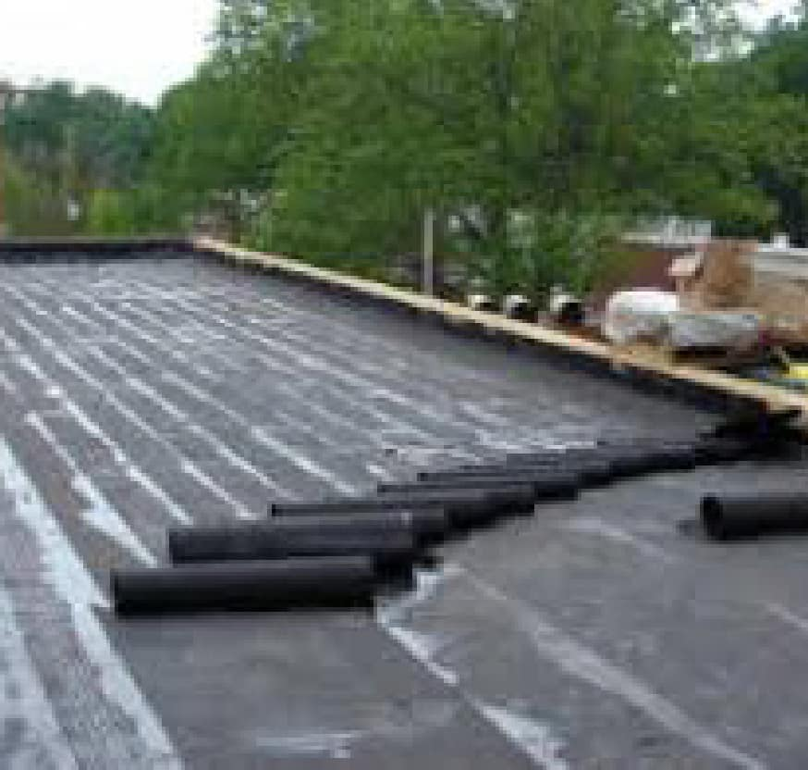
Standing System
EPDM (Rubber)
TPO/PVC (Plastic)
ROOFING SYSTEMS
KEEGAN TUNE
Ballasted
Modified Bitumen
Built Up

Slide 8
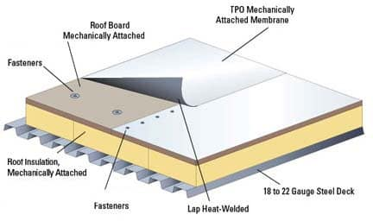
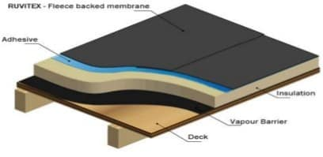
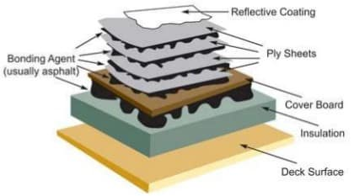
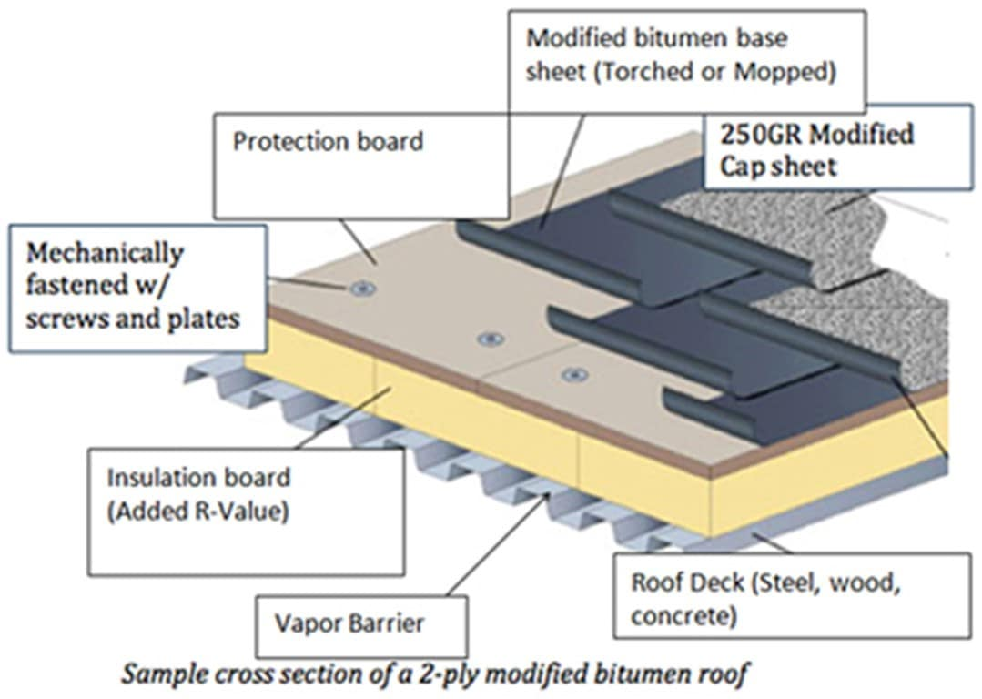
ROOF
ASSEMBLIES
KEEGAN TUNE
Standing Seam
Single Ply; Fully Adhered
Built Up
Modified Bitumen

Slide 9
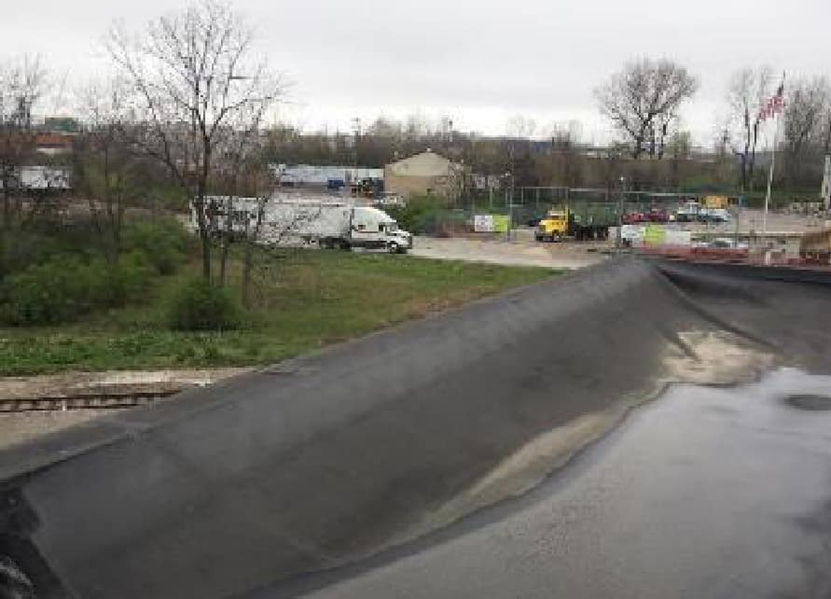
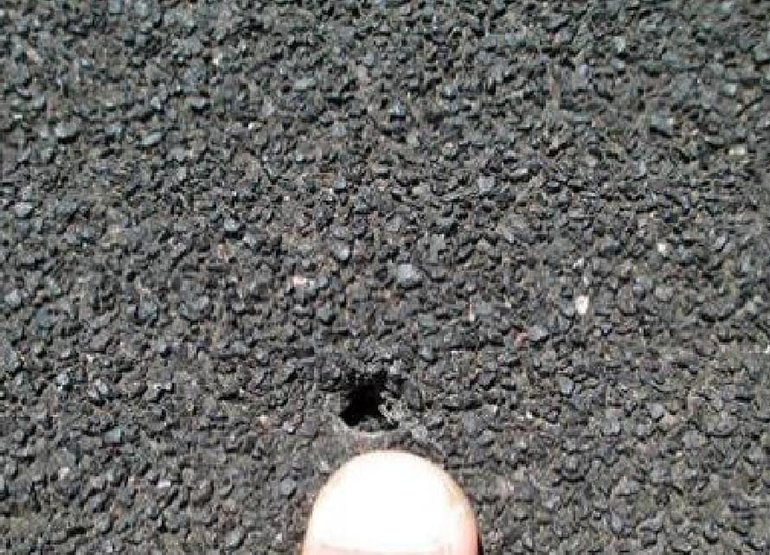
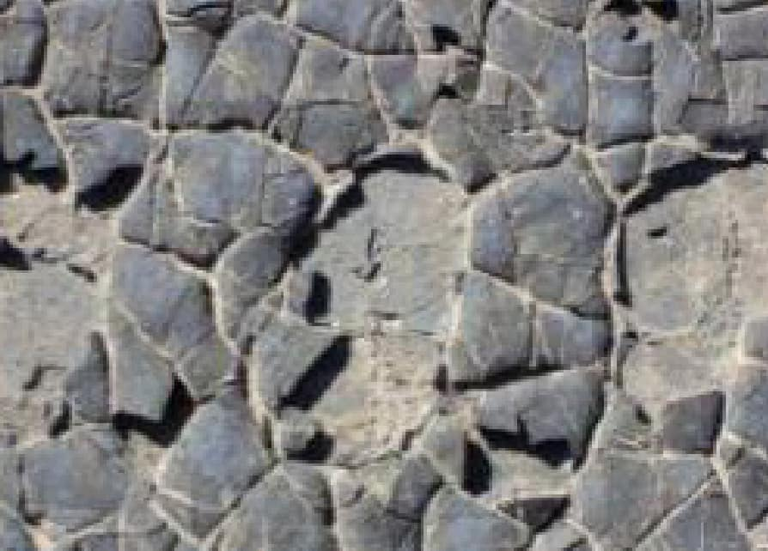
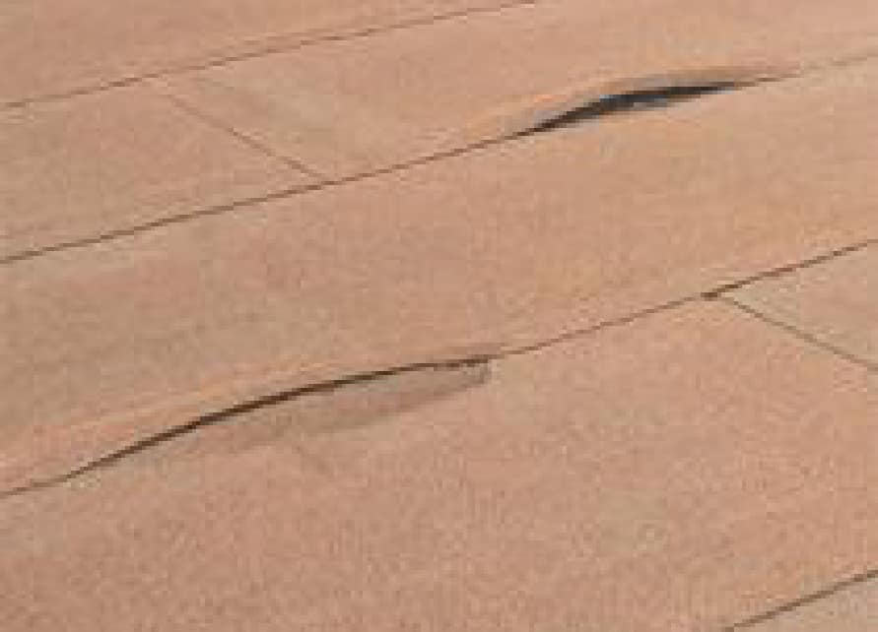
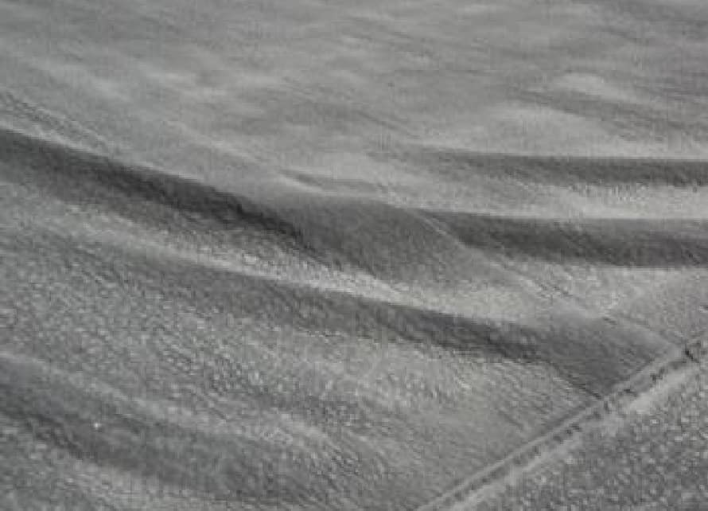
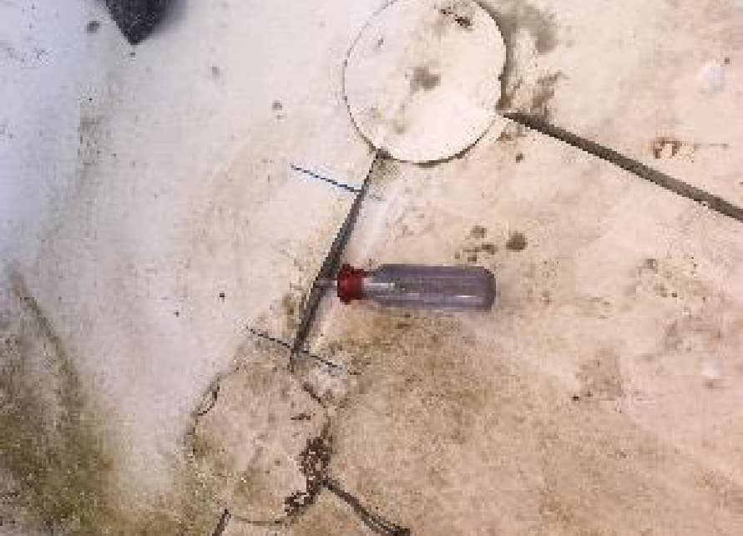
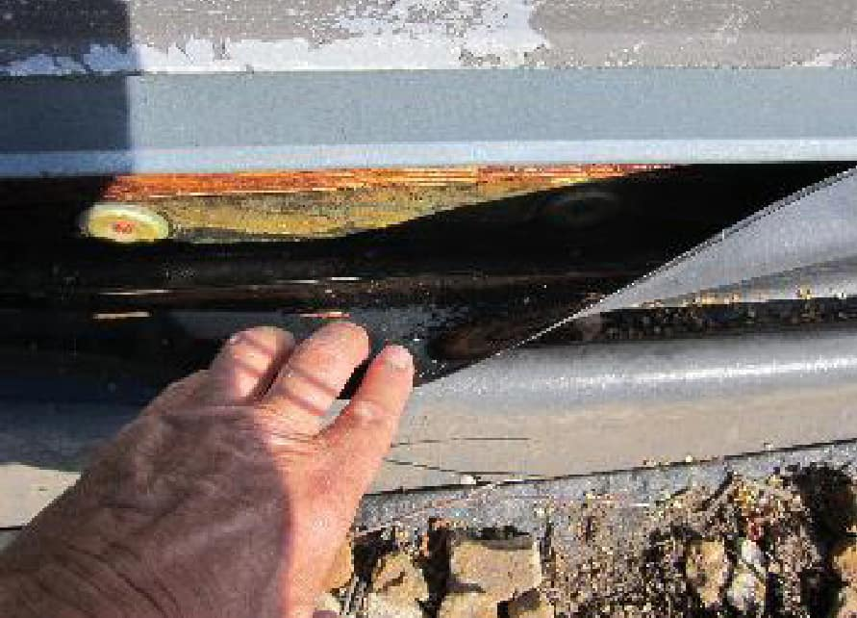
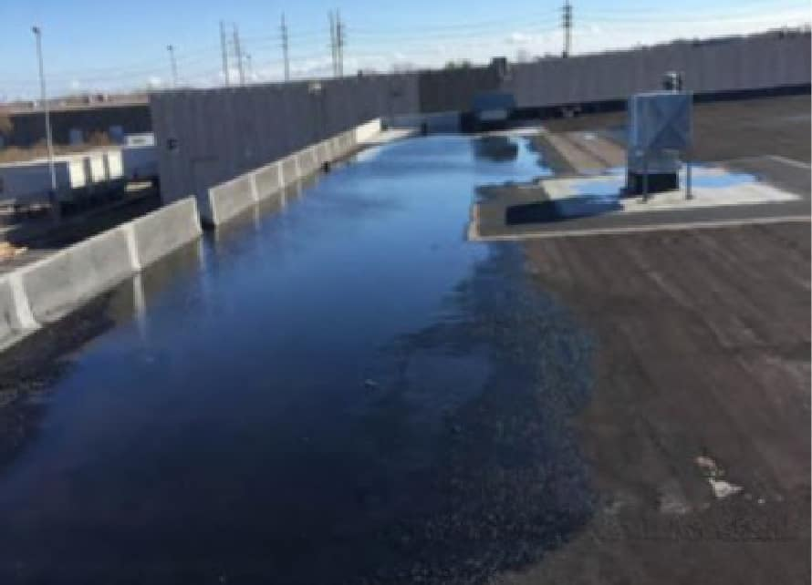
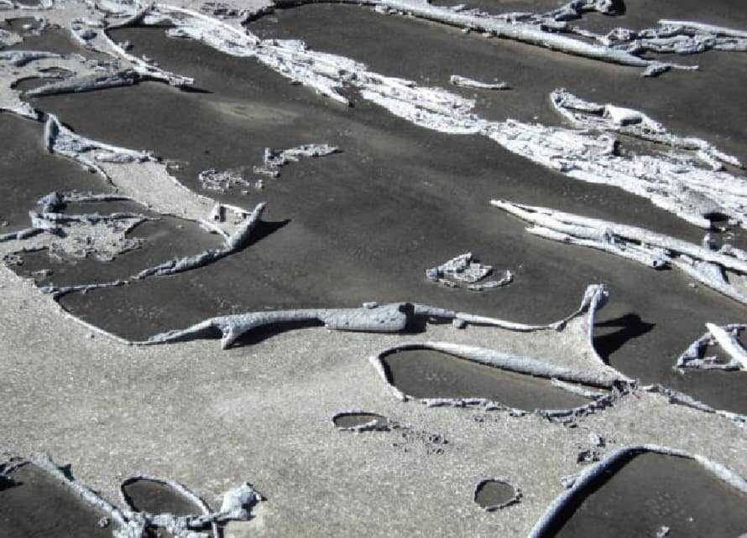
ISSUES TO LOOK FOR
Tenting
Holes
Alligatoring
Blistering
Wrinkling
Split Seams
KEEGAN TUNE
Failed Flashings
Ponding Water
Failed Coatings

Slide 10
FACTORS INCLUDE:
LIFE SPAN OF A ROOFING
SYSTEM
APPROXIMATELY 20 YEARS
MILLS/THICKNESS
MANUFACTURER LOCATION
FOOT TRAFFIC MAINTENANCE
PLUS MANY OTHERS

Slide 11

5-10 Years
Urethane Sealant Replacement Wall Coatings
10-15 Years
Failed Corner Bead Due to Water
GENERAL ROOF
REPAIR TIMELINE
KEEGAN TUNE
Intrusion
Crack-Spall Repair
Lathe Replacement and Patching
Flashing
Vapor Barrier

Slide 12
BUDGETING TIPS
ANNUAL MAINTENANCE DOLLARS
Increase by 2-5%
Annual Inspection

Slide 13
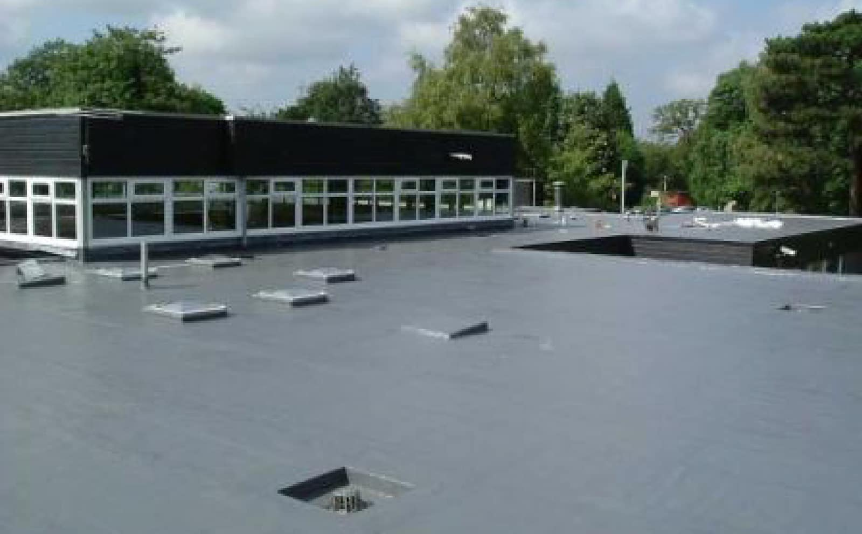
LIQUID APPLIED
MEMBRANE
Restoration of Existing Roof
Increases Useful Life
Good For Roofs With Extensive Penetrations
Eco-Friendly
Not Considered a Roof Layer
KEEGAN TUNE

Slide 14
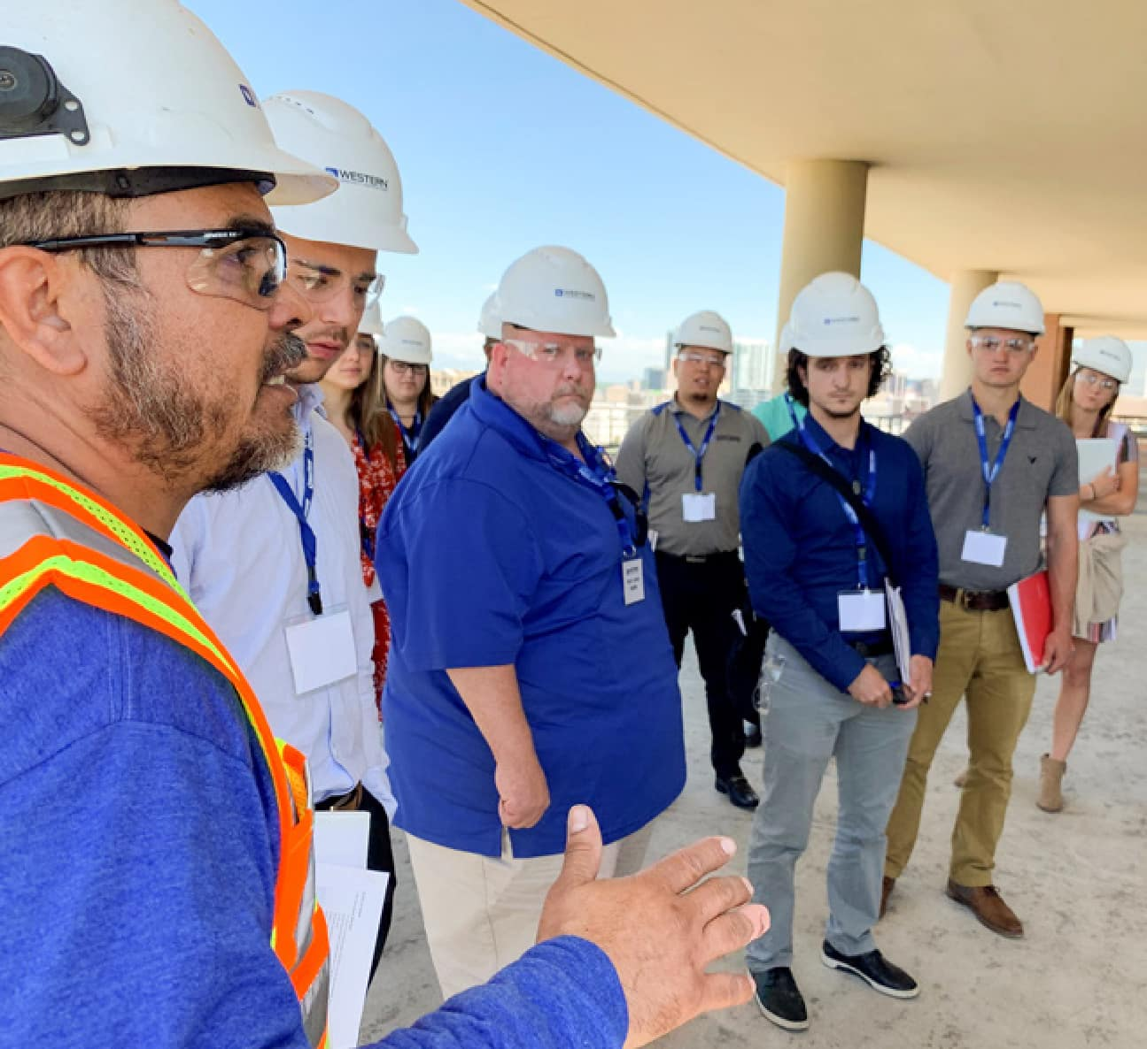
TYPES OF
COMMERCIAL BUILDING
CONSTRUCTION

Slide 15
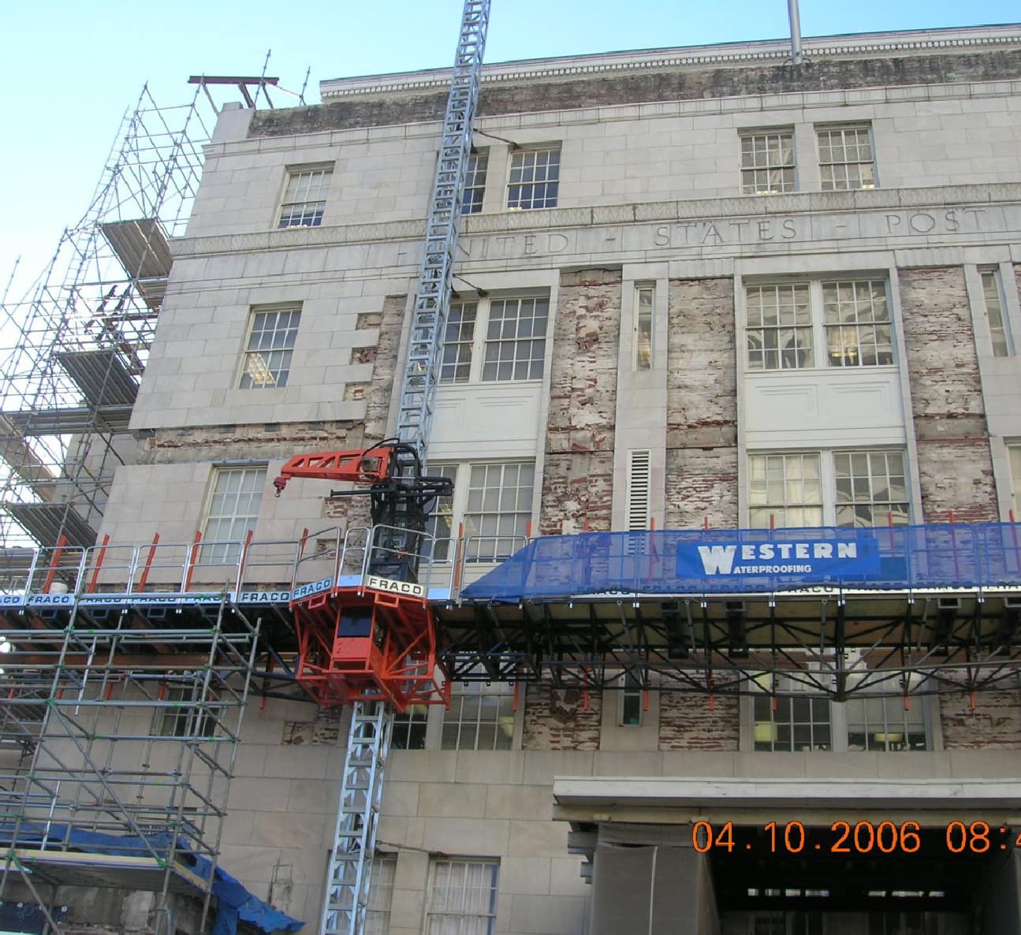
FULL MASONRY
/LOAD BEARING

Slide 16
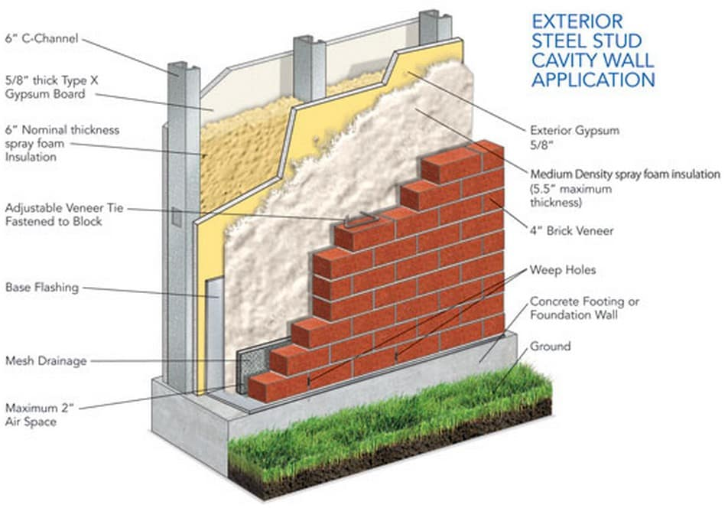
VENEER WALL
SYSTEM

Slide 17
5-10 Years
Building, Cleaning and Sealing Urethane Sealant Replacement
15-20 Years
Silicone Sealant Replacement
20-25 Years
Tuckpointing Masonry Masonry Restoration
Structural—Steel and Pinning
Flashing Systems—Lintels and Shelf Angles
MASONRY REPAIR TIMELINE
KEEGAN TUNE

Slide 18
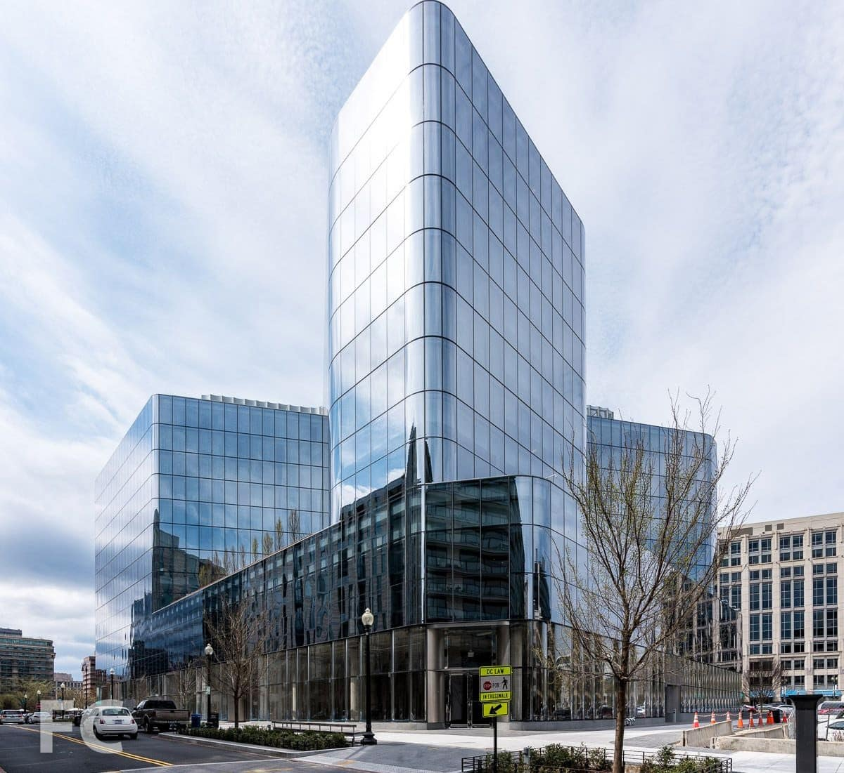
CURTAIN WALL

Slide 19
5-10 Years
Urethane Sealant Replacement
15-20 Years
CURTAIN WALL
REPAIR TIMELINE
KEEGAN TUNE
Silicone Sealant Replacement
Wet Seal/Wet Glaze

Slide 20
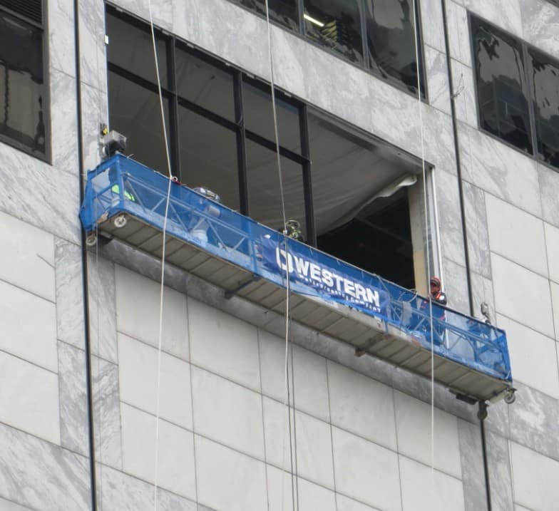
PRECAST
CONCRETE

Slide 21
5-10 Years
Building Cleaning and Sealing Urethane Sealant Replacement
15-20 Years
Silicone Sealant Replacement
PRE-CAST REPAIR TIMELINE
KEEGAN TUNE
20-25 Years
Structural—Steel and Pinning
Support Steel Replacement

Slide 22
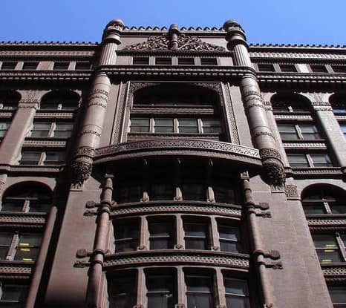
TERRA COTTA

Slide 23
5 Years
Building Cleaning and Sealing
10-20 Years
Sealants
TERRA COTTA
REPAIR TIMELINE
KEEGAN TUNE
20-25 Years
Structural
Pinning
Replicas—FRP and GFRC

Slide 24
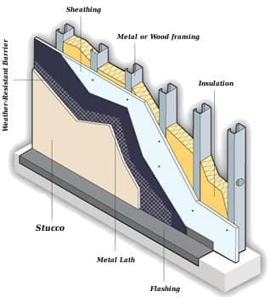
STUCCO

Slide 25
5-10 Years
Urethane Sealant Replacement Wall Coatings
10-15 Years
Failed Corner Bead Due To Water Intrusion
STUCCO REPAIR TIMELINE
KEEGAN TUNE
Crack-Spall Repair
Lathe Replacement and Patching
Flashing
Vapor Barrier

Slide 26
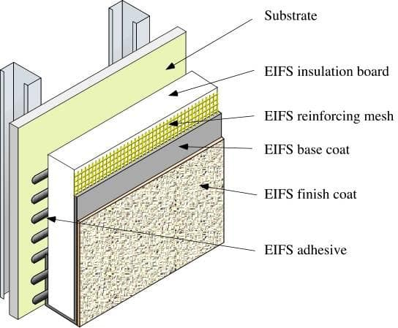
EIFS

Slide 27
5-10 Years
Urethane Sealant Replacement Wall Coatings
Punctured and Damaged EIFS Finish
10-15 Years
EIFS REPAIR TIMELINE
KEEGAN TUNE
Repair of Insulating Material and
EIFS Mesh
Finish Coat Replacement and
Patching
Flashing

Slide 28

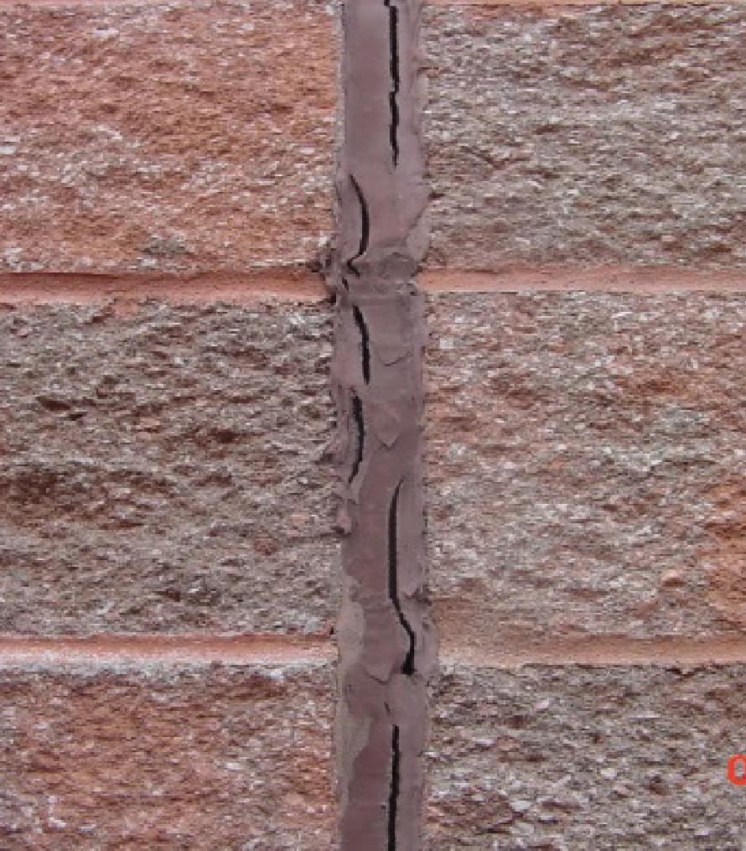
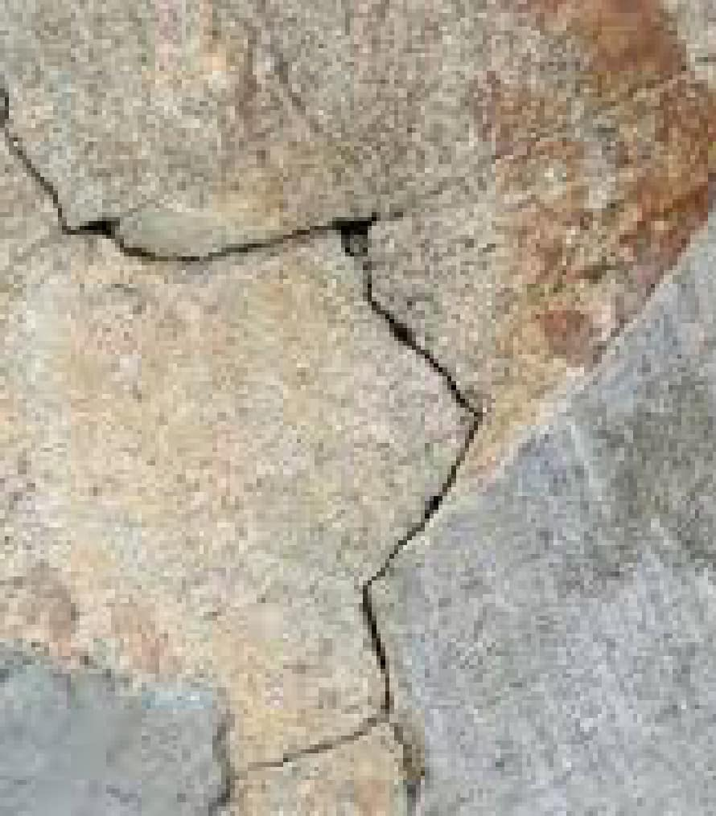
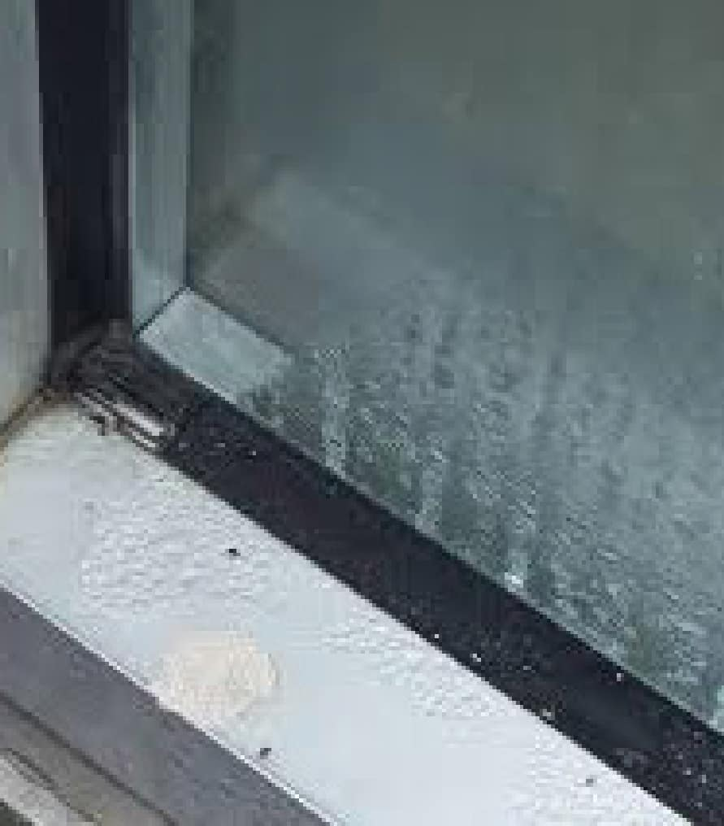
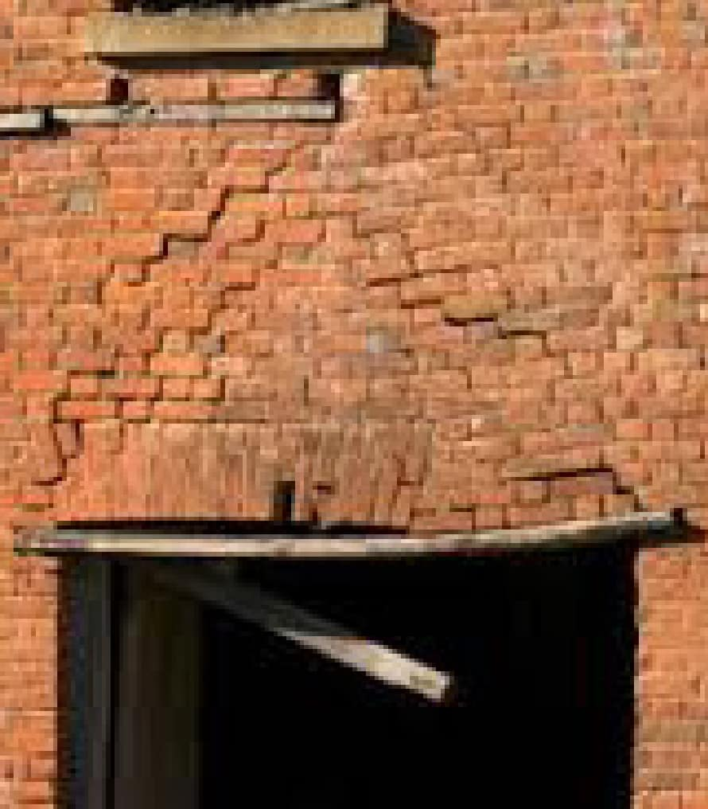
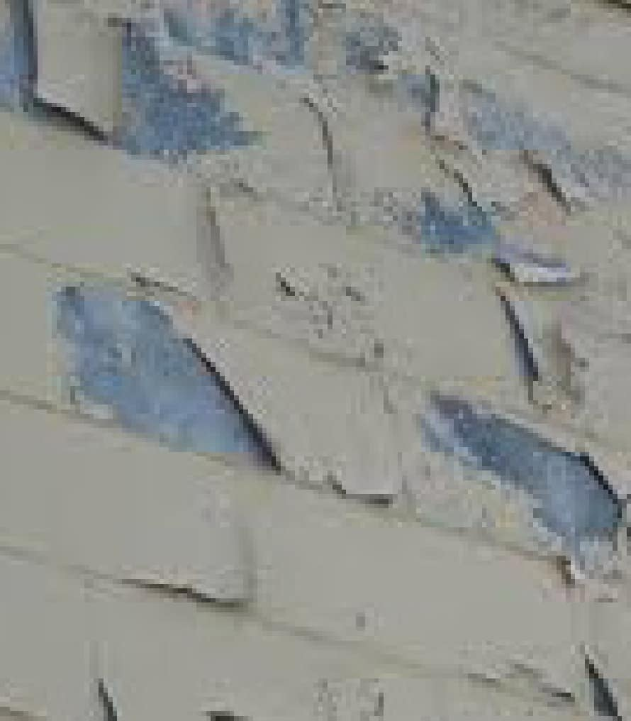

ISSUES TO LOOK FOR
Efflorescence
Sealant Failures
Cracking/Delamination/Rust
KEEGAN TUNE
Window Leaks
Window Lintels/Sills/Mullions
Delaminated Coating

Slide 29
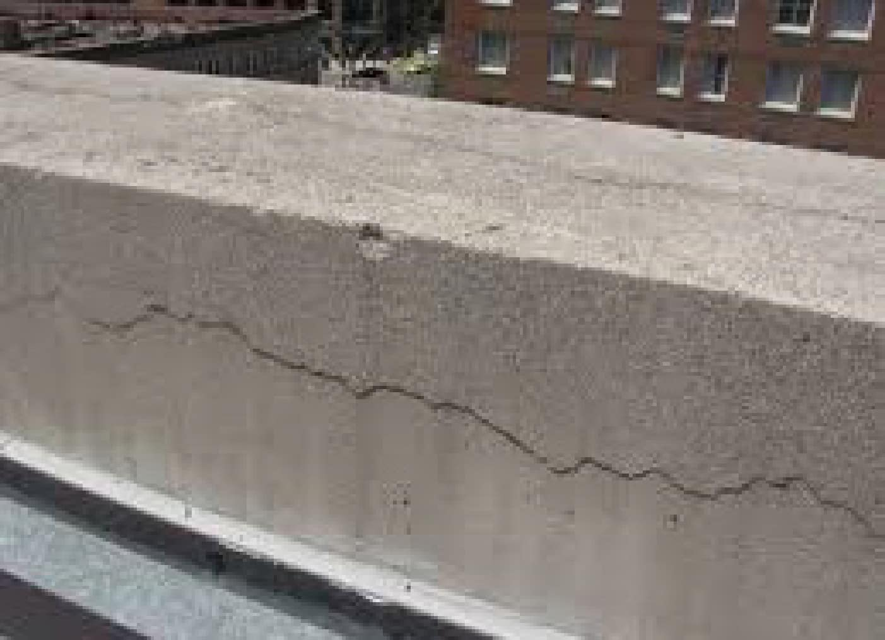
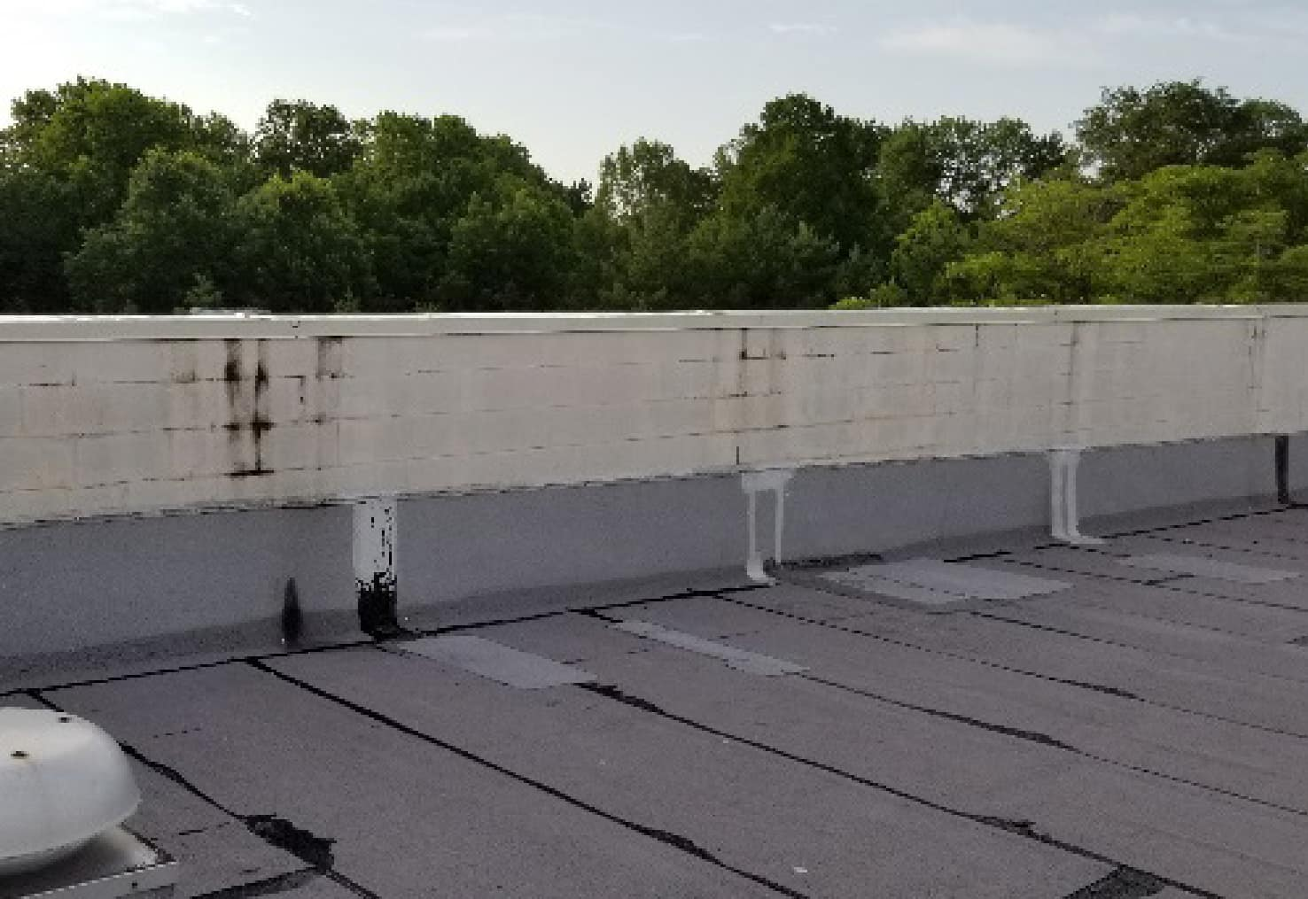
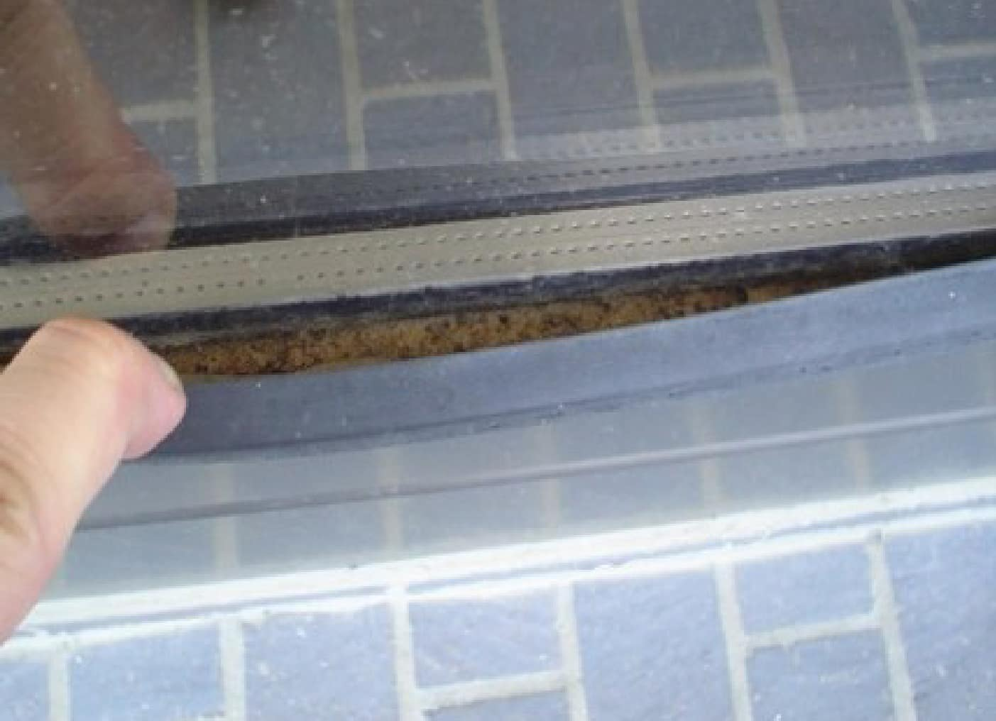
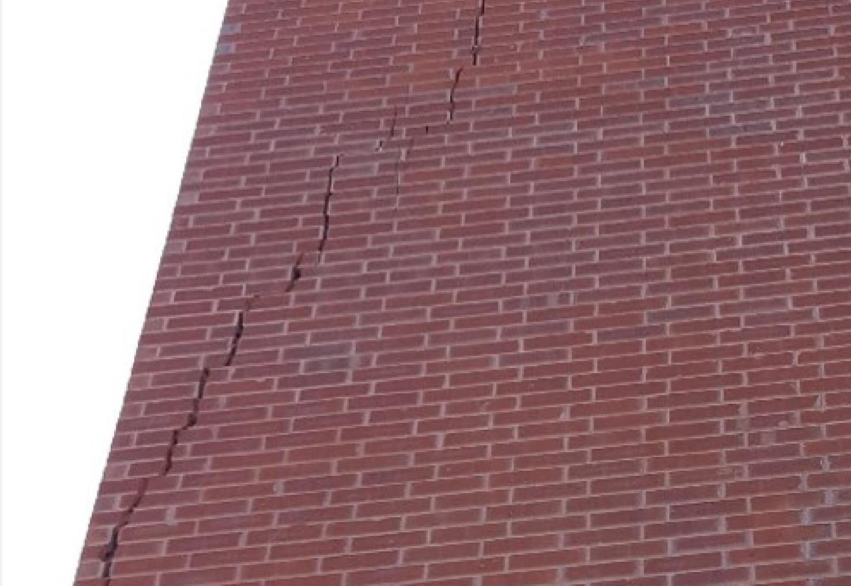
ISSUES TO LOOK FOR
Parapet Wall and Caps
Roof Flashing
KEEGAN TUNE
Window Gaskets/Sealant
Cracking

Slide 30

TANYA SHEPHERD
BUDGETING TIPS

Slide 31
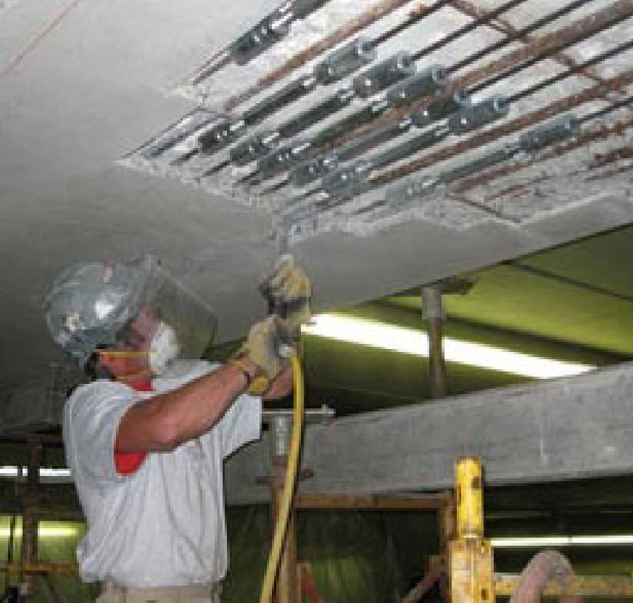
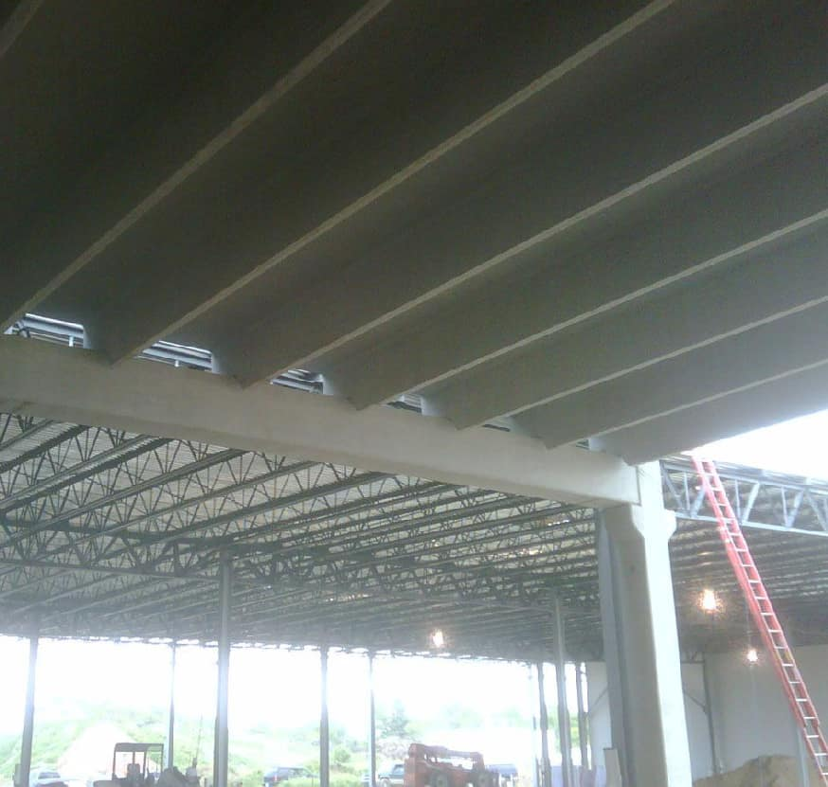
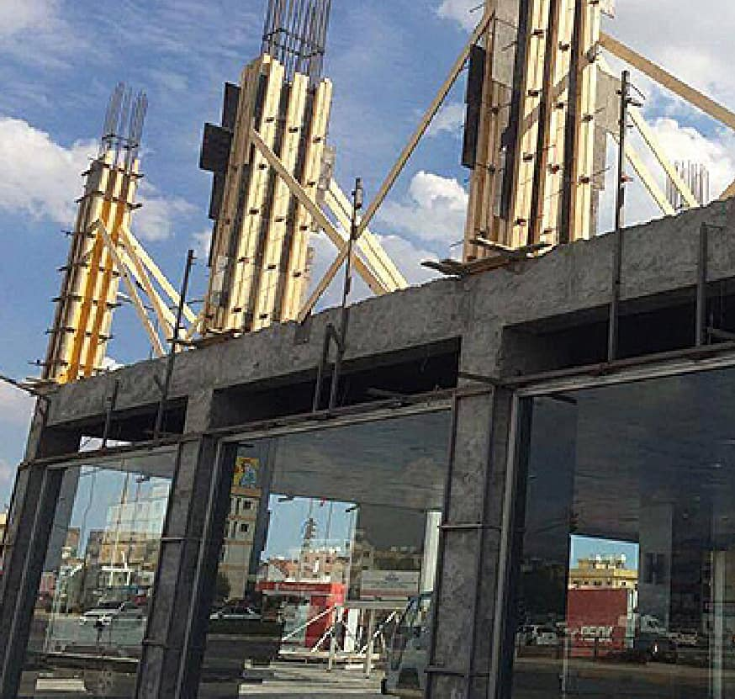
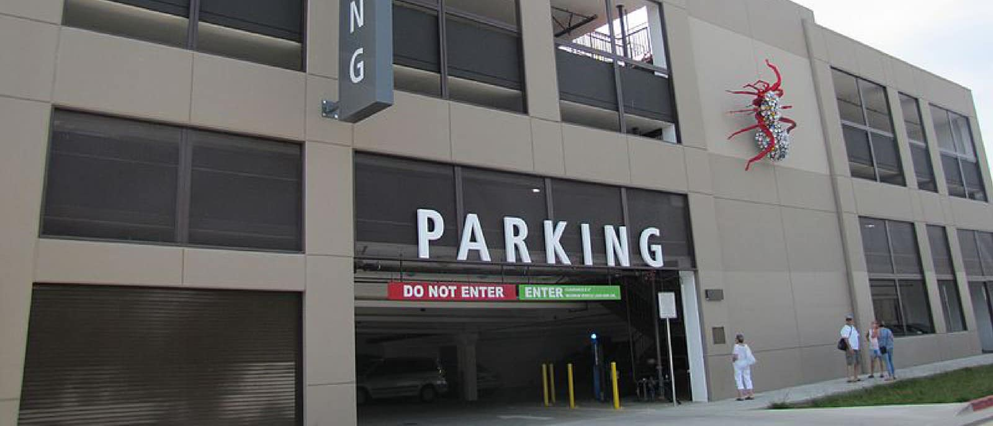
Post-Tension
Double Tee
Cast-in-Place Concrete
COMMON TYPES OF PARKING
STRUCTURES
KEEGAN TUNE

Slide 32
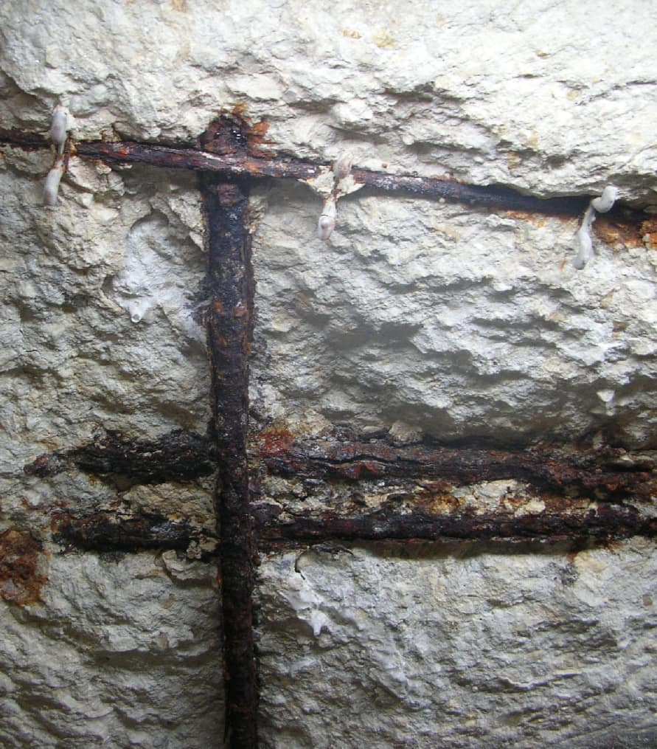
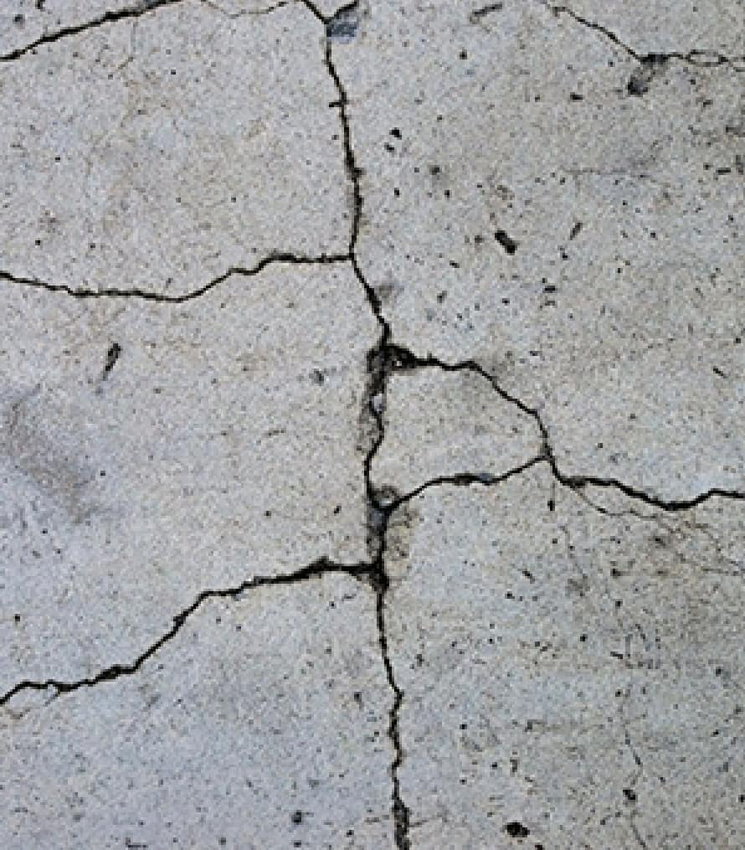




ISSUES TO LOOK FOR
Corrosion
Cracking
Cracking/Delamination/Rust
KEEGAN TUNE
Scaling
Leaching
Delaminated Coating

Slide 33

ISSUES TO LOOK FOR
Expansion Joint
Caulk Joint
?
KEEGAN TUNE
?
?
?

Slide 34

TANYA SHEPHERD
DECK
COATING
Why
To Protect Concrete, Particularly After Repairs
Application
New Concrete Areas
Repair and Maintenance of Existing Coatings

Slide 35


BEFORE
AFTER

Slide 36
5-10 Years
Need info
PARKING GARAGE REPAIR TIMELINE
KEEGAN TUNE
10-15 Years
Need info

Slide 37

TANYA SHEPHERD
BUDGETING OVERVIEW
Work with a reputable contractor
Utilize assessments for operating and capital budget
Include annual maintenance dollars
If full budget is not approved, partner with contractor to evaluate where to best spend money

Slide 38

TANYA SHEPHERD
PARTNER WITH WESTERN
SPECIALTY
CONTRACTORS TODAY!
Building Assessments Immediate Repairs
Short- and Long-Term Repair Plans Leak Investigation
Budget Preparation
Training and Education

