Slide 1
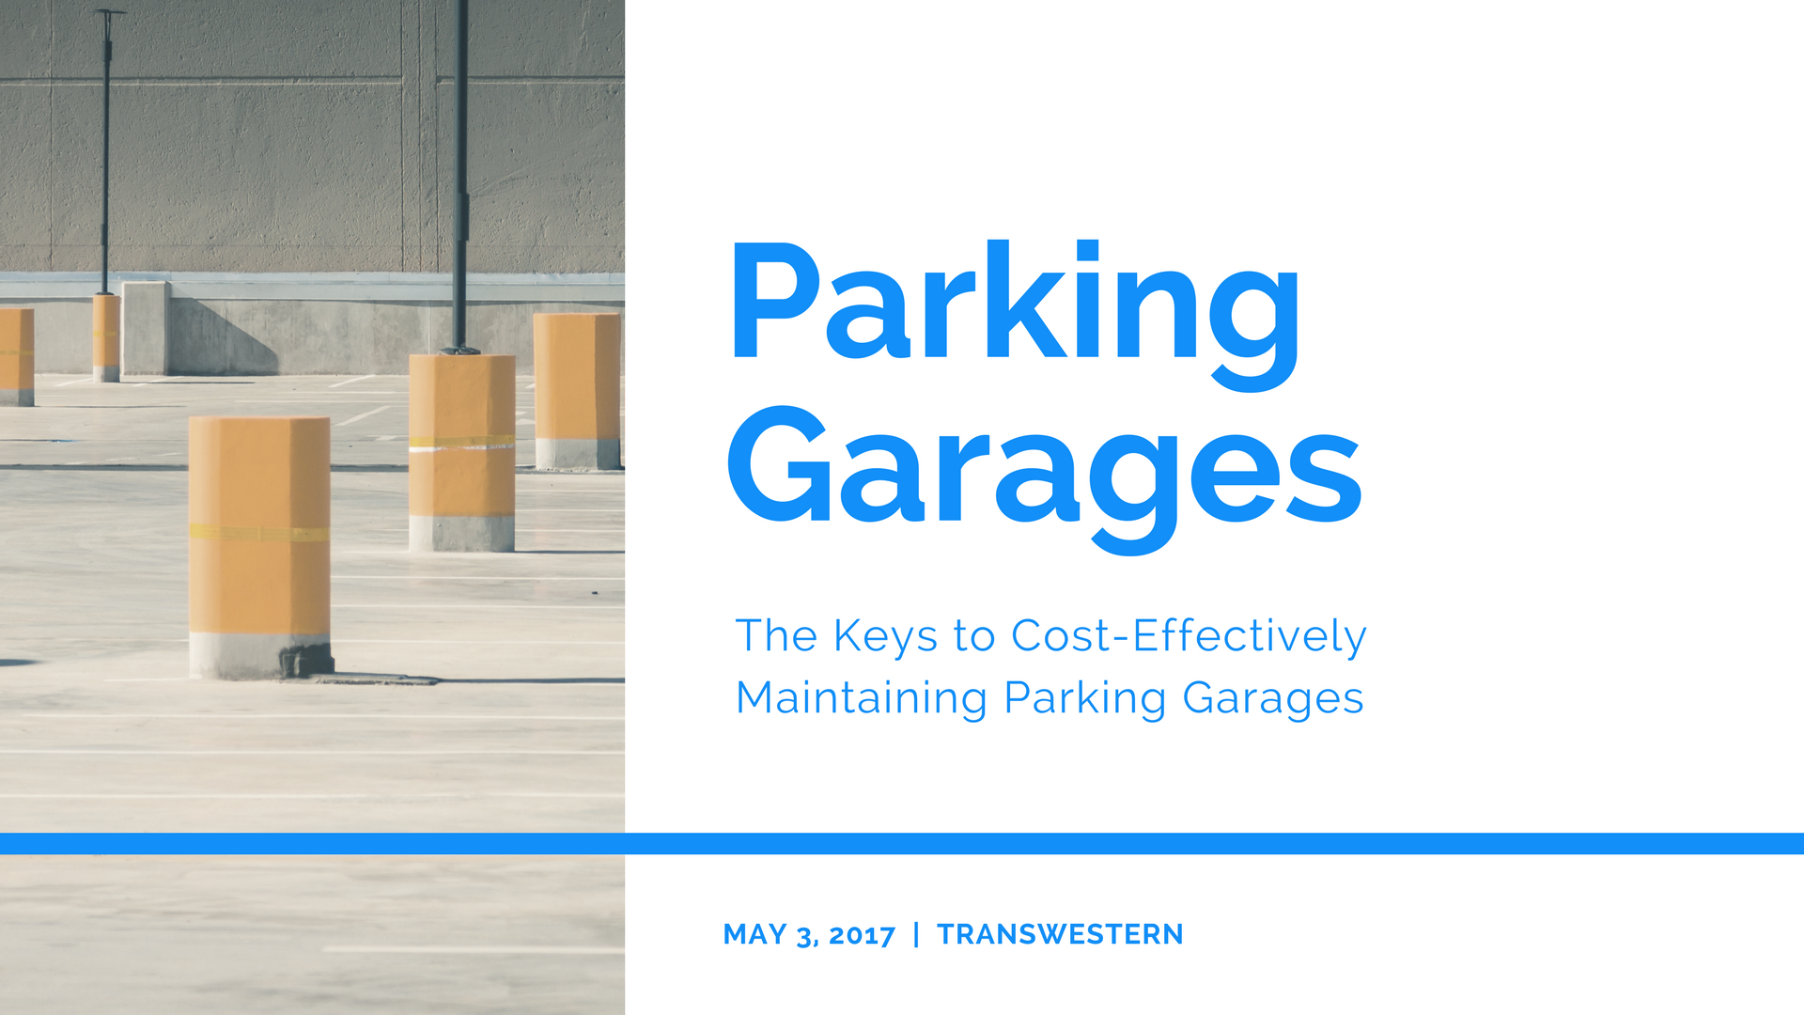
Notes:
This was a lunch and learn presentation for Transwestern. They specifically requested that we cover parking garage maintenance and how to make it more cost effective. We chose to go a slightly different route than most Western presentations. There were two main ways we were different from most Western presentations:
We did not spend a large amount of time talking about Western at the beginning.
We did not focus on explaining specific work types and how we do our work outside of the case studies. Instead we focused on providing simple, actionable tips that our audience could start implementing right away.
Essentially, the goal was to show them that we are the right contractor for their project instead of trying to tell them that we are.

Slide 2
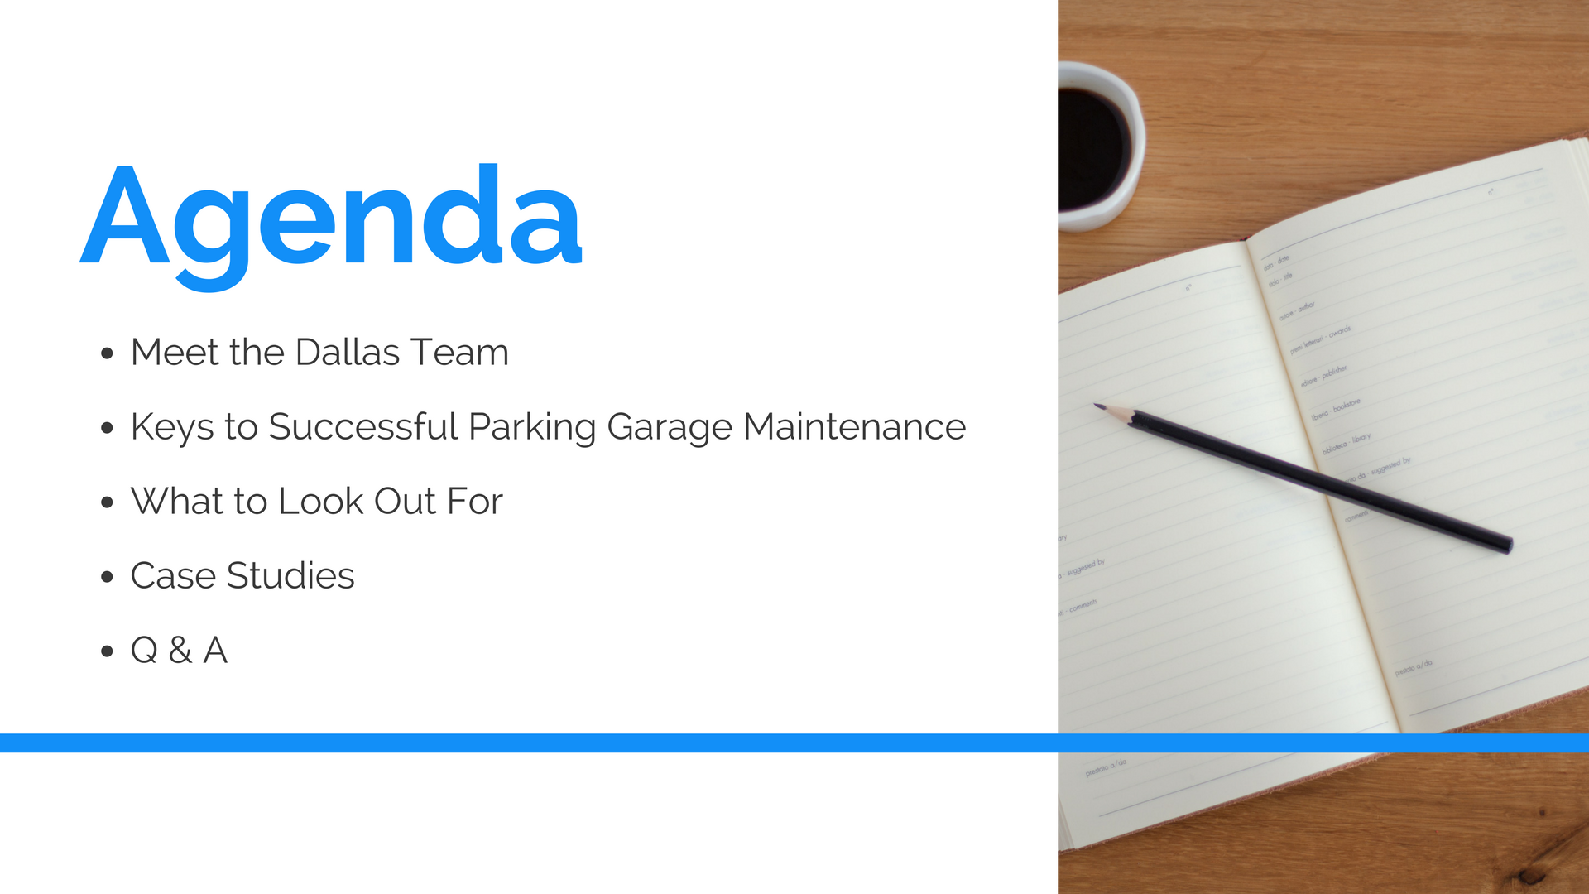

Slide 3
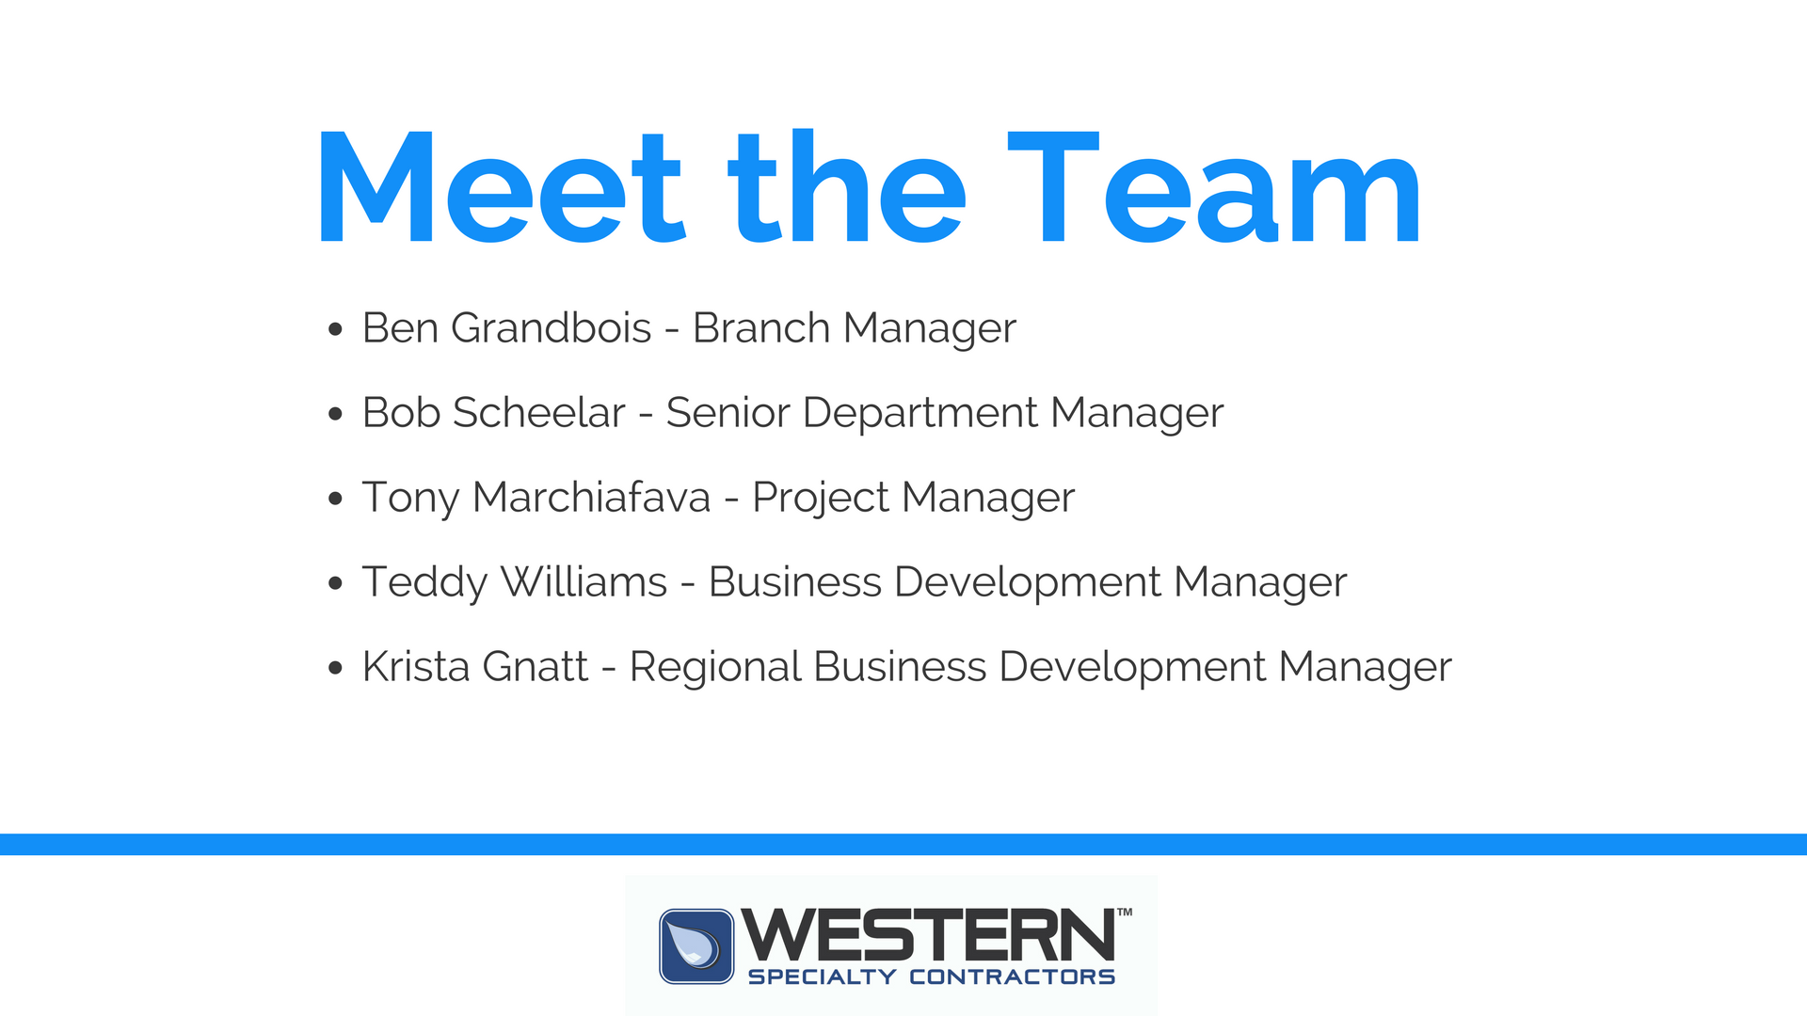

Slide 4

Notes:
This is an overview of the basic elements a Senior Chief Engineer (our audience) needs in their maintenance plan.

Slide 5

Notes:
1) Parking Garage Inspections

Slide 6
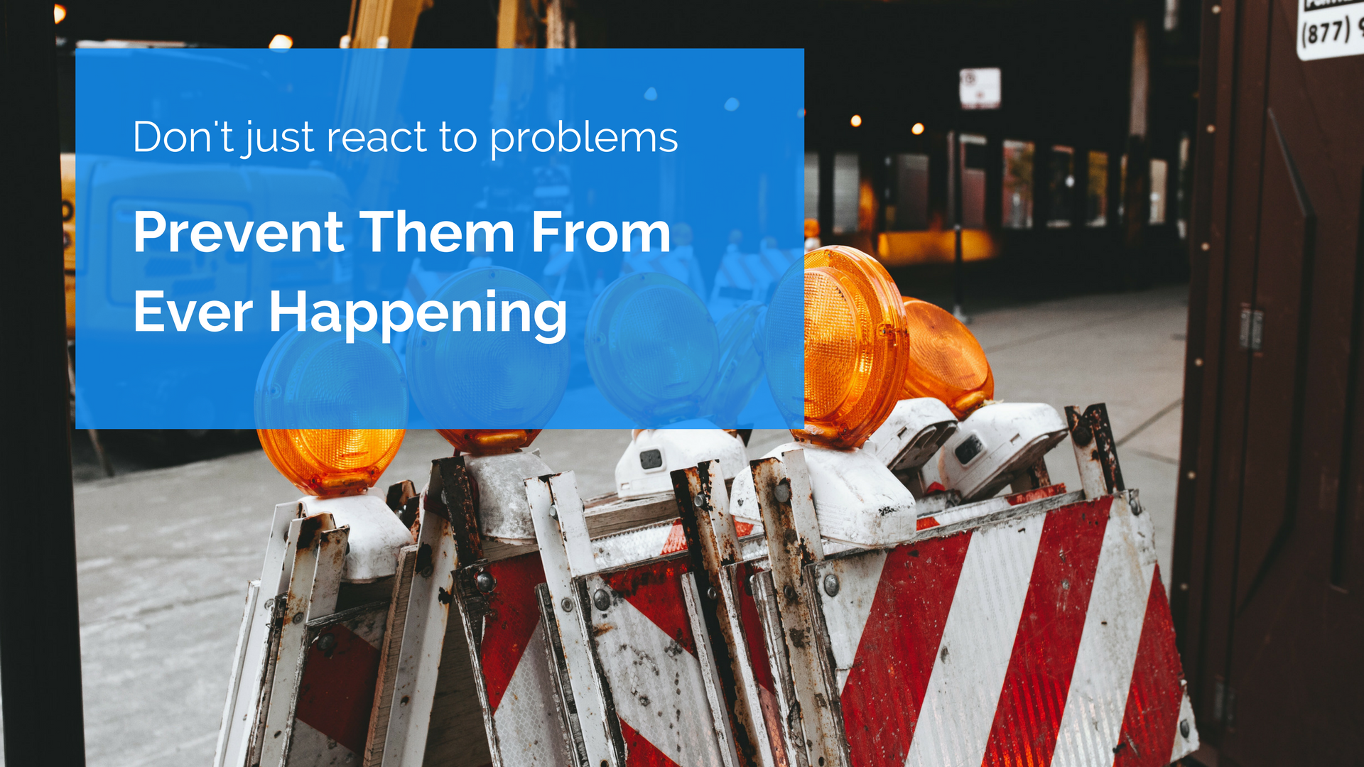
Notes:
1) Parking Garage Inspections
This slide talks about the end goal or result of implementing parking garage inspections: You stop reacting to problems, instead you prevent them from ever happening.

Slide 7
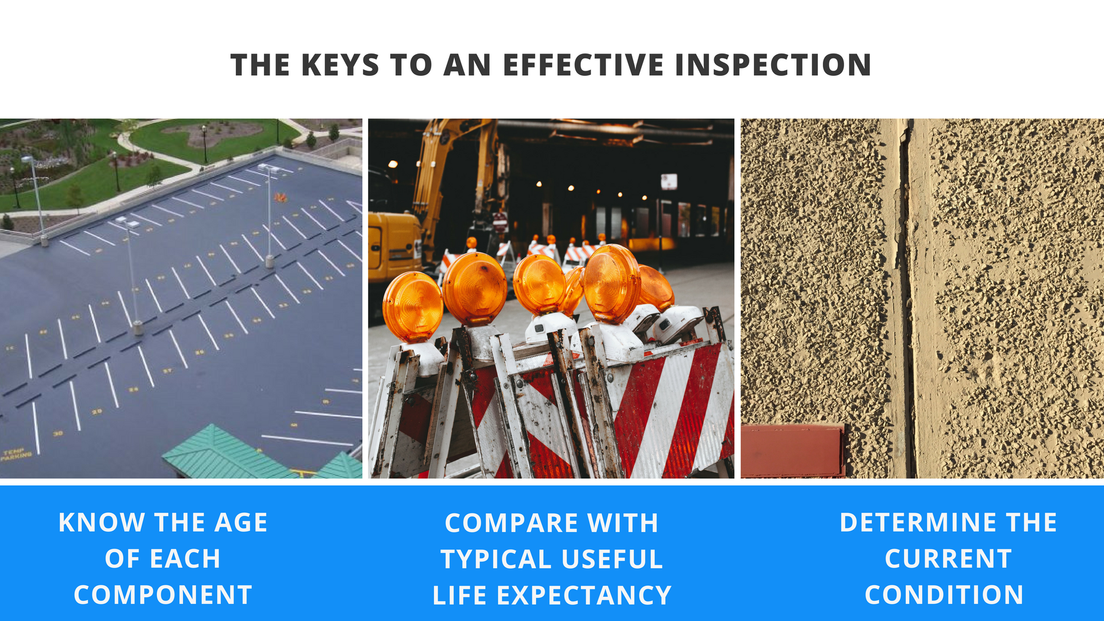
Notes:
1) Parking Garage Inspections
This slide shows three simple steps that Senior Chief Engineers can use for an effective garage inspection.
Know the general age of each component (e.g. joint sealants, deck coating, etc.) so you can …
Compare it to the typical useful life expectancy of each component. That way, you can know which components have the highest probability of needing repair. (e.g. joint sealants were installed 6 years ago, the specific type of joint sealant that was installed typically lasts 5 years … so, there’s a good chance this item needs some maintenance.
Determine the actual, current condition.

Slide 8

Notes:
1) Parking Garage Inspections
Summary slide.

Slide 9
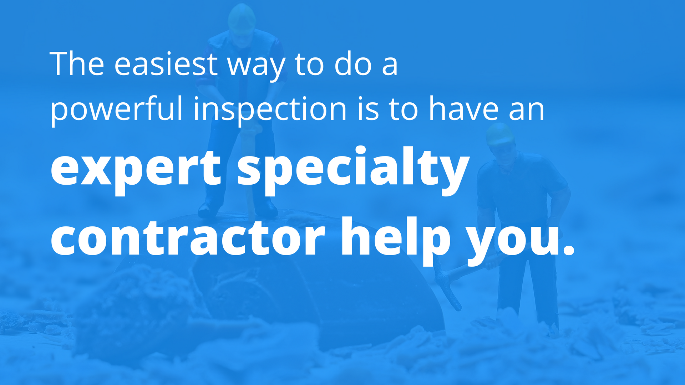
Notes:
1) Parking Garage Inspections
Bold Statement Slide
“The easiest way to do everything we just talked about is by calling Western!”

Slide 10
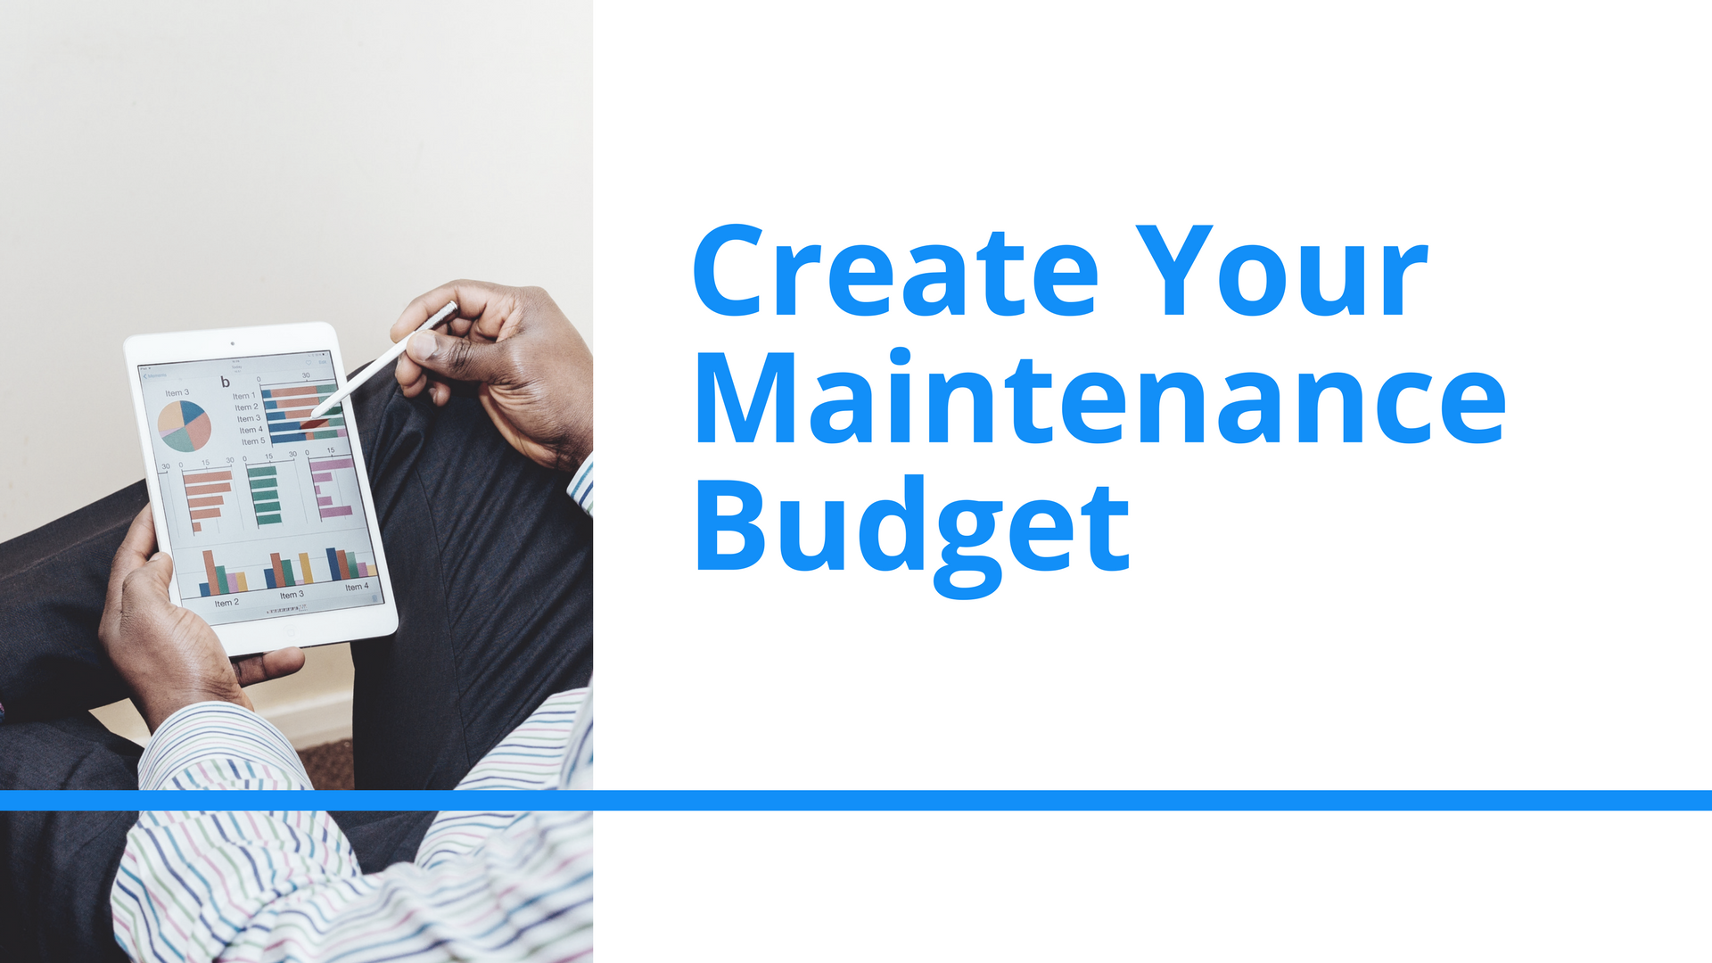
Notes:
2) Budget

Slide 11
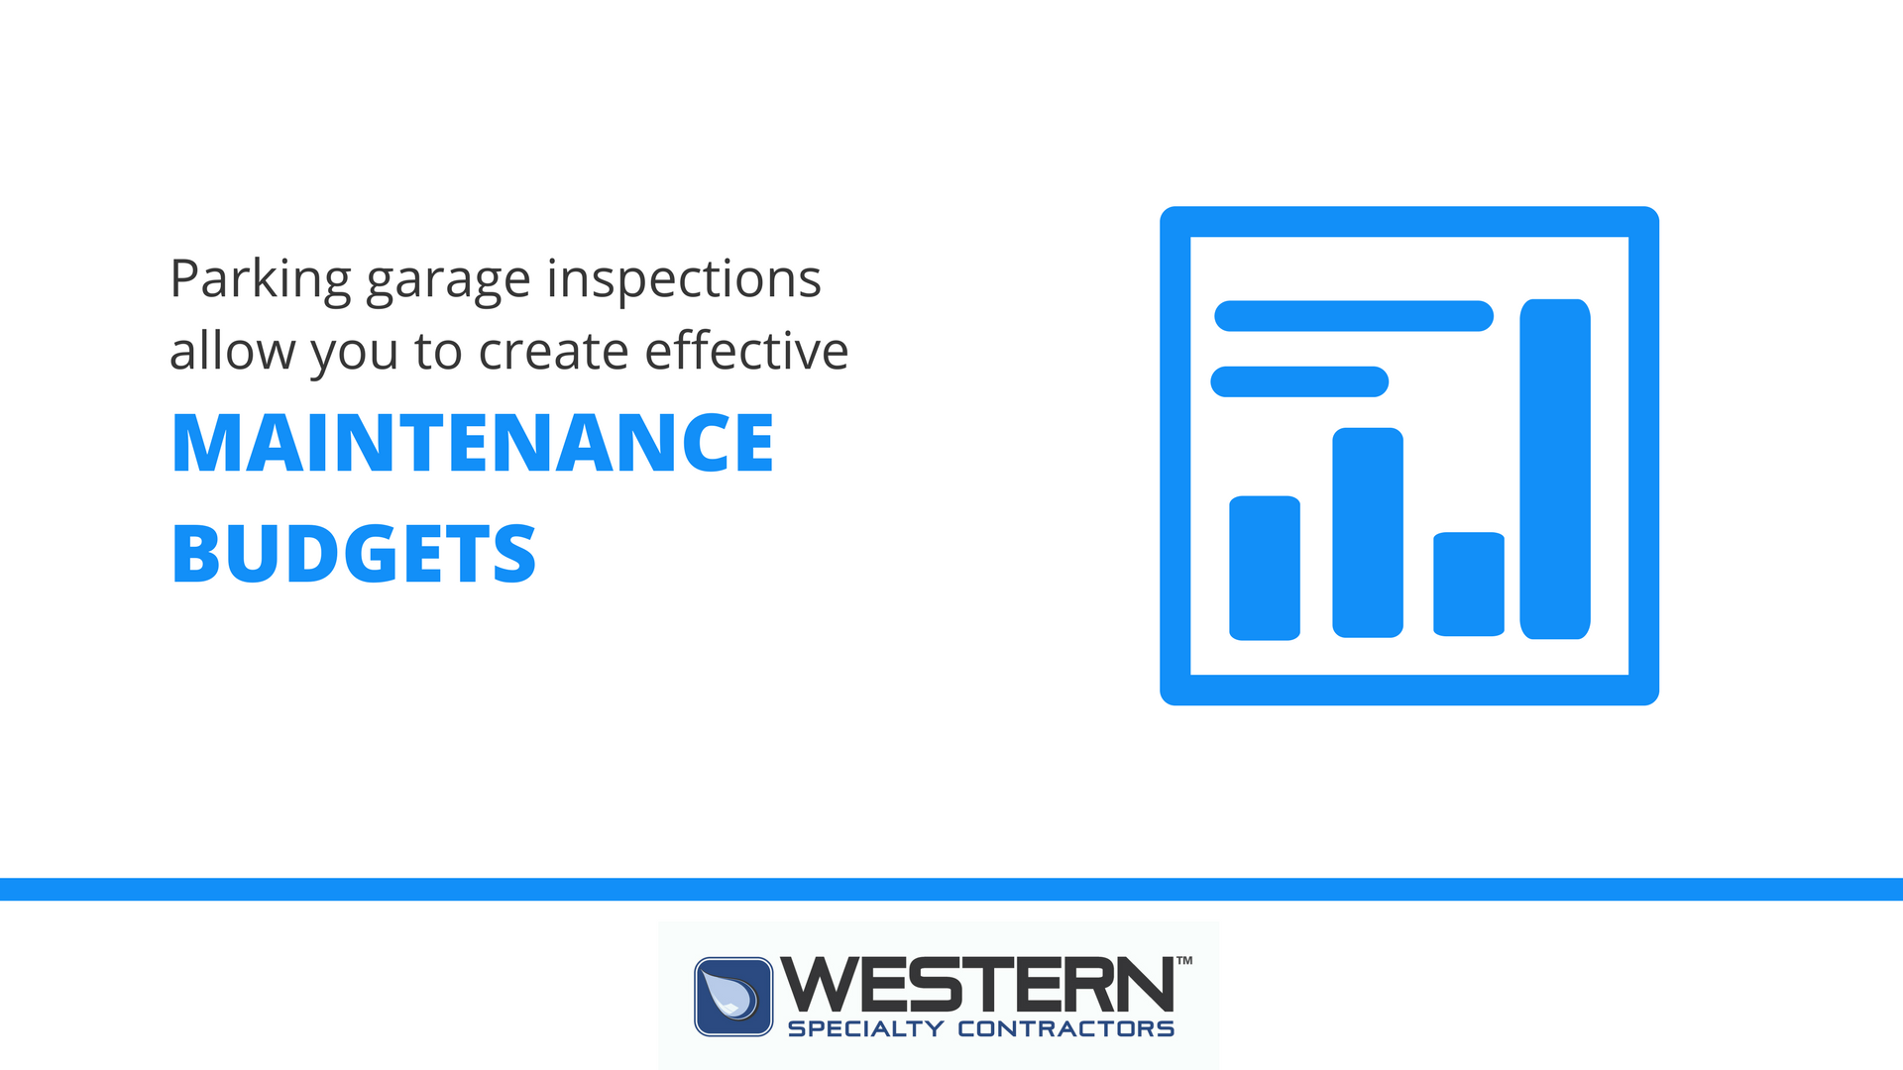
Notes:
2) Budget
This slide ties in item #1: Inspections, to #2: Budgets.
“You can’t create an accurate budget, unless you do an inspection with an expert contractor.

Slide 12
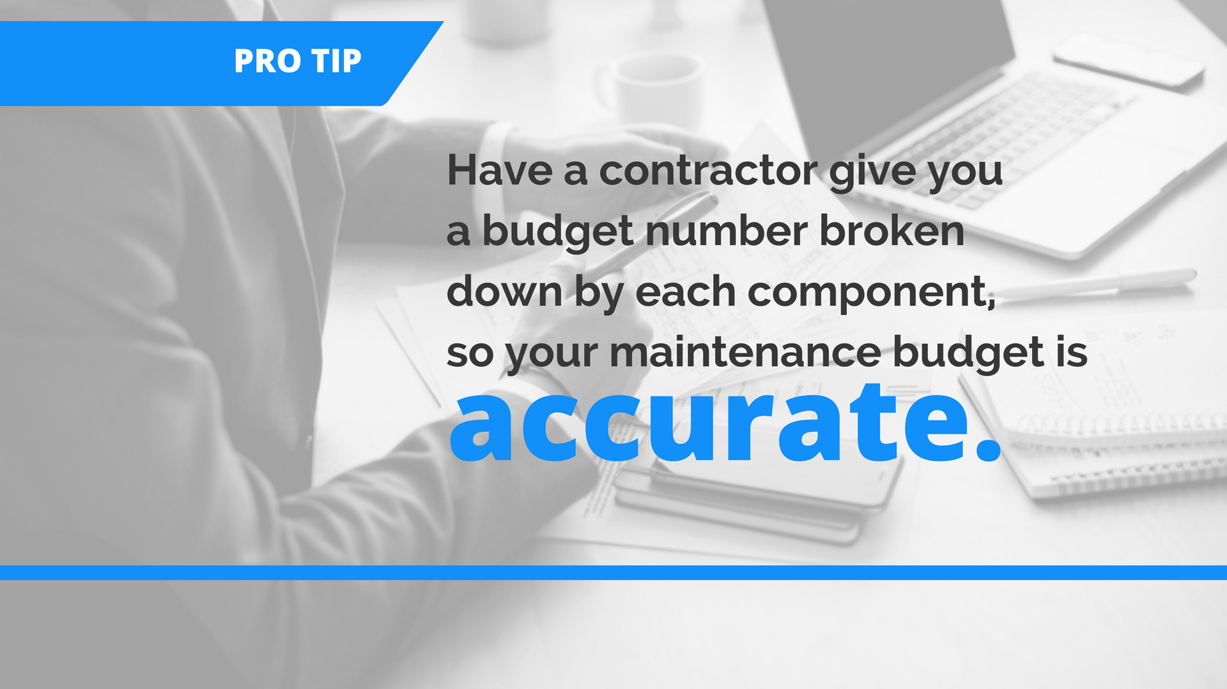
Notes:
2) Budget
This slide also puts an emphasis on involving Western in the process. Similar to slide 9.

Slide 13
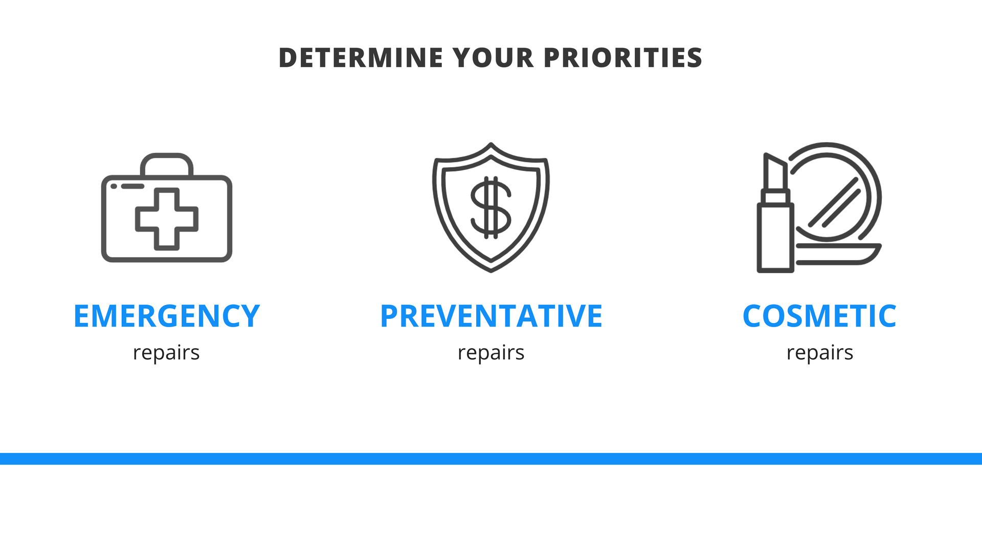
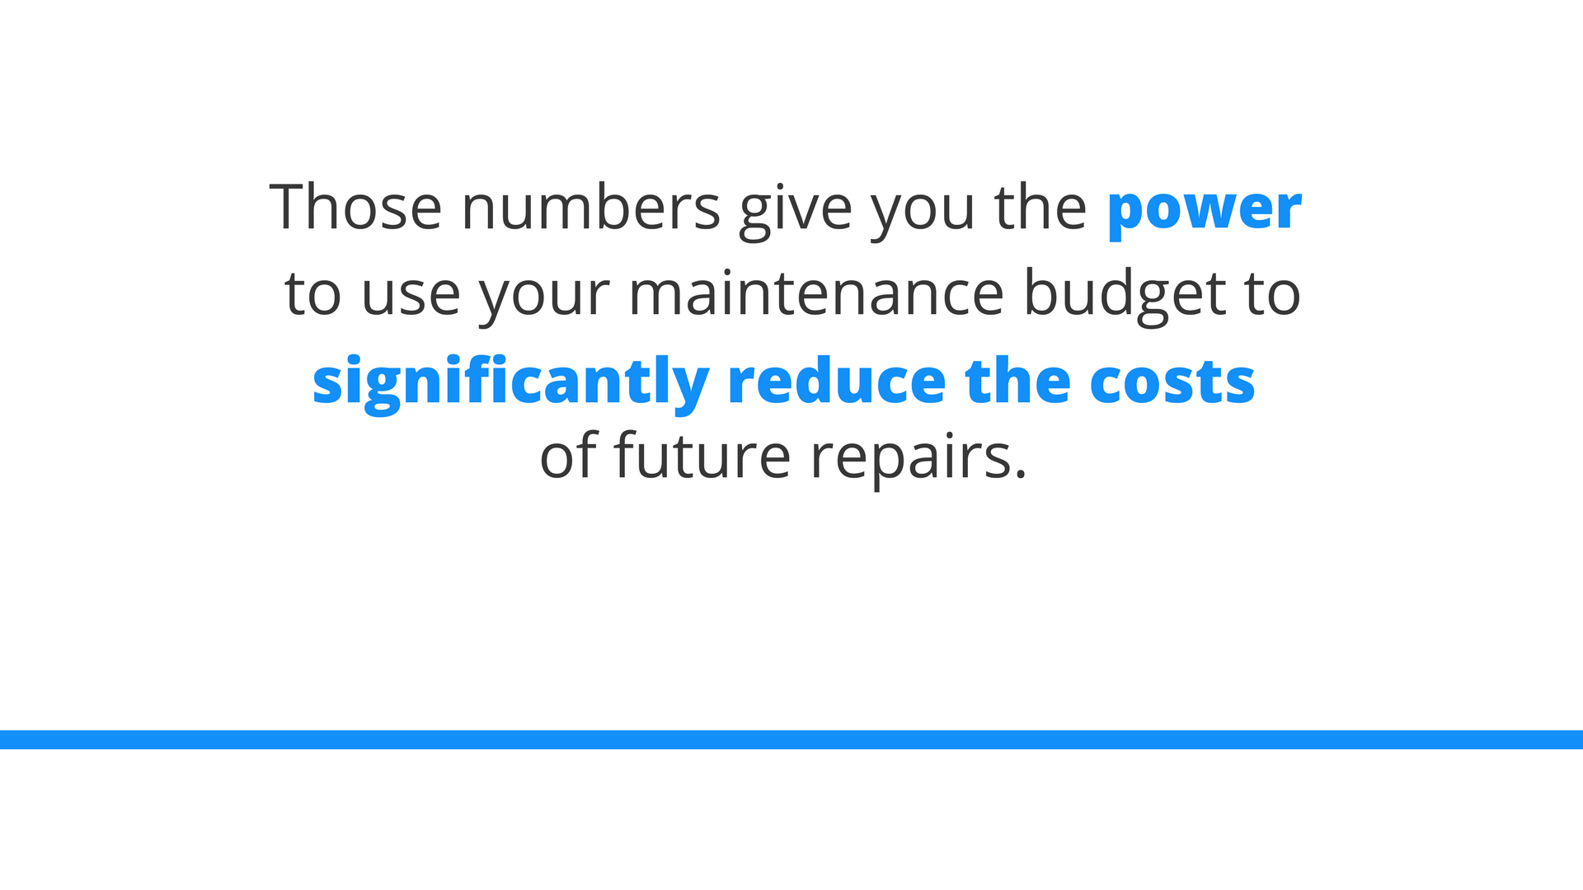
Notes:
2) Budget
Bold Statement Slide
Similar to slide #9, this is the main idea we want the audience to take away from this section.
Design note: Using different font colors to draw the audience’s attention to certain words.

Slide 14

Notes:
3) Hire the right contractor

Slide 15
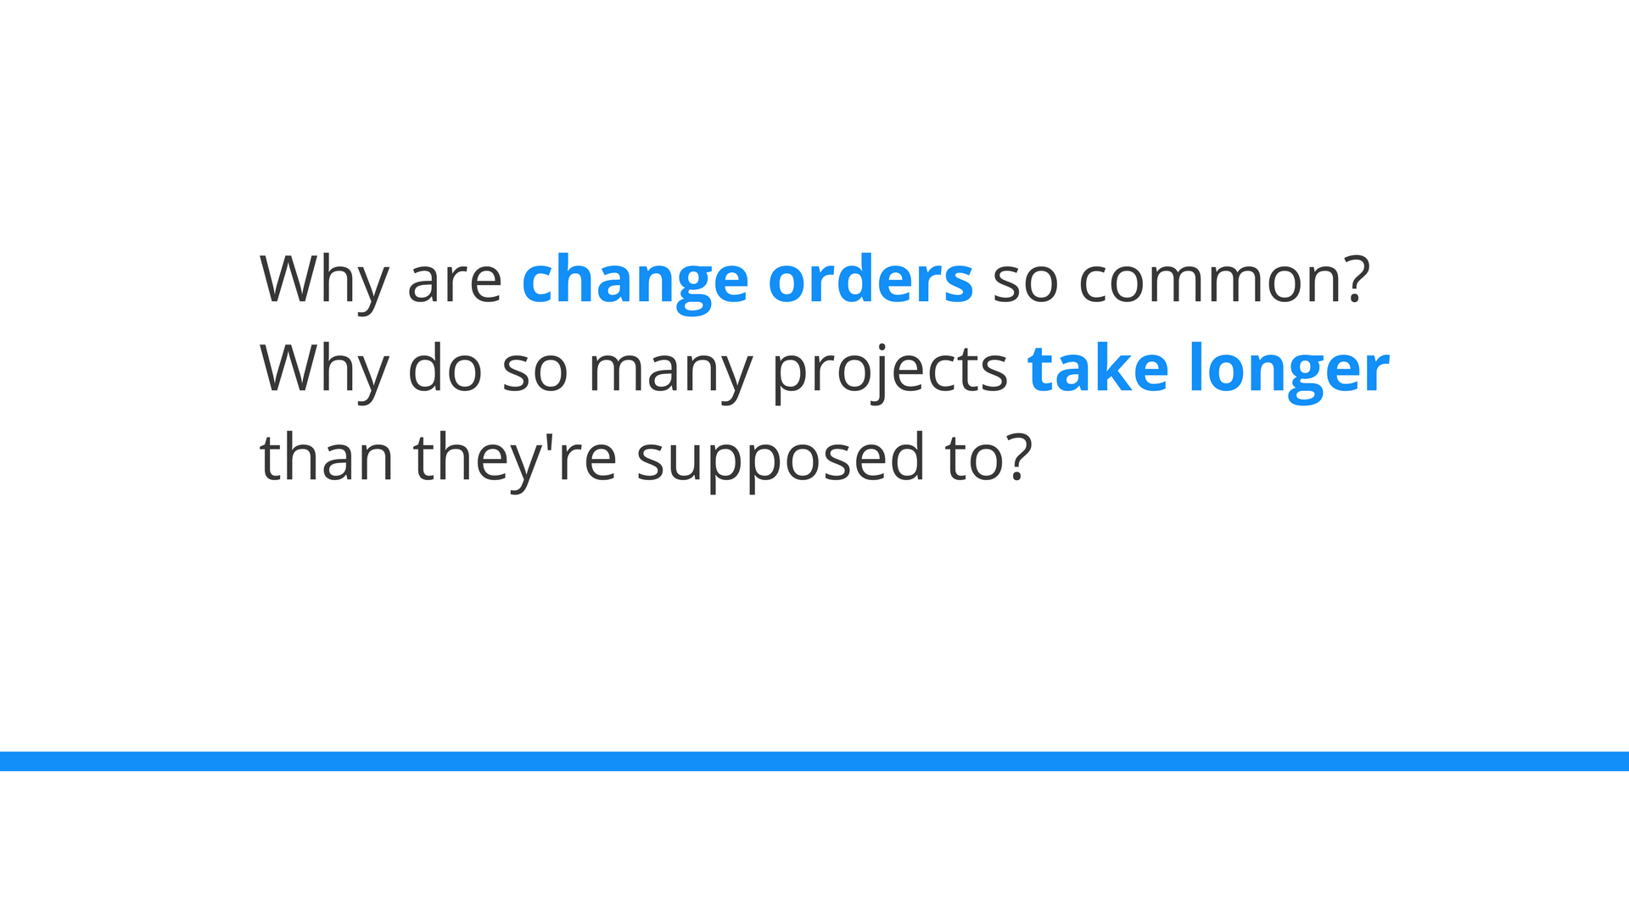
Notes:
3) Hire the right contractor
Design note: Using different font colors to draw the audience’s attention to certain words.

Slide 16
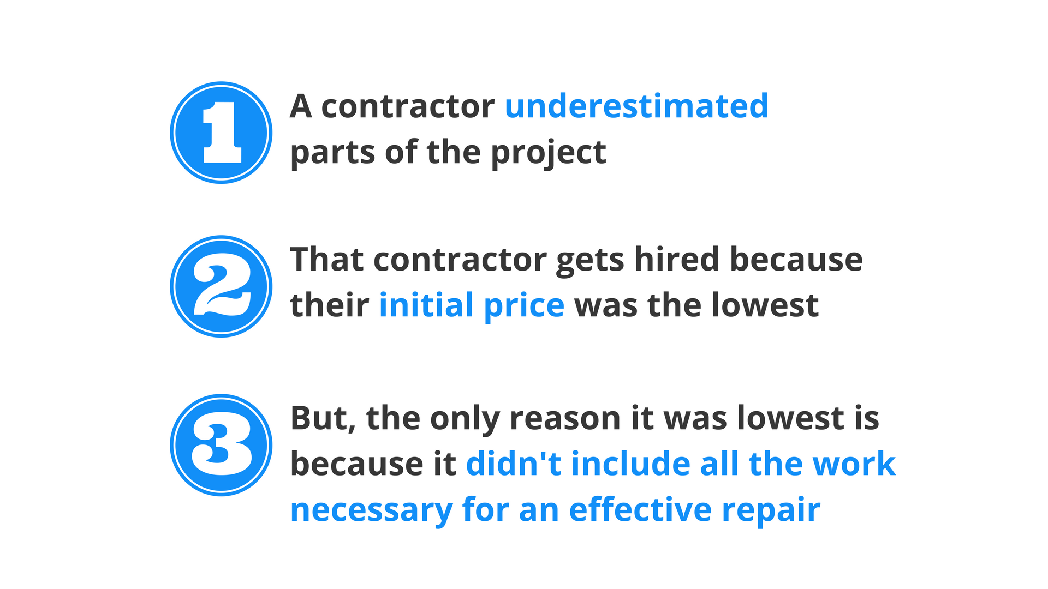
Notes:
3) Hire the right contractor
Three reasons, explained chronologically, why change orders and delays are so common.

Slide 17
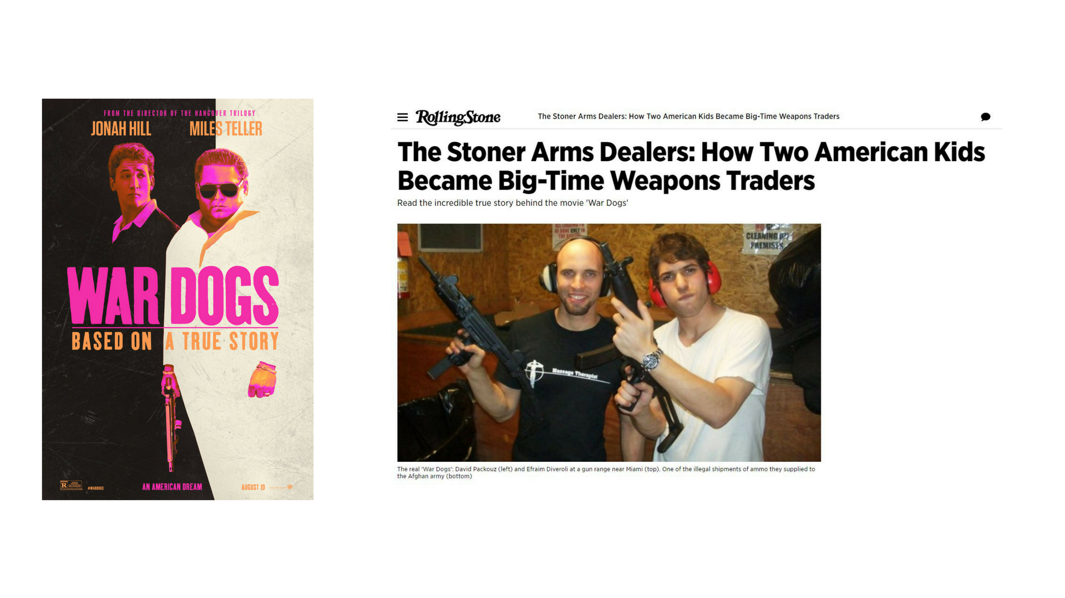
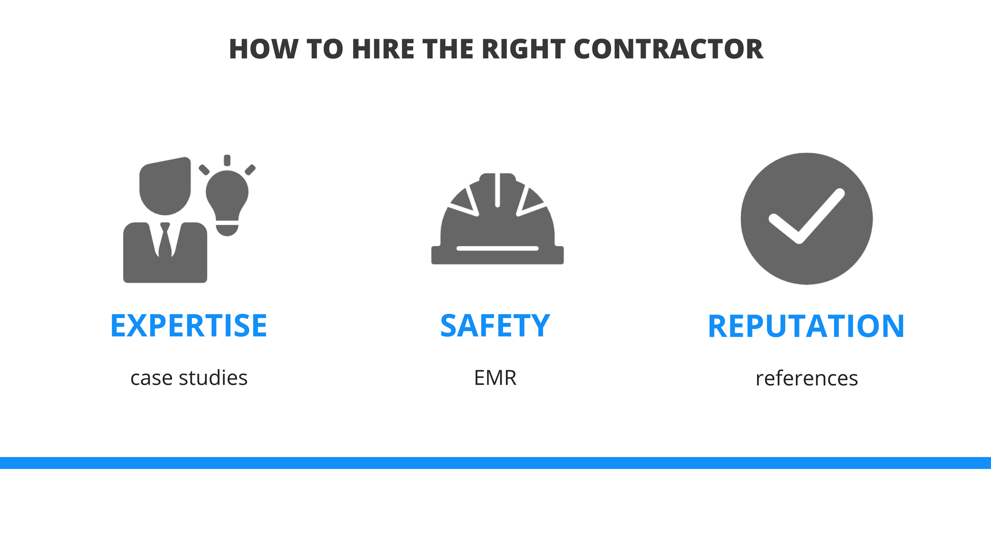
Notes:
3) Hire the right contractor
Three simple things that a Senior Chief Engineer should take into consideration when hiring a contractor and simple ways to get the information they need.

Slide 18
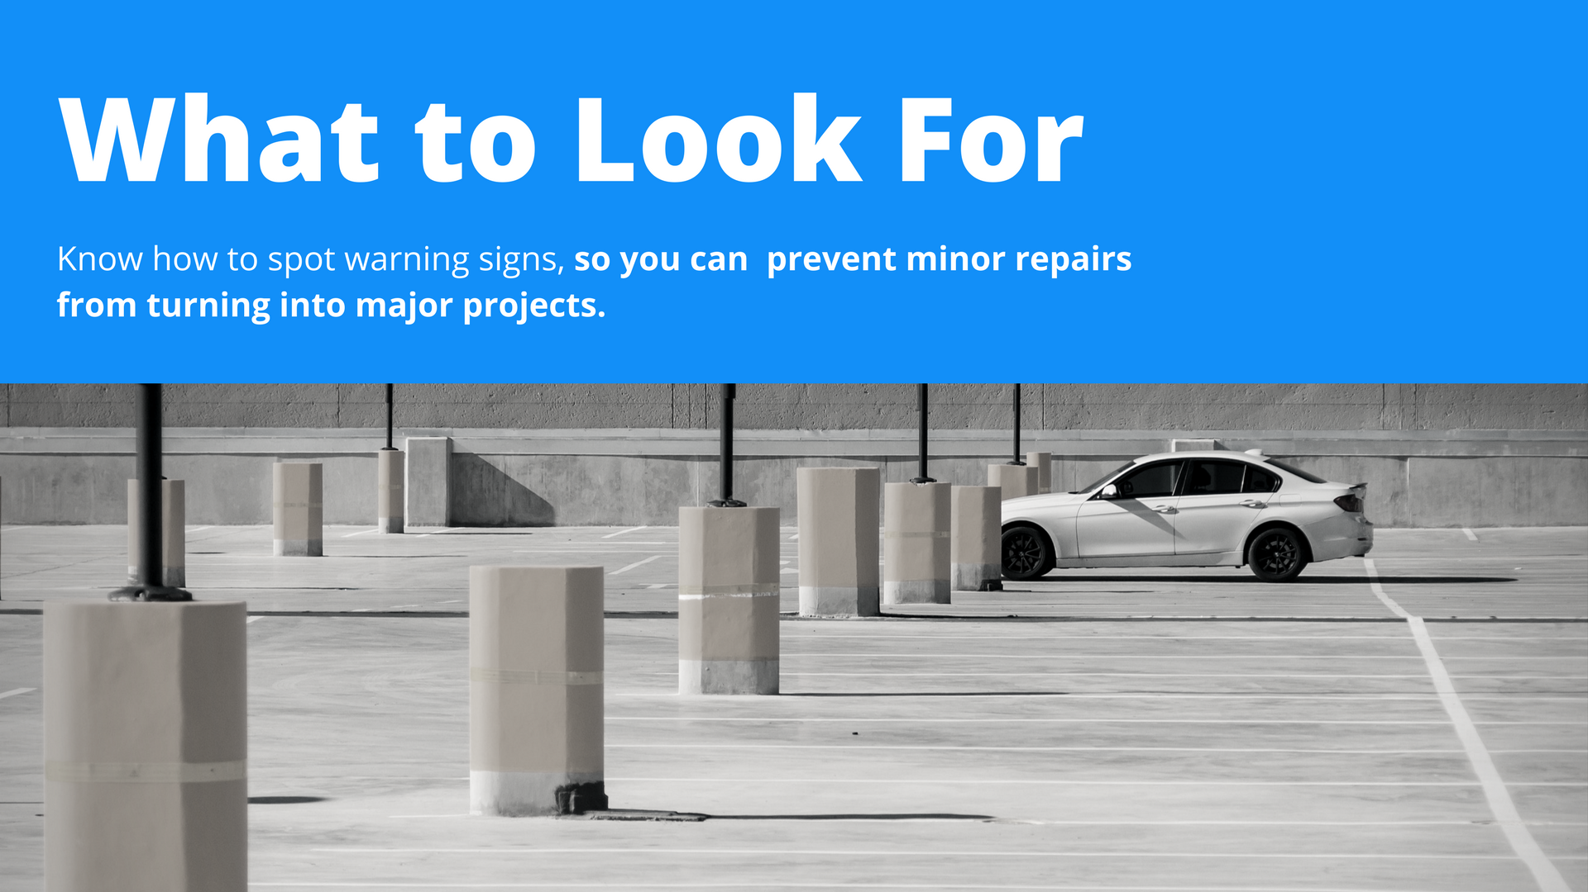
Notes:
This is the start of a new section: Parking Garage warning signs. The idea was to, primarily show them what warning signs they need to look for to prevent bigger problems from developing.
Western presentations typically explain, in great detail, how we would fix each of these warning signs. But we held off on doing that in this section. The reason for that is warning signs are things they can easily understand and relate to. They also give the Senior Chief Engineers actionable things they can do on their properties. Explaining “how” we fix each of these repairs is just information to them. It’s important for them to understand, but it’s not as engaging for them as tips they can take back and use at their property right now. We got into explaining the “how” more in the case studies.

Slide 19
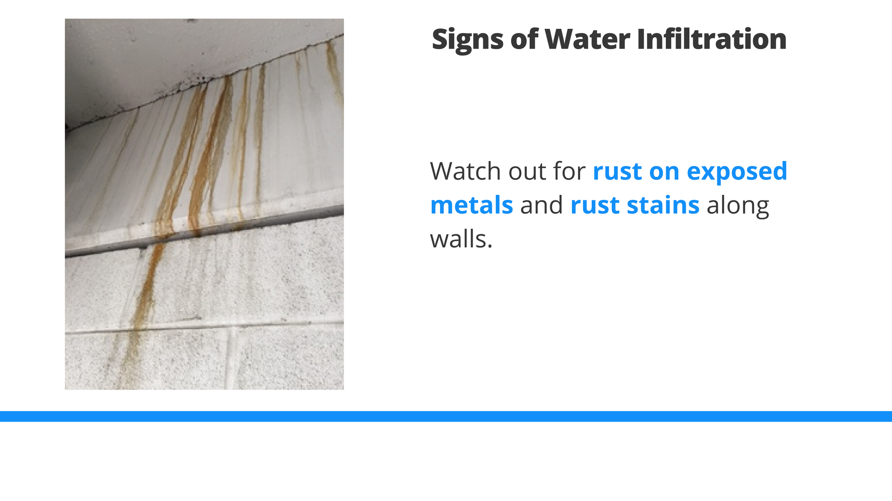

Slide 20
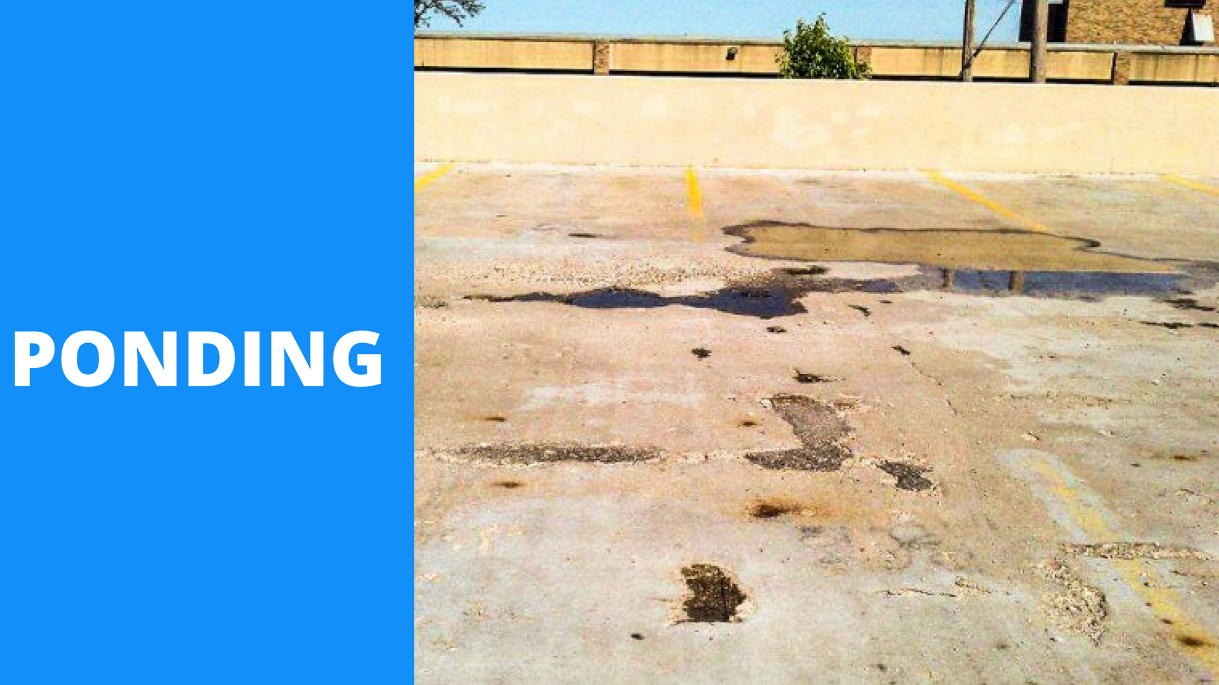

Slide 21
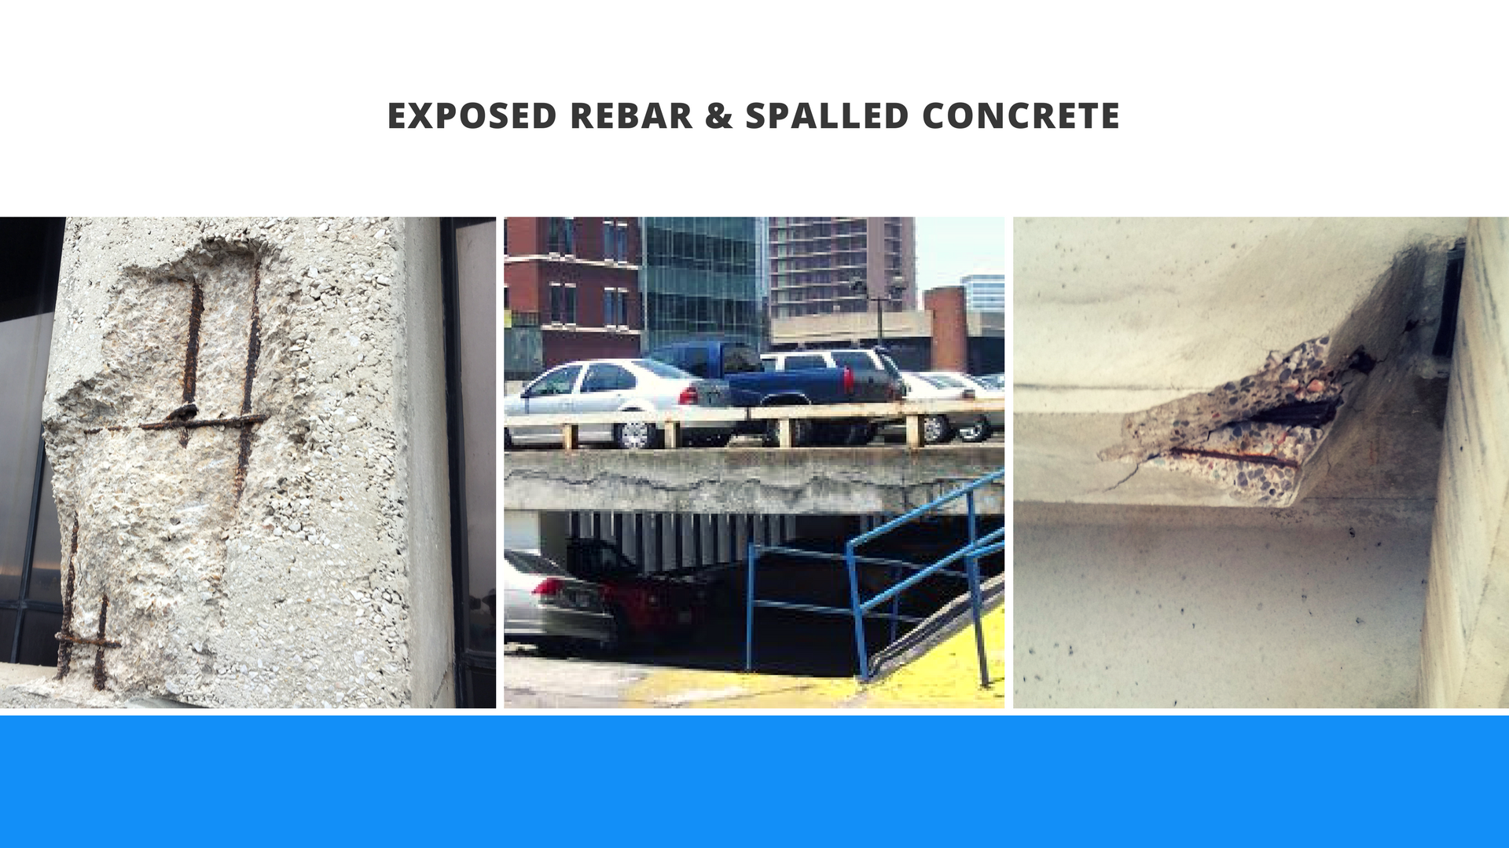

Slide 22
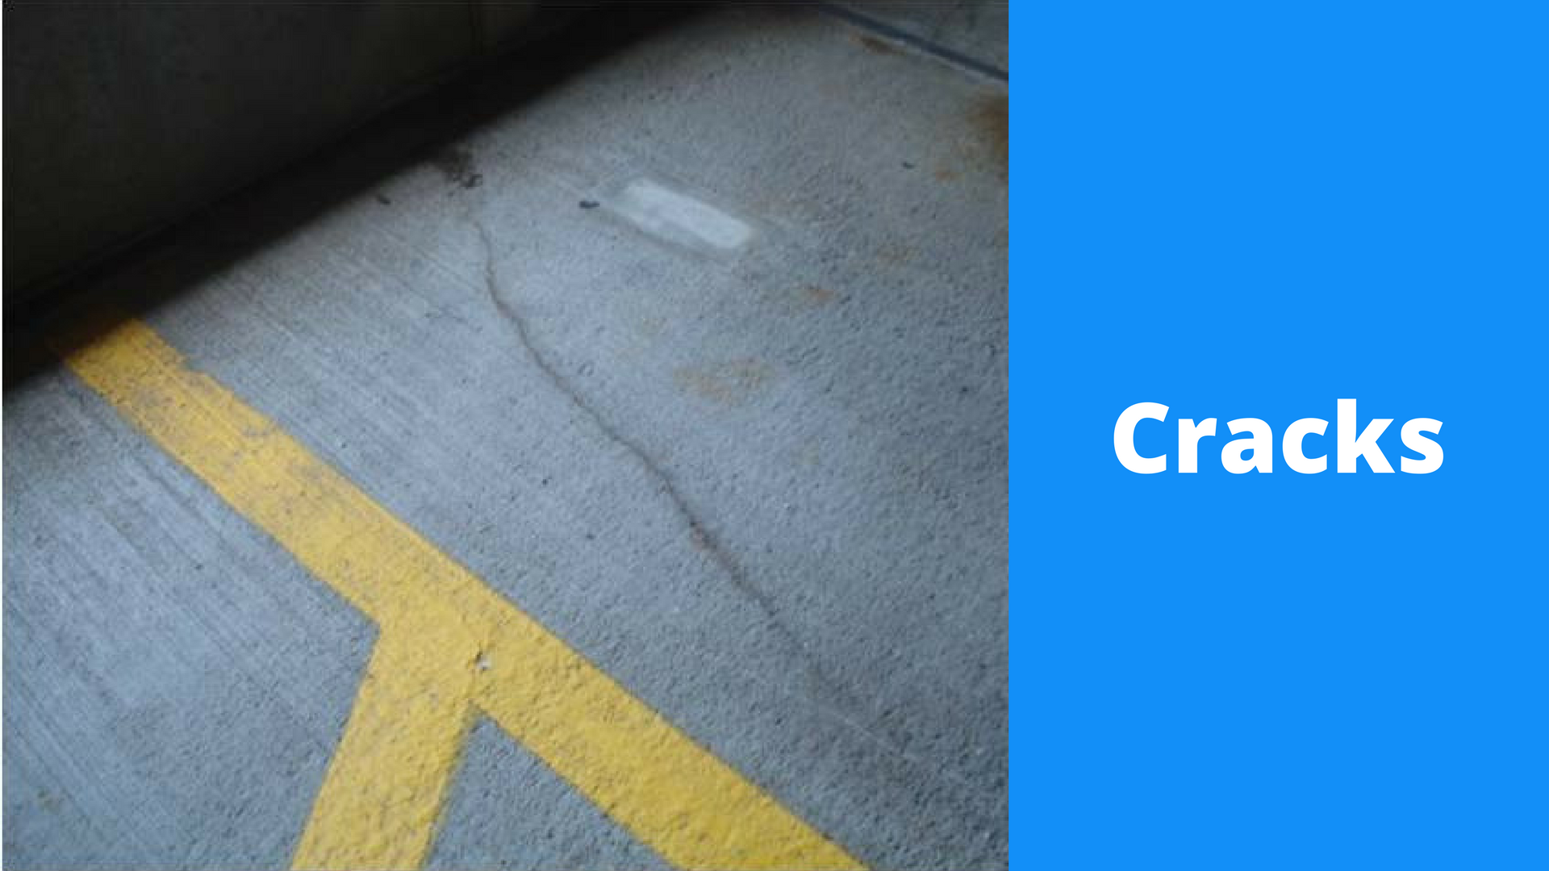

Slide 23
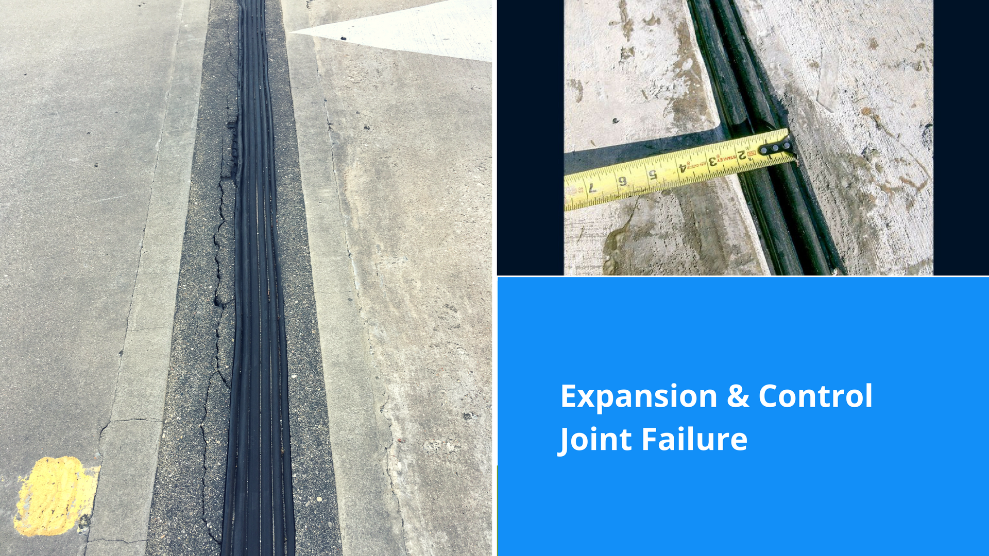

Slide 24


Slide 25
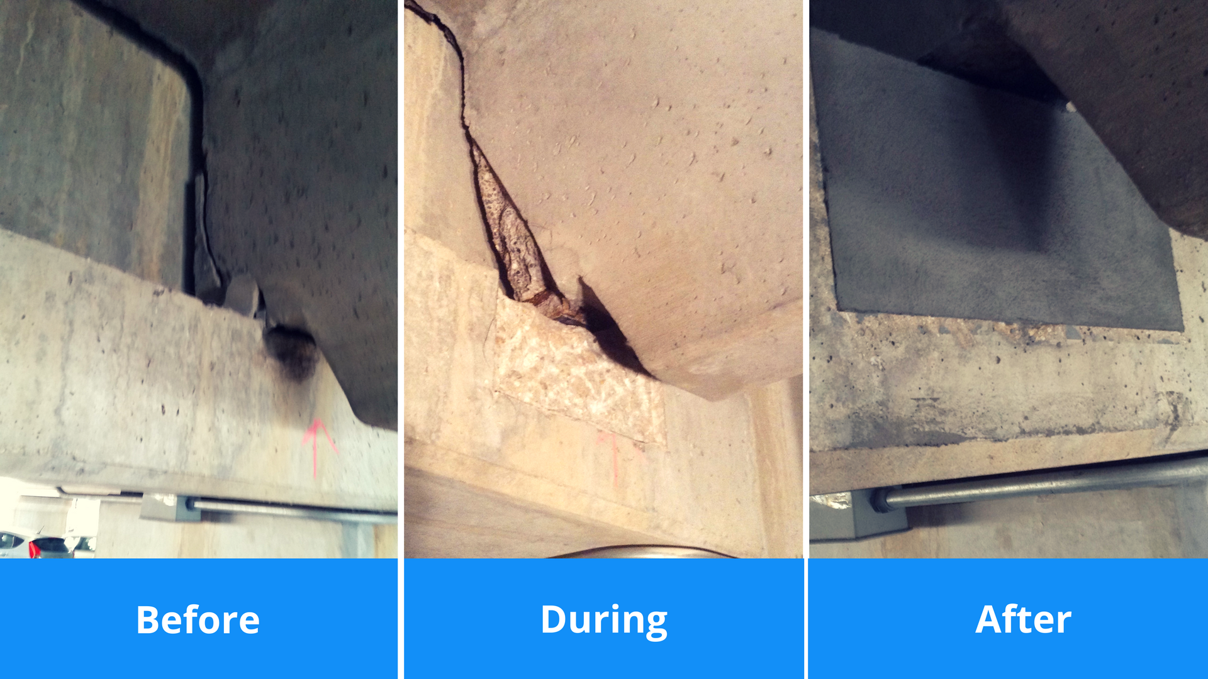

Slide 26
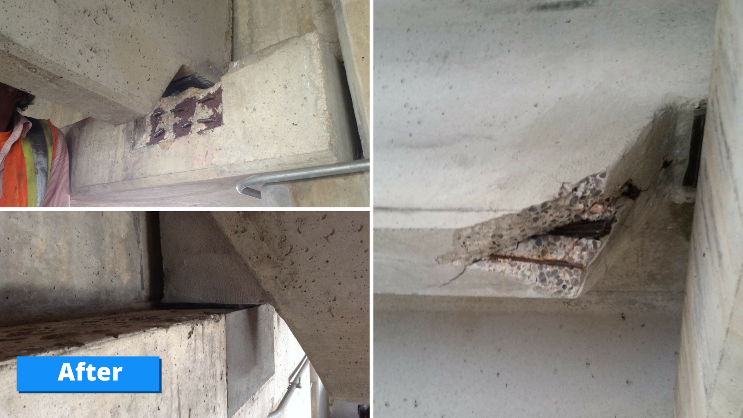

Slide 27
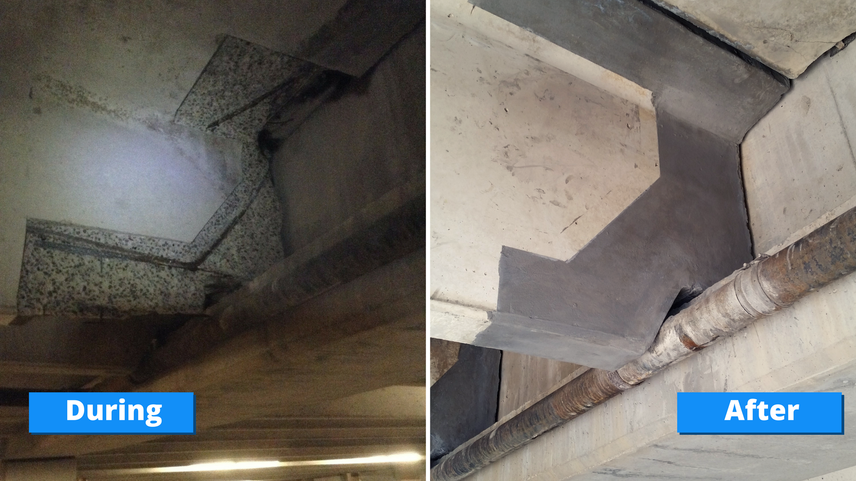

Slide 28
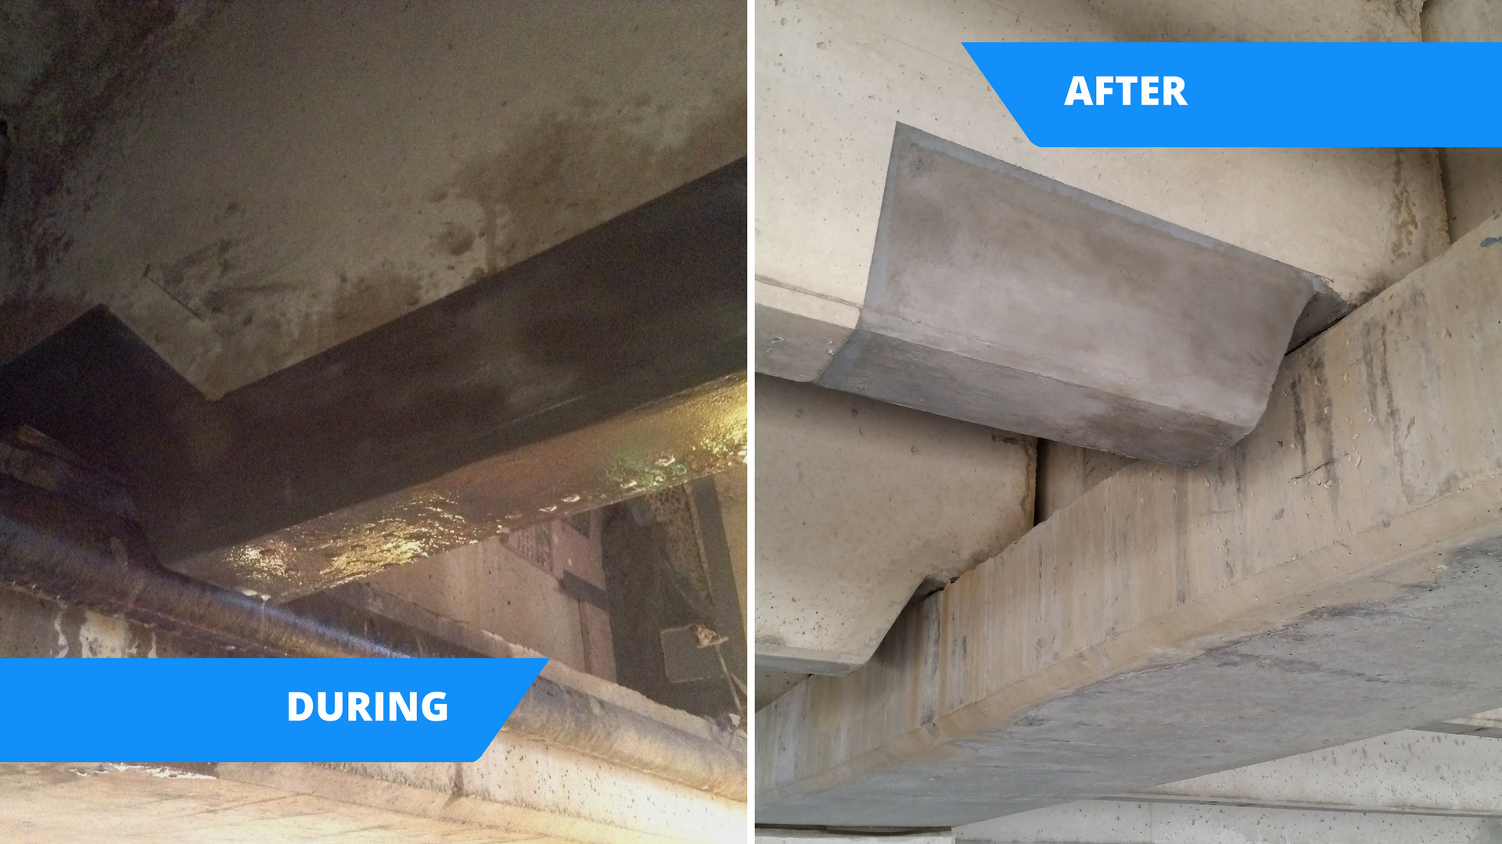

Slide 29
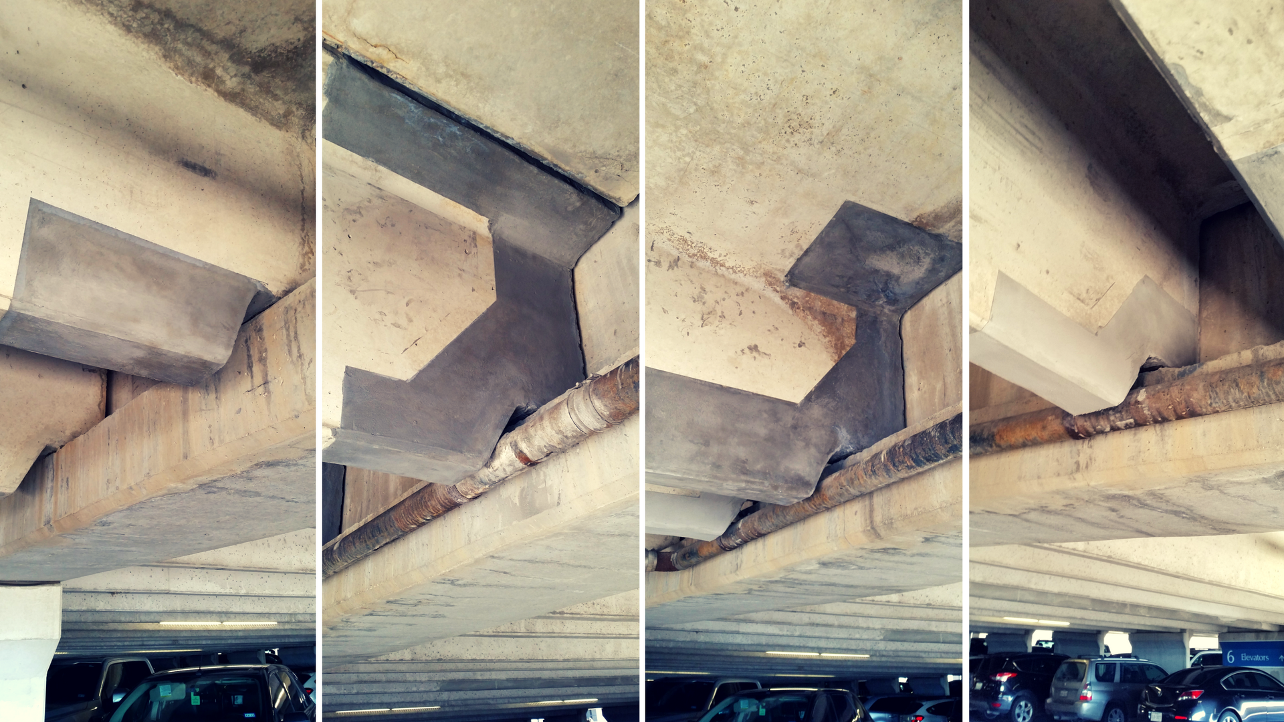

Slide 30
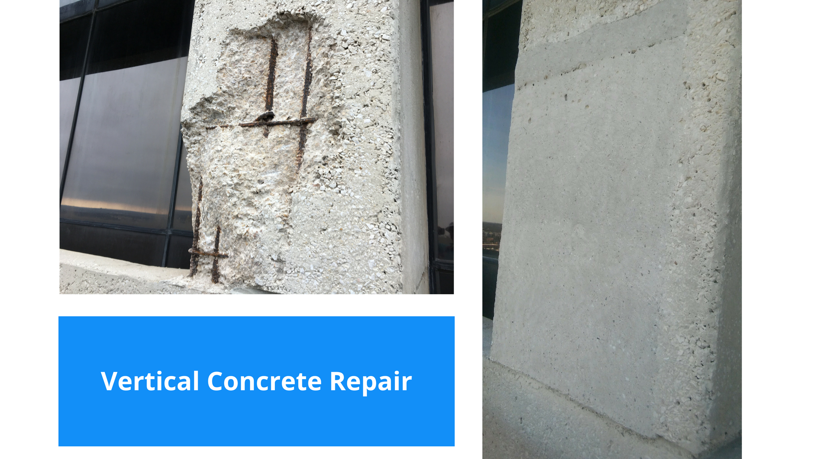

Slide 31
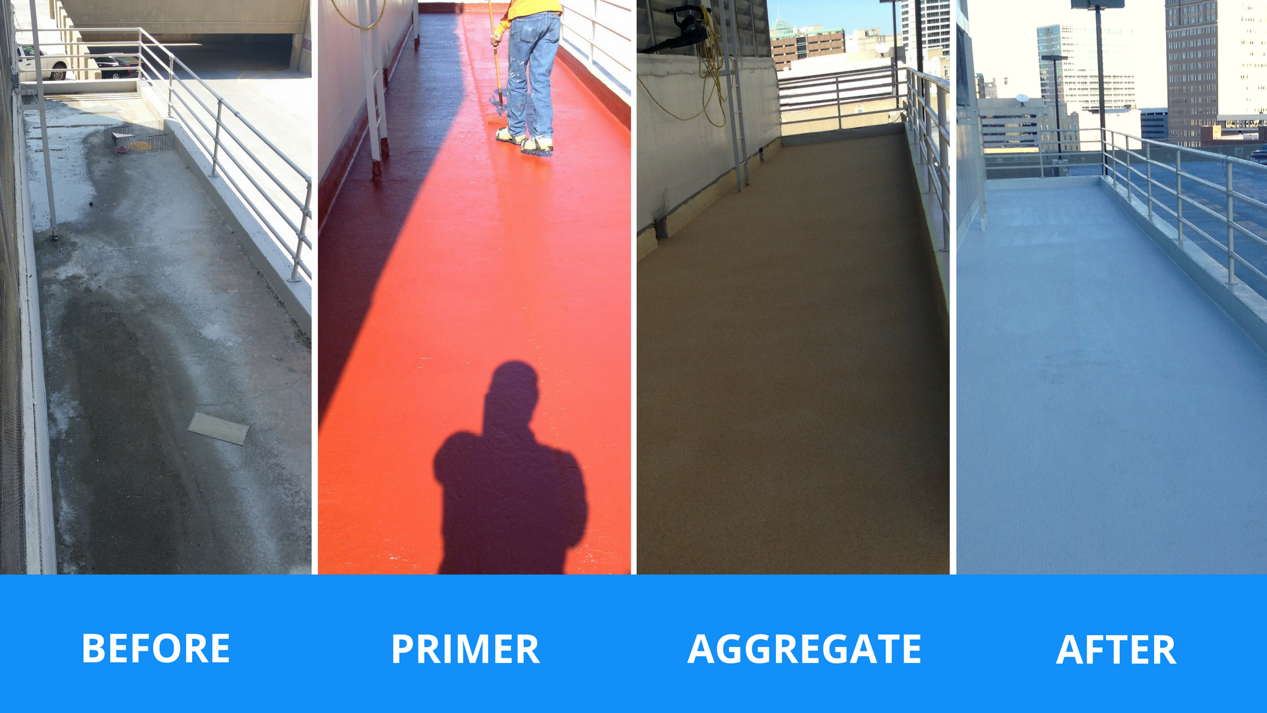

Slide 32
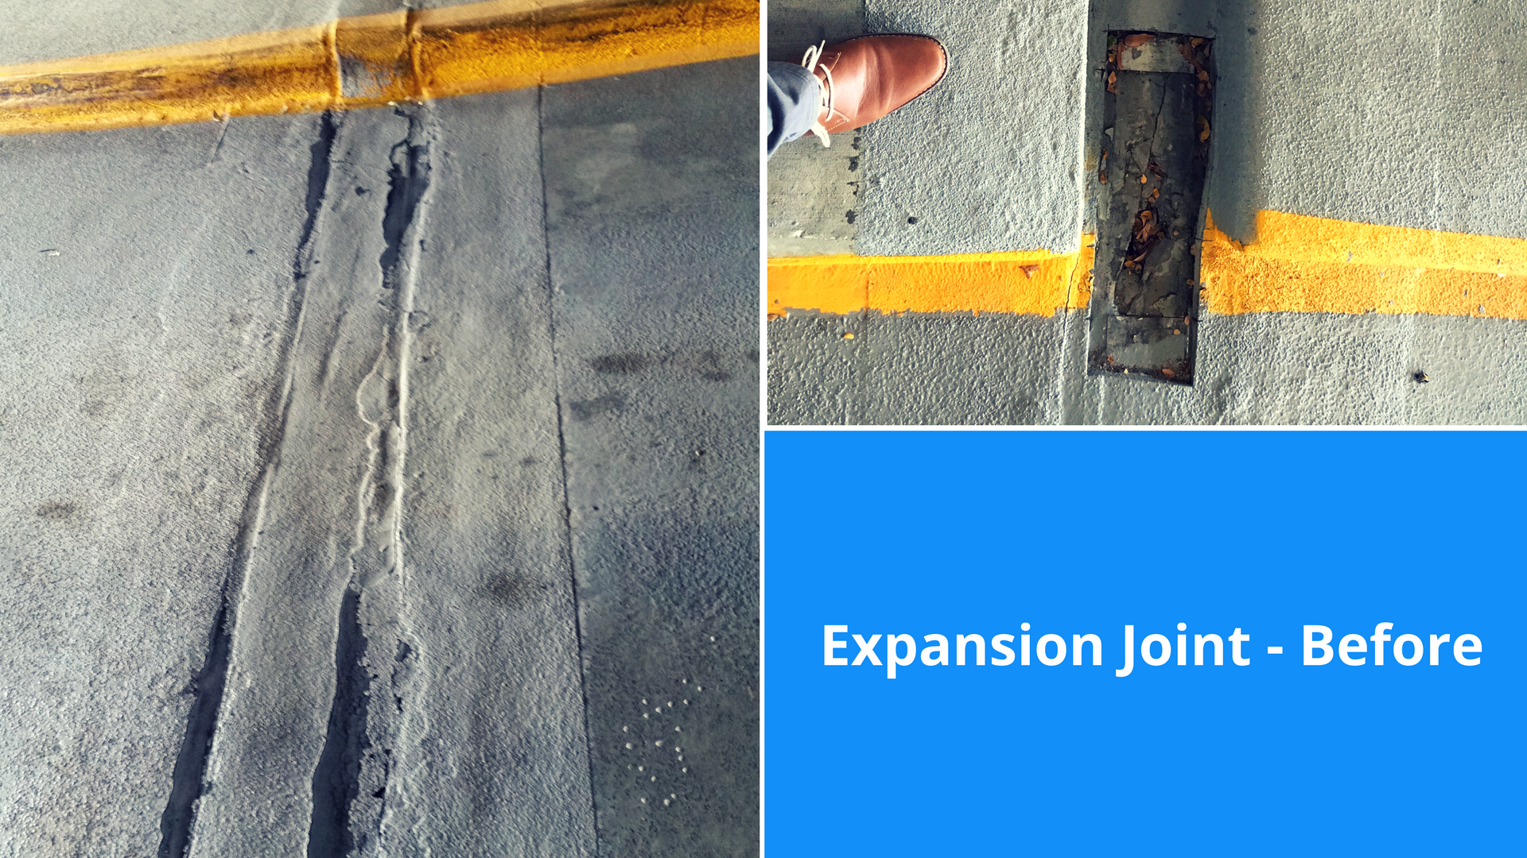

Slide 33
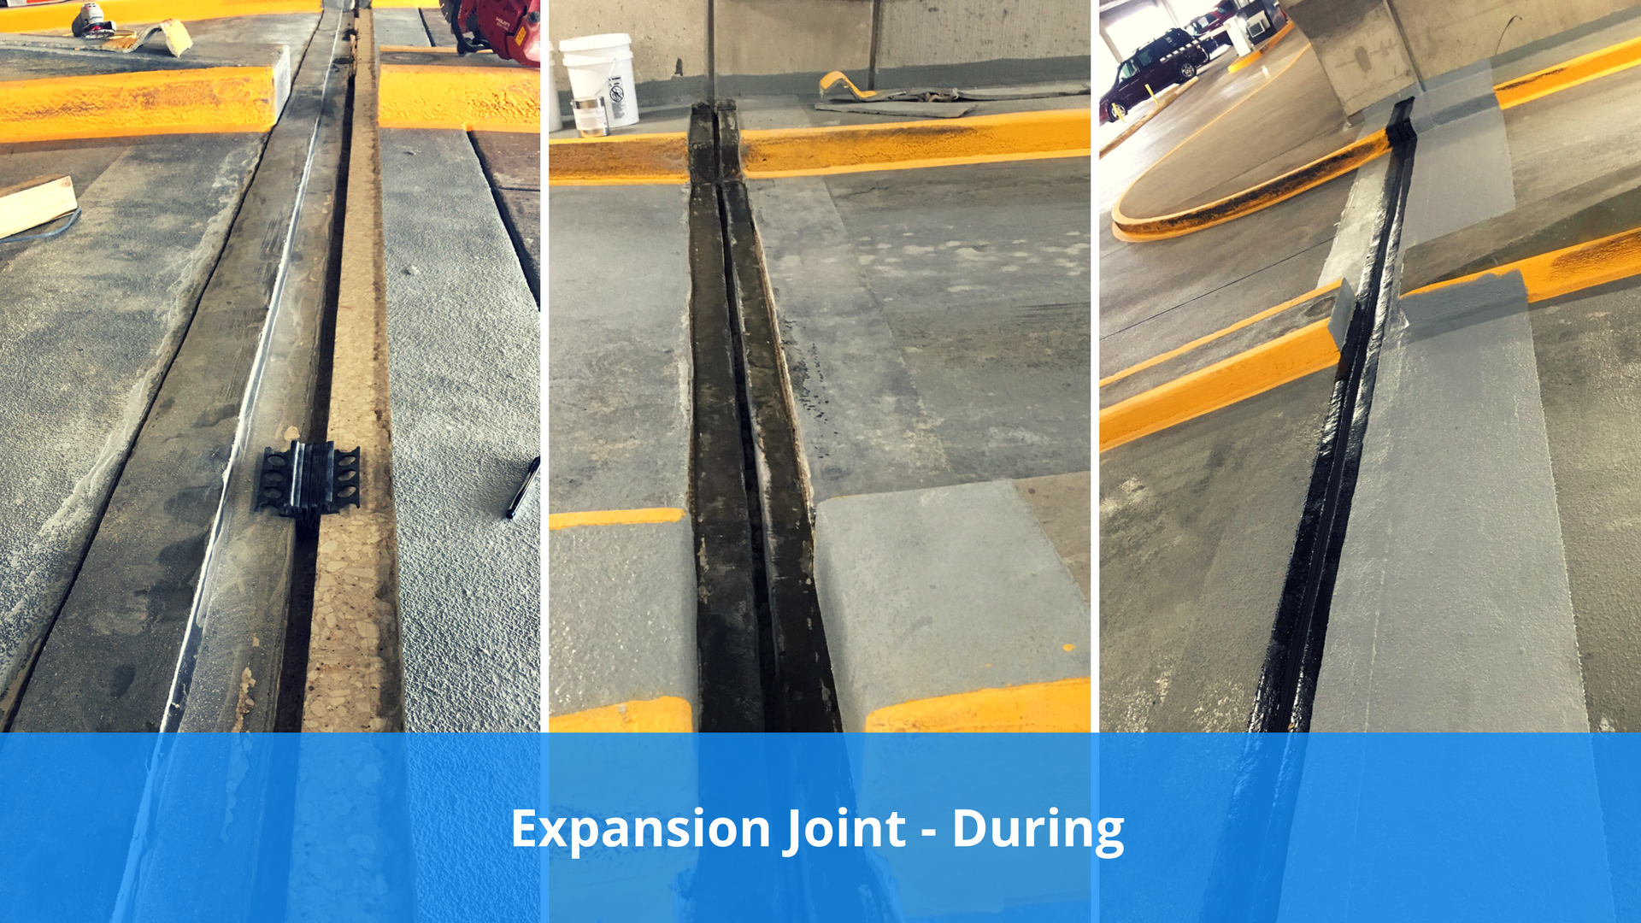

Slide 34
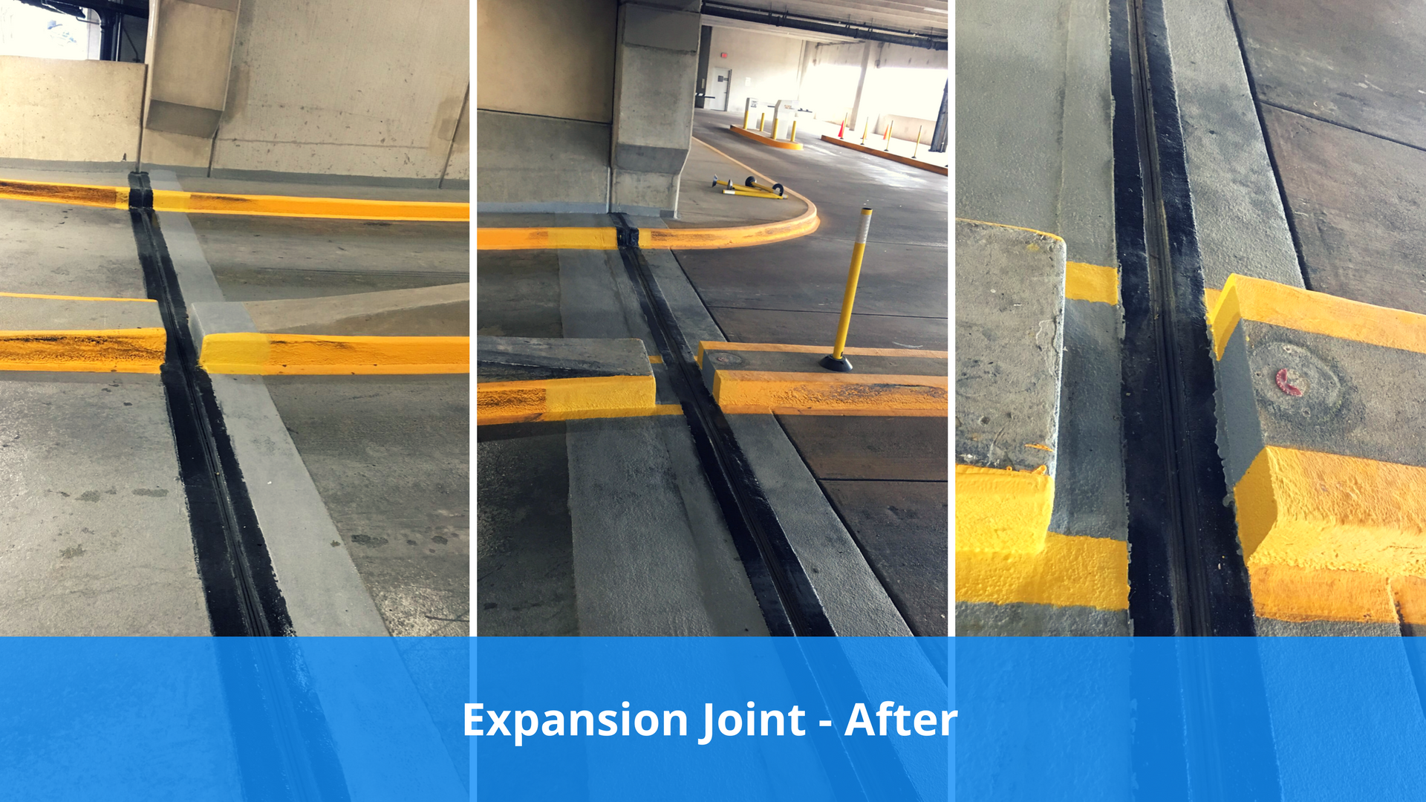

Slide 35
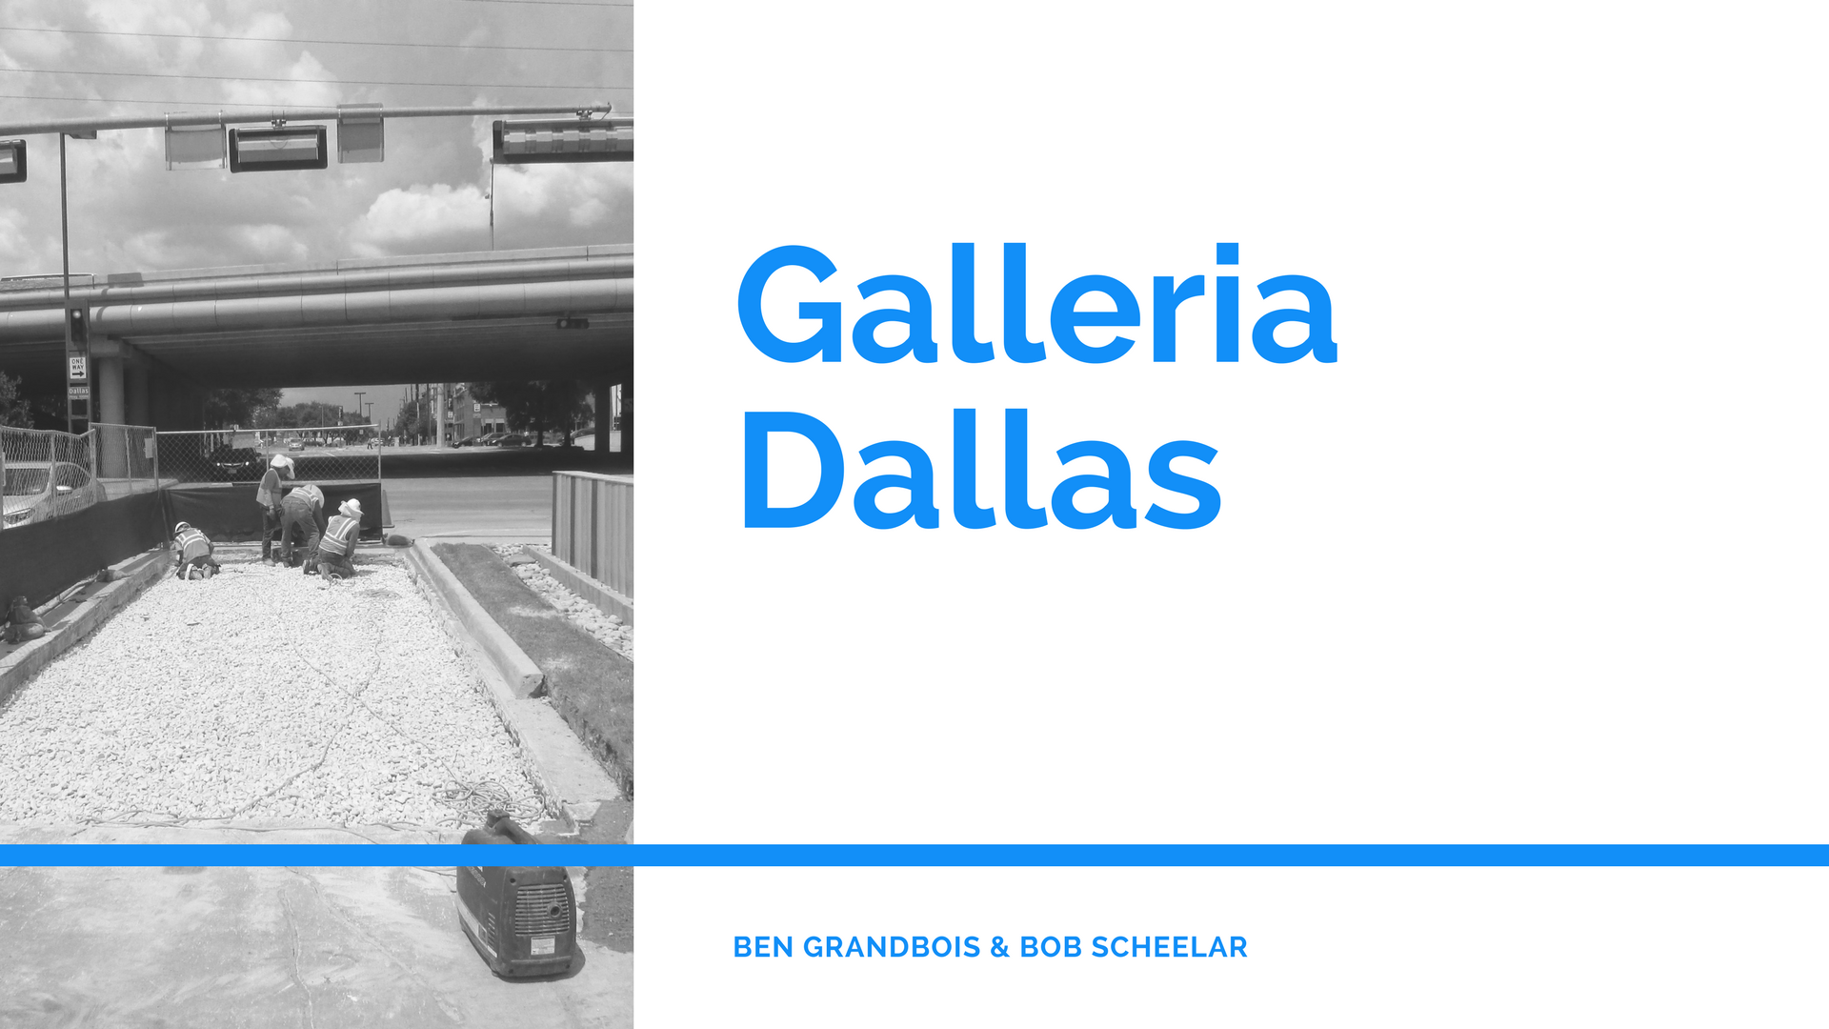

Slide 36
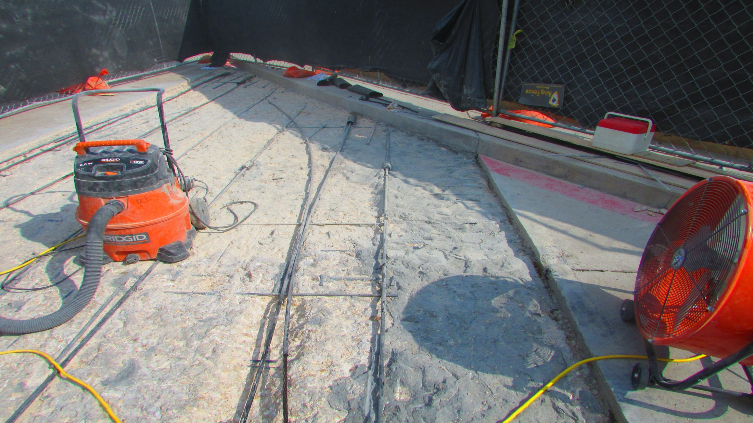

Slide 37
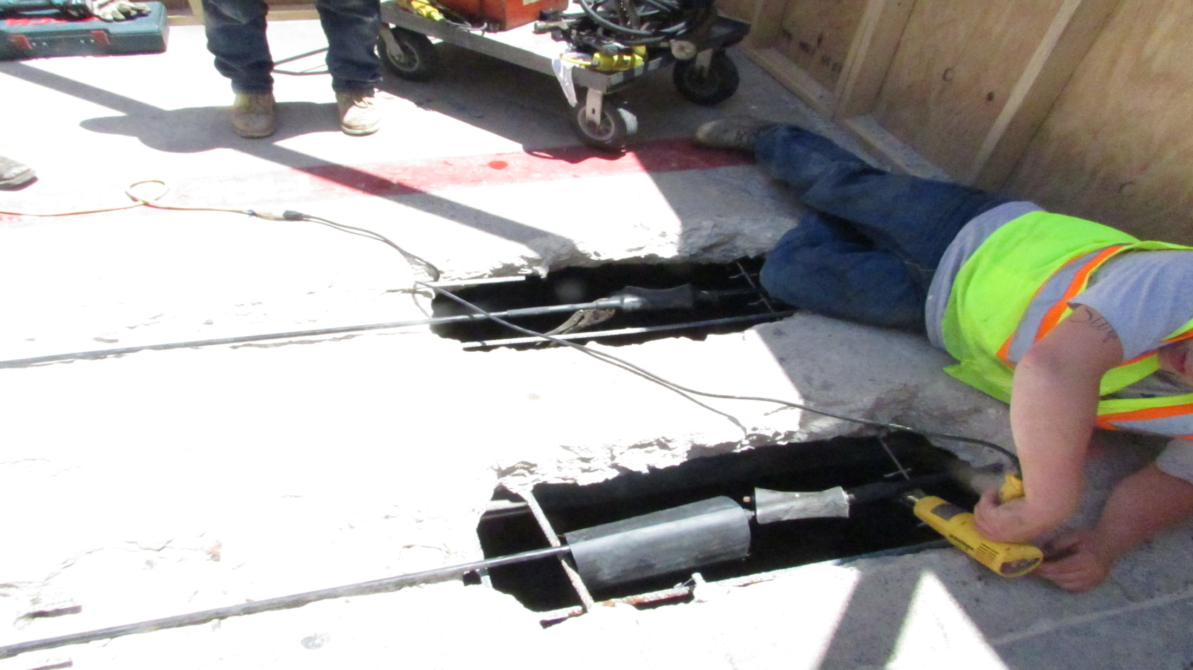

Slide 38
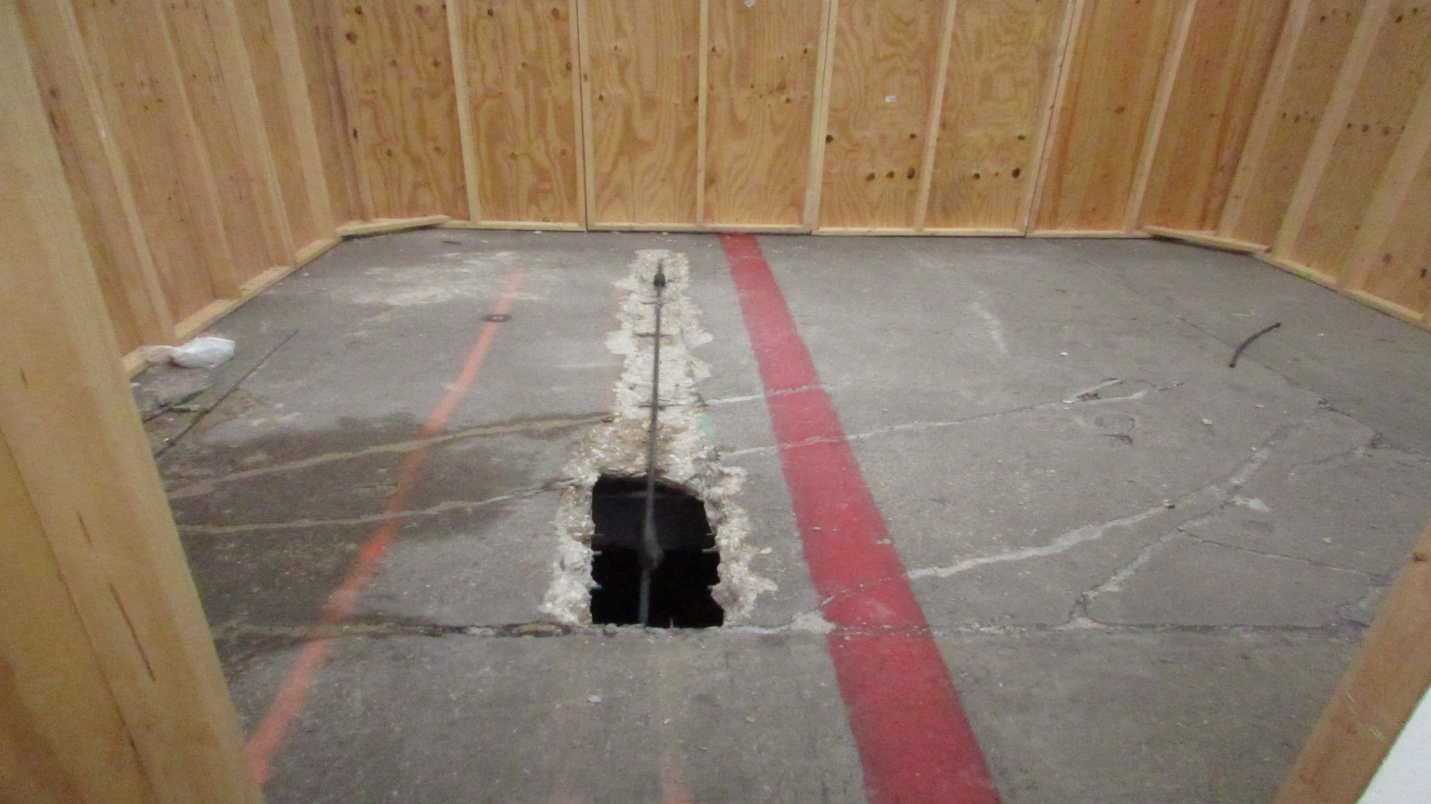

Slide 39
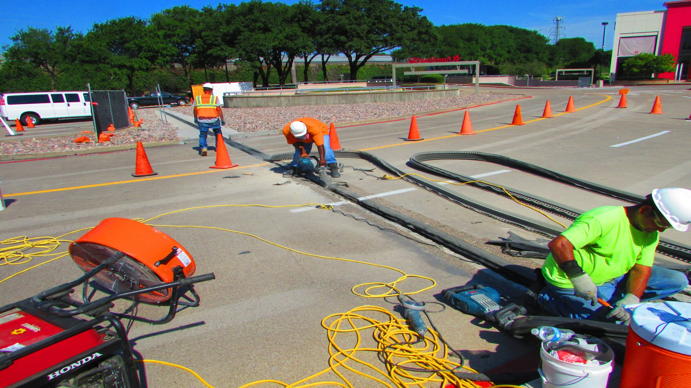

Slide 40
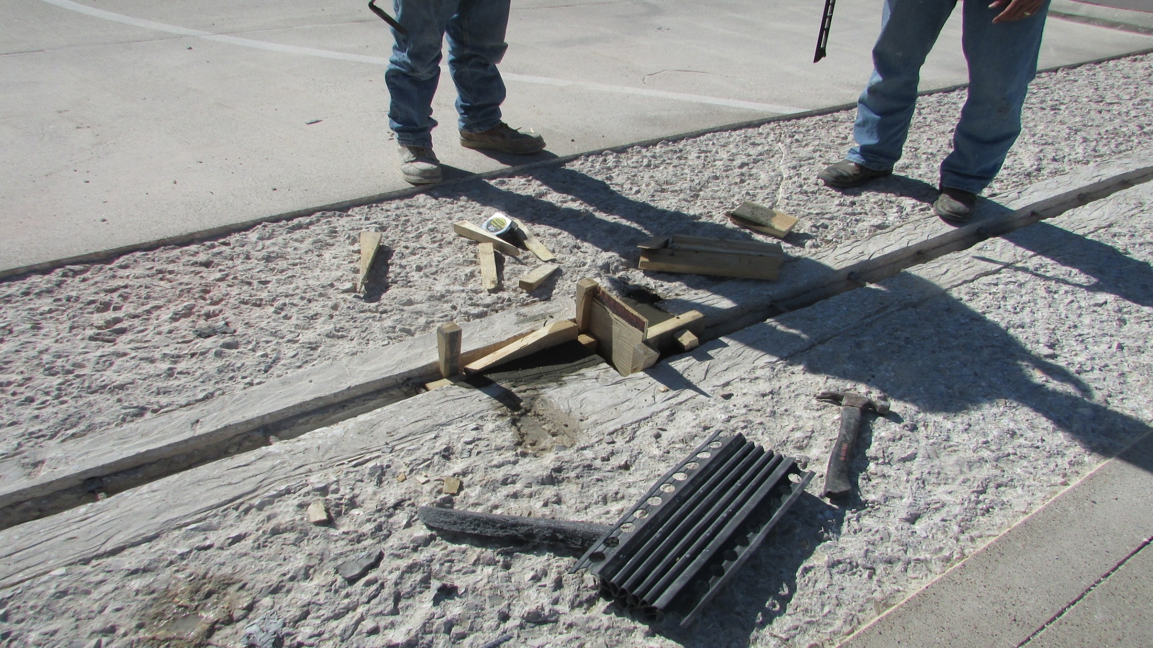

Slide 41
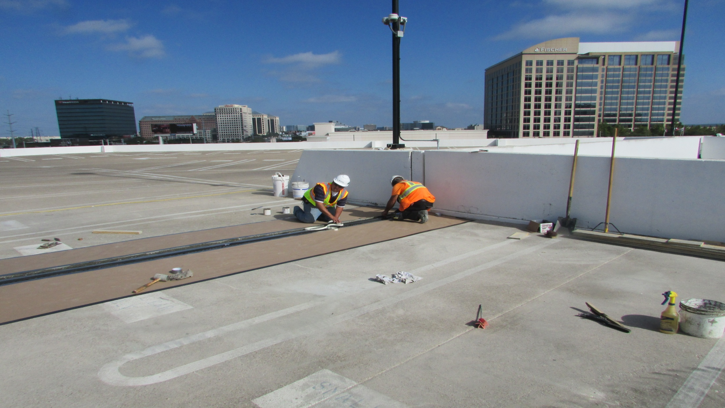
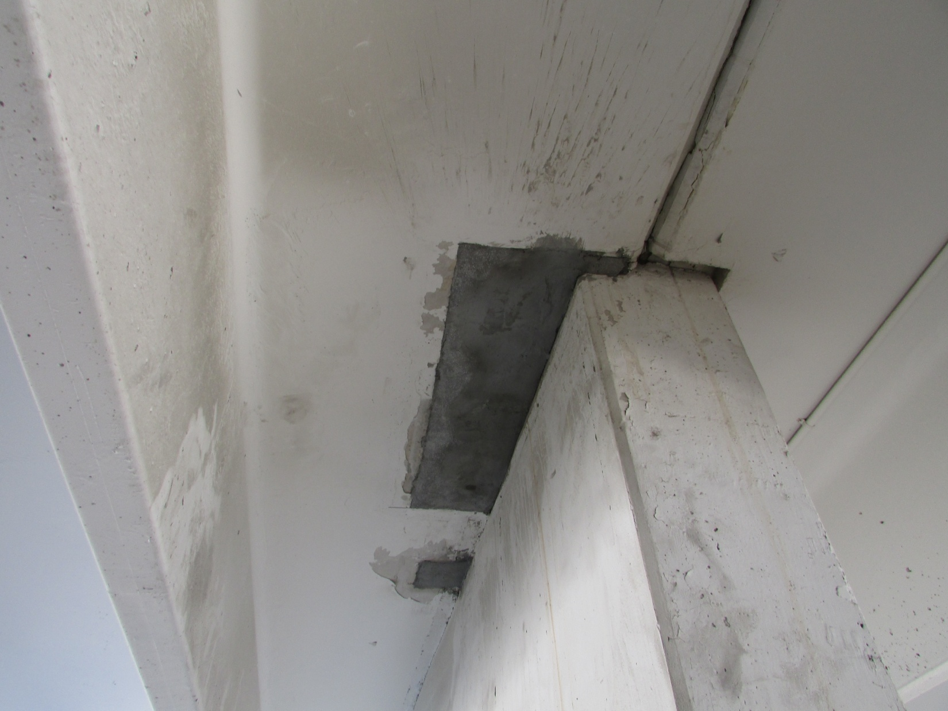

Slide 42
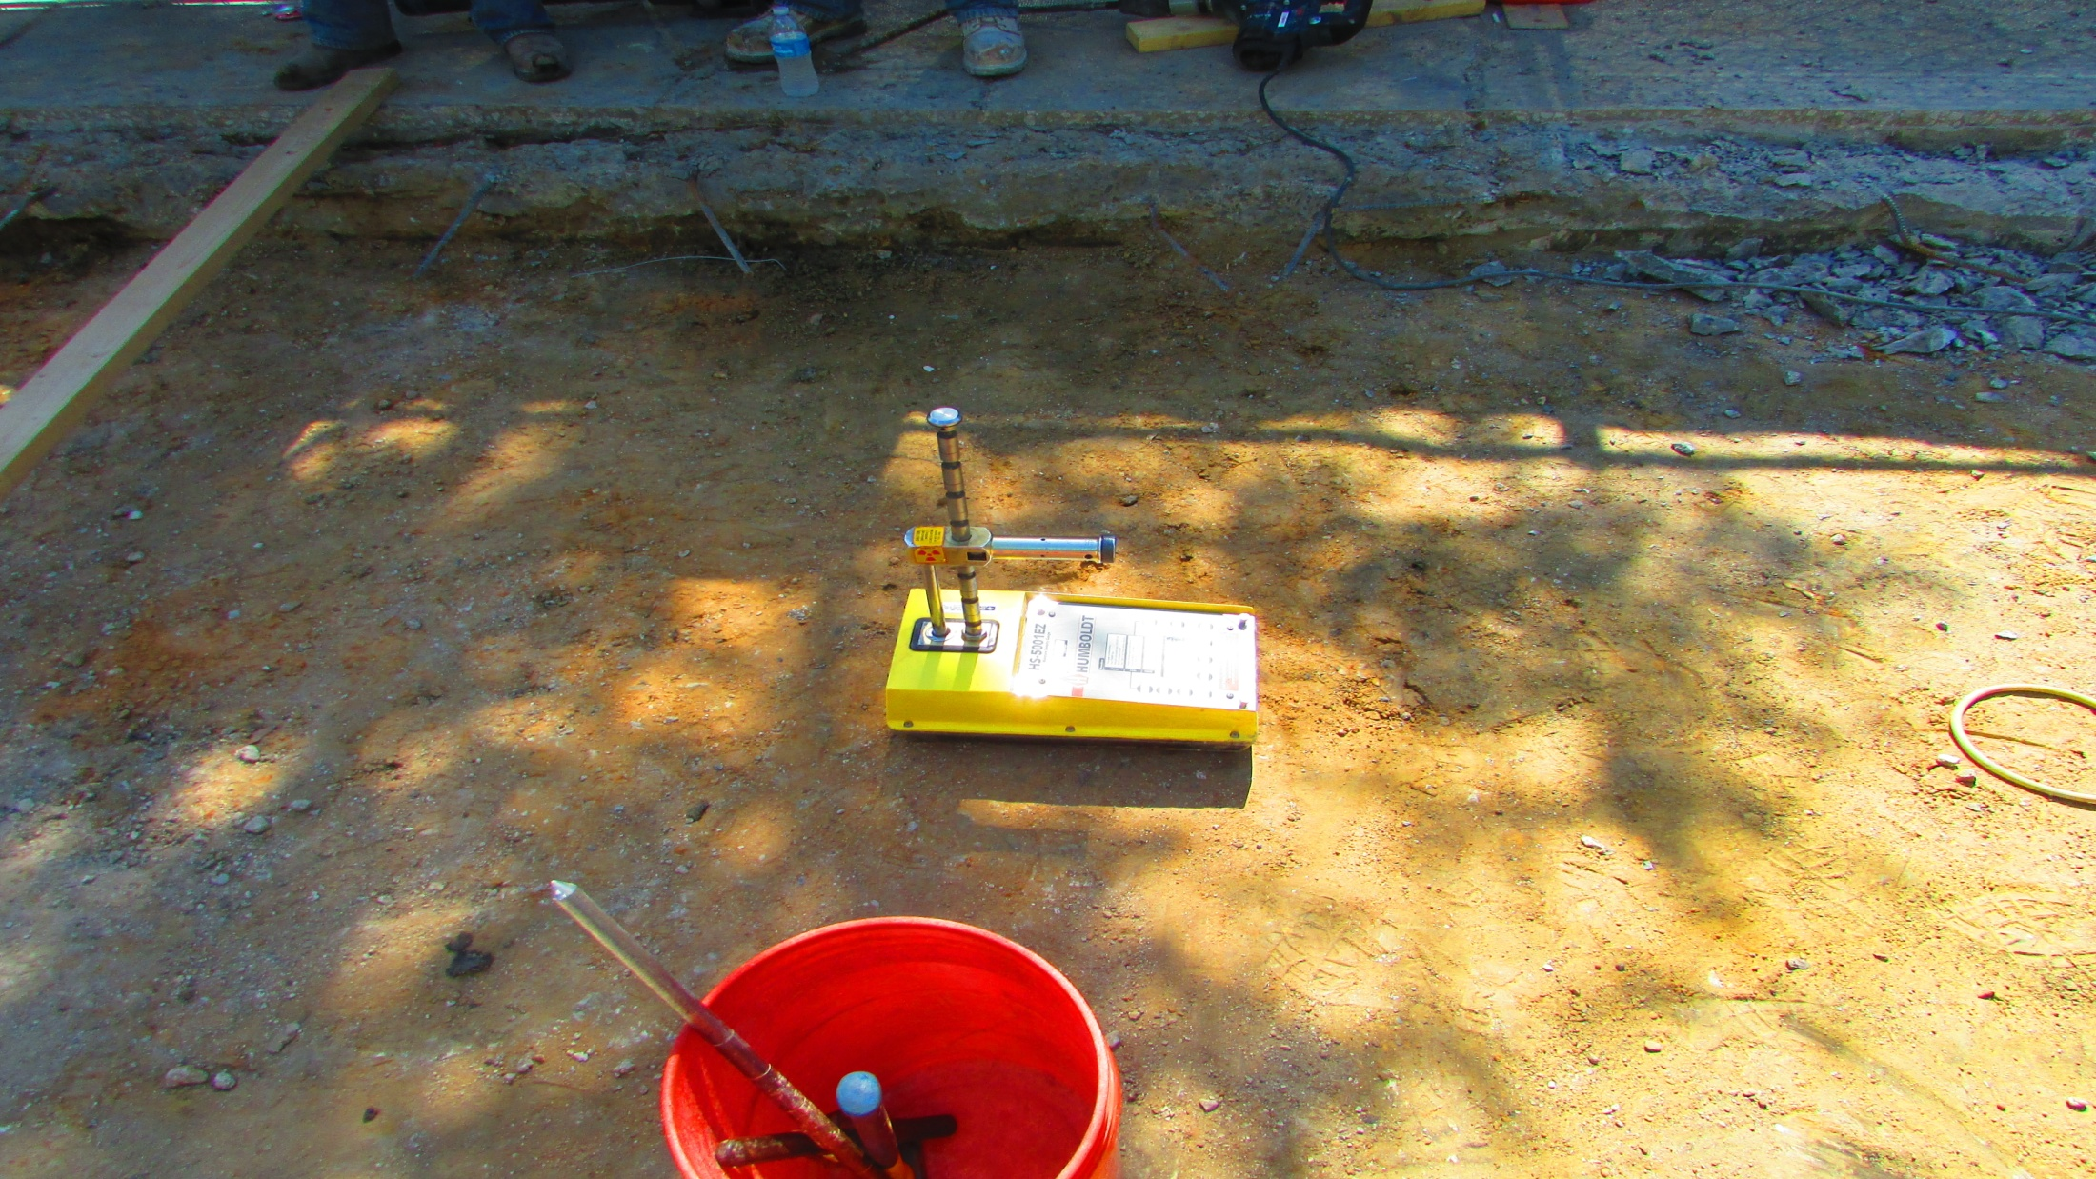

Slide 43
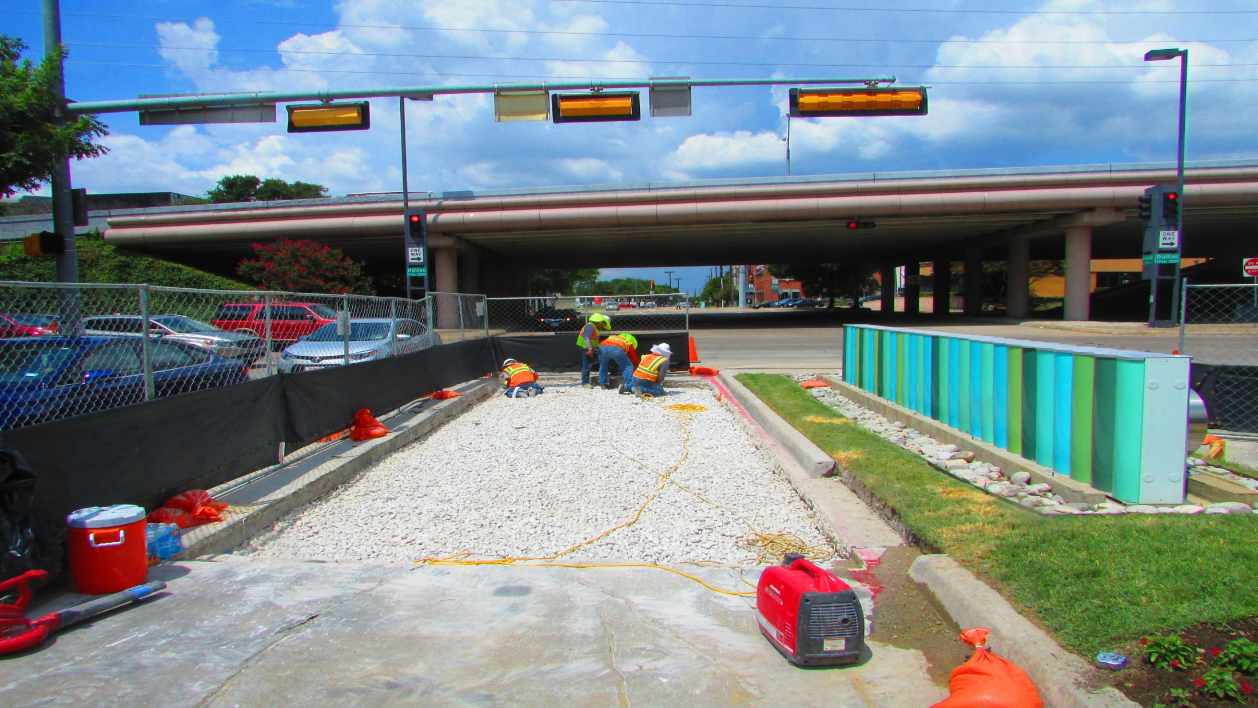

Slide 44
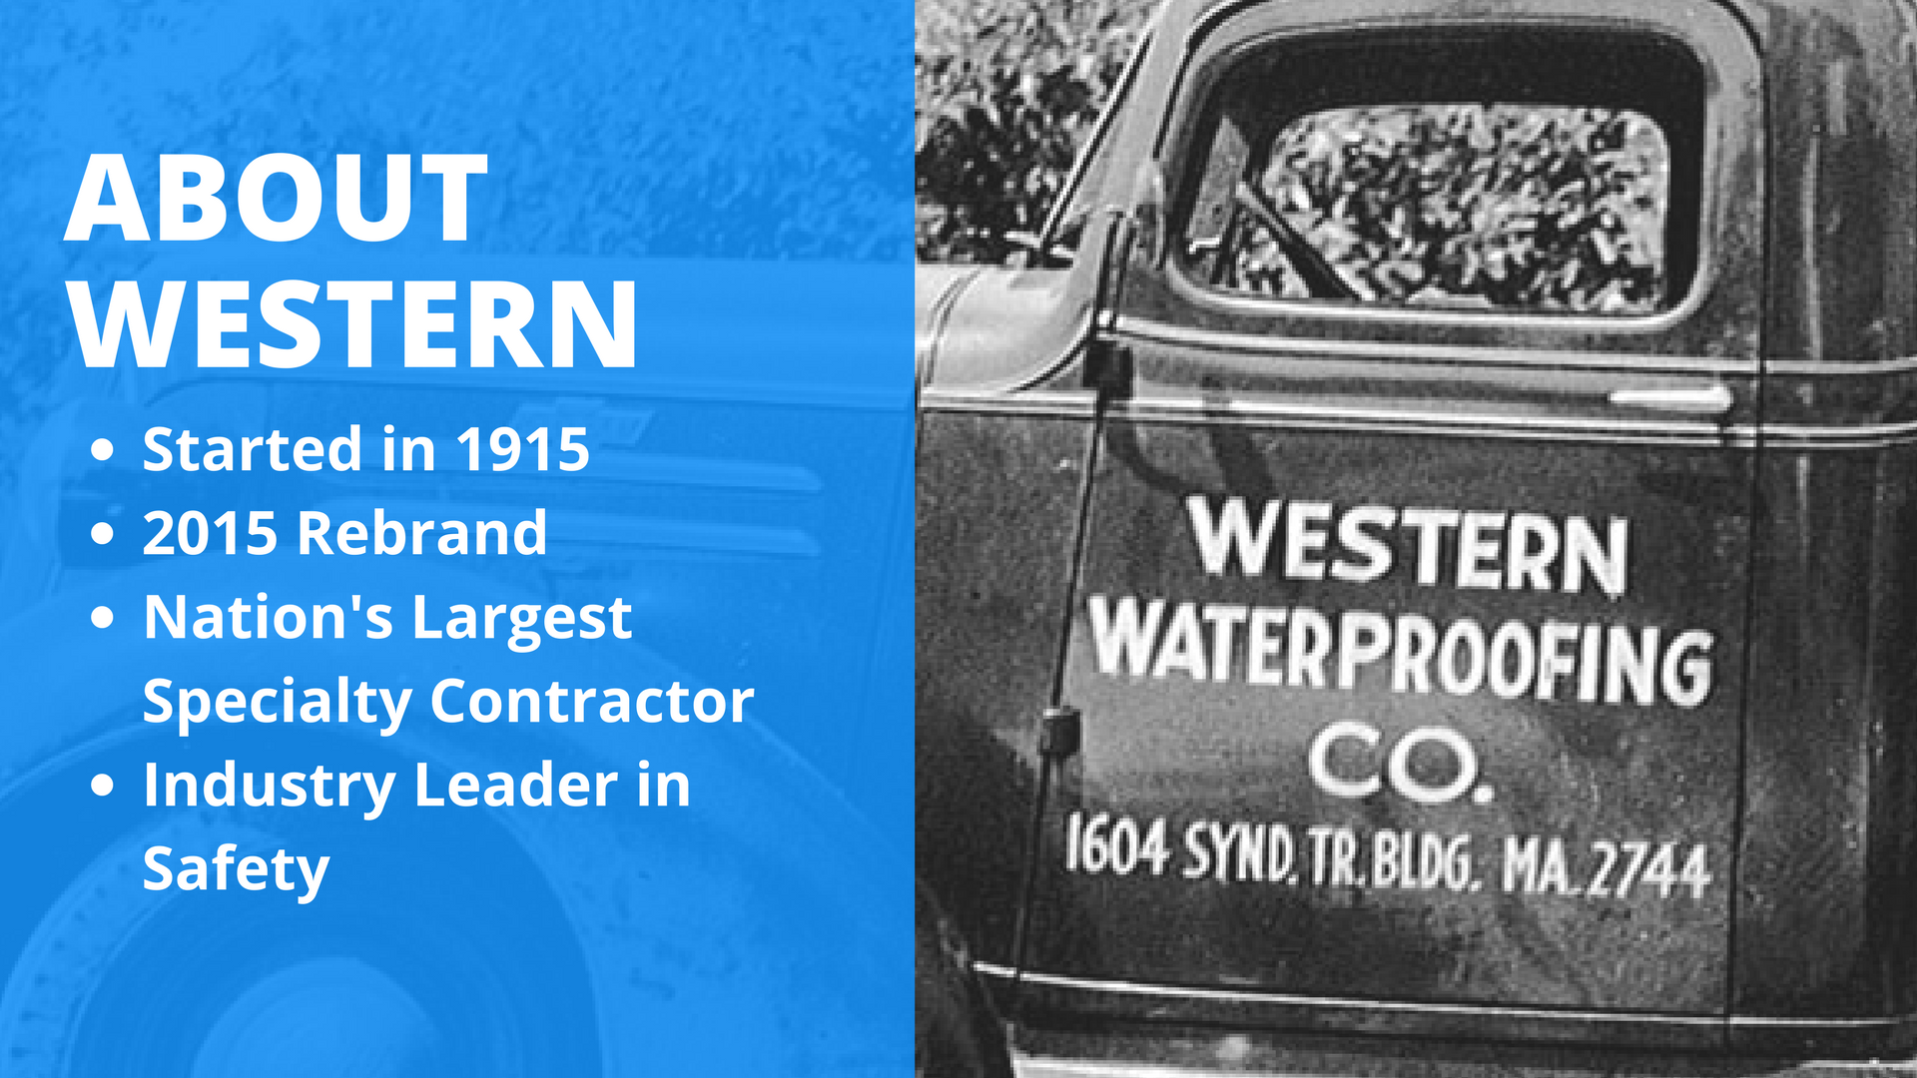
Notes:
Like we already covered … We talked about Western at the end of the presentation rather than the beginning. The main reason for doing this was to create a very engaging presentation for the audience right from the get go. Regarding the thought of “we need to establish our expertise at the beginning so our audience will take us seriously” …
We focused on showing them that we were an expert rather than telling them
We talked with our main contact at Transwestern about introducing us … he told him team about Western as an introduction for the presentation … we felt that was plenty to convince the audience on “why” they should listen to us
Frankly, talking about Western at the beginning of presentation is boring for the audience … they don’t really care about who we are, yet. They care about making their lives easier/better.
So, at this point of the presentation, we’ve spent about an hour solely delivering high-value, educational information, strategies, and tips without talking a ton about who we are. This not only captivates the audience’s attention much better (they’re thinking, “This isn’t the type of presentation I’m used to! All their doing is helping us, instead of trying to sell me on something.”) … but it sets them up to be a lot more receptive, attentive, and engaged once we start talking about Western.
That way, we can give them very clear next steps on what they should do to get us working with them (see slide #48).

Slide 45


Slide 46


Slide 47
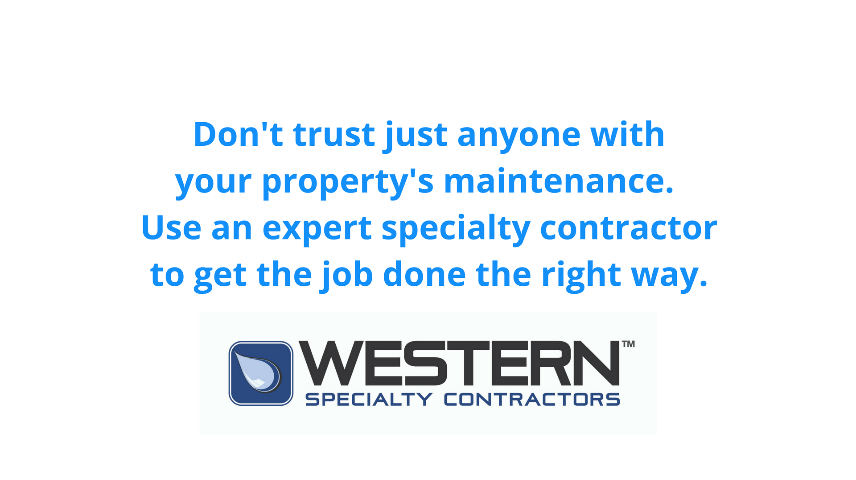

Slide 48


Slide 49
