Slide 1
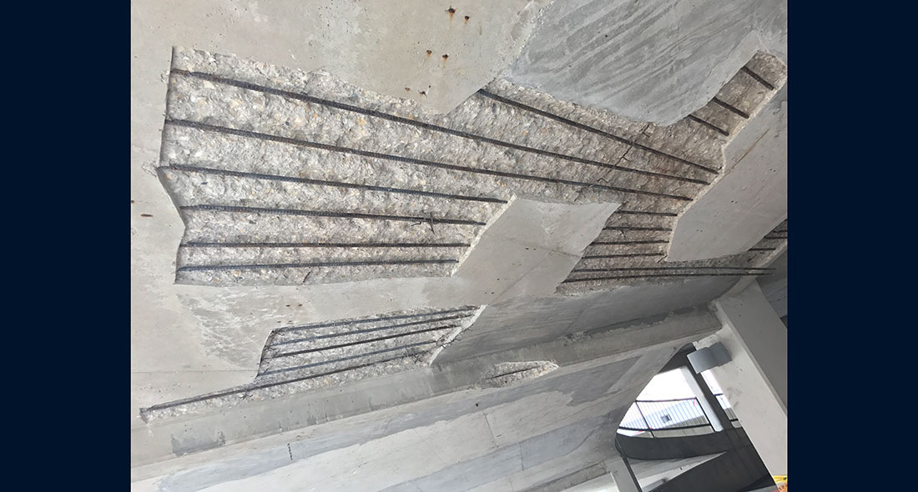

Parking Garage Restoration

Slide 2


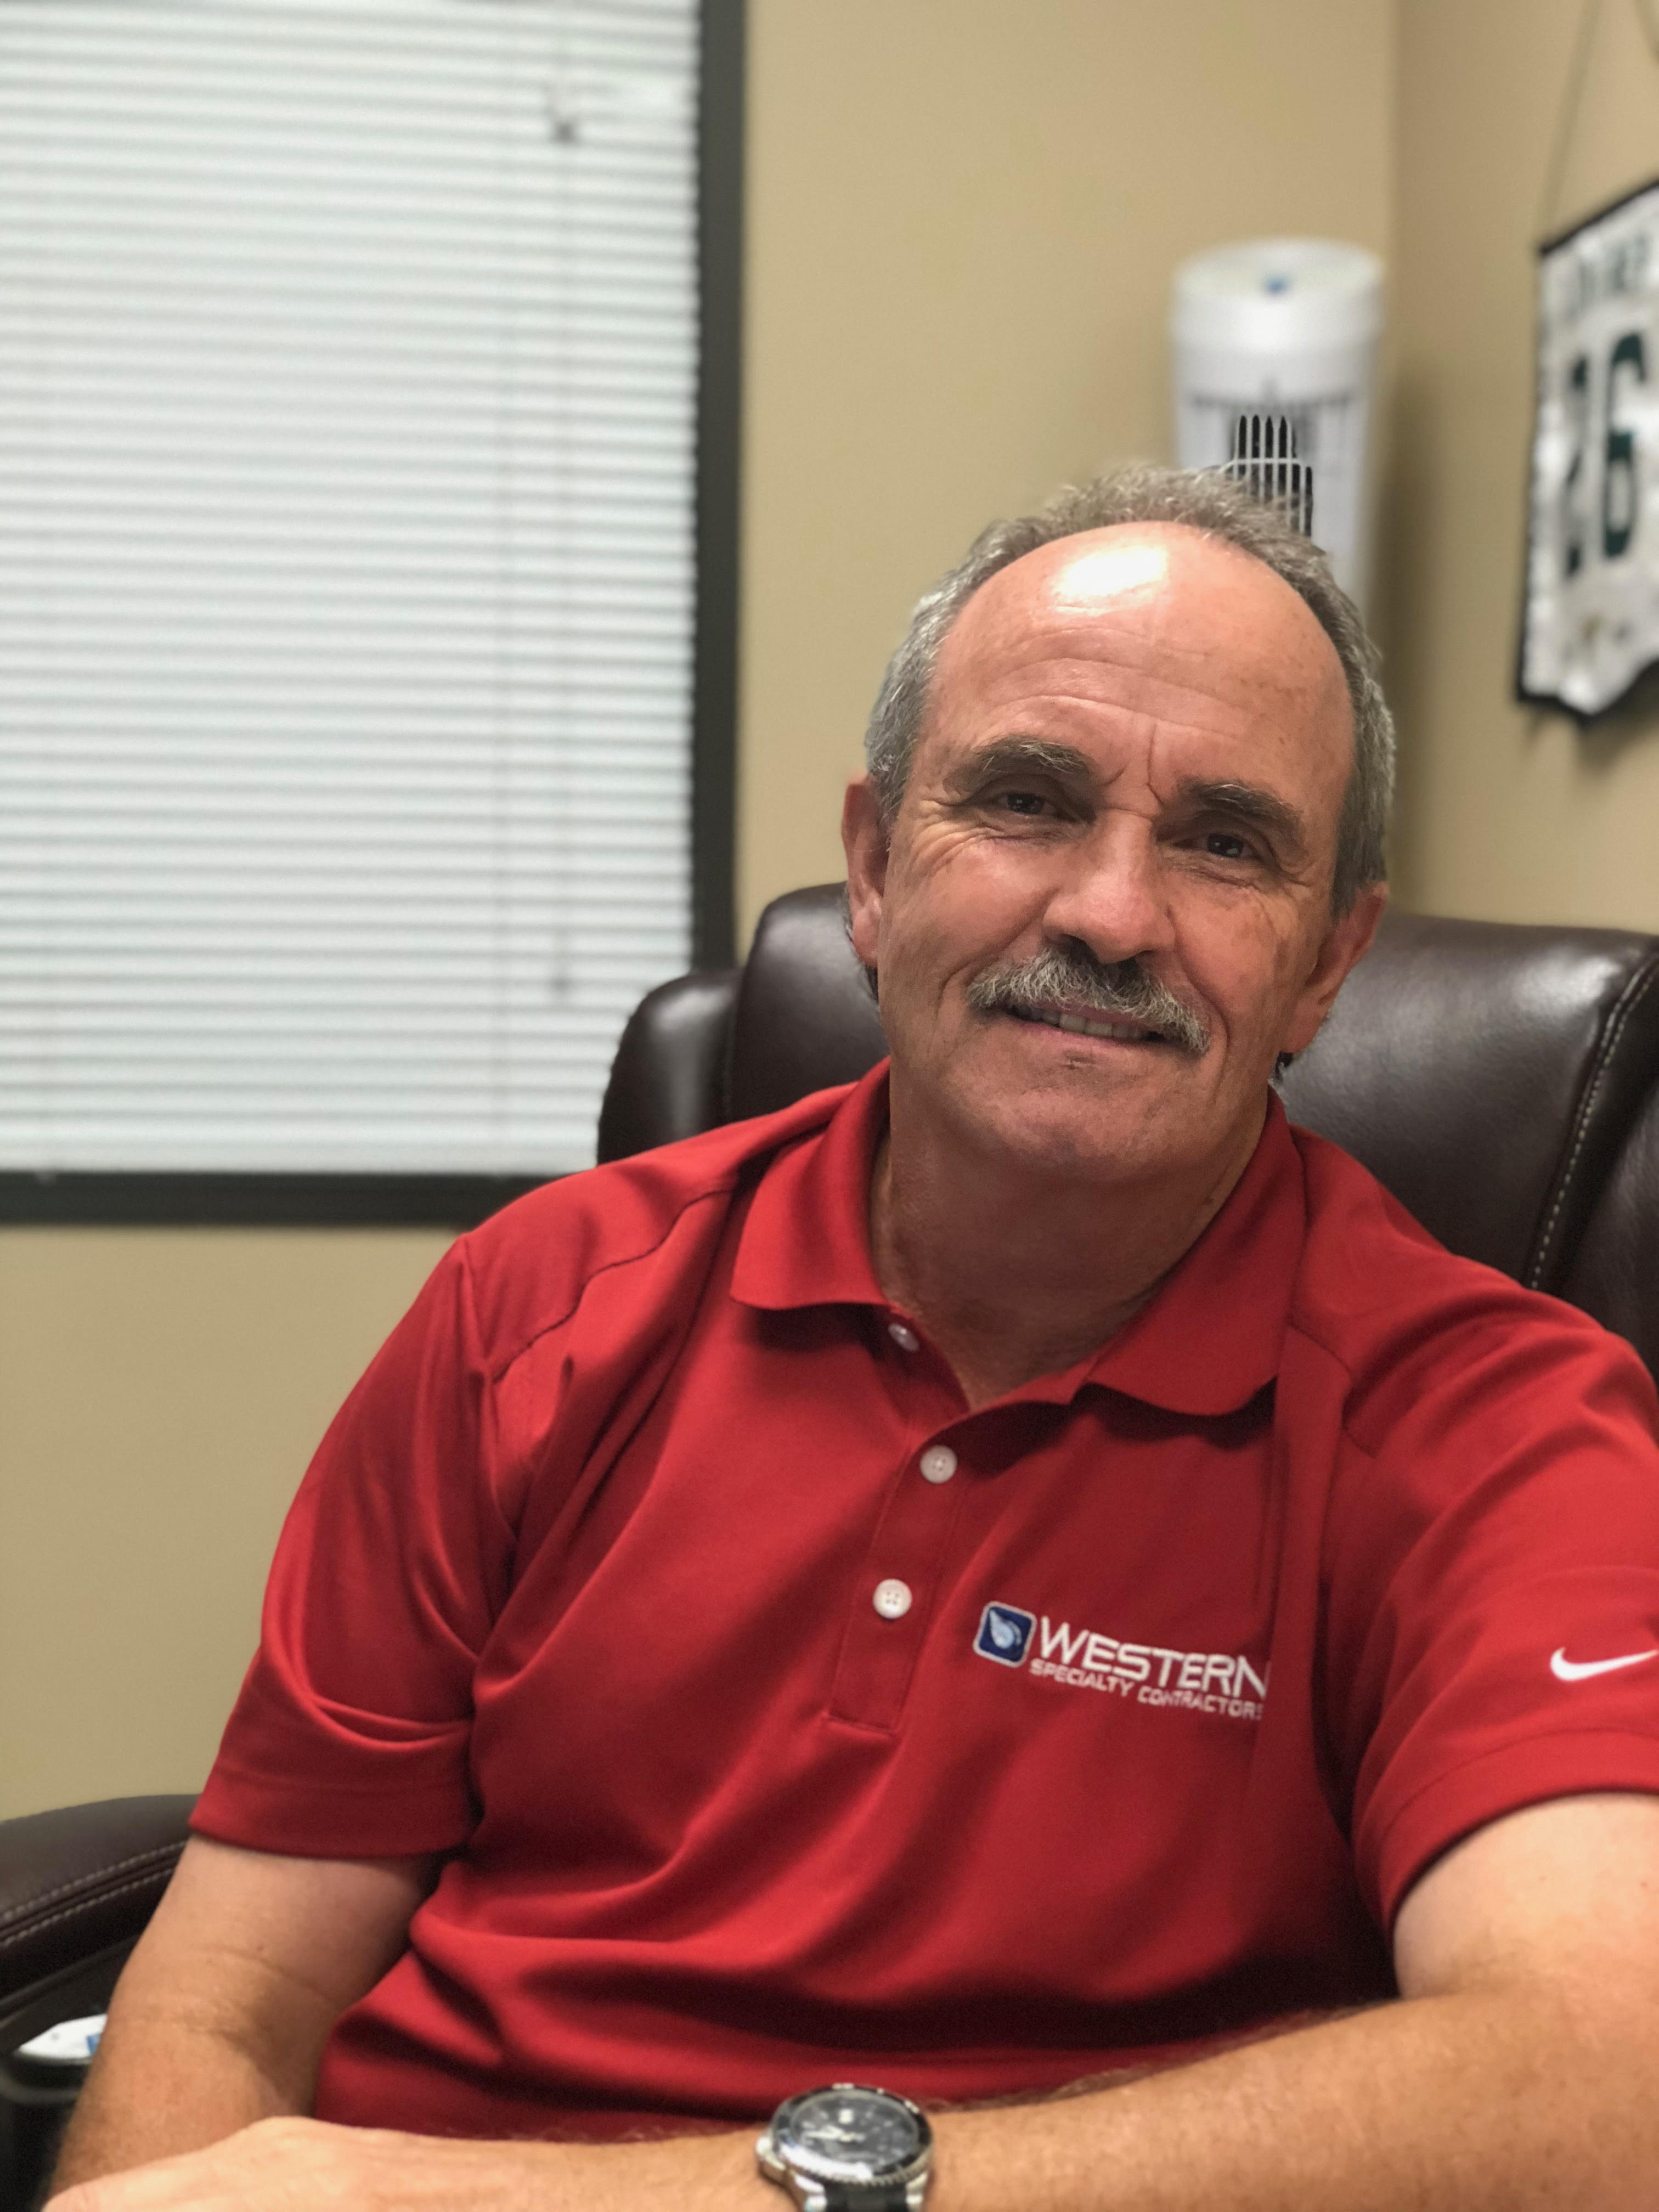
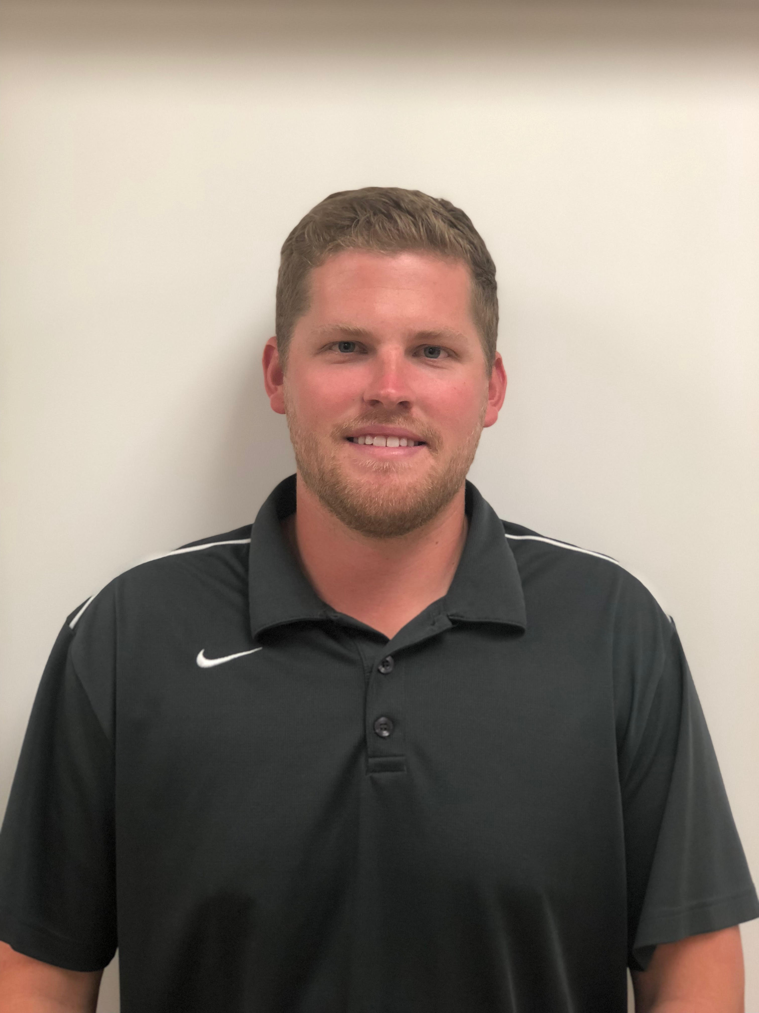

Meet Our Team
Ed Carter
Krista Gnatt
Bob Scheelar
Dallas Branch Manager
Sr. National Account Asset Manager
Department Manager
Bryce Duncan
Teddy Williams
Project Manager
National Accounts Asset Manager

Slide 3
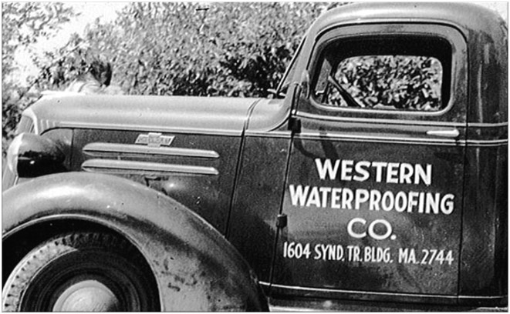
About Us
Founded in 1915
30 branches nationwide
Family owned and operated
Invested in client satisfaction
Clients are partners
Western is the nation’s largest specialty contractor in concrete, masonry, waterproofing, and facades restoration.

Slide 4



95% of Services Self Performed
Masonry/Façade Restoration
Concrete Restoration
Waterproofing
Exterior Coatings
Caulking & Sealants
Deck Coatings
Liquid Roofing
Building Cleaning
Historic Preservation
Plaza Restoration
Masonry
Concrete
Waterproofing

Slide 5
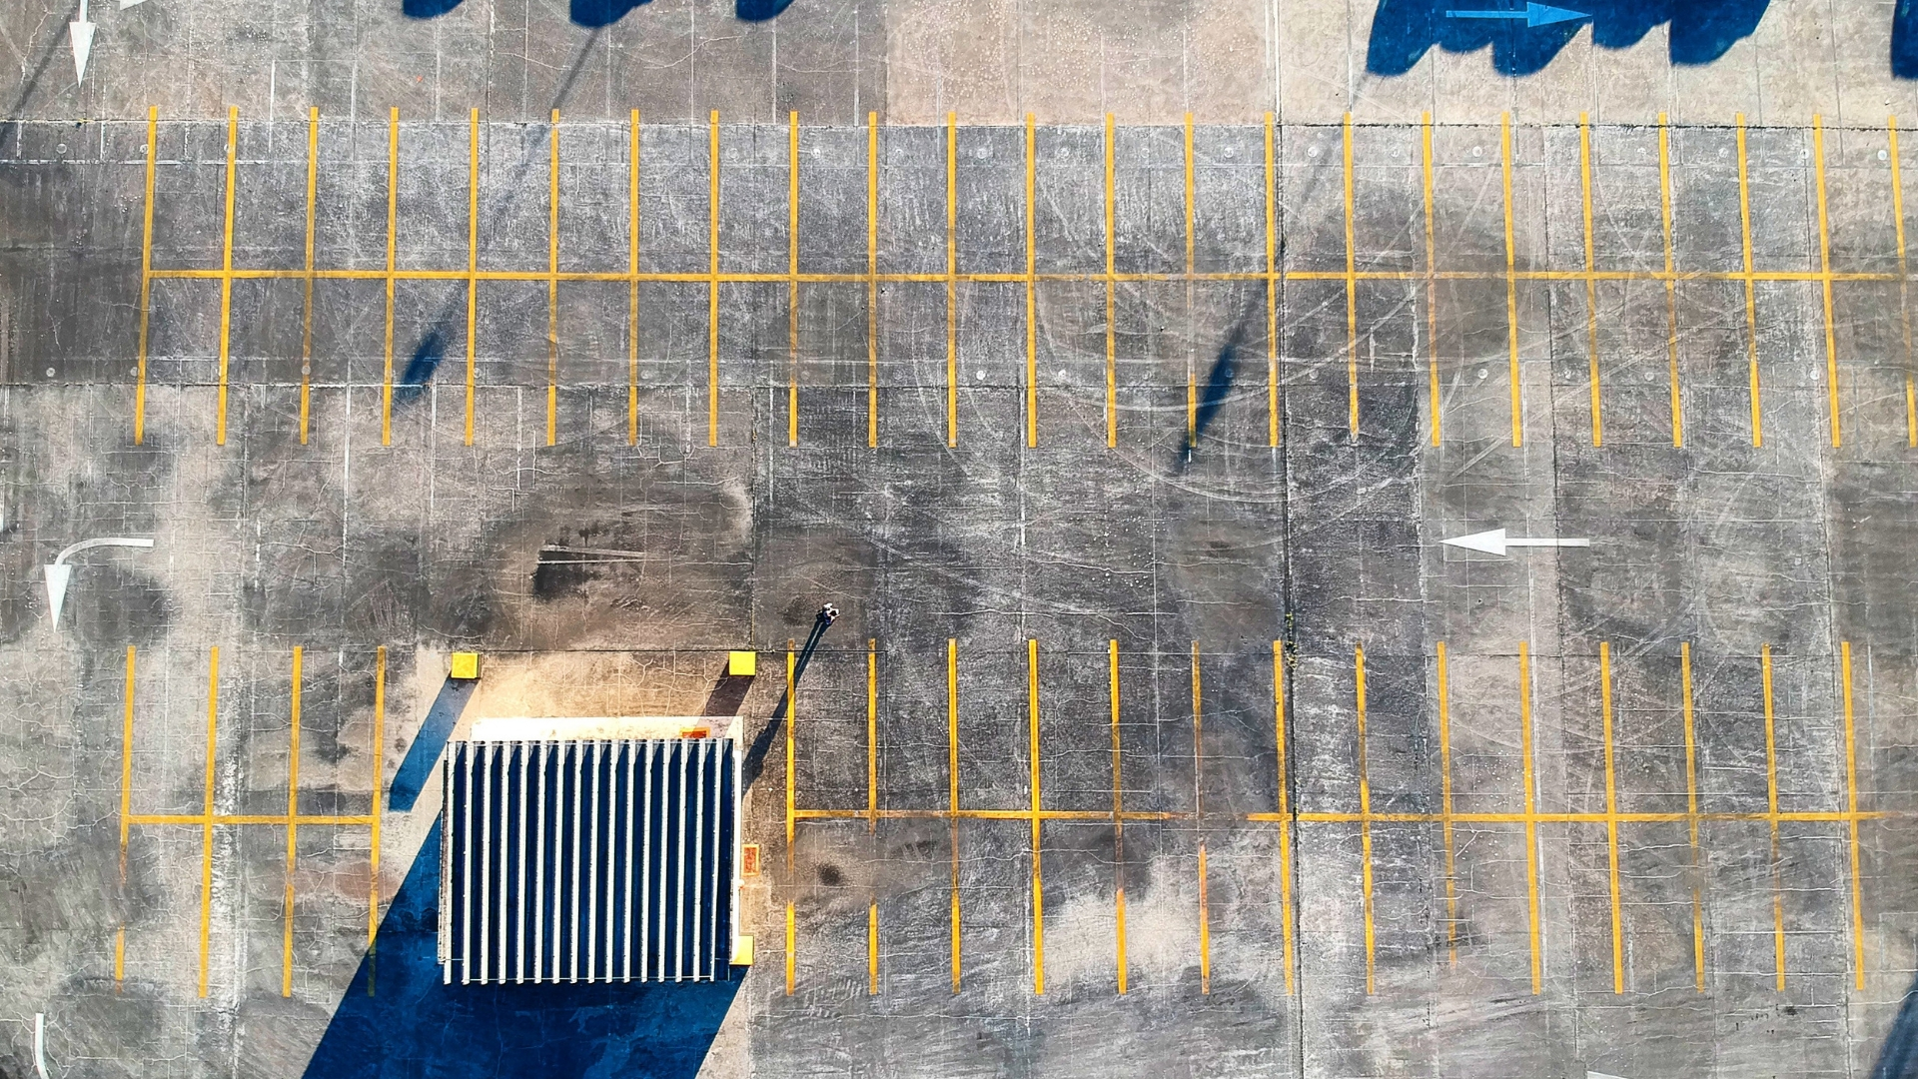
Parking Structure Restoration Services
Concrete Repair / Replacement
Structural Repairs
Expansion Joint Install / Replacement
Clear Sealer Application
Deck Coating Installation
Post Tension Repair
Epoxy Injections
Chemical Grout Injections
And Much More!

Slide 6
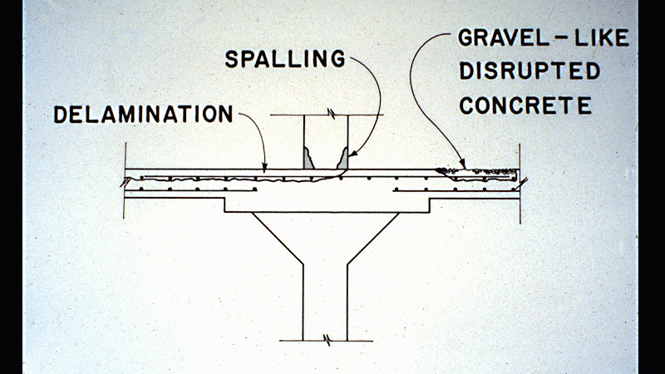


Slide 7
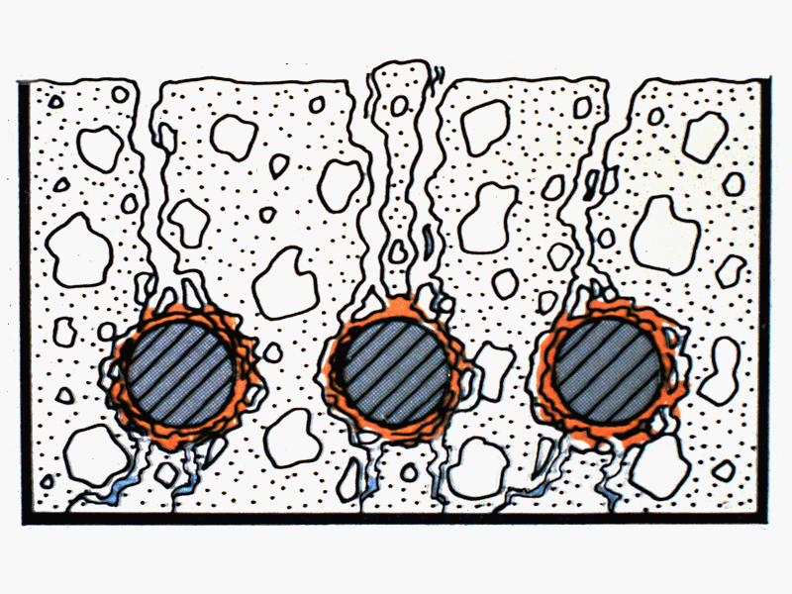

Slide 8
Reinforcement
Concrete is strong in compression, however it is weak in tension as the cement holding the aggregate in place can crack, allowing the structure to fail.
Reinforced concrete solves these problems by adding steel reinforcing bars to carry the tensile loads

Slide 9
Causes of Deterioration
Road Salt (Chloride)
Moisture
Freeze Thaw Cycles
Salt Air / Water
Poor Design Mix
Poor Workmanship
Lack Of Maintenance
Movement
Acid Rain
Daily Usage
Carbonation
Chloride Admixtures
Hazardous Materials

Slide 10
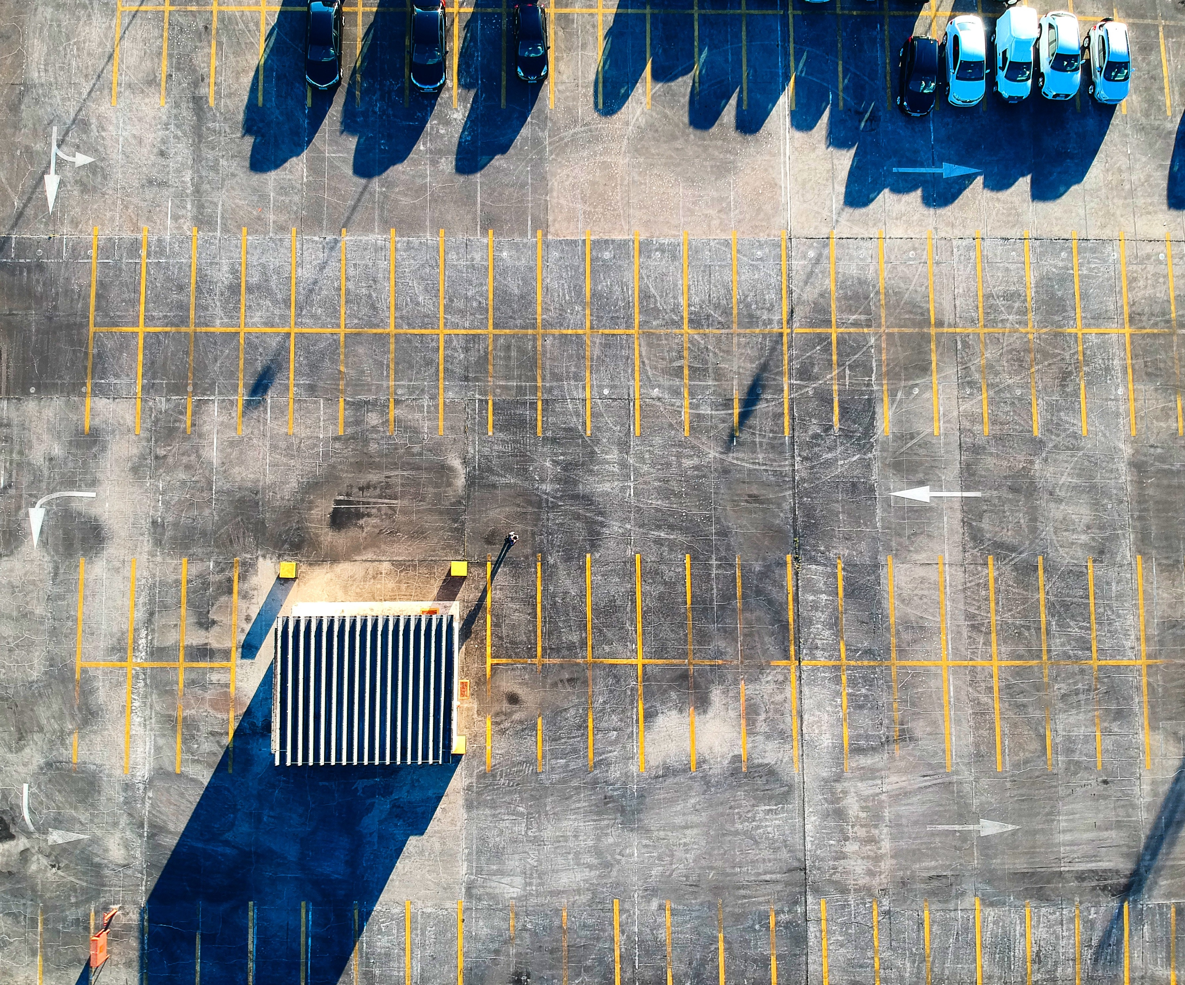
5 Crucial Warning Signs for Parking Structure Maintenance
What Parts of the Garage to Inspect & What to Look For

Slide 11
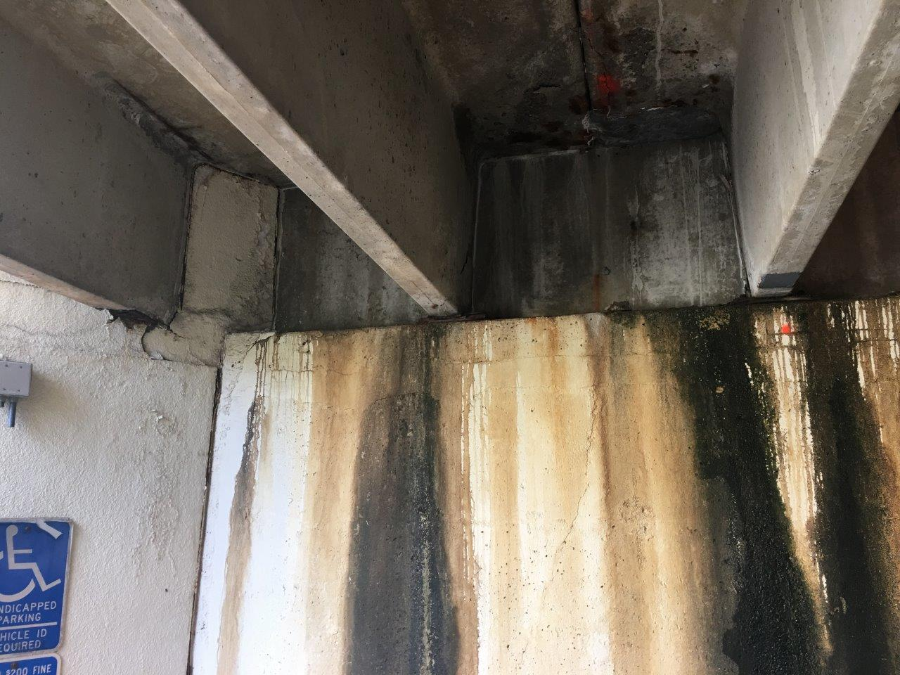
Water Leakage
Exposed metals rusting, rust stains along walls, and efflorescence.

Slide 12
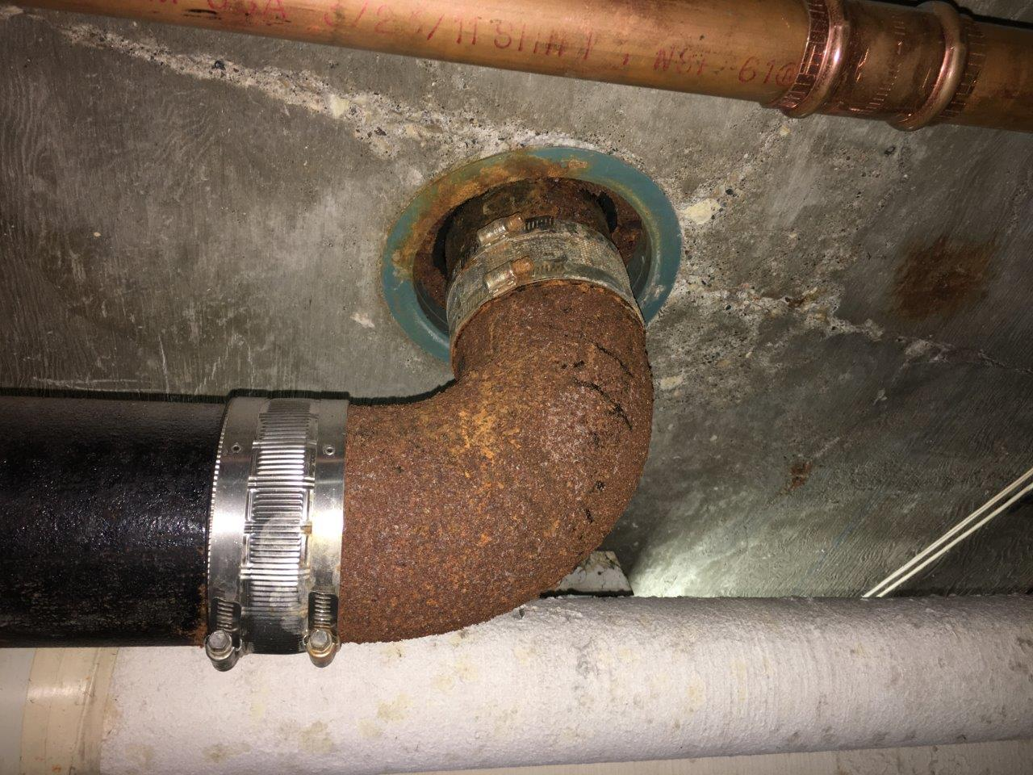
Rust

Slide 13
Stains

Slide 14
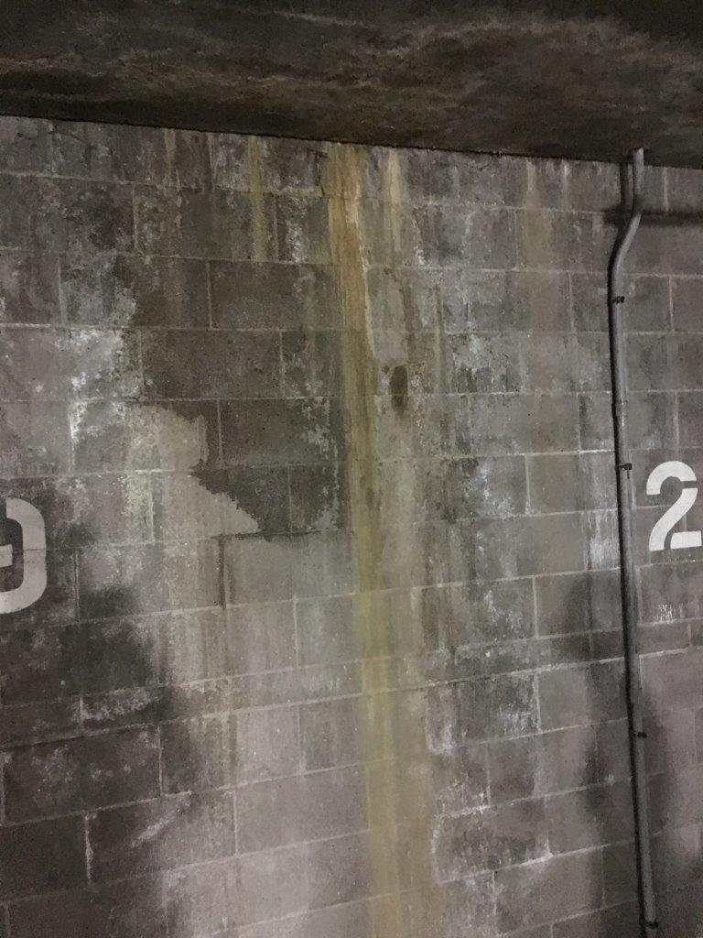
Efflorescence

Slide 15
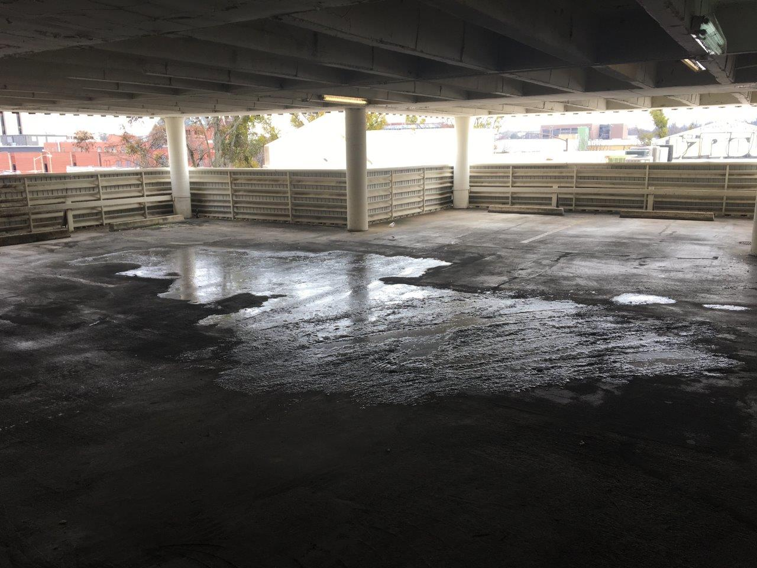
Ponding Water
Standing water and clogged drains.

Slide 16
Ponding

Slide 17
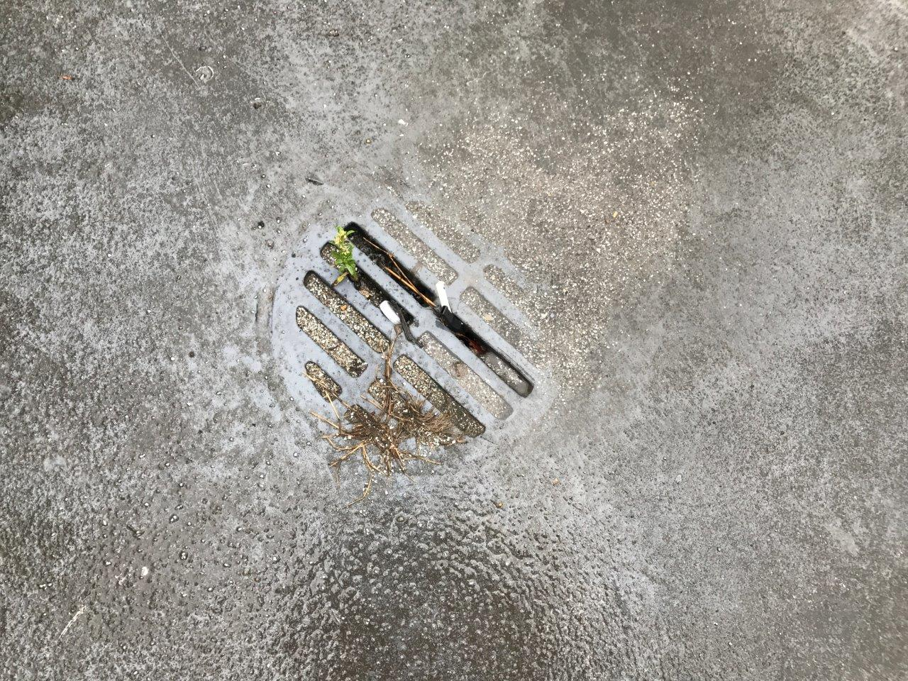
Clogged
Drains

Slide 18
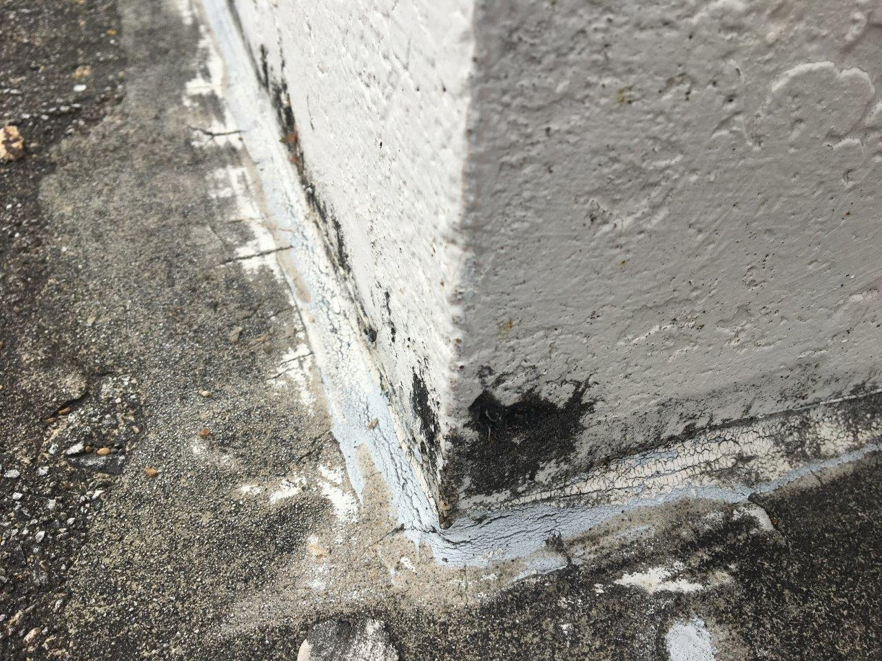
Expansion & Control Joint Failure
Catch it while it’s minor.

Slide 19
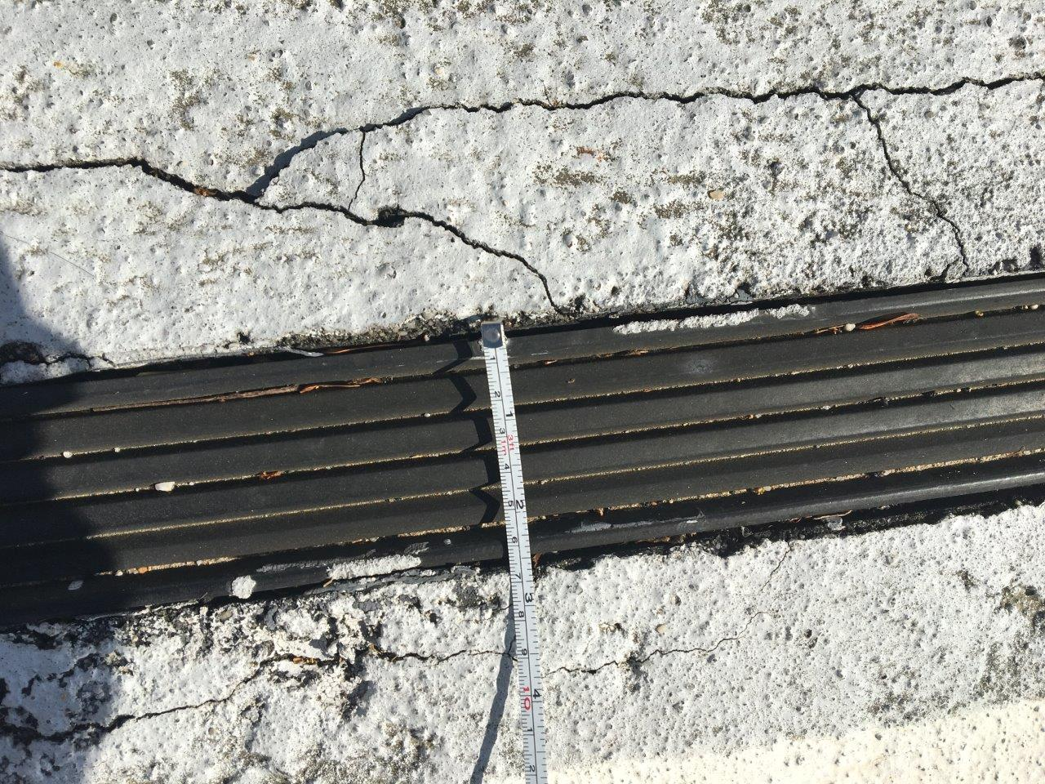
Expansion
Joints

Slide 20
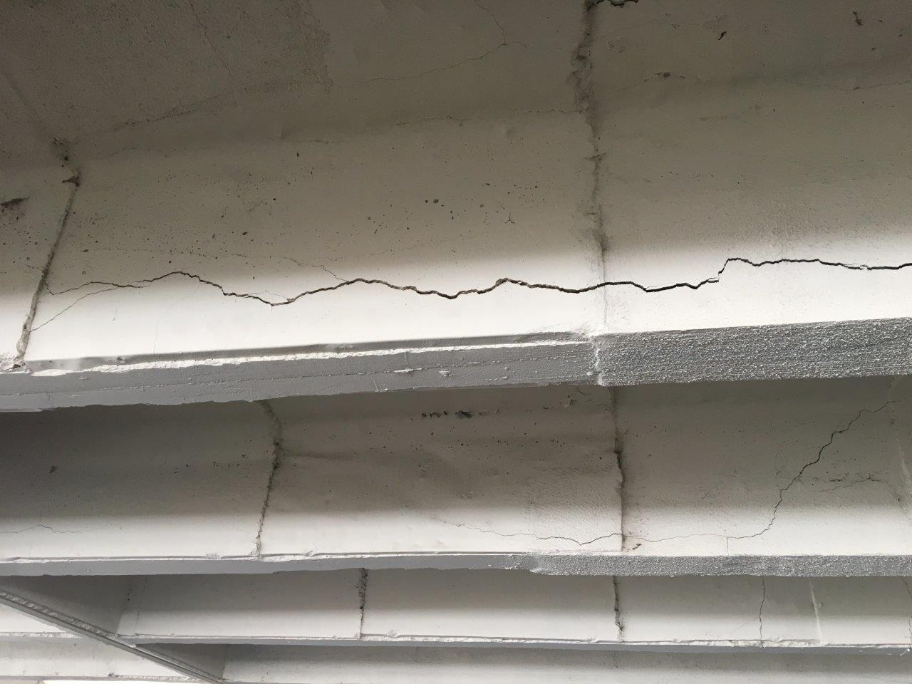
Concrete Issues
Delaminated, Spalled, Horizontally Cracked & Vertically Cracked Concrete.

Slide 21
Beams

Slide 22
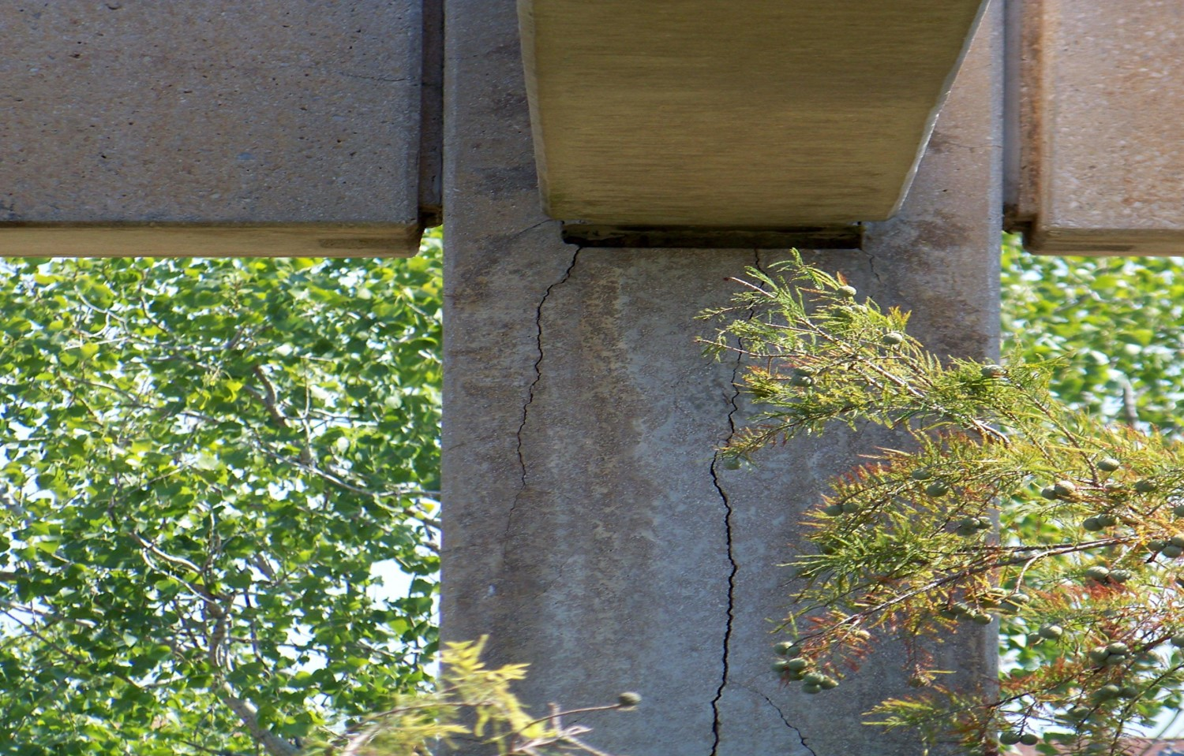
Columns

Slide 23
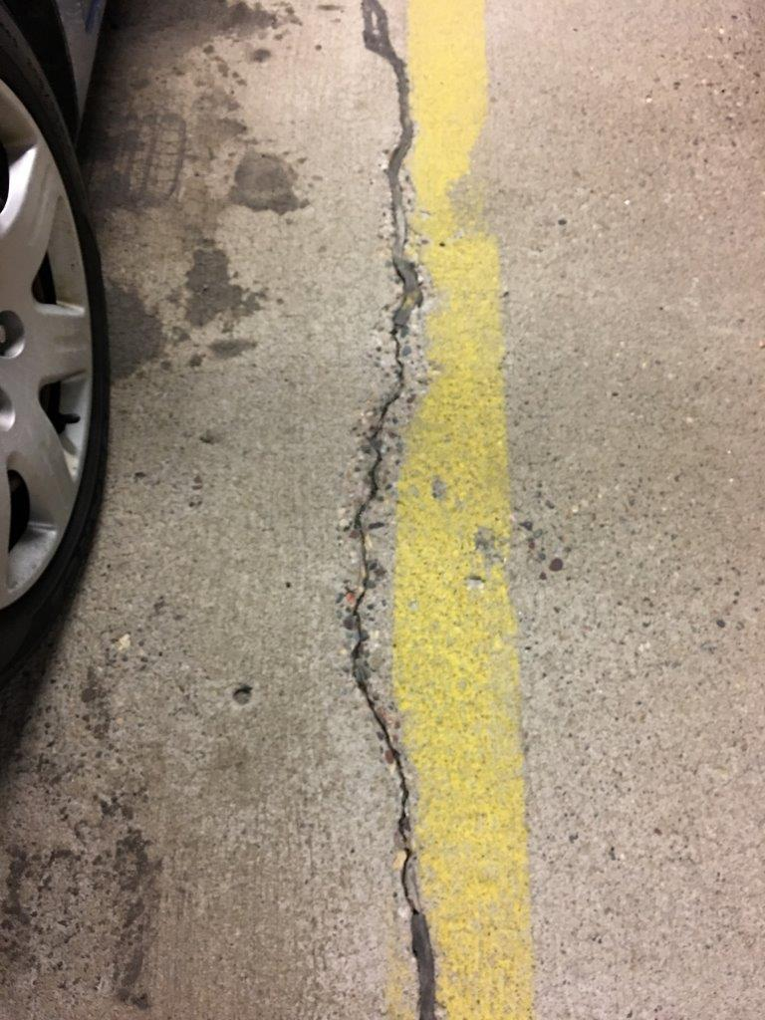
Cracking

Slide 24
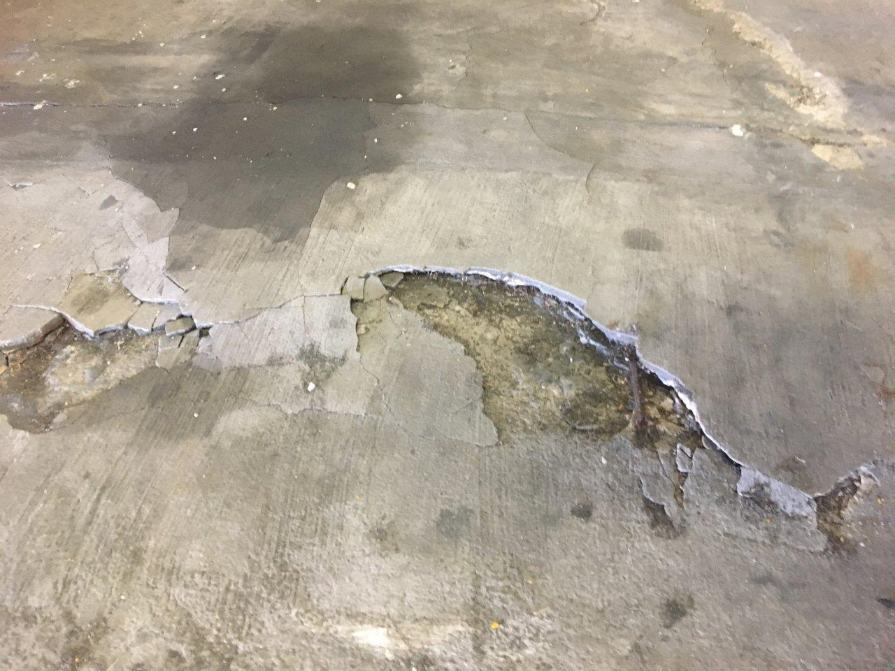
Spalling

Slide 25
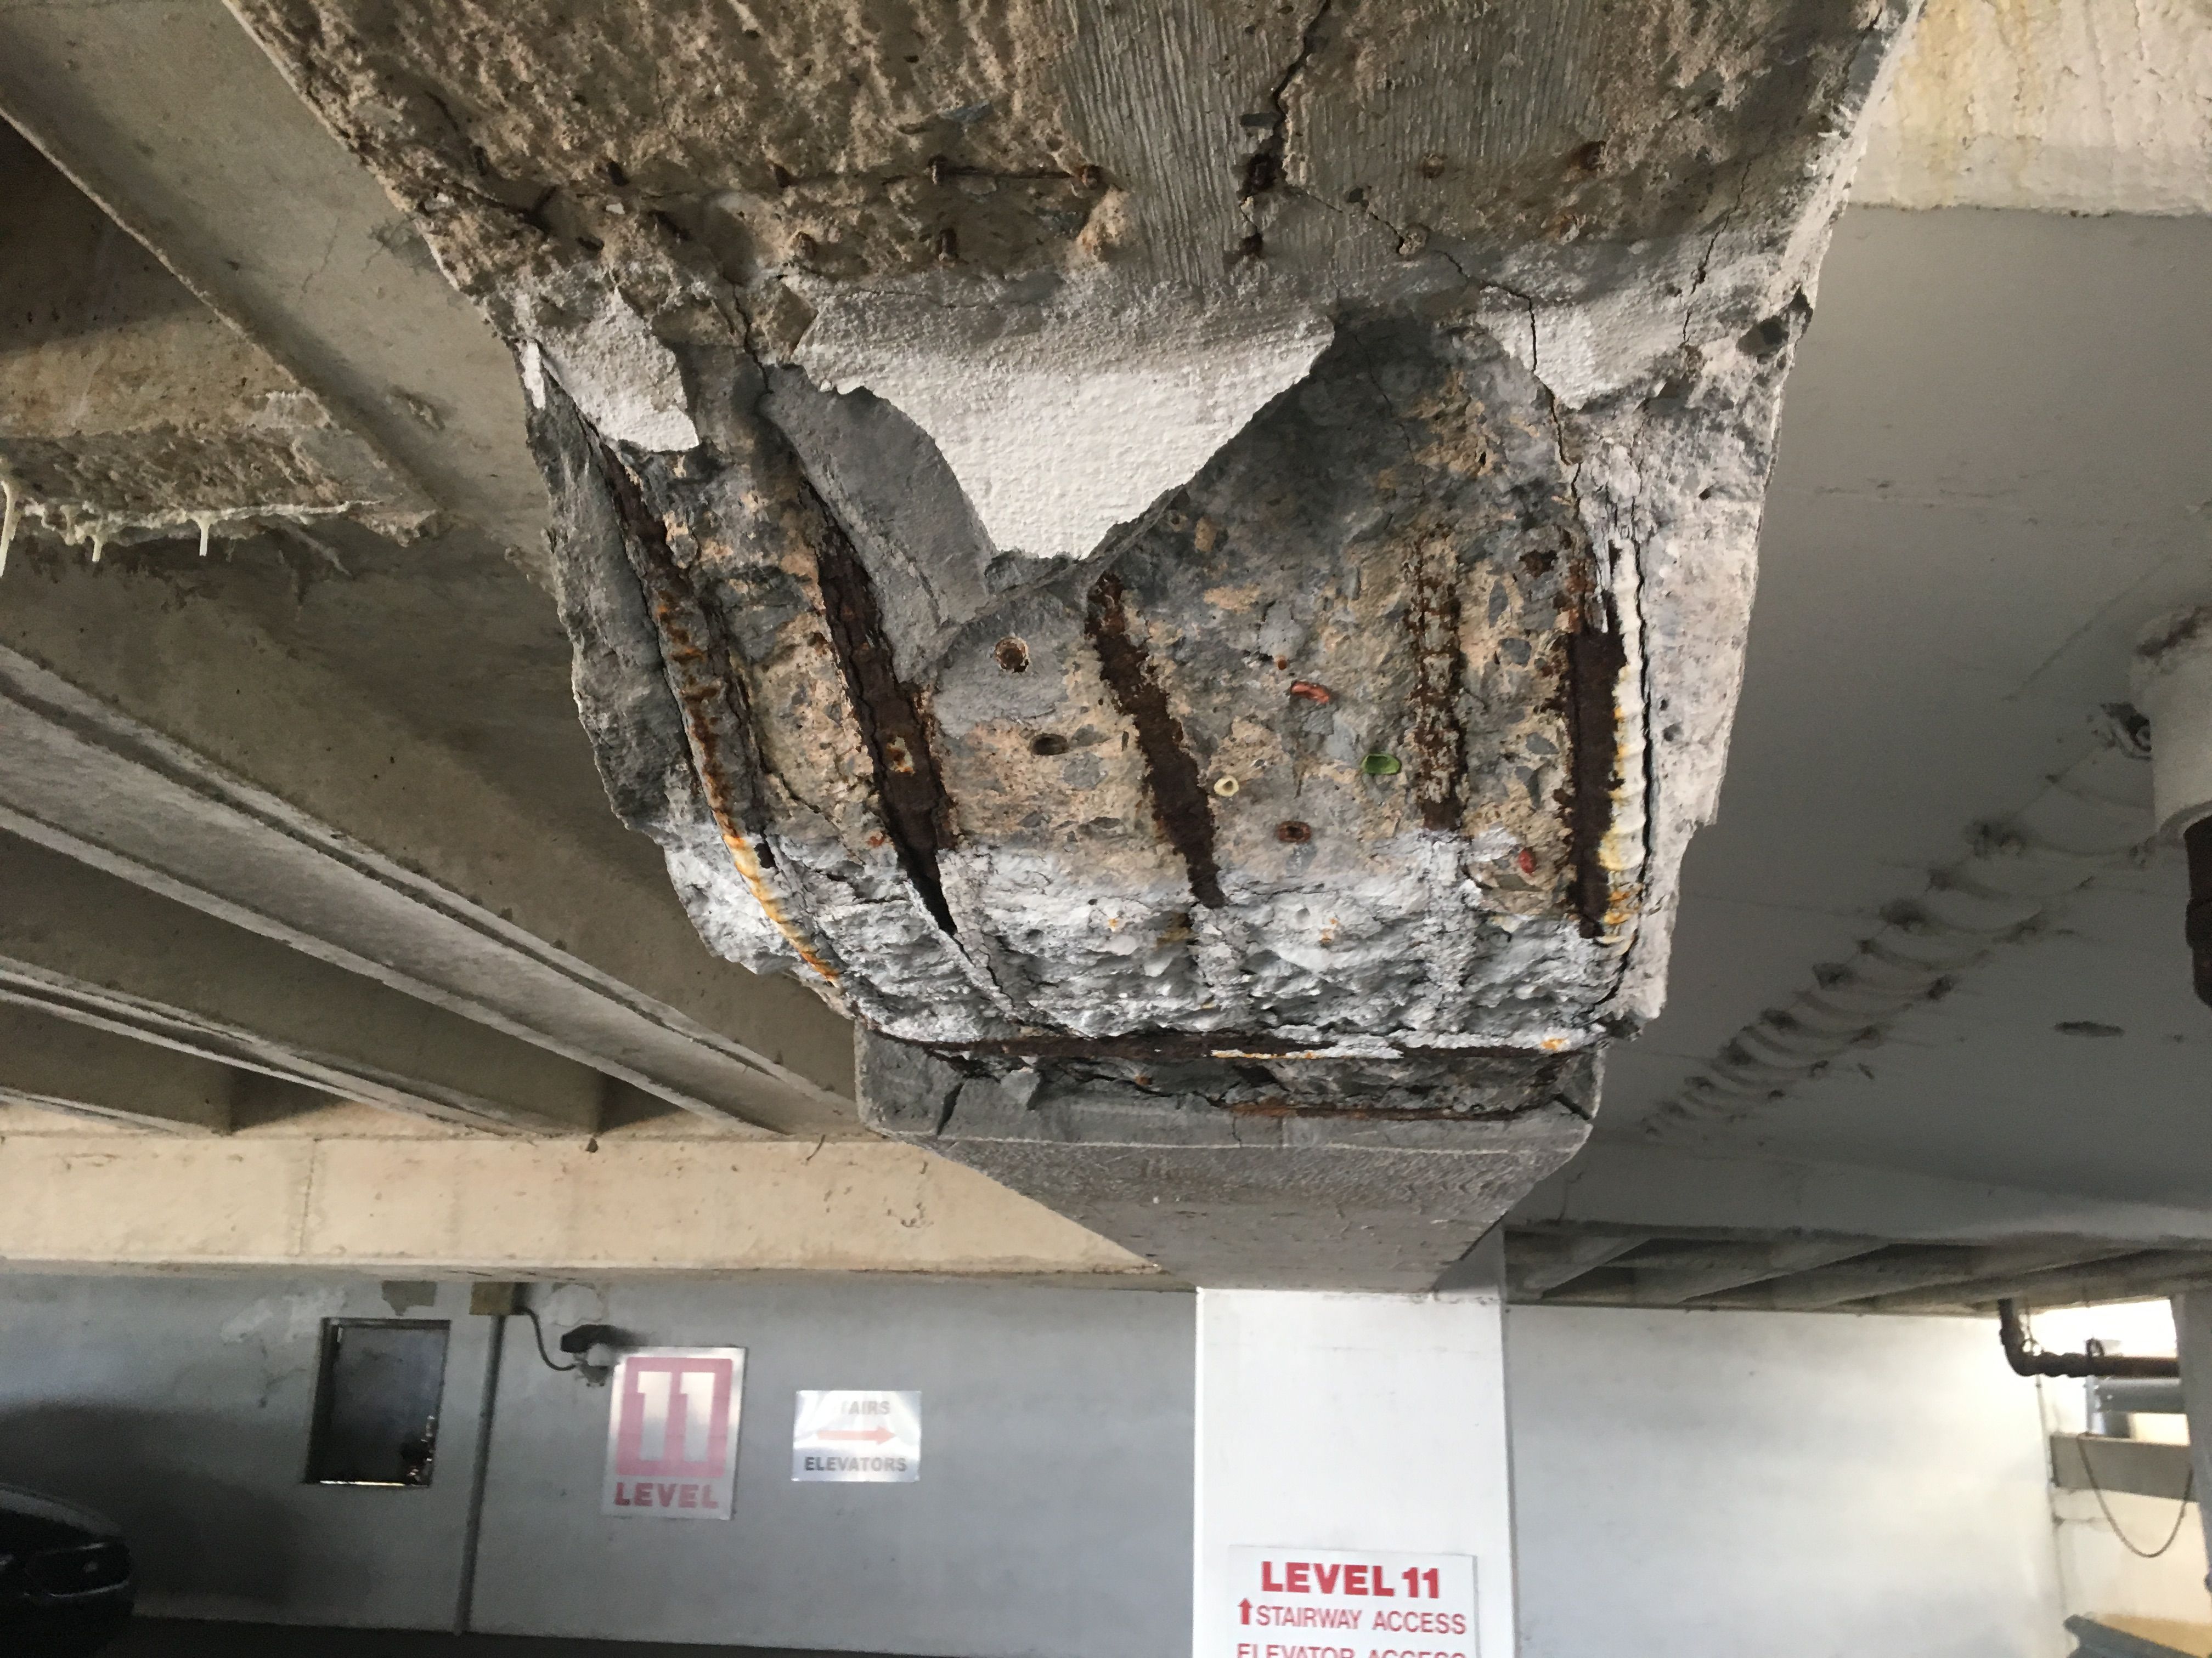
Exposed Rebar (Reinforcing Steel)
If rebar can be seen, there’s a problem that deserves swift attention.

Slide 26
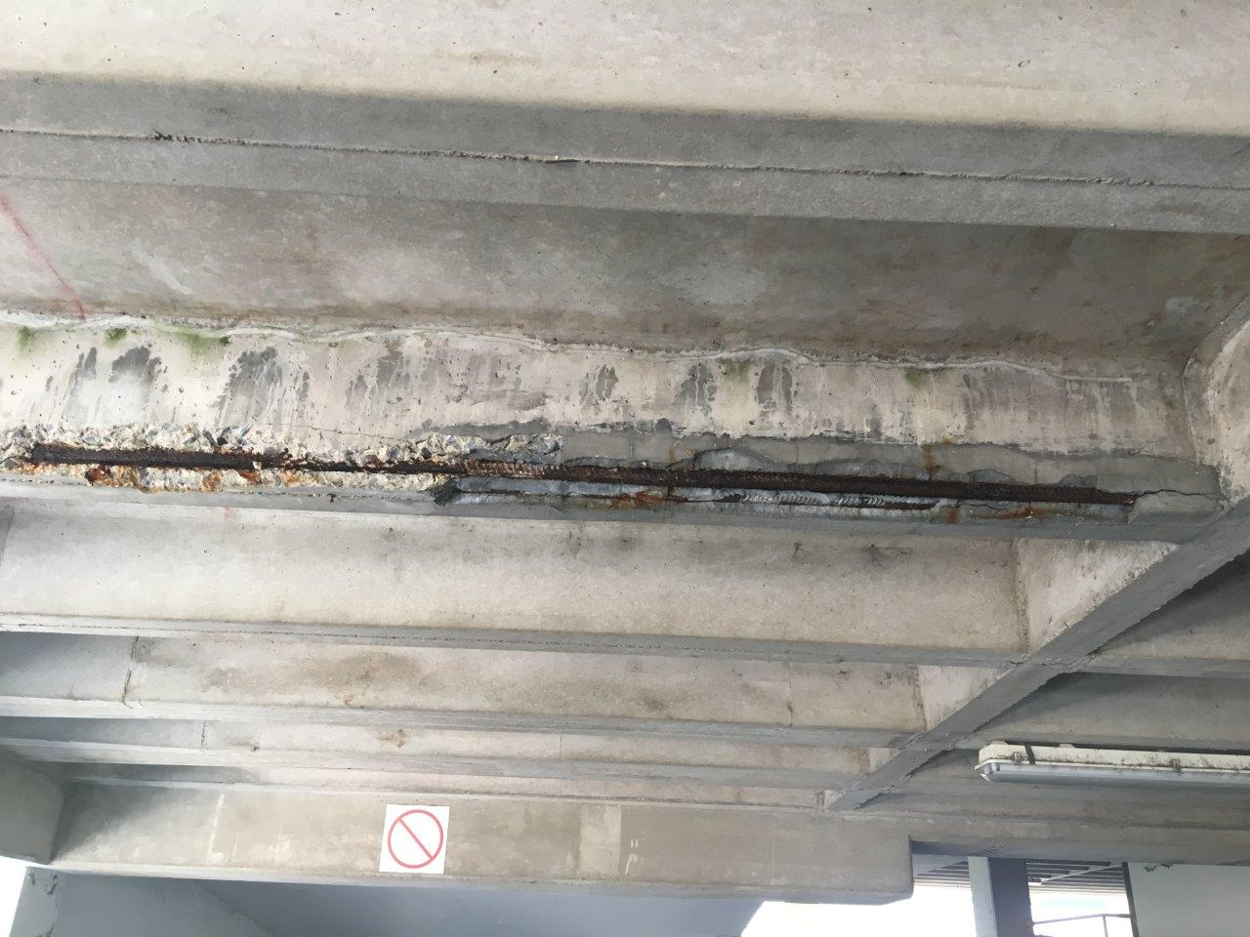
Exposed Steel

Slide 27
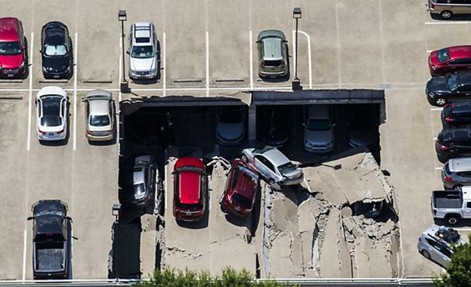
Preserve Your Parking Structure
What Parts of the Garage to Inspect & What to Look For

Slide 28
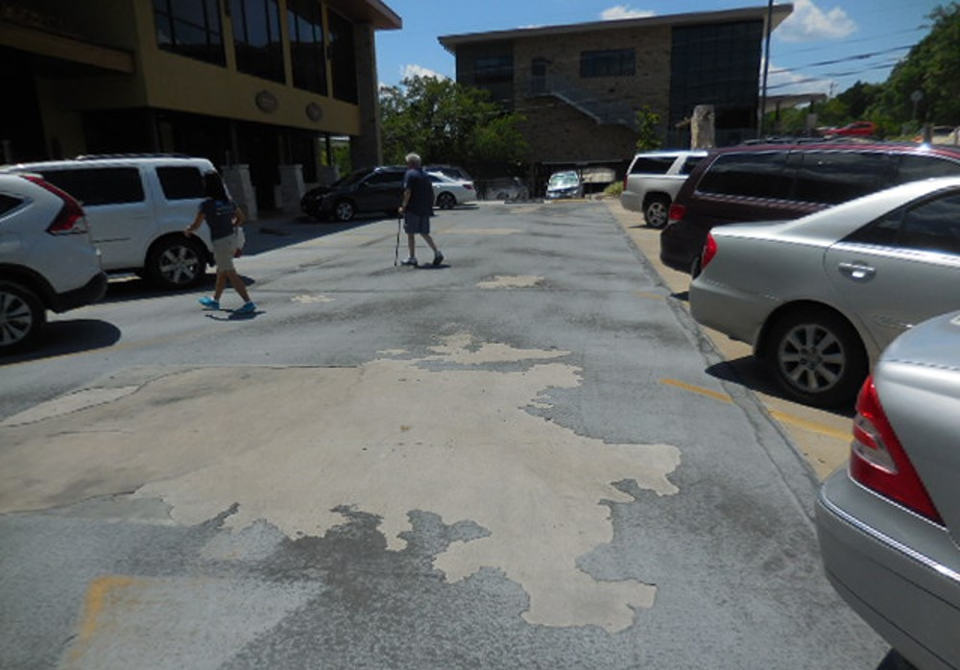
Deck Coating Before

Slide 29
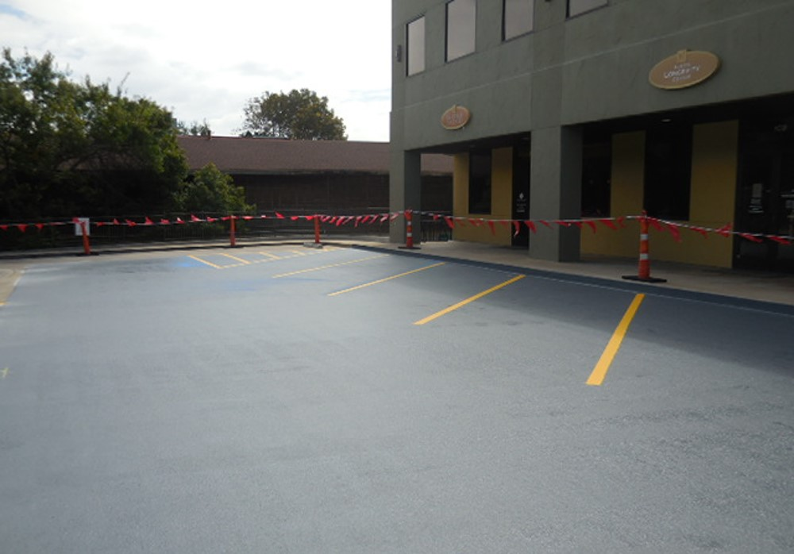
Deck Coating After

Slide 30
Parking Structure Restoration Services
Concrete Repair / Replacement
Structural Repairs
Expansion Joint Install / Replacement
Clear Sealer Application
Deck Coating Installation
Post Tension Repair
Epoxy Injections
Chemical Grout Injections
And Much More!

Slide 31
Template Title
Type your content here. Type your content here. Type your content here. Type your content here. Type your content here. Type your content here. Type your content here. Type your content here.
Type your content here. Type your content here. Type your content here. Type your content here.

