Slide 1

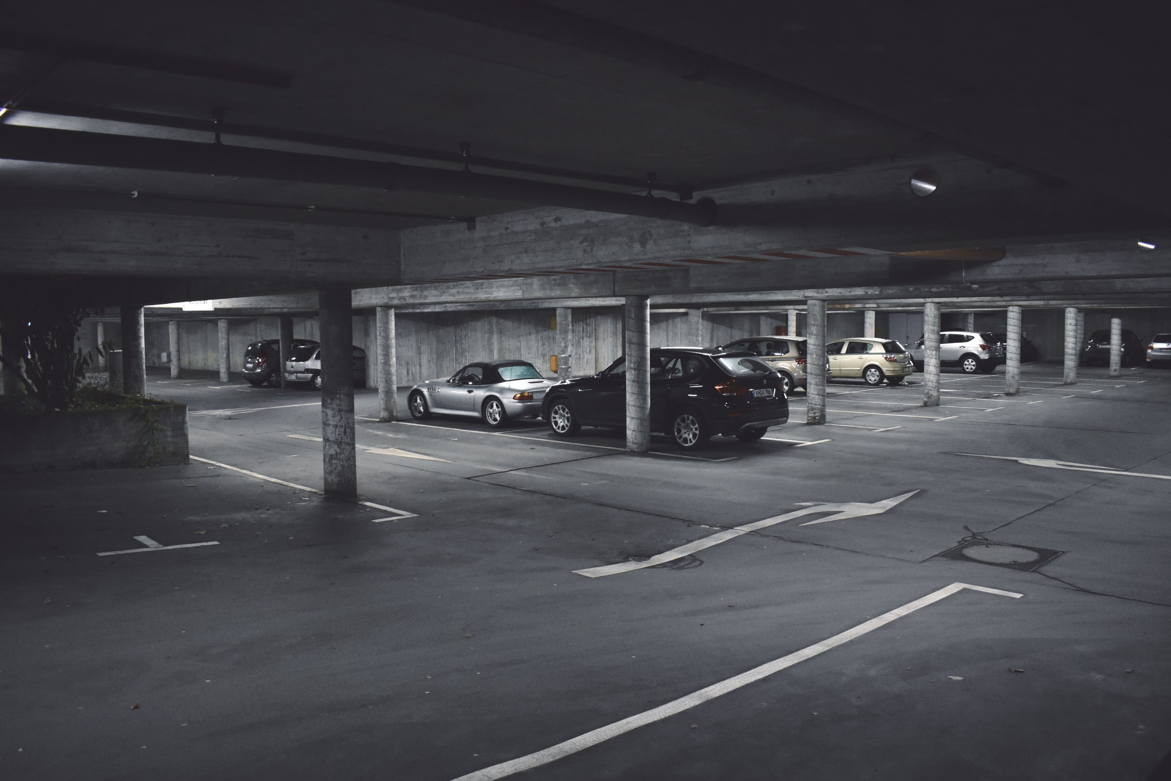
Parking Garage Slides for Sika Presentation
Parking Garage Maintenance Playbook
Western & Sika

Slide 2
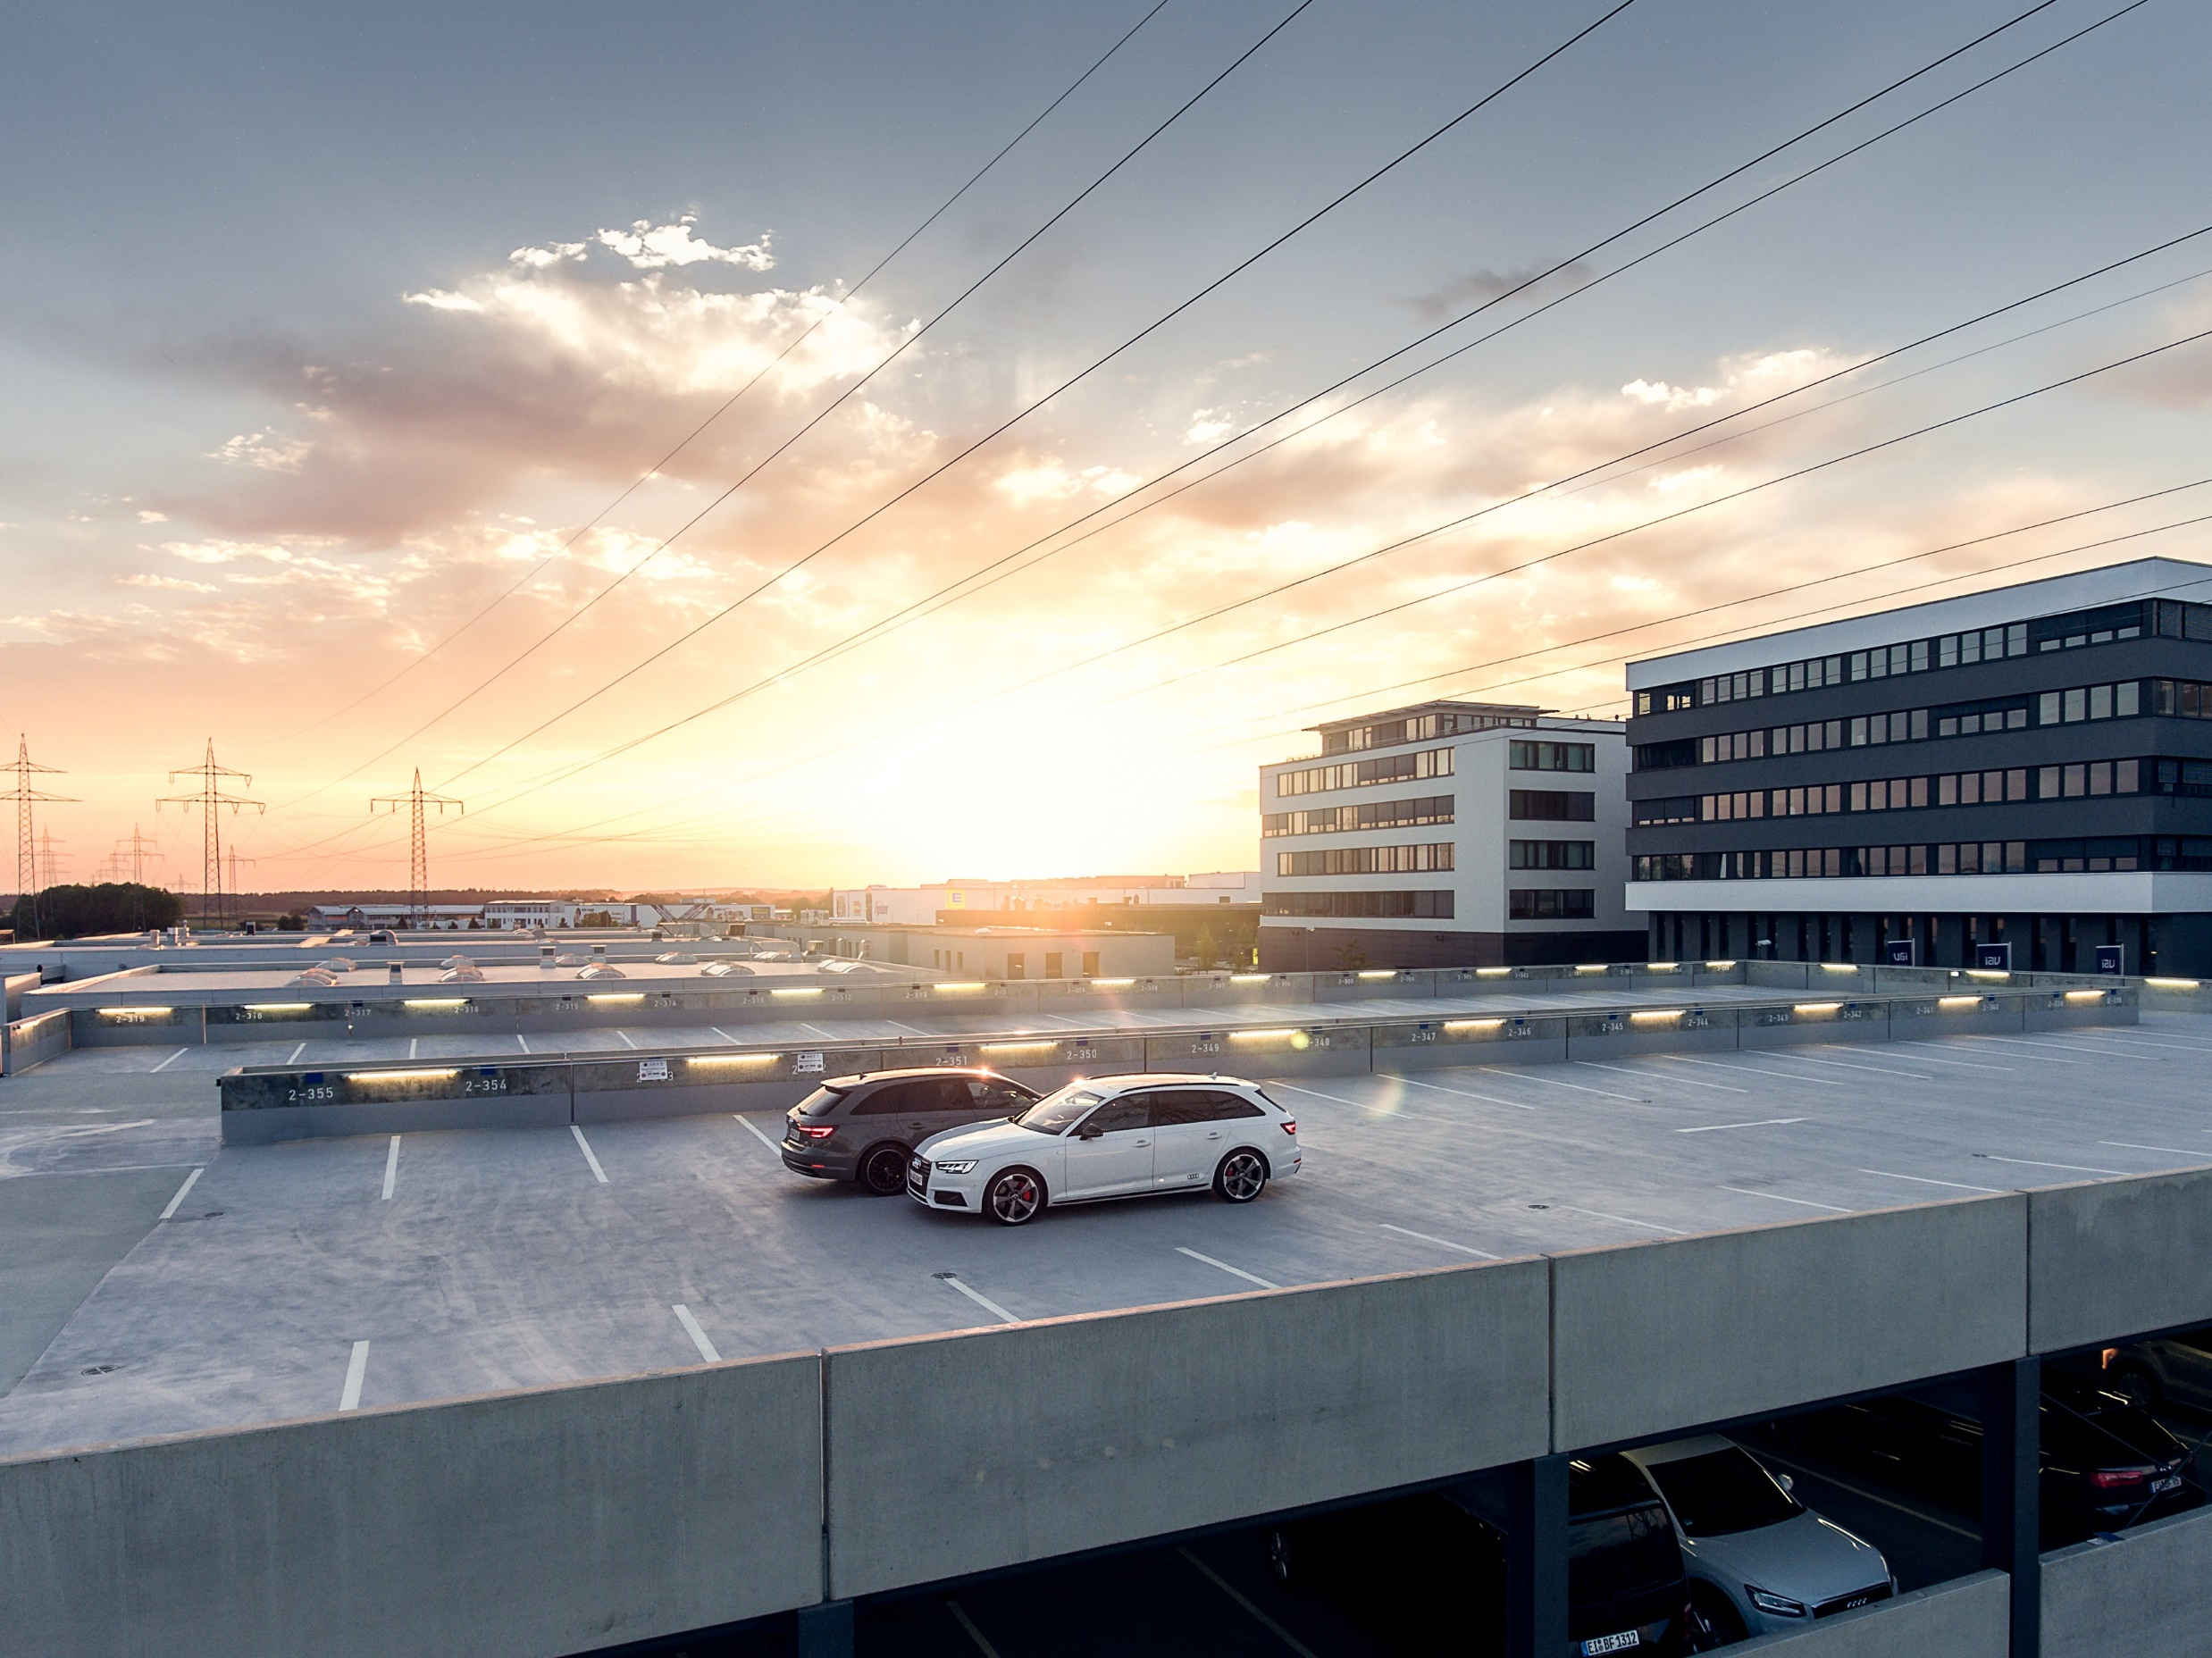
Conditions to be Checked
Part one
Parking Garage Maintenance Playbook

Slide 3
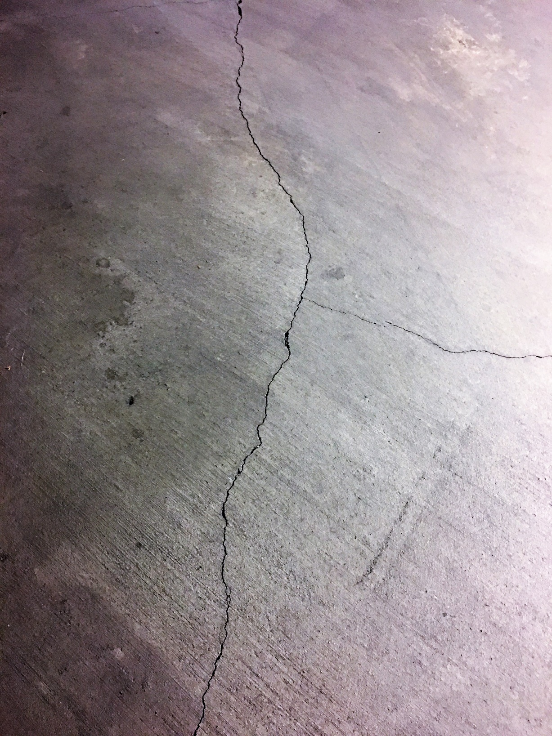
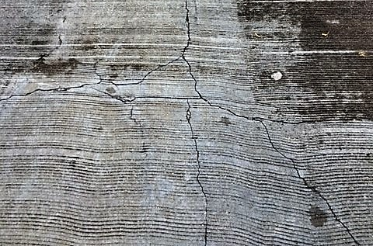
Cracking
Parking Garage Maintenance Playbook
Noticeable fissures caused by construction or service-related stress resulting in moisture and chloride entry into the concrete.

Slide 4
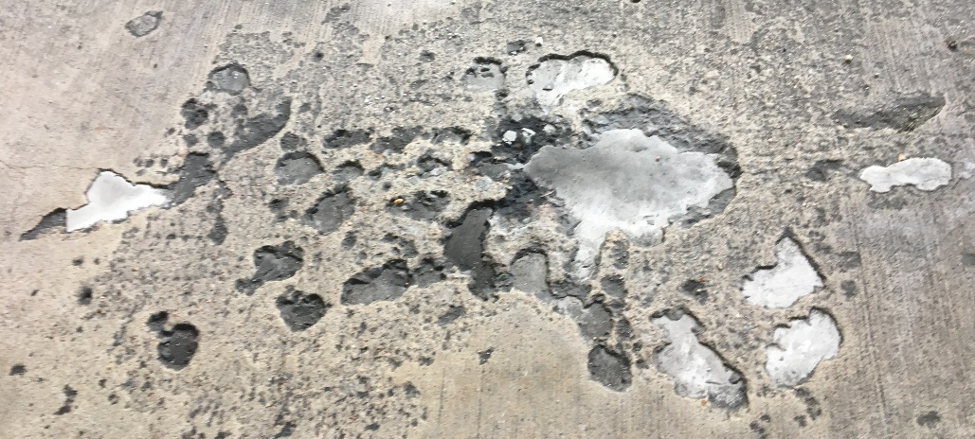
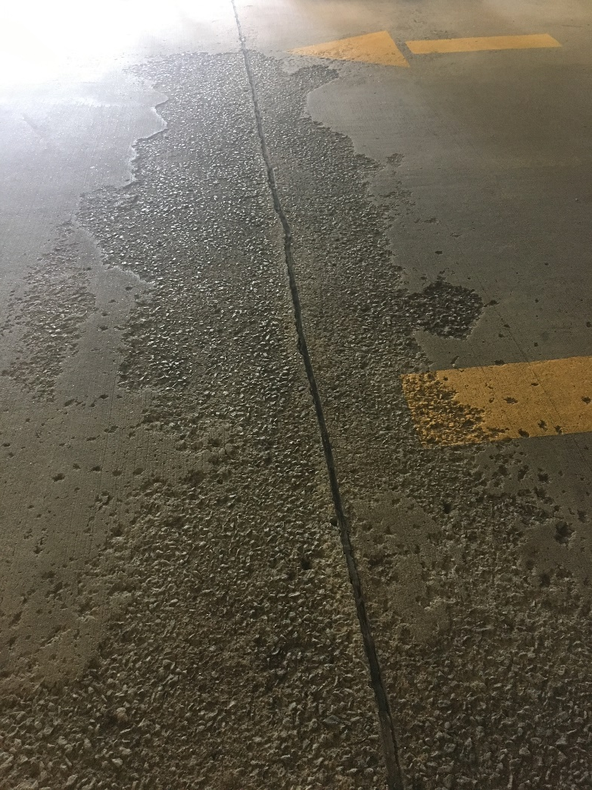
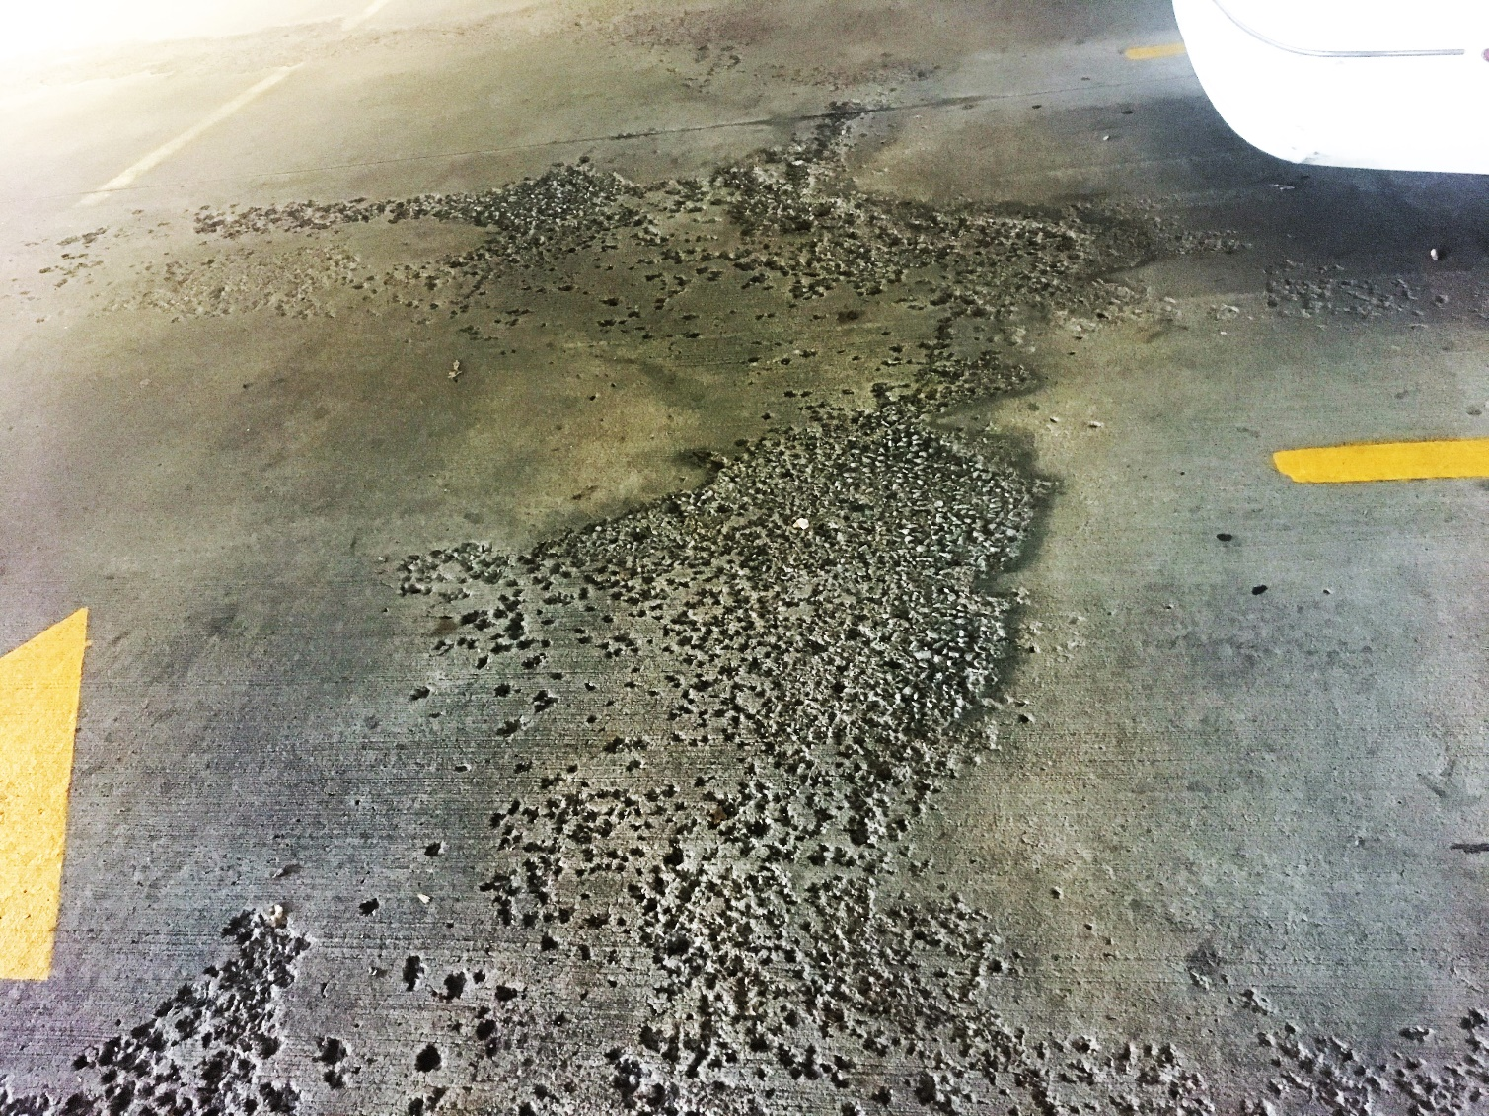
Scaling
Parking Garage Maintenance Playbook
The loss of the surface of the concrete caused by the freeze-thaw cycle and inadequate air entrainment in the concrete.

Slide 5
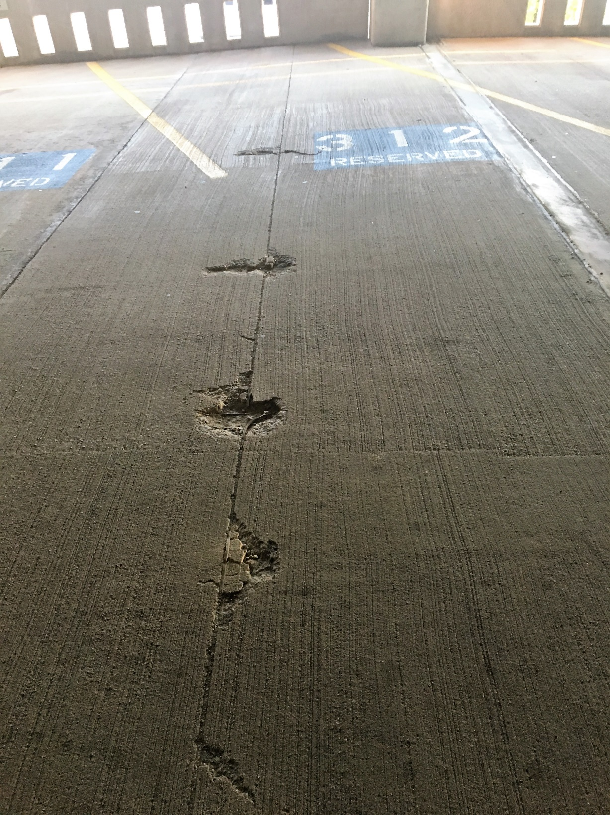
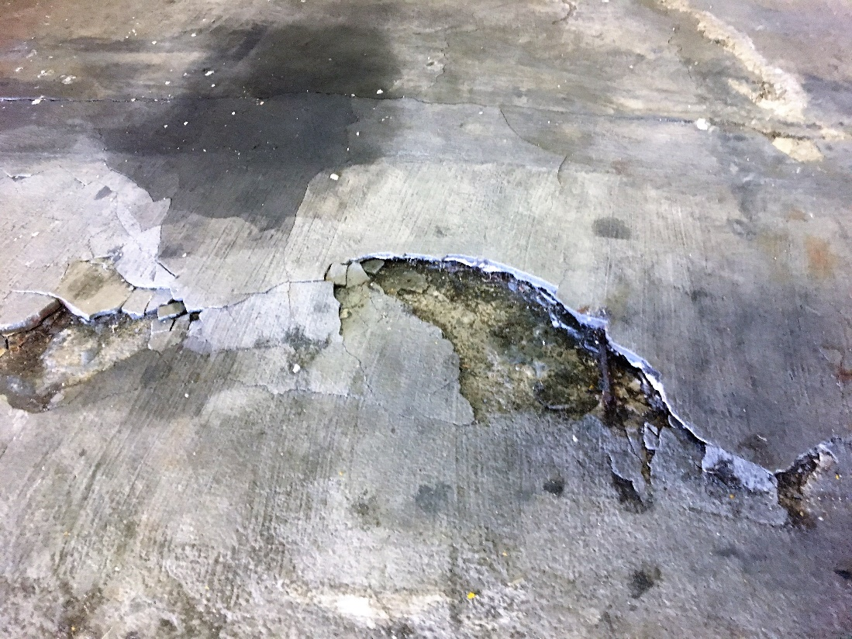
Spalling
Parking Garage Maintenance Playbook
Potholes resulting from corrosion induced stress.

Slide 6
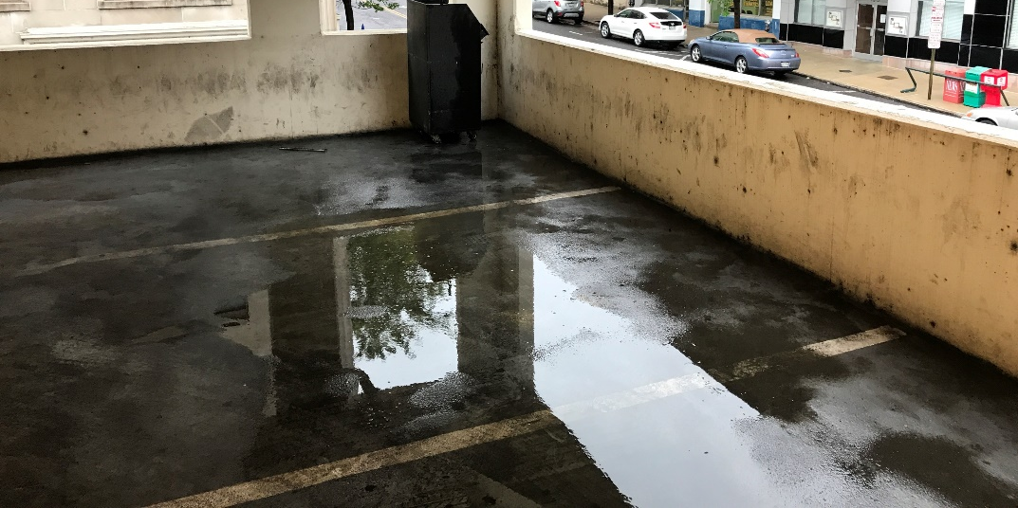
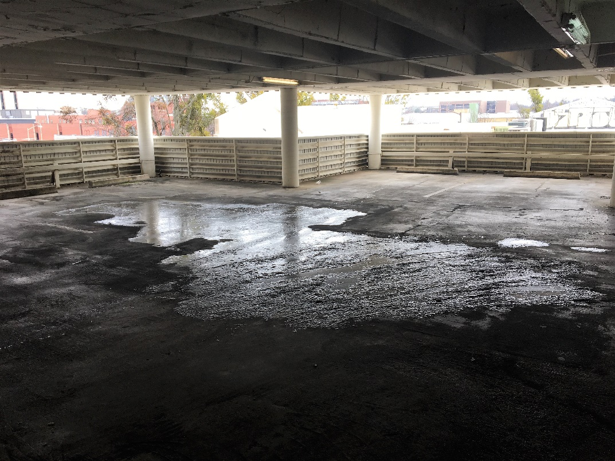
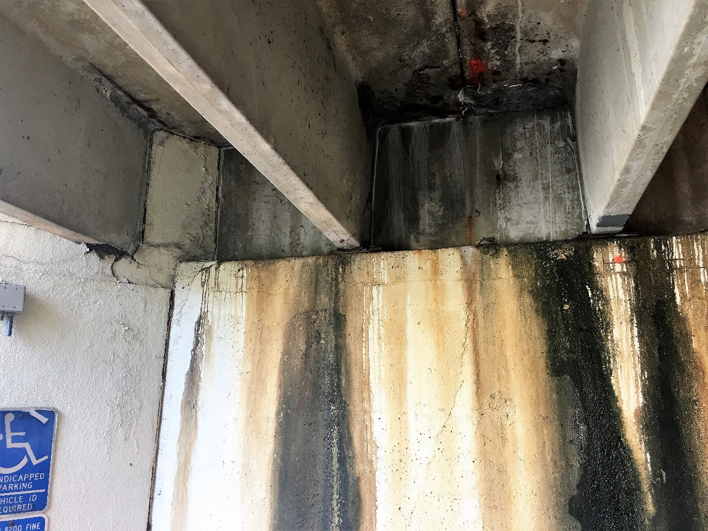
Leaking
Parking Garage Maintenance Playbook
Tell-tale signs include standing water, stains, and possible damage to the floor below.

Slide 7
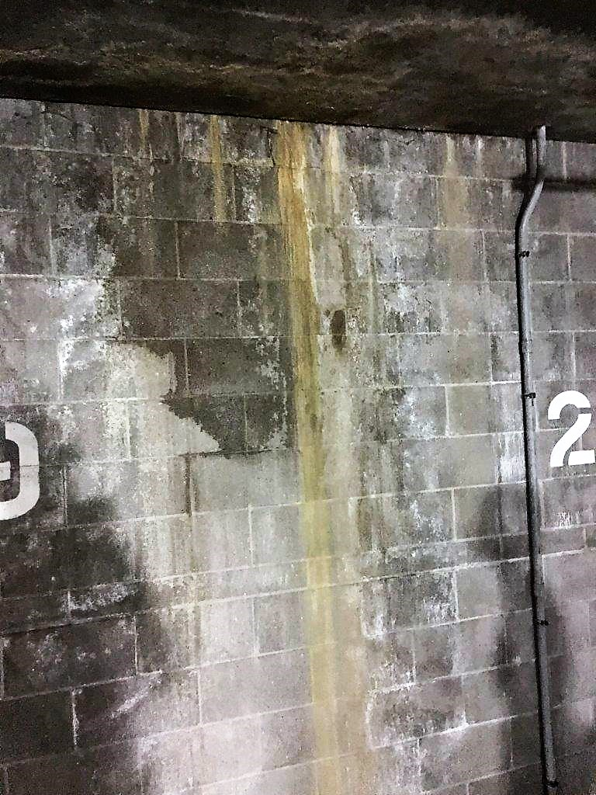
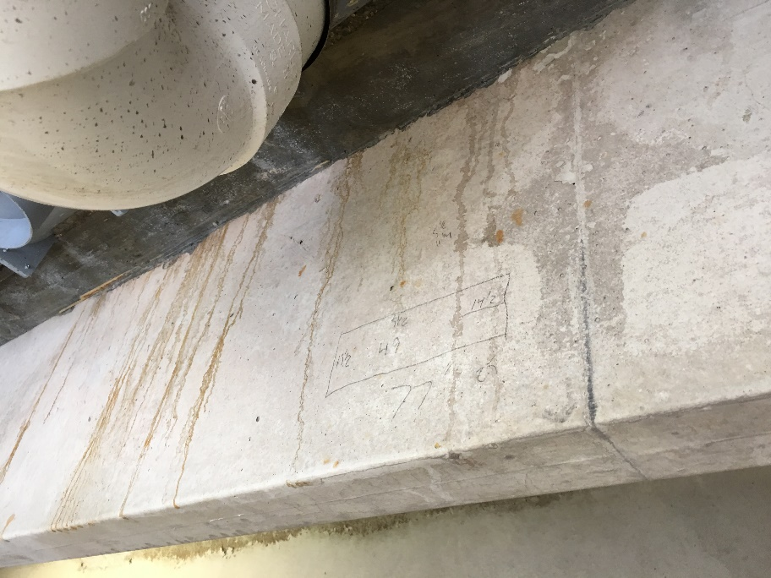
Leaching
Parking Garage Maintenance Playbook
Water migration through the concrete slab that can result in corrosion of reinforcing steel and subsequent delamination and spalling of concrete.

Slide 8
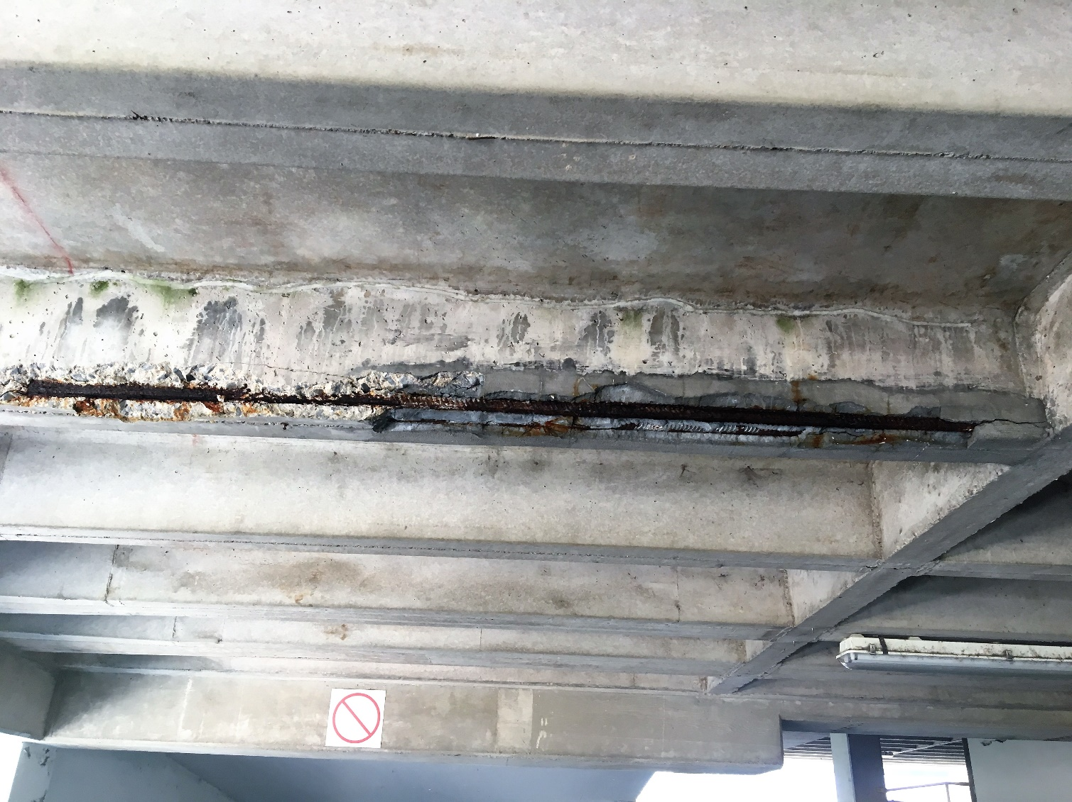
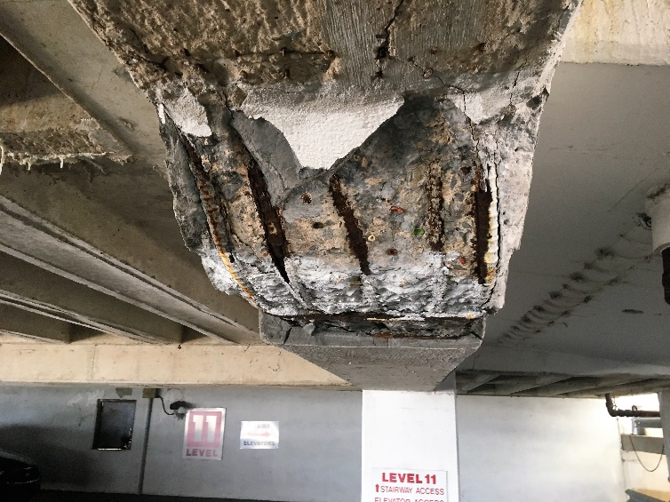
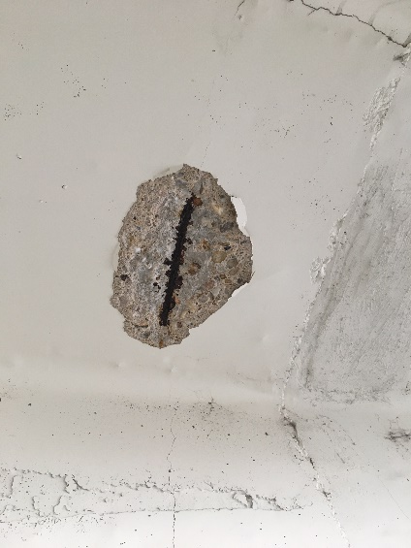
Exposed Reinforcing Steel
Parking Garage Maintenance Playbook
Caused by concrete deterioration resulting in dangerous corrosion of the reinforcing steel.

Slide 9
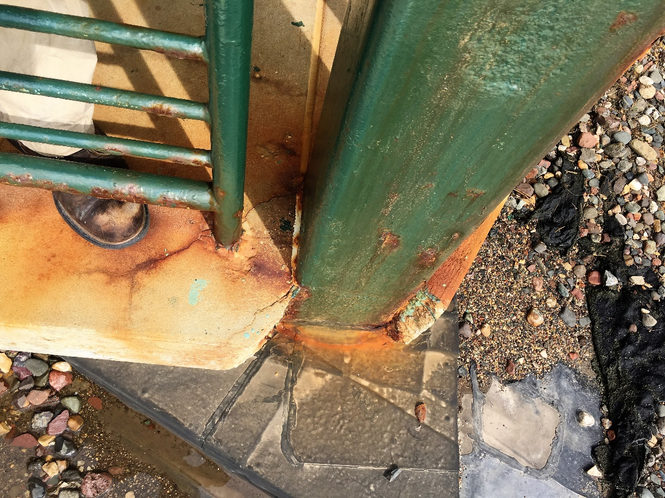
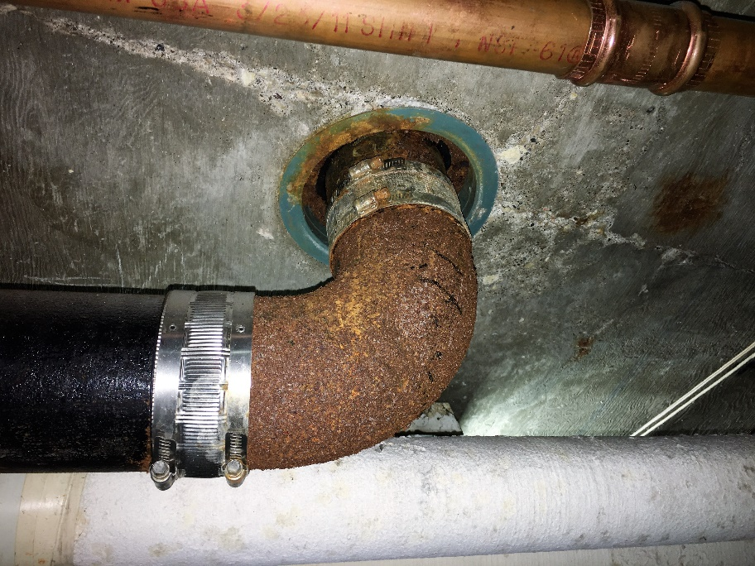
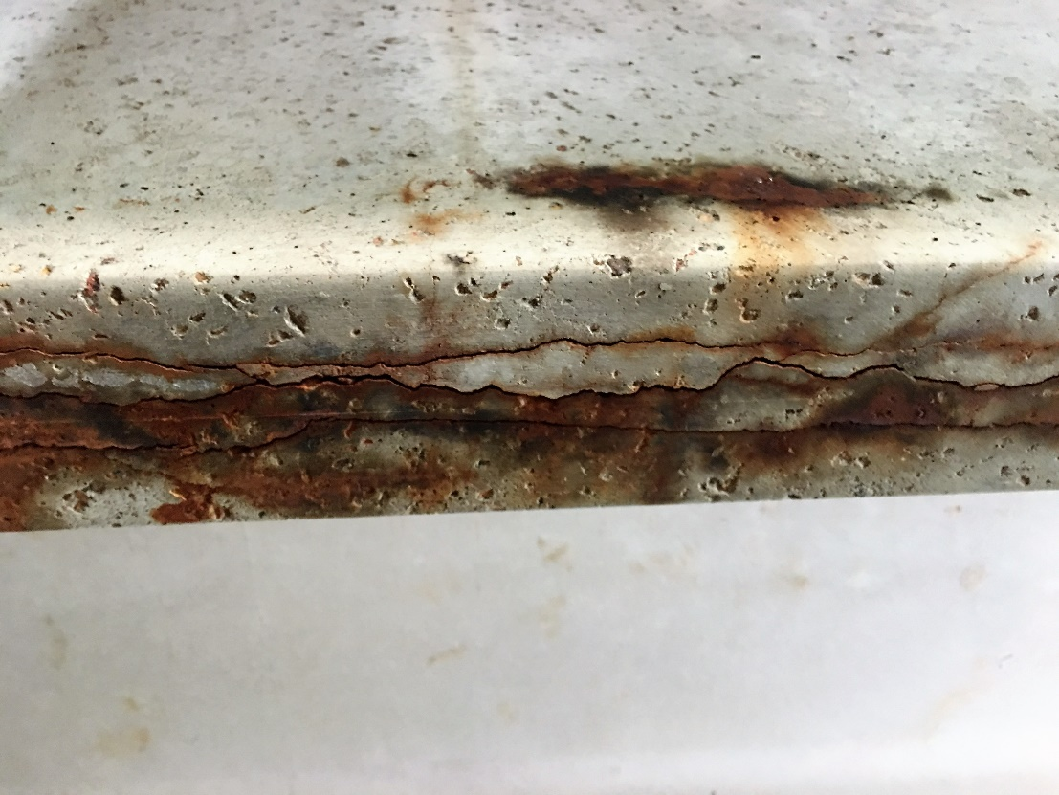
Rust
Parking Garage Maintenance Playbook
Orange and brown staining that indicates corrosion.

Slide 10
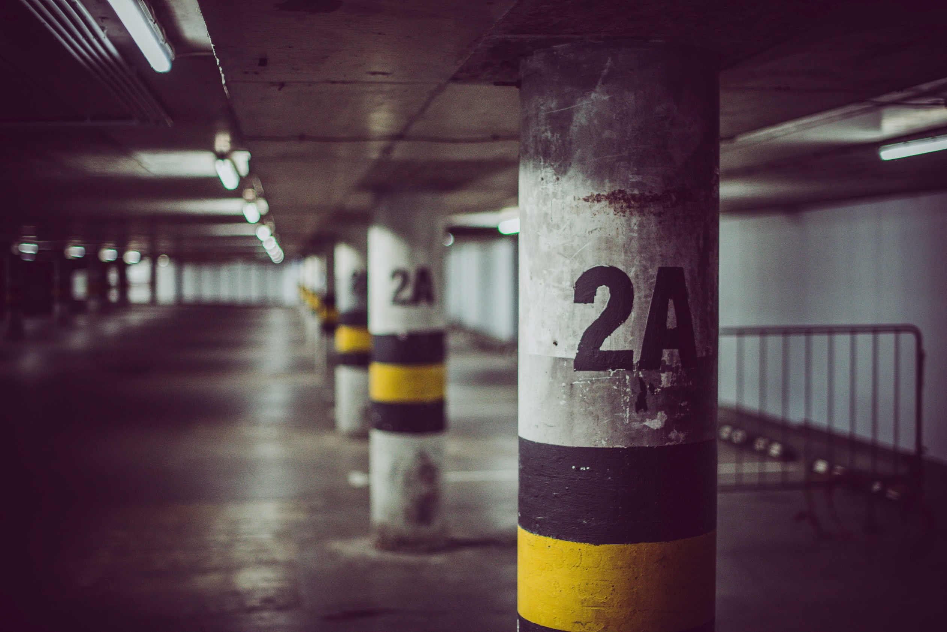
Parts of the Garage to Inspect
Parking Garage Maintenance Playbook
Part two

Slide 11

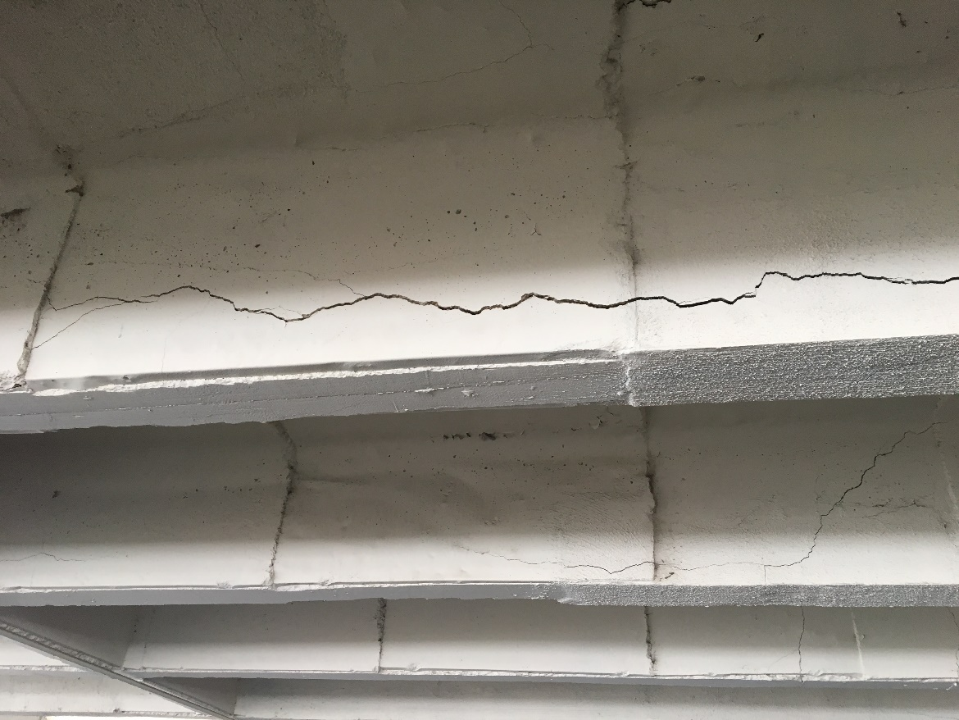
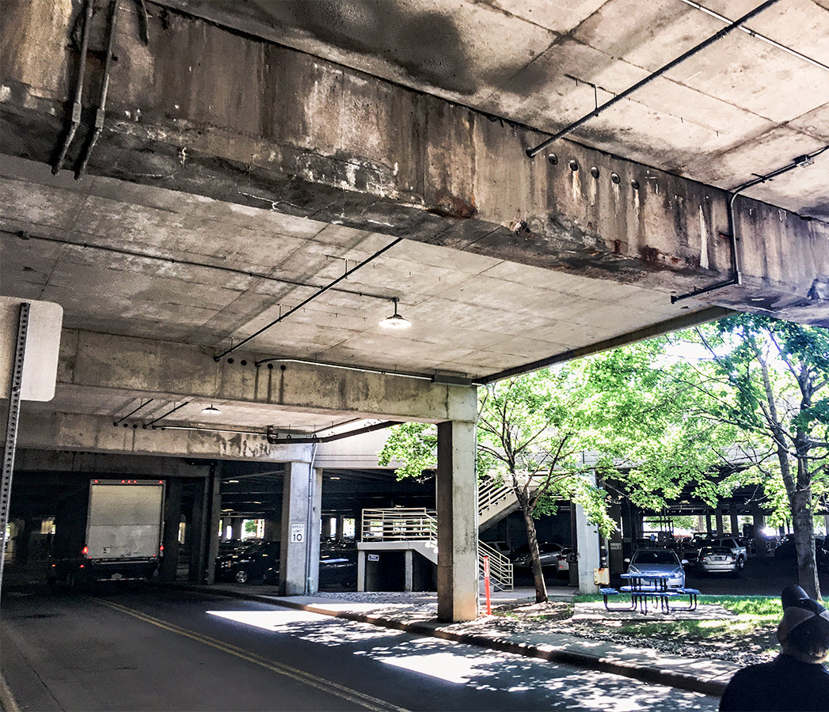
Concrete Beams
Parking Garage Maintenance Playbook
A visual survey should be done to detect corrosion and exposed steel.

Slide 12
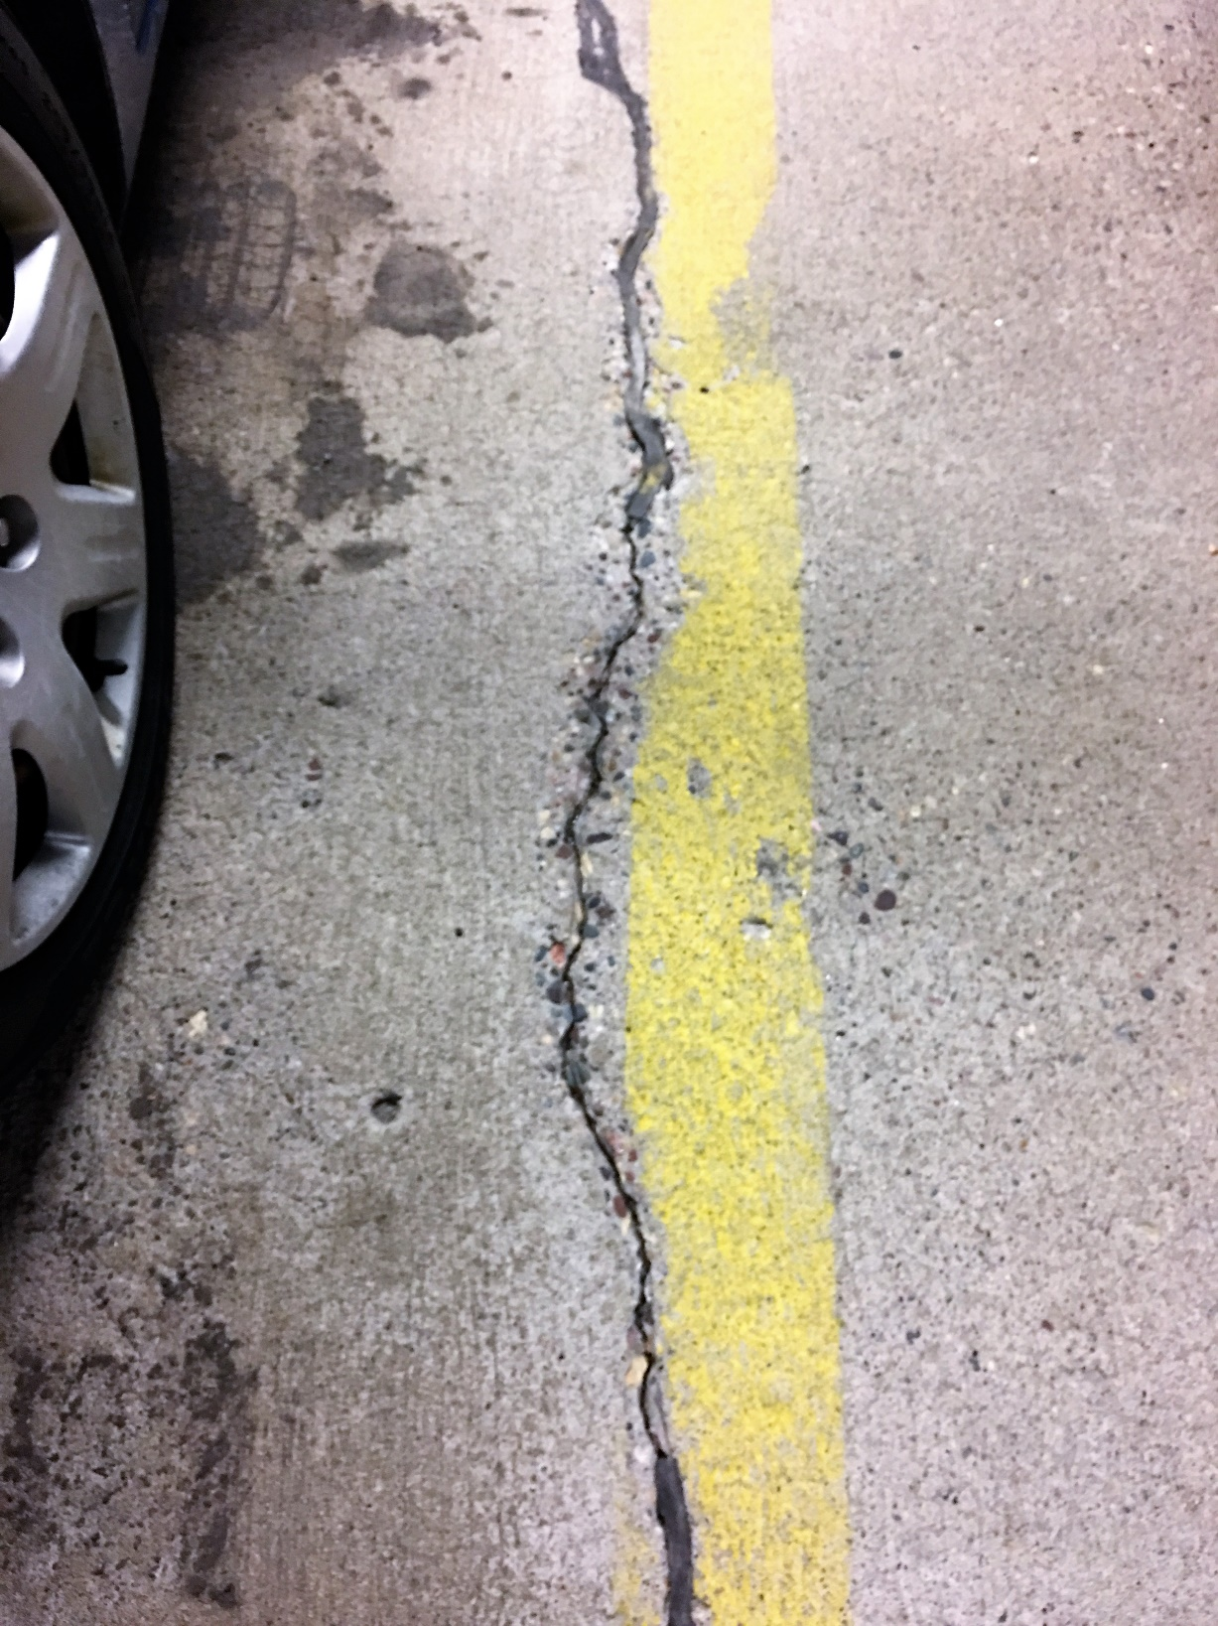
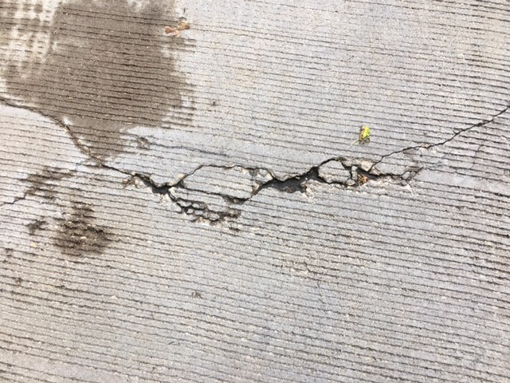
Concrete
Slabs
Parking Garage Maintenance Playbook
Floors and ceiling should be carefully checked for normal wear, initial and advanced deterioration.

Slide 13
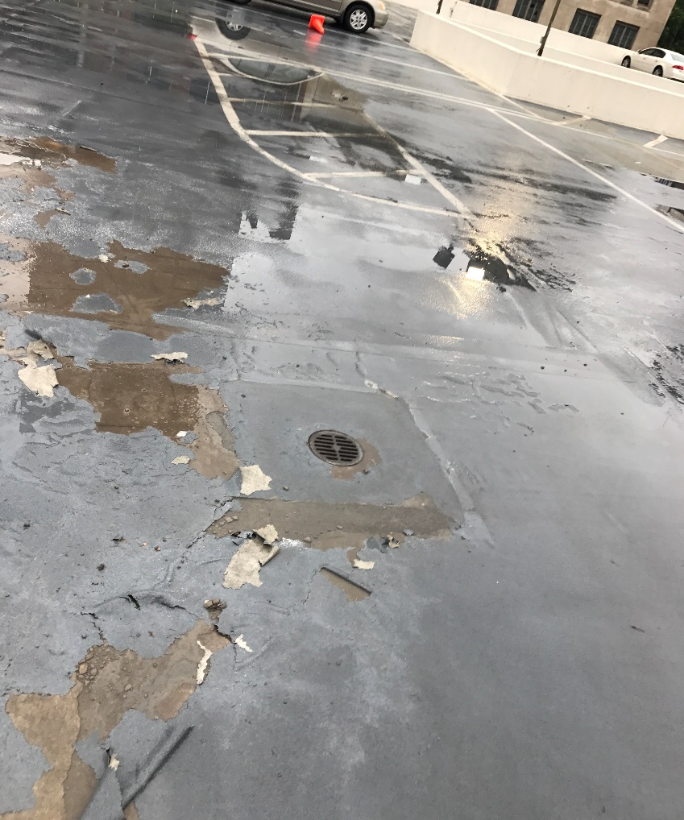
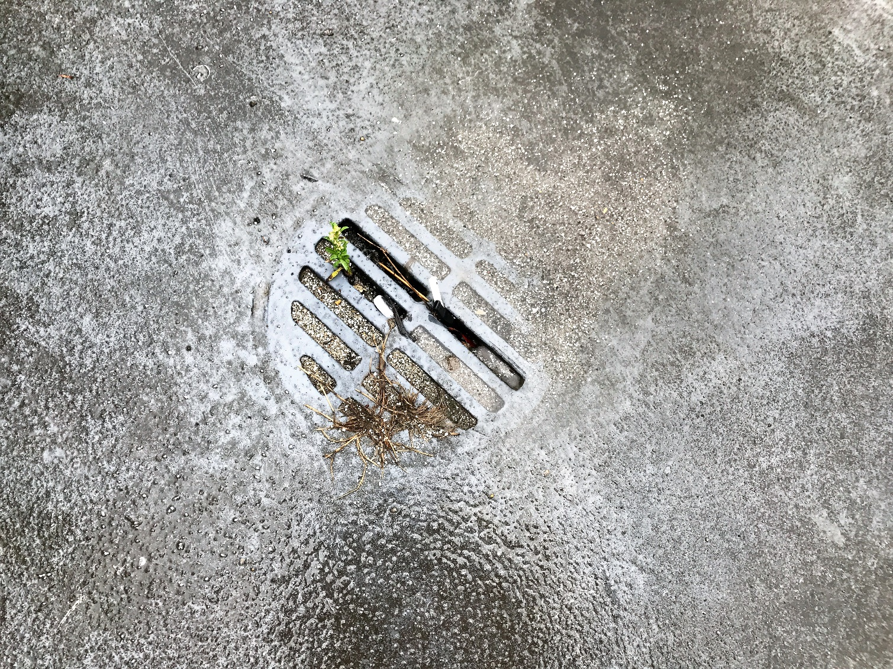
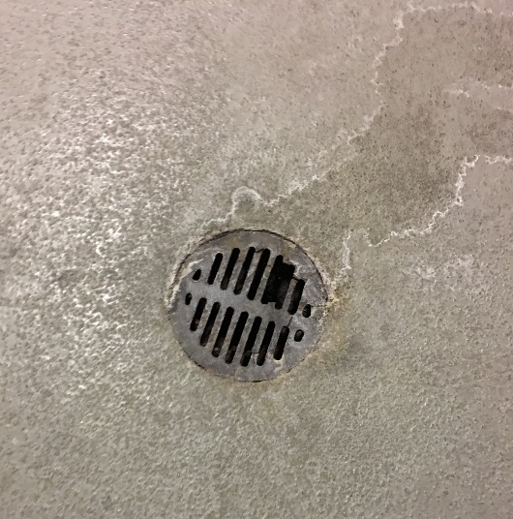
Drains
Parking Garage Maintenance Playbook
Check for obstruction causing water to pond and possibly leach through the concrete slabs.

Slide 14
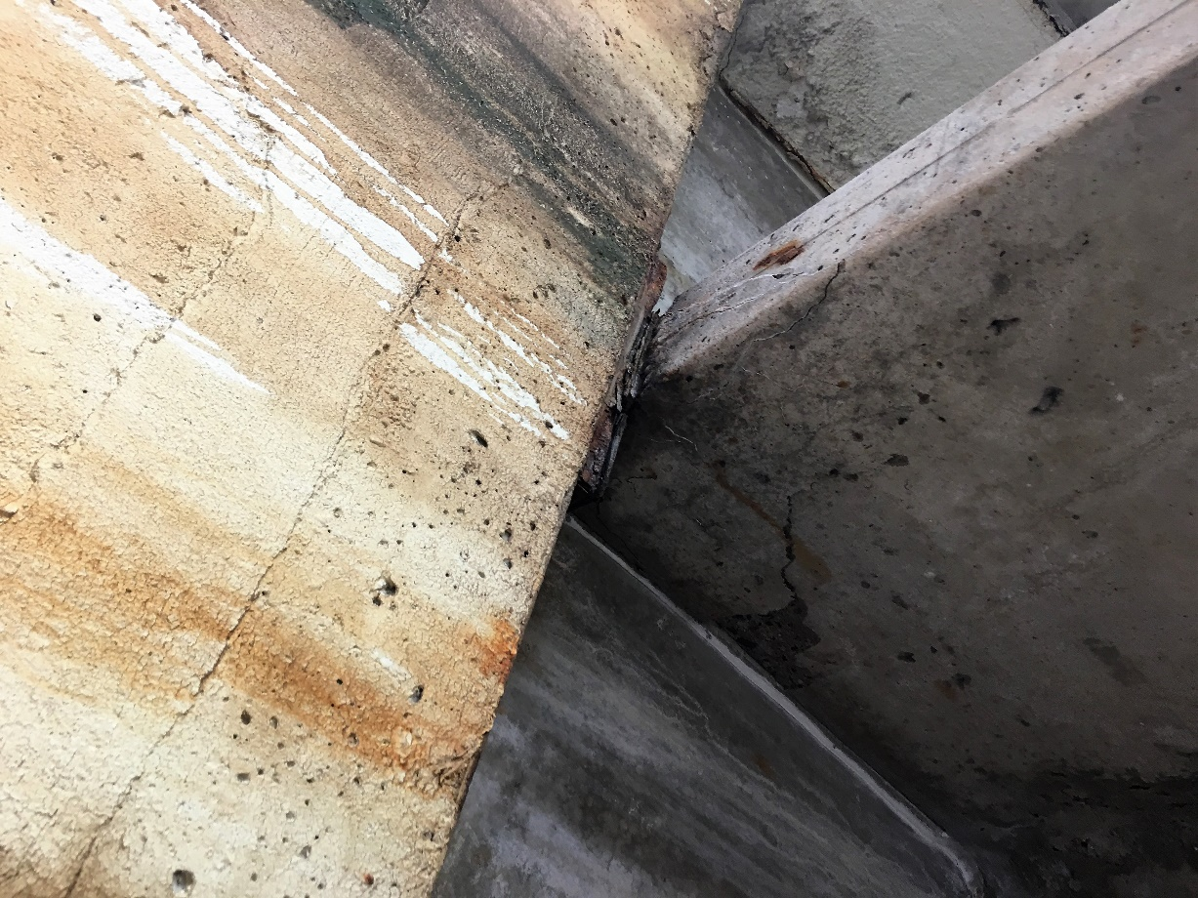
Walls
Parking Garage Maintenance Playbook
Check for cracks, water entry points, and other signs of stress and deterioration.

Slide 15
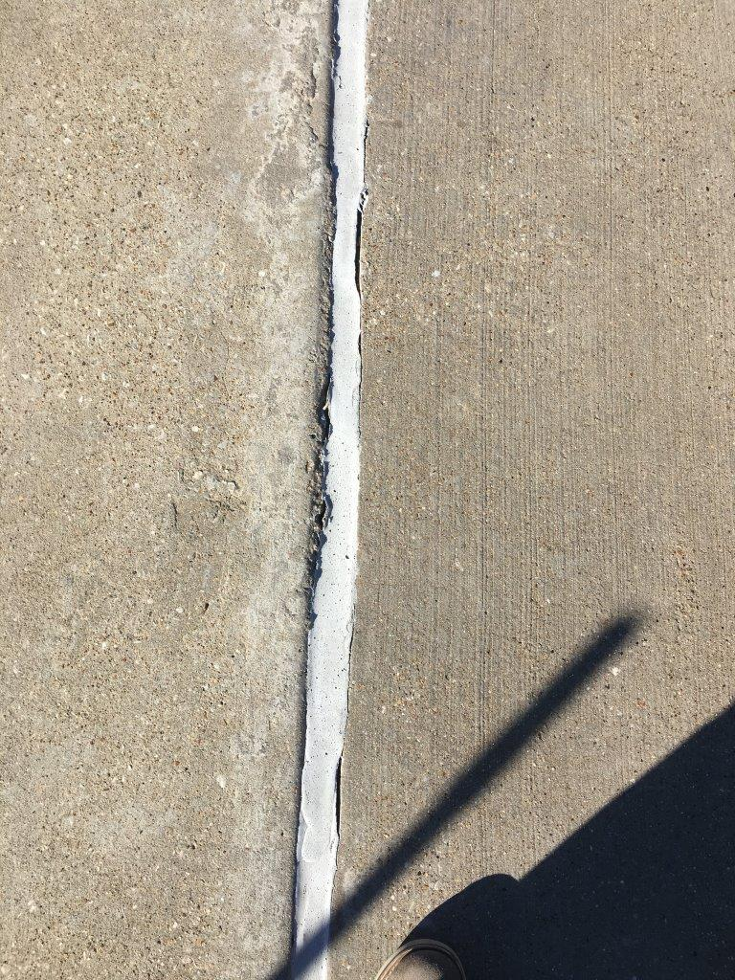
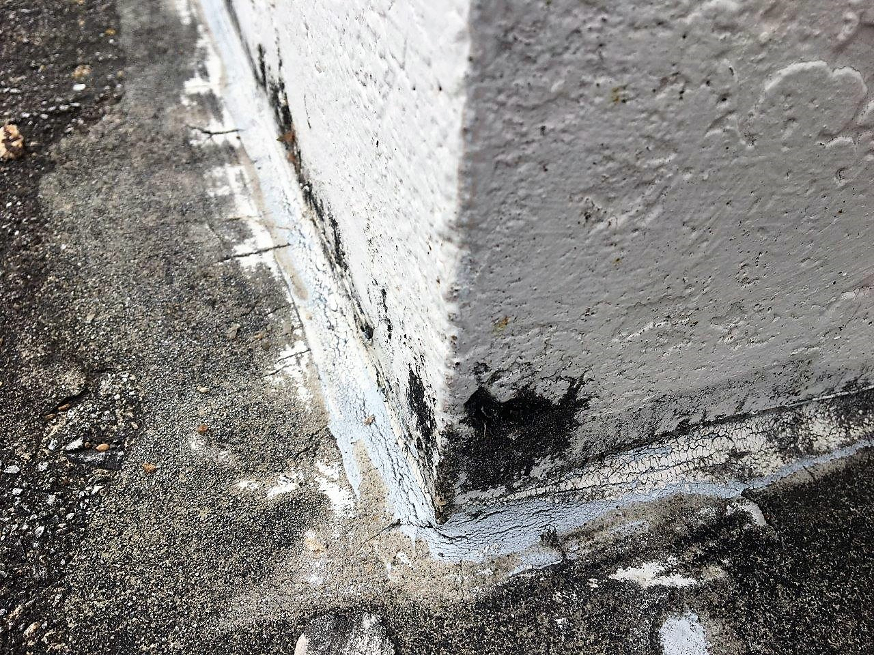
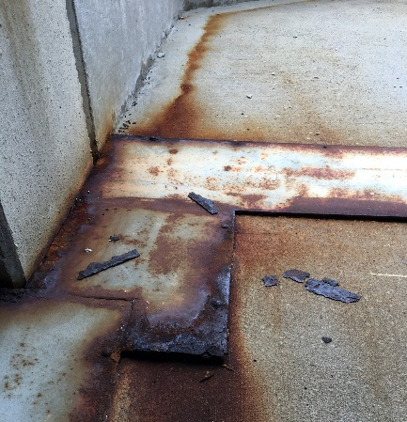
Expansion and Control Joints
Parking Garage Maintenance Playbook
Check for joint failure or damage from traffic or snow plows.

Slide 16
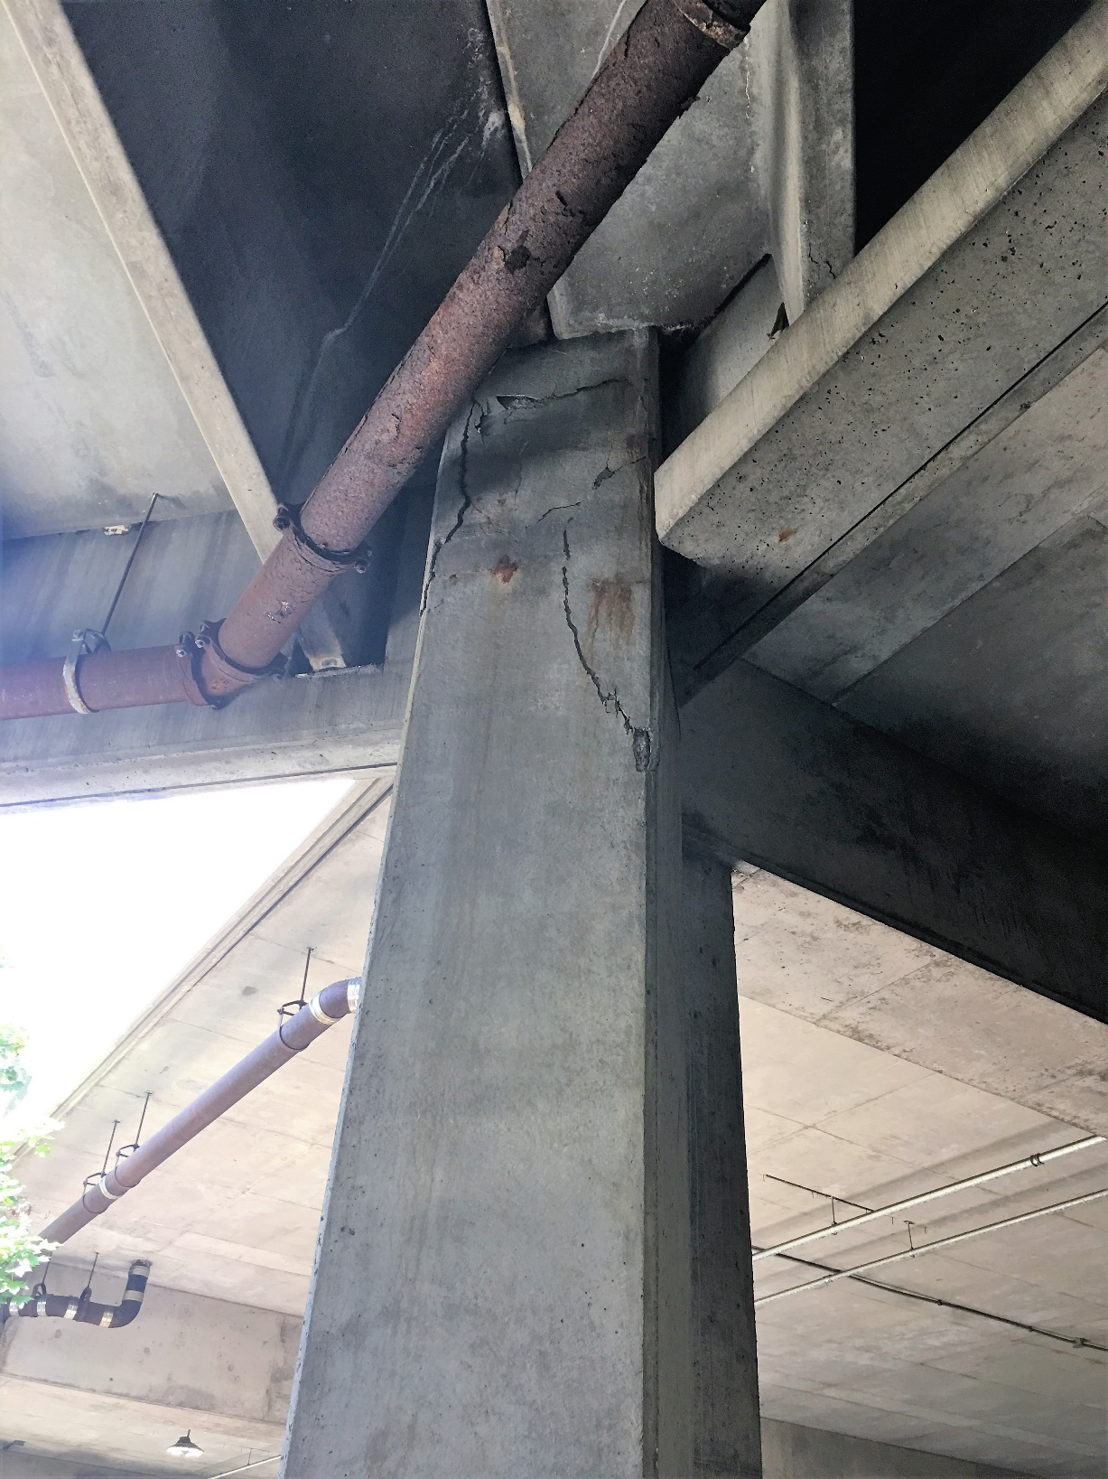
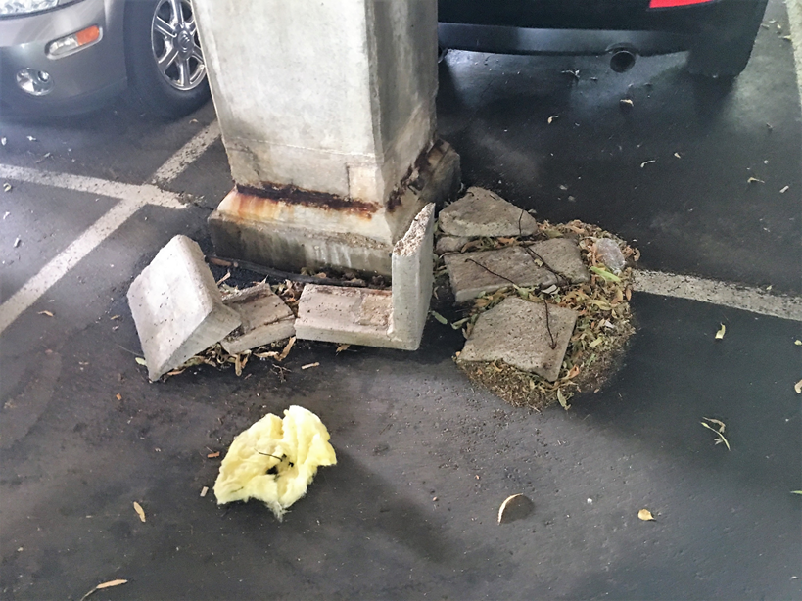
Support Columns
Parking Garage Maintenance Playbook
Monitor for any signs of cracking or stress.

